Slide 1
BGP Hijacking
Hannah Gardner & Jeremy Gill
Advisors: Jorge Crichigno & Jose Gomez
Department of Integrated Information Technology
University of South Carolina
December 2nd, 2021

Slide 2
Agenda
Introduction
Background Information
Problem Description
Proposed Solution
Conclusion

Slide 3
Introduction
The Internet is a network of networks, or autonomous systems (AS).
Border Gateway Protocol (BGP) allows autonomous systems to connect to other autonomous systems.
BGP offers network stability because it can find alternative routes in cases of route failures.

Slide 4
Background Information
BGP peers/neighbors are two routers which have established a connection to exchange routing information.
BGP peers advertise networks to update each peer’s routing table.
Fig 1: Two autonomous systems, AS 100 and AS 200 communicate through external BGP (EBGP)
Notes:
In the above figure, AS 100 and AS 200 are BGP peers who advertise their networks.

Slide 5
Background Information
BGP hijacking occurs when malicious routers advertise networks that do not belong to them (i.e., impersonating legitimate routers).
Consequently, the attacker can reroute Internet traffic.
This traffic can be monitored or redirected, resulting in performance degradation.

Slide 6
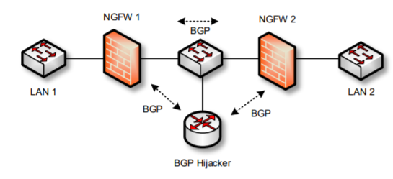
Problem Description
BGP routes can be hijacked when a malicious actor spoofs route information.
In this scenario, there are 2 networks, LAN 1 and LAN 2. A malicious router advertises that it is LAN 2, therefore redirecting traffic moving from LAN 1 to LAN 2 to itself.
Intended route
Redirected route
Fig. 2: Traffic is redirected from its intended recipient to a malicious actor via spoofing.

Slide 7
Proposed Solution
BGP authentication adds a layer of security between trusted peers.
BGP authentication uses the Message Digest 5 (MD5) cryptographic hash function to produce a signature that can only be reproduced by legitimate peers.

Slide 8
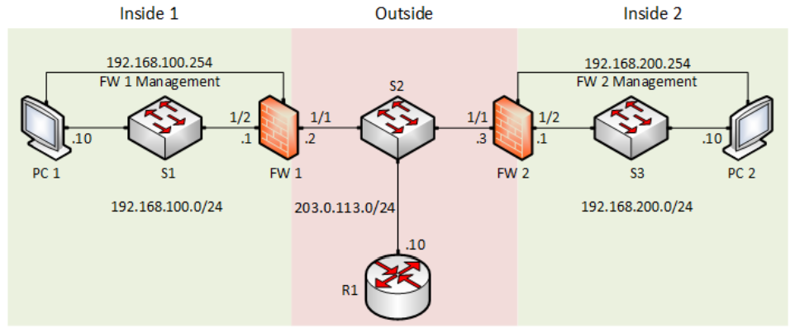
Proposed Solution
The malicious router hijacks the route between the 100 network and the 200 network.
By observing the routing table, we see that the 200 network’s next-hop changes from 203.0.113.3 to 203.0.113.10
This means the router has hijacked the route!

Slide 9
Proposed Solution
With BGP authentication, this is no longer possible.

Slide 10
Conclusion
BGP is necessary for networks to connect and communicate with other networks.
BGP authentication greatly reduces the vulnerability of threat actors posing as legitimate networks and stealing data.

