Slide 1





Fundamentals of P4 and DPDK
Elie Kfoury, Jorge Crichigno
University of South Carolina (USC)
https://research.cec.sc.edu/cyberinfra
University of South Carolina (USC)
The Engagement and Performance Operations Center (EPOC)
Minority Serving - Cyberinfrastructure Consortium (MS-CC)
Hands-on Workshop on Science DMZ and P4-DPDK
Thursday, April 17, 2025.

Slide 2
Agenda
Overview on packet processing
Kernel-bypass (DPDK)
P4 language
Programming DPDK with P4
Advances in Network Interface Cards
Security applications offload to next-generation NICs
Conclusion

Slide 3
Packet Processing on End Hosts

Slide 4
Packet Processing
The Network Interface Card (NIC) driver pre-allocates kernel memory buffers where the packets are stored
User space
Application
Kernel space
Memory buffers
NIC driver
Packet buffer
Packet buffer
Packet buffer
…
Packet buffer
Rinku Shah and Priyanka Naik, Kernel-bypass techniques for high-speed network packet processing. https://tinyurl.com/3bzfehja

Slide 5
Packet Processing
The Network Interface Card (NIC) driver pre-allocates kernel memory buffers where the packets are stored
The NIC driver pre-allocate the transmit (TX) and receive (RX) ring buffer in the memory
User space
Application
Kernel space
Memory buffers
NIC driver
Packet buffer
Packet buffer
Packet buffer
TX
RX
…
Packet buffer
NIC
Rinku Shah and Priyanka Naik, Kernel-bypass techniques for high-speed network packet processing. https://tinyurl.com/3bzfehja

Slide 6
Packet Processing
The Network Interface Card (NIC) driver pre-allocates kernel memory buffers where the packets are stored
The NIC driver pre-allocate the transmit (TX) and receive (RX) ring buffer in the memory
The ring buffers store the packet buffer pointer and its length
User space
Application
Kernel space
Memory buffers
NIC driver
Packet buffer
Packet buffer
Packet buffer
TX
RX
…
Packet buffer
NIC
Rinku Shah and Priyanka Naik, Kernel-bypass techniques for high-speed network packet processing. https://tinyurl.com/3bzfehja
Notes:
The NIC driver pre-allocates kernel memory buffers where the packets are stored
The NIC driver pre-allocate the transmit (TX) and receive (RX) ring buffer in the memory
The ring buffers are circular queues shared between the NIC and the driver
The ring buffers store the packet buffer pointer and its length

Slide 7
Packet Processing
The Network Interface Card (NIC) driver pre-allocates kernel memory buffers where the packets are stored
The NIC driver pre-allocate the transmit (TX) and receive (RX) ring buffer in the memory
The ring buffers store the packet buffer pointer and its length
The NIC copies the packet to the location using Direct Memory Access (DMA)
User space
Application
Kernel space
Memory buffers
NIC driver
Packet buffer
Packet buffer
TX
RX
…
Packet buffer
NIC
Hardware RX queue
Rinku Shah and Priyanka Naik, Kernel-bypass techniques for high-speed network packet processing. https://tinyurl.com/3bzfehja

Slide 8
Packet Processing
The Network Interface Card (NIC) driver pre-allocates kernel memory buffers where the packets are stored
The NIC driver pre-allocate the transmit (TX) and receive (RX) ring buffer in the memory
The ring buffers store the packet buffer pointer and its length
The NIC copies the packet to the location using Direct Memory Access (DMA)
The NIC triggers an interrupt
User space
Application
Kernel space
Memory buffers
NIC driver
Packet buffer
Packet buffer
TX
RX
…
Packet buffer
NIC
Hardware RX queue
Rinku Shah and Priyanka Naik, Kernel-bypass techniques for high-speed network packet processing. https://tinyurl.com/3bzfehja

Slide 9
Packet Processing
Interrupt processing:
The CPU pauses the process in execution
Rinku Shah and Priyanka Naik, Kernel-bypass techniques for high-speed network packet processing. https://tinyurl.com/3bzfehja

Slide 10
Packet Processing
Interrupt processing:
The CPU pauses the process in execution
Switch from user space to kernel space
Rinku Shah and Priyanka Naik, Kernel-bypass techniques for high-speed network packet processing. https://tinyurl.com/3bzfehja

Slide 11
Packet Processing
Interrupt processing:
The CPU pauses the process in execution
Switch from user space to kernel space
Acknowledge of schedule bottom-half processing
Rinku Shah and Priyanka Naik, Kernel-bypass techniques for high-speed network packet processing. https://tinyurl.com/3bzfehja

Slide 12
Packet Processing
Interrupt processing:
The CPU pauses the process in execution
Switch from user space to kernel space
Acknowledge of schedule bottom-half processing
Switch back to user space
Rinku Shah and Priyanka Naik, Kernel-bypass techniques for high-speed network packet processing. https://tinyurl.com/3bzfehja

Slide 13
Packet Processing
Interrupt processing:
The CPU initiates the bottom-half when it is free
Switch from user space to kernel space
Rinku Shah and Priyanka Naik, Kernel-bypass techniques for high-speed network packet processing. https://tinyurl.com/3bzfehja

Slide 14
Packet Processing
Interrupt processing:
The CPU initiates the bottom-half when it is free
Switch from user space to kernel space
Dynamically allocate packet data structure
Remove Ethernet header and pass to network stack
Rinku Shah and Priyanka Naik, Kernel-bypass techniques for high-speed network packet processing. https://tinyurl.com/3bzfehja

Slide 15
Packet Processing
Interrupt processing:
The CPU initiates the bottom-half when it is free
Switch from user space to kernel space
Dynamically allocate packet data structure
For all packets in buffer
Remove Ethernet header and pass to network stack
Rinku Shah and Priyanka Naik, Kernel-bypass techniques for high-speed network packet processing. https://tinyurl.com/3bzfehja

Slide 16
Packet Processing Overheads
Too many context switches, polluting CPU cache
Per-packet interrupt overhead
Dynamic allocation of packet data structure
Packet copy between the kernel and user space
Rinku Shah and Priyanka Naik, Kernel-bypass techniques for high-speed network packet processing. https://tinyurl.com/3bzfehja

Slide 17
Packet Processing Overheads
Too many context switches, polluting CPU cache
Per-packet interrupt overhead
Dynamic allocation of packet data structure
Packet copy between the kernel and user space
Link Capacity | Packet Size | Time Budget per Packet
10 Mbps | 64 bytes | 51,200 ns
100 Mbps | 64 bytes | 5,120 ns
1 Gbps | 64 bytes | 512 ns
10 Gbps | 64 bytes | 51.2 ns
100 Gbps | 64 bytes | 5.12 ns
Rinku Shah and Priyanka Naik, Kernel-bypass techniques for high-speed network packet processing. https://tinyurl.com/3bzfehja

Slide 18
Kernel-bypass
One approach to avoid the overhead is to bypass the kernel
DPDK is a set of optimized libraries for processing packets in the user space
DPDK bypasses the kernel
DPDK uses Poll Mode Drivers (PMD) which constantly poll the NICs for new packets
This avoids the overheads resulting from interrupts
User space
Application
DPDK Poll Mode Driver (PMD)
Kernel space
DPDK-supported NIC
DPDK: Data Plane Development Kit

Slide 19
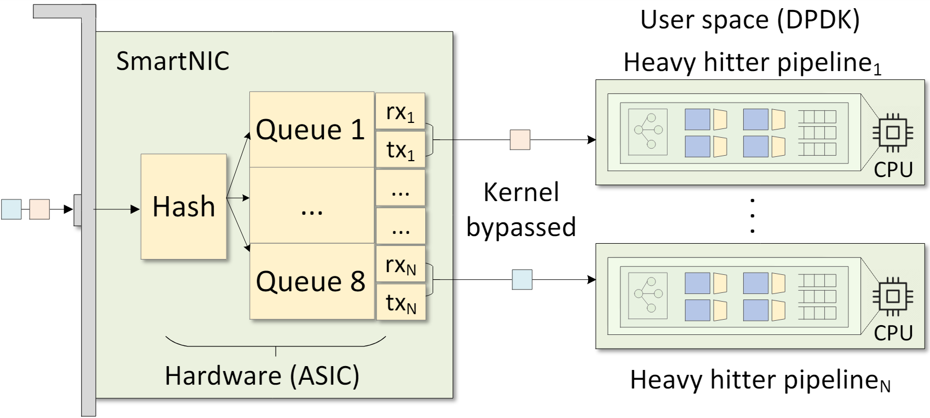
Multicore CPUs
DPDK enables packet processing on multicore CPUs
The Receive Side Scaling (RSS) technique is used to distribute the packets to the CPU cores
The CPU cores can run different packet processing pipelines

Slide 20
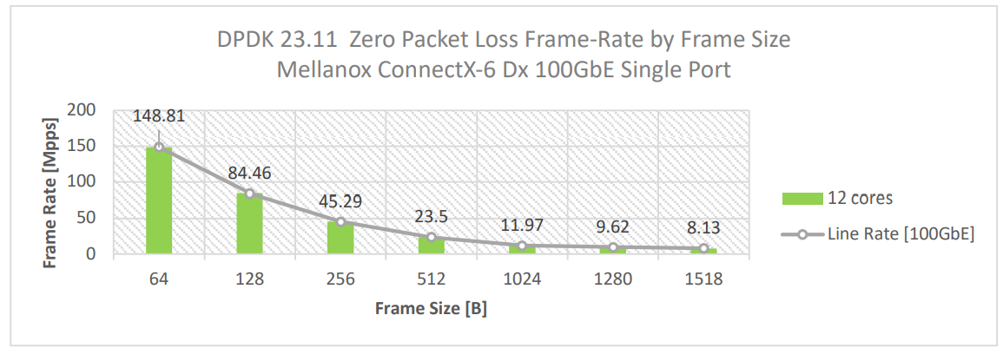
DPDK Performance
Layer-3 forwarding (l3fwd) is implemented in DPDK¹
100Gbps line rate for 64 bytes packets
¹NVIDIA NICs Performance Report with DPDK 23.11. https://fast.dpdk.org/doc/perf/DPDK_23_11_NVIDIA_NIC_performance_report.pdf

Slide 21
DPDK Challenges
DPDK is complex and required deep understanding of C and DPDK libraries
DPDK requires millions of lines of code in C to implement a software switch
Difficult to add new features to the large code

Slide 22
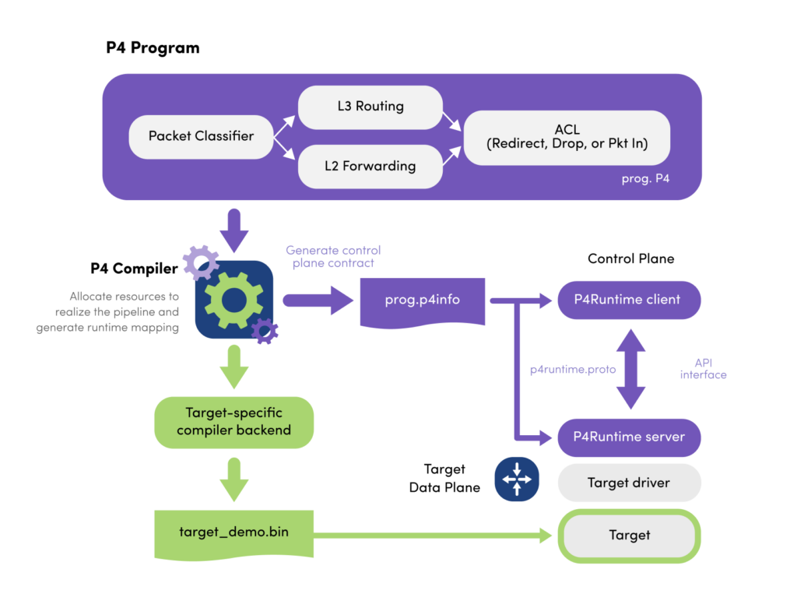
P4 Language
P4 emerged as domain-specific language to define packet processing:
Define and parse new protocols
Customize packet processing functions

Slide 23
PISA: Protocol Independent Switch Architecture
Match+Action Stage
Memory
ALU
Programmable Parser
Programmable Match-Action Pipeline
N. McKeown. Creating an End-to-End Programming Model for Packet Forwarding. Available: https://www.youtube.com/watch?v=fiBuao6YZl0&t=4216s

Slide 24
PISA: Protocol Independent Switch Architecture
N. McKeown. Creating an End-to-End Programming Model for Packet Forwarding. Available: https://www.youtube.com/watch?v=fiBuao6YZl0&t=4216s
24

Slide 25
Example P4 Program
Parser Program
Header and Data Declarations
Tables and Control Flow
parser parse_ethernet { extract(ethernet); return switch(ethernet.ethertype) { 0x8100 : parse_vlan_tag; 0x0800 : parse_ipv4; 0x8847 : parse_mpls; default: ingress; }
header_type ethernet_t { … }
header_type l2_metadata_t { … }
header ethernet_t ethernet;
header vlan_tag_t vlan_tag[2];
metadata l2_metadata_t l2_meta;
table port_table { … }
control ingress { apply(port_table); if (l2_meta.vlan_tags == 0) { process_assign_vlan();
} }
Memory
ALU
Programmable Parser
Programmable Match-Action Pipeline
N. McKeown. Creating an End-to-End Programming Model for Packet Forwarding. Available: https://www.youtube.com/watch?v=fiBuao6YZl0&t=4216s
25

Slide 26
Why P4 for CPU?
Processing packets on the server is very similar to a switch pipeline
Packets need to be parsed
Match and action operations are performed on the packets
Packets are sent to the network or the host
Memory
ALU
Programmable Parser
Programmable Deparser
Programmable Match-Action Pipeline

Slide 27
Why P4 for CPU?
The P4 description for a data plane is short
For example, a full implementation of a data center switch requires¹:
~5000 lines of code in P4
Millions of lines of code in C with DPDK
Lines of code (LOC) for implementing defenses against common cyberattacks¹
Attack | DPDK | P4
DNS amplification | 898 | 255
HTTP flood | 1184 | 354
SlowLoris | 995 | 513
UDP flood | 911 | 376
Elephant flow (heavy hitter) | 903 | 373
¹Running P4 programs as DPDK applications - Cristian Dumitrescu & Han Wang – Intel. https://www.youtube.com/watch?v=xJR-5DcqhlY

Slide 28
Why P4 for CPU?
DPDK is complex and required deep understanding of C and DPDK libraries
P4’s high-level abstraction simplifies the development of complex packet processing
P4 quickly adapts and deploys new network functions to the data plane

Slide 29
Why P4 for CPU?
DPDK is complex and required deep understanding of C and DPDK libraries
P4’s high-level abstraction simplifies the development of complex packet processing
P4 quickly adapts and deploys new network functions to the data plane
Combining P4 with DPDK enables highly customizable, high-performance network applications that benefit from both the programmability of P4 and the efficiency of DPDK

Slide 30
P4-DPDK
P4-DPDK is an initiative that translates P4 code to DPDK

Slide 31
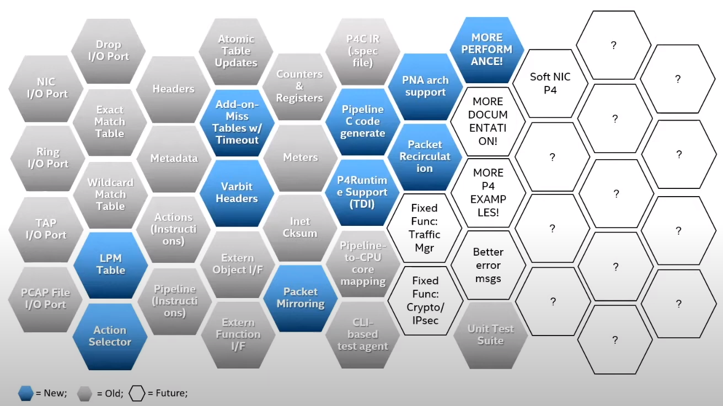
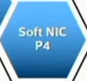
P4-DPDK Supported Features
Do not develop from scratch, simply write P4 and get DPDK - Cristian Dumitrescu, Intel. https://tinyurl.com/38574yh9

Slide 32
P4 Across the Network Stack
P4 has been used in targets other than switches:
SmartNICs: NICs with a programmable pipeline implemented in FPGA, ASIC, or SoC
Virtual switches: software switches used to connect virtual networks such as Open vSwitch (OvS)
End hosts stacks: User space and kernel space

Slide 33
P4 Across the Network Stack
P4 has been used in targets other than switches:
SmartNICs: NICs with a programmable pipeline implemented in FPGA, ASIC, or SoC
Virtual switches: software switches used to connect virtual networks such as Open vSwitch (OvS)
End hosts stacks: User space and kernel space
The vision is to create an end-to-end programmable network
N. McKeown, The Network will be programmed by many, operated by a few. The Networking Channel: https://tinyurl.com/3wukc8zn

Slide 34
Conclusion
The packet processing stack on the server has overheads due to context switching, interrupts, packet copy, etc.
DPDK minimize the overhead by bypassing the kernel
DPDK can leverage multicore CPU to enhance the packet processing performance
P4-DPDK combines the expressiveness of P4 and the performance of DPDK
A shared vision in the community is to create a fully programmable stack including switches, servers, and NICs

