Slide 1



Motivation for Cybersecurity Training
Elie Kfoury
University of South Carolina (USC)
https://research.cec.sc.edu/cyberinfra
University of South Carolina (USC)
Minority Serving - Cyberinfrastructure Consortium (MS-CC)
Hands-On P4-DPDK Workshop
Friday, May 30, 2025.

Slide 2
Introduction
Widespread attacks on desktops, laptops, smartphone, tablets, servers, etc.
Information security is focused on protecting electronic information of organizations and users

Slide 3

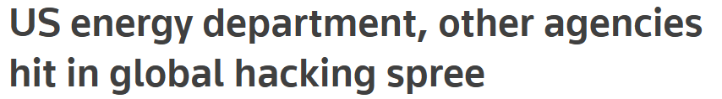
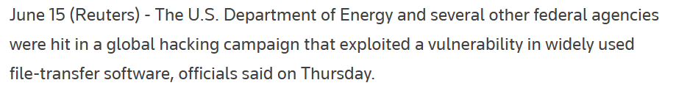
Introduction
Widespread attacks on desktops, laptops, smartphone, tablets, servers, etc.
Information security is focused on protecting electronic information of organizations and users

Slide 4
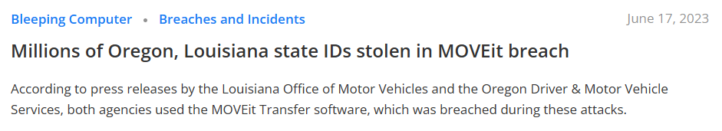
Introduction
Widespread attacks on desktops, laptops, smartphone, tablets, servers, etc.
Information security is focused on protecting electronic information of organizations and users

Slide 5
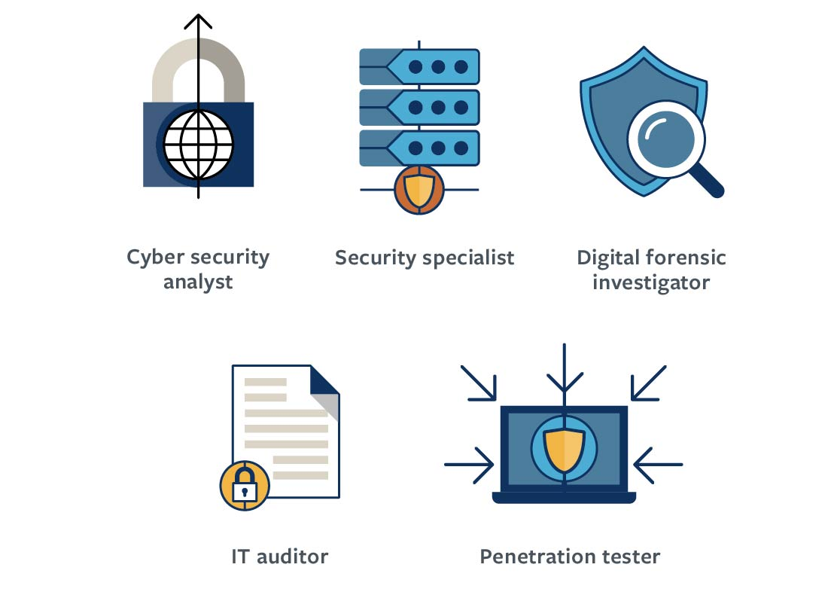
Information Security Employment
Security is rarely outsourced
Job outlook is exceptionally strong
U.S. Bureau of Labor Statistics (BLS)
“Occupational Outlook Handbook” indicates job outlook for information security analysts through end of decade expected to grow by more than 32%, much faster than average

Slide 6
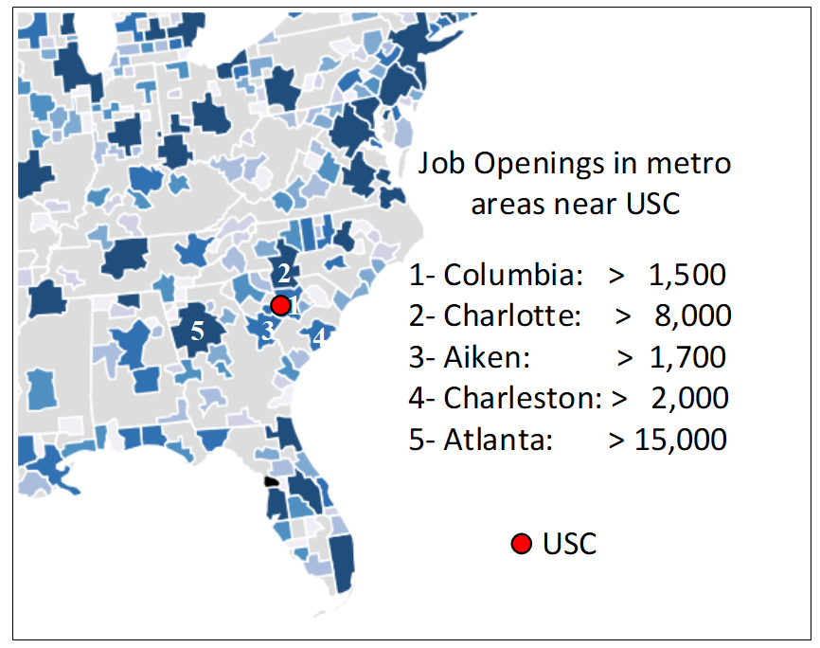
Information Security Employment
Security is rarely outsourced
Job outlook is exceptionally strong
U.S. Bureau of Labor Statistics (BLS)
“Occupational Outlook Handbook” indicates job outlook for information security analysts through end of decade expected to grow by more than 32%, much faster than average
https://www.cyberseek.org/

Slide 7
Today’s Security Attacks
Balances manipulated on prepaid debit cards (intrusion)
Twitter accounts exploited
ATM malware
Aircraft manipulation
Computer cluster for cracking passwords
Electronic data records stolen
…

Slide 8
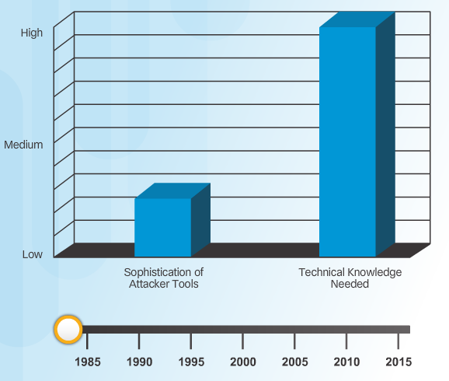
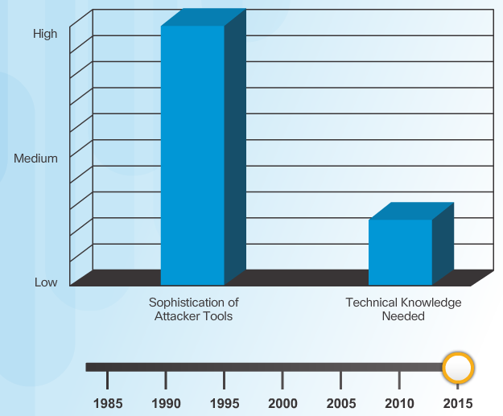
Attack Tools Sophistication
Script kiddies
Unskilled users; goal: breaking into computers (damage)
Download automated hacking software (scripts)
Attack software today has attack capabilities that are even easier for unskilled users; ~40% of attacks performed by script kiddies

Slide 9
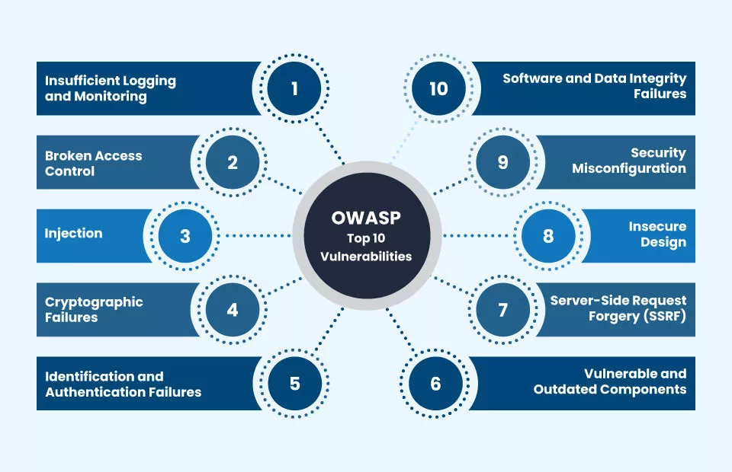
Information Security Terminology: Vulnerability
Vulnerability is a weakness that allows a threat agent to bypass security
A software defect that allows an unauthorized user to gain control of a computer
Open Worldwide Application Security Project (OWASP)

Slide 10
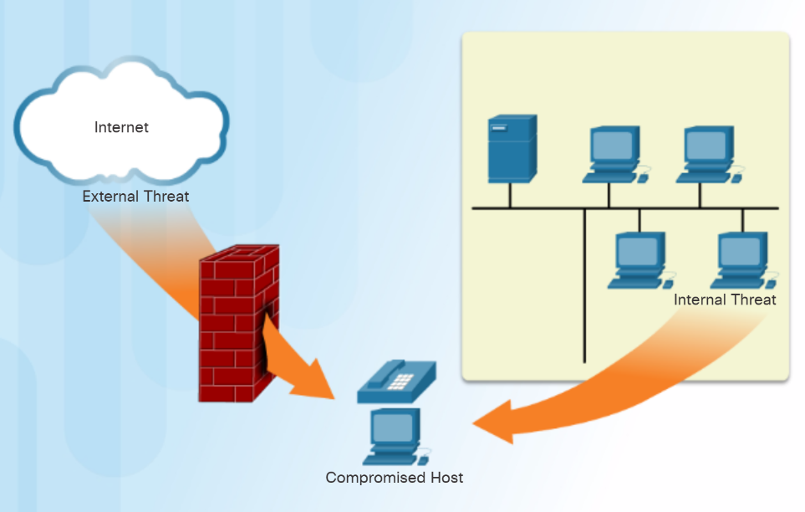
Information Security Terminology: Threat Vector
A threat vector is a path by which an attacker can gain access to a server, host, or network
For example, an attacker, knowing that a web server’s OS has not been patched, can use the threat vector (exploiting the vulnerability) to steal user passwords
Web - fake sites; email – links, attachments

Slide 11
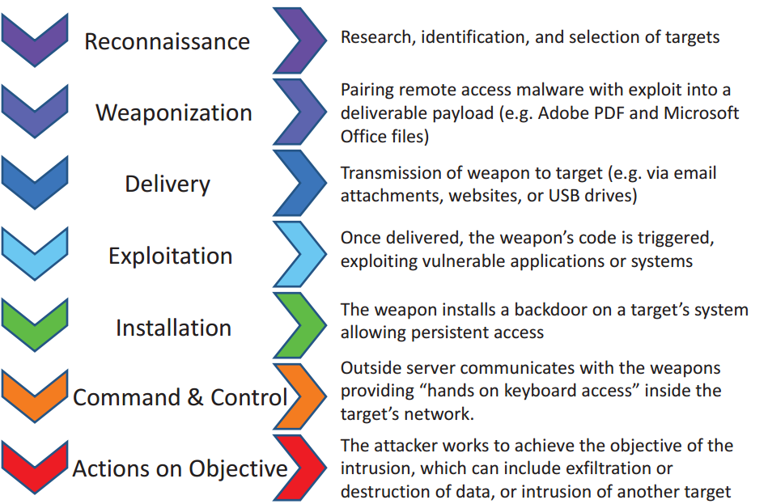
Steps of an Attack
Cyber kill chain model

Slide 12



Cybersecurity (Security+) and P4
Programmable Switches
Motivation for P4 Programmable Switches
Jorge Crichigno
University of South Carolina
http://ce.sc.edu/cyberinfra
Western Academy Support and Training Center (WASTC)
University of South Carolina (USC)
Energy Sciences Network (ESnet)
June 19th, 2023

Slide 13
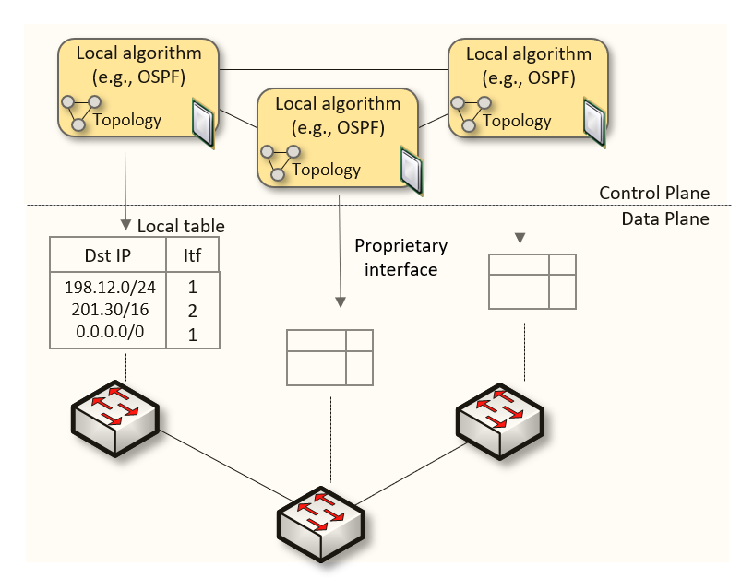
Traditional (Legacy) Networking
Since the explosive growth of the Internet in the 1990s, the networking industry has been dominated by closed and proprietary hardware and software
The interface between control and data planes has been historically proprietary
Vendor dependence: slow product cycles of vendor equipment, no innovation from network owners
A router is a monolithic unit built and internally accessed by the manufacturer only

Slide 14
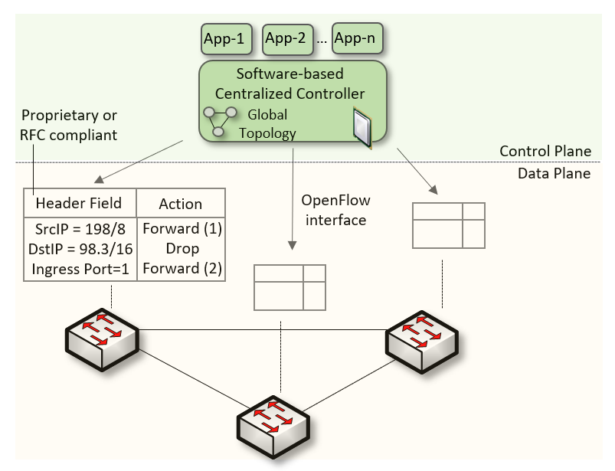
Software-defined Networking
Protocol ossification has been challenged first by SDN
SDN (1) explicitly separates the control and data planes, and (2) enables the control plane intelligence to be implemented as a software outside the switches
The function of populating the forwarding table is now performed by the controller

Slide 15
Software-defined Networking
SDN is limited to the OpenFlow specifications
Forwarding rules are based on a fixed number of protocols / header fields (e.g., IP, Ethernet)
The data plane is designed with fixed functions (hard-coded)
Functions are implemented by the chip designer

Slide 16
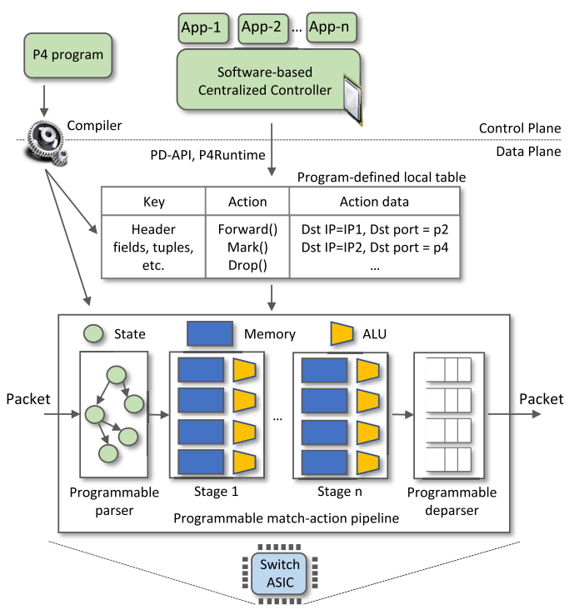
P4 Programmable Switches
The programmable forwarding can be viewed as a natural evolution of SDN
P4 programmable switches permit a programmer to program the data plane
P4 stands for stands for Programming Protocol-independent Packet Processors

Slide 17
P4 Programmable Switches
The programmable forwarding can be viewed as a natural evolution of SDN
P4 programmable switches permit a programmer to program the data plane
Defining and parsing new protocols
Customizing packet processing functions
Measuring events occurring in the data plane with nanosecond resolution
Inspecting and analyzing each packet (per-packet analysis)
P4 stands for stands for Programming Protocol-independent Packet Processors

Slide 18
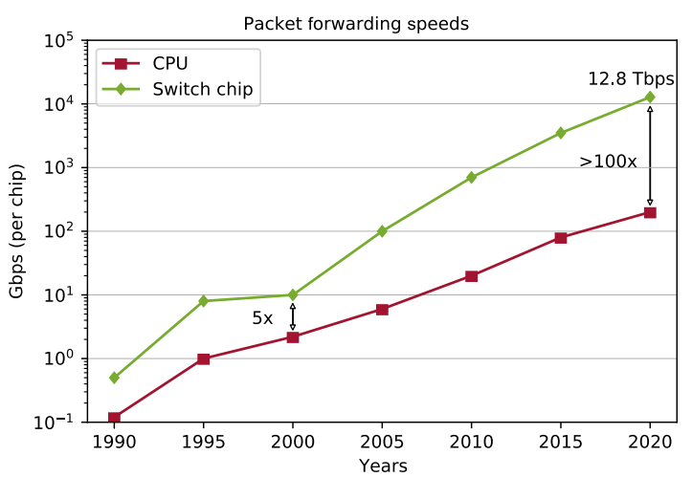
P4 Programmable Switches
The programmer can implement
New encapsulations and secure tunnels
Mitigation techniques for DDoS attacks at terabit rates
Traffic anonymization systems at line rate
Customized firewalls
DNS deep packet inspection at line rate
Reproduced from N. McKeown, “Creating an End-to-End Programming Model for Packet Forwarding.” https://www.youtube.com/watch?v=fiBuao6YZl0&t=4216s

