Slide 1
Mitigating UDP Abuses
Collins Khuu, Tucker Baron
Advisors: Jorge Crichigno, Jose Gomez
Department of Integrated Information Technology
University of South Carolina
Tuesday, December 2nd, 2021

Slide 2
Agenda
Purpose.
Introduction.
Problem description.
Proposed solution and implementation.
Conclusion.

Slide 3
Purpose
Understand UDP’s lack of flow control.
Understand QoS Policy rules.
Understand UDP abuse attacks.
Understand how to mitigate UDP abuse attack using a next generation Palo Alto firewall.

Slide 4
Introduction
UDP (User Datagram Protocol) does not implement any congestion control mechanisms.
UDP can be unreliable since it does not enforce that all the packets are delivered correctly.
Often used in audio / video streaming and online games.
In contrast, TCP (Transmission Control Protocol) can handle congestion over networks.
TCP is more reliable than UDP and ensures that all the packets are delivered correctly.

Slide 5
Background Information
Palo Alto Next-generation Firewalls.
QoS (Quality of Service) is used to achieve outcomes such as:
Allocating bandwidth.
Prioritizing network / application traffic.
Figure 1. QoS Traffic Flow
Source: PAN-OS® Administrator’s Guide

Slide 6
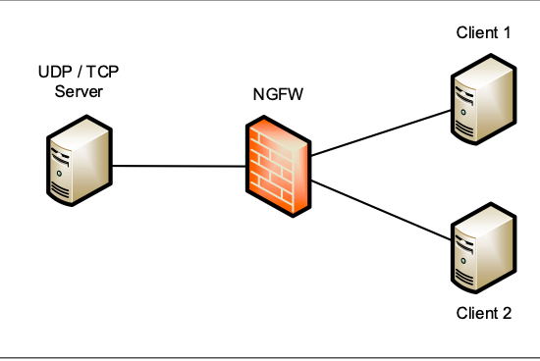
Problem Description
Without congestion control, application using UDP generates traffic at a high rate.
Overflows at routers, switches, and other network devices.
Unfair bandwidth allocations and starvation within a network.
Network devices are prone to UDP abuse attacks.
Figure 2. Network Topology

Slide 7
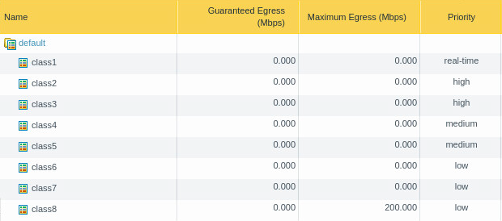
Proposed Solution and Implementation
UDP abuse attacks can be mitigated through NGFWs.
Configure default QoS profile class egress and priority.
Create QoS policy.
Apply QoS profile to the relevant interface.
Figure 3. Adjusted QoS Default Profile

Slide 8
Proposed Solution and Implementation
UDP abuse attacks can be mitigated through NGFWs.
Configure default QoS profile class egress and priority.
Create QoS policy.
Apply QoS profile to the relevant interface.
Figure 4. QoS Policy
Figure 5. QoS Profile for ethernet1/1

Slide 9
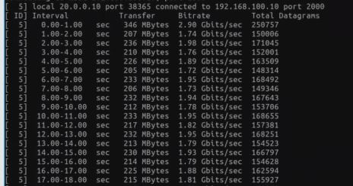
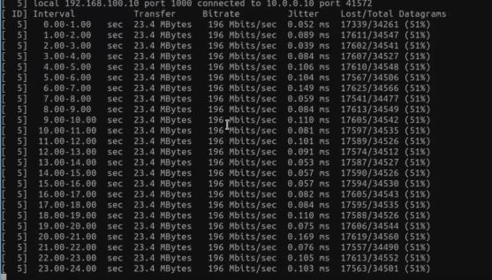
Results
The resulting bitrates of UDP.
Figure 6. Result after two minute iperf3 test

Slide 10
Conclusion
A next-generation firewall is an effective measure in mitigation of a UDP abuse attack.
This QoS Policy can be applied to many different network topologies, and the rate of UDP flow can be set according to the available bandwidth of the network.

