Slide 1
CLI Testing and Troubleshooting
Doug Southworth・ Texas Advanced Computing Center・ dsouthworth@tacc.utexas.edu

Slide 2
If you’re wondering why I’ve brought you here…
Motivations and Methods

Slide 3
What is perfSONAR?
perfSONAR is a tool to:
Set network performance expectations
Find network problems (“soft failures”)
Help fix these problems
All in multi-domain environments
These problems are all harder when multiple networks are involved
perfSONAR is provides a standard way to publish active and passive monitoring data
This data is interesting to network researchers as well as network operators
Notes:
Quick outline of what perfSONAR is

Slide 4
Soft Failures Cause Packet Loss and Degraded TCP Performance
Local
(LAN)
With loss, high performance beyond metro distances is essentially impossible
International
Metro Area
Regional
Continental
Measured (TCP Reno)
Measured (HTCP)
Theoretical (TCP Reno)
Measured (no loss)
Notes:
TCP works well over short distances (e.g. 1% packet loss on the LAN will produce high throughput).
The further out you get the more pronounced the problems will be as the algorithms cope with retransmissions.

Slide 5
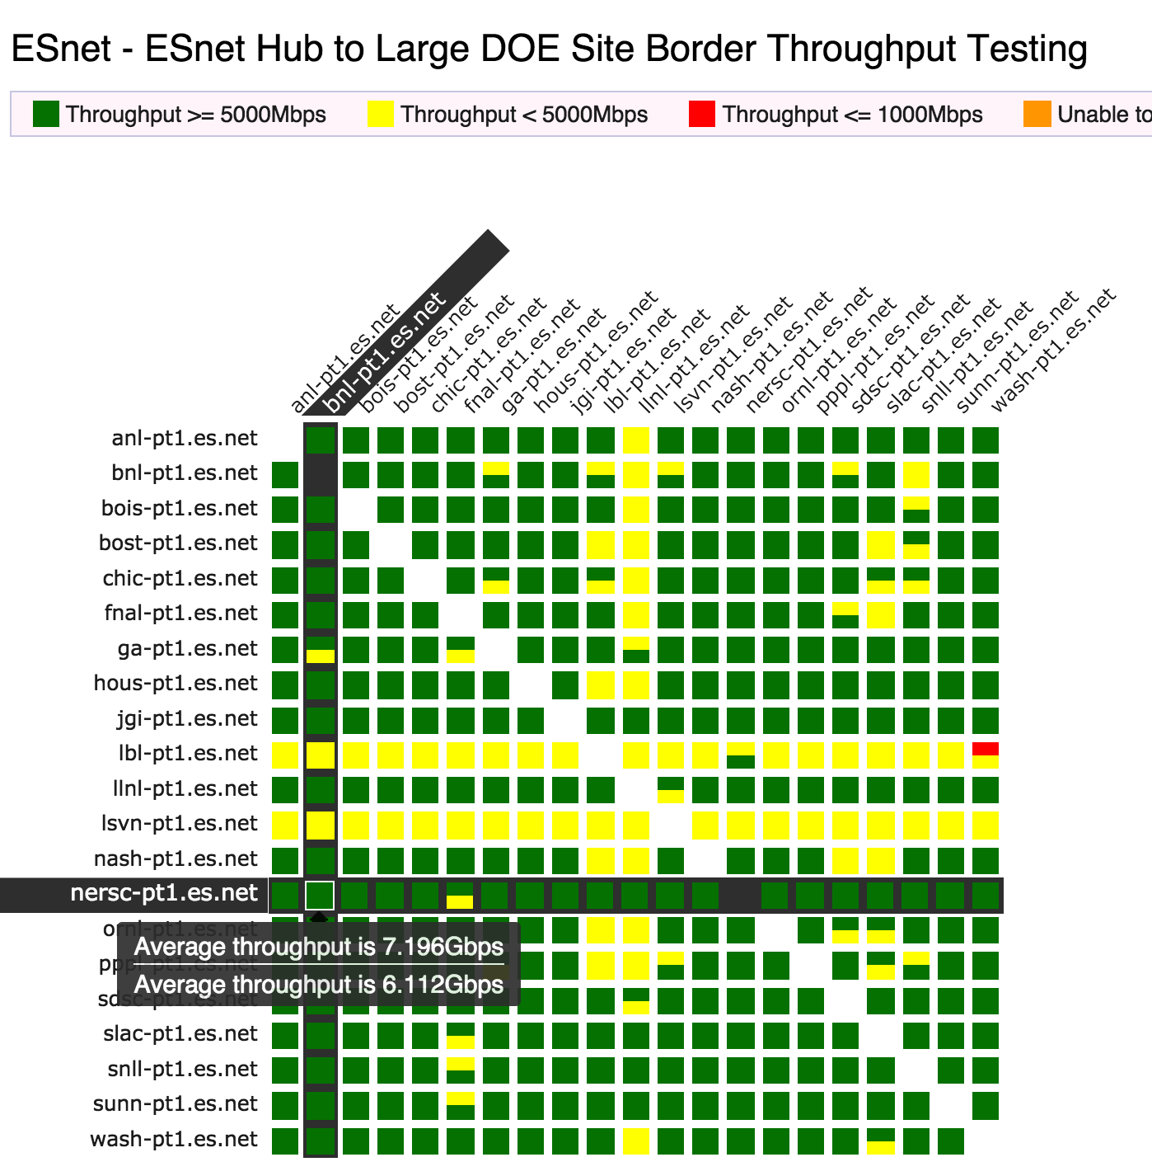
perfSONAR Dashboard: Improving network visibility
Status at-a-glance
Packet loss
Throughput
Correctness
Current live instances at http://pas.net.internet2.edu/
http://ps-dashboard.es.net/
Drill-down capabilities:
Test history between hosts
Ability to correlate with other events
Very valuable for fault localization and isolation
Notes:
Dashboards – requires coordination of testing

Slide 6
Stop letting that pS node gather dust
perfSONAR has a lot of value as a day-to-day tool; it’s not just a software package that puts a green square on a mesh
If you use it more often, you’ll tend to keep it updated and operational
Having an outdated, insecure node is worse than not having one at all
The goal is proactive analysis, troubleshooting, and resolution
R&E networks, like old British cars, need us: they aren’t self sufficient
Researchers rely on our networks to do their work, and they won’t necessarily speak up when there’s a problem
pS gives you eyes to see what’s going on beyond your borders
Notes:
The point is the pS is more than just a performance number generating machine.

Slide 7
WE NEED YOU!
perfSONAR is a community effort, and not just for development.
Your node gives us all eyes into the global R&E infrastructure

Slide 8
Commands and Syntax

Slide 9
Simulating Performance
It’s infeasible to perform at-scale data movement all the time – as we see in other forms of science, we need to rely on simulations
Network performance comes down to a couple of key metrics:
Throughput (e.g. “how much can I get out of the network”)
Latency (time it takes to get to/from a destination)
Packet loss/duplication/ordering (for some sampling of packets, do they all make it to the other side without serious abnormalities occurring?)
Network utilization (the opposite of “throughput” for a moment in time)
We can get many of these from a selection of active and passive measurement tools – enter the perfSONAR Toolkit
Notes:
Idea – we are measuring performance by testing what is possible. If OWAMP runs stable and loss free, video will work out ok. If throughput is stable and high, bulk data movement should work on the network (does not test disk)

Slide 10
pscheduler – The Secret Sauce
pscheduler is the engine that drives perfSONAR
Coordinates timeslots and schedules tests between nodes
Creates a common syntax that all tools use
Handles the storage of results
This approach to test management ensures that:
Tests that could impact each other’s performance, like throughput, are never run simultaneously
Simplified coordination, where you don’t need an engineer at the other end to start a daemon, open a port, etc.
Access control is maintained and test limits are enforced

Slide 11
Basic syntax
pscheduler task [options] test-type [test-options]
task is what you want pscheduler to do
test-type is how you want pscheduler to do it
There’s more than one tool to run many of these tests, and pscheduler gives you the option to choose that tool:
iperf2/iperf3/nuttcp for bandwidth
traceroute/tracepath/paris-traceroute for routing
--help is your friend!

Slide 12
Remote Commands, AKA, Your Best Friends
--source and --dest flags do what you expect they would, but neither end has to be your node
You can run most tests between two remote nodes
This includes perfSONAR’s built-in self-diagnostic tools
This core piece of functionality is what makes perfSONAR useful in day-to-day troubleshooting activities and makes it more than just a simple performance data collector

Slide 13
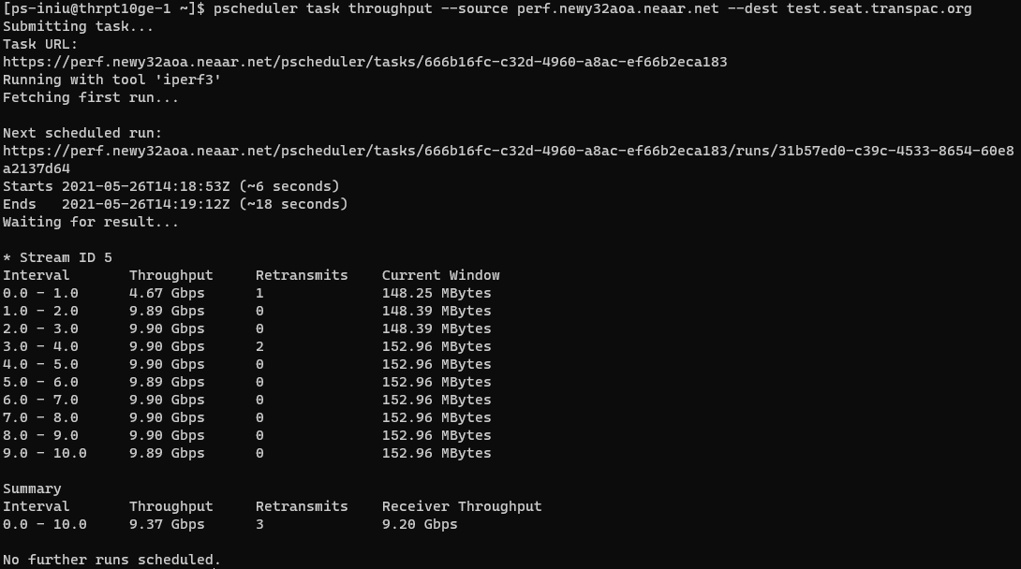

Slide 14
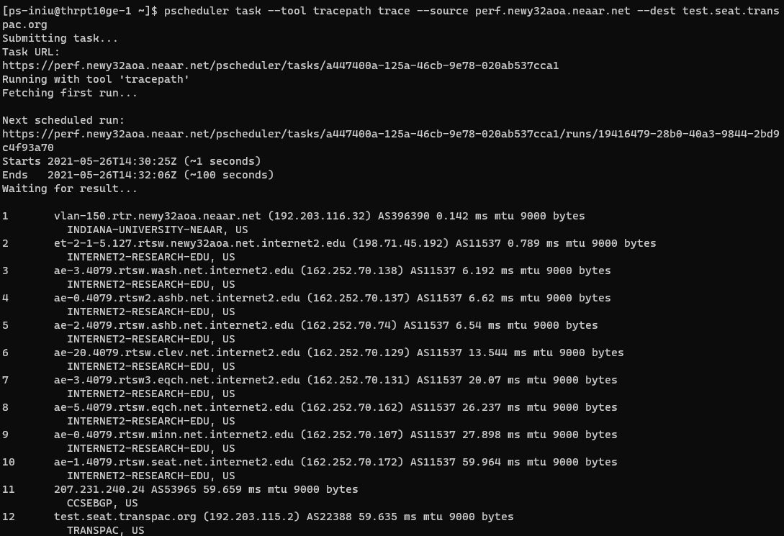

Slide 15
Wait, did you say built-in diagnostics??
pscheduler troubleshoot
See if your node has the basic, necessary services running, if PMTUD is working, if the clock is synched to an NTP source, etc.
pscheduler troubleshoot $remote_node1
Same as above, but adds in the same tests on a remote node to ensure your two nodes can successfully complete a test
pscheduler troubleshoot --host=$remote_node1 $remote_node2
Same as the first two, but checking two remote nodes against each other

Slide 16
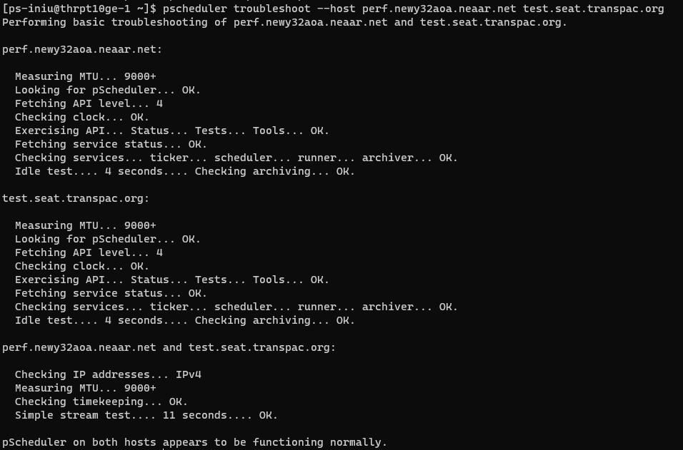
Demonstration icon by luketaibai from The Noun Project

Slide 17
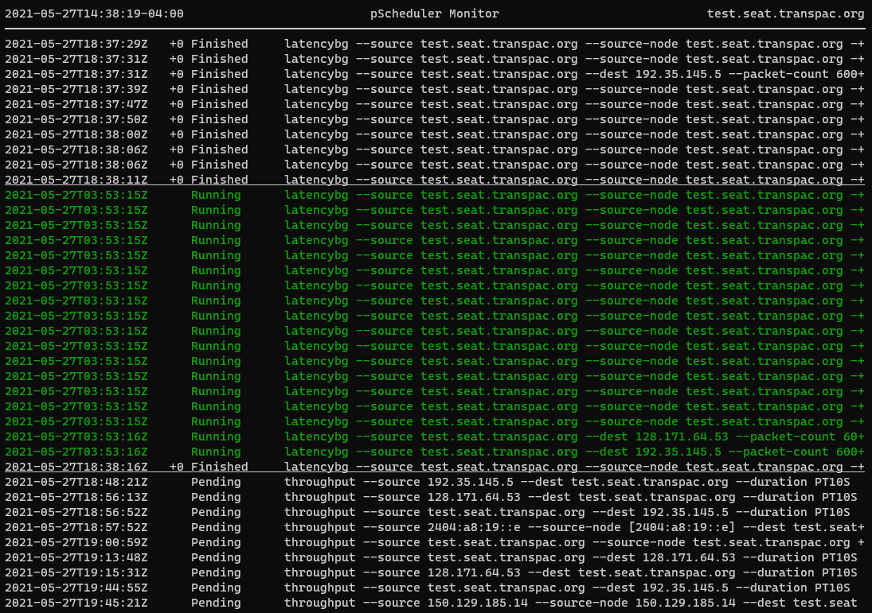
Yeah, but what about pscheduler monitor?
Yep, that works too.
pscheduler monitor --host=$remote_host
You can even plot a host’s schedule:
pscheduler plot-schedule --host=$remote_host

Slide 18
In The Wild
Examples from real world scenarios

Slide 19
NRAO/UVA <> SARAO Performance Problem
Data sharing from the National Radio Astronomy Observatory, located on the University of Virginia campus, to the South African Radio Astronomy Observatory
Low performance – 4.8Mbps
Initial testing from the South African side revealed a few potential problems, such as asymmetric routing and paths with unnecessarily circuitous routes.
These were identified using normal traceroutes and quickly corrected
No appreciable change in performance

Slide 20
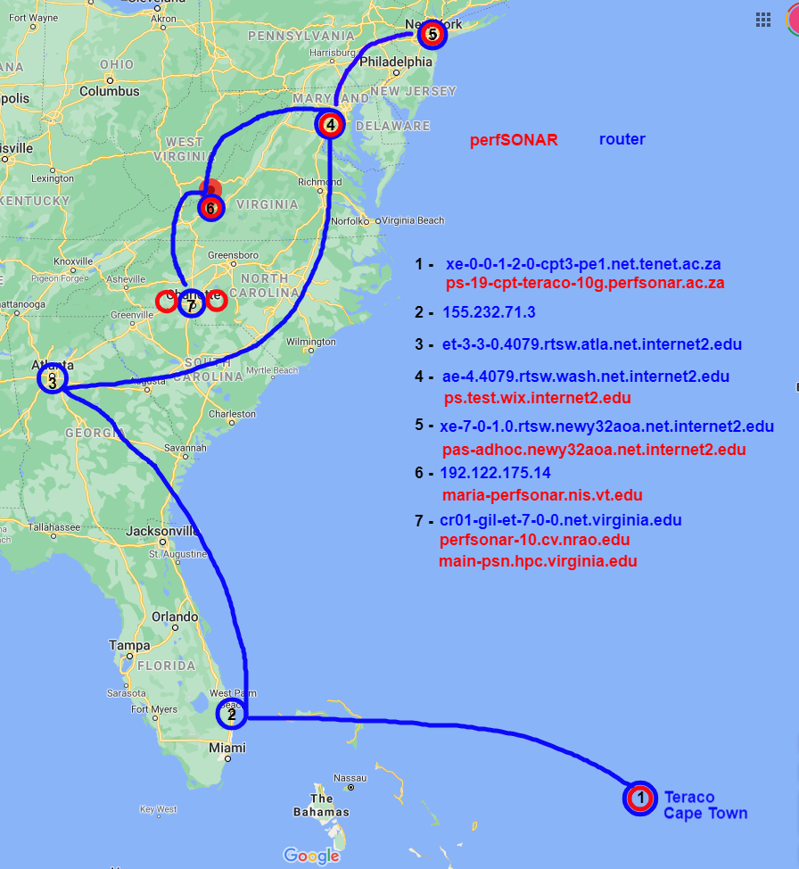
Identification of possible pS toolkits
1 te0-1-0-1-cpt2-pe1.net.tenet.ac.za (155.232.40.9) AS2018 0.703 ms
…
5 155.232.71.3 AS2018 166.6 ms
TENET-1, ZA
6 et-3-3-0.4079.rtsw.atla.net.internet2.edu (162.252.70.42) AS11537 172.712 ms
INTERNET2-RESEARCH-EDU, US
7 ae-4.4079.rtsw.wash.net.internet2.edu (198.71.45.7) AS11537 185.775 ms
INTERNET2-RESEARCH-EDU, US
8 ae-0.4079.rtsw2.ashb.net.internet2.edu (162.252.70.137) AS11537 186.419 ms
INTERNET2-RESEARCH-EDU, US
9 ae-2.4079.rtsw.ashb.net.internet2.edu (162.252.70.74) AS11537 185.845 ms
INTERNET2-RESEARCH-EDU, US
10 192.122.175.14 AS40220 186.368 ms
MARIA, US
11 br01-udc-et-1-0-0-20.net.virginia.edu (192.35.48.33) AS225 188.065 ms
VIRGINIA-AS, US
12 cr01-udc-et-4-2-0.net.virginia.edu (128.143.236.6) AS225 188.448 ms
VIRGINIA-AS, US
13 cr01-gil-et-7-0-0.net.virginia.edu (128.143.236.89) AS225 203.281 ms
VIRGINIA-AS, US
14 perfsonar-10.cv.nrao.edu (198.51.208.55) AS225 188.179 ms
VIRGINIA-AS, US

Slide 21
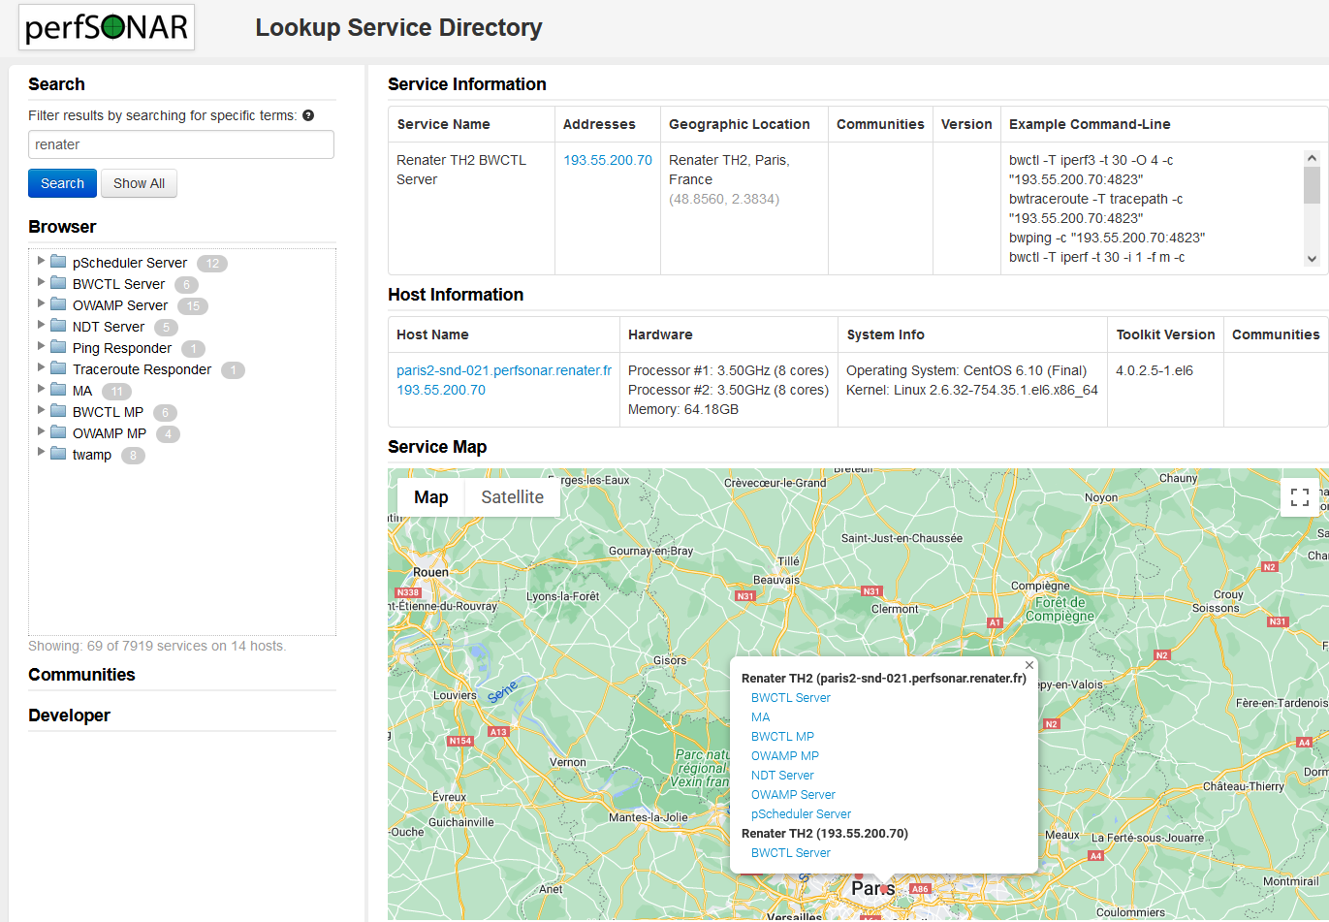
perfSONAR Lookup Service Directory
http://stats.es.net/ServicesDirectory/
Lookup listed testpoints and toolkits by almost any criteria:
Hostname
IP address
Institution
City
Country
REN
pS instance must have commodity internet access to be listed.

Slide 22
Initial problem isolation
Tests from various domestic and international perfSONAR nodes to UVAs campus were telling:
CHPC South Africa -> Internet2 Washington - 6.67 Gbps
Internet2 Albany -> Internet2 Washington - 9.893 Gbps
Internet2 Washington -> NRAO - 3.31 Gbps (lots of retries)
Internet2 Washington -> HPC University Virginia - 2.21 Gbps (lots of retries)
NRAO -> HPC University Virginia - 6.64 Gbps (lots of retries)

Slide 23
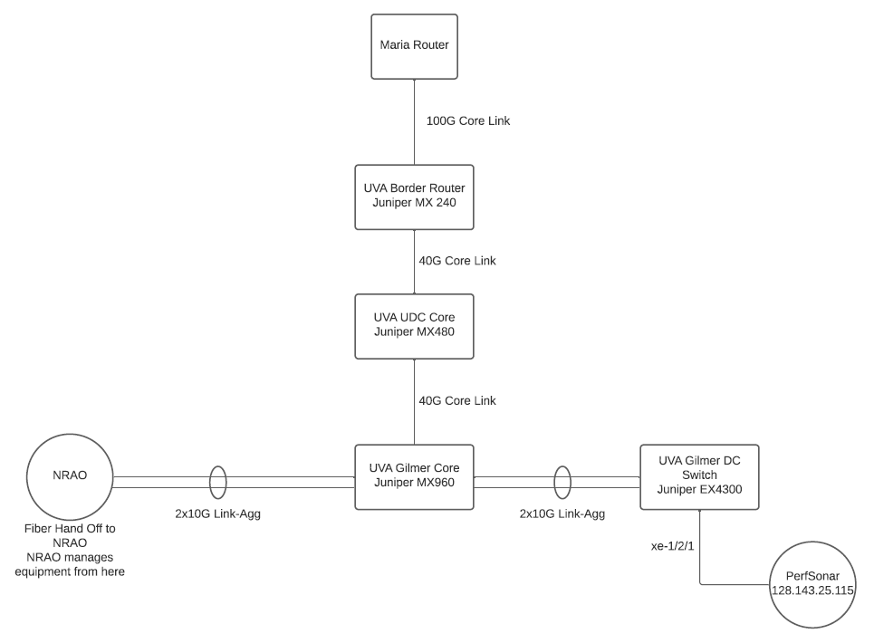
UVA/NRAO Network
MTU 9000
MTU 1500?

Slide 24
Path MTU Discovery (PMTUD)
Is a layer 3 construct
Requires UDP and ICMP to function
UDP packets larger than the MTU setting of the receiving router interface will trigger an ICMP “unreachable” message back to the sending router, which in turn causes a renegotiation to a lower MTU
All is not lost if PMTUD doesn’t work
Smart transfer tools can figure out a common MTU, at the cost of time
Packets sent at 9K can be fragmented to adhere to a smaller MTU, at the cost of performance…unless the no-fragment flag is set
Neither of these scenarios is good for high performance. PMTUD should be made to work and common MTUs enforced wherever possible

Slide 25
Further isolation
Working inward from a known good ESnet perfSONAR node to UVA:
Interval Throughput Retransmits Current Window
0.0 - 1.0 9.13 Gbps 22 33.17 MBytes
1.0 - 2.0 9.35 Gbps 0 33.58 MBytes
2.0 - 3.0 9.38 Gbps 0 33.58 MBytes
3.0 - 4.0 9.38 Gbps 0 33.58 MBytes
4.0 - 5.0 9.38 Gbps 0 33.58 MBytes
5.0 - 6.0 9.35 Gbps 0 33.58 MBytes
6.0 - 7.0 9.36 Gbps 0 33.58 MBytes
7.0 - 8.0 9.38 Gbps 0 33.58 MBytes
8.0 - 9.0 9.37 Gbps 0 33.58 MBytes
9.0 - 10.0 9.37 Gbps 0 33.58 MBytes
Summary
Interval Throughput Retransmits Receiver Throughput
0.0 - 10.0 9.35 Gbps 22 9.25 Gbps
This test looks good, because the hosts successfully negotiate 1500 MTU

Slide 26
Negotiations break down
Working inward from a known good ESnet perfSONAR node to NRAO:
(Keep in mind, we know MTU 9000 on both ends, but with a step down to 1500 in the middle of the UVA campus)
Interval Throughput Retransmits Current Window
0.0 - 1.0 2.54 Mbps 2 8.95 KBytes
1.0 - 2.0 0.00bps 1 8.95 KBytes
2.0 - 3.0 0.00bps 0 8.95 KBytes
3.0 - 4.0 0.00bps 31 3.07 KBytes
4.0 - 5.0 0.00bps 67 5.12 KBytes
5.0 - 6.0 4.45 Mbps 2 17.41 KBytes
6.0 - 7.0 8.26 Mbps 0 33.79 KBytes
7.0 - 8.0 23.28 Mbps 0 94.21 KBytes
8.0 - 9.0 51.75 Mbps 0 218.11 KBytes
9.0 - 10.0 83.88 Mbps 0 392.19 KBytes
Summary
Interval Throughput Retransmits Receiver Throughput
0.0 - 10.0 17.42 Mbps 103 10.29 Mbps
9000B packets failing
1500B packets after re-negotiation

Slide 27
Traceroute: ESnet to NRAO
traceroute to perfsonar-10.cv.nrao.edu (198.51.208.55), 30 hops max, 60 byte packets
1 esneteastrt1-eastdcpt1.es.net (198.124.238.37) 0.549 ms 0.544 ms 0.547 ms
2 newycr5-ip-a-esneteastrt1.es.net (198.124.218.17) 1.969 ms 1.963 ms 1.953 ms
3 aofacr5-ip-a-newycr5.es.net (134.55.37.77) 2.330 ms 2.304 ms 2.313 ms
4 et-2-1-5.197.rtsw.newy32aoa.net.internet2.edu (64.57.28.14) 2.323 ms 2.324 ms 2.327 ms
5 ae-3.4079.rtsw.wash.net.internet2.edu (162.252.70.138) 7.571 ms 7.672 ms 7.528 ms
6 ae-0.4079.rtsw2.ashb.net.internet2.edu (162.252.70.137) 8.095 ms 8.077 ms 8.061 ms
7 ae-2.4079.rtsw.ashb.net.internet2.edu (162.252.70.74) 28.089 ms 18.414 ms 18.454 ms
8 192.122.175.14 (192.122.175.14) 8.221 ms 8.179 ms 8.205 ms
9 br01-udc-et-1-0-0-20.net.virginia.edu (192.35.48.33) 10.310 ms 10.310 ms 10.383 ms
10 cr01-udc-et-4-2-0.net.virginia.edu (128.143.236.6) 12.609 ms 12.603 ms 12.638 ms
11 cr01-gil-et-7-0-0.net.virginia.edu (128.143.236.89) 12.407 ms 12.403 ms 12.393 ms
12 perfsonar-10.cv.nrao.edu (198.51.208.55) 10.058 ms 10.032 ms 10.022 ms
Well, that looks good. Let’s try tracepath and see where the MTU changes

Slide 28
Tracepath: ESnet to NRAO
1?: [LOCALHOST] pmtu 9000
1: esneteastrt1-eastdcpt1.es.net 0.788ms
1: bnlmr2-bnlpt1.es.net 0.728ms
2: no reply
3: aofacr5-ip-b-newycr5.es.net 2.411ms asymm 2
4: et-2-1-5.197.rtsw.newy32aoa.net.internet2.edu 2.468ms asymm 3
5: ae-3.4079.rtsw.wash.net.internet2.edu 8.176ms asymm 4
6: ae-0.4079.rtsw2.ashb.net.internet2.edu 8.889ms asymm 5
7: ae-2.4079.rtsw.ashb.net.internet2.edu 8.242ms asymm 6
8: 192.122.175.14 8.522ms asymm 7
9: no reply
10: no reply
11: no reply
12: no reply
Traceroute works, but tracepath doesn’t??

Slide 29
Different Tools, Different Packets
Traceroute uses small 60B UDP packets
Tracepath uses larger 64KB UDP packets
So, somewhere we have a roadblock. Small packets can make it through, but larger ones are dropped (not fragmented).
How do we figure out the max size? Trial and error. Start at 9K and cut the size in half until you get a response, then sneak back up until the packets disappear again.

Slide 30
Tracepath: ESnet to NRAO, 1509 bytes
1: esneteastrt1-eastdcpt1.es.net 0.340ms
2: no reply
3: aofacr5-ip-a-newycr5.es.net 2.279ms asymm 2
4: et-2-1-5.197.rtsw.newy32aoa.net.internet2.edu 2.310ms asymm 3
5: ae-3.4079.rtsw.wash.net.internet2.edu 7.574ms asymm 4
6: ae-0.4079.rtsw2.ashb.net.internet2.edu 9.422ms asymm 5
7: ae-2.4079.rtsw.ashb.net.internet2.edu 7.986ms asymm 6
8: 192.122.175.14 8.123ms asymm 7
9: no reply
MARIA
UVA

Slide 31
Tracepath: ESnet to NRAO, 1508 bytes
1: bnlmr2-bnlpt1.es.net 0.327ms
2: no reply
3: aofacr5-ip-b-newycr5.es.net 2.332ms asymm 2
4: et-2-1-5.197.rtsw.newy32aoa.net.internet2.edu 2.338ms asymm 3
5: ae-3.4079.rtsw.wash.net.internet2.edu 7.668ms asymm 4
6: ae-0.4079.rtsw2.ashb.net.internet2.edu 9.833ms asymm 5
7: ae-2.4079.rtsw.ashb.net.internet2.edu 7.872ms asymm 6
8: 192.122.175.14 8.166ms asymm 7
9: br01-udc-et-1-0-0-20.net.virginia.edu 9.998ms asymm 7
9?: br01-udc-et-1-0-0-20.net.virginia.edu asymm 7
10: cr01-udc-et-4-2-0.net.virginia.edu 10.470ms asymm 8
11: cr01-gil-et-7-0-0.net.virginia.edu 10.208ms asymm 9
12: cr01-gil-et-7-0-0.net.virginia.edu 10.253ms pmtu 1500
12: perfsonar-10.cv.nrao.edu 10.154ms !H
Resume: pmtu 1500
MARIA
UVA

Slide 32
Problem located
The issue was between the MARIA router and the UVA router
The MARIA interface was configured for MTU 9192
The UVA interface was configured for MTU 1518
With PMTUD broken there was no hope for external MTU 9000 equipment to negotiate an appropriate MTU with the NRAO node
UVA changed the MTU on their router interface to match that of MARIA, while keeping their downstream equipment at their campus standard MTU 1500

Slide 33
Ping verification
ping -s 8972 -M do -c 4 perfsonar-10.cv.nrao.edu (don’t fragment)
PING perfsonar-10.cv.nrao.edu (198.51.208.55) 8972(9000) bytes of data.
From cr01-gil-et-7-0-0.net.virginia.edu (128.143.236.89) icmp_seq=1 Frag needed and DF set (mtu = 1500)
ping: local error: Message too long, mtu=1500
ping: local error: Message too long, mtu=1500
ping: local error: Message too long, mtu=1500
ping -s 8972 -M dont -c 4 perfsonar-10.cv.nrao.edu (do fragment)
PING perfsonar-10.cv.nrao.edu (198.51.208.55) 8972(9000) bytes of data.
8980 bytes from perfsonar-10.cv.nrao.edu (198.51.208.55): icmp_seq=1 ttl=55 time=10.3 ms
8980 bytes from perfsonar-10.cv.nrao.edu (198.51.208.55): icmp_seq=2 ttl=55 time=10.2 ms
8980 bytes from perfsonar-10.cv.nrao.edu (198.51.208.55): icmp_seq=3 ttl=55 time=10.2 ms
8980 bytes from perfsonar-10.cv.nrao.edu (198.51.208.55): icmp_seq=4 ttl=55 time=10.2 ms

Slide 34
Yeah, yeah, but what about performance??
Before:
pscheduler task throughput --source cpt-chpc-10g.perfsonar.ac.za --dest perfsonar-10.cv.nrao.edu
Summary
Interval Throughput Retransmits Receiver Throughput
0.0 - 10.0 380.37 Kbps 58 108.18 Kbps
After:
pscheduler task throughput -t 30 --source cpt-chpc-10g.perfsonar.ac.za --dest perfsonar-10.cv.nrao.edu
Summary
Interval Throughput Retransmits Receiver Throughput
0.0 - 30.0 2.67 Gbps 0 2.62 Gbps

Slide 35
You think we need one more? You think we need one more.
Alright. We’ll do one more.

Slide 36
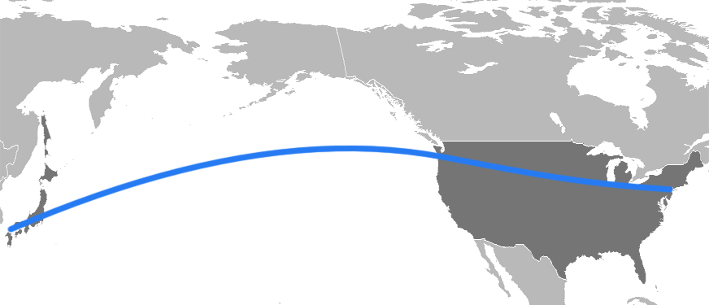
City College of New York (CCNY) to Kyutech Institute (JGN)
Reported asymmetric, poor performance across GRE tunnel
JGN 🡪 CCNY (TCP)
No packet loss
79Mbps throughput
CCNY🡪 JGN (TCP)
0.082% packet loss
8Mbps throughput
CCNY
Kyutech Institute
Tested UDP performance, however, was symmetric at 90Mbps either direction
Notes:
There was no actual expected performance number that was communicated to us, other than that JGN (reasonably) believed the performance should at least be symmetric.

Slide 37
Initial troubleshooting
Used perfSONAR nodes along the path to test to closest open node available-at ManLan.
Nodes located at
APAN/Tokyo
TransPAC/Seattle
Internet2/Chicago
NEAAR/ManLan
TransPAC
Internet2
NEAAR
APAN
Testing to NYC showed good performance and no packet loss- indicating problem was likely within CCNY
Notes:
These tests were conducted outside of CCNY from four publicly available perfSONAR nodes that were situated along the same network path as the CCNY GRE tunnel. At the time of this testing there were no perfSONAR nodes on the CCNY campus.

Slide 38
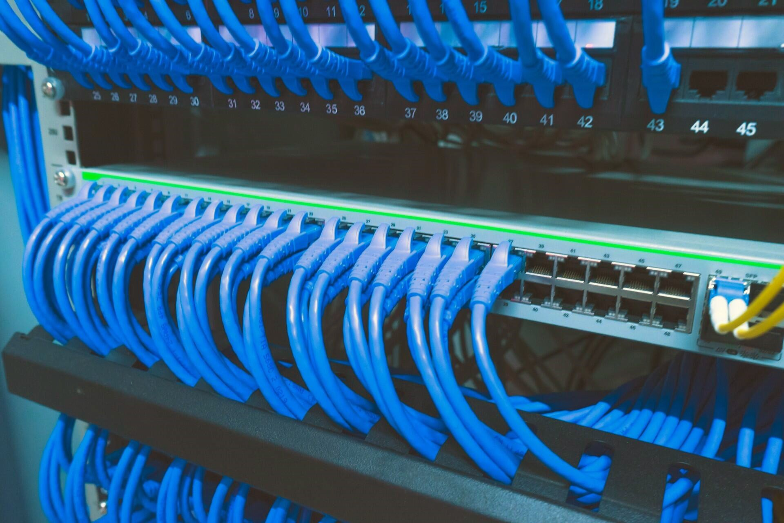
Internal troubleshooting
CCNY and EPOC engineers installed perfSONAR node in researcher’s lab
Tests from prior locations to lab showed same packet loss as original problem
Verified issue within campus
Notes:
Testing was completed from the newly installed perfSONAR node in the researcher’s lab on the CCNY campus. This testing did not involve the GRE tunnel.

Slide 39
Regional troubleshooting
NYSERNet
Regional network for NY
Provides R&E connectivity for CCNY
Engineers installed a new CCNY pS node at campus edge
Testing edge to lab
Packet fragmentation and MTU issues on the ingress path to CCNY
Packet loss isolated to specific segment of the CCNY campus network
Notes:
NYSERNet perfSONAR node located at the same point in the network where CCNY’s connectivity originated.

Slide 40
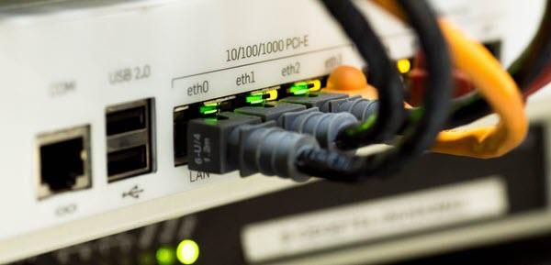
Problem located
With this data
CCNY engineers did additional local troubleshooting
Cause identified as outdated network security device
Replacement had been scheduled, expedited due to results
After replacement
pS tests verified performance was greatly improved
Notes:
Specifics about the updated equipment are unknown, with CCNY siting “security concerns”.

Slide 41
Final Results
CCNY/JGN GRE tunnel shows consistent, symmetric performance
JGN 🡪 CCNY (TCP)
No packet loss
80Mbps throughput
CCNY 🡪 JGN (TCP)
No packet loss
85Mbps throughput
10-fold improvement
CCNY
Kyutech Institute
Notes:
There was no actual expected performance number that was communicated to us, other than that JGN (reasonably) believed the performance should at least be symmetric.

Slide 42
Questions and Answers
Question and answer icon by iconosphere from The Noun Project

Slide 43
Thanks! For more information, please visit our web site: https://www.perfsonar.net
Thanks icon by priyanka from The Noun Project

Slide 44
CLI Testing and Troubleshooting
Doug Southworth・ Texas Advanced Computing Center ・ dsouthworth@tacc.utexas.edu

