Slide 1

BGP Essentials
Ken Miller, Jason Zurawski
ken@es.net, zurawski@es.net
ESnet / Lawrence Berkeley National Laboratory
Modern Cyberinfrastructure for Research Data Management Workshop
University of Central Florida
February 16-17, 2023
National Science Foundation Award #1826994
https://epoc.global

Slide 2
Outline
Preliminaries
R&E routing architecture
  What it is
  Why it matters
  Examples of problems
  Simplified ESnet &. FRGP Routing Architecture
BGP Steering mechanisms and real world examples
  Examples
  Localpref
  AS Path Padding
  Communities
  Multi Exit Discriminators (MEDs)
Questions
Notes:
Eli - Strategy / Hans - Practical

Slide 3
What is BGP
BGP or Border Gateway Protocol is protocol used between routers to exchange routing information and reachability information between or inside AS on the Internet.
BGP makes the Internet work, and in most cases it just works
  Needs to be tuned for best performance
BGP makes routing decisions based on paths, network policies and rule-sets, etc.

Slide 4
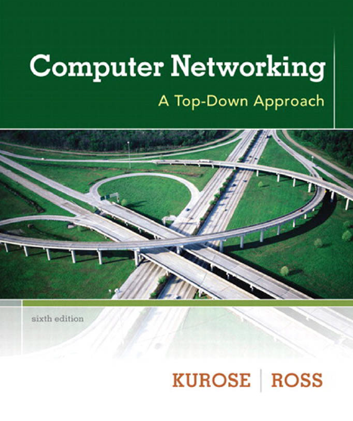
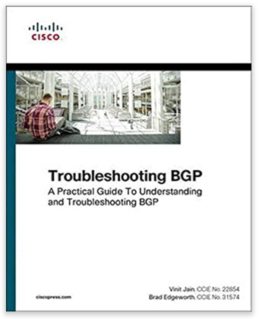
Introduction to BGP
BGP is complex
Even after having read books and RFCs, students (instructors) may find it difficult to fully master BGP without having practiced it
As a critical protocol for the Internet, it is important to understand it

Slide 5
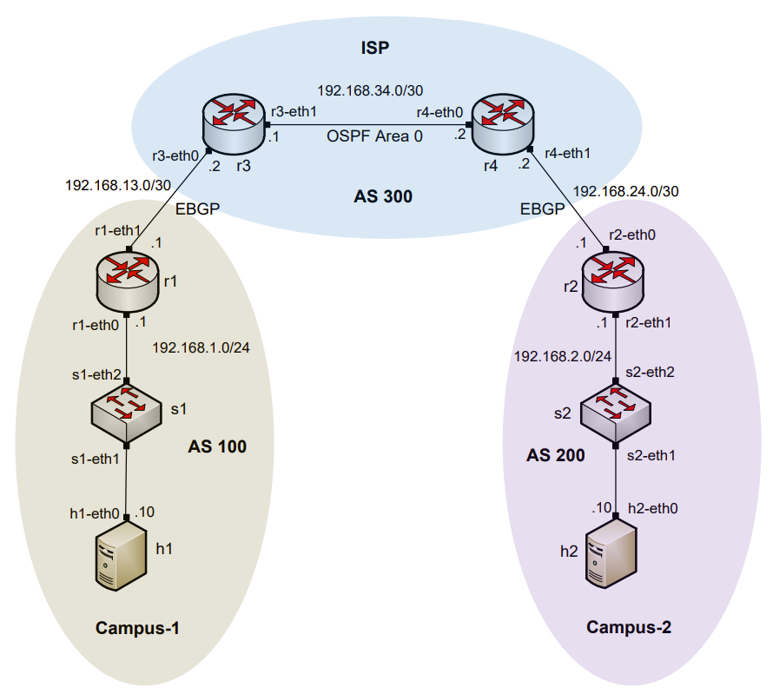
AS, IGP, EGP
Routers are organized into Autonomous Systems (ASes or ASs)
What is an AS (RFC 1771)?
What is an Interior Gateway Protocol (IGP)?
What is an Exterior Gateway Protocol (EGP)?
“A set of routers under the single technical administration, using an IGP and common metrics to route packets within the AS, and using an EGP to route packets to other ASs.”
A routing protocol used to exchange routing information within an AS (e.g., RIP, OSPF)
A routing protocol used to exchange routing information between Ases
eBGP is the most prevalent example of an EGP

Slide 6
Why BGP rather than an IGP?
An IGP moves packets as efficiently as possible within an AS
A IGP does not worry about policies (limited routing policies can be enforced with IGP)
  A corporate AS is normally not willing to carry (transit) traffic originating from a foreign AS
  A Research and Education Network (REN) may not want to carry commercial traffic
  Traffic starting or ending at Apple should not transit Google, etc.
BGP is designed to handle all these cases and enforce routing policies, both within and between ASes

Slide 7
BGP Route Advertisements within an AS
BGP advertisements from an AS to another is referred to as External BGP (EBGP)
BGP advertisements within an AS is referred to as internal BGP (IBGP)

Slide 8
BGP Route Advertisements between ASs
In BGP route advertisements, each border router prepends its own AS number to the route before advertising the route to the next AS
Notes:
This is one of the ways that interdomain routing protocols differ from intradomain protocols

Slide 9
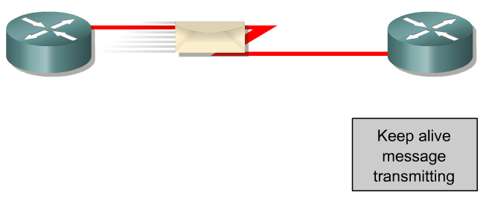
BGP – Best Path
The main goal is to provide interdomain routing
BGP selects one path as the best path
It places the selected path in its routing table and propagates the path to its neighbors
Is this the best path? Does it meet the path selection criteria? If so, add to routing table.
BGP Update
BGP Table
Routing Table
Network
Network
Rick Graziani, “Implementing Cisco IP Routing,” Cisco Press, 2015

Slide 10
Agenda
Preliminaries
Commodity vs. R&E routing architecture
  What it is
  Why it matters
  Examples of problems
  Simplified ESnet & FRGP Routing Architecture
BGP Steering mechanisms and real world examples
  Localpref
  AS Path Padding
  Communities
  Multi Exit Discriminators (MEDs)
  Examples (Good and Bad)
Questions
Notes:
Eli - Strategy / Hans - Practical

Slide 11
BGP in the wild
Over 74,000 Autonomous Systems (ASN) in March 2022.
Over 1,000,000 IPv4 routes advertised.
Over 182,000 IPv6 routes advertised.
Each Router running BGP builds its own routing table with best path information to a subset of the internet.
We all have to do our part
  All routing decisions made locally
  Emergent behavior is important
Motivation examples to follow
Data from: https://bgp.he.net/report/prefixes#_prefixes

Slide 12
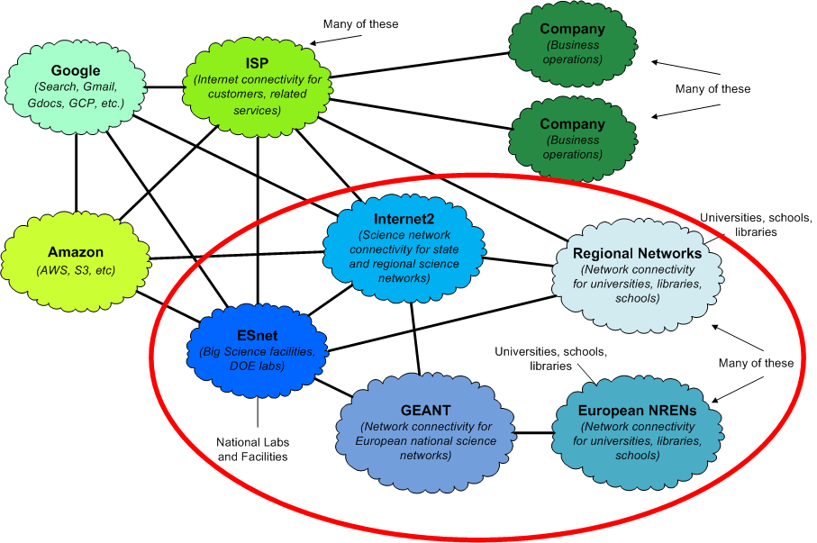
R&E vs. Commodity
Multiple cloud providers

Slide 13
R&E Routing Architecture Vs. Commodity.
Research and Education Networks
  Bandwidth
  Performance Engineering
  Deterministic behavior
  Community
Commodity Networks
  Traffic shaping
  DoS protections
  Unknown architecture
R&E networks are engineered to support science while commodity networks are not
  Keep the science traffic on the science networks!

Slide 14
BGP Use in ESnet

Slide 15
ESnet Routing Architecture (High-Level, Simplified)
Routing policy applied at ingress (import policy on peerings)
  Routing policy sets communities based on peering type
  Routing policy sets localpref set based on peering type - simplified version:
    ESnet site - high
    R&E peering - medium
    Commercial Peering - low
    Transit - very low
  Communities control route announcement behavior to sites and peers
  Localpref controls forwarding behavior within ESnet network
This allows us to group routes based on connectivity capability and type of peer organization, and use normal BGP route selection within those groups
  Forwarding is sane and high performance
  This is more complex than a campus needs (we’re a national backbone), but ideas still hold

Slide 16
Site Or Campus Routing Isn’t Backbone Routing
Many of the tools are the same (e.g. BGP policy)
Goals are sometimes different
  Backbone: multiple peers, resilience to route leaks, BCP38 filters, etc.
  Campus: support security policy, keep transit costs down, etc.
  High performance for science: common goal
  Cost reduction: common goal (flat rate vs. charge by the bit)
Don’t try to replicate ESnet’s policy on your campus perimeter
  Not necessarily a good fit
  Know Your Network
Make sure you understand the tools you have, and use them to get as much as you can out of the infrastructure you’ve got
Keep science traffic on science networks - every site has to do this unless your provider is explicitly doing it for you

Slide 17
BGP Use in FRGP

Slide 18
FRGP Routing Architecture
Front Range GigaPoP is a regional R&E network in Colorado / Wyoming / New Mexico
Compact routing core consisting of 4 Juniper MX routers in Denver-area exchanges and strategic carrier locations.
Dark fiber, DWDM and Metro Ethernet technologies to aggregate customer access
We use a very similar BGP policy to Esnet
  Localpref groups – same idea (Customer > Research > Commercial Peer > Transit )
  On a Campus, you may only be concerned with Research and Transit
We also use BGP Communities to tag groups of routes as they are learned
  This helps us with announcements (export policy)
Two explicit routing instances : research (vrf) and commercial Internet (global routing table)
  These are implemented as MPLS/BGP Layer3 VPNs
  Most customers using BGP have two VLAN tags and two BGP sessions, for each table
We have a blended VRF for customers that prefer the simplicity of default routing only
  This consists of the research VRF plus a default route that points to the commercial table

Slide 19
Internet DFZ routing vs Campus / LAN
Routing asymmetry is commonly observed, expected feature of the multihomed AS
This is because each AS makes independent routing decisions
A step further- if you announce the same route to two external peer ASes, you should not assume a specific distribution of inbound traffic across those two connections. It will probably be unbalanced.
In this scenario, we can try to influence what happens by making suggestions to the neighboring ASes. We will discuss some of these techniques later.
When thinking BGP, it is useful to think about unidirectional concepts:
  Received / Learned routes are used to send (transmit) packets
  Advertised routes will influence where you receive traffic. – “Announcements attract traffic”

Slide 20
BGP hygiene - Preventing routing leaks and hijacks
Default policy = readvertise all routes among external peers (disallowing AS loops)
This is a reasonable policy for Internet backbone routers. The rest of us must have policy in place for proper routing behavior!
If you are an end-site, at a minimum, you should have policy in place to ensure that you’re only advertising your own route(s) to all neighbors.
For many networks, BGP policy can be nuanced and complex. This can lead to unintended advertisements.

Slide 21
Agenda
Preliminaries
Commodity vs. R&E routing architecture
  What it is
  Why it matters
  Examples of problems
  Simplified ESnet & FRGP Routing Architecture
BGP Steering mechanisms and real world examples
  Localpref
  AS Path Padding
  Communities
  Multi Exit Discriminators (MEDs)
  Examples (Good and Bad)
Questions
Notes:
Eli - Strategy / Hans - Practical

Slide 22
So what do we do?
To first order, this means we need to use BGP policy to keep R&E traffic on R&E networks
  Announcements attract traffic
  Routing determines the path the traffic takes through the network - BGP gives us the tools
BGP is a path vector protocol
  For a given prefix, the shorter AS path is preferred
  If AS path length is the same, then other criteria are used, in order (“BGP path selection algorithm”)
Override BGP’s use of AS path length when choosing between R&E and commodity paths
  R&E path will be longer in the general case (more organizations involved)
  Use normal BGP route selection between R&E routes, and between commodity routes
  Remember - hop count is a legacy metric

Slide 23
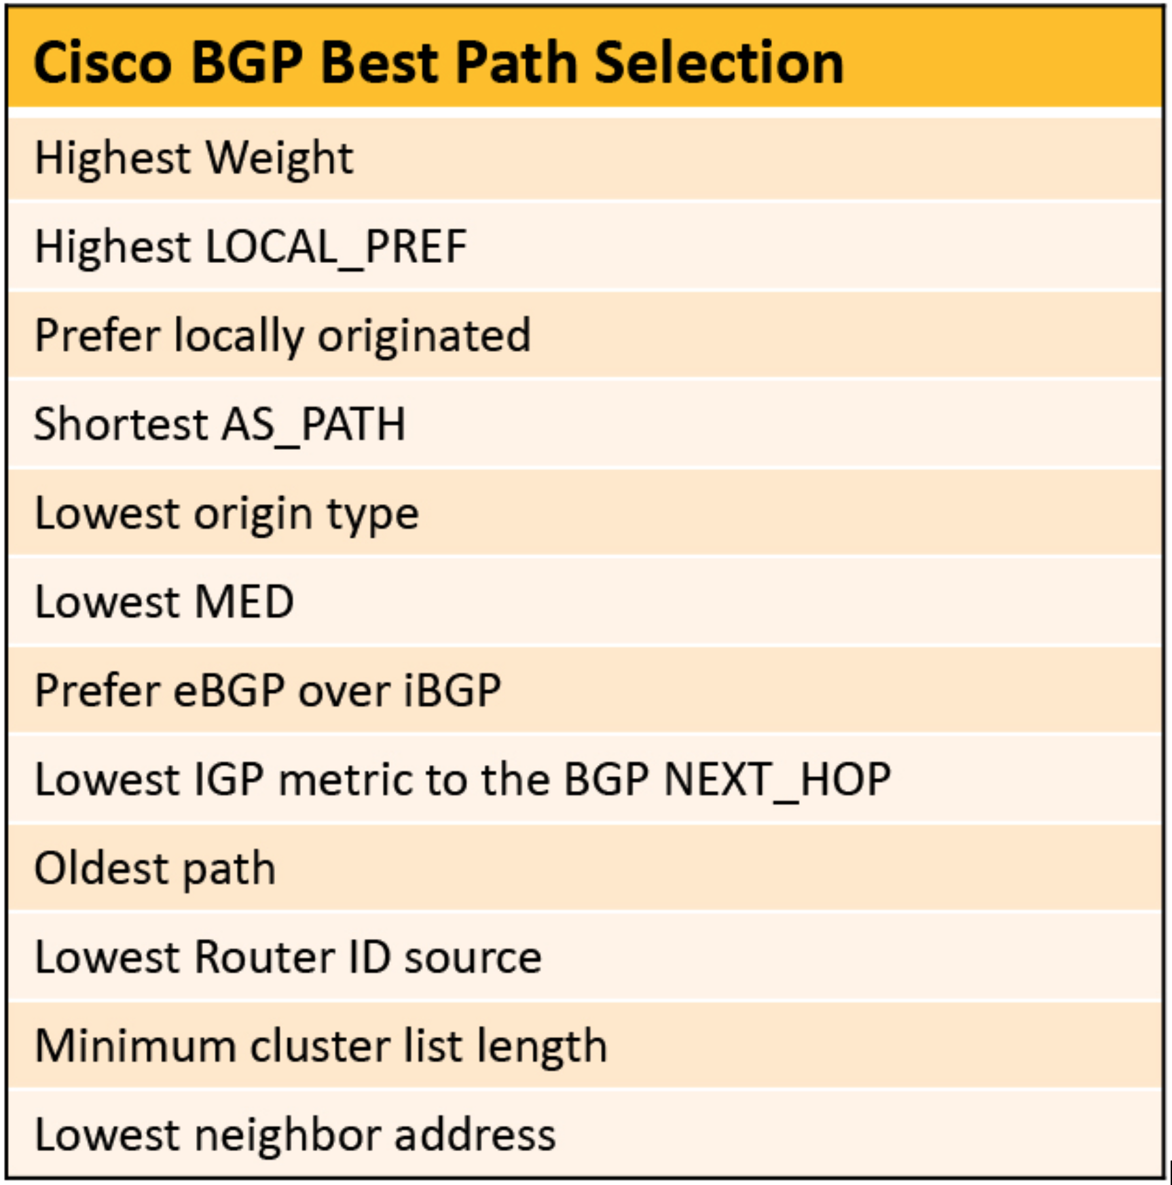
BGP - Care and feeding
BGP just works in many cases but needs tuned for performance
Best path selection is a 10+ step process!
Common steering mechanisms:
  Localpref
  Communities
  AS Padding
  MEDs

Slide 24
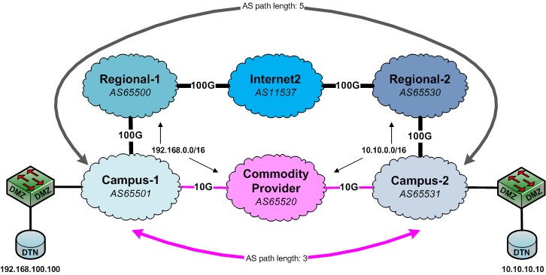
BGP AS Path Length Illustrated
Notes:
If you’re paying for commodity by the bit, sending 100TB over commodity may not be desirable
You’re paying for Internet2 already - this sort of transfer is what science networks are built to handle

Slide 25
LocalPref (e.g. “outbound route”)
Indicates to routers in the AS which path is preferred to exit the AS (higher is better)
Can be done per-prefix
Modifies path for outbound traffic
Exchanged only among routers within the same AS (passed only via IBGP, not via EBGP)
very frequently used in provider networks
R&E
Commodity
LocalPref: 200
LocalPref: 100
Local

Slide 26
Public BGP Community Strings offered by Internet2
https://noc.net.internet2.edu/i2network/maps-documentation/documentation/bgp-communities.html
Set LocalPref on your advertised prefixes
  Default - 100
  11537:40 - Low
  11537:160 - High
Prefix identification?
  11537:5004 - Amazon
Where does the prefix enter the network?
  11537:242 New York
Emergency!
  11537:911 - Discard all traffic destined to these prefixes!
AS Path Padding?
  65001:65000 - prepend x1

Slide 27
BGP Community Strings
A community string is a number value that the peer uses like a tag.
Tagging prefixes with communities tells the peer to handle the prefixes in a special way.
Can make changes to routing policy based on per prefix strings
Prefixes can have multiple community strings
Can provide useful information about the prefix
Communities that might be useful to external networks should be made public
  Provides a mechanism for peers to affect a network’s internal behavior
  Common uses: change local preference, DDoS mitigation
Look for upstream networks published communities
  Regional?
  National?
Notes:
an end network could make great use of them informationally but also use them to make better choices and even influence routing of their traffic

Slide 28
AS Path Padding
BGP will choose shortest AS Path
Add one or more copies of your AS# to prefixes advertised to specific neighbors.
* 180.208.59.0/24 202.112.61.57 - - - 4538 4538 24364 133465 133465 133465 65300 i

Slide 29
(MED) Multi Exit Discriminator (e.g. “inbound route”)
Indicates to external neighbors the preferred path into an AS
Useful when you have N+1 connections to a network
Lowest number preferred
MED can be sent to EBGP peers:
  Routers propagate a MED within their AS
  But do not pass it on to the next AS
This may, or may not, be honored by the neighboring AS
  Back to first principles – forwarding decisions are made locally
Regional
Regional
MED: 5
MED: 10
Local

Slide 30
Why does this matter? Example 1 - OSC
Data transfers between Ohio Supercomputer Center and NERSC were slow
Turns out they were going over commodity instead of R&E paths
Commodity networks often throttle high-speed flows
  What does a multi-gigabit traffic spike mean?
  Commodity: another DoS attack - this should be stopped!
  R&E: another scientist doing normal things - this is core mission!
What does it look like on the wire?

Slide 31
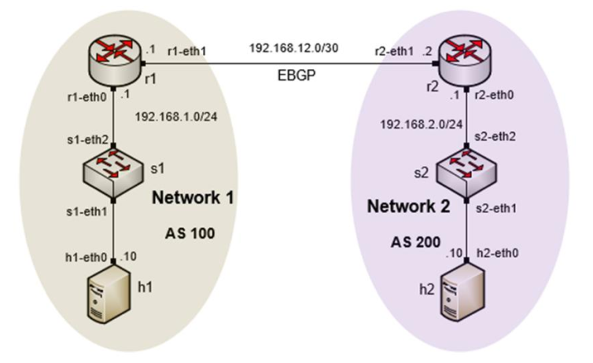
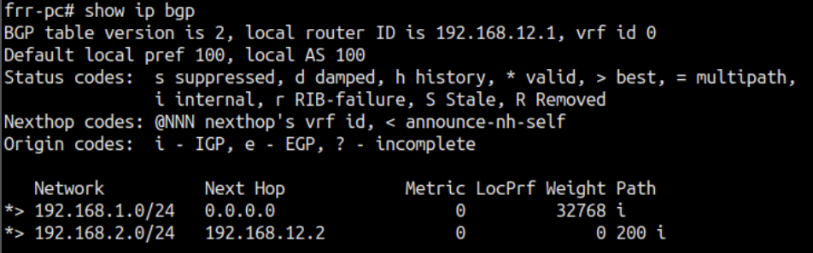
Next-hop Attribute
Unlike IGPs, BGP routes AS by AS, not router by router
The next-hop address for a network from another AS is an IP address of the entry point of the next AS along the path to that destination network
This default behavior is sometimes overridden through an iBGP export/outbound policy known as “next-hop self”
BGP table router r1
Rick Graziani, “Implementing Cisco IP Routing,” Cisco Press, 2015

Slide 32
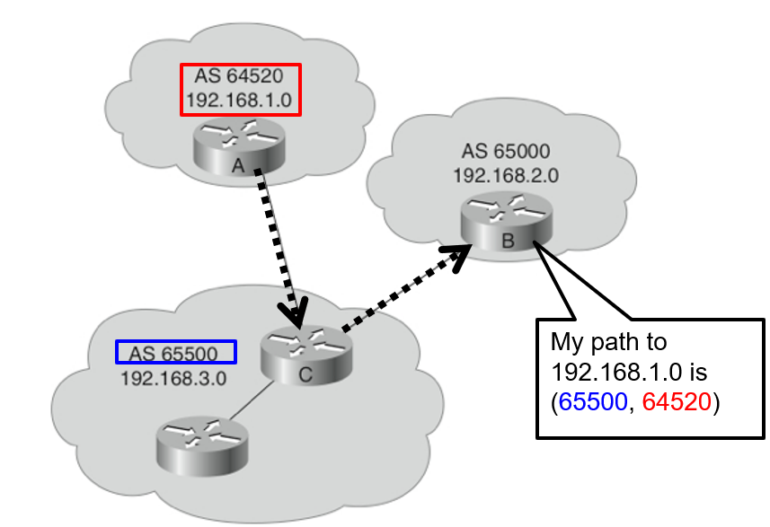
The AS-Path Attribute
Whenever a route update passes through an AS, the AS number is prepended to that update
Router A: advertises network 192.168.1.0 in AS 64520
Router C: prepends its own AS number to it and advertises the route to Router B
Router B: the path to reach 192.168.1.0 is:
  65500, 64520
Rick Graziani, “Implementing Cisco IP Routing,” Cisco Press, 2015

Slide 33
Origin Attribute
Defines the origin of the path information
The origin attribute can be one of three values:
IGP (“i”)
  The route is interior to the originating AS
  Normally when the network command is used
EGP (“e”)
  The route is learned via EGP
  EGP is legacy and no longer supported
Incomplete (“?”)
  The route’s origin is unknown / some other means
  It usually occurs when a route is redistributed into BGP
BGP table router r1
Rick Graziani, “Implementing Cisco IP Routing,” Cisco Press, 2015

Slide 34
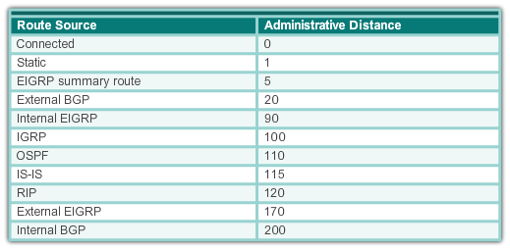
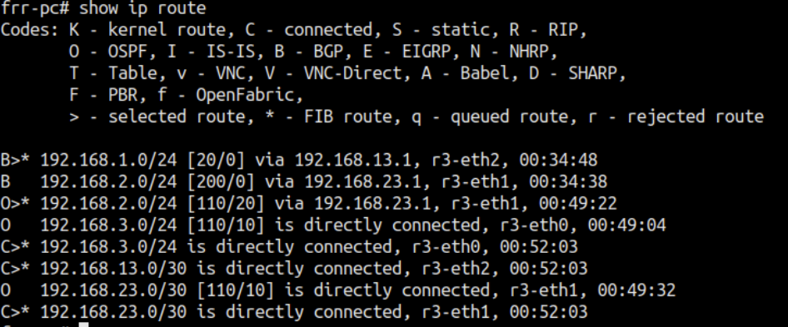
Administrative Distance
A router may run multiple routing protocols / static routes
If BGP and OSPF are configured on a router, both protocols may provide different best paths (analogous to map software)
How does the router know which protocol to choose?
  The route with lower Administrative Distance is installed in the routing table
Rick Graziani, “Implementing Cisco IP Routing,” Cisco Press, 2015

Slide 35
The Weight Attribute - For “Outbound Route”
vendor-specific attribute (e.g. Cisco)
  Juniper has a different mechanism to achieve a similar result
Configured locally and not propagated to any other routers
Higher weight is preferred
Weight takes precedence over Local Preference
Value from 0 to 65535
Default is 32768
Default is 0 for routes not originated by this router
Rick Graziani, “Implementing Cisco IP Routing,” Cisco Press, 2015

Slide 36
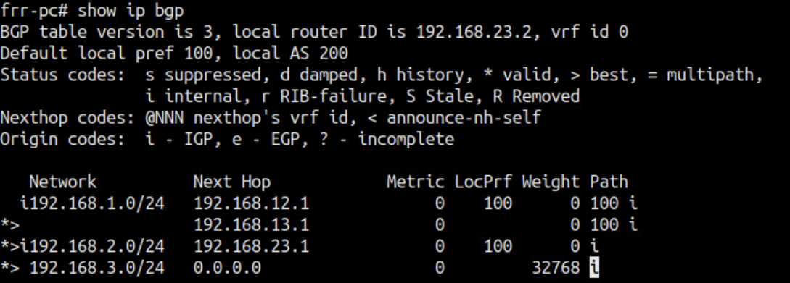
BGP Table
Internal version number of the table
This number is incremented whenever the table changes

Slide 37
Status Code
Code | Meaning
s | Table entry is suppressed
d | Table entry is dampened
h | Table entry history
* | Table entry is valid
> | Table entry is the best entry to use for this network
i | Table entry was learned via an internal BGP session
r | Table entry is a RIB-failure
S | Table entry is stale
= | Table entry has multipath to use for this network
b | Table entry has a backup path to use for this network
x | The table entry has a best external route to use for this network
Displayed at the beginning of each line in the table
This example is for Cisco
Notes:
AS 2 and AS 3 buy transit service from AS 1

Slide 38
EXAMPLES
OSC to NERSC Routing
Regional Network with 2 paths of different capacity
Campus with commodity and R&E paths

Slide 39
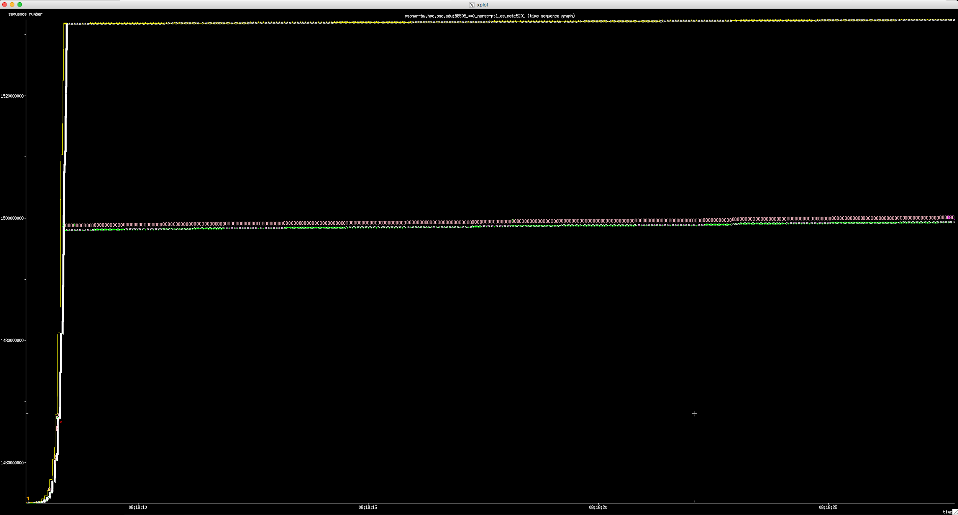

Slide 40
Example 2
2 peerings to Regional provider.
  1x100G, 1x10G
Asymmetrical traffic to coming back into campus via the congested 10G
Before
Interval Throughput
0.0 - 10.0 27.97 Mbps
After
Interval Throughput
0.0 - 10.0 717.75 Mbps

Slide 41
Example 3
Routing Asymmetry
  Preferring comercial path out
  R&E path in
1 University 1 1.103 ms mtu 9000 bytes
2 Regional 2.163 ms mtu 1500 bytes
3 Regional to ISP link 5.425 ms mtu 1500 bytes
4 Hurricane Electric (206.223.118.37) 13.309 ms mtu 1500 bytes
5 Hurricane Electric (184.105.81.205) AS6939 17.328 ms mtu 1500 bytes
6 Hurricane Electric (184.105.65.166) AS6939 21.361 ms mtu 1500 bytes
7 Hurricane Electric to University 2(184.105.48.246) AS6939 24.856 ms mtu 1500 bytes
8 University 2 mtu 1500 bytes
9 University 2 perfSONAR node mtu 1500 bytes
University 2 Route *[BGP/170] 9w6d 05:38:46, MED 0, localpref 150
University 2 Route *[BGP/170] 1w2d 09:49:01, MED 0, localpref 100
Multiple Routing tables advertised from Regional to Campus

Slide 42
Other examples
https://connect.geant.org/2017/05/15/taking-it-to-the-limit-testing-the-performance-of-re-networking
  Commodity path showed two problems
    Packet loss
    DoS mitigation killed high-speed flows
  Configure-before-use or test-before-use model impedes science
https://indico.geant.org/event/1/contributions/11/attachments/47/207/190521_-_PT_TNC2019_v8.pdf
  Multi-nation testing of R&E vs. commodity
  Results indicate R&E paths perform better, even with more hops
    Key point - hop count is a legacy metric because modern routers are ASIC-based
Common theme: R&E networks are engineered to support science while commodity networks are not
  This shouldn’t surprise us - high speed science is what we’ve been doing for years
  But this means we have to keep the science traffic on the science networks!

Slide 43
Agenda
Preliminaries
Commodity vs. R&E routing architecture
  What it is
  Why it matters
  Examples of problems
  Simplified ESnet & FRGP Routing Architecture
BGP Steering mechanisms and real world examples
  Localpref
  AS Path Padding
  Communities
  Multi Exit Discriminators (MEDs)
  Examples (Good and Bad)
Questions
Notes:
Eli - Strategy / Hans - Practical

Slide 44
Questions?
Transfer Performance problems? EPOC is here to help!
epoc@tacc.utexas.edu
https://epoc.global/
NSF Award: 1826994

Slide 45
BGP Essentials
Ken Miller, Jason Zurawski
ken@es.net, zurawski@es.net
ESnet / Lawrence Berkeley National Laboratory
Modern Cyberinfrastructure for Research Data Management Workshop
University of Central Florida
February 16-17, 2023
National Science Foundation Award #1826994
https://epoc.global

