Slide 1
BGP Security
Ken Miller, Jason Zurawski
ken@es.net, zurawski@es.net
ESnet / Lawrence Berkeley National Laboratory
Modern Cyberinfrastructure for Research Data Management Workshop
University of Central Florida
February 16-17, 2023
National Science Foundation Award #1826994
https://epoc.global

Slide 2
BGP is an OLD protocol
Has been in use since 1994
https://datatracker.ietf.org/doc/html/rfc1654
Security was not a concern and not baked into the protocol
Believes (without help) all advertisements from peers with no checks.
It also by default can re-advertise to other peers what it learns.

Slide 3
Hijacking, Leaking, and spoofing…
MANRS reports over 10,000 routing outages or attacks in 2018*
40% of all incidents believed to be attacks.
Incidents can quickly scale to global problems.
*https://www.manrs.org/2019/02/routing-security-getting-better-but-no-reason-to-rest/

Slide 4
Route / Prefix Hijacking
When a network advertises/originates a route that belongs to another network (without permission)
Not always malicious can easily be caused by misconfiguration
https://www.manrs.org/2020/09/what-is-bgp-prefix-hijacking-part-1/

Slide 5
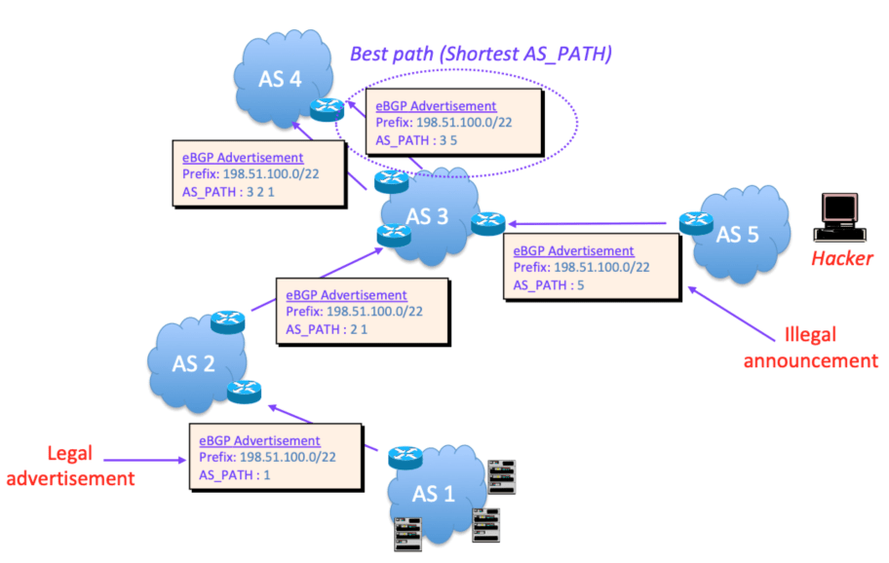
Route / Prefix Hijacking - How it works
AS Path length
https://www.manrs.org/2020/09/what-is-bgp-prefix-hijacking-part-1/

Slide 6
Example: Youtube and Pakistan Telecom
Before, during and after Sunday, 24 February 2008: AS36561 (YouTube) announces 208.65.152.0/22.
Sunday, 24 February 2008, 18:47 (UTC): AS17557 (Pakistan Telecom) starts announcing 208.65.153.0/24. AS3491 (PCCW Global) propagates the announcement. Routers around the world receive the announcement, and YouTube traffic is redirected to Pakistan.
Sunday, 24 February 2008, 20:07 (UTC): YouTube changes to announcing two /24s. Some traffic starts going back to YouTube.
https://www.ripe.net/publications/news/industry-developments/youtube-hijacking-a-ripe-ncc-ris-case-study
https://www.cnet.com/culture/how-pakistan-knocked-youtube-offline-and-how-to-make-sure-it-never-happens-again/

Slide 7
Example: Youtube and Pakistan Telecom 2
Sunday, 24 February 2008, 20:18 (UTC): AS36561 (YouTube) starts announcing 208.65.153.128/25 and 208.65.153.0/25. Because of the longest prefix match rule, every router that receives these announcements will send the traffic to YouTube.
Sunday, 24 February 2008, 20:51 (UTC): All prefix announcements originated by AS17557 (Pakistan Telecom) via AS3491 (PCCW Global), are prepended by another 17557. The longer AS path means that more routers prefer the announcement originated by YouTube.
Sunday, 24 February 2008, 21:01 (UTC): AS3491 (PCCW Global) withdraws all prefixes originated by AS17557 (Pakistan Telecom), thus stopping the hijack of 208.65.153.0/24.

Slide 8
Other Hijacking examples
2018: Amazon DNS routes hijacked and redirected to malicious DNS server: https://www.internetsociety.org/blog/2018/04/amazons-route-53-bgp-hijack/
2020: Rostelecom hijacks internet traffic for Google, AWS, Cloudflare, and others: https://www.zdnet.com/article/russian-telco-hijacks-internet-traffic-for-google-aws-cloudflare-and-others/

Slide 9
Resource Public Key Infrastructure (RPKI) to the rescue (maybe?)
Regional Internet Registries (RIR’s) certifies owners of AS numbers and IP addresses.
They also certify route announcements
Route Origin Authorization (ROAs) show that you are authorized to advertise the IP addresses
Allows you to verify addresses advertised to your router are authorized to be advertised by that entity
Router can set the route as Valid, Invalid, or unknown
Create route policy depending on those results
Allows reject on wrong AS, wrong prefix, or too specific advertisement
https://www.noction.com/blog/rpki-overview
Notes:
2 things you can do 1. Work with your RIR to publish ROA’s for your space that will allow others to validate your advertisements. 2. Start validating others routes.

Slide 10
Route Leak
RFC7908 - “A route leak is the propagation of routing announcement(s) beyond their intended scope.”
A multihomed stub network announces routes from one upstream providers routes to one or more of its other upstream providers
Stub network becomes an inadvertent transit provider.
Only announce AS’s and prefixes that you originate.
https://datatracker.ietf.org/doc/html/rfc7908

Slide 11
Simple Campus/Institution Route Leak Example
X: AS5, AS1
X: AS4, AS5, AS1
AS5
AS4
X: AS1
X: AS2, AS4, AS5, AS1
X
AS1
AS2
X: AS2, AS3, AS1
X: AS3, AS1
AS3
Stub network AS3 creates route leak advertising AS1 to AS2.

Slide 12
Route Leak Example
2017: Rostelecom Route Leak Targets E-Commerce Services: https://www.thousandeyes.com/blog/rostelecom-route-leak-targets-ecommerce-services
Confirmation that traffic destined for those E-Commerce sites went through the leakers network (possible inspection?)

Slide 13
Route Policy to fix Leaks - Overview
BGP Operations and Security RFC: https://datatracker.ietf.org/doc/html/rfc7454
Includes lots of great best practices for AS and prefix filtering
Good Primer: https://www.noction.com/wp-content/uploads/2019/08/BGP-Filtering-Best-Practices.pdf

Slide 14
Route Policy to fix Leaks - Inbound
Loose Inbound Filtering Highlights include:
Don’t accept your own prefixes from a peer.
Filter Bogons (Addresses not assigned)
IPv4 not so much anymore but IPv6 YES
Be careful of more specific prefixes
IPv4: more specific than a /24
IPv6: more specific than a /48
Strict Filtering: use scripts or tool to validate incoming prefixes against route registries.
https://www.irr.net/
Notes:
campus centric

Slide 15
Route Policy to fix Leaks - Outbound
If you are a multihomed only advertise what you originate.
Don’t advertise private space (RFC1918)
Prefixes used on your internal networks
Default route
Notes:
Campus centric

Slide 16
IP Spoofing
Attacker creates and send IP packets with false source address
Commonly used in Distributed Denial of Service (DDOS) attacks
DNS, memcached, NTP, UDP - lots of vulnerabilities
November 2021: Microsoft detects and mitigates a 3.47Tbps (340 million packets per second) 15 minute long DDOS attack using UDP reflection.
https://azure.microsoft.com/en-us/blog/azure-ddos-protection-2021-q3-and-q4-ddos-attack-trends/

Slide 17
Source Address Validation and IP Spoofing
Unicast Reverse Path Forwarding (uRPF)
Router checks it’s forwarding information table (FIB) for source address in each packet.
Strict: Source Address must be reachable via incoming interface (strict) or in the FIB (loose) or packet is dropped.
Can be done with ACL’s as well but can require a lot of manual configuration.
Best Current Practices (BCP) 38
http://www.bcp38.info/index.php/Main_Page
https://datatracker.ietf.org/doc/html/rfc2827
https://learn.nsrc.org/bgp/urpf
https://blog.apnic.net/2022/02/07/source-address-validation-use-cases-and-gap-analysis/

Slide 18
BGPSec
RPKI doesn’t validate the entire ASPATH of a prefix.
BGPSec intended to verify the full path.
https://datatracker.ietf.org/doc/html/rfc8205 and more
IETF working groups moving forward (https://datatracker.ietf.org/wg/sidrops/about/)
No commercial implementations yet.
few open source projects (https://github.com/usnistgov/NIST-BGP-SRx)

Slide 19
Takeaways!
Routing will not take care of itself
Old routes may not work well with new networks
New routes may not work as planned
How do we address routing anomalies as a community?
The Routing Working Group!

Slide 20
How we used to solve this:
I think I’ve found a bad route. How do I address this?
Start a conversation! “Hello, it appears that there’s a lot of traffic going between your institution and X that probably shouldn’t
Can we work together to improve it?"

Slide 21
What do we do now?
Routing Working Group case process
Cases are submitted via the mailing list, slack or at the monthly meeting
Teams are selected to assist with the case by the chairs
The case is added to the master case list (open access)
RWG Master Case List
A folder is created for the specific case and team members are given access to the documentation
Most cases are worked on via email or slack
Case updates are given at each RWG meeting

Slide 22
Routing Working Group - What are the goals?
Engineering focus
Document possible erroneous routes
Identify teams to address them
Check in together as we work through them
Policy Focus
Detail routing policies for paths
Including preferred backup paths!
Verify if policy is being followed

Slide 23
Routing Challenges We’ve Observed
Asymmetrical routing - meaning a source to a destination takes one path and takes a different path when it returns to the source
R&E data takes a less efficient route around the world - affecting performance
Europe to Asia routes traversing the US
Africa to Europe routes traversing the US
R&E data takes a commodity route when an R&E path is available
New R&E links are removed or added but routing does not adjust appropriately
Leaking of Private ASN’s into the global routing table by R&E networks
IP blocks advertised with a Bogon Origin ASN’s within R&E routing table

Slide 24
ITB <> Starlight
Summary: Asymmetrical routing is preventing access the starlight ESnet DTN.
Route from ITB to ESnet Chicago is using R&E networks via TEIN, TransPAC and Pacific Wave
Chicago ESnet to ITB is using the PCCW and commercial paths.
Resolution: Worked with ESnet to update accepted routes from TransPAC to use R&E path. Trace routes are symmetrical now, We received confirmation from ITB engineers that they are able to access the DTN.
Team: Simon Peter Green (SingAREN) , Basuki Suhardiman (ITB) , Brenna Meade (IU)

Slide 25
Singapore to New Zealand
Summary: Traffic from Singapore to New Zealand traversing the US, and is asymmetrical
Resolution: Asymmetric routing has been resolved by moving traffic to the Singapore <> Guam link and confirmed via PS tests for both IPv4 and IPv6
Routes before changing the routing:
SingAREN@SG -> SingAREN@LA - > Internet2@LA -> REANNZ
SingAREN@SG -> APAN-JP -> Transpac@SEA -> REANNZ
Current symmetrical routing (using Guam <> Singapore link) :
SingAREN@SG -> GOREX-> REANNZ
Team: Brenna Meade (IU) , Dylan Hall (REANNZ) , Francis Lee (SingAREN), Simon Green (SingAREN)

Slide 26
Taiwan to Indonesia
Perfsonar tests indicate asymmetric routes
Taiwan to Indonesia (16 hops)
ASGCNET <> APAN <> SINET <> TEIN2 <> BANDUNG-NET
Indonesia to Taiwan (11 hops)
BANDUNG-NET <> TIEN2 <> ASGCNET
Resolution: Peering was changed at ASGCNET to prefer BANDUNG-NET
NetSage

Slide 27
Questions?
Transfer Performance problems? EPOC is here to help!
epoc@tacc.utexas.edu
https://epoc.global/
NSF Award: 1826994

Slide 28
BGP Security
Ken Miller, Jason Zurawski
ken@es.net, zurawski@es.net
ESnet / Lawrence Berkeley National Laboratory
Modern Cyberinfrastructure for Research Data Management Workshop
University of Central Florida
February 16-17, 2023
National Science Foundation Award #1826994
https://epoc.global

