Slide 1
perfSONAR Topics
Ken Miller, Jason Zurawski
ken@es.net, zurawski@es.net
ESnet / Lawrence Berkeley National Laboratory
Modern Cyberinfrastructure for Research Data Management Workshop
University of Central Florida
February 16-17, 2023
National Science Foundation Award #1826994
https://epoc.global

Slide 2
Outline
Problem Statement on Network Connectivity
Supporting Scientific Users
Network Performance & TCP Behaviors w/ Packet Loss
What is perfSONAR
Deployment Overview
Command's & Syntax
Examples
Conclusions
Notes:
Make the point that the complexity of the network is too much for anyone to grasp – and with the complexity we need tools/methods to bite off smaller parts of the problem

Slide 3
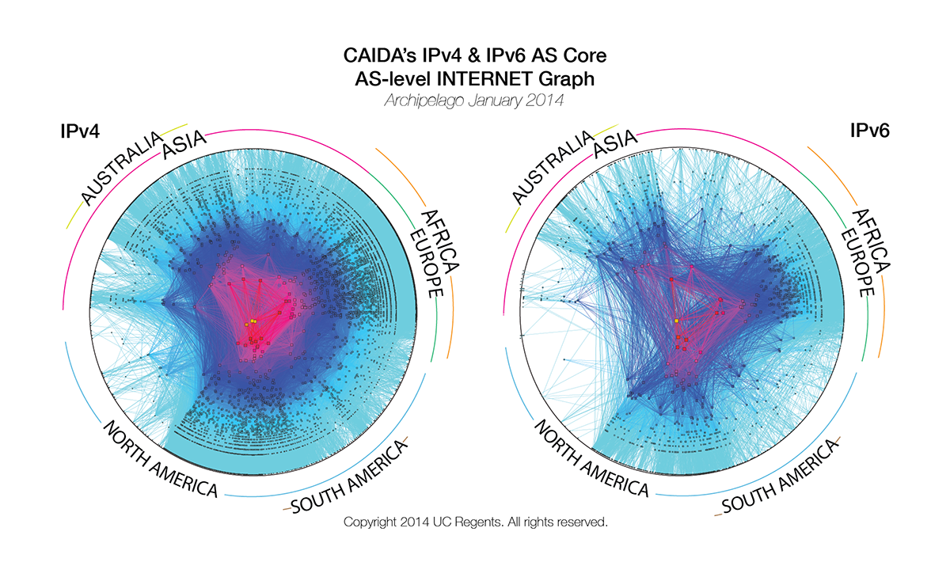
Problem Statement
The global Research & Education network ecosystem is comprised of hundreds of international, national, regional and local-scale networks.
Notes:
Make the point that the complexity of the network is too much for anyone to grasp – and with the complexity we need tools/methods to bite off smaller parts of the problem

Slide 4
Problem Statement
While these networks all interconnect, each network is owned and operated by separate organizations (called “domains”) with different policies, customers, funding models, hardware, bandwidth and configurations.
Notes:
MAP is courtesy of the GLIF
perfSONAR is designed to be multi-domain, so drive home the fact that all transfers are multi-domain

Slide 5
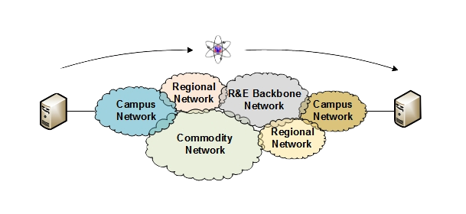
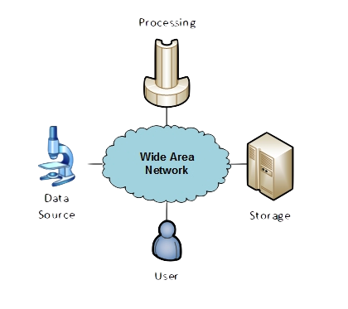
The R&E Community
The global Research & Education network ecosystem is comprised of hundreds of international, national, regional and local-scale resources – each independently owned and operated.
This complex, heterogeneous set of networks must operate seamlessly from “end to end” to support science and research collaborations that are distributed globally.
Data mobility is required; there is no liquid market for HPC resources (people use what they can get – DOE, XSEDE, NOAA, etc. etc.)
To stay competitive, we must learn the use patterns, and support them
This may mean making sure your network, and the networks of others, are functional
Notes:
Getting into the end to end argument – we can’t just ensure things work locally.

Slide 6
Outline
Problem Statement on Network Connectivity
Supporting Scientific Users
Network Performance & TCP Behaviors w/ Packet Loss
What is perfSONAR
Deployment Overview
Command's & Syntax
Examples
Conclusions
Notes:
Make the point that the complexity of the network is too much for anyone to grasp – and with the complexity we need tools/methods to bite off smaller parts of the problem

Slide 7
Understanding Data Trends
http://www.es.net/science-engagement/science-requirements-reviews/
Notes:
This comes from ESnet requirements review data (starting in 2007). Smaller collaborations produce less data than larger ones, but their numbers are greater. Across the board increases as instrumentation, processing, storage, becomes better/more widely available.

Slide 8
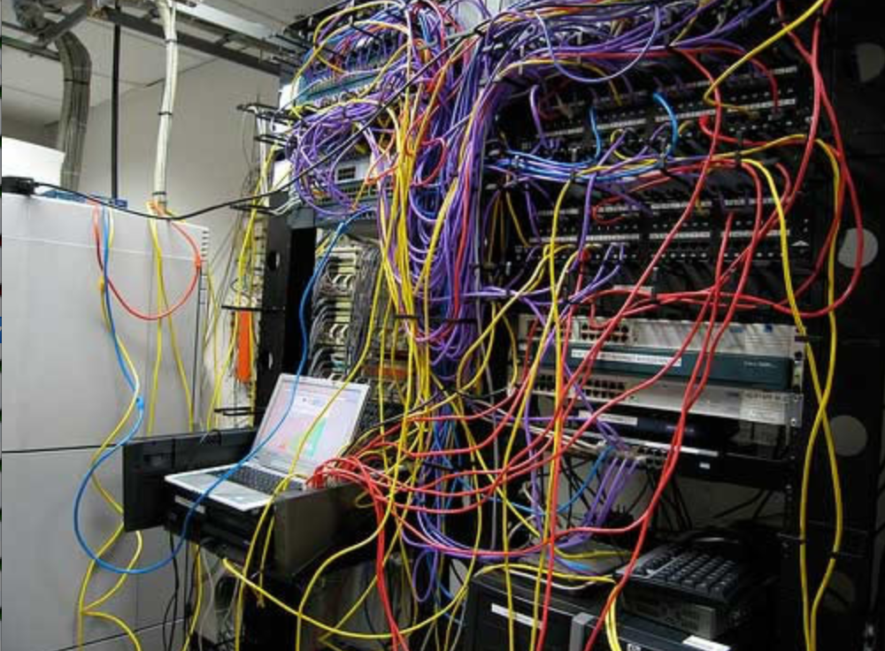
Challenges to Network Adoption
Causes of performance issues are complicated for users.
Lack of communication and collaboration between the CIO’s office and researchers on campus.
Lack of IT expertise within a science collaboration or experimental facility
User’s performance expectations are low (“The network is too slow”, “I tried it and it didn’t work”).
Cultural change is hard (“we’ve always shipped disks!”).
Scientists want to do science not IT support
The Capability Gap
Notes:
Reasons why it is hard for users to embrace networks – its challenging to get things working.

Slide 9
Outline
Problem Statement on Network Connectivity
Supporting Scientific Users
Network Performance & TCP Behaviors w/ Packet Loss
What is perfSONAR
Deployment Overview
Command's & Syntax
Examples
Conclusions
Notes:
Make the point that the complexity of the network is too much for anyone to grasp – and with the complexity we need tools/methods to bite off smaller parts of the problem

Slide 10
Let’s Talk Performance …
"In any large system, there is always something broken.”
- Jon Postel
Modern networks are occasionally designed to be one-size-fits-most
e.g. if you have ever heard the phrase “converged network”, the design is to facilitate CIA (Confidentiality, Integrity, Availability)
It’s all TCP
Bulk data movement is a common thread (move the data from the microscope, to the storage,
to the processing, to the people – and they are all sitting in different facilities)
This fails when TCP suffers due to path problems (ANYWHERE in the path)
It’s easier to work with TCP than to fix it (20+ years of trying…)
TCP suffers the most from unpredictability; Packet loss/delays are the enemy
Small buffers on the network gear and hosts
Incorrect application choice
Packet disruption caused by overzealous security
Congestion from herds of mice
It all starts with knowing your users, and knowing your network
Notes:
Why is it a challenge? It’s the complexity, and it’s the tools.
We basically need to accommodate TCP to do anything useful.

Slide 11
Where Are The Problems?
Congested or faulty links between domains
Latency dependant problems inside domains with small RTT
Source
Campus
Backbone
Destination
Campus
S
D
NREN
Regional
Congested intra- campus links
Notes:
Isolating problems is challenging – consider the following sets of domains. If things are ‘slow’, it could be anything (or multiple things)
We need something that examines the entire path, and pulls out trouble

Slide 12
Local Testing Will Not Find Everything
Performance is poor when RTT exceeds ~10 ms
Performance is good when RTT is < ~10 ms
Source
Campus
R&E
Backbone
Destination
Campus
S
D
Switch with small buffers
Regional
Regional
Notes:
The magic buffer zone – if we are < 10ms, we often don’t see problems. Throughput still works well because TCP can perform well over short distances with lots of loss.
As we get further out, we notice the pain.
This leads to some false diagnostics at times – e.g. if we have a problem locally, but we only see it when we go far away, its tempting to say the problem is out there, far away. See the switch with small buffers locally as the example.

Slide 13
Soft Failures Cause Packet Loss and Degraded TCP Performance
Local
(LAN)
With loss, high performance beyond metro distances is essentially impossible
International
Metro Area
Regional
Continental
Measured (TCP Reno)
Measured (HTCP)
Theoretical (TCP Reno)
Measured (no loss)
Notes:
TCP works well over short distances (e.g. 1% packet loss on the LAN will produce high throughput).
The further out you get the more pronounced the problems will be as the algorithms cope with retransmissions.

Slide 14
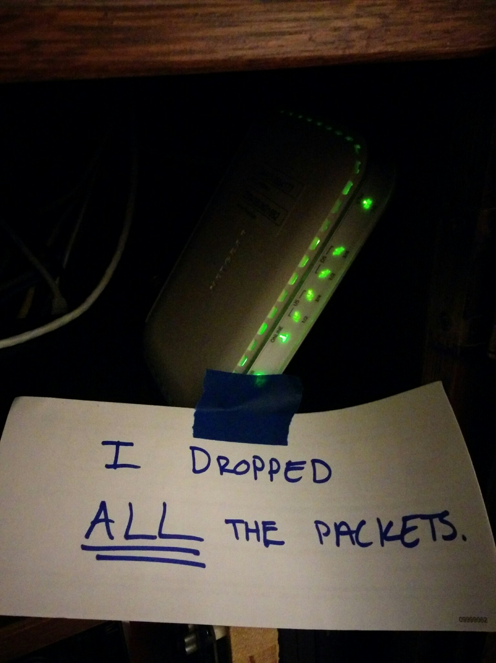
Soft Network Failures
Soft failures are where basic connectivity functions, but high performance is not possible.
TCP was intentionally designed to hide all transmission errors from the user:
“As long as the TCPs continue to function properly and the internet system does not become completely partitioned, no transmission errors will affect the users.” (From IEN 129, RFC 716)
Some soft failures only affect high bandwidth long RTT flows.
Hard failures are easy to detect & fix
soft failures can lie hidden for years!
One network problem can often mask others
Notes:
Introduce the soft network failure – not a loss of connectivity. This is what perfSONAR is designed to find since they are challenging to see unless you are testing end to end over a large distance.

Slide 15
Problem Statement: Hard vs. Soft Failures
“Hard failures” are the kind of problems every organization understands
Fiber cut
Power failure takes down routers
Hardware ceases to function
Classic monitoring systems are good at alerting hard failures
i.e., NOC sees something turn red on their screen
Engineers paged by monitoring systems
“Soft failures” are different and often go undetected
Basic connectivity (ping, traceroute, web pages, email) works
Performance is just poor
How much should we care about soft failures?
Notes:
Answer: we need to care *a lot* about soft failures – see next

Slide 16
Causes of Packet Loss
Network Congestion
Easy to confirm via SNMP, easy to fix with $$
This is not a ‘soft failure’, but just a network capacity issue
Often people assume congestion is the issue when it fact it is not.
Under-buffered switch dropping packets
Hard to confirm
Under-powered firewall dropping packets
Hard to confirm
Dirty fibers or connectors, failing optics/light levels
Sometimes easy to confirm by looking at error counters in the routers
Overloaded or slow receive host dropping packets
Easy to confirm by looking at CPU load on the host

Slide 17
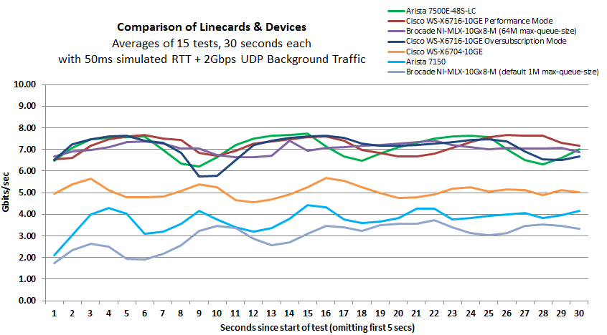
Under-buffered Switches are probably our biggest problem today
Notes:
Testing done by Michael Smitasin , LBL
1 10G TCP flow competing with 2GB background UDP

Slide 18
Outline
Problem Statement on Network Connectivity
Supporting Scientific Users
Network Performance & TCP Behaviors w/ Packet Loss
What is perfSONAR
Deployment Overview
Command's & Syntax
Examples
Conclusions
Notes:
Make the point that the complexity of the network is too much for anyone to grasp – and with the complexity we need tools/methods to bite off smaller parts of the problem

Slide 19
But … It’s Not Just the Network
Perhaps you are saying to yourself “I have no control over parts of my campus, let alone the 5 networks that sit between me and my collaborators”
Significant gains are possible in isolated areas of the OSI Stack
Things “you” control:
Choice of data movement applications (say no to SCP and RSYNC)
Configuration of local gear (hosts, network devices)
Placement and configuration of diagnostic tools, e.g. perfSONAR
Use of the diagnostic tools
Things that need some help:
Configuration of remote gear
Addressing issues when the diagnostic tools alarm
Getting someone to “care”
Notes:
Don’t stop at network architecture, fix other stuff too

Slide 20
Network Monitoring
All networks do some form monitoring.
Addresses needs of local staff for understanding state of the network
Would this information be useful to external users?
Can these tools function on a multi-domain basis?
Beyond passive methods, there are active tools.
E.g. often we want a ‘throughput’ number. Can we automate that idea?
Wouldn’t it be nice to get some sort of plot of performance over the course of a day? Week? Year? Multiple endpoints?
perfSONAR = Measurement Middleware
Notes:
Everyone does it – but not everyone monitors end to end
perfSONAR is nothing earth shattering, it’s a way to share measurements and make it easy to deploy/figure out what is going on

Slide 21
perfSONAR
All the previous Science DMZ network diagrams have little perfSONAR boxes everywhere
The reason for this is that consistent behavior requires correctness
Correctness requires the ability to find and fix problems
You can’t fix what you can’t find
You can’t find what you can’t see
perfSONAR lets you see
Especially important when deploying high performance services
If there is a problem with the infrastructure, need to fix it
If the problem is not with your stuff, need to prove it
Many players in an end to end path
Ability to show correct behavior aids in problem localization
Notes:
perfSONAR = visbibility

Slide 22
What is perfSONAR?
perfSONAR is a tool coordinated suite of tools to:
Set network performance expectations
Find network problems (“soft failures”)
Helps coordinate fixing these problems
… all in multi-domain environments
These problems are all harder when multiple networks are involved
perfSONAR provides a standardized way to publish active and passive monitoring data
This data is interesting to network researchers as well as network operators
Notes:
Enables Federation
Service oriented
Designed with ‘multi-domain’ in mind
Brings together useful tools to address different needs
Several active and passive tools
Interface to configure regular testing
Diagnostic tools ready with ‘0 configuration’
Easy to install, easy to use
ISO image can be burned to CD/USB key
‘Wizard’ interface for configuration
Encouraging people to deploy ‘known good’ measurement points near domain boundaries
“known good” = hosts that are well configured, enough memory and CPU to drive the network, proper TCP tuning, clean path, etc.
Community Adoption
Over 1300 instances seen world wide
40+ countries
100s of domains

Slide 23
perfSONAR History
perfSONAR can trace its origin to the Internet2 “End 2 End performance Initiative” from the year 2000. What has changed since then?
The Good News:
TCP is much less fragile; Cubic is the default CC alg, autotuning is and larger TCP buffers are everywhere
Reliable parallel transfers via tools like Globus Online
High-performance UDP-based commercial tools like Aspera
The Bad News:
The wizard gap is still large
Jumbo frame use is still small
Under-buffered and switches and routers are still common
Under-powered/misconfigured firewalls are common
Soft failures still go undetected for months
Users still might not know or understand what kind of performance to expect
Notes:
Improvements in 15 years since the idea came about – but lots of room to grow

Slide 24
Simulating Performance
It’s infeasible to perform at-scale data movement all the time – as we see in other forms of science, we need to rely on simulations
Network performance comes down to a couple of key metrics:
Throughput (e.g. “how much can I get out of the network”)
Latency (time it takes to get to/from a destination)
Packet loss/duplication/ordering (for some sampling of packets, do they all make it to the other side without serious abnormalities occurring?)
Network utilization (the opposite of “throughput” for a moment in time)
We can get many of these from a selection of active and passive measurement tools – enter the perfSONAR Toolkit
Notes:
Idea – we are measuring performance by testing what is possible. If OWAMP runs stable and loss free, video will work out ok. If throughput is stable and high, bulk data movement should work on the network (does not test disk)

Slide 25
perfSONAR Toolkit
The “perfSONAR Toolkit” is an open source implementation and packaging of the perfSONAR measurement infrastructure and protocols
http://docs.perfsonar.net/install_getting.html
All components are available as RPMs, DEBs, and bundled as CentOS 7, Debian 9 or Ubuntu 16 and 18-based packages (as of perfSONAR v. 4.2.4)
perfSONAR tools are much more accurate if run on a dedicated perfSONAR host
Very easy to install and configure
Usually takes less than 30 minutes
Notes:
Install via the ISO – RPMs if you don’t want to do that

Slide 26
Outline
Problem Statement on Network Connectivity
Supporting Scientific Users
Network Performance & TCP Behaviors w/ Packet Loss
What is perfSONAR
Deployment Overview
Command's & Syntax
Examples
Conclusions
Notes:
Make the point that the complexity of the network is too much for anyone to grasp – and with the complexity we need tools/methods to bite off smaller parts of the problem

Slide 27
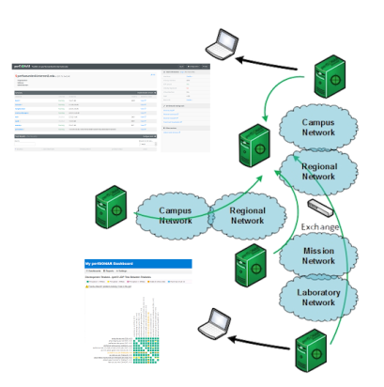
Toolkit “Beacon” Use Case
The general use case is to establish some set of tests to other locations/facilities
To answer the what/why questions:
Regular testing with select tools helps to establish patterns – how much bandwidth we would see during the course of the day – or when packet loss appears
We do this to ‘points of interest’ to see how well a real activity (e.g. Globus transfer) would do.
If performance is ‘bad’, don’t expect much from the data movement tool
Notes:
General use case – make the tools available and let people test against you

Slide 28
Benefits: Finding needles in haystacks
Above all, perfSONAR allows you to maintain a healthy, high-performing network because it helps identify the “soft failures” in the network path.
Classical monitoring systems have limitations
Performance problems are often only visible at the ends
Individual network components (e.g. routers) have no knowledge of end host state
perfSONAR tests the network in ways that classical monitoring systems do not
More perfSONAR distributions equal better network visibility.
Notes:
Metcalf law argument – only useful because people are using it

Slide 29
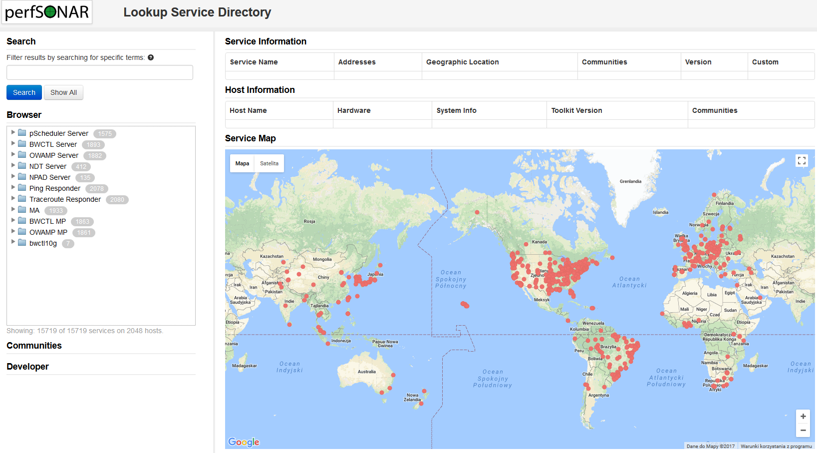
http://stats.es.net/ServicesDirectory/
Notes:
View public instances

Slide 30
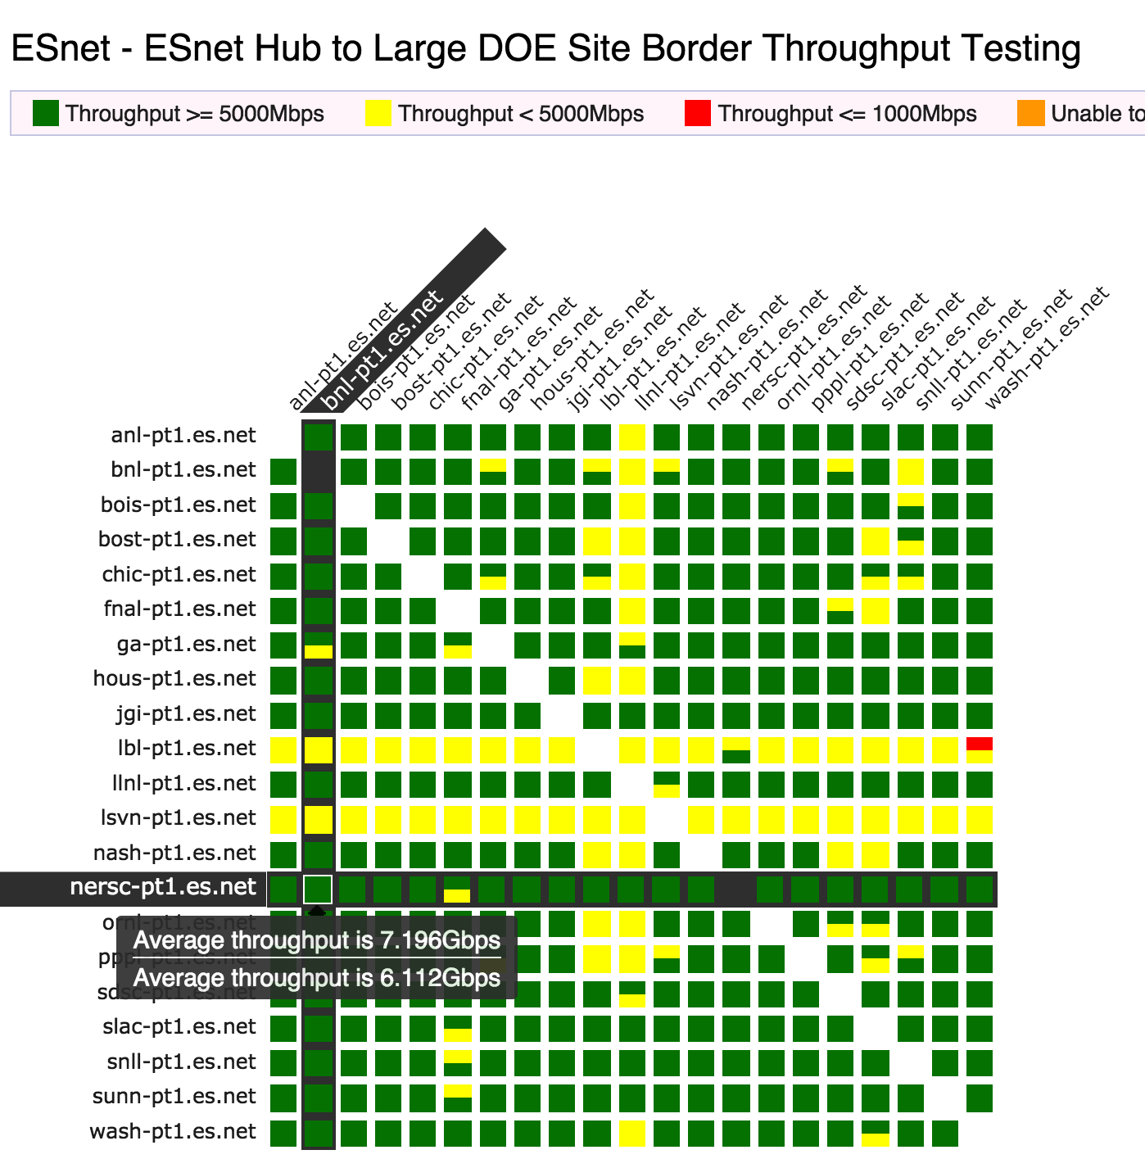
perfSONAR Dashboard: Raising Expectations and improving network visibility
Status at-a-glance
Packet loss
Throughput
Correctness
Current live instances at http://pas.net.internet2.edu/
http://ps-dashboard.es.net/
Drill-down capabilities:
Test history between hosts
Ability to correlate with other events
Very valuable for fault localization and isolation
Notes:
Dashboards – requires coordination of testing

Slide 31
Outline
Problem Statement on Network Connectivity
Supporting Scientific Users
Network Performance & TCP Behaviors w/ Packet Loss
What is perfSONAR
Deployment Overview
Command's & Syntax
Examples
Conclusions
Notes:
Make the point that the complexity of the network is too much for anyone to grasp – and with the complexity we need tools/methods to bite off smaller parts of the problem

Slide 32
pscheduler – The Secret Sauce
pscheduler is the engine that drives perfSONAR
Coordinates timeslots and schedules tests between nodes
Creates a common syntax that all tools use
Handles the storage of results
This approach to test management ensures that:
Tests that could impact each other’s performance, like throughput, are never run simultaneously
Simplified coordination, where you don’t need an engineer at the other end to start a daemon, open a port, etc.
Access control is maintained and test limits are enforced

Slide 33
Basic syntax
pscheduler task [options] test-type [test-options]
task is what you want pscheduler to do
test-type is how you want pscheduler to do it
There’s more than one tool to run many of these tests, and pscheduler gives you the option to choose that tool:
iperf2/iperf3/nuttcp for bandwidth
traceroute/tracepath/paris-traceroute for routing
--help is your friend!

Slide 34
Remote Commands, AKA, Your Best Friends
--source and --dest flags do what you expect they would, but neither end has to be your node
You can run most tests between two remote nodes
This includes perfSONAR’s built-in self-diagnostic tools
This core piece of functionality is what makes perfSONAR useful in day-to-day troubleshooting activities and makes it more than just a simple performance data collector

Slide 35
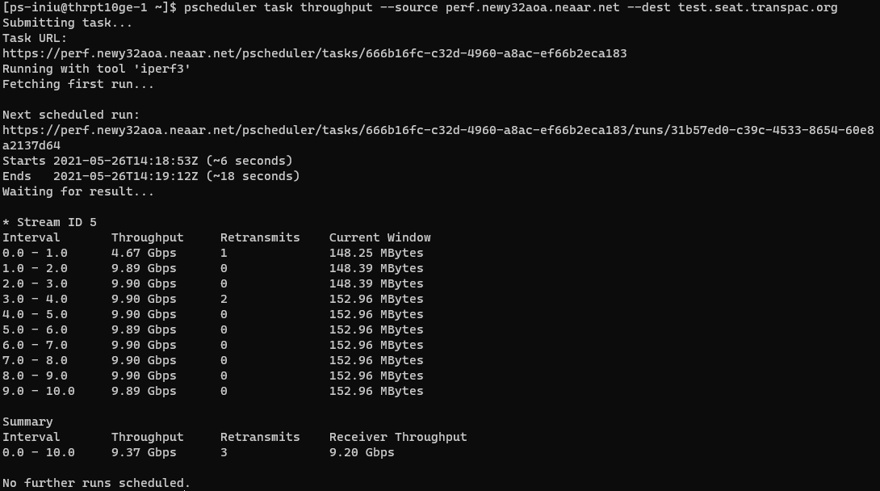

Slide 36
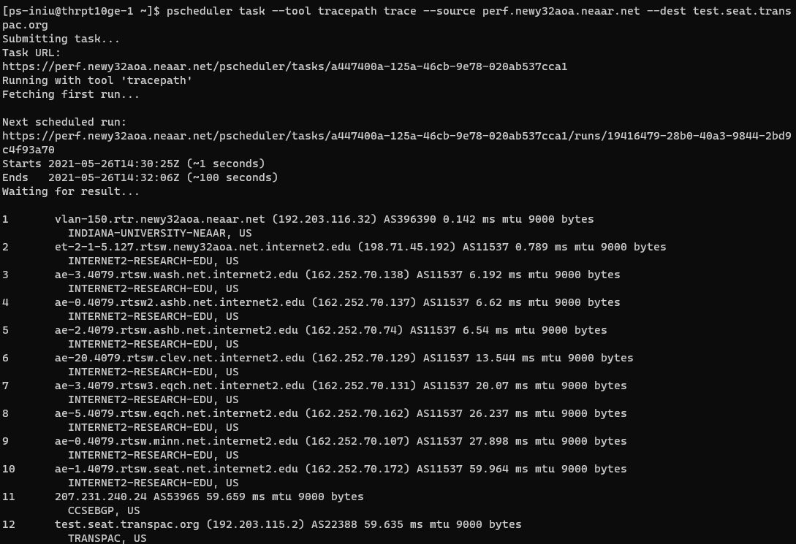

Slide 37
Outline
Problem Statement on Network Connectivity
Supporting Scientific Users
Network Performance & TCP Behaviors w/ Packet Loss
What is perfSONAR
Deployment Overview
Command's & Syntax
Examples
Conclusions
Notes:
Make the point that the complexity of the network is too much for anyone to grasp – and with the complexity we need tools/methods to bite off smaller parts of the problem

Slide 38
NRAO/UVA <> SARAO Performance Problem
Data sharing from the National Radio Astronomy Observatory, located on the University of Virginia campus, to the South African Radio Astronomy Observatory
Low performance – 4.8Mbps
Initial testing from the South African side revealed a few potential problems, such as asymmetric routing and paths with unnecessarily circuitous routes.
These were identified using normal traceroutes and quickly corrected
No appreciable change in performance

Slide 39
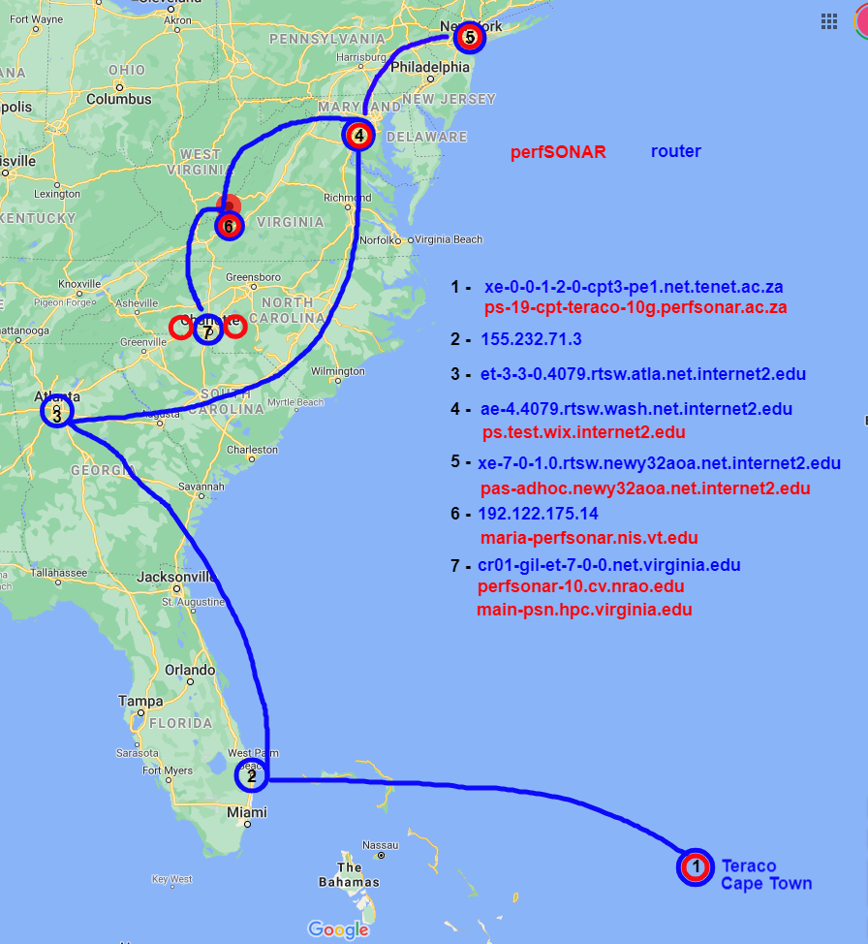
Identification of possible pS toolkits
1 te0-1-0-1-cpt2-pe1.net.tenet.ac.za (155.232.40.9) AS2018 0.703 ms
…
5 155.232.71.3 AS2018 166.6 ms
TENET-1, ZA
6 et-3-3-0.4079.rtsw.atla.net.internet2.edu (162.252.70.42) AS11537 172.712 ms
INTERNET2-RESEARCH-EDU, US
7 ae-4.4079.rtsw.wash.net.internet2.edu (198.71.45.7) AS11537 185.775 ms
INTERNET2-RESEARCH-EDU, US
8 ae-0.4079.rtsw2.ashb.net.internet2.edu (162.252.70.137) AS11537 186.419 ms
INTERNET2-RESEARCH-EDU, US
9 ae-2.4079.rtsw.ashb.net.internet2.edu (162.252.70.74) AS11537 185.845 ms
INTERNET2-RESEARCH-EDU, US
10 192.122.175.14 AS40220 186.368 ms
MARIA, US
11 br01-udc-et-1-0-0-20.net.virginia.edu (192.35.48.33) AS225 188.065 ms
VIRGINIA-AS, US
12 cr01-udc-et-4-2-0.net.virginia.edu (128.143.236.6) AS225 188.448 ms
VIRGINIA-AS, US
13 cr01-gil-et-7-0-0.net.virginia.edu (128.143.236.89) AS225 203.281 ms
VIRGINIA-AS, US
14 perfsonar-10.cv.nrao.edu (198.51.208.55) AS225 188.179 ms
VIRGINIA-AS, US

Slide 40
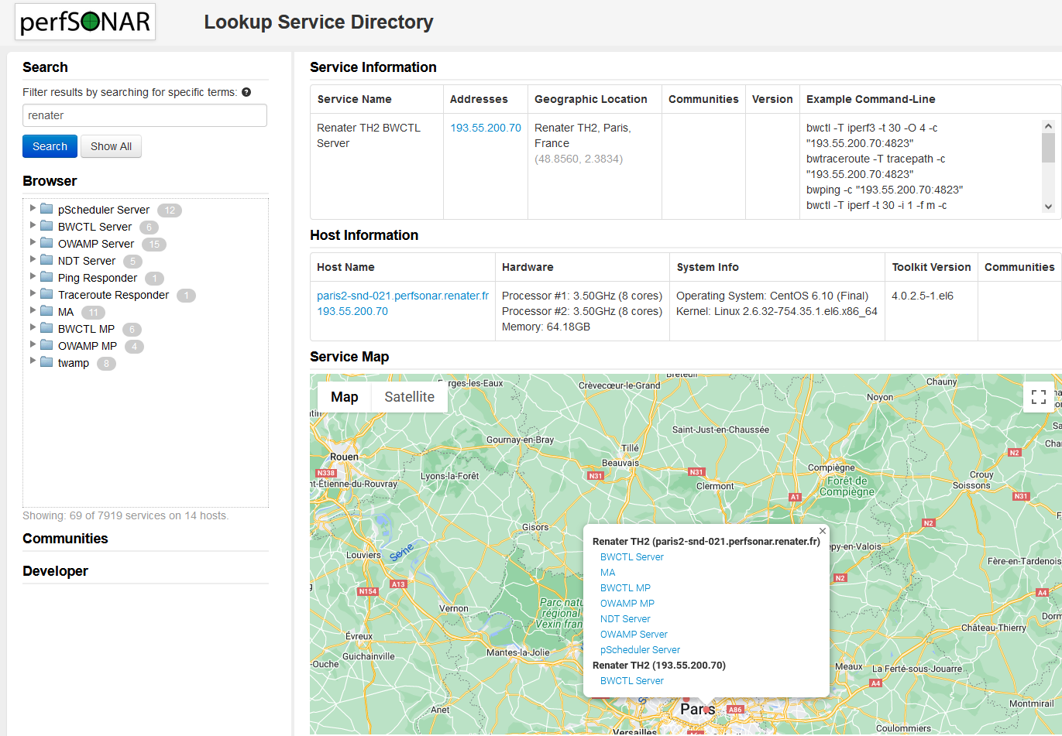
perfSONAR Lookup Service Directory
Lookup listed testpoints and toolkits by almost any criteria:
Hostname
IP address
Institution
City
Country
REN
pS instance must have commodity internet access to be listed.
http://stats.es.net/ServicesDirectory/

Slide 41
Initial problem isolation
Tests from various domestic and international perfSONAR nodes to UVAs campus were telling:
CHPC South Africa -> Internet2 Washington - 6.67 Gbps
Internet2 Albany -> Internet2 Washington - 9.893 Gbps
Internet2 Washington -> NRAO - 3.31 Gbps (lots of retries)
Internet2 Washington -> HPC University Virginia - 2.21 Gbps (lots of retries)
NRAO -> HPC University Virginia - 6.64 Gbps (lots of retries)

Slide 42
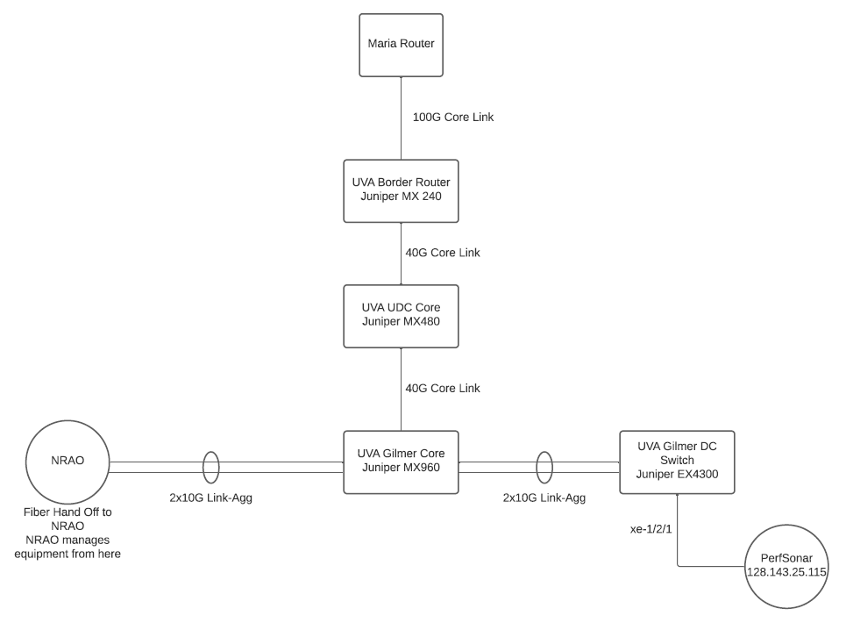
UVA/NRAO Network
MTU 9000
MTU 1500?

Slide 43
Path MTU Discovery (PMTUD)
Is a layer 3 construct
Requires UDP and ICMP to function
UDP packets larger than the MTU setting of the receiving router interface will trigger an ICMP “unreachable” message back to the sending router, which in turn causes a renegotiation to a lower MTU
All is not lost if PMTUD doesn’t work
Smart transfer tools can figure out a common MTU, at the cost of time
Packets sent at 9K can be fragmented to adhere to a smaller MTU, at the cost of performance…unless the no-fragment flag is set
Neither of these scenarios is good for high performance. PMTUD should be made to work and common MTUs enforced wherever possible

Slide 44
Further isolation
Working inward from a known good ESnet perfSONAR node to UVA:
Interval Throughput Retransmits Current Window
0.0 - 1.0 9.13 Gbps 22 33.17 MBytes
1.0 - 2.0 9.35 Gbps 0 33.58 MBytes
2.0 - 3.0 9.38 Gbps 0 33.58 MBytes
3.0 - 4.0 9.38 Gbps 0 33.58 MBytes
4.0 - 5.0 9.38 Gbps 0 33.58 MBytes
5.0 - 6.0 9.35 Gbps 0 33.58 MBytes
6.0 - 7.0 9.36 Gbps 0 33.58 MBytes
7.0 - 8.0 9.38 Gbps 0 33.58 MBytes
8.0 - 9.0 9.37 Gbps 0 33.58 MBytes
9.0 - 10.0 9.37 Gbps 0 33.58 MBytes
Summary
Interval Throughput Retransmits Receiver Throughput
0.0 - 10.0 9.35 Gbps 22 9.25 Gbps
This test looks good, because the hosts successfully negotiate 1500 MTU

Slide 45
Negotiations break down
Working inward from a known good ESnet perfSONAR node to NRAO:
(Keep in mind, we know MTU 9000 on both ends, but with a step down to 1500 in the middle of the UVA campus)
Interval Throughput Retransmits Current Window
0.0 - 1.0 2.54 Mbps 2 8.95 KBytes
1.0 - 2.0 0.00bps 1 8.95 KBytes
2.0 - 3.0 0.00bps 0 8.95 KBytes
3.0 - 4.0 0.00bps 31 3.07 KBytes
4.0 - 5.0 0.00bps 67 5.12 KBytes
5.0 - 6.0 4.45 Mbps 2 17.41 KBytes
6.0 - 7.0 8.26 Mbps 0 33.79 KBytes
7.0 - 8.0 23.28 Mbps 0 94.21 KBytes
8.0 - 9.0 51.75 Mbps 0 218.11 KBytes
9.0 - 10.0 83.88 Mbps 0 392.19 KBytes
Summary
Interval Throughput Retransmits Receiver Throughput
0.0 - 10.0 17.42 Mbps 103 10.29 Mbps
9000B packets failing
1500B packets after re-negotiation

Slide 46
Traceroute: ESnet to NRAO
traceroute to perfsonar-10.cv.nrao.edu (198.51.208.55), 30 hops max, 60 byte packets
1 esneteastrt1-eastdcpt1.es.net (198.124.238.37) 0.549 ms 0.544 ms 0.547 ms
2 newycr5-ip-a-esneteastrt1.es.net (198.124.218.17) 1.969 ms 1.963 ms 1.953 ms
3 aofacr5-ip-a-newycr5.es.net (134.55.37.77) 2.330 ms 2.304 ms 2.313 ms
4 et-2-1-5.197.rtsw.newy32aoa.net.internet2.edu (64.57.28.14) 2.323 ms 2.324 ms 2.327 ms
5 ae-3.4079.rtsw.wash.net.internet2.edu (162.252.70.138) 7.571 ms 7.672 ms 7.528 ms
6 ae-0.4079.rtsw2.ashb.net.internet2.edu (162.252.70.137) 8.095 ms 8.077 ms 8.061 ms
7 ae-2.4079.rtsw.ashb.net.internet2.edu (162.252.70.74) 28.089 ms 18.414 ms 18.454 ms
8 192.122.175.14 (192.122.175.14) 8.221 ms 8.179 ms 8.205 ms
9 br01-udc-et-1-0-0-20.net.virginia.edu (192.35.48.33) 10.310 ms 10.310 ms 10.383 ms
10 cr01-udc-et-4-2-0.net.virginia.edu (128.143.236.6) 12.609 ms 12.603 ms 12.638 ms
11 cr01-gil-et-7-0-0.net.virginia.edu (128.143.236.89) 12.407 ms 12.403 ms 12.393 ms
12 perfsonar-10.cv.nrao.edu (198.51.208.55) 10.058 ms 10.032 ms 10.022 ms
Well, that looks good. Let’s try tracepath and see where the MTU changes

Slide 47
Tracepath: ESnet to NRAO
1?: [LOCALHOST] pmtu 9000
1: esneteastrt1-eastdcpt1.es.net 0.788ms
1: bnlmr2-bnlpt1.es.net 0.728ms
2: no reply
3: aofacr5-ip-b-newycr5.es.net 2.411ms asymm 2
4: et-2-1-5.197.rtsw.newy32aoa.net.internet2.edu 2.468ms asymm 3
5: ae-3.4079.rtsw.wash.net.internet2.edu 8.176ms asymm 4
6: ae-0.4079.rtsw2.ashb.net.internet2.edu 8.889ms asymm 5
7: ae-2.4079.rtsw.ashb.net.internet2.edu 8.242ms asymm 6
8: 192.122.175.14 8.522ms asymm 7
9: no reply
10: no reply
11: no reply
12: no reply
Traceroute works, but tracepath doesn’t??

Slide 48
Different Tools, Different Packets
Traceroute uses small 60B UDP packets
Tracepath uses larger 64KB UDP packets
So, somewhere we have a roadblock. Small packets can make it through, but larger ones are dropped (not fragmented).
How do we figure out the max size? Trial and error. Start at 9K and cut the size in half until you get a response, then sneak back up until the packets disappear again.

Slide 49
Tracepath: ESnet to NRAO, 1509 bytes
1: esneteastrt1-eastdcpt1.es.net 0.340ms
2: no reply
3: aofacr5-ip-a-newycr5.es.net 2.279ms asymm 2
4: et-2-1-5.197.rtsw.newy32aoa.net.internet2.edu 2.310ms asymm 3
5: ae-3.4079.rtsw.wash.net.internet2.edu 7.574ms asymm 4
6: ae-0.4079.rtsw2.ashb.net.internet2.edu 9.422ms asymm 5
7: ae-2.4079.rtsw.ashb.net.internet2.edu 7.986ms asymm 6
8: 192.122.175.14 8.123ms asymm 7
9: no reply
MARIA
UVA

Slide 50
Tracepath: ESnet to NRAO, 1508 bytes
1: bnlmr2-bnlpt1.es.net 0.327ms
2: no reply
3: aofacr5-ip-b-newycr5.es.net 2.332ms asymm 2
4: et-2-1-5.197.rtsw.newy32aoa.net.internet2.edu 2.338ms asymm 3
5: ae-3.4079.rtsw.wash.net.internet2.edu 7.668ms asymm 4
6: ae-0.4079.rtsw2.ashb.net.internet2.edu 9.833ms asymm 5
7: ae-2.4079.rtsw.ashb.net.internet2.edu 7.872ms asymm 6
8: 192.122.175.14 8.166ms asymm 7
9: br01-udc-et-1-0-0-20.net.virginia.edu 9.998ms asymm 7
9?: br01-udc-et-1-0-0-20.net.virginia.edu asymm 7
10: cr01-udc-et-4-2-0.net.virginia.edu 10.470ms asymm 8
11: cr01-gil-et-7-0-0.net.virginia.edu 10.208ms asymm 9
12: cr01-gil-et-7-0-0.net.virginia.edu 10.253ms pmtu 1500
12: perfsonar-10.cv.nrao.edu 10.154ms !H
Resume: pmtu 1500
MARIA
UVA

Slide 51
Problem located
The issue was between the MARIA router and the UVA router
The MARIA interface was configured for MTU 9192
The UVA interface was configured for MTU 1518
With PMTUD broken there was no hope for external MTU 9000 equipment to negotiate an appropriate MTU with the NRAO node
UVA changed the MTU on their router interface to match that of MARIA, while keeping their downstream equipment at their campus standard MTU 1500

Slide 52
Yeah, yeah, but what about performance??
Before:
pscheduler task throughput --source cpt-chpc-10g.perfsonar.ac.za --dest perfsonar-10.cv.nrao.edu
Summary
Interval Throughput Retransmits Receiver Throughput
0.0 - 10.0 380.37 Kbps 58 108.18 Kbps
After:
pscheduler task throughput -t 30 --source cpt-chpc-10g.perfsonar.ac.za --dest perfsonar-10.cv.nrao.edu
Summary
Interval Throughput Retransmits Receiver Throughput
0.0 - 30.0 2.67 Gbps 0 2.62 Gbps

Slide 53
Outline
Problem Statement on Network Connectivity
Supporting Scientific Users
Network Performance & TCP Behaviors w/ Packet Loss
What is perfSONAR
Deployment Overview
Conclusions
Notes:
Make the point that the complexity of the network is too much for anyone to grasp – and with the complexity we need tools/methods to bite off smaller parts of the problem

Slide 54
Benefit: Active and Growing Community
Active email lists and forums provide:
Instant access to advice and expertise from the community.
Ability to share metrics, experience and findings with others to help debug issues on a global scale.
Joining the community automatically increases the reach and power of perfSONAR
The more endpoints means exponentially more ways to test and discover issues, compare metrics

Slide 55
perfSONAR Community
The perfSONAR collaboration is working to build a strong user community to support the use and development of the software.
perfSONAR Mailing Lists
Announcement Lists:
https://lists.internet2.edu/sympa/subscribe/perfsonar-announce
Users List:
https://lists.internet2.edu/sympa/subscribe/perfsonar-user

Slide 56
Resources
perfSONAR website
http://www.perfsonar.net/
perfSONAR Documentation
http://docs.perfsonar.net/
perfSONAR mailing lists
http://www.perfsonar.net/about/getting-help/
perfSONAR directory
http://stats.es.net/ServicesDirectory/
perfSONAR YouTube Channel
https://www.youtube.com/channel/UCjK-P49pAKK9hUrrNbbe0Sg
FasterData Knowledgebase
http://fasterdata.es.net/

Slide 57
perfSONAR Topics
Ken Miller, Jason Zurawski
ken@es.net, zurawski@es.net
ESnet / Lawrence Berkeley National Laboratory
Modern Cyberinfrastructure for Research Data Management Workshop
University of Central Florida
February 16-17, 2023
National Science Foundation Award #1826994
https://epoc.global

