Slide 1
Infrastructure for the Campus Network (e.g., Science DMZ, elements, perfSONAR)
Jason Zurawski
zurawski@es.net
ESnet / Lawrence Berkeley National Laboratory
SoX Virtual Training Workshop
March 22, 29, 2023
National Science Foundation Award #1826994
https://epoc.global

Slide 2
Outline
Introduction
Solution Space
Putting it Together
Conclusions / QA

Slide 3
Measurable Outcomes
How to prepare for research use of technology on a campus?
“Build CI” – but is this all?
Improve scientific outcomes in some measurable way
Things to consider (pre, during, post):
Has it/will it all work as expected? (e.g. more than plugging in wires)
Will we all be satisfied at the end? (researchers are the survey population, not just the IT org …)
How do you know when you/we are done? Are you ever done?
Think of this set of content as a reset – we don’t want to build IT for the sake of building IT
Tie things back to the user/use cases, and be sensible about the design, installation, and operation

Slide 4
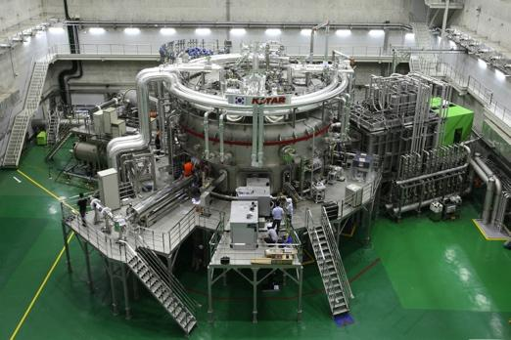
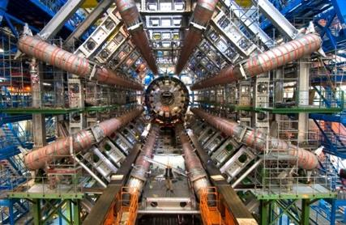
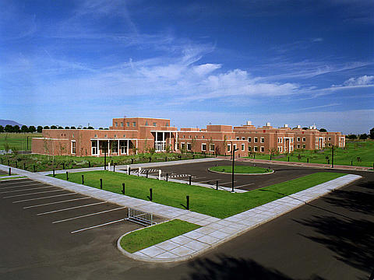
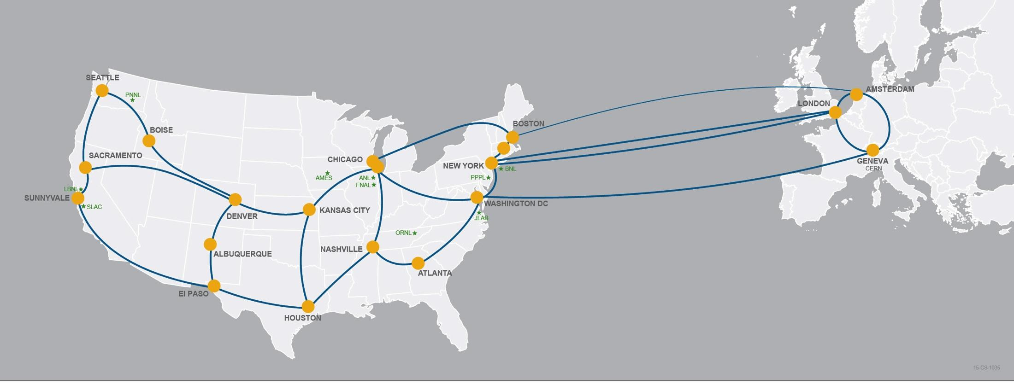
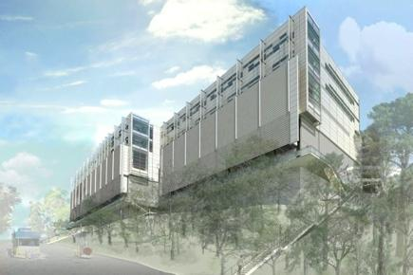
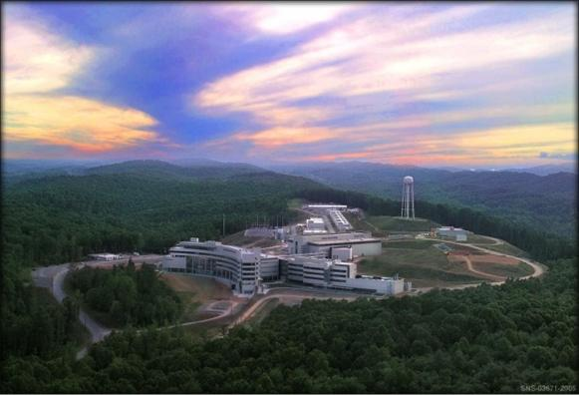
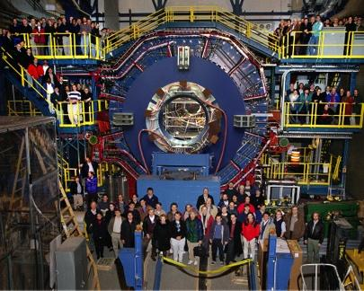
Network as Infrastructure Instrument
Connectivity is the first step – usability must follow

Slide 5
Outline
Introduction
Solution Space
Understanding the Solution Space (Users, Use Cases, Long Term Impacts)
Preliminaries (e.g. Network Protocols 101)
Architecture & Design
Monitoring and Measurement
Data Mobility
Security and Policy
Putting it Together
Conclusions / QA

Slide 6
Common Theme / New Mindset
We aren’t building a “Network Architecture”, we want a “Data Architecture”
A lot of the items that will be thrown at you transcend the traditional network space.
To get there:
Understand the data pipeline for your target user/use case – cradle to retirement home
This implies all the things:
Creation
Usage
Transfer/Share
Curation

Slide 7
Outline
Introduction
Solution Space
Understanding the Solution Space (Users, Use Cases, Long Term Impacts)
Preliminaries (e.g. Network Protocols 101)
Architecture & Design
Monitoring and Measurement
Data Mobility
Security and Policy
Putting it Together
Conclusions / QA

Slide 8
Data Movement / TCP Background
The data mobility performance requirements for data intensive science are beyond what can typically be achieved using traditional methods
Default host configurations (TCP, filesystems, NICs)
Converged network architectures designed for commodity traffic
Conventional security tools and policies
Legacy data transfer tools (e.g. SCP, FTP)
Wait-for-trouble-ticket operational models for network performance
Notes:
The Science DMZ model is a set of ideas – the diagrams that follow are examples.

Slide 9
TCP – Ubiquitous and Fragile
Networks provide connectivity between hosts – how do hosts see the network?
From an application’s perspective, the interface to “the other end” is a socket
Communication is between applications – mostly over TCP
Congestion dictates performance – back off when danger is sensed to preserve/protect resources
TCP – the fragile workhorse
TCP is (for very good reasons) timid – packet loss is interpreted as congestion
Packet loss in conjunction with latency is a performance killer
Like it or not, TCP is used for the vast majority of data transfer applications (more than 95% of ESnet traffic is TCP)

Slide 10
A small amount of packet loss makes a huge difference in TCP performance
With loss, high performance beyond metro distances is essentially impossible
Local
(LAN)
International
Metro Area
Regional
Continental
Measured (TCP Reno)
Measured (HTCP)
Theoretical (TCP Reno)
Measured (no loss)
Notes:
On a 10 Gb/s LAN path the impact of low packet loss rates is minimal
On a 10 Gb/s WAN path the impact of low packet loss rates is enormous
Beyond your metro area, zero loss is essentially required for performance
Where are your collaborators? Where are your users?
When global collaboration is the norm, nobody can afford to be a local-only resource

Slide 11
Data Movement / TCP Background
The Science DMZ model describes a performance-based approach
Dedicated infrastructure for wide-area data transfer
Well-configured data transfer hosts with modern tools
Capable network devices
High-performance data path which does not traverse commodity LAN
Proactive operational models that enable performance
Well-deployed test and measurement tools (perfSONAR)
Periodic testing to locate issues instead of waiting for users to complain
Security posture well-matched to high-performance science applications
Notes:
The Science DMZ model is a set of ideas – the diagrams that follow are examples.

Slide 12
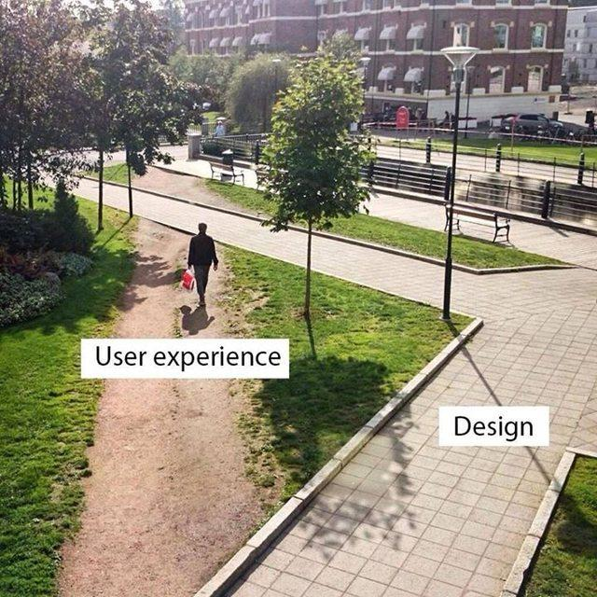
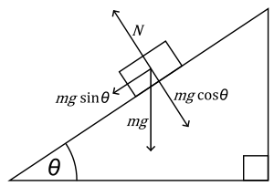
The Science DMZ in 1 Slide
Consists of four key components, all required:
“Friction free” network path
Highly capable network devices (wire-speed, deep queues)
Virtual circuit connectivity option
Security policy and enforcement specific to science workflows
Located at or near site perimeter if possible
Dedicated, high-performance Data Transfer Nodes (DTNs)
Hardware, operating system, libraries all optimized for transfer
Includes optimized data transfer tools such as Globus Online and GridFTP
Performance measurement/test node
perfSONAR
Engagement with end users
Details at http://fasterdata.es.net/science-dmz/
© 2013 Wikipedia

Slide 13
Outline
Introduction
Solution Space
Understanding the Solution Space (Users, Use Cases, Long Term Impacts)
Preliminaries (e.g. Network Protocols 101)
Architecture & Design
Monitoring and Measurement
Data Mobility
Security and Policy
Putting it Together
Conclusions / QA

Slide 14
Science DMZ Takes Many Forms
There are a lot of ways to combine these things – it all depends on what you need to do
Small installation for a project or two
Facility inside a larger institution
Institutional capability serving multiple departments/divisions
Science capability that consumes a majority of the infrastructure
Some of these are straightforward, others are less obvious
Key point of concentration: eliminate sources of packet loss / packet friction

Slide 15
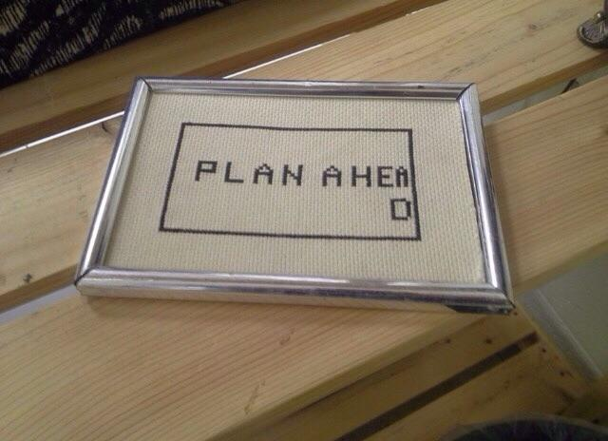
Legacy Method: Ad Hoc DTN Deployment
This is often what gets tried first
Data transfer node deployed where the owner has space
This is often the easiest thing to do at the time
Straightforward to turn on, hard to achieve performance
If lucky, perfSONAR is at the border
This is a good start
Need a second one next to the DTN
Entire LAN path has to be sized for data flows
Entire LAN path is part of any troubleshooting exercise
This usually fails to provide the necessary performance.
Notes:
Previous slide is diagram for this; just say these things while showing previous slide

Slide 16
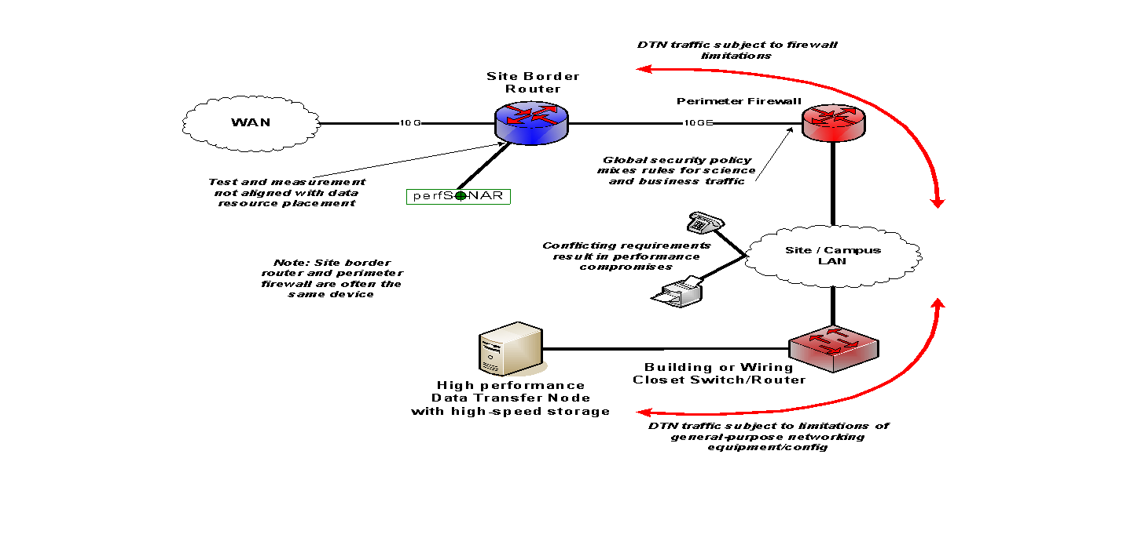
Ad Hoc DTN Deployment
Notes:
DTN node deep within campus infrastructure.

Slide 17
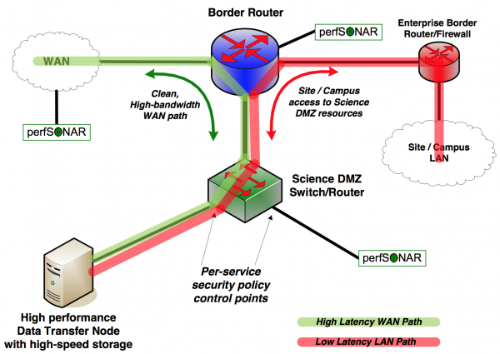
A better approach: simple Science DMZ
Notes:
Add-on to existing network infrastructure
All that is required is a port on the border router
Small footprint, pre-production commitment
Easy to experiment with components and technologies
DTN prototyping
perfSONAR testing
Limited scope makes security policy exceptions easy
Only allow traffic from partners
Add-on to production infrastructure – lower risk

Slide 18
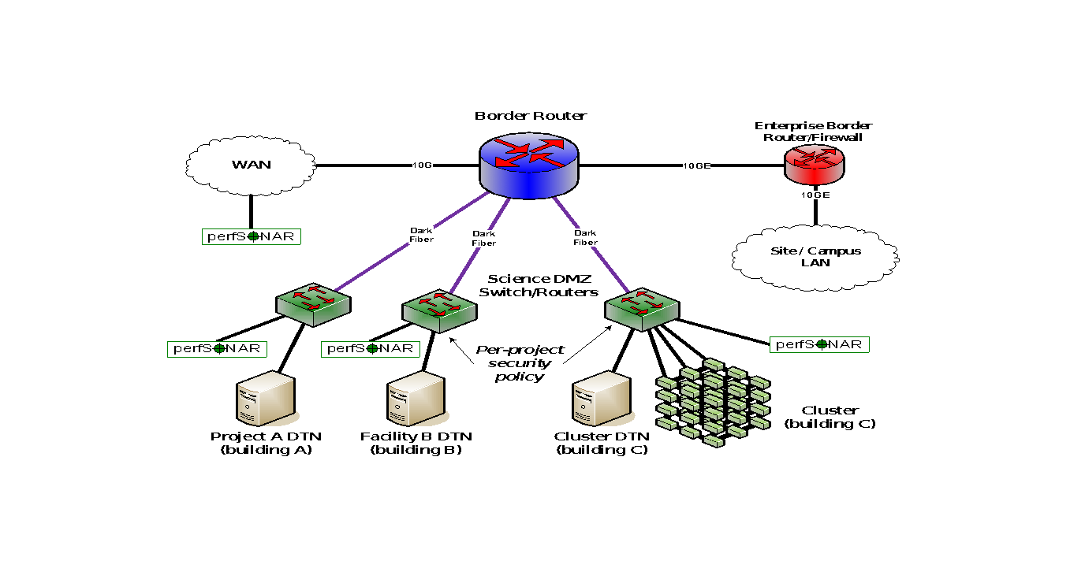
Multiple Science DMZs –
Dark Fiber to Dedicated Switches

Slide 19
Equipment – Routers and Switches
Requirements for Science DMZ gear are different than the enterprise
No need to go for the kitchen sink list of services
A Science DMZ box only needs to do a few things, but do them well
Support for the latest LAN integration magic with your Windows Active Directory environment is probably not super-important
A clean architecture is important
How fast can a single flow go?
Are there any components that go slower than interface wire speed?
There is a temptation to go cheap
Hey, it only needs to do a few things, right?
You typically don’t get what you don’t pay for
(You sometimes don’t get what you pay for either)

Slide 20
Common Circumstance: Multiple Ingress Data Flows, Common Egress
Hosts will typically send packets at the speed of their interface (1G, 10G, etc.)
Instantaneous rate, not average rate
If TCP has window available and data to send, host sends until there is either no data or no window
Hosts moving big data (e.g. DTNs) can send large bursts of back-to-back packets
This is true even if the average rate as measured over seconds is slower (e.g. 4Gbps)
On microsecond time scales, there is often congestion
Router or switch must queue packets or drop them

Slide 21
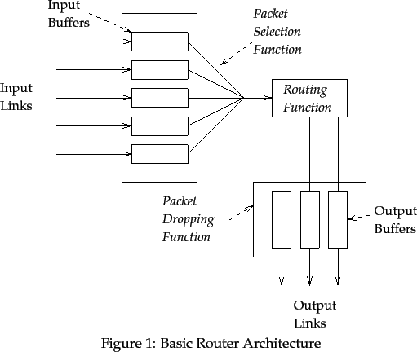
All About That Buffer (No Cut Through)

Slide 22
All About That Buffer (No Cut Through)
Data arrives from multiple sources
Buffers have a finite amount of memory
Some have this per interface
Others may have access to a shared memory region with other interfaces
The processing engine will:
Extract each packet/frame from the queues
Pull off header information to see where the destination should be
Move the packet/frame to the correct output queue
Additional delay is possible as the queues physically write the packet to the transport medium (e.g. optical interface, copper interface)

Slide 23
All About That Buffer (No Cut Through)
The Bandwidth Delay Product
The amount of “in flight” data for a TCP connection (BDP = bandwidth * round trip time)
Example: 10Gb/s cross country, ~100ms
10,000,000,000 b/s * .1 s = 1,000,000,000 bits
1,000,000,000 / 8 = 125,000,000 bytes
125,000,000 bytes / (1024*1024) ~ 125MB
Ignore the math aspect: its making sure there is memory to catch and send packets
At ALL hops
As the speed increases, there are more packets.
If there is not memory, we drop them, and that makes TCP react, and the user sad.

Slide 24
All About That Buffer (No Cut Through)
Buffering isn’t as important on the LAN (this is why you are normally pressured to buy ‘cut through’ devices)
Change the math to make the Latency 1ms and the expectation 10Gbps = 1.25MB
‘Cut through’ and low latency switches are designed for the data center, and can handle typical data center loads that don’t require buffering (e.g. same to same speeds, destinations within the broadcast domain)
Buffering *MATTERS* for WAN Transfers
Placing something with inadequate buffering in the path reduces the buffer for the entire path. E.g. if you have an expectation of 10Gbps over 100ms – don’t place a 12MB buffer anywhere in there – your reality is now ~10x less than it was before (e.g. 10Gbps @ 10ms, or 1Gbps @ 100ms)

Slide 25
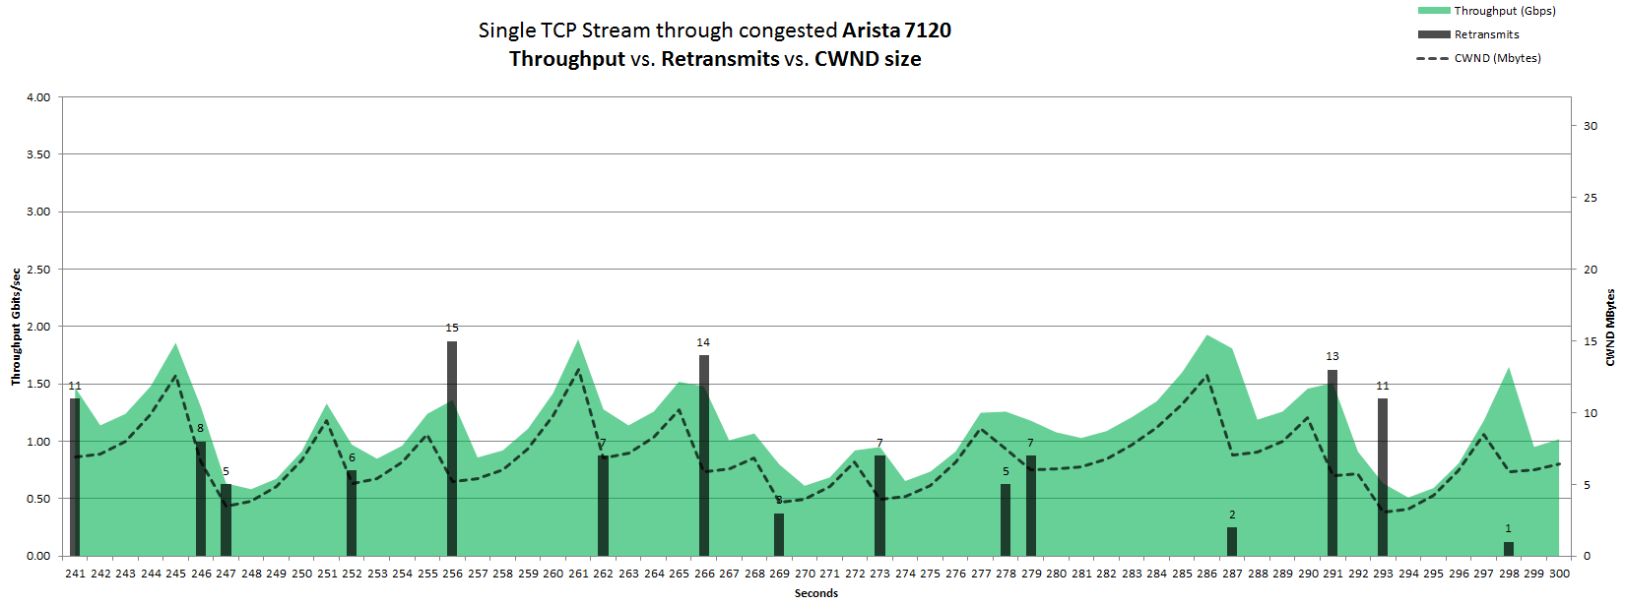
TCP’s Congestion Control
50ms simulated RTT
Congestion w/ 2Gbps UDP traffic
HTCP / Linux 2.6.32
Slide from Michael Smitasin, LBLnet

Slide 26
Outline
Introduction
Solution Space
Understanding the Solution Space (Users, Use Cases, Long Term Impacts)
Preliminaries (e.g. Network Protocols 101)
Architecture & Design
Monitoring and Measurement
Data Mobility
Security and Policy
Putting it Together
Conclusions / QA

Slide 27
Test and Measurement – Keeping the Network Clean
The wide area network, the Science DMZ, and all its systems can be functioning perfectly
Eventually something is going to break
Networks and systems are built with many, many components
Sometimes things just break – this is why we buy support contracts
Other problems arise as well – bugs, mistakes, whatever
We must be able to find and fix problems when they occur
Why is this so important? Because we use TCP!
Notes:
Remember one of the pieces was perfSONAR?

Slide 28
perfSONAR
Network diagrams throughout these materials have little perfSONAR boxes everywhere
The reason for this is that consistent behavior requires correctness
Correctness requires the ability to find and fix problems
You can’t fix what you can’t find
You can’t find what you can’t see
perfSONAR lets you see
Especially important when deploying high performance services
If there is a problem with the infrastructure, need to fix it
If the problem is not with your stuff, need to prove it
Many players in an end to end path
Ability to show correct behavior aids in problem localization

Slide 29
Outline
Introduction
Solution Space
Understanding the Solution Space (Users, Use Cases, Long Term Impacts)
Preliminaries (e.g. Network Protocols 101)
Architecture & Design
Monitoring and Measurement
Data Mobility
Security and Policy
Putting it Together
Conclusions / QA

Slide 30
Solution Space – Data Mobility
DTN History & Purpose:
Original concept came from initial Science DMZ Design (~2012)
Basic idea:
Host(s) dedicated to the task of data movement (and only data movement)
Limited application set (data movement tools), and users (rarely shell access)
Specific security policy enforced on the switch/router ACLs
Ports for data movement tools, most in a ‘closed wait’ state
Nothing to impact the data channel
Typically 2 footed:
Limited reach into local network (e.g. ‘control channel’: shared filesystem, instruments)
WAN piece that the data tools use (e.g. ‘data channel’)
Position this, and the pS node, in the DMZ enclave near the border

Slide 31
Solution Space – Data Mobility
10G
10G
10G
40G/100G
Downstream
Notes:
Next two classes are the same from a systems perspective
(main different from a workflow perspective—i.e. double copy workflow for SANs but not with distributed/global file systems)
We see these storage architectures in DTNs at data and HPC facilities
But whatever you choose for storage will depend on your environment, requirements, and resources.
______________________
System reasoning: what kind of card used on the backend to the storage system—FC/Ethernet/Inifiniband look the same
But the workflow is what’s different
No block device communication between DTN kernel Global fs
For SAN and internal disks—DTN kernel sees it as “owning”/managing blocks in SAN or RAID
_____________________________
Distributed file systems—high quality of service
much more reliable
easy to manage
however, typically performance is much lower because they are usually a shared system—don’t know the workload of other users—possibility of contesting traffic
i.e., we see this at data centers/supercomputers
they do have bottlenecks. I/O is the storage controller (EMC is limited to 8G right now)
Same I/O capacity but no bottleneck with infiniband connections.
enterprise level system
IB
56 G/link and easy to aggregate
reliable networking—no packet loss
fairly cheap
Distributed filesystem: this is similar to the storage system, except that the exported volumes are not RAW but file system (PNFS, Lustre, GPFS…). This set up is typical of a tiered system: data is acquired and processed, and stored. Then the DTN read from the shared storage.
Storage Systems: These are usually more massive systems (EMC, Netapp, DDN, etc) providing raw volumes to servers. The connectivity is usually fiber, but it can also be infiniband and ethernet.
This class benefits storage capacity.
POINT: look at what your infrastructure requirements are
how much capacity do you need for the next 3 years—will your system scale the way you want?
how reliable does your storage have to be—source of truth or is it a pain to resend the data if a disk goes down? (i.e., choose your RAID appropriately)
performance of storage what you need? If its 10G—laptops won’t do that
don’t need to invest in super fast storage if you only want to use laptops

Slide 32
Solution Space – Data Mobility
10G
10G
10G
40G/100G
Downstream
Notes:
Next two classes are the same from a systems perspective
(main different from a workflow perspective—i.e. double copy workflow for SANs but not with distributed/global file systems)
We see these storage architectures in DTNs at data and HPC facilities
But whatever you choose for storage will depend on your environment, requirements, and resources.
______________________
System reasoning: what kind of card used on the backend to the storage system—FC/Ethernet/Inifiniband look the same
But the workflow is what’s different
No block device communication between DTN kernel Global fs
For SAN and internal disks—DTN kernel sees it as “owning”/managing blocks in SAN or RAID
_____________________________
Distributed file systems—high quality of service
much more reliable
easy to manage
however, typically performance is much lower because they are usually a shared system—don’t know the workload of other users—possibility of contesting traffic
i.e., we see this at data centers/supercomputers
they do have bottlenecks. I/O is the storage controller (EMC is limited to 8G right now)
Same I/O capacity but no bottleneck with infiniband connections.
enterprise level system
IB
56 G/link and easy to aggregate
reliable networking—no packet loss
fairly cheap
Distributed filesystem: this is similar to the storage system, except that the exported volumes are not RAW but file system (PNFS, Lustre, GPFS…). This set up is typical of a tiered system: data is acquired and processed, and stored. Then the DTN read from the shared storage.
Storage Systems: These are usually more massive systems (EMC, Netapp, DDN, etc) providing raw volumes to servers. The connectivity is usually fiber, but it can also be infiniband and ethernet.
This class benefits storage capacity.
POINT: look at what your infrastructure requirements are
how much capacity do you need for the next 3 years—will your system scale the way you want?
how reliable does your storage have to be—source of truth or is it a pain to resend the data if a disk goes down? (i.e., choose your RAID appropriately)
performance of storage what you need? If its 10G—laptops won’t do that
don’t need to invest in super fast storage if you only want to use laptops

Slide 33
Software – Data Transfer
Using the right data transfer tool is STILL very important
Sample Results: Berkeley, CA to Argonne, IL (near Chicago ) RTT = 53 ms, network capacity = 10Gbps.
Notes
scp is 24x slower than GridFTP on this path!!
to get more than 1 Gbps (125 MB/s) disk to disk requires RAID array.
Assume host TCP buffers are set correctly for the RTT
Tool | Throughput
scp | 330 Mbps
wget, GridFTP, FDT, 1 stream | 6 Gbps
GridFTP and FDT, 4 streams | 8 Gbps (disk limited)

Slide 34
To Reiterate:
Data movement is hard to get right
Lots of moving parts
Software, Servers, Networks, and People
Testing will reveal that it may not be ideal
Testing will also motivate you to make it ideal
Shared experience around the community – lift all the boats, share all the knowledge, etc.

Slide 35
Outline
Introduction
Solution Space
Understanding the Solution Space (Users, Use Cases, Long Term Impacts)
Preliminaries (e.g. Network Protocols 101)
Architecture & Design
Monitoring and Measurement
Data Mobility
Security and Policy
Putting it Together
Conclusions / QA

Slide 36
Science DMZ Security
Goal: Disentangle security policy and enforcement for science flows from enterprise / business systems
Rationale
Science data traffic is simple from a security perspective
Narrow application set on Science DMZ
Data transfer, data streaming packages
No printers, document readers, web browsers, building control systems, financial databases, staff desktops, etc.
Security controls that are typically implemented to protect business resources routinely cause performance problems
Separation allows each to be optimized

Slide 37
Science DMZ as Security Architecture
Allows for better segmentation of risks, more granular application of controls to those segmented risks.
Limit risk profile for high-performance data transfer applications
Apply specific controls to data transfer hosts
Avoid including unnecessary risks, unnecessary controls
Remove degrees of freedom – focus only on what is necessary
Easier to secure
Easier to achieve performance
Easier to troubleshoot

Slide 38
Outline
Introduction
Solution Space
Putting it Together
Conclusions / QA

Slide 39
Collaboration Within The Organization
All stakeholders should collaborate on Science DMZ design, policy, and enforcement
The security people have to be on board
Remember: security people already have political cover – it’s called the firewall
If a host gets compromised, the security officer can say they did their due diligence because there was a firewall in place
If the deployment of a Science DMZ is going to jeopardize the job of the security officer, expect pushback
The Science DMZ is a strategic asset, and should be understood by the strategic thinkers in the organization
Changes in security models
Changes in operational models
Enhanced ability to compete for funding
Increased institutional capability – greater science output

Slide 40
Sensible Usage Policies
Define access methods
E.g. shared DTN that plugs into storage vs. someone’s laptop
Tools that can be used
People who get accounts
Consider: http://fasterdata.es.net/science-dmz/science-dmz-users/
Define AUP
What can/should/will be sent across the infrastructure
What happens when something bad occurs
How often the AUP is reviewed
Consider: http://fasterdata.es.net/science-dmz/usage-policy/
Define monitoring/measurement/security expectations
Let the pros monitor/keep things up to date
Let the users just use
BE TRANSPARENT

Slide 41
Putting it All Together
Know the users, know the use cases
Data Architecture – e.g. support the ingress and egress of information at all layers
Network Gear
Data Transfer Software / Hardware
Measurement / Monitoring
Security Infrastructure
Facilitate Usage
Have a good story for long term usage/onboarding/expansion/maintenance

Slide 42
Outline
Introduction
Solution Space
Putting it Together
Conclusions / QA

Slide 43
Questions?
EPOC Helpdesk (send in anything you want):
epoc@tacc.utexas.edu

Slide 44
Infrastructure for the Campus Network (e.g., Science DMZ, elements, perfSONAR)
Jason Zurawski
zurawski@es.net
ESnet / Lawrence Berkeley National Laboratory
SoX Virtual Training Workshop
March 22, 29, 2023
National Science Foundation Award #1826994
https://epoc.global

