Slide 1
Stitching Together Innovation with FABRIC Users
Bluefield Data Processing Units (DPUs)
Elie Kfoury
Tuesday, November 11, 2025

Slide 2
Welcome and Introduction

Slide 3
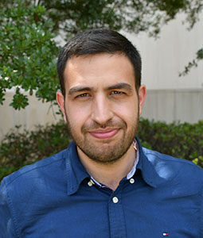
Elie Kfoury
University of South Carolina | Assistant Professor

Slide 4
Agenda
Need for hardware acceleration
Background on Data Processing Units (DPUs)
Bluefield-3 DPU
DOCA programming and demo
P4 programming and demo
Training material
Q&A

Slide 5
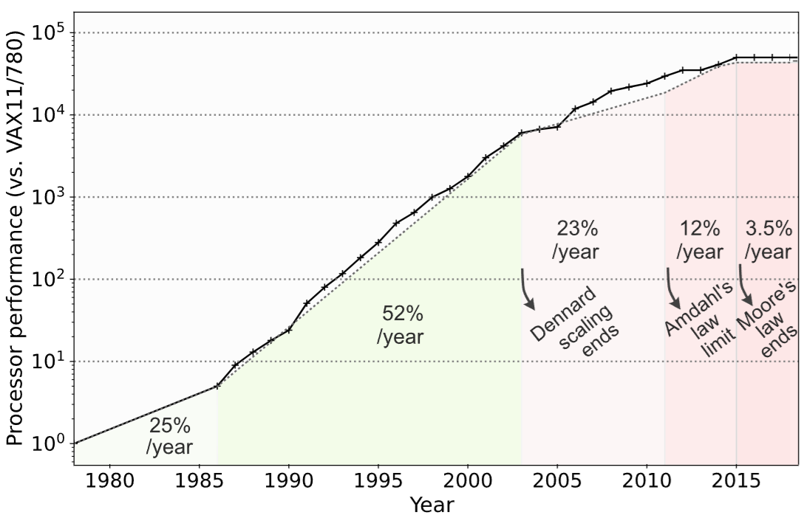
Growth of CPU Performance
End of Moore’s Law and Dennard Scaling, and the limit of Amdahl’s Law
Notes:
This chart shows how the rate at which processor performance doubled has slowed over time. Up to the early 2000s, performance roughly doubled every 18–24 months in line with Moore’s Law and Dennard scaling. After around 2005, that doubling slowed dramatically as power and parallelism limits were reached, ending the era of rapid performance scaling

Slide 6
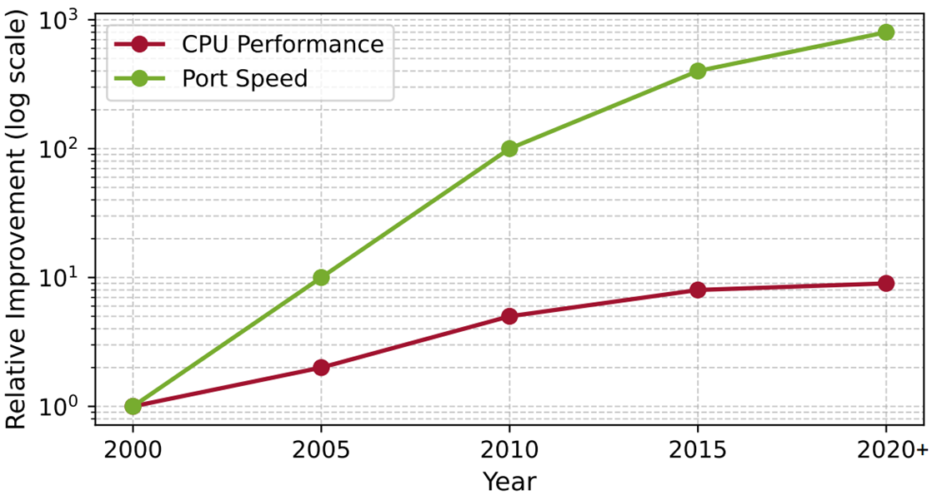
Growth of CPU Performance
Link speeds continue to rise exponentially while CPU performance has plateaued

Slide 7
Growth of CPU Performance
Link speeds continue to rise exponentially while CPU performance has plateaued
The gap between CPU performance and network speeds has led to domain-specific accelerators (DSAs)

Slide 8
Data Processing Units (DPUs)
DPUs use DSAs to offload processing from general purpose CPU
Programmable packet processing pipeline, regular expression, encryption/decryption, etc.
The DSAs are typically implemented on ASIC or FPGAs
DPUs also include general-purpose CPU cores for managing the system

Slide 9
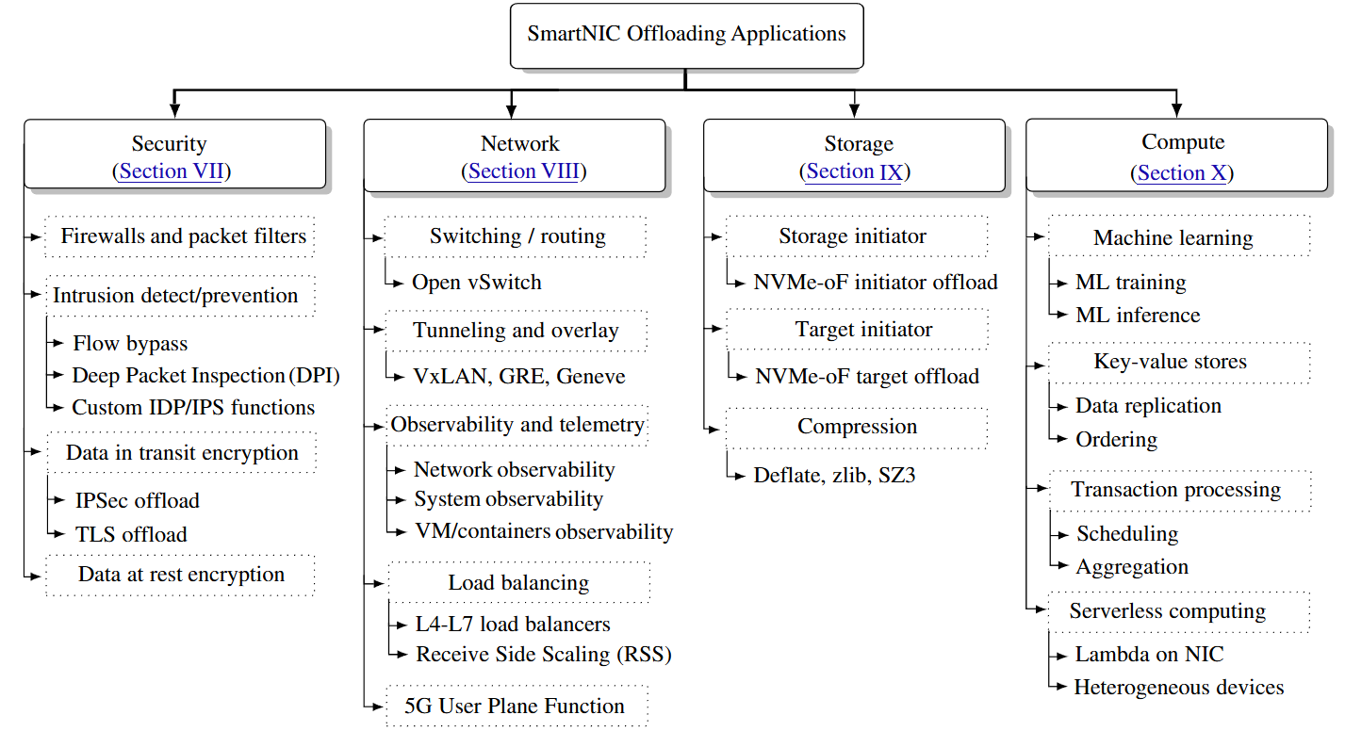
Data Processing Units (DPUs)
DPUs have been used to offload a variety of applications and infrastructure functions
Kfoury, Elie, et al. "A comprehensive survey on SmartNICs: Architectures, development models, applications, and research directions." IEEE Access (2024).

Slide 10
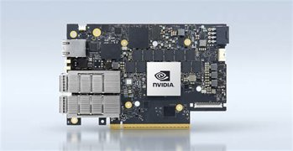
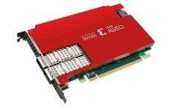
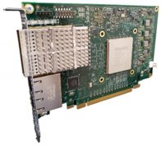
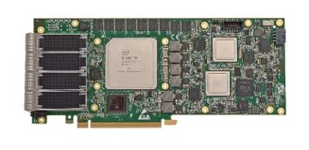
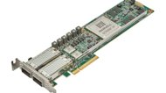
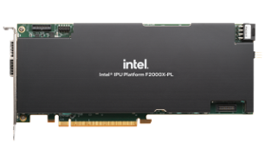
DPUs Available Today
NVIDIA – BlueField family of Data Processing Units
AMD – Pensando and Alveo FPGA
Intel – Infrastructure Processing Units (IPUs)
Intel – FPGA variants (Silicom)
Marvell Octeon (DPU with ARM based CPU)
Others

Slide 11
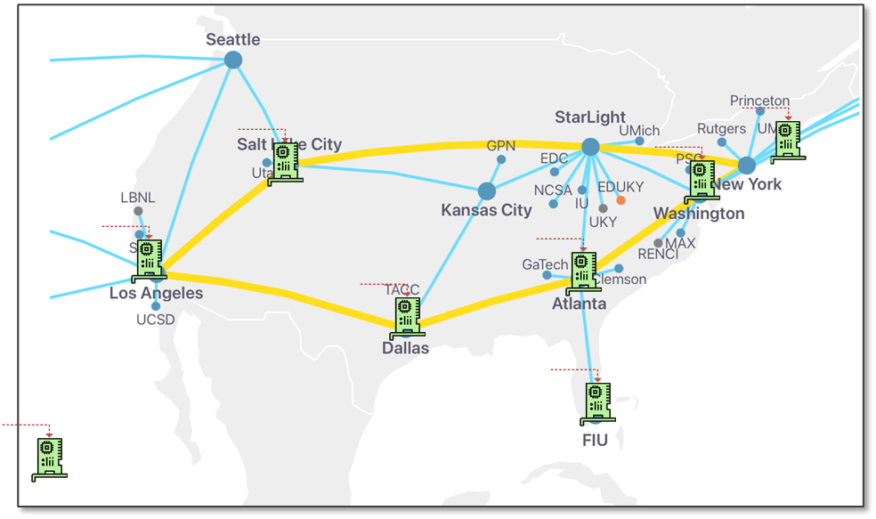
DPUs on FABRIC
BlueField-3 DPUs are being installed on various FABRIC sites
Currently the following sites have DPUs installed (more will be available soon): MASS, DALL, SALT, FIU, LOSA, NEWY, ATLA, HAWI

Slide 12
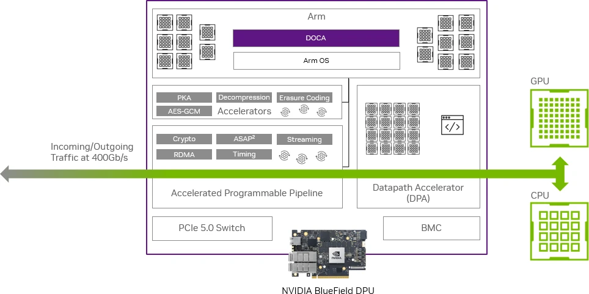
BlueField-3 Architecture
BlueField-3 include programmable pipeline, datapath accelerator, ARM cores, and various DSAs

Slide 13
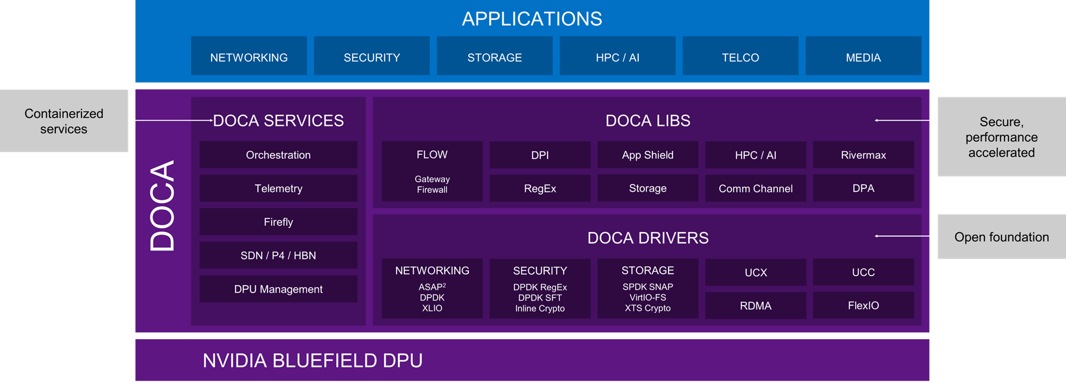
DOCA Software Stack
DOCA is a comprehensive SDK, compilers, services, and tools for BlueField DPUs

Slide 14
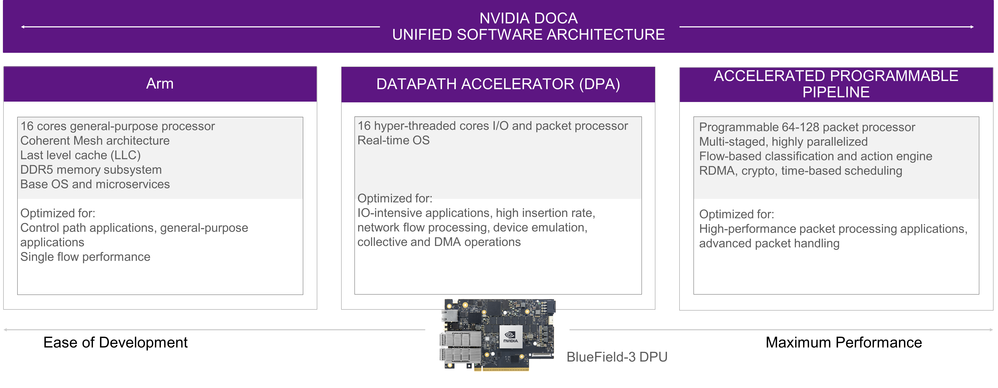
BlueField-3 Components
BlueField-3 include programmable pipeline, datapath accelerator, ARM cores, and DSAs
DOCA, DPDK, P4-DPDK

Slide 15
BlueField-3 Components
BlueField-3 include programmable pipeline, datapath accelerator, ARM cores, and DSAs
C (RISC-V)

Slide 16
BlueField-3 Components
BlueField-3 include programmable pipeline, datapath accelerator, ARM cores, and DSAs
P4, OvS HW offload, DOCA Flow

Slide 17
DOCA Programming: Accelerator Invocation

Slide 18
DOCA Programming
DOCA exposes APIs to invoke the accelerators (e.g., decompression, direct memory access (DMA), crypto, etc.)
The workflow consists of:
Device discovery
Create memory map (MMAP)
Create & start a buffer inventory
Create a Progress Engine (PE)
Create and configure the accelerator instance
Allocate and submit a task
Drive progress & handle completion
Cleanup

Slide 19
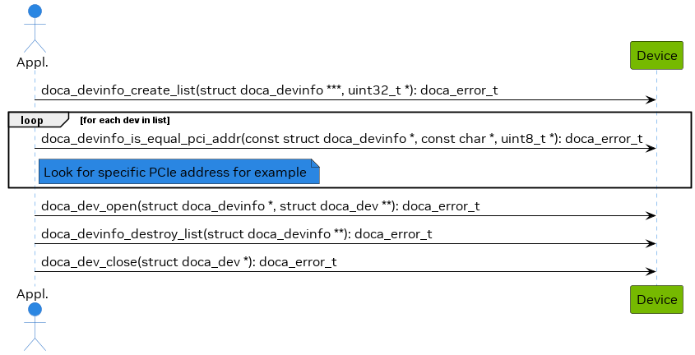
Device Discovery
To work with DOCA libraries, an application must open a device available on the DPU
Open Device by PCI address

Slide 20
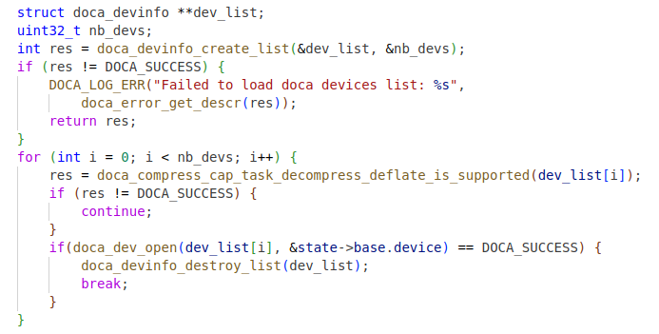
Device Discovery
To work with DOCA libraries, an application must open a device available on the DPU
Open Device by PCI address
Open Device by capability

Slide 21
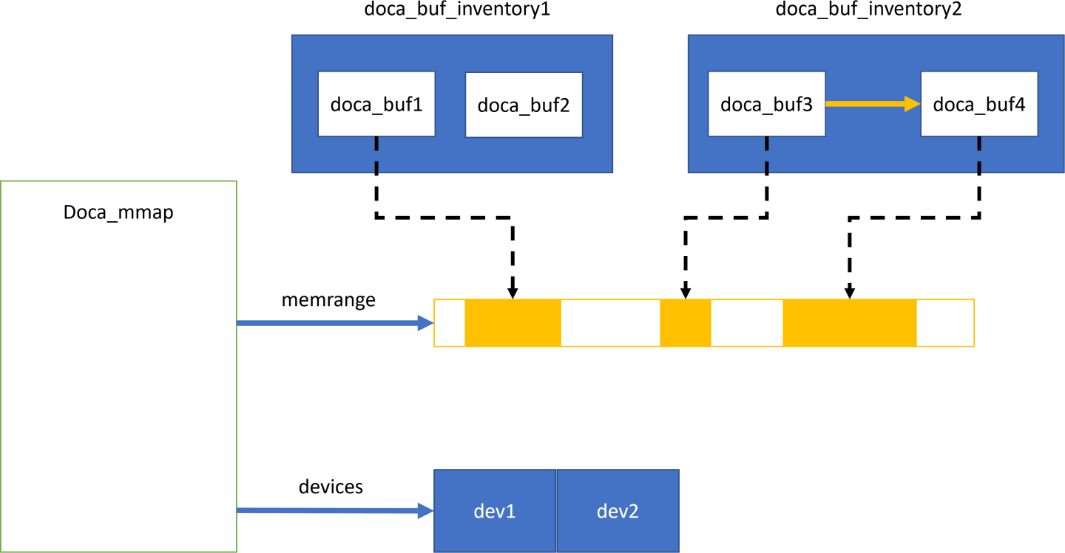
Memory Map (Mmap)
doca_mmap serves as the memory pool for data buffers
The application provides a single memory region, as well as permissions for certain devices to access

Slide 22
Buffer Inventory
doca_buf is the data buffer descriptor
This is not the actual data buffer, rather, it is a descriptor that holds metadata on the "pointed" data buffer
doca_buf_inventory serves as a pool of doca_buf

Slide 23
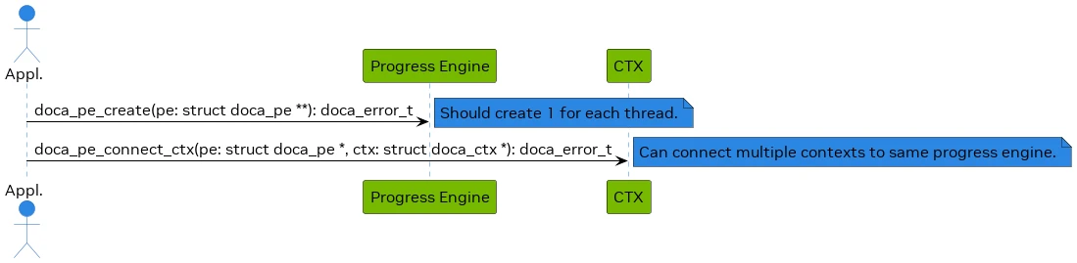
Progress Engine (PE)
The progress engine PE is responsible for scheduling workloads (i.e., picking the next workload to execute).
PE enables asynchronous processing and handling of multiple tasks and events

Slide 24
Accelerator Instance
Create an instance of the accelerator
DOCA compress
DOCA SHA
DOCA RDMA
DOCA DMA
DOCA Ethernet
DOCA Comch
DOCA App Shield
…

Slide 25
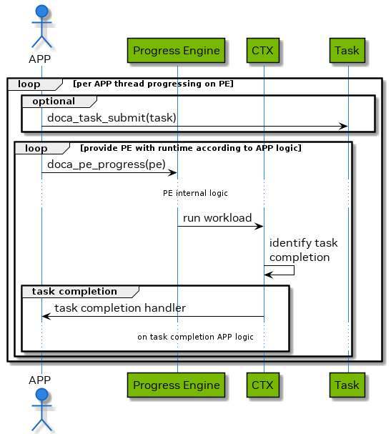
Task Submission and Completion
Submit task and wait for completion

Slide 26
Cleanup
Gracefully release everything to avoid leaks and dangling mappings
Make sure all tasks are complete before stopping/destroying resources

Slide 27
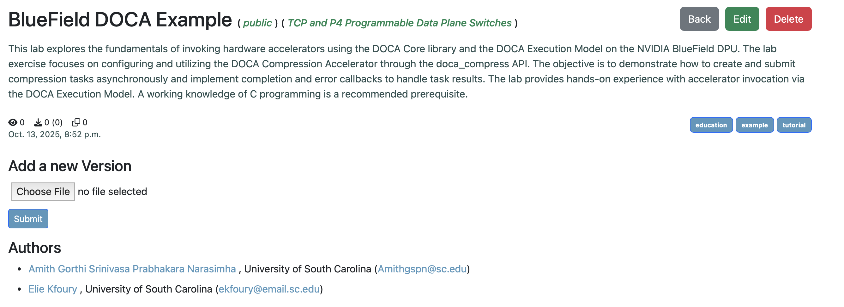
DOCA Example on Artifact Manager
Compression acceleration example is available on the Artifact Manager

Slide 28
Programming the Accelerated Pipeline with P4

Slide 29
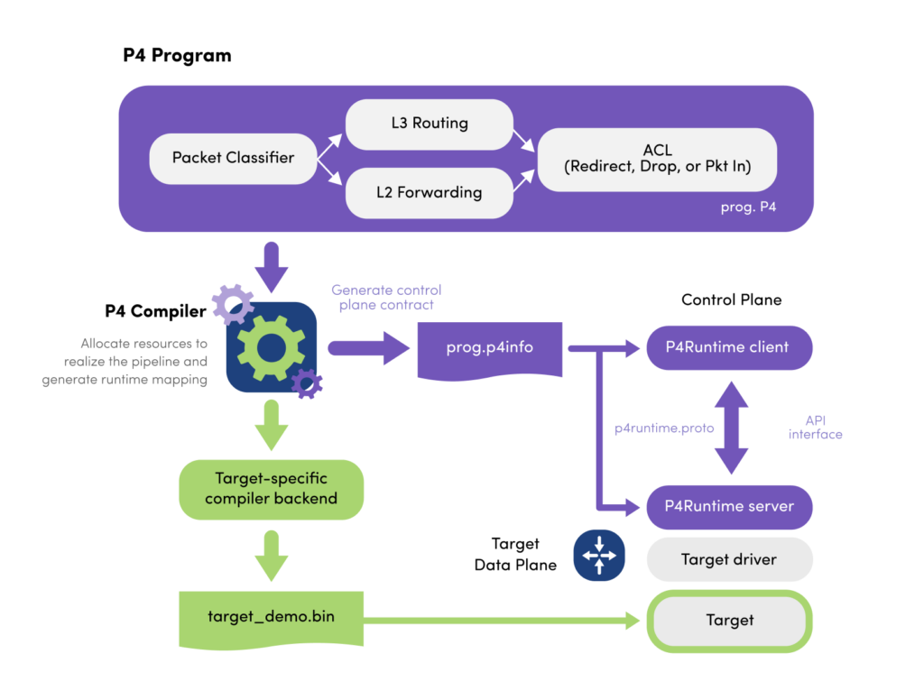
P4 Language
P4 emerged as domain-specific language to define packet processing:
Define and parse new protocols
Customize packet processing functions
Offload packet processing from CPU

Slide 30
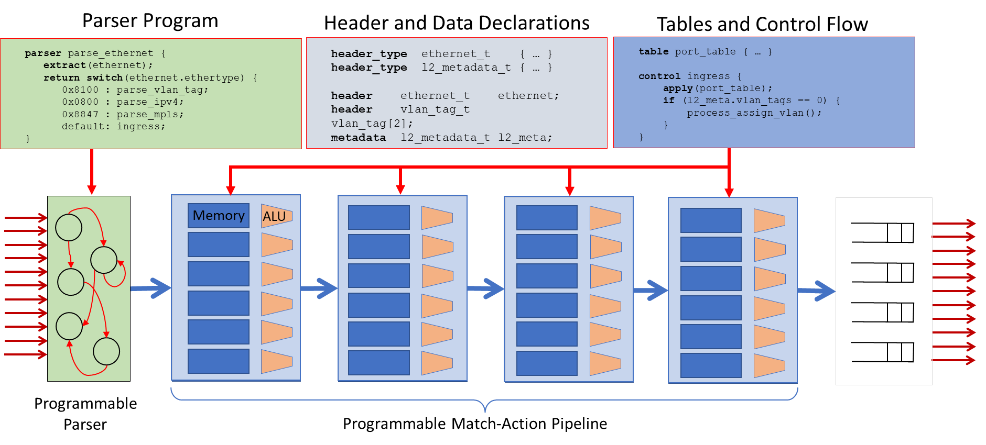
PISA: Protocol Independent Switch Architecture
N. McKeown. Creating an End-to-End Programming Model for Packet Forwarding. Available: https://www.youtube.com/watch?v=fiBuao6YZl0&t=4216s

Slide 31
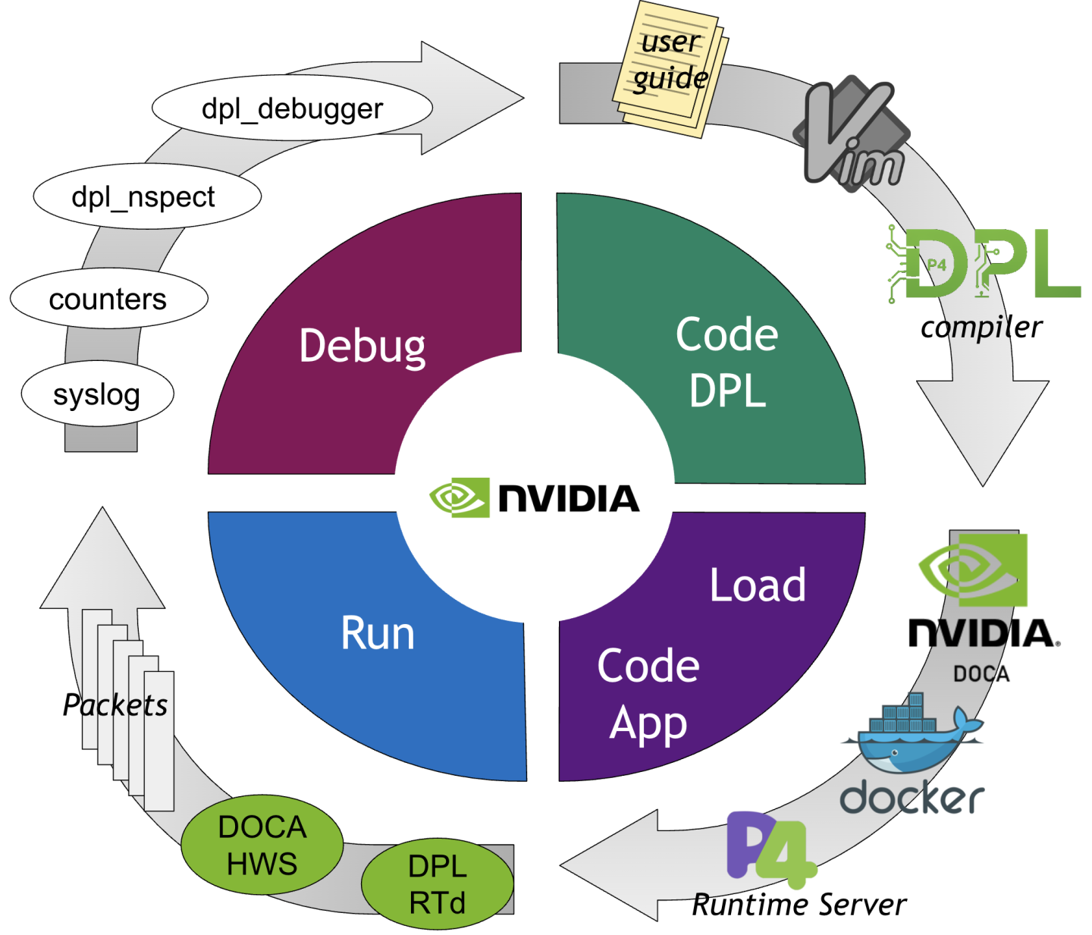
DPL Overview
DOCA Pipeline Language (DPL) introduces a software development solution based on the P4 language
DPL is derived from the P4-16 language specification

Slide 32
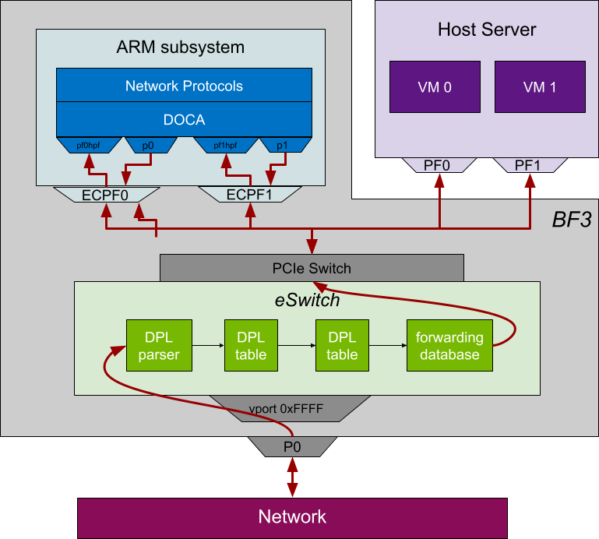
DPL Overview
DOCA Pipeline Language (DPL) introduces a software development solution based on the P4 language
DPL is derived from the P4-16 language specification

Slide 33
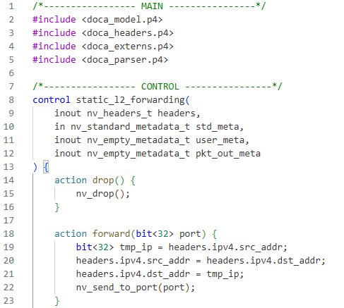
P4 DPL Example
Simple L2 forwarding example available on Artifact Manager

Slide 34
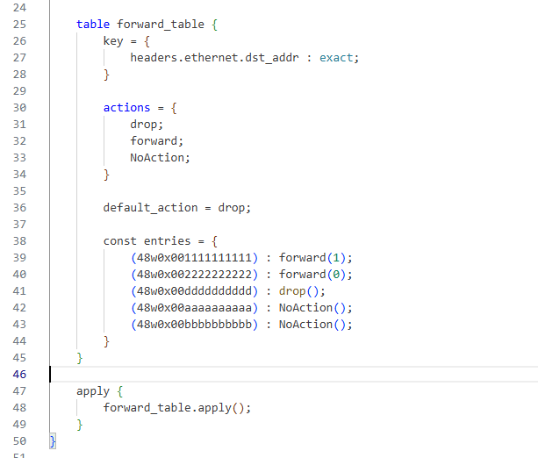
P4 DPL Example
Simple L2 forwarding example available on Artifact Manager

Slide 35

P4 DPL Example
Simple L2 forwarding example available on Artifact Manager

Slide 36
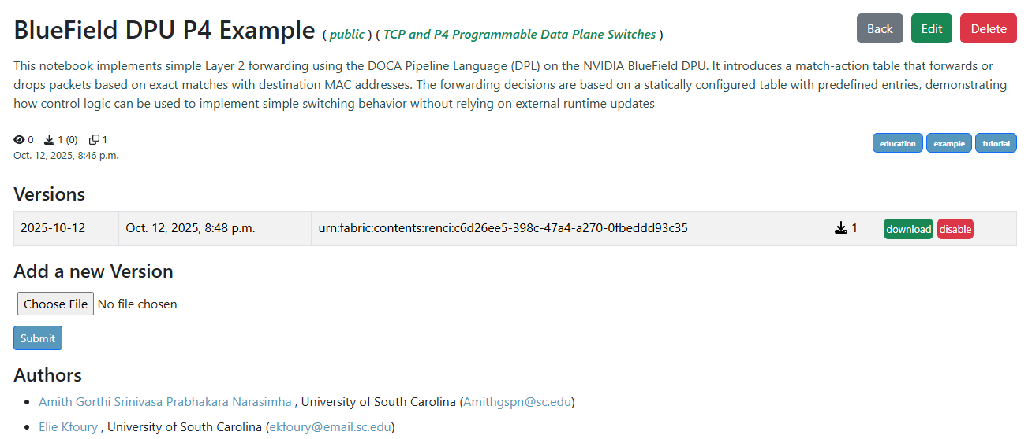
P4 Example on Artifact Manager
Simple L2 forwarding example available on Artifact Manager

Slide 37
DPU Training Labs
on USC’s NETLAB

Slide 38
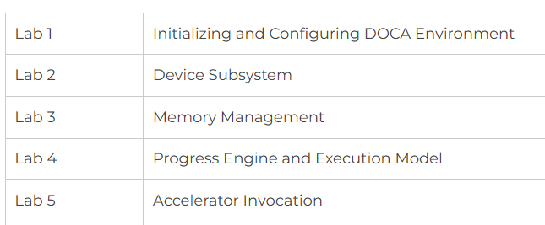
DPU Labs
DPU cybertraining is supported by NSF Cybertraining program, award #2417823
Lab libraries available to learn about DPU programming:
DPU Programming using DOCA
DPU Programming using P4 DPL
Introduction to P4-DPDK
P4-DPDK Security applications

Slide 39
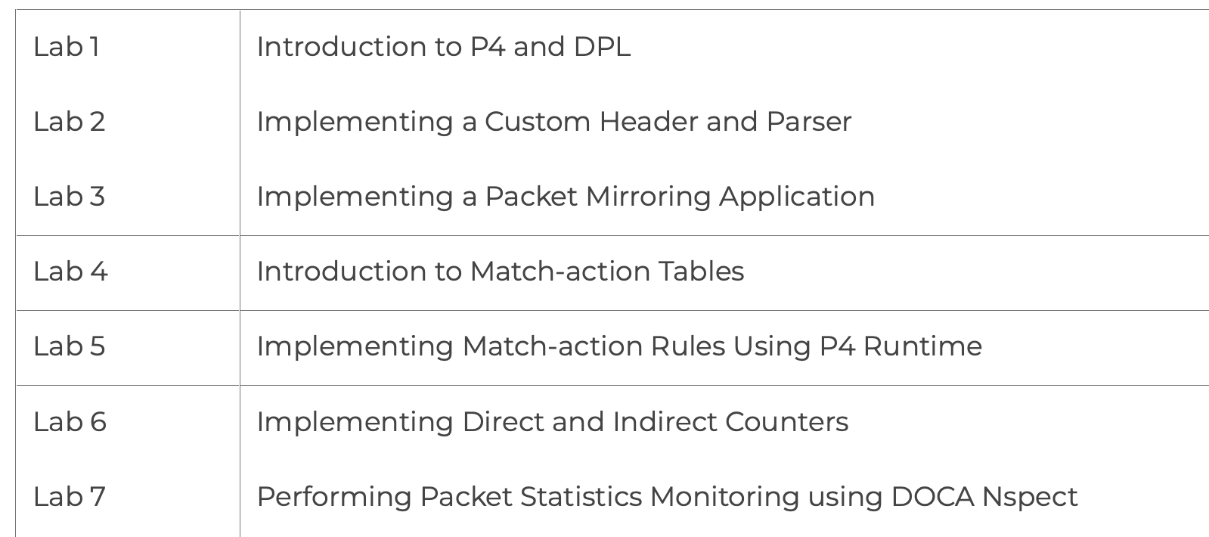
DPU Labs
DPU cybertraining is supported by NSF Cybertraining program, award #2417823
Lab libraries available to learn about DPU programming:
DPU Programming using DOCA
DPU Programming using P4 DPL
Introduction to P4-DPDK
P4-DPDK Security applications

Slide 40
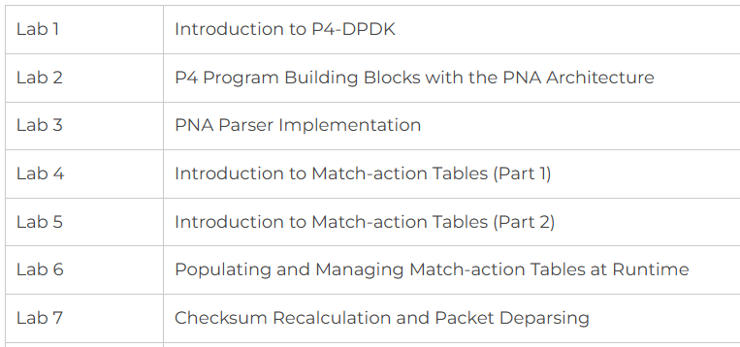
DPU Labs
DPU cybertraining is supported by NSF Cybertraining program, award #2417823
Lab libraries available to learn about DPU programming:
DPU Programming using DOCA
DPU Programming using P4 DPL
Introduction to P4-DPDK
P4-DPDK Security applications

Slide 41
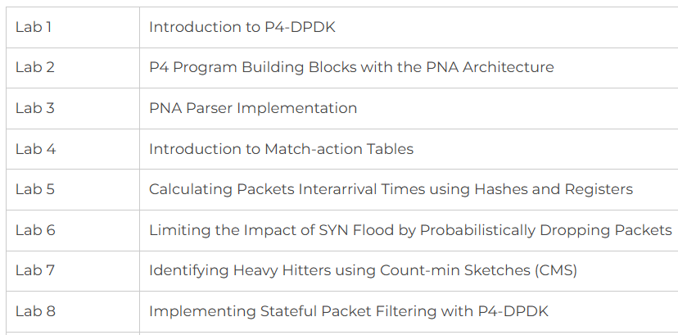
DPU Labs
DPU cybertraining is supported by NSF Cybertraining program, award #2417823
Lab libraries available to learn about DPU programming:
DPU Programming using DOCA
DPU Programming using P4 DPL
Introduction to P4-DPDK
P4-DPDK Security applications

Slide 42

DPU Workshops
2025 Supercomputing tutorial, Nov 16, St. Louis, MO
2025 Internet2 Technology Exchange (TechEx), Dec 8-12, Denver, CO
Online workshops
More information on workshops and training resources:
https://research.cec.sc.edu/cyberinfra/workshops
https://research.cec.sc.edu/cyberinfra/cybertraining

Slide 43


Acknowledgements
This work was supported by the U.S. National Science Foundation (NSF), under awards 2417823 and 2346726
The authors would also like to acknowledge the FABRIC team.

Slide 44
Q&A

Slide 45
Acknowledgements
In addition to our presenter, we would like to acknowledge the behind-the-scenes team that diligently worked to bring this webinar to production:﻿
KC Wang, content
Chelsea Davis, project manager
Jayasree Jaganatha, social media specialist

Slide 46
Resources
Connect With Us
Newsletter Signup: bit.ly/FABRICnewsletter
Office Hour Sign Up: bit.ly/FABRIC-Office-Hours
Call to Action
FABRIC Matrix: https://bit.ly/FABRICmatrix
Other Resources
Website: bit.ly/m/FABRICtestbed
YouTube: youtube.com/@fabrictestbed
FABRIC Account: portal.fabric-testbed.net
Ambassador Program: bit.ly/FABRIC-Ambassador-Program
FABRIC LinkedIn: linkedin.com/company/fabrictestbed
Citing FABRIC: bit.ly/citing-fabric

Slide 47
Thank You for Attending!
Join us for our upcoming webinars:
Date - Stitching Together Innovation with FABRIC Users
Date - Mastering FABRIC: Tips and Tricks Webinar
Visit our YouTube Channel: youtube.com/@fabrictestbed

