Slide 1

Introduction to the Science DMZ
Jason Zurawski
zurawski@es.net
ESnet / Lawrence Berkeley National Laboratory
UCF / FLR Workshop on Networking Topics
May 21-22, 2025
National Science Foundation Award #2328479
https://epoc.global

Slide 2
Outline
Introduction
Solution Space
Conclusions / QA

Slide 3
Motivation/Background
Networks are an essential part of data-intensive science
  Connect data sources to data analysis
  Connect collaborators to each other
Performance is critical, but often overlooked
  Exponential data growth
  Constant human factors
  Data movement and data analysis must keep up
Effective use of wide area (long-haul) networks by scientists has historically been difficult

Slide 4
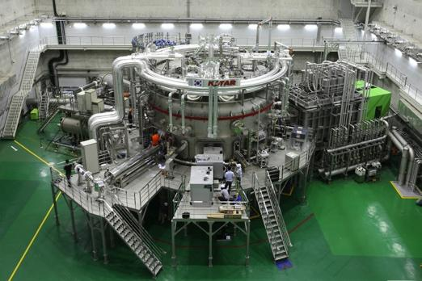
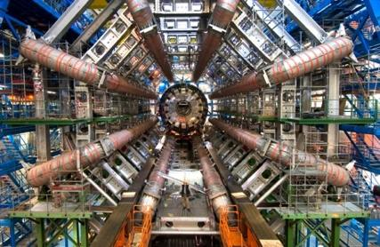
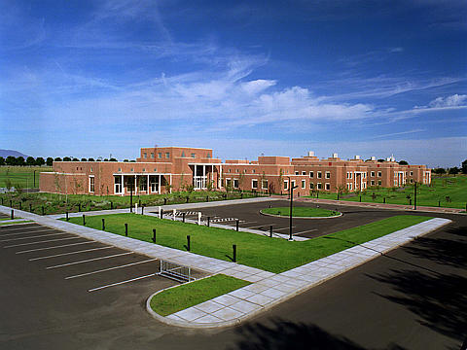
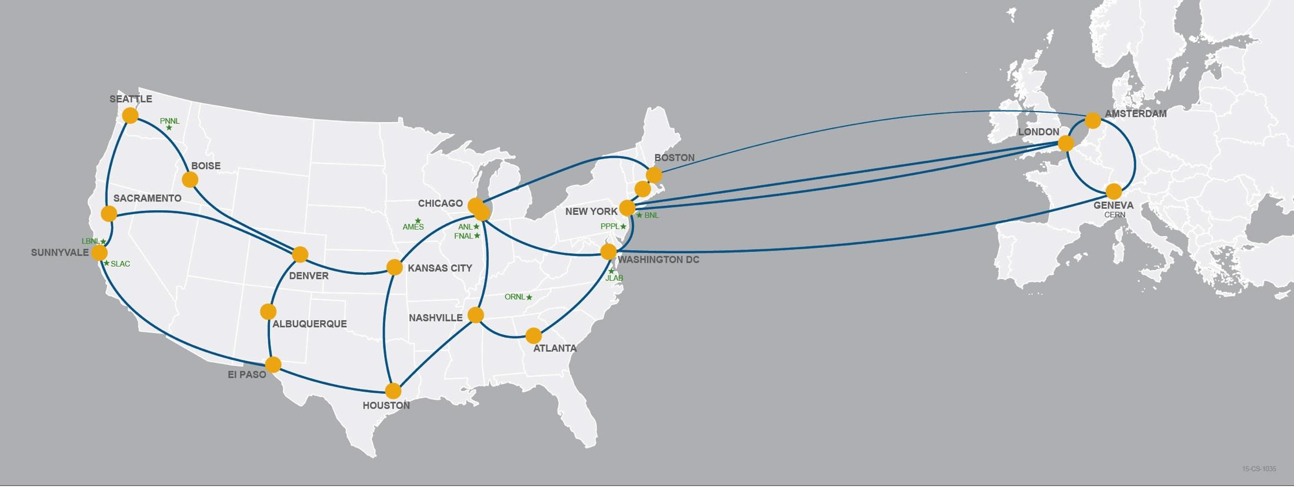
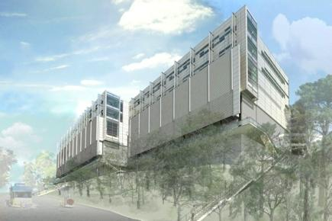
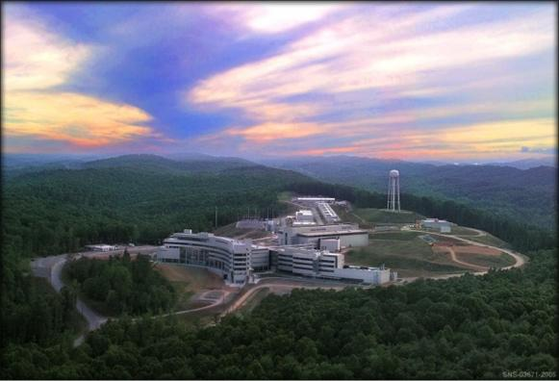
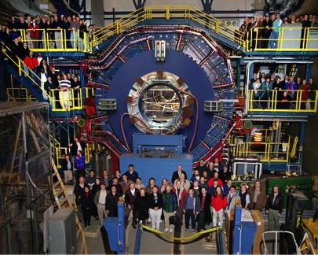
Network as Infrastructure Instrument
Connectivity is the first step – usability must follow

Slide 5
Outline
Introduction
Solution Space
  Understanding the Solution Space (Users, Use Cases, Long Term Impacts)
  Preliminaries (e.g. Network Protocols 101)
  Architecture & Design
  Data Mobility
Conclusions / QA

Slide 6
Common Theme / New Mindset
We aren’t building a “Network Architecture”, we want a “Data Architecture”
  A lot of the items that will be thrown at you transcend the traditional network space.
To get there:
  Understand the data pipeline for your target user/use case – cradle to retirement home
  This implies all the things:
    Creation
    Usage
    Transfer/Share
    Curation

Slide 7
Common Theme / New Mindset
What you build must be
  Usable – if this becomes a ‘walled garden’, what’s the point? Make it such that people can be easily onboarded and integrated.
  Defensible – it is not, nor should it be, the wild west. Control the users and use cases, but don’t impact the usage.
  Scalable – as demand grows. Think cornfields and baseball diamonds.
  an institutional capability / source of pride – this is something that will draw more users / research dollars if created/marketed/operated correctly. Treat it as such.

Slide 8
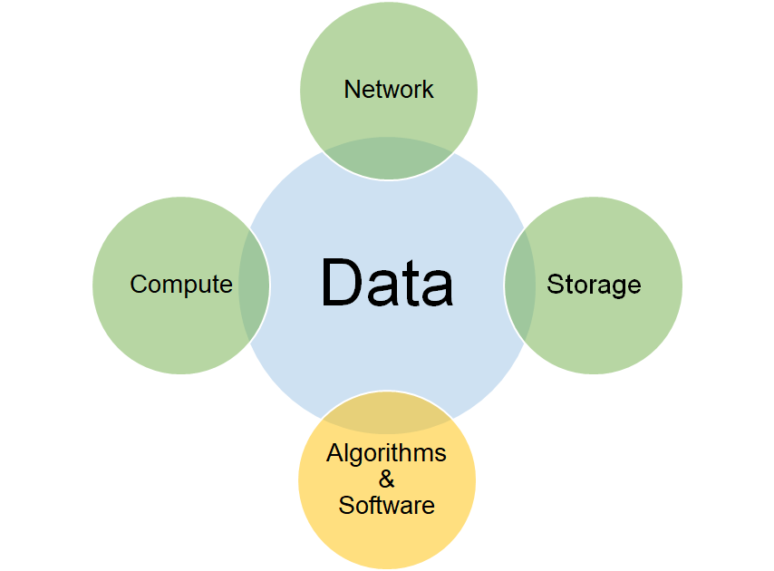
Science
Some specific issues for networks are
  Development of services
  Planning capacity growth
  Creation of collaborations

Slide 9
Outline
Introduction
Solution Space
  Understanding the Solution Space (Users, Use Cases, Long Term Impacts)
  Preliminaries (e.g. Network Protocols 101)
  Architecture & Design
  Data Mobility
Conclusions / QA

Slide 10
Data Movement / TCP Background
The data mobility performance requirements for data intensive science are beyond what can typically be achieved using traditional methods
  Default host configurations (TCP, filesystems, NICs)
  Converged network architectures designed for commodity traffic
  Conventional security tools and policies
  Legacy data transfer tools (e.g. SCP, FTP)
  Wait-for-trouble-ticket operational models for network performance
Notes:
The Science DMZ model is a set of ideas – the diagrams that follow are examples.

Slide 11
TCP – Ubiquitous and Fragile
Networks provide connectivity between hosts – how do hosts see the network?
  From an application’s perspective, the interface to “the other end” is a socket
  Communication is between applications – mostly over TCP
  Congestion dictates performance – back off when danger is sensed to preserve/protect resources
TCP – the fragile workhorse
  TCP is (for very good reasons) timid – packet loss is interpreted as congestion
  Packet loss in conjunction with latency is a performance killer
  Like it or not, TCP is used for the vast majority of data transfer applications (more than 95% of ESnet traffic is TCP)

Slide 12
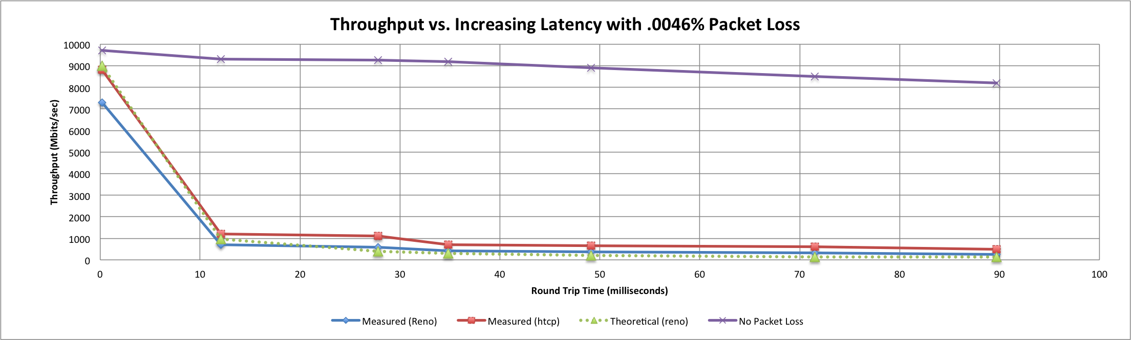
A small amount of packet loss makes a huge difference in TCP performance
With loss, high performance beyond metro distances is essentially impossible
Local
(LAN)
International
Metro Area
Regional
Continental
Measured (TCP Reno)
Measured (HTCP)
Theoretical (TCP Reno)
Measured (no loss)
Notes:
On a 10 Gb/s LAN path the impact of low packet loss rates is minimal
On a 10 Gb/s WAN path the impact of low packet loss rates is enormous
Beyond your metro area, zero loss is essentially required for performance
Where are your collaborators? Where are your users?
When global collaboration is the norm, nobody can afford to be a local-only resource

Slide 13
Data Movement / TCP Background
The Science DMZ model describes a performance-based approach
  Dedicated infrastructure for wide-area data transfer
    Well-configured data transfer hosts with modern tools
    Capable network devices
    High-performance data path which does not traverse commodity LAN
  Proactive operational models that enable performance
    Well-deployed test and measurement tools (perfSONAR)
    Periodic testing to locate issues instead of waiting for users to complain
  Security posture well-matched to high-performance science applications
Notes:
The Science DMZ model is a set of ideas – the diagrams that follow are examples.

Slide 14
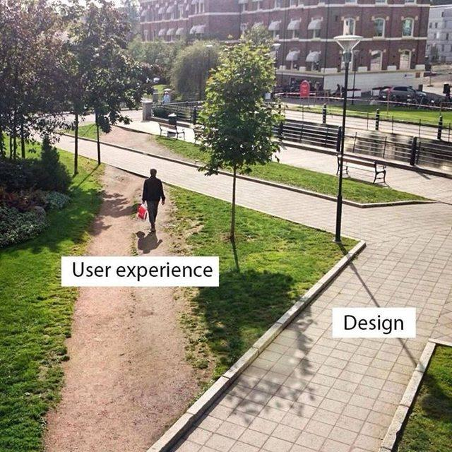
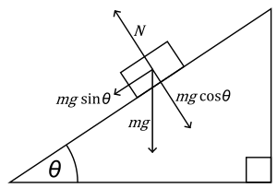


The Science DMZ in 1 Slide
Consists of four key components, all required:
“Friction free” network path
  Highly capable network devices (wire-speed, deep queues)
  Virtual circuit connectivity option
  Security policy and enforcement specific to science workflows
  Located at or near site perimeter if possible
Dedicated, high-performance Data Transfer Nodes (DTNs)
  Hardware, operating system, libraries all optimized for transfer
  Includes optimized data transfer tools such as Globus Online and GridFTP
Performance measurement/test node
  perfSONAR
Engagement with end users
  Details at http://fasterdata.es.net/science-dmz/
© 2013 Wikipedia

Slide 15
Outline
Introduction
Solution Space
  Understanding the Solution Space (Users, Use Cases, Long Term Impacts)
  Preliminaries (e.g. Network Protocols 101)
  Architecture & Design
  Data Mobility
Conclusions / QA

Slide 16
Science DMZ Takes Many Forms
There are a lot of ways to combine these things – it all depends on what you need to do
  Small installation for a project or two
  Facility inside a larger institution
  Institutional capability serving multiple departments/divisions
  Science capability that consumes a majority of the infrastructure
Some of these are straightforward, others are less obvious
Key point of concentration: eliminate sources of packet loss / packet friction

Slide 17
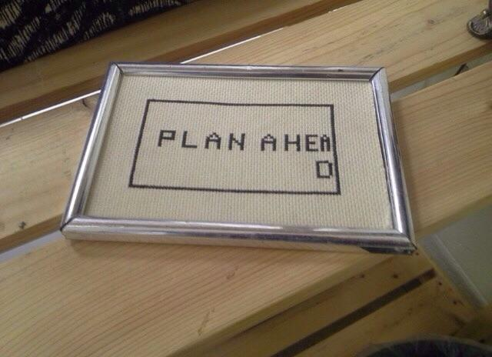
Legacy Method: Ad Hoc DTN Deployment
This is often what gets tried first
Data transfer node deployed where the owner has space
  This is often the easiest thing to do at the time
  Straightforward to turn on, hard to achieve performance
If lucky, perfSONAR is at the border
  This is a good start
  Need a second one next to the DTN
Entire LAN path has to be sized for data flows
Entire LAN path is part of any troubleshooting exercise
This usually fails to provide the necessary performance.
Notes:
Previous slide is diagram for this; just say these things while showing previous slide

Slide 18
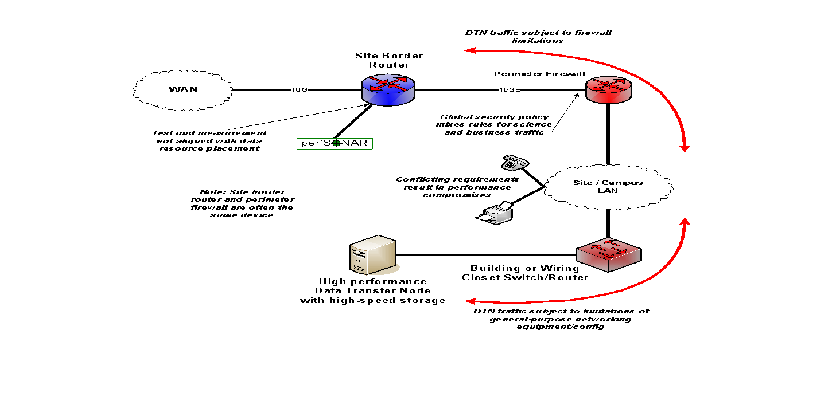
Ad Hoc DTN Deployment
Notes:
DTN node deep within campus infrastructure.

Slide 19
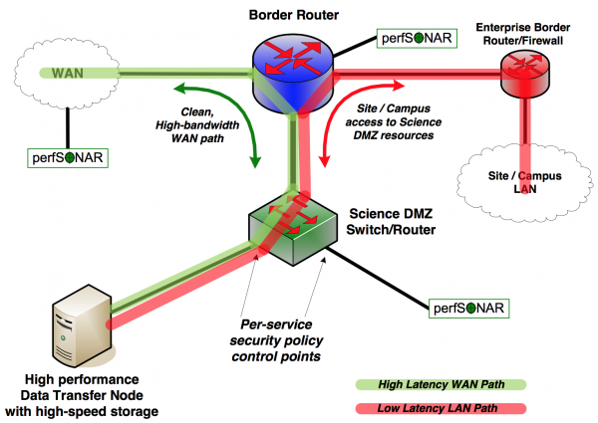
A better approach: simple Science DMZ
Notes:
Add-on to existing network infrastructure
All that is required is a port on the border router
Small footprint, pre-production commitment
Easy to experiment with components and technologies
DTN prototyping
perfSONAR testing
Limited scope makes security policy exceptions easy
Only allow traffic from partners
Add-on to production infrastructure – lower risk

Slide 20
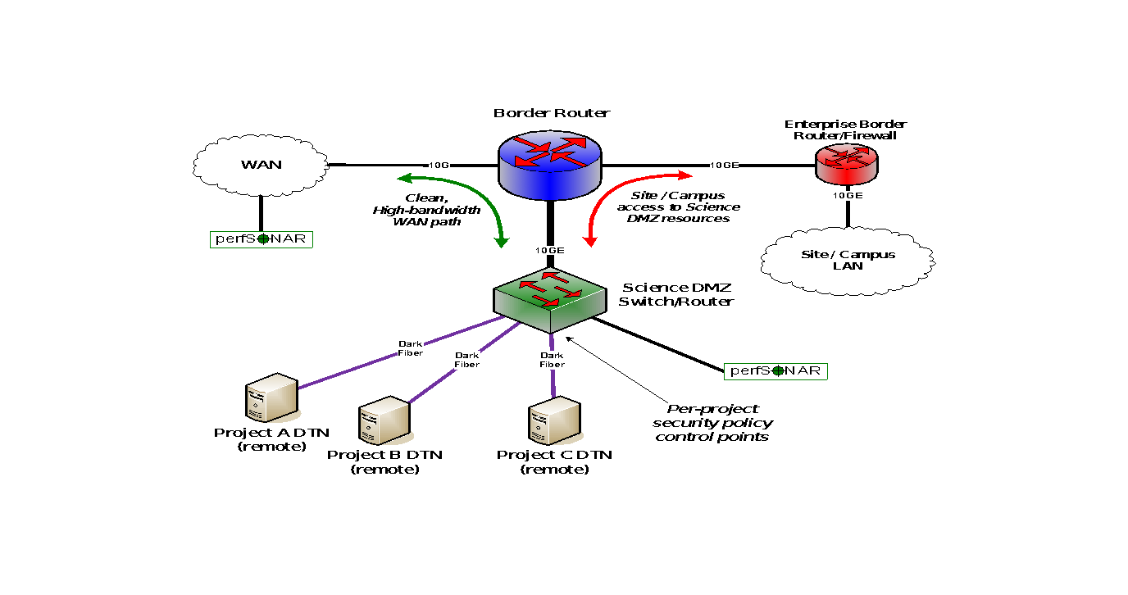
Distributed Science DMZ – Dark Fiber

Slide 21
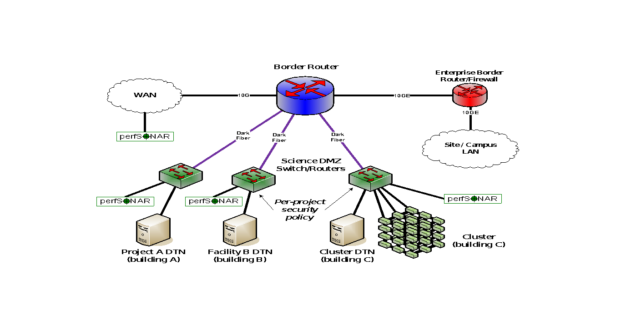
Multiple Science DMZs –
Dark Fiber to Dedicated Switches

Slide 22
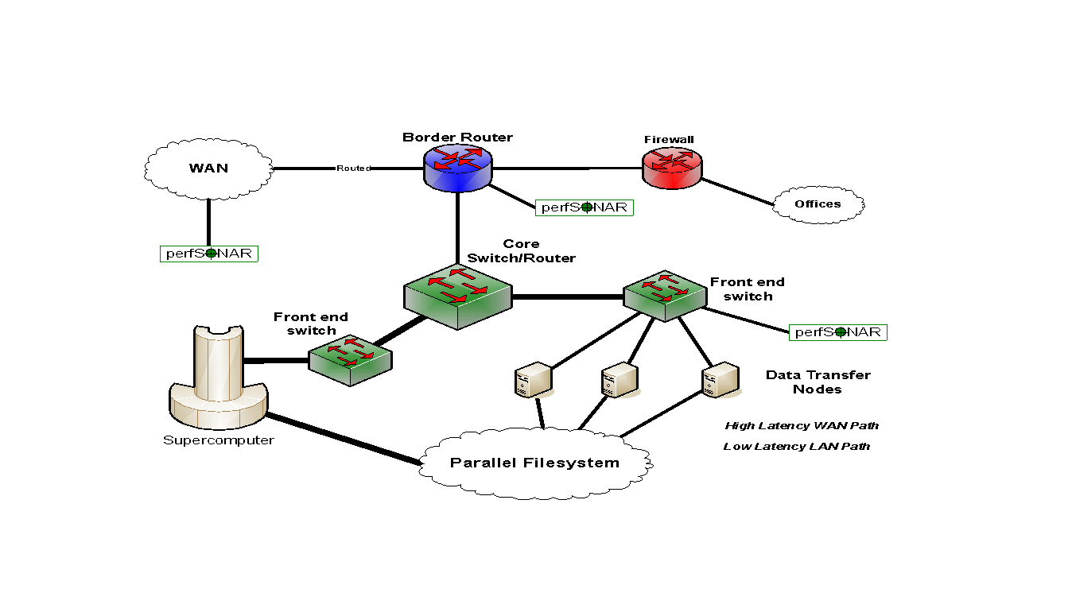
Science DMZ Model in HPC Facility
Notes:
DTNs are not part of major computational resource, and so are not entangled with its config
They are part of the filesystem – the DTNs are the external interface to the filesystem.

Slide 23
Outline
Introduction
Solution Space
  Understanding the Solution Space (Users, Use Cases, Long Term Impacts)
  Preliminaries (e.g. Network Protocols 101)
  Architecture & Design
  Data Mobility
Conclusions / QA

Slide 24
Next Steps – Building On The Science DMZ
Enhanced cyberinfrastructure substrate exists and it works
  Wide area networks (ESnet, Internet2, Regionals)
  Science DMZs connected to those networks
  DTNs in the Science DMZs
What does the scientist see?
  Scientist sees a science application
    Data transfer
    Data portal
    Data analysis
  Science applications are the user interface to networks and DMZs
Large-scale data-intensive science requires that we build larger structures on top of those components
Notes:
Key points:
The underlying substrate is good, but we have to build things on it that are useful to scientists
Scientists don’t care about the substrate (networking people care, but scientists just want it to work)
So, the science application needs to see benefit from the Science DMZs, DTNs, networks, etc.

Slide 25
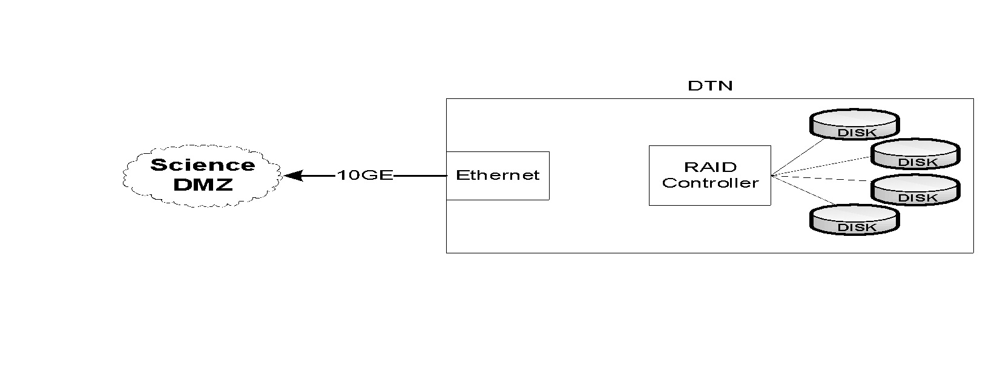
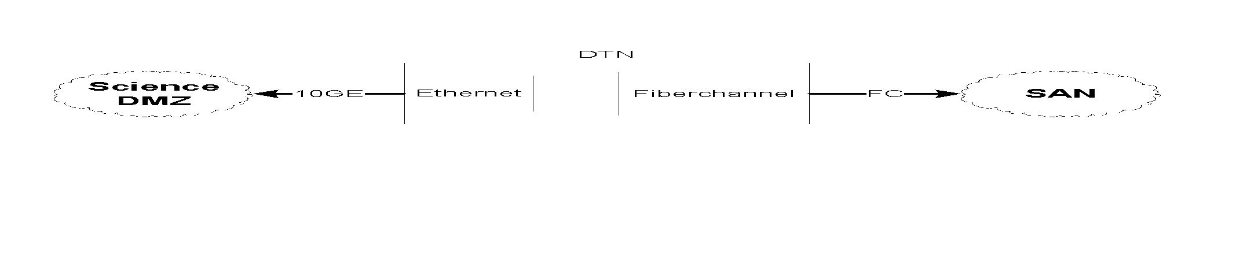
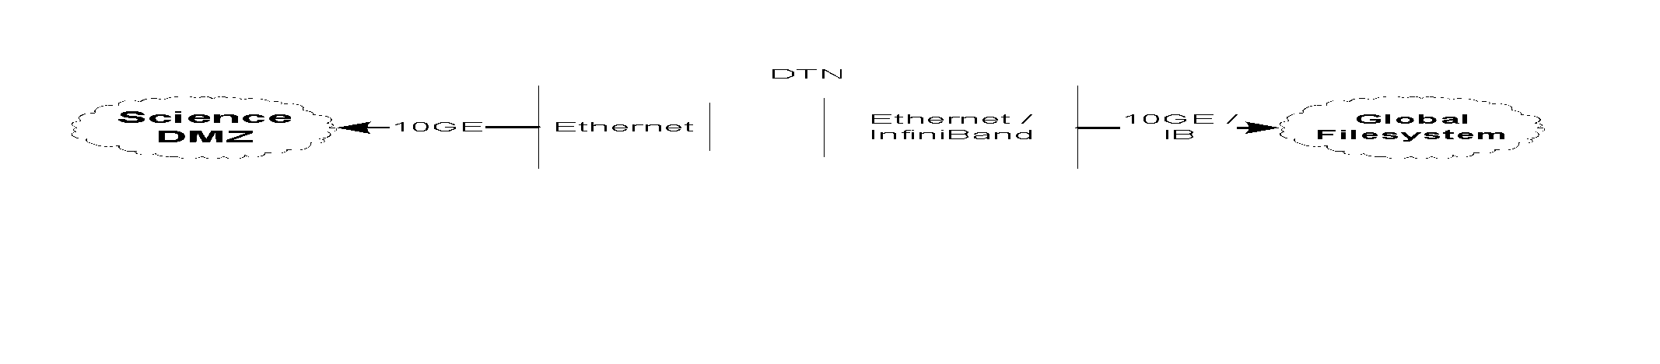
DTN Architecture Considerations
DTNs can be all ‘internal’, e.g. not connected to external storage, or ‘pass through’ where they have access to external storage
Discuss options with your scientific users – figure out which workflow will work best!
Notes:
Next is: what does the storage look like for a DTN?
There are various ways you can bring storage into or to your server
3 main classes
The 1st and most common DTN choice is local storage within the DTN
Perks:
no external dependencies
deployable anywhere
But
limited scalability
and only tools for managing storage come from RAID controllers
_____________
Local storage: the storage system (just a bunch of drives / JBOD) is packaged with the server. That can from 12 drivers up to 48 drives depending on vendor/model. In addition, external chassis with more drives can be added, connected to the server with SAS or FC. This is ideal for standalone servers since it does not require plumbing for the storage subsystem.
However, maintenance is typically more difficult since it does not have all the tooling that usually comes with storage systems.

Slide 26
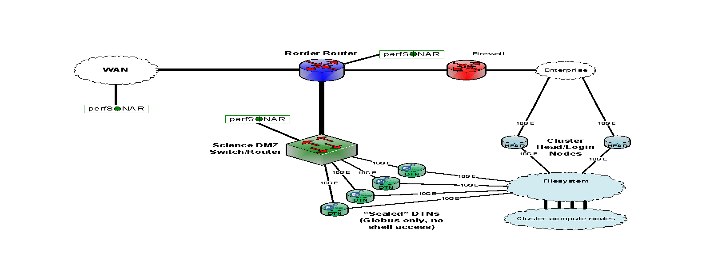
Solution Space – Data Mobility
10G
10G
10G
40G/100G
Downstream
Notes:
Next two classes are the same from a systems perspective
(main different from a workflow perspective—i.e. double copy workflow for SANs but not with distributed/global file systems)
We see these storage architectures in DTNs at data and HPC facilities
But whatever you choose for storage will depend on your environment, requirements, and resources.
______________________
System reasoning: what kind of card used on the backend to the storage system—FC/Ethernet/Inifiniband look the same
But the workflow is what’s different
No block device communication between DTN kernel Global fs
For SAN and internal disks—DTN kernel sees it as “owning”/managing blocks in SAN or RAID
_____________________________
Distributed file systems—high quality of service
much more reliable
easy to manage
however, typically performance is much lower because they are usually a shared system—don’t know the workload of other users—possibility of contesting traffic
i.e., we see this at data centers/supercomputers
they do have bottlenecks. I/O is the storage controller (EMC is limited to 8G right now)
Same I/O capacity but no bottleneck with infiniband connections.
enterprise level system
IB
56 G/link and easy to aggregate
reliable networking—no packet loss
fairly cheap
Distributed filesystem: this is similar to the storage system, except that the exported volumes are not RAW but file system (PNFS, Lustre, GPFS…). This set up is typical of a tiered system: data is acquired and processed, and stored. Then the DTN read from the shared storage.
Storage Systems: These are usually more massive systems (EMC, Netapp, DDN, etc) providing raw volumes to servers. The connectivity is usually fiber, but it can also be infiniband and ethernet.
This class benefits storage capacity.
POINT: look at what your infrastructure requirements are
how much capacity do you need for the next 3 years—will your system scale the way you want?
how reliable does your storage have to be—source of truth or is it a pain to resend the data if a disk goes down? (i.e., choose your RAID appropriately)
performance of storage what you need? If its 10G—laptops won’t do that
don’t need to invest in super fast storage if you only want to use laptops

Slide 27
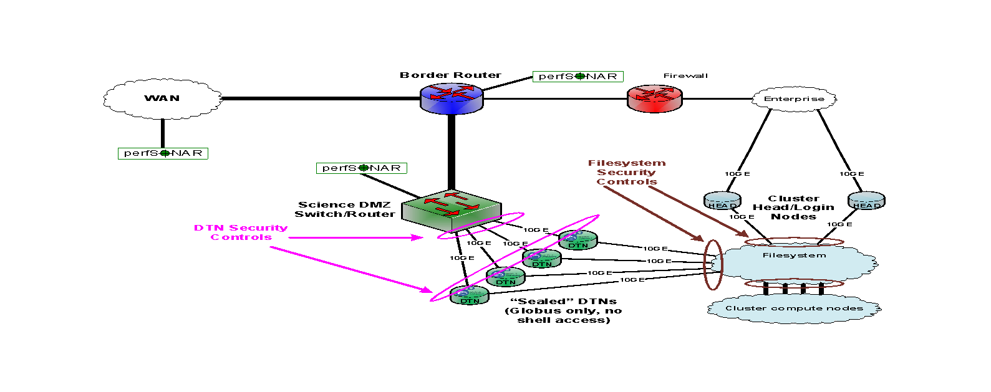
Solution Space – Data Mobility
10G
10G
10G
40G/100G
Downstream
Notes:
Next two classes are the same from a systems perspective
(main different from a workflow perspective—i.e. double copy workflow for SANs but not with distributed/global file systems)
We see these storage architectures in DTNs at data and HPC facilities
But whatever you choose for storage will depend on your environment, requirements, and resources.
______________________
System reasoning: what kind of card used on the backend to the storage system—FC/Ethernet/Inifiniband look the same
But the workflow is what’s different
No block device communication between DTN kernel Global fs
For SAN and internal disks—DTN kernel sees it as “owning”/managing blocks in SAN or RAID
_____________________________
Distributed file systems—high quality of service
much more reliable
easy to manage
however, typically performance is much lower because they are usually a shared system—don’t know the workload of other users—possibility of contesting traffic
i.e., we see this at data centers/supercomputers
they do have bottlenecks. I/O is the storage controller (EMC is limited to 8G right now)
Same I/O capacity but no bottleneck with infiniband connections.
enterprise level system
IB
56 G/link and easy to aggregate
reliable networking—no packet loss
fairly cheap
Distributed filesystem: this is similar to the storage system, except that the exported volumes are not RAW but file system (PNFS, Lustre, GPFS…). This set up is typical of a tiered system: data is acquired and processed, and stored. Then the DTN read from the shared storage.
Storage Systems: These are usually more massive systems (EMC, Netapp, DDN, etc) providing raw volumes to servers. The connectivity is usually fiber, but it can also be infiniband and ethernet.
This class benefits storage capacity.
POINT: look at what your infrastructure requirements are
how much capacity do you need for the next 3 years—will your system scale the way you want?
how reliable does your storage have to be—source of truth or is it a pain to resend the data if a disk goes down? (i.e., choose your RAID appropriately)
performance of storage what you need? If its 10G—laptops won’t do that
don’t need to invest in super fast storage if you only want to use laptops

Slide 28
Outline
Introduction
Solution Space
Conclusions / QA

Slide 29
Questions?
EPOC Helpdesk (send in anything you want):
  epoc@tacc.utexas.edu

Slide 30
Introduction to the Science DMZ
Jason Zurawski
zurawski@es.net
ESnet / Lawrence Berkeley National Laboratory
UCF / FLR Workshop on Networking Topics
May 21-22, 2025
National Science Foundation Award #2328479
https://epoc.global

