Slide 1
Mitigating SYN Attacks with NGFWs
Jesse Leonard and Cameron McDuffie
Advisors: Jorge Crichigno, Ali Mazloum, Jose Gomez
Department of Integrated Information Technology
University of South Carolina
December 2nd, 2021

Slide 2
Agenda
Purpose
Introduction
Problem Description
Background Information
Proposed Solution
Analyzing SYN Packets
Conclusion

Slide 3
Purpose
Understand the TCP handshake
Understand SYN flood attacks
Understand NGFW's abilities and configurations
Mitigate Denial of Service (via SYN flood) using a NGFW
Find a balanced solution between protection and resource allocation

Slide 4
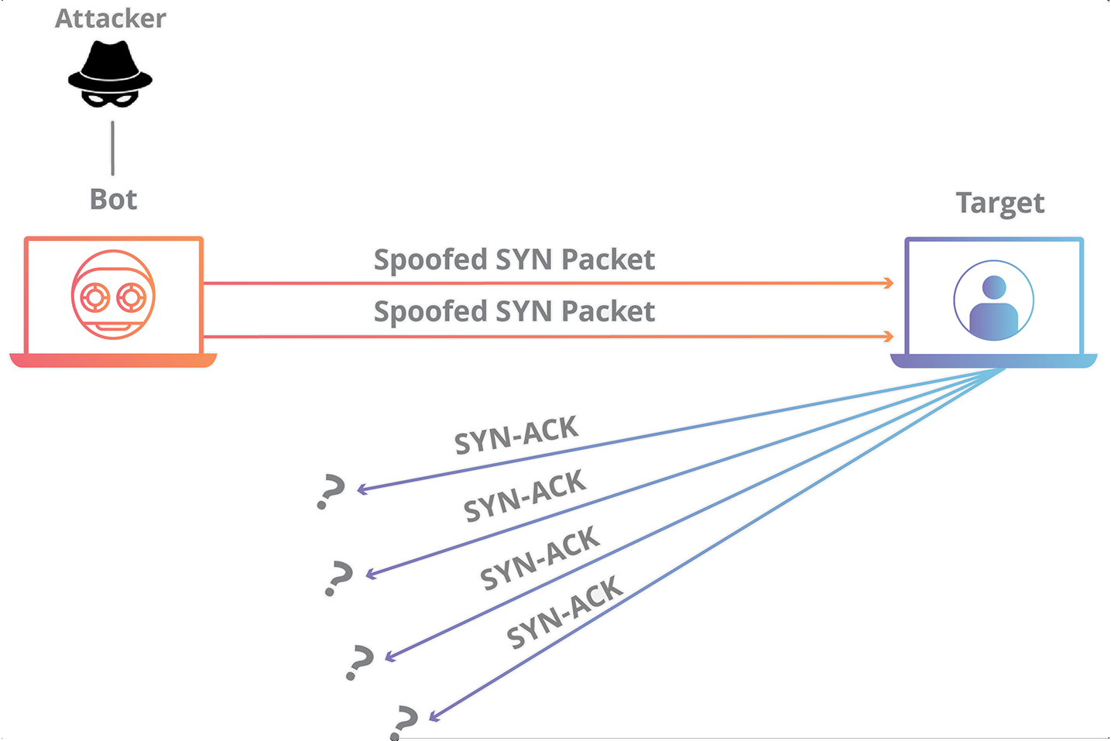
Introduction
SYN Flood – Type of DDoS (Denial of Service) Attack
Utilizes TCP three-way handshake
Three types of attacks
Direct
Spoof
Distributed

Slide 5
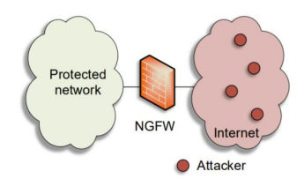
Problem Description
Protect a network against SYN attacks using a NGFW
Implement a protection policy
Server is unable to respond to legitimate traffic, policy prevents this

Slide 6
Background Information
Traditional Firewalls
Identify traffic based on protocol, IP address, and port number
Attacks pass through open firewall ports intended for legitimate traffic
TCP
Main transport-layer protocol used on the internet
Establishes connections to take place between devices

Slide 7
Proposed Solution
Filtered traffic is monitored via wireshark, only TCP SYN packets will show
DoS protection profile allows the firewall to block illegitimate traffic
Firewall generates SYN cookies to understand what traffic is legitimate
If a client does not return a cookie with the ACK packet, it is dropped

Slide 8
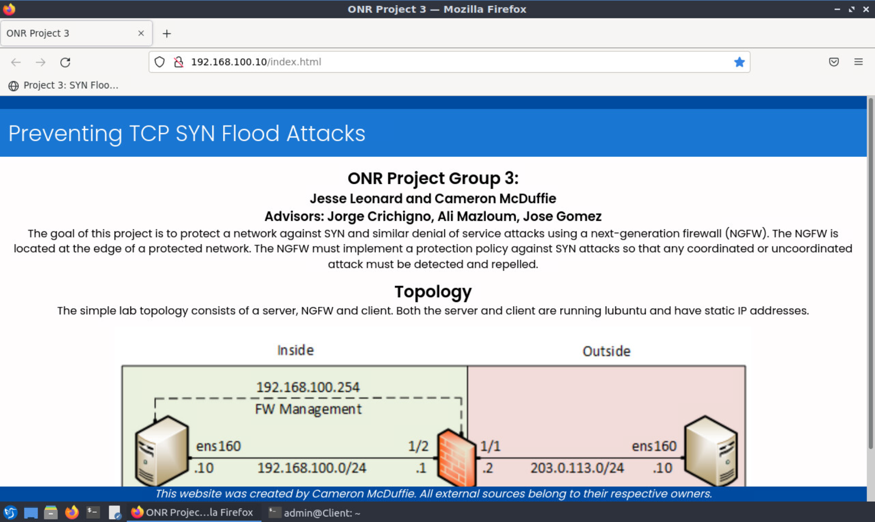
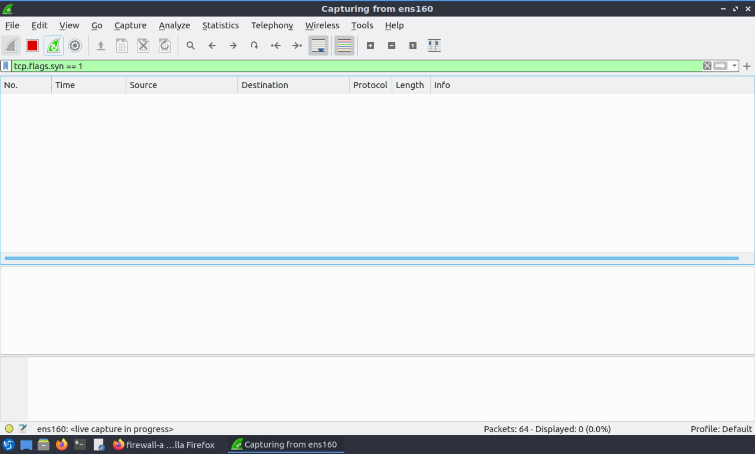
Solution Results
A website is hosted on port 80 of the server to test availability during an attack
DoS protection profile is enabled
When accessing the website during an attack, it is still available

Slide 9
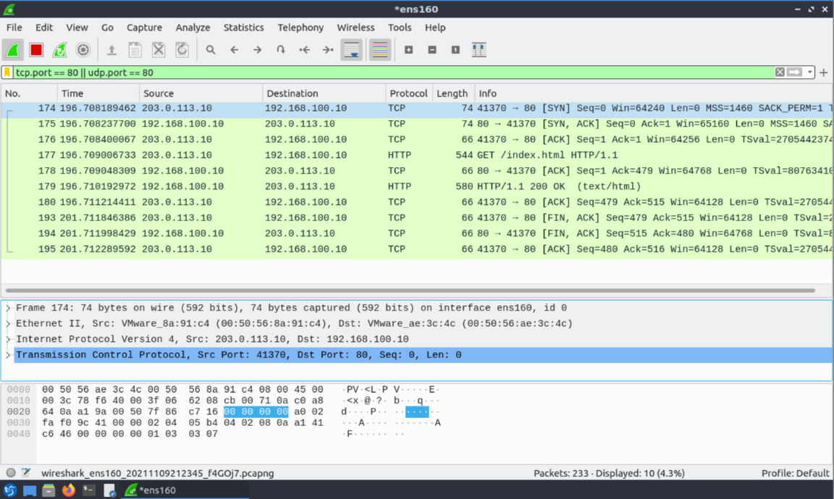
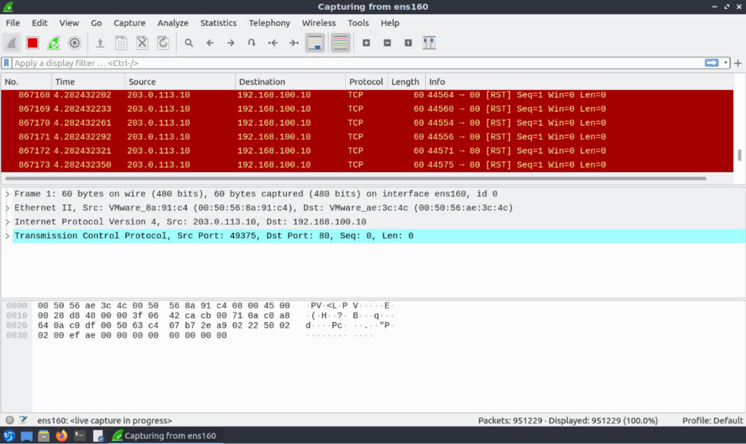
Analyzing SYN Packets
Normal Traffic
SYN Attack Traffic
Notes:
At least 20 other logs were blocked by our security policy.

Slide 10
Conclusion
Why is this work important?
Future projects/concepts with this knowledge
Questions?
Thank you for listening and watching

