Slide 1
Hands-on Session: Essentials of BGP, EBGP, IBGP
Ali AlSabeh, Jorge Crichigno
University of South Carolina
http://ce.sc.edu/cyberinfra
Internet2 Technology Exchange
Monday December 5th, 2022
Denver, Colorado
Notes:
Session time: 12:15-1:45pm

Slide 2
A Short Overview of BGP

Slide 3
BGP – Best Path
Prefer the path with highest weight (configured locally; set to 0 (default) for routes not originated by the router)
If weights are the same, prefer the path with highest local preference (set to 100 by default)
If the local preferences are the same, prefer the path that was originated by BGP running on the router or redistributed from an Interior Gateway Protocol (IGP)
If no route was originated, prefer the path with the shortest AS_PATH
If the paths have the same AS_PATH length, prefer the path with the lowest origin type (IGP is lower than Exterior Gateway Protocol (EGP), and EGP is lower than Incomplete)
If the origin codes are the same, prefer the path with the lowest MED attribute (set to 0 by default)
If the paths have the same MED, prefer the External path (EBGP) over the Internal path (IBGP)
If the paths are still the same, prefer the path through the closest IGP neighbor (lowest IGP metric)
If both paths are external, prefer the path that was received first (oldest one)
If the paths are still the same, prefer the path from the BGP router with the lowest router ID
If the router ID is the same for multiple paths, prefer the path with the lowest IP address
Rick Graziani, “Implementing Cisco IP Routing,” Cisco Press, 2015
Notes:
Page 391, BGP book
# lowest origin type: The most common scenario here is that the prefix was redistributed into Border Gateway Protocol from some other protocol, typically an IGP.
# 4 Without route manipulation, the most common reason for path selection is Step 4, the preference for the shortest AS-path
# 6: If multiple paths have the same number of autonomous systems to traverse, the second most common decision point is Step 7, which states that an externally learned path from an EBGP neighbor is preferred over a path learned from an IBGP neighbor. A router in an autonomous system prefers to use the ISP’s bandwidth to reach a network rather than using internal bandwidth to reach an IBGP neighbor on the other side of its own autonomous system

Slide 4
BGP – Best Path
Without route manipulation, the most common reason for path selection is Step 4
If no route was originated, prefer the path with the shortest AS_PATH
If multiple paths have the same number of autonomous systems to traverse, the second most common decision point is Step 7
If the paths have the same MED, prefer EBGP over IBGP
Rick Graziani, “Implementing Cisco IP Routing,” Cisco Press, 2015
Notes:
Page 391, BGP book
# lowest origin type: The most common scenario here is that the prefix was redistributed into Border Gateway Protocol from some other protocol, typically an IGP.
# 4 Without route manipulation, the most common reason for path selection is Step 4, the preference for the shortest AS-path
# 6: If multiple paths have the same number of autonomous systems to traverse, the second most common decision point is Step 7, which states that an externally learned path from an EBGP neighbor is preferred over a path learned from an IBGP neighbor. A router in an autonomous system prefers to use the ISP’s bandwidth to reach a network rather than using internal bandwidth to reach an IBGP neighbor on the other side of its own autonomous system

Slide 5
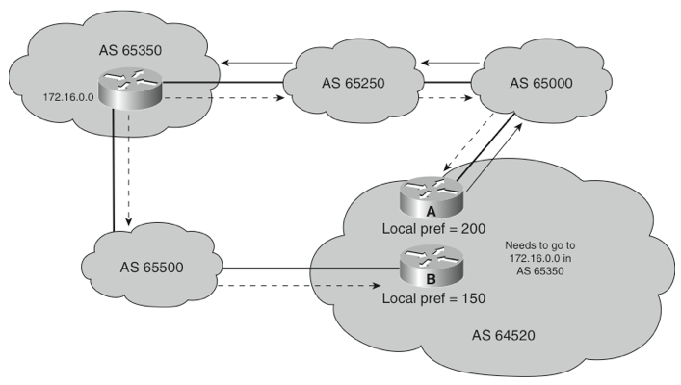
The Local Preference Attribute
Indicates to routers in the AS which path is preferred to exit the AS (higher is better)
AS 64520 receives updates about network 172.16.0.0 from two directions:
via AS 65500 (65500, 65350)
via AS 65000 (65000, 65250, 65350)
Local preference:
On Router A for network 172.16.0.0 is 200
On Router B for network 172.16.0.0 is 150
Local preference information is exchanged within AS 64520 via IBGP
All traffic in AS 64520 addressed to network 172.16.0.0 is sent to Router A as an exit point from AS 64520
172.16.0.0
My Local Preference is higher, so I am the preferred exit point.
IBGP
Rick Graziani, “Implementing Cisco IP Routing,” Cisco Press, 2015

Slide 6
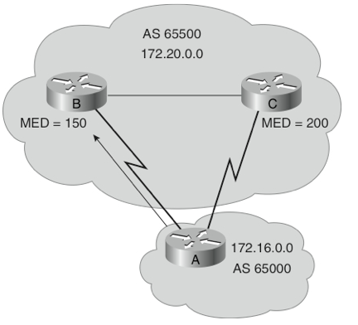
The Med Attribute
Indicates to external neighbors the preferred path into an AS
By default, a router compares the MED only for paths from neighbors in the same AS. Lowest Wins!
MED is sent to EBGP peers:
Those routers propagate the MED within their AS
But do not pass it on to the next AS
172.20.0.0
Rick Graziani, “Implementing Cisco IP Routing,” Cisco Press, 2015
Notes:
Optional nontransitive: Might or might not be recognized by a BGP router and is not passed on to other routers, for example, Multi-Exit Discriminator (MED), originator ID.
A way for an AS to try to influence another AS as to which way it should send its traffic when there are multiple entry points.
MED does not participate in path selection unless the network administrator of the neighbor autonomous system manipulates the paths using MED

Slide 7
Configuring IBGP and EBGP Sessions, Local Preference, and MED
Lab activities are described in Lab 8, BGP Lab Series

Slide 8
Hands-on Labs on BGP
Webpage with PowerPoint presentations:
http://ce.sc.edu/cyberinfra/workshop_2022_ie2_bgp.html
Hands-on session 2 (10:40-11:40pm): if you are not already registered, access the labs for Session 2 (Local Preference and MED attributes) using the following link:
https://portal.netdevgroup.com/learn/34b2cp/enroll/

Slide 9
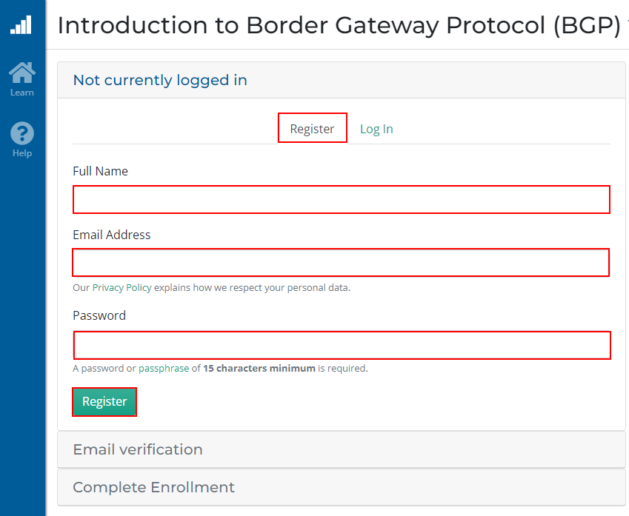
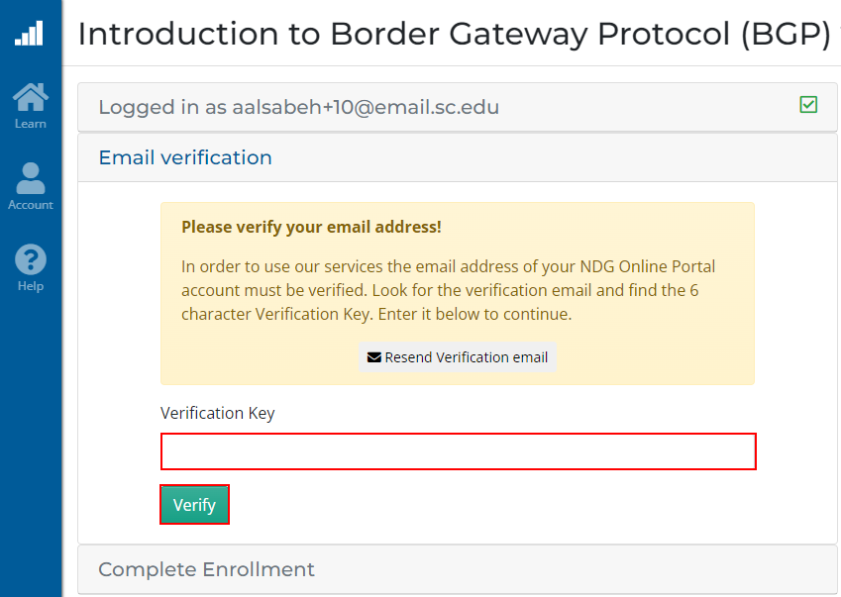
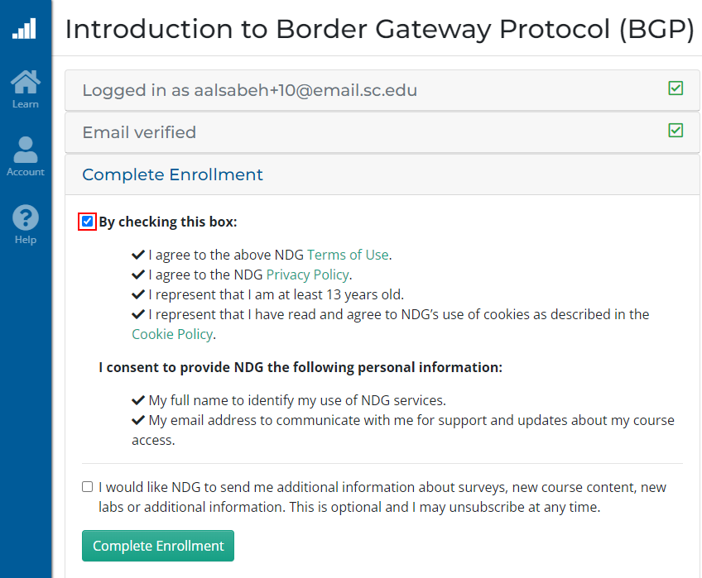
Registering to the Netlab Portal
Click on the enrollment link: https://portal.netdevgroup.com/learn/34b2cp/enroll/
Register and check your email for the verification key
Finalize the registration by claiming your free access

Slide 10
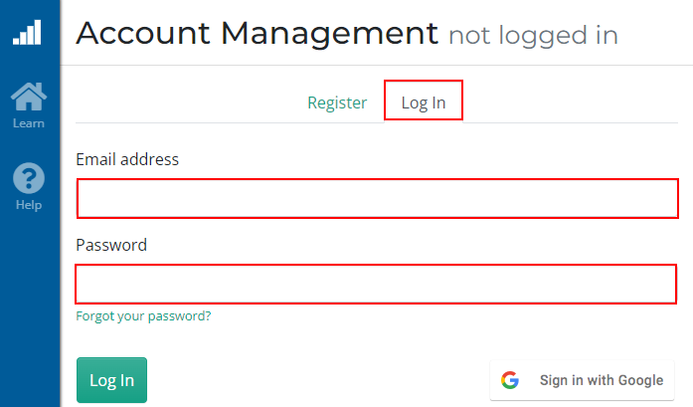
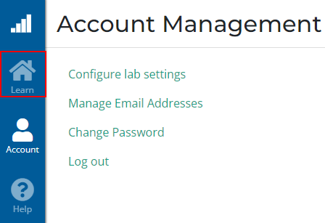
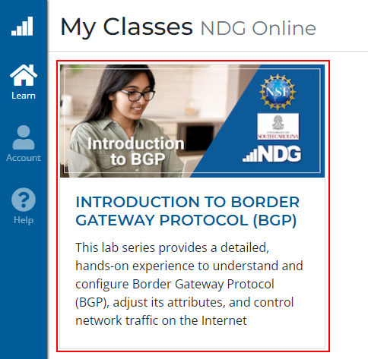
Accessing the Virtual Labs
If already registered, login to the portal: https://portal.netdevgroup.com/account/login
Click on the course “Introduction to Border Gateway Protocol (BGP)”
Select the lab you want to run (e.g., Lab 3)

Slide 11
Lab Topology
Configure IBGP within AS 200
Configure EBGP between AS 100 and AS 200
Configure LOCAL_PREF and MED attributes to favor the primary link over the secondary one
Primary link
Secondary link

Slide 12
Lab Topology
Local_PREF attribute configuration on routers r2 and r3
Configure a route-map
Set the LOCAL_PREF attribute
Assign the route-map to the BGP neighbor
Primary link
Secondary link

Slide 13
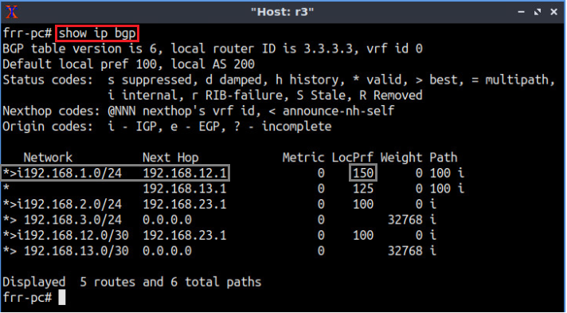
Lab Topology
BGP table of router r3 after configuring the LOCAL_PREF attribute
Primary link
Secondary link

Slide 14
Lab Topology
MED attribute configuration on routers r2 and r3
Configure a route-map
Set the MED attribute
Assign the route-map to the BGP neighbor
Primary link
Secondary link

Slide 15
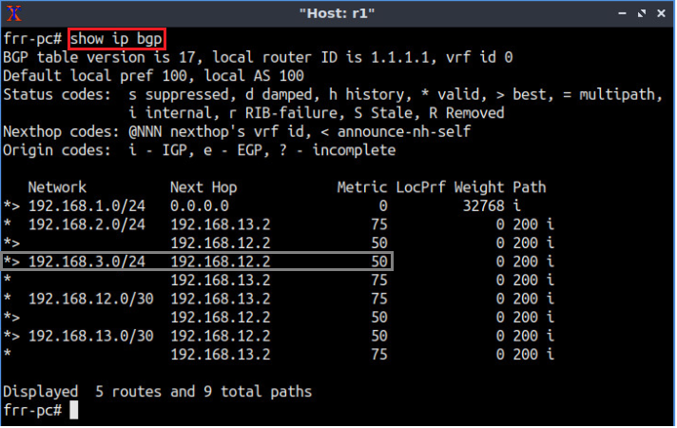
Lab Topology
BGP table of router r1 after configuring the MED attribute
Primary link
Secondary link

