Slide 1



DPUs on the FABRIC Testbed
Elie Kfoury*, Jennifer Kim^, Jorge Crichigno*
* College of Engineering and Computing, University of South Carolina
^ Internet2
Internet2 Technology Exchange (TechEx)
December 8, 2025
Denver, Colorado

Slide 2
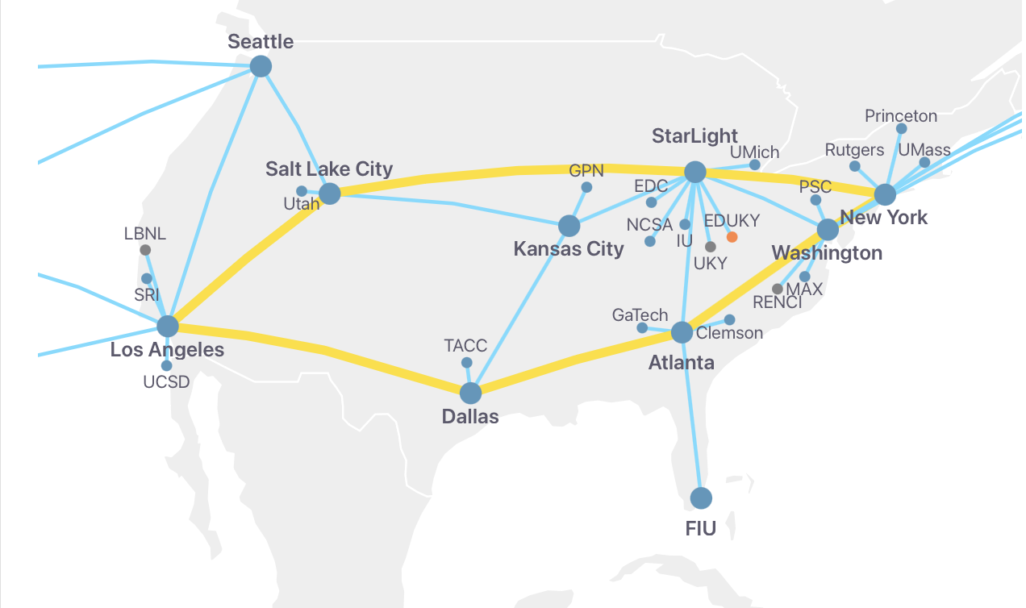
DPUs on FABRIC
BlueField-3 DPUs are installed on various FABRIC sites
Currently the following sites have DPUs installed (more will be available soon):
  100G DPU: TACC, MICH, MASS, NCSA, DALL, FIU, LOSA, KANS, NEWY, ATLA, SEAT, PSC, RUTG, HAWI
  400G DPU: SALT, WASH
2

Slide 3
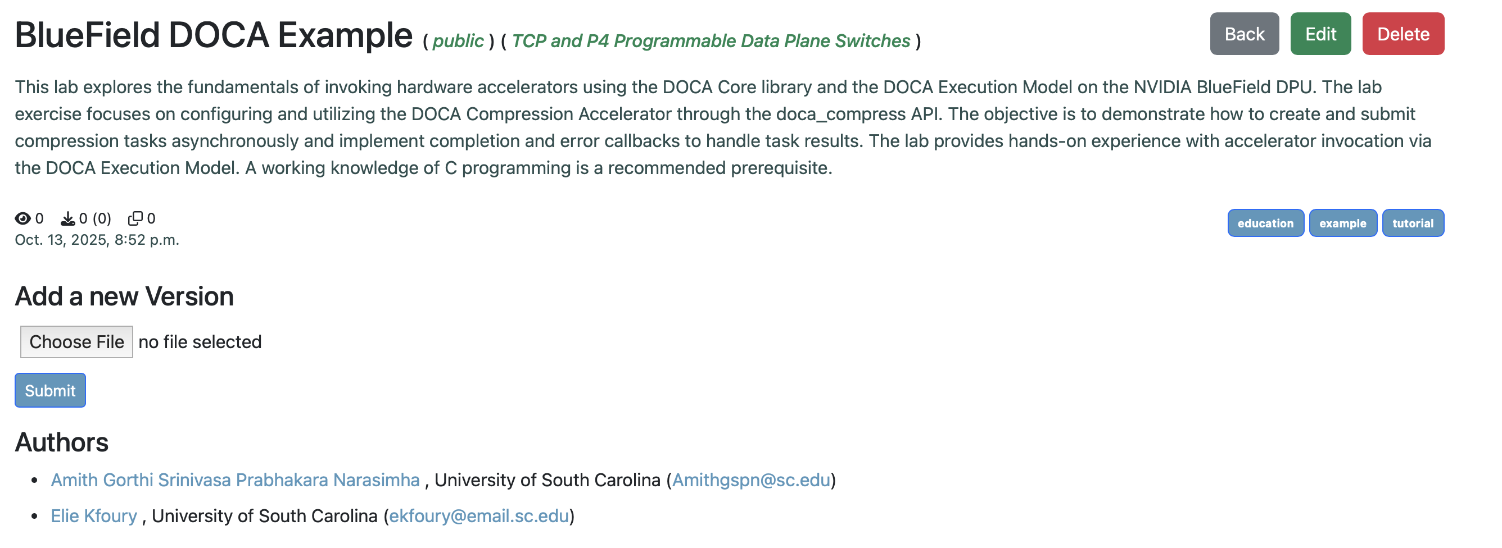
DOCA Example on Artifact Manager
Compression acceleration example is available on the Artifact Manager

Slide 4
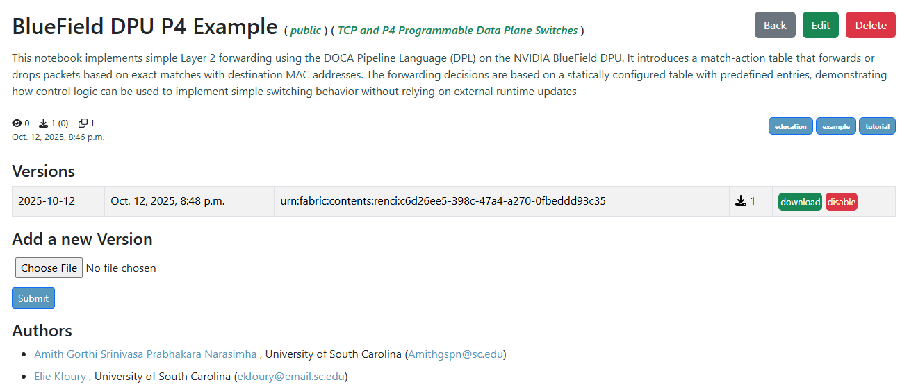
P4 Example on Artifact Manager
Simple L2 forwarding example available on Artifact Manager

Slide 5

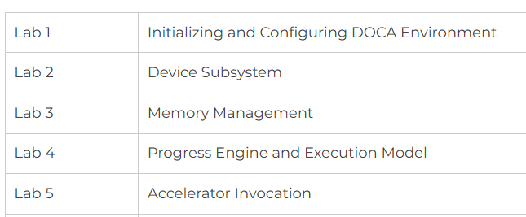
DPU Labs
DPU cybertraining is supported by NSF Cybertraining program, award #2417823
Lab libraries available to learn about DPU programming:
  DPU Programming using DOCA
  DPU Programming using P4 DPL
  Introduction to P4-DPDK
  P4-DPDK Security applications

Slide 6
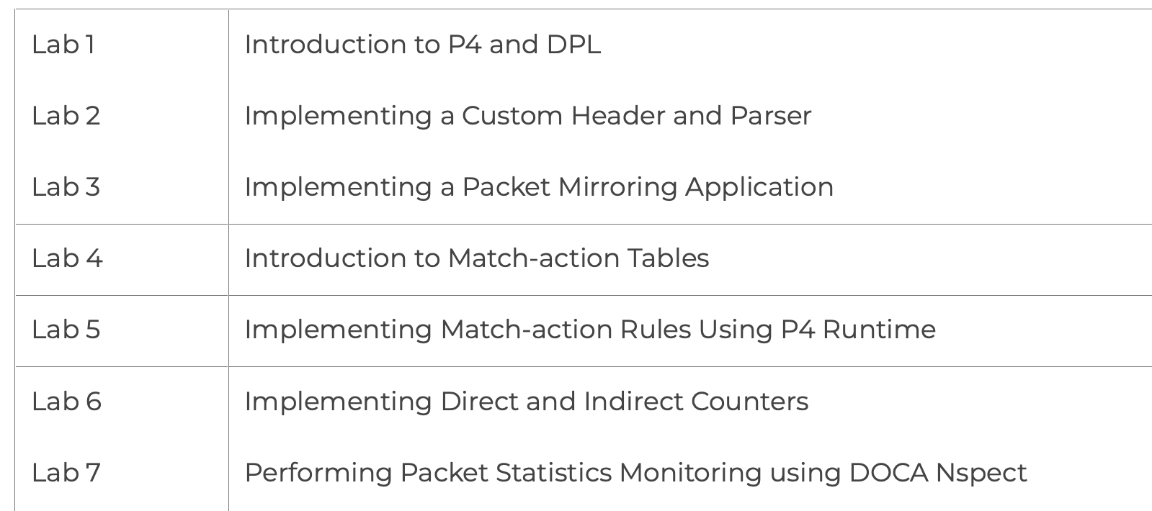
DPU Labs
DPU cybertraining is supported by NSF Cybertraining program, award #2417823
Lab libraries available to learn about DPU programming:
  DPU Programming using DOCA
  DPU Programming using P4 DPL
  Introduction to P4-DPDK
  P4-DPDK Security applications

Slide 7
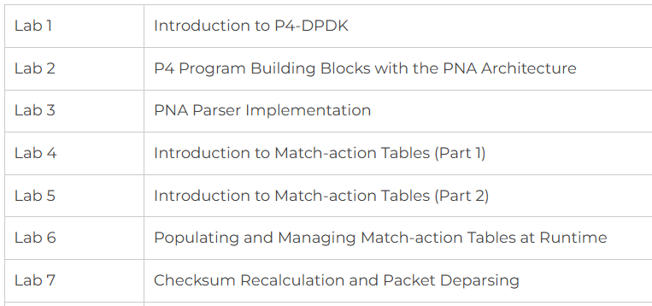
DPU Labs
DPU cybertraining is supported by NSF Cybertraining program, award #2417823
Lab libraries available to learn about DPU programming:
  DPU Programming using DOCA
  DPU Programming using P4 DPL
  Introduction to P4-DPDK
  P4-DPDK Security applications

Slide 8
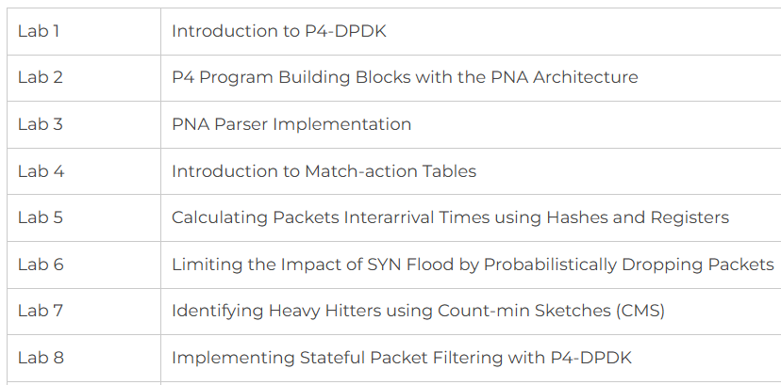
DPU Labs
DPU cybertraining is supported by NSF Cybertraining program, award #2417823
Lab libraries available to learn about DPU programming:
  DPU Programming using DOCA
  DPU Programming using P4 DPL
  Introduction to P4-DPDK
  P4-DPDK Security applications

Slide 9


Cybertraining Material Developed at USC
Information about lab libraries is available at: https://research.cec.sc.edu/cyberinfra/cybertraining
Programmable data plane devices
DPU Programming using P4
DPU Programming using DOCA
P4-DPDK Security
Introduction to P4-DPDK
Cybersecurity Apps with P4 Programmable Data Planes
P4 Programmable Data Planes: Applications, Stateful Elements, Custom Packet Processing
Intro to P4 Programmable Switches
Intro to P4 Programmable Switches with Intel’s Tofino
P4 Monitoring Applications
Traditional Protocols
Software-defined Networking (SDN)
Open vSwitch
Network Tools and Protocols
Introduction to IPv6
Open Shortest Path First (OSPF)
Introduction to BGP
MPLS and Advanced BGP
Cybersecurity, Management, and Science DMZs
Zeek IDS/IPS
Cybersecurity Fundamentals
perfSONAR 5
P4-perfSONAR
Network Management Tools
High-speed Networks: A Tutorial

Slide 10


Acknowledgement
This work was supported by the U.S. National Science Foundation (NSF), under awards 2417823 and 2346726
The authors would also like to acknowledge the FABRIC team.

