Slide 1
Effectiveness of Application Identification in Next-Generation Firewalls
Christian Tsirlis, Brad Wilson
Advisor: Jorge Crichigno
Department of Integrated Information Technology
University of South Carolina
April 22nd, 2021

Slide 2
Agenda
Purpose
Introduction
Problem description
Background information
Next-generation Firewalls (NGFWs) and how they compare to traditional firewalls
Application Identification
Proposed solution and implementation
Conclusion

Slide 3
Purpose
Understand Application Identification
Understand Security Policy rules
Implement Application Identification in Security Policies
Protect network from outside attackers by analyzing traffic traversing the network
Build stronger policies to minimize attacks

Slide 4
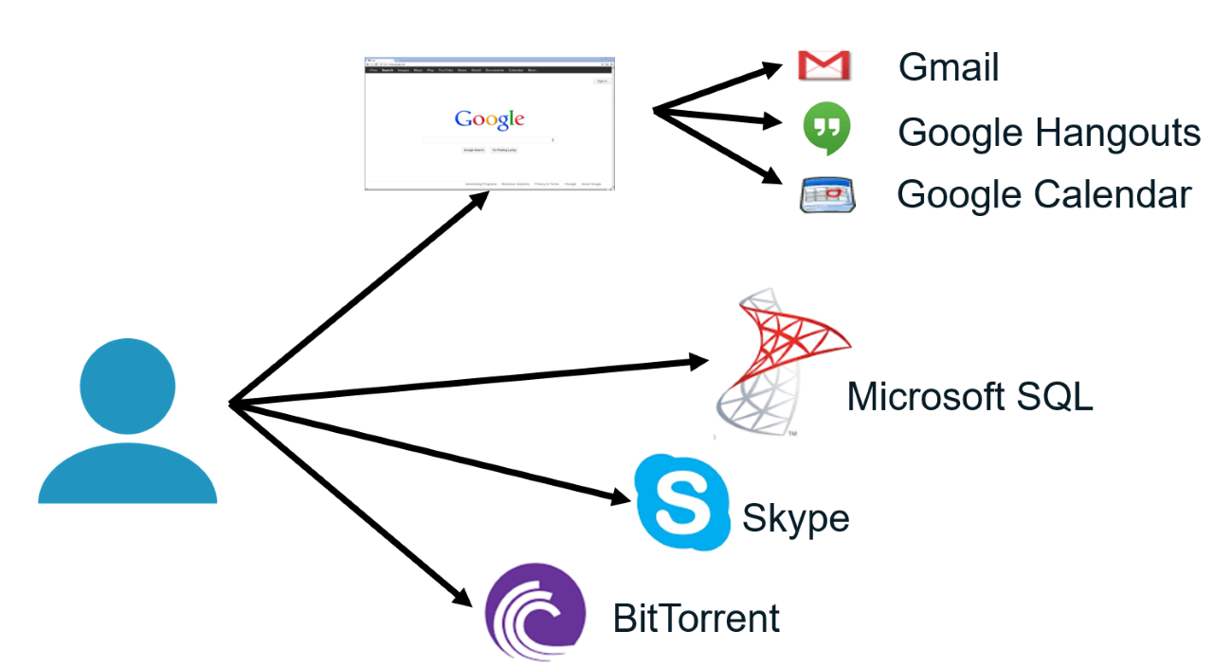
Introduction
An application is a program or feature whose traffic can be labeled and monitored.
Figure 1. Example of Applications and their sub-applications

Slide 5
Problem Description
Suspected malicious activity from Internet attempting to access internal network
Evasive applications from Internet trying to enter internal network
Effectiveness of security policies using Application Identification to protect internal network
Figure 2. Network Topology

Slide 6
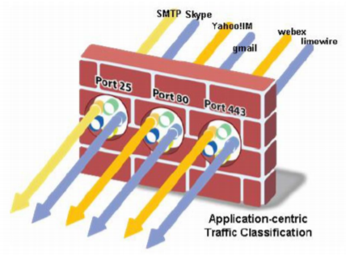
Background Information
Traditional Firewalls
Identify traffic by IP address, port and protocol
Create holes which can be exploited by attackers
Application Identification
Identifies traffic by application
Helps detect applications that evade traditional firewall
Figure 3. Shows how applications can enter a Traditional firewall

Slide 7
Proposed Solution and Implementation
Application Identification was used to analyze Skype application
Results
Skype uses numerous IP destination addresses to connect
Security policy blocks any file sharing and chat messages
Security policy fails to block audio/video calls
Figure 4. Security Policy for Application Identification using Skype
Figure 2. Network Topology

Slide 8
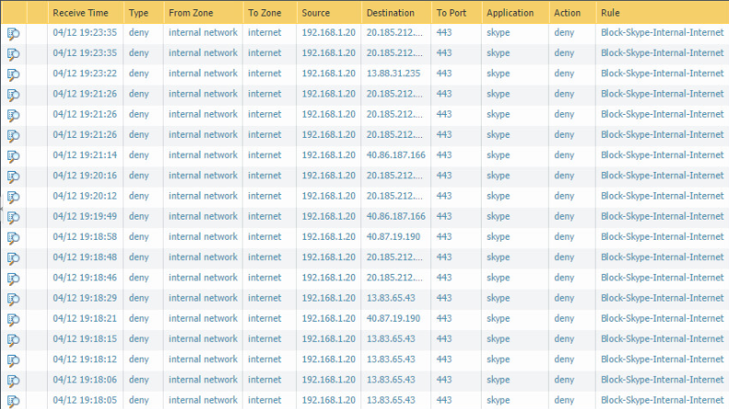
Analyzing Skype Data
Figure 5. Monitor logs showing numerous IP destination addresses
Notes:
At least 20 other logs were blocked by our security policy.

Slide 9
Twitter Results
Twitter-base
Blocking this application was successful
Example
Could not access twitter at all
Twitter-posting
Blocking this application was unsuccessful
Examples
Could like tweets
Could comment on tweets
Could retweet

Slide 10
Twitter Data

Slide 11
Conclusion
Why is this work important?
Our test highlights, that there are some weaknesses in Application Identification and how applications are evolving and finding a way to evade firewalls.
Future work includes deeper packet analysis
Questions?
Thank you for listening and watching

