Slide 1



KNIT 6: A FABRIC Community Workshop
Unconference Sessions
Understanding the Performance of TCP BBRv2
using FABRIC
Jose Gomez, Elie Kfoury, Ali Mazloum, Jorge Crichigno
University of South Carolina
http://ce.sc.edu/cyberinfra
University of South Carolina (USC)
Texas Advanced Computing Center
Austin, TX
April 25th, 2023

Slide 2
Agenda
TCP Traditional Congestion Control Algorithms
BBR
Motivation
Results and Evaluations
Demo
Limitations
Lessons Learned

Slide 3
TCP Traditional Congestion Control
The principles of window-based CC were described in the 1980s¹
Traditional CC algorithms follow the additive-increase multiplicative-decrease (AIMD) form of congestion control
1. V. Jacobson, M. Karels, Congestion avoidance and control, ACM SIGCOMM Computer Communication Review 18 (4) (1988).

Slide 4
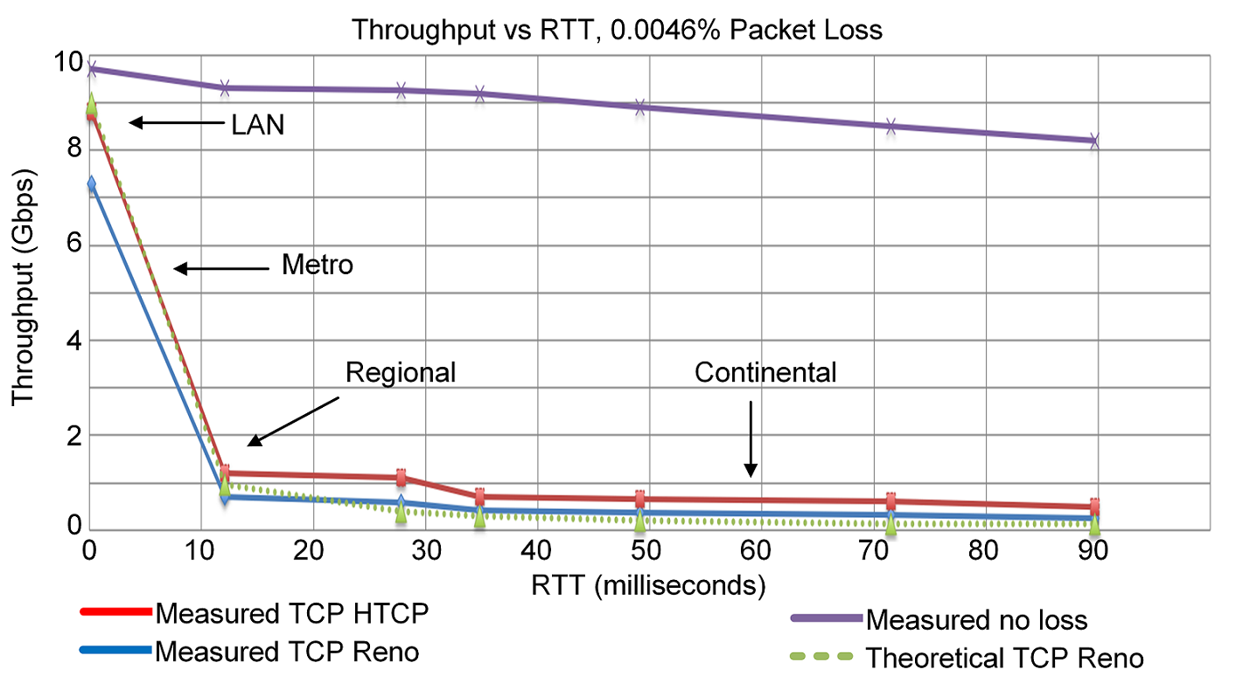
TCP Traditional Congestion Control
The principles of window-based CC were described in the 1980s¹
Traditional CC algorithms follow the additive-increase multiplicative-decrease (AIMD) form of congestion control
1. V. Jacobson, M. Karels, Congestion avoidance and control, ACM SIGCOMM Computer Communication Review 18 (4) (1988).

Slide 5
BBR: Model-based CC
TCP Bottleneck Bandwidth and RTT (BBR) is a rate-based congestion-control algorithm¹
BBR represented a disruption to the traditional CC algorithms:
  is not governed by AIMD control law
  does not the use packet loss as a signal of congestion
At any time, a TCP connection has one slowest link bottleneck bandwidth (btlbw)
1. N. Cardwell et al. "BBR v2, A Model-based Congestion Control." IETF 104, March 2019.

Slide 6
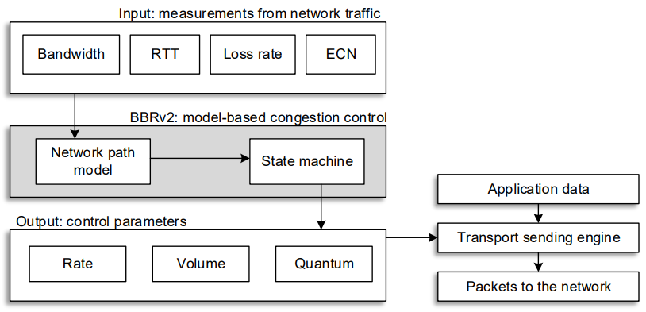
BBRv2
BBRv2 overcomes the shortcomings of BBRv1
BBRv2 measures the bandwidth, the RTT, the packet loss rate, and the ECN mark rate
The measurements are used to estimate the bandwidth-delay product (BDP)
BBRv2 does not always apply a multiplicative decrease for every round trip where packet loss occurs

Slide 7
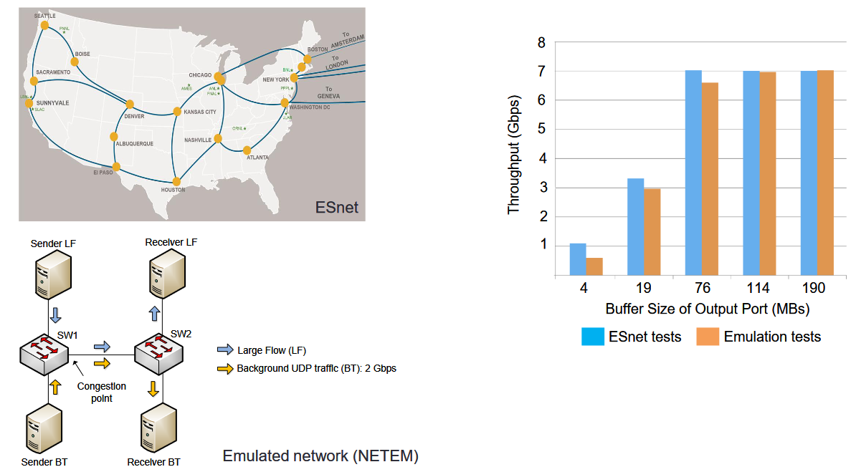
ESnet vs Emulated Network
ESnet vs emulated network, 10 Gbps links, 70 msec RTT (NETEM emulates delays)
M. Smitasin and B. Tierney, “Evaluating network buffer size requirements,” Proc. Technol. Exchange Workshop, Oct. 2015. Online:
https://meetings.internet2.edu/media/medialibrary/2015/10/05/20151005-smitasin-buffersize.pdf

Slide 8
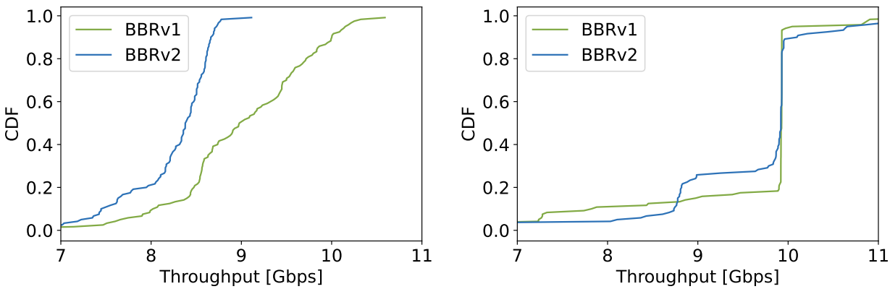
Motivation
Understanding the behavior of BBRv2 in a testbed with real propagation delay
Observing the dynamics of BBRv2 in a Wide Area Network (WAN)
Analyzing the differences between an emulated environment and a real testbed
This work leverage the distributed architecture of the FABRIC testbed to reproduce WAN conditions and test the performance of BBRv2
(a)
(b)
CDF of the bottleneck bandwidth estimation of BBRv1 and BBRv2. (a) with 45ms emulated delay. (b) with 45ms propagation delay.

Slide 9
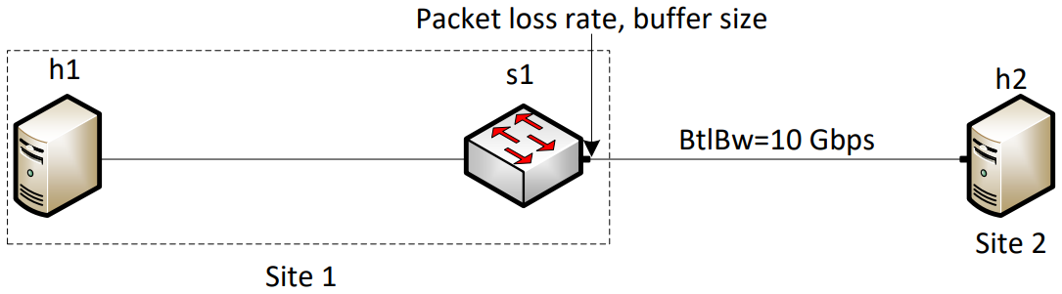
Experimental Setup
The experiments used a software switch to limit the rate and emulate packet losses
The rate is limited using the Token Bucket Filter (TBF) in Linux
Packet losses are emulated using NETEM
The sites are selected based on the experiment

Slide 10
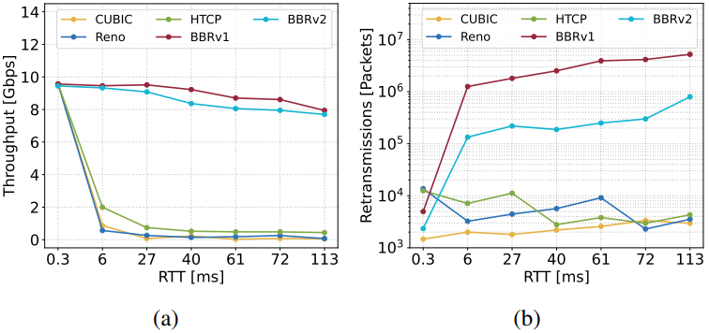
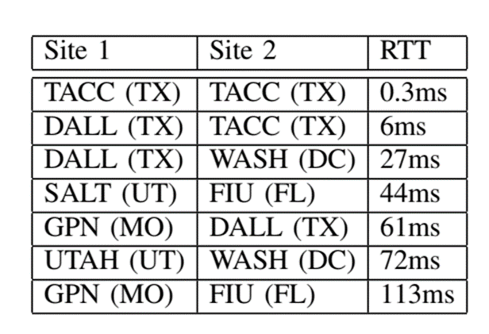
Results and Evaluations
Experiment 1: Performance in a WAN with packet losses
The rate is limited to 10Gbps
The emulated packet loss rate is 0.0046% (i.e., 1/22,000)
Performance of CUBIC, Reno, HTCP, BBRv1, and BBRv2 as a function of the RTT. (a) Throughput. (b) Retransmissions.
Topology used for the evaluations

Slide 11
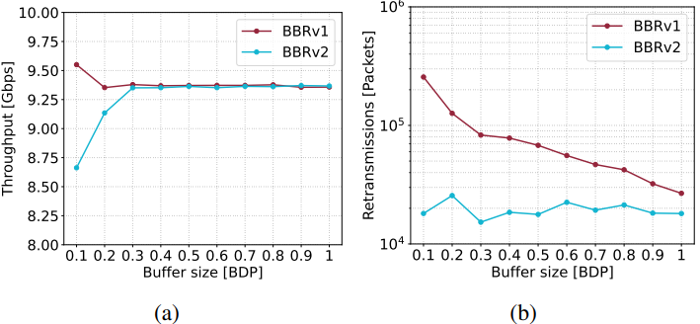
Results and Evaluations
Experiment 2: Retransmissions as a function of the buffer size
The RTT between the hosts is 45 milliseconds (SALT, FIU)
BBRv2 presents lower packet loss rates than BBRv1
Performance test as a function of the BDP. (a) Throughput. (b) Retransmissions.

Slide 12
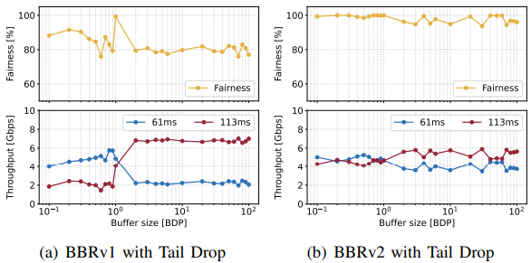
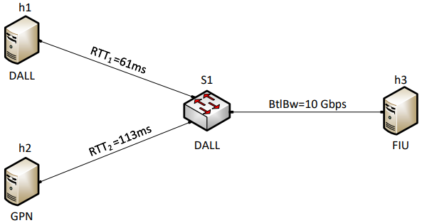
Results and Evaluations
Experiment 3: RTT unfairness
RTT unfairness occurs when flows with smaller RTTs obtain a higher throughput
BBRv1 flows present the opposite behavior
BBRv2 reduces the RTT unfairness of competing flows
Topology used for running the RTT unfairness experiment
Fairness index and throughput as functions of the buffer size for two competing flows. (a) BBRv1. (b) BBRv2.

Slide 13
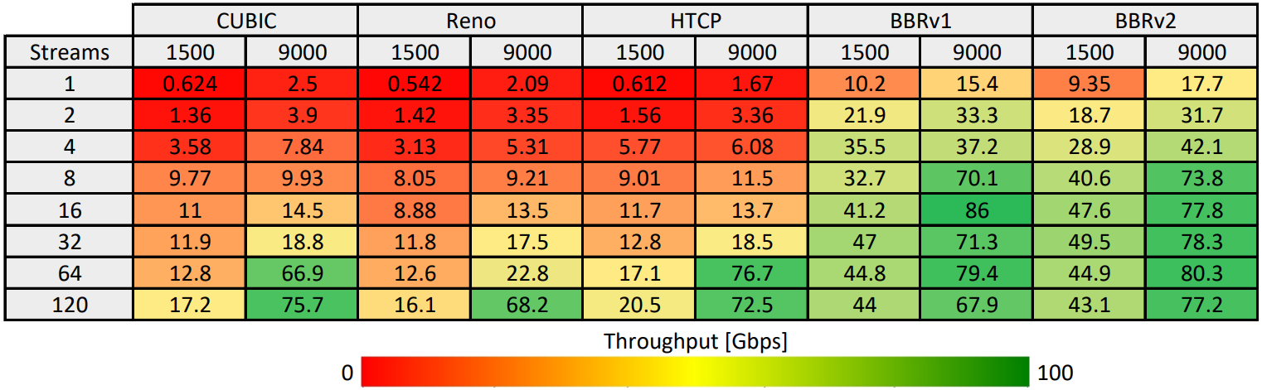
Results and Evaluations
Experiment 4: Parallel streams and different MTUs
The rate is not limited (i.e., 100Gbps)
The RTT between the sites is 26 milliseconds (DALL, SALT)
BBRv1 and BBRv2 achieve throughputs over 70Gbps with eight streams
Average throughput belonging to different CCAs as a function of the number of streams and the MTU.

Slide 14
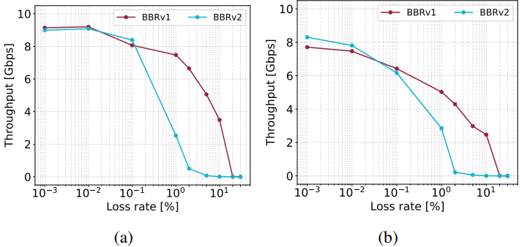
Results and Evaluations
Experiment 5: Throughput as a function of packet losses
The performance of BBRv2 is close to that of BBRv1 for loss rates less than 1%
(a) RTT = 26ms (DALL, SALT)
(b) RTT = 57ms (UCSD, UMASS)

Slide 15
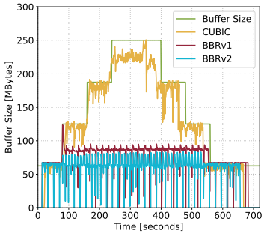
Results and Evaluations
Experiment 6: Queue occupancy
Link is limited to 10Gbps, the RTT is 50ms
Bandwidth-delay Product = 10Gbps * 50ms = 62.5MB
BBRv2 keeps the queue occupancy around BDP, even with bloated buffers

Slide 16
Limitations
Configuration of the intermediary devices (e.g., routers and switches)
  Link capacity
  Router buffer size
  Queue allocation
The experiments modified the buffer size of a software switch
Shared Network Interface Cards (NICs)
Performance isolation

Slide 17
Lessons Learned
FABRIC can be used to test protocols and applications under WAN conditions
The testbed can support a wide variety of experiments
Its programmable infrastructure allows defining customized network environments
BBRv2 provides improved fairness compared to BBRv1, particularly when dealing with flows that have different RTTs
BBRv2 can achieve comparable throughput to BBRv1, while also exhibiting a lower retransmission rate

Slide 18

Future Work
Leveraging programmable data plane switches for fine-grained measurements
Replicating the results in FABRIC

Slide 19

This work is supported by NSF award number 2118311
For additional information, please refer to
http://ce.sc.edu/cyberinfra/
Email: jcrichigno@cec.sc.edu, ekfoury@email.sc.edu

