Slide 1
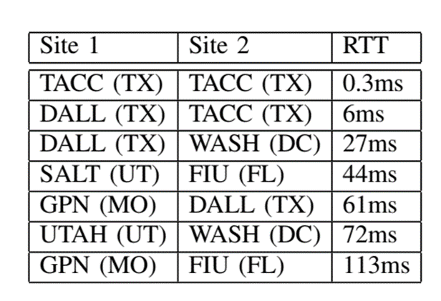
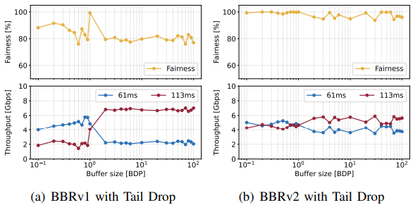
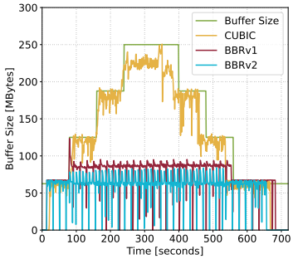
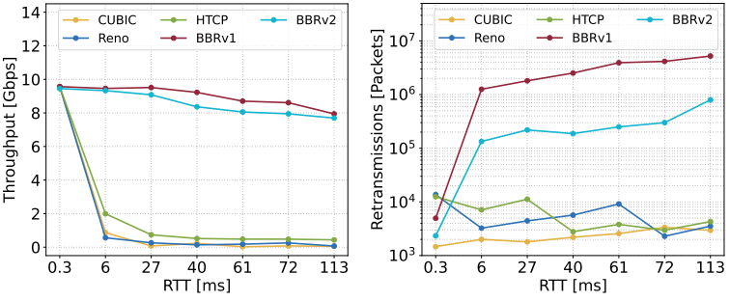
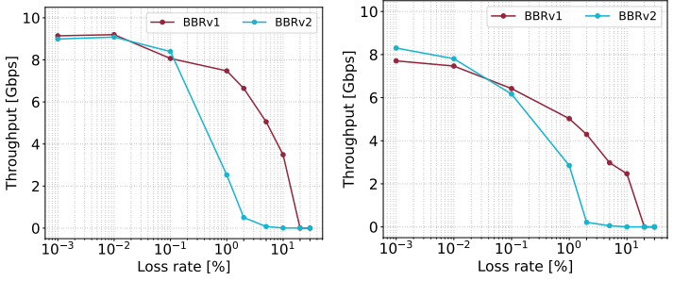
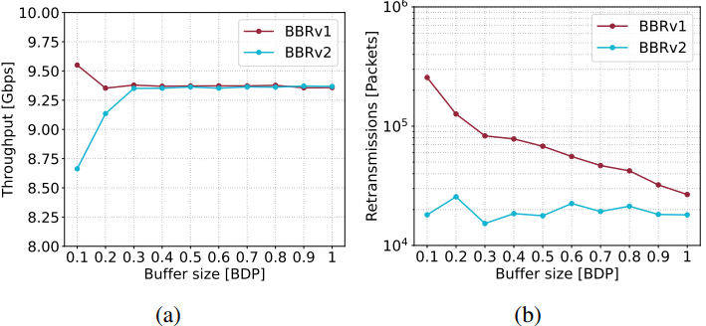
Understanding the Performance of TCP BBRv2
using FABRIC
Jose Gomez, Elie Kfoury, Jorge Crichigno
Integrated Information Technology Department, University of South Carolina, Columbia, South Carolina
Abstract
Experimental Setup
RTT Unfairness
Results: Queue Occupancy
This work presents a performance evaluation of the Bottleneck Bandwidth and Round-trip Time version 2 (BBRv2)
The experiments are conducted in FABRIC, a national-scale experimental network infrastructure
Evaluations conducted on FABRIC to reproduce the network conditions of Wide Area Networks (WANs)
The tests presented in this paper evaluate:
The throughput as a function of the Round-trip Time
The RTT unfairness of BBRv1 and BBRv2
The queue occupancy,
The packet loss rate as a function of the router’s buffer size
This work also presents and discusses the influence of Active Queue Management (AQM) algorithms
Software switch to limit the rate and emulate packet losses
Rate is limited using the Token Bucket Filter (TBF) in Linux
Packet losses are emulated using NETEM
The sites are selected based on the experiment
Experiment 3: RTT unfairness
RTT unfairness occurs when flows with smaller RTTs obtain a higher throughput
BBRv1 flows present the opposite behavior
BBRv2 reduces the RTT unfairness of competing flows
DALL – FIU: 61ms, GPN – FIU: 113ms
Experiment 6: Queue occupancy
Link is limited to 10Gbps, the RTT is 50ms
Bandwidth-delay Product = 10Gbps * 50ms = 62.5MB
BBRv2 keeps the queue occupancy around BDP, even with bloated buffers
Related Work
Kfoury et al. [1] used Mininet to conduct a performance evaluation of BBRv2
Gomez et al. [2] executed additional evaluation tests on BBRv2, but they also used Mininet
Tierney et al. [3] described and performed experiments to assess the suitability of BBRv2 for use on Data Transfer Nodes (DTNs)
Scherrer et al. [4] presented a fluid model of BBRv1 and BBRv2 to complement the previous studies
[1] Kfoury et al., “An emulation-based evaluation of TCP BBRv2 alpha for wired broadband,” Computer Communications, 2020.
[2] Gomez et al., “A performance evaluation of TCP BBRv2 alpha,” in 2020 TSP.
[3] Tierney et al., “Exploring the BBRv2 congestion control algorithm for use on data transfer nodes,” in 2021 INDIS.
[4] S. Scherrer et al., “Model-based insights on the performance, fairness, and stability of BBR,” in IMC 2022
Performance in a WAN with Packet Losses
Parallel Streams and Different MTUs
Experiment 1: Performance in a WAN with packet losses
The rate is limited to 10Gbps
The emulated packet loss rate is 0.0046% (i.e., 1/22,000)
Cubic, Reno, HTCP: Loss-based congestion control algorithms
BBRv1, BBRv2: model-based congestion control algorithms
Throughput with loss-based algorithms degrades when the RTT is high and there are packet losses
Experiment 4: Parallel streams and different MTUs
The rate is not limited (i.e., 100Gbps)
The RTT between the sites is 26 milliseconds (DALL, SALT)
BBRv1 and BBRv2 achieve throughputs over 70Gbps with eight streams
Limitations
Configuration of the intermediary devices (e.g., routers and switches)
Link capacity
Router buffer size
Queue allocation
The experiments modified the buffer size of a software switch
Shared Network Interface Cards (NICs)
Performance isolation
Motivation
Lessons Learned
Throughput with Various Packet Loss Rates
FABRIC can be used to test protocols and applications under WAN conditions
The testbed can support a wide variety of experiments
Its programmable infrastructure allows defining customized network environments
BBRv2 provides improved fairness compared to BBRv1, particularly when dealing with flows that have different RTTs
BBRv2 can achieve comparable throughput to BBRv1, while also exhibiting a lower retransmission rate
Understanding the behavior of BBRv2 in a testbed with real propagation delay
Observing the dynamics of BBRv2 in a Wide Area Network (WAN)
Analyzing the differences between an emulated environment and a real testbed
This work leverage the distributed architecture of the FABRIC testbed to reproduce WAN conditions and test the performance of BBRv2
(a) (b)
CDF of the bottleneck bandwidth estimation of BBRv1 and BBRv2. (a) with 45ms emulated delay. (b) with 45ms propagation delay.
Experiment 5: Throughput as a function of packet losses
The performance of BBRv2 is close to that of BBRv1 for loss rates less than 1%
(left) RTT = 26ms (DALL, SALT)
(right) RTT = 57ms (UCSD, UMASS)
Retransmissions with Various Buffers
Experiment 2: Retransmissions as a function of the buffer size
The RTT between the hosts is 45 milliseconds (SALT, FIU)
BBRv2 presents lower packet loss rates than BBRv1
Conclusion and Future Work
This project evaluated the performance of BBRv2 using FABRIC.
Results show that BBRv2 performs similarly to its predecessor, BBRv1, presenting a lower retransmission rate.
BBRv1 and BBRv2 achieve higher throughput with various RTTs than CUBIC, Reno, and HTCP.
Future works can evaluate the performance metrics using a P4-programmable switch
P4 switches perform fine-grained measurements, providing better visibility on the dynamics of the congestion control algorithm
Acknowledgement
This work was supported by the U.S. National Science Foundation, Office of Advanced Cyberinfrastructure, award #2118311

