Slide 1



Overview of BGP Attributes
Jorge Crichigno
University of South Carolina (USC)
SoX Virtual Workshop – Online
Wednesday March 29, 2023

Slide 2
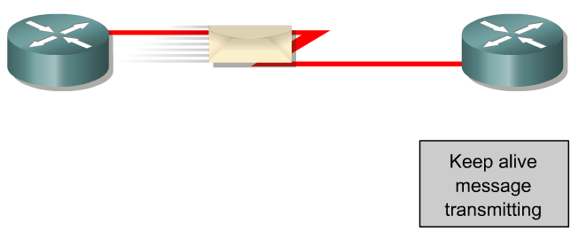
BGP – Best Path
The main goal is to provide interdomain routing
BGP selects one path as the best path
It places the selected path in its routing table and propagates the path to its neighbors
Is this the best path? Does it meet the path selection criteria? If so, add to routing table.
BGP Update
BGP Table
Routing Table
Network
Network
Rick Graziani, “Implementing Cisco IP Routing,” Cisco Press, 2015

Slide 3
BGP – Best Path
Prefer the path with highest weight (configured locally; set to 0 (default) for routes not originated by the router)
If weights are the same, prefer the path with highest local preference (set to 100 by default)
If the local preferences are the same, prefer the path that was originated by BGP running on the router or redistributed from an Interior Gateway Protocol (IGP)
If no route was originated, prefer the path with the shortest AS_PATH
If the paths have the same AS_PATH length, prefer the path with the lowest origin type (IGP is lower than Exterior Gateway Protocol (EGP), and EGP is lower than Incomplete)
If the origin codes are the same, prefer the path with the lowest MED attribute (set to 0 by default)
If the paths have the same MED, prefer the External path (EBGP) over the Internal path (IBGP)
If the paths are still the same, prefer the path through the closest IGP neighbor (lowest IGP metric)
If both paths are external, prefer the path that was received first (oldest one)
If the paths are still the same, prefer the path from the BGP router with the lowest router ID
If the router ID is the same for multiple paths, prefer the path with the lowest IP address
Rick Graziani, “Implementing Cisco IP Routing,” Cisco Press, 2015
Notes:
Page 391, BGP book
# lowest origin type: The most common scenario here is that the prefix was redistributed into Border Gateway Protocol from some other protocol, typically an IGP.
# 4 Without route manipulation, the most common reason for path selection is Step 4, the preference for the shortest AS-path
# 6: If multiple paths have the same number of autonomous systems to traverse, the second most common
decision point is Step 7, which states that an externally learned path from an EBGP neighbor is preferred
over a path learned from an IBGP neighbor. A router in an autonomous system prefers to use the ISP’s
bandwidth to reach a network rather than using internal bandwidth to reach an IBGP neighbor on the other
side of its own autonomous system

Slide 4
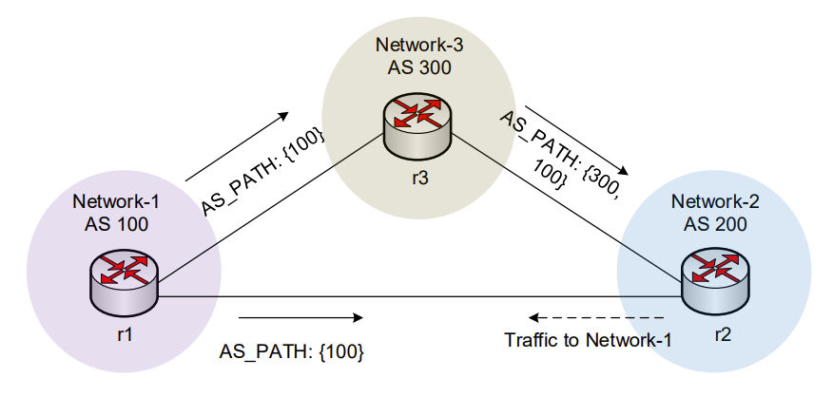
BGP – Best Path
Without route manipulation, the most common reason for path selection is Step 4
  Prefer the path with the shortest AS_PATH
Notes:
Page 391, BGP book
# lowest origin type: The most common scenario here is that the prefix was redistributed into Border Gateway Protocol from some other protocol, typically an IGP.
# 4 Without route manipulation, the most common reason for path selection is Step 4, the preference for the shortest AS-path
# 6: If multiple paths have the same number of autonomous systems to traverse, the second most common
decision point is Step 7, which states that an externally learned path from an EBGP neighbor is preferred
over a path learned from an IBGP neighbor. A router in an autonomous system prefers to use the ISP’s
bandwidth to reach a network rather than using internal bandwidth to reach an IBGP neighbor on the other
side of its own autonomous system

Slide 5
BGP – Best Path
Without route manipulation, the most common reason for path selection is Step 4
  Prefer the path with the shortest AS_PATH
If multiple paths have the same length, the second most common decision point is Step 7
  If the paths have the same MED, prefer EBGP over (internal) IBGP
  We sometimes refer to this as “hot potato” routing
Notes:
Page 391, BGP book
# lowest origin type: The most common scenario here is that the prefix was redistributed into Border Gateway Protocol from some other protocol, typically an IGP.
# 4 Without route manipulation, the most common reason for path selection is Step 4, the preference for the shortest AS-path
# 6: If multiple paths have the same number of autonomous systems to traverse, the second most common
decision point is Step 7, which states that an externally learned path from an EBGP neighbor is preferred
over a path learned from an IBGP neighbor. A router in an autonomous system prefers to use the ISP’s
bandwidth to reach a network rather than using internal bandwidth to reach an IBGP neighbor on the other
side of its own autonomous system

Slide 6
BGP – Best Path
Without route manipulation, the most common reason for path selection is Step 4
  Prefer the path with the shortest AS_PATH
If multiple paths have the same length, the second most common decision point is Step 7
  If the paths have the same MED, prefer EBGP over (internal) IBGP
  We sometimes refer to this as “hot potato” routing
The network administrator can manipulate some attributes to modify the path
  Weight and Local Preference modify the outbound path
  MED modifies the inbound path
Notes:
Page 391, BGP book
# lowest origin type: The most common scenario here is that the prefix was redistributed into Border Gateway Protocol from some other protocol, typically an IGP.
# 4 Without route manipulation, the most common reason for path selection is Step 4, the preference for the shortest AS-path
# 6: If multiple paths have the same number of autonomous systems to traverse, the second most common
decision point is Step 7, which states that an externally learned path from an EBGP neighbor is preferred
over a path learned from an IBGP neighbor. A router in an autonomous system prefers to use the ISP’s
bandwidth to reach a network rather than using internal bandwidth to reach an IBGP neighbor on the other
side of its own autonomous system

Slide 7
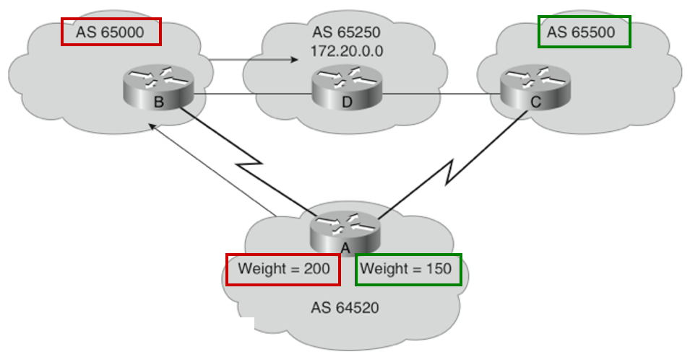
The Weight Attribute - For “Outbound Route”
Configured locally and not propagated to any other routers (higher is better)
This is a vendor-specific attribute – Cisco supports it
Juniper has a different mechanism to achieve a similar result
Weight takes precedence over Local Preference
Value from 0 to 65535; default is 32768
Default is 0 for routes not originated by this router
Rick Graziani, “Implementing Cisco IP Routing,” Cisco Press, 2015

Slide 8
The Weight Attribute - For “Outbound Route”
Router A has two ways to reach 172.20.0.0
  via Router B (AS 65000)
  via Router C (AS 65500)
Router A is configured to set the weight of updates coming from:
  Router B to 200
  Router C to 150
Weight for Router B is higher, so Router A uses Router B as a next hop to reach 172.20.0.0
Rick Graziani, “Implementing Cisco IP Routing,” Cisco Press, 2015

Slide 9
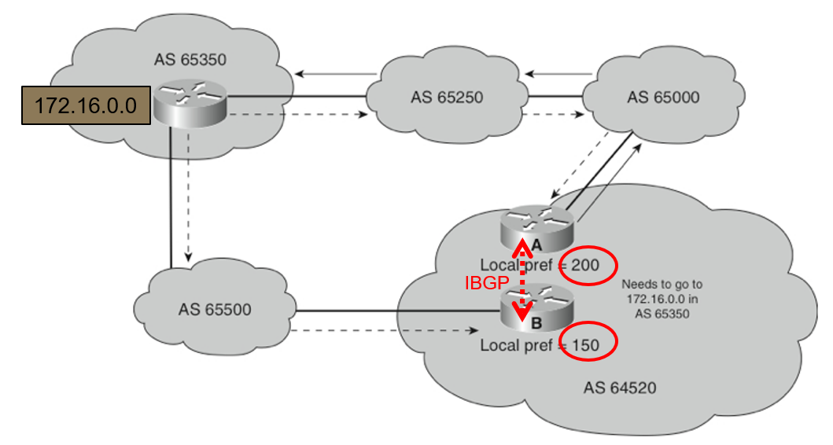
Local Preference Attribute – For “Outbound Route”
A well-known discretionary attribute
Indicates to routers in the AS which path is preferred to exit the AS (higher is better)
Configured on a router
Exchanged only among routers within the same AS (passed only via IBGP, not via EBGP)
Default value on a Cisco/FRR router is 100
Local Preference takes precedence over AS_PATH
This is very frequently used in provider networks
Rick Graziani, “Implementing Cisco IP Routing,” Cisco Press, 2015
Notes:
Well-known discretionary: Must be recognized by all BGP routers and passed on to other BGP routers but need not be present in an update, for example, local preference.

Slide 10
Local Preference Attribute – For “Outbound Route”
A well-known discretionary attribute
Indicates to routers in the AS which path is preferred to exit the AS (higher is better)
Configured on a router
Exchanged only among routers within the same AS (passed only via IBGP, not via EBGP)
Default value on a Cisco/FRR router is 100
Local Preference takes precedence over AS_PATH
This is very frequently used in provider networks
All traffic in AS 64520 to 172.16.0.0 is sent
via router A
Rick Graziani, “Implementing Cisco IP Routing,” Cisco Press, 2015
Notes:
Well-known discretionary: Must be recognized by all BGP routers and passed on to other BGP routers but need not be present in an update, for example, local preference.

Slide 11
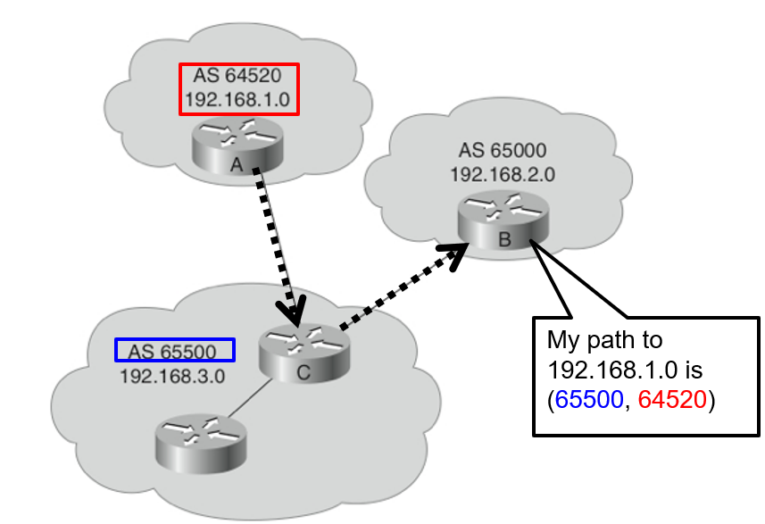
The AS-Path Attribute
Well-known mandatory attribute
Whenever a route update passes through an AS, the AS number is prepended to that update
Router A: advertises network 192.168.1.0 in AS 64520
Router C: prepends its own AS number to it and advertises the route to Router B
Router B: the path to reach 192.168.1.0 is:
  65500, 64520
Rick Graziani, “Implementing Cisco IP Routing,” Cisco Press, 2015

Slide 12
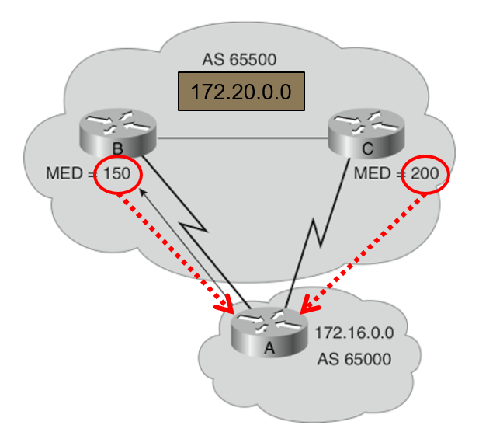
The Med Attribute – For “Inbound Route”
Multi-Exit Discriminator (MED), also called metric
Indicates to external neighbors the preferred path into an AS
By default, a router compares MED for paths from neighbors in the same AS (lowest is better)
MED is sent to EBGP peers:
  Those routers propagate the MED within their AS, but do not pass it on to the next AS
  This may, or may not, be honored by the neighboring AS
Rick Graziani, “Implementing Cisco IP Routing,” Cisco Press, 2015
Notes:
MED is an Optional nontransitive: Might or might not be recognized by a BGP router and is not passed on to other routers, for example, Multi-Exit Discriminator (MED), originator ID.
A way for an AS to try to influence another AS as to which way it should send its traffic when there are multiple entry points.
MED does
not participate in path selection unless the network administrator of the neighbor autonomous system
manipulates the paths using MED

Slide 13
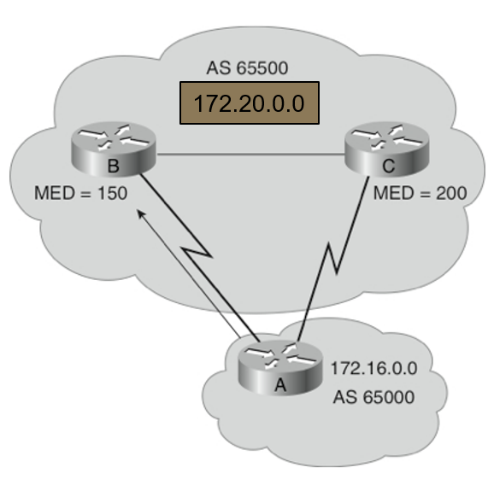
The Med Attribute – For “Inbound Route”
Router B has set the MED to 150 for 172.20.0.0
Router C has set the MED to 200 for 172.20.0.0
Router A receives EBGP updates from routers B and C
  Router A selects router B as the best next hop to get to 172.20.0.0 because of the lower MED
Rick Graziani, “Implementing Cisco IP Routing,” Cisco Press, 2015
Notes:
MED is an Optional nontransitive: Might or might not be recognized by a BGP router and is not passed on to other routers, for example, Multi-Exit Discriminator (MED), originator ID.
A way for an AS to try to influence another AS as to which way it should send its traffic when there are multiple entry points.
MED does
not participate in path selection unless the network administrator of the neighbor autonomous system
manipulates the paths using MED

Slide 14
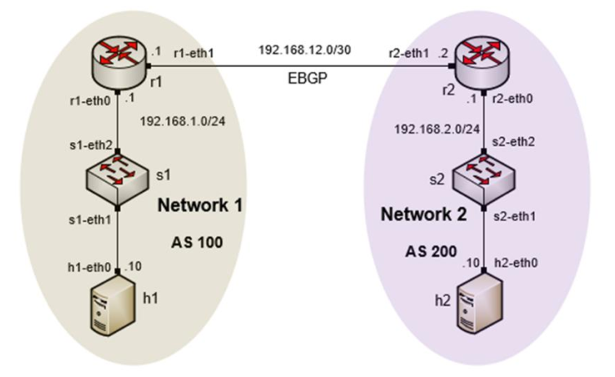
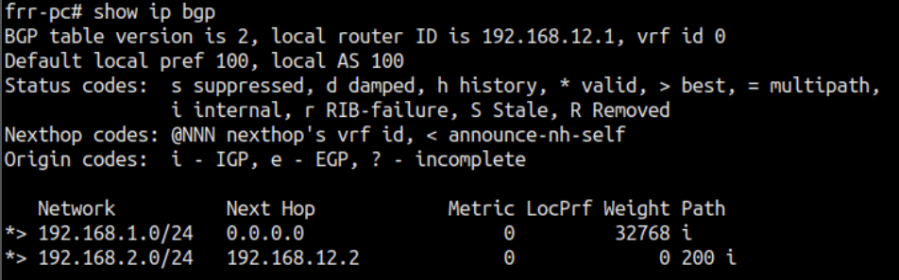
Next-hop Attribute
Next Hop
A well-known mandatory attribute
Unlike IGPs, BGP routes AS by AS, not router by router
The next-hop address for a network from another AS is an IP address of the entry point of the next AS along the path to that destination network
BGP table router r1
Rick Graziani, “Implementing Cisco IP Routing,” Cisco Press, 2015

Slide 15
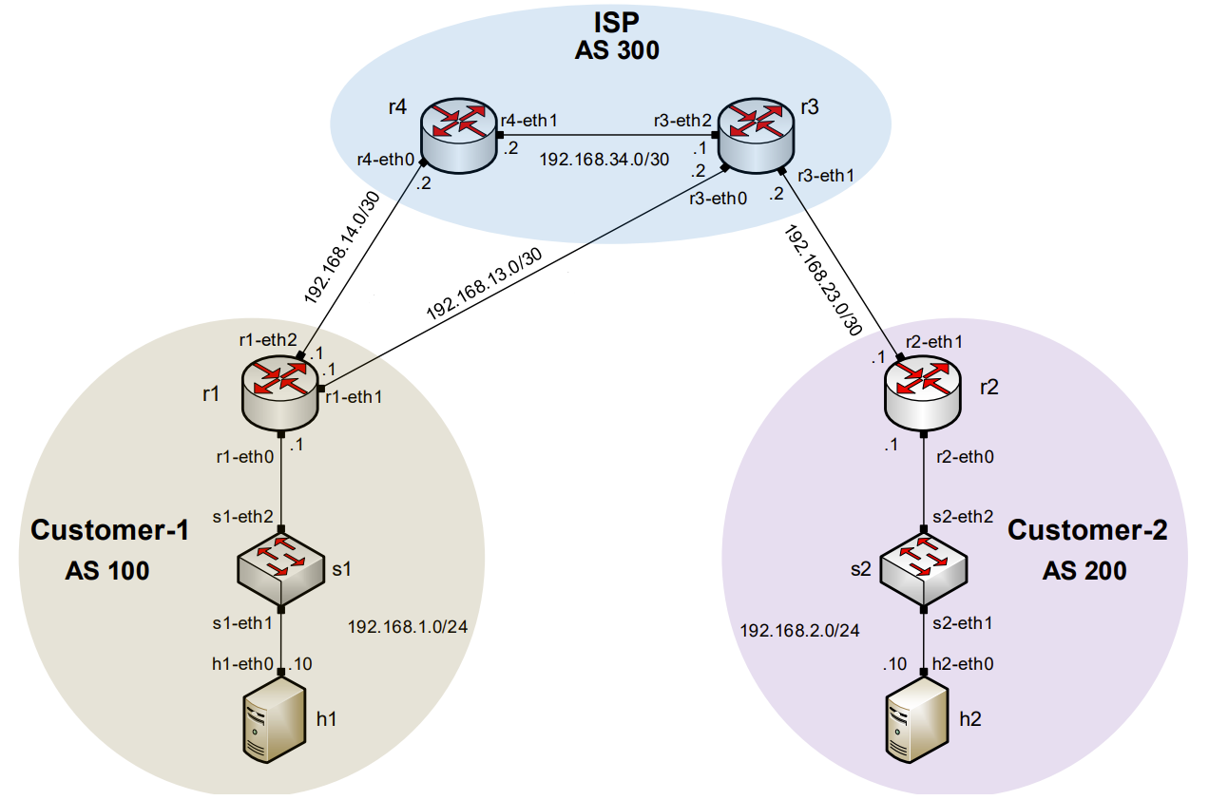
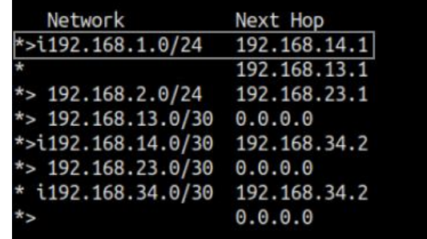
Next-hop Attribute
The next-hop address for a network from another AS is an IP address of the entry point of the next AS along the path to that destination network
Next Hop
BGP table router r3

Slide 16
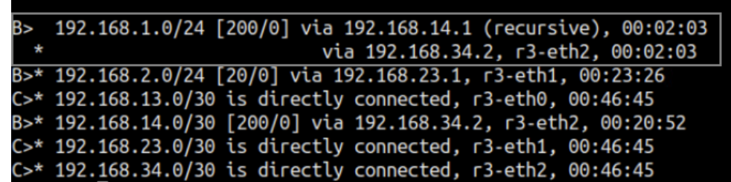
Next-hop Attribute
The next-hop address for a network from another AS is an IP address of the entry point of the next AS along the path to that destination network
Routing table router r3
Next Hop
BGP table router r3

Slide 17
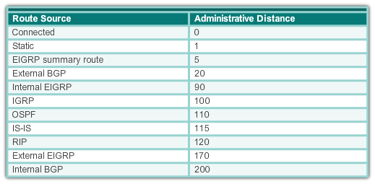
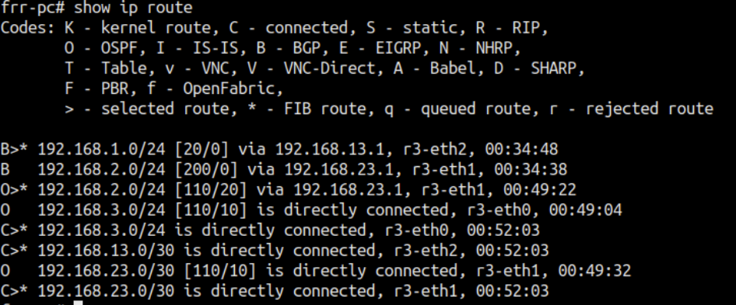
Administrative Distance
A router may run multiple routing protocols / static routes
If BGP and OSPF are configured on a router, both protocols may provide different best paths (analogous to google-maps and mapquest)
How does the router know which protocol to choose?
  The route with lower Administrative Distance is installed in the routing table
Rick Graziani, “Implementing Cisco IP Routing,” Cisco Press, 2015

Slide 18
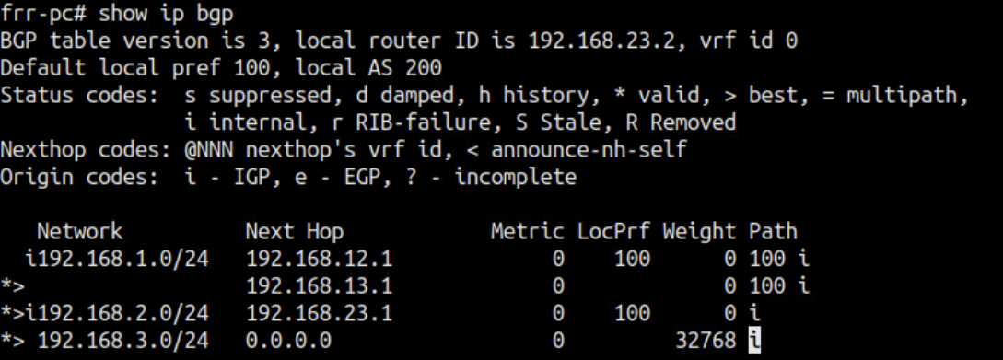
Status Code
Code | Meaning
s | Table entry is suppressed
d | Table entry is dampened
h | Table entry history
* | Table entry is valid
> | Table entry is the best entry to use for this network
i | Table entry was learned via an internal BGP session
r | Table entry is a RIB-failure
S | Table entry is stale
= | Table entry has multipath to use for this network
b | Table entry has a backup path to use for this network
x | The table entry has a best external route to use for this network
Displayed at the beginning of each line in the table
Notes:
AS 2 and AS 3 buy transit service from AS 1

Slide 19
Origin Attribute
A well-known mandatory attribute
Defines the origin of the path information
The origin attribute can be one of three values:
IGP (“i”)
  The route is interior to the originating AS
  Normally when the network command is used
EGP (“e”)
  The route is learned via EGP
  EGP is legacy and no longer supported
Incomplete (“?”)
  The route’s origin is unknown / some other means
  It usually occurs when a route is redistributed into BGP
BGP table router r1
Rick Graziani, “Implementing Cisco IP Routing,” Cisco Press, 2015

Slide 20
Additional Slides
Notes:
AS 2 and AS 3 buy transit service from AS 1

Slide 21
BGP Table
Internal version number of the table
This number is incremented whenever the table changes

