Slide 1

An Overview of P4 Programmable Switches
and Applications
Jorge Crichigno
College of Engineering and Computing, University of South Carolina
jcrichigno@cec.sc.edu
https://research.cec.sc.edu/cyberinfra
Electrical and Computer Engineering Seminar
Brigham Young University
Provo, Utah – April 11, 2024
Notes:
Engineering Building # 206

Slide 2
Agenda
Introduction to P4 Programmable Switches
DGA Family Classification using DNS Deep Packet Inspection on P4 Switches
Dynamic Router’s Buffer Sizing using P4 Switches
Conclusion

Slide 3






Cyberinfrastructure Lab (CI) at USC
Elie Kfoury
Assistant Professor
Jose Gomez
PhD Student
Samia Choueiri
PhD Student
Ali AlSabeh
PhD Student
Ali Mazloum
PhD Student
Christian Vega
PhD Student

Slide 4
Introduction to P4 Programmable Switches

Slide 5
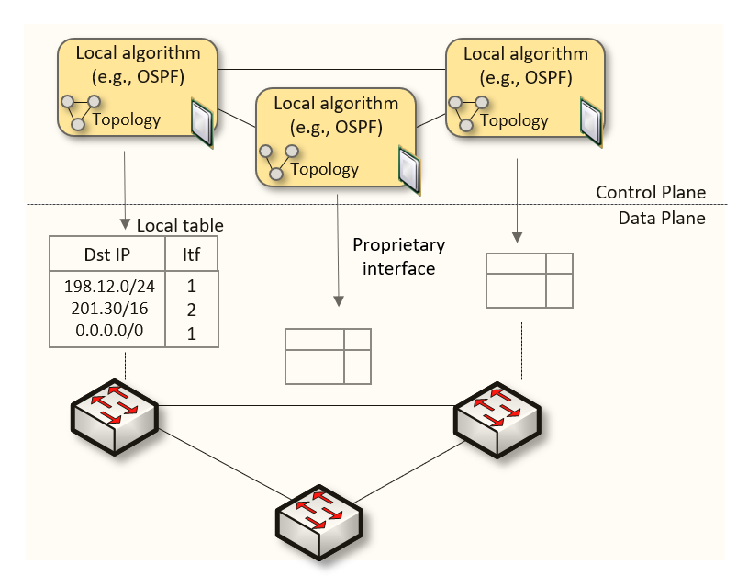
Traditional (Legacy) Networking
Since the explosive growth of the Internet in the 1990s, the networking industry has been dominated by closed and proprietary hardware and software
The interface between control and data planes has been historically proprietary
  Vendor dependence: slow product cycles of vendor equipment, no innovation from programmers

Slide 6
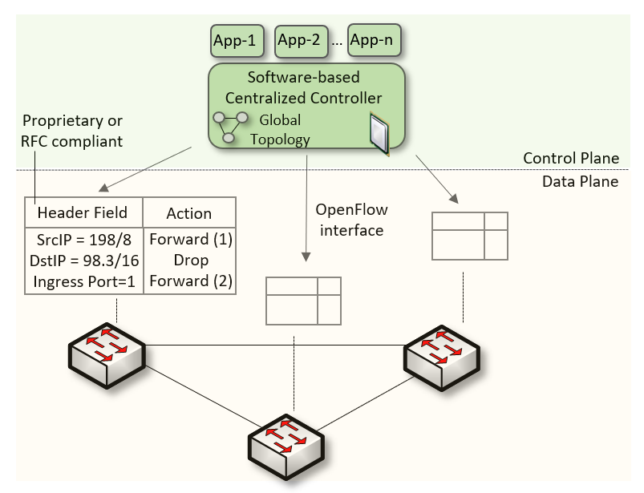
Software-Defined Networking (SDN)
Protocol ossification has been challenged first by SDN
SDN (1) explicitly separates the control and data planes, and (2) enables the control plane intelligence to be implemented as a software outside the switches by end programmers
The function of populating the forwarding table is now performed by the controller

Slide 7
SDN Limitation
SDN is limited to the OpenFlow specifications
  Forwarding rules are based on a fixed number of protocols / header fields (e.g., IP, Ethernet)
The data plane is designed with fixed functions (hard-coded)
  Functions are implemented by the chip designer

Slide 8
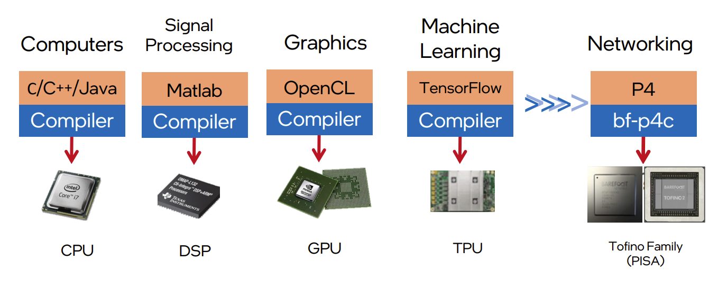
Can the Data Plane be Programmable?
Evolution of the computing industry
1970s 1970s-80s 1990s-2000s 2010s 2017
1. Vladimir Gurevich, “Introduction to P4 and Data Plane Programmability,” https://tinyurl.com/2p978tm9.

Slide 9
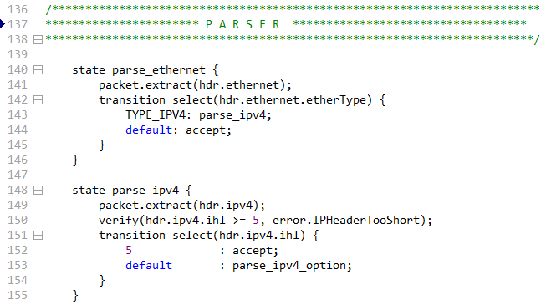
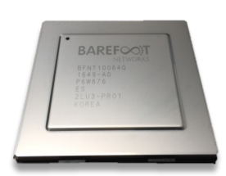
P4 Programmable Switches
P4¹ programmable switches permit programmers to program the data plane
P4 code
Programmable chip
1. P4 stands for stands for Programming Protocol-independent Packet Processors
Notes:
A programmer can program the ASIC (application-specific integrated circuit)

Slide 10
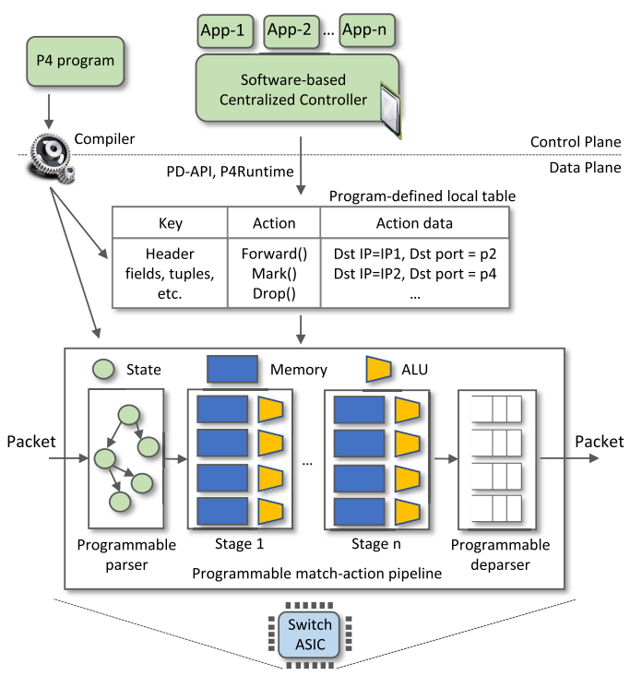
P4 Programmable Switches
P4¹ programmable switches permit programmers to program the data plane
  Define and parse new protocols
  Customize packet processing functions
  Measure events occurring in the data plane with
  high precision
  Offload applications to the data plane
1. P4 stands for stands for Programming Protocol-independent Packet Processors

Slide 11
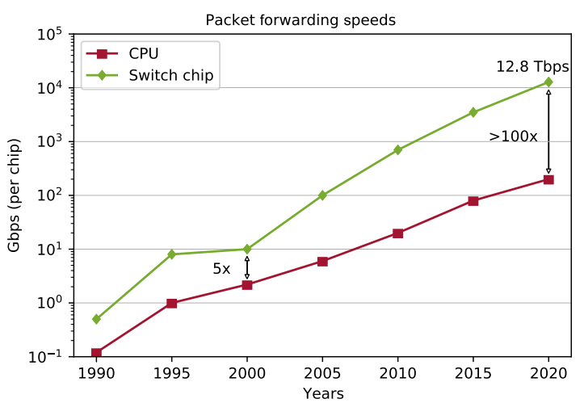
P4 Programmable Switches
P4¹ programmable switches permit programmers to program the data plane
  Define and parse new protocols
  Customize packet processing functions
  Measure events occurring in the data plane with
  high precision
  Offload applications to the data plane
Reproduced from N. McKeown. Creating an End-to-End Programming Model for Packet Forwarding. Available: https://www.youtube.com/watch?v=fiBuao6YZl0&t=631s

Slide 12

DGA Family Classification using DNS Deep Packet
Inspection on P4 Programmable Switches
NSF Cybertraining 2118311: “Cybertraining on P4 Programmable Devices using an Online Scalable
Platform with Physical and Virtual Switches and Real Protocol Stacks”

Slide 13
Introduction to DGAs
Attackers often use a Command and Control (C2) server to establish communication between infected host/s and bot master
Domain Generation Algorithms (DGAs) are the de facto dynamic C2 communication method used by malware, including botnets, ransomware, and many others

Slide 14
Introduction to DGAs
DGAs evade firewall controls by frequently changing the domain name selected from a large pool of candidates
The malware makes DNS queries to resolve the IP addresses of these generated domains
Only a few of these queries will be successful; most of them will result in Non-Existent Domain (NXD) responses
(1) DNS queries. (2) (NXD) replies. (3) Eventually, a query for the actual domain is sent and malware-C2 communication starts.

Slide 15
Introduction to DGAs
DGAs evade firewall controls by frequently changing the domain name selected from a large pool of candidates
The malware makes DNS queries to resolve the IP addresses of these generated domains
Only a few of these queries will be successful; most of them will result in Non-Existent Domain (NXD) responses

Slide 16
Proposed System
The proposed system uses P4 programmable data plane switches to
  Run a customized packet parser
  Collect fine-grained measurements
  Perform per-packet inspection
  Process packets at line rate
1. A. AlSabeh, K. Friday, E. Kfoury, J. Crichigno, E. Bou-Harb, “On DGA Detection and Classification using P4 Programmable Switches,” under review, Journal of Computers and Security.
Notes:
The P4 switch collects and stores the context-aware features of the hosts
When an NXD response is received, the switch performs DPI on the domain name to extract its context-less features
The switch sends the collected features to the control plane
The control plane runs the intelligence to classify the DGA family and initiate the appropriate incidence response

Slide 17
Proposed System
The switch collects and stores the traffic features of the hosts (Traffic Pattern Analysis)
  Number of IP addresses contacted, number of DNS requests made, Inter-arrival Time (IAT) between consecutive IP packets, time it takes for the first NXD response to arrive, IAT between subsequent NXD responses
Notes:
The P4 switch collects and stores the context-aware features of the hosts
When an NXD response is received, the switch performs DPI on the domain name to extract its context-less features
The switch sends the collected features to the control plane
The control plane runs the intelligence to classify the DGA family and initiate the appropriate incidence response

Slide 18
Proposed System
When an NXD response is received, the switch performs deep-packet inspection (DPI) on the domain name to extract domain features (Domain Name Analysis)
  For classification, the data plane sends the collected features to the control plane, which runs the intelligence to classify the DGA family and initiate the appropriate response
Notes:
The P4 switch collects and stores the context-aware features of the hosts
When an NXD response is received, the switch performs DPI on the domain name to extract its context-less features
The switch sends the collected features to the control plane
The control plane runs the intelligence to classify the DGA family and initiate the appropriate incidence response

Slide 19
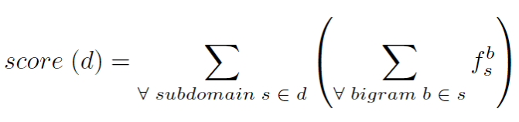

Proposed System
The scheme uses the bigram technique for the domain name analysis:
  It computes the bigram of the domain name; a bigram model may suffice to predict whether a domain name is a legitimate human readable domain
  The frequency value of a bigram b is pre-computed and stored in a Match-Action Table (MAT)
  Example: the bigrams of “google” are: “go”, “oo”, “og”, “gl”, “le”
  The lower the score, the more random the domain name
Where is the frequency of the bigram b in the subdomain s
$$f_{s}^{b}$$

Slide 20
Evaluation
Experimental setup
  Hundreds of GB of malware samples; 1,311 samples containing 50 DGA families¹
  We used samples that receive NXD responses containing domain names generated by DGAs¹
  The collected dataset was used to train ML models offline on a general-purpose CPU
  80% of data was used for training and 20% for testing
¹ D. Lohmann, “DGArchive.” [Online]. Available: https://tinyurl. com/yc6whwrc.

Slide 21
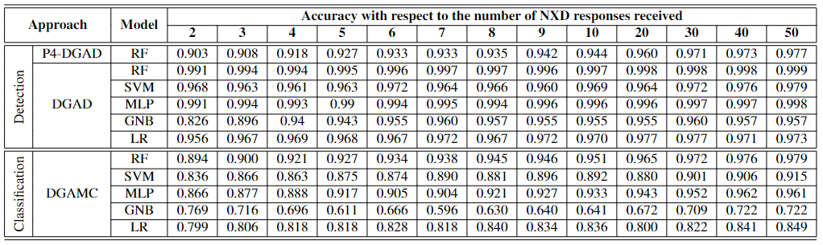
Evaluation
The evaluation reports the accuracy (ACC) of different ML classifiers during the first 50 NXD responses
  P4-DGAD RF (detection) is fully implemented in the data plane
  For detection, all algorithms have an ACC > 0.9 with four or more NXD responses
  For classification, the ACC of the proposed scheme is comparable to that of CPU-based schemes (with minimal control-plane intervention)
RF: Random Forest; SVM: Support Vector Machine; MLP: Multilayer perceptron; LR: Logistic Regression; GNB: Gaussian Naive Bayes
P4-DGAD: DGA detection algorithm runs fully in the data plane
DGAD: Detection algorithm runs in the control plane
DGAMC: Classifier algorithm runs in the control plane
Notes:
RF-DGAD vs P4-DGAD: The depth of the trees and the number of the trees are increased when computed in the control plane (much more resources). Therefore, the accuracy is improved.

Slide 22
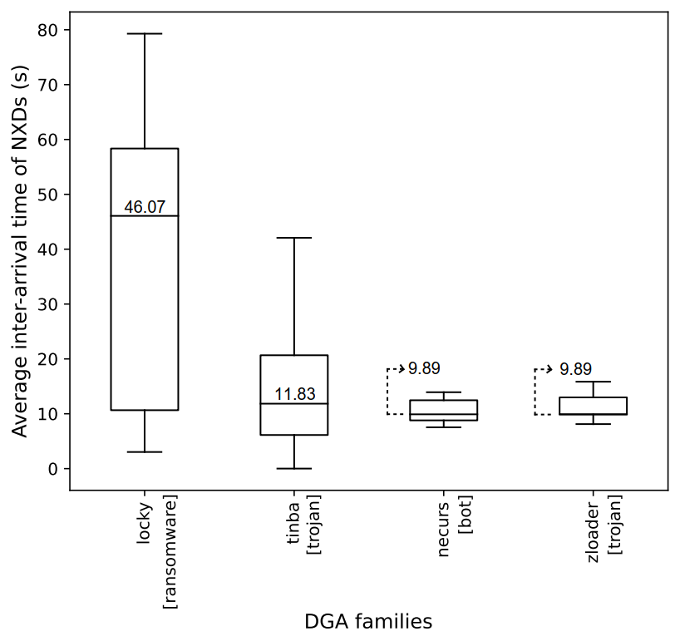
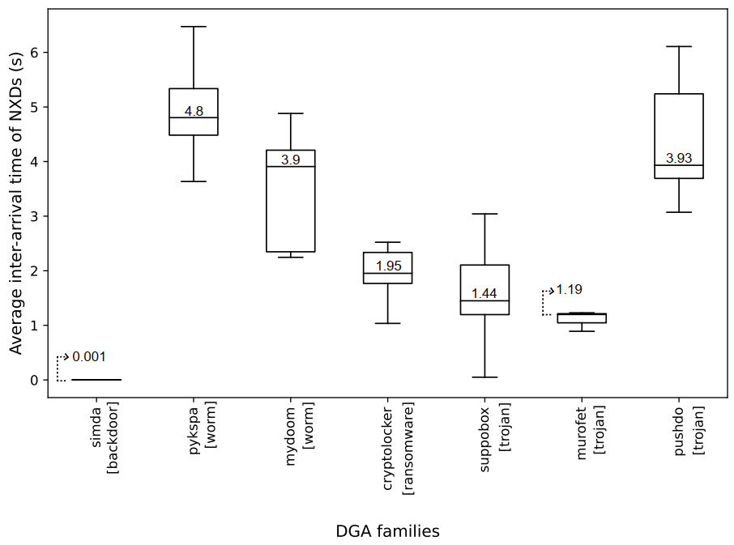
Evaluation
The scheme can accurately characterize traffic flows (traffic features)
Interarrival times between NXDs of DGA families with the largest number of samples

Slide 23
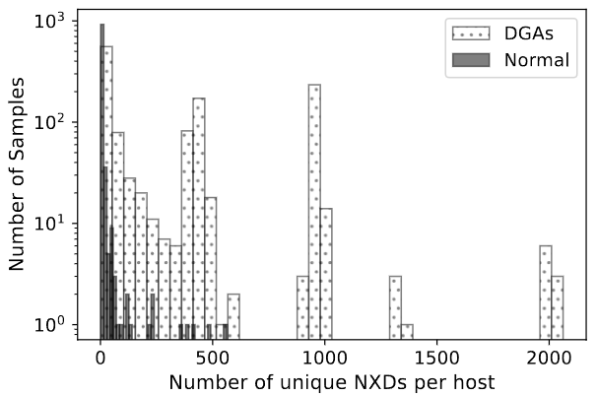
Evaluation
The scheme can accurately characterize traffic flows (traffic features)
  Normal (benign) hosts typically generates a few NXDs (at most)
Number of hosts
Number of different NXDs per host

Slide 24
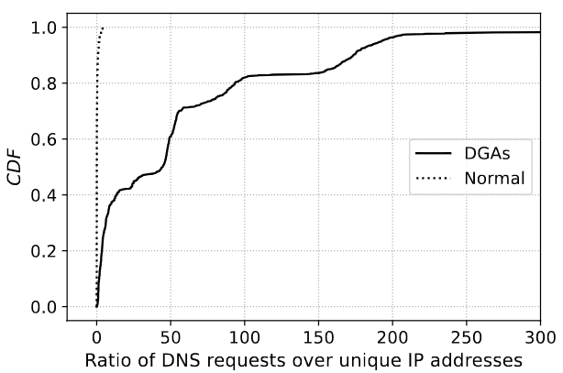
Evaluation
The scheme can accurately characterize traffic flows (traffic features)
  When a normal (benign) hosts queries a given domain, the DNS system returns a corresponding IP address (ratio of DNS requests to IP addresses is approximately 1)
  DGAs often query hundreds of domains; only few queries return an IP address (at best) (ratio of DNS requests to IP addresses > 1)

Slide 25
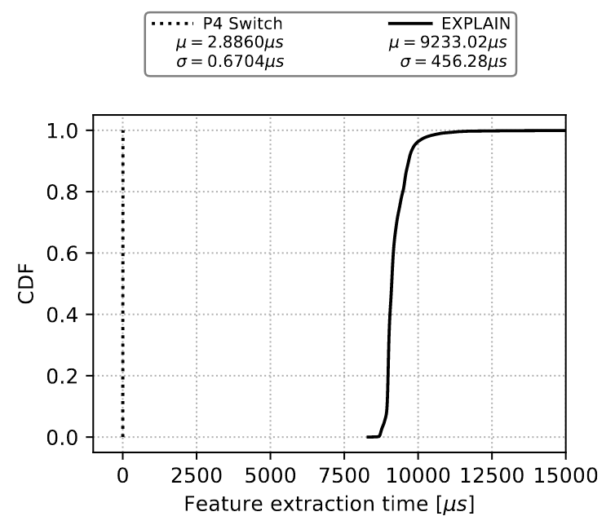
Evaluation
Comparison of the feature extraction time of the proposed approach vs EXPLAIN¹
  The proposed approach runs on the switch data plane
  EXPLAIN runs on a general-purposed CPU with 64 GB RAM, 2.9 GHz processor with eight cores
¹A. Drichel, N. Faerber, U. Meyer, “First step towards explainable DGA multiclass classification,” in the 16th International Conference on
Availability, Reliability and Security, pp. 1–13, 2021.

Slide 26
DEMO – High-resolution Measurements https://youtu.be/cWaWxsqVAgc

Slide 27

P4 PDP Switches based on Intel’s Tofino Chip - Demo

Slide 28
DEMO – DoS https://youtu.be/EGQHUdrQ80M

Slide 29
P4 PDP Switches based on Intel’s Tofino Chip - Demo

Slide 30
Dynamic Router’s Buffer Sizing using Passive
Measurements and P4 Programmable Switches
NSF CC* 2346726: “CC* Integration-Small: Enhancing Data Transfers by
Enabling Programmability and Closed-loop Control in a Non-programmable Science DMZ”

Slide 31
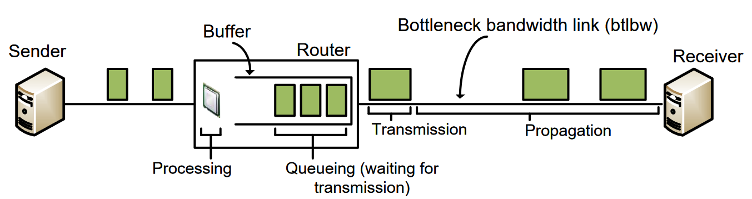
Buffer Sizing Problem
Routers and switches are designed to include packet buffers
The size of buffers impacts the performance of the network
If the buffer allocated to an interface is
  Very large, then packets may experience excessive delay (“bufferbloat”)
  Very small, then there may be a large packet drop rate and low link utilization

Slide 32
Buffer Sizing Problem
Th General rule-of-thumb in the 90s was that the buffer size must equal the Bandwidth-delay product (BDP)
  Buffer = C * RTT
  C is the capacity of the port and RTT is the average round-trip time (RTT)
The “Stanford Rule” corrected the previous rule
  Buffer = (𝐶 ∗𝑅𝑇𝑇)/(√𝑁)
  N is the number of long (persistent over time) flows traversing the port
Operators hardcode the buffer size based on the typical traffic pattern

Slide 33
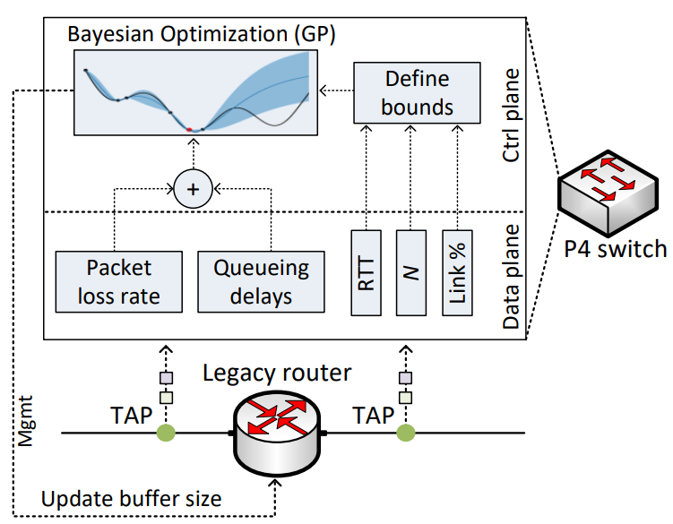
Proposed System
The buffer size is dynamically modified
A P4 switch is deployed passively to compute:
  Number of long flows
  Average RTT
  Queueing delays
  Packet loss rates
The control plane sequentially searches for a buffer that minimizes delays and losses
The searching algorithm is Bayesian Optimization (BO) with Gaussian Processes¹
¹ E. Kfoury, J. Crichigno, E. Bou-Harb, “P4Tune: Enabling Programmability in Non-Programmable Networks,” IEEE Communications Magazine, Vol. 61, Issue 3, Jun. 2023

Slide 34
Proposed System
The buffer size is dynamically modified
A P4 switch is deployed passively to compute:
  Number of long flows
  Average RTT
  Queueing delays
  Packet loss rates
The control plane sequentially searches for a buffer that minimizes delays and losses
The searching algorithm is Bayesian Optimization (BO) with Gaussian Processes
Closed-loop control system
¹ E. Kfoury, J. Crichigno, E. Bou-Harb, “P4Tune: Enabling Programmability in Non-Programmable Networks,” IEEE Communications Magazine, Vol. 61, Issue 3, Jun. 2023

Slide 35
Proposed System
The system incorporates
  Customized packet processing
  Nanosecond resolution measurements
  Per-packet visibility
  Packet processing at line rate
Closed-loop control system
¹ E. Kfoury, J. Crichigno, E. Bou-Harb, “P4Tune: Enabling Programmability in Non-Programmable Networks,” IEEE Communications Magazine, Vol. 61, Issue 3, Jun. 2023

Slide 36
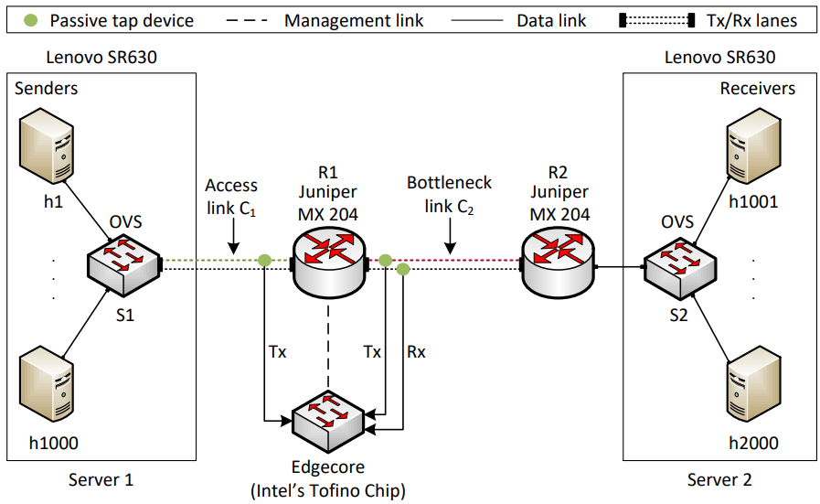
Evaluation
1000 senders
P4 switch: Wedge100BF-32X with Intel’s Tofino ASIC
Legacy router: Juniper router MX-204
Different congestion control algorithms
Access network:
  C₁ = 40Gbps, C₂ = 1Gbps
Core network:
  C₁ = 10Gbps, C₂ = 2.5Gbps

Slide 37
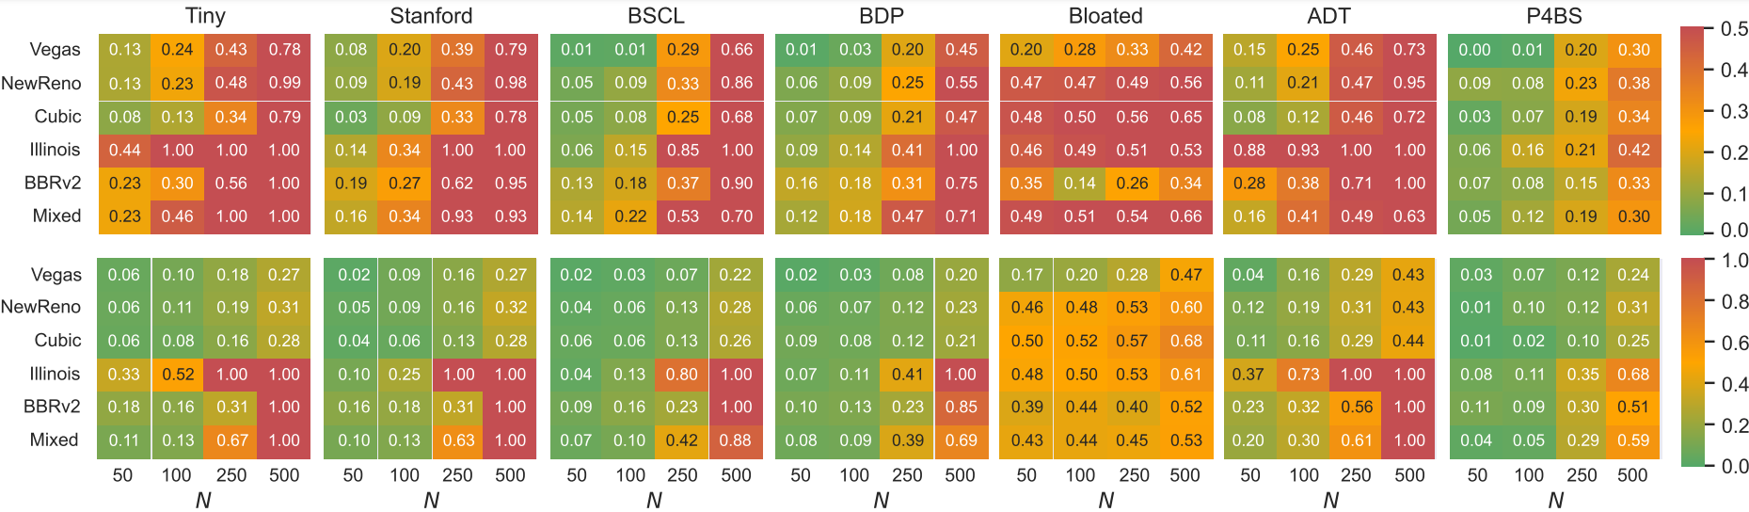
Results
Combined metric accounting for packet loss and delay [0, 1] (the lower, the better)
Top heatmaps: access network
Bottom heatmaps: core network
The Mixed scenario combines multiple congestion control algorithms¹
1. E. Kfoury, J. Crichigno, E. Bou-Harb, “P4BS: Leveraging Passive Measurements From P4 Switches to Dynamically Modify a Router’s Buffer Size,” IEEE Transactions on Network and Service Management, February 2024.

Slide 38
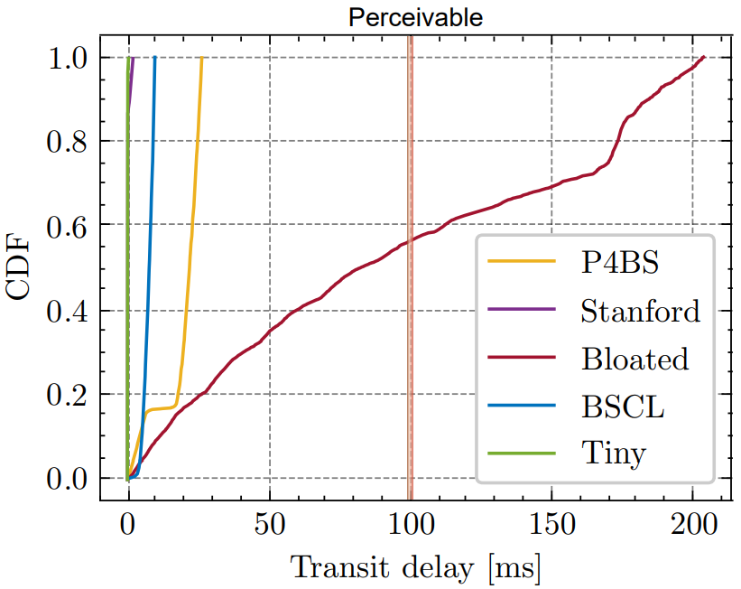
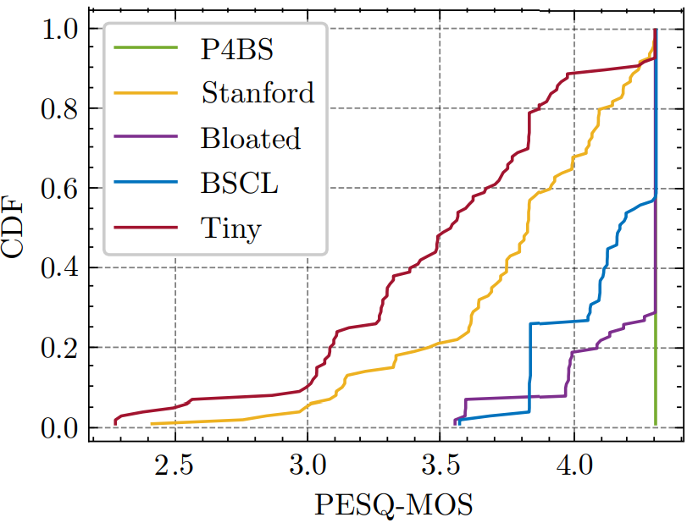
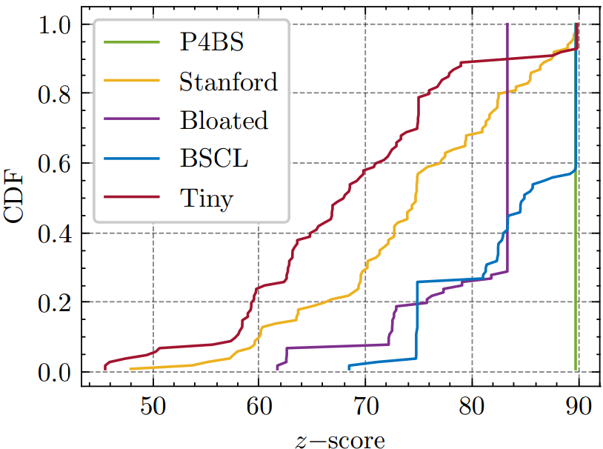
Results
100 VoIP calls playing 20 reference speech samples (G.711.a)
The Perceptual Evaluation of Speech Quality (PESQ) compares an error-free audio signal to a degraded one (the higher, the better)
The z-score considers both the delay and the PESQ (the higher, the better)
1. E. Kfoury, J. Crichigno, E. Bou-Harb, “P4BS: Leveraging Passive Measurements From P4 Switches to Dynamically Modify a Router’s Buffer Size,” IEEE Transactions on Network and Service Management, February 2024.
Notes:
MOS stands for Mean Opinion Score

Slide 39
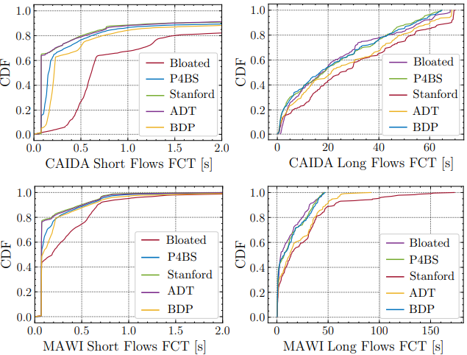
Results
These results use real traffic traces from CAIDA¹ and MAWI²
They include long and short flows
P4BS found a balance such that:
  The FCT of short flows is close to that of the Stanford buffer
  The FCT of long flows is close to that of the bloated buffer
¹ Center for Applied Internet Data Analysis (CAIDA). https://www.caida.org/
² MAWI Working Group Traffic Archive. https://mawi.wide.ad.jp/mawi/

Slide 40
Conclusion
P4 programmable switches enable programmers to control how packets are processed, produce fine-grained measurements, customize parsers and functions, and compute at line rate
Such capabilities can be used to solve a variety of problems, e.g.,
  Buffer sizing problem, where programmability is enabled in non-programmable devices
  DGA problem, where the P4 application can detect DGAs using a combination of DNS deep packet inspection and traffic characterization

Slide 41
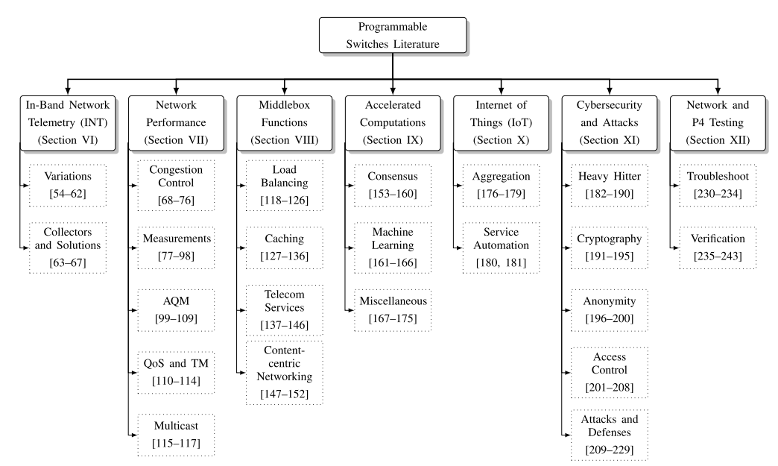
Conclusion
Data plane programmability is enabling a wave of innovation
¹E. Kfoury, J. Crichigno, E. Bou-Harb, "An Exhaustive Survey on P4 Programmable Data Plane Switches: Taxonomy, Applications, Challenges, and Future Trends", IEEE Access, June 2021.

Slide 42
Contact Information
Jorge Crichigno
College of Engineering and Computing, University of South Carolina
jcrichigno@cec.sc.edu
http://ce.sc.edu/cyberinfra

Slide 43
Offloading Media Traffic to
P4 Programmable Data Plane Switches

Slide 44
Voice and Video
Supporting protocols are divided into two main categories
  Signaling protocols: establish and manage the session; e.g., Session Initiation Protocol (SIP)
  Media protocols: transfer actual audio and video streams; e.g., Real Time Protocol (RTP)
Desirable Quality-of-Service (QoS) characteristics
  Delay- and jitter-sensitive, low values
  Occasional losses are tolerated
SIP server, registrar
SIP
SIP
Media (RTP)
User agent client (UAC)
User agent server (UAS)

Slide 45
Network Address Translation (NAT)
NAT maps ports and private IP addresses to ephemeral ports and public IP addresses
  Used in campus / enterprise networks, operators¹
NAT introduces various issues
  NAT prevents a user from outside from initiating a session
  If both users are behind NAT, then cannot communicate
Campus network

Slide 46
Relay Server for Media Traffic
Intermediary device
RTP Information at relay server
SIP server
Relay server
 | Device IP - port | Allocated IP - port
A
B
A
B

Slide 47
Relay Server for Media Traffic
Intermediary device
SIP establishes the session
  RTP ports are unknown
  The relay server allocates a port on behalf of each end user
RTP Information at relay server
SIP server
Relay server
 | Device IP - port | Allocated IP - port
A |  | IP_{R} - P_{RA}
B |  | IP_{R} - P_{RB}
A
B

Slide 48
Relay Server for Media Traffic
Intermediary device
SIP establishes the session
  RTP ports are unknown
  The relay server allocates a port on behalf of each end user
The relay server receives and relays the RTP traffic
RTP Information at relay server
SIP server
Relay server
 | Device IP - port | Allocated IP - port
A | IP_{A’} - P_{A’} | IP_{R} - P_{RA}
B | IP_{B’} - P_{B’} | IP_{R} - P_{RB}
IP_{A’} - p_{A’}
IP_{B’} - p_{B’}
A
B

Slide 49
Relay Server for Media Traffic
Intermediary device
SIP establishes the session
  RTP ports are unknown
  The relay server allocates a port on behalf of each end user
The relay server receives and relays the RTP traffic
RTP Information at relay server
SIP server
Relay server
 | Device IP - port | Allocated IP - port
A | IP_{A’} - P_{A’} | IP_{R} - P_{RA}
B | IP_{B’} - P_{B’} | IP_{R} - P_{RB}
IP_{A’} - p_{A’}
IP_{B’} - p_{B’}
A
B

Slide 50
Implementation and Evaluation
OpenSIPS, an open-source implementation of a SIP server
RTPProxy, a high-performance relay server for RTP streams
SIPp: an open-source SIP traffic generator that can establish multiple concurrent sessions and generate media (RTP) traffic
Iperf3: traffic generator used to generate background UDP traffic
Edgecore Wedge100BF-32X: programmable switch
Edgecore w/
Tofino Chip
Intel Xeon
4 cores, 2.20GHz
Intel Xeon
4 cores, 2.20GHz

Slide 51
Implementation and Evaluation
Two scenarios are considered:
  “Server-based relay”: relay server is used to relay media between end devices
  “Switch-based relay”: the switch is used to relay media
UAC (SIPp) generates 900 media sessions, 30 per second
The test lasts for 300 seconds
G.711 media encoding codec (160 bytes every 20ms)

Slide 52
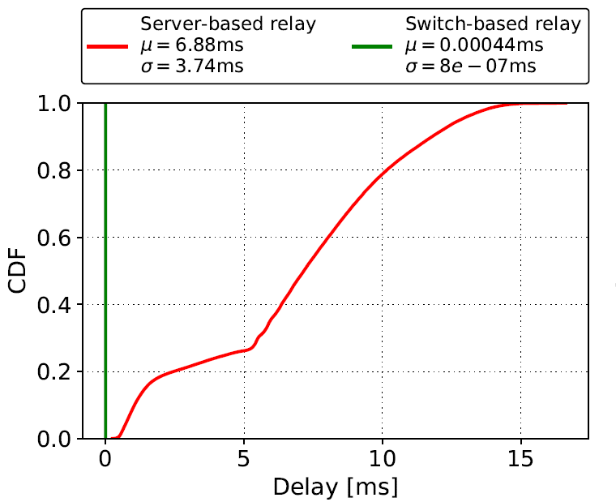
Results
Delay: time interval starting when a packet is received from the UAC by the switch’s ingress port and ending when the packet is forwarded by the switch’s egress port to the UAS
  Delay contributions of the switch and the relay server

Slide 53
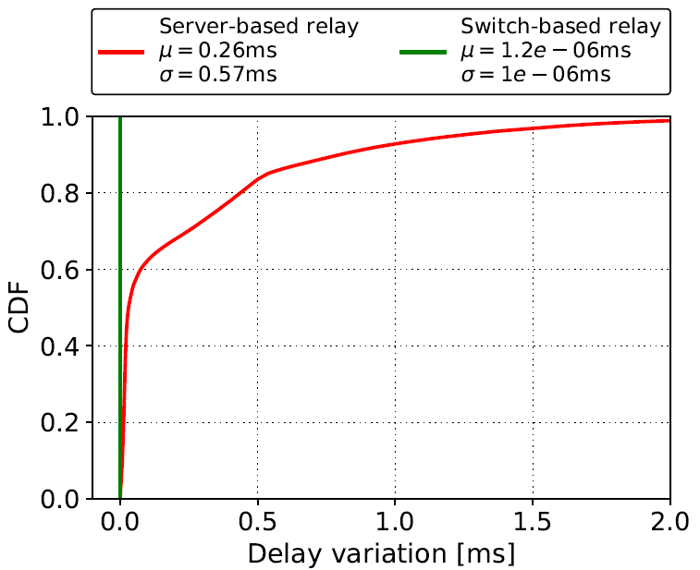
Results
Delay variation: the absolute value of the difference between the delay of two consecutive packets
  Analogous to jitter, as defined by RFC 4689

Slide 54
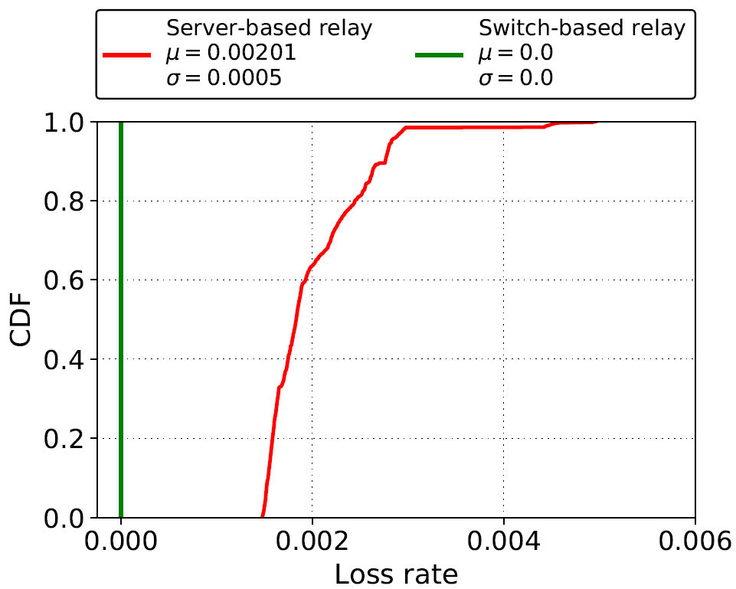
Results
Loss rate: number of packets that fail to reach the destination
  Calculation is based on the sequence number of the RTP header

Slide 55
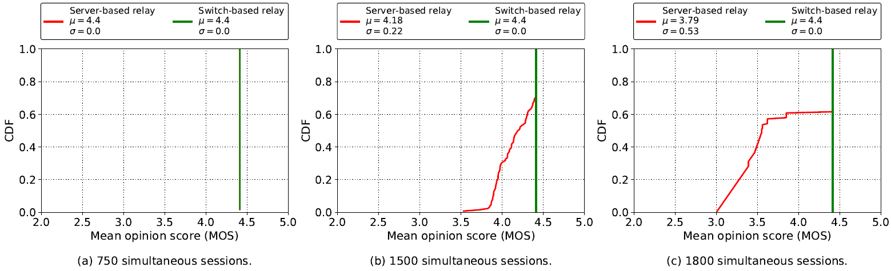
Results
Mean Opinion Score (MOS): estimation of the quality of the media session
  A reference quality indicator standardized by ITU-T
  Maximum for G.711 is ~4.4

Slide 56
Lessons Learned
Advantages of offloading relay application to the data plane:
  Performance: ~1,000,000 sessions vs ~1,000 sessions per core
  Optimal QoS parameters: delay, delay variation, packet loss rate
Limited resources
Avoid complex application logic

