Slide 1
Measurement Collection through Custom
Packet Processing in P4
Ali Mazloum, Jorge Crichigno
University of South Carolina
https://research.cec.sc.edu/cyberinfra/
amazloum@email.sc.edu, jcrichigno@cec.sc.edu
IIT Department, University of South Carolina
April 22, 2024

Slide 2
Agenda
Experimental Topology
System Design
Data Plane
Control Plane
Data Collection and Visualization
Conclusion
2

Slide 3
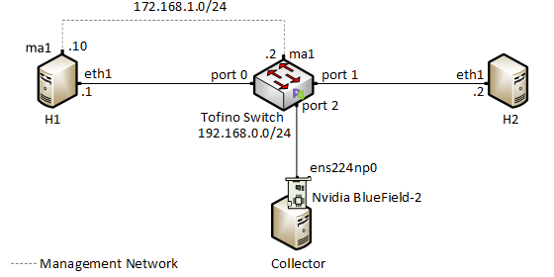
Experimental Topology
The topology consists of three servers connected by a P4 programmable switch
Two servers are used to exchange data, and one server operates as the collector
3

Slide 4
System Design
The data plane is responsible for calculating per-flow the statistics
The control plane periodically triggers the data plane to report the measurements
The data plane utilizes a custom header to append the calculated statistics
The control plane processes and stores the reports received from the data plane of the switch
Data Plane
Control Plane
Measurement calculation
Measurement reporting
Periodic triggering
Measurement collection
4

Slide 5
Data Plane
5

Slide 6
Control Plane
6

Slide 7
Data Collection and Visualization
InfluxDB is used to store the measurements
Grafana is used to query and visualize the measurements
7

Slide 8
Conclusion
The system utilizes the data plane to calculate and report per-flow statistics and the control plane to initiate reporting events
Reports are packets with a custom header structure that carry the statistics to the collector
The data plane appends the statistics and the required metadata to the custom headers
Adding a new metric is performed by adding a new header field to the custom header
The control plane of a remote collector extracts the statistics from the headers of the reports
InfluxDB and Grafana are used to store and visualize the measurements
8

