Slide 1

Cyber-training, Research, and Education Opportunities at the University of South Carolina
Jorge Crichigno
Department of Integrated Information Technology (IIT)
University of South Carolina
jcrichigno@cec.sc.edu
http://ce.sc.edu/cyberinfra
SC Cyber-Security Webinar Series
October 8, 2020

Slide 2
Agenda
Department of Integrated Information Technology at UofSC
Academic programs
Virtual platform
Industry collaboration
Research

Slide 3
IIT Department
The Department of Integrated Information Technology (IIT) is within the College of Engineering and Computing (CEC) at the University of South Carolina (UofSC)
IIT offers undergraduate and graduate degree programs
Its research focuses on the areas of cyber infrastructure, database systems, data analytics, health information technology, and human-computer interaction
It is more practical than theoretical; IIT emphasizes operations, applications
Partnership with industry for internships, materials

Slide 4
Academic Programs
BSc In Integrated Information Technology
ABET accredited
120 credit hours
400-hour internship
Curriculum includes
  Cybersecurity
  IT Business Operations
  Databases
  Networking
  Project Management
  Web Development
The department is developing a fully online BSc

Slide 5
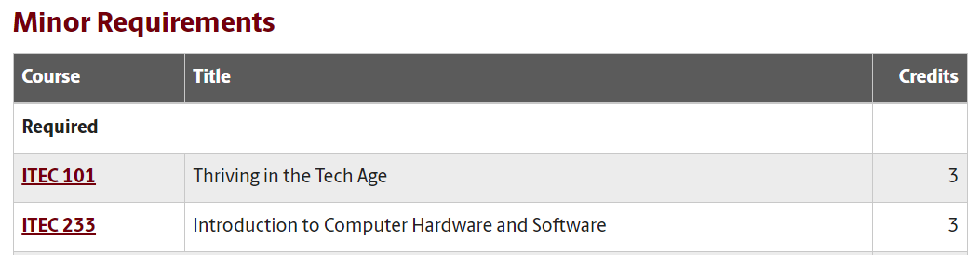
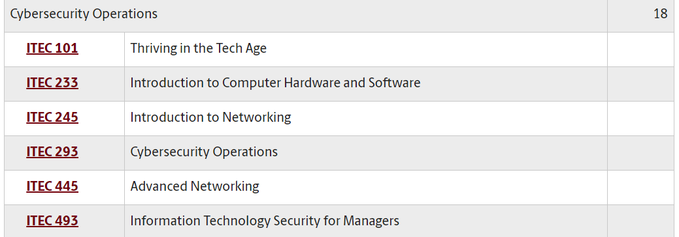
Academic Programs
Minor in Integrated Information Technology
18 credit hours
Several concentrations
  Cybersecurity Operations
  IT Business Operations
  Databases
  Networking
  Project Management
  Web Development
Courses map learning objectives to the U.S. NICE framework (ITEC 293, ITEC 445, ITEC 493)
The National Initiative for Cybersecurity Education (NICE) Framework is a national-focused resource that categorizes and describes cybersecurity work

Slide 6
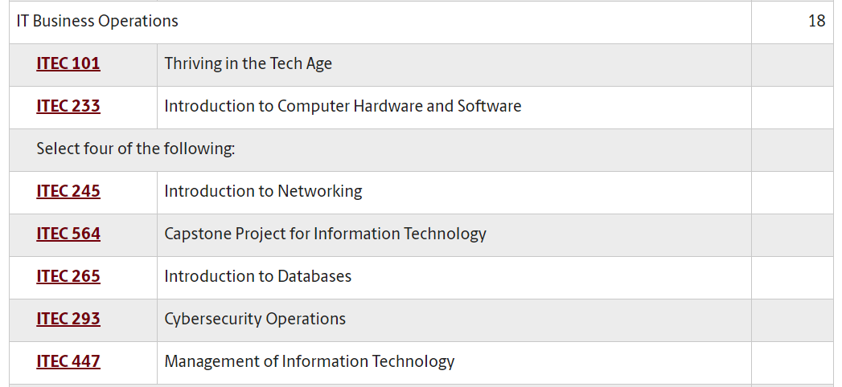
Academic Programs
Minor in Integrated Information Technology
18 credit hours
Several concentrations
  Cybersecurity Operations
  IT Business Operations
  Databases
  Networking
  Project Management
  Web Development

Slide 7
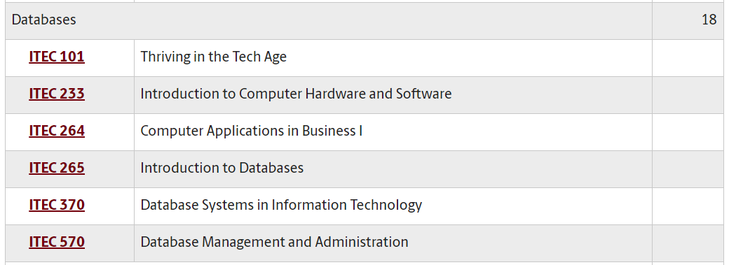
Academic Programs
Minor in Integrated Information Technology
18 credit hours
Several concentrations
  Cybersecurity Operations
  IT Business Operations
  Databases
  Networking
  Project Management
  Web Development

Slide 8
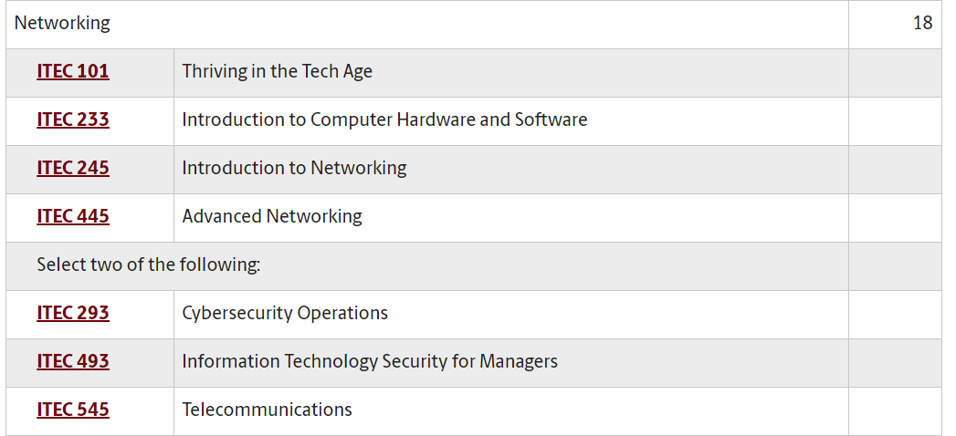
Academic Programs
Minor in Integrated Information Technology
18 credit hours
Several concentrations
  Cybersecurity Operations
  IT Business Operations
  Databases
  Networking
  Project Management
  Web Development

Slide 9
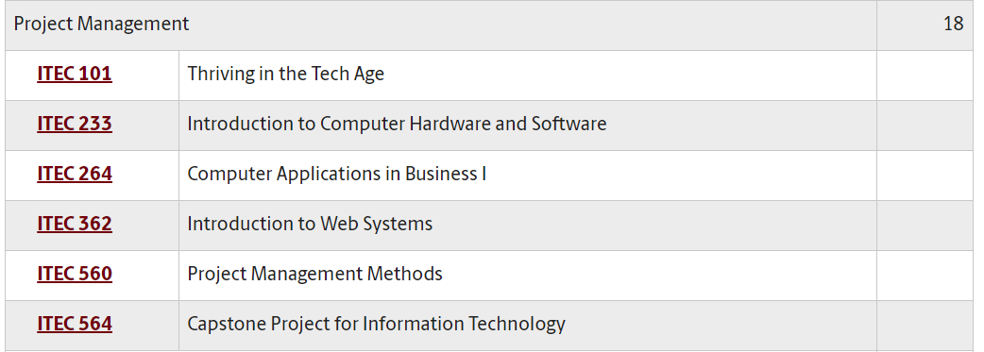
Academic Programs
Minor in Integrated Information Technology
18 credit hours
Several concentrations
  Cybersecurity Operations
  IT Business Operations
  Databases
  Networking
  Project Management
  Web Development

Slide 10
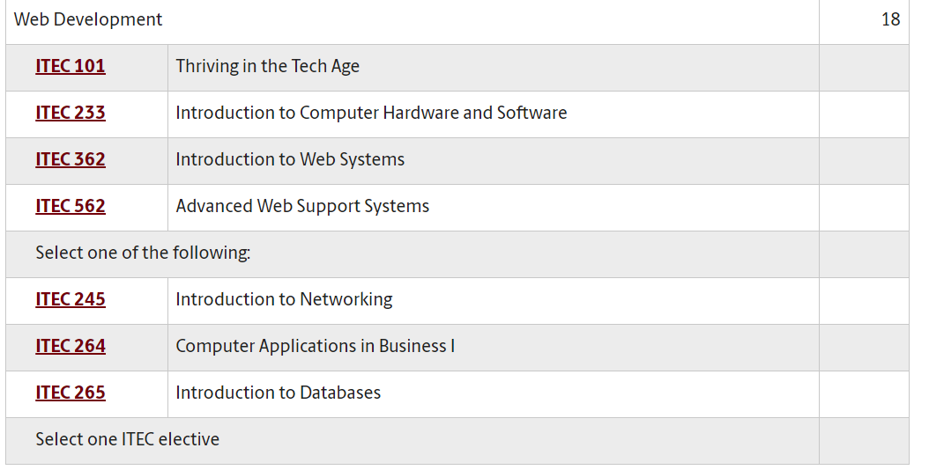
Academic Programs
Minor in Integrated Information Technology
18 credit hours
Several concentrations
  Cybersecurity Operations
  IT Business Operations
  Databases
  Networking
  Project Management
  Web Development

Slide 11
Academic Programs
The Department is developing
  A PhD in Informatics (approval expectation in 2021)
  Undergraduate and graduate certificates
More practical than theoretical
Partnership with industry
  Cisco Network Academy
  Palo Alto Networks Cybersecurity Academy
  VMware IT Academy
  Intel’s Barefoot Academy
  Juniper Networks
Flexible program

Slide 12
Virtual Platform
IIT programs incorporate much hands-on activities
The IEEE and ACM are the main societies which guide IT education
  IT curriculum should emphasize “learning IT core concepts combined with authentic practice” and “use of professional tools and platforms” ¹
Physical labs are typically used to teach and train IT students
COVID exacerbated the needs of efficient technologies for hands-on education in IT
UofSC works with the Network Development Group (NDG)², VMware, Palo Alto Cybersecurity Academy, Cisco, and others to virtualize labs
A virtual platform enables an institution to move traditional curriculum relying on physical labs into an online format
“Information Technology Curricula Guideline 2017 (IT2017),” report by the ACM / IEEE Task Force on Information Technology Curricula, Dec. 2017. Online: https://tinyurl.com/yxauot8w
Network Development Group (NDG). Online: https://netdevgroup.com

Slide 13
Virtual Platform
Virtualization is a technology by which the software portion of a device (e.g., PC, routers, etc.) can execute on a general-purpose physical server as a virtual machine
A pod is a set of virtual machines needed for the completion of a virtual lab exercise
The pod can be as simple as a single isolated virtual machine, or as complex as autonomous systems with live traffic flowing to/from the Internet
Server hosting pods for virtual labs

Slide 14
Virtual Platform
USC (SC), SCC (NC), and NDG are building a distributed virtual platform
The goal is scalability, using the resources available on campus networks
Since January 2020, the distributed platform has served more than 7,000 learners

Slide 15
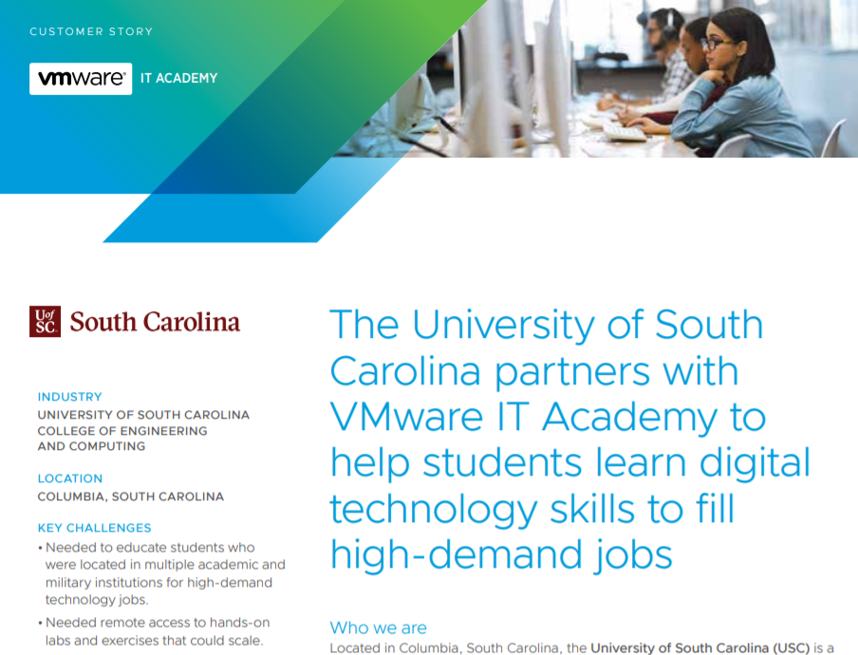







Virtual Platform
There are multiple types of pods
  Pods to learn concepts traditionally covered by academic programs
  Pods to learn skills and techniques covered by certificate programs
  Pods to perform research
Industry partners are essential

Slide 16
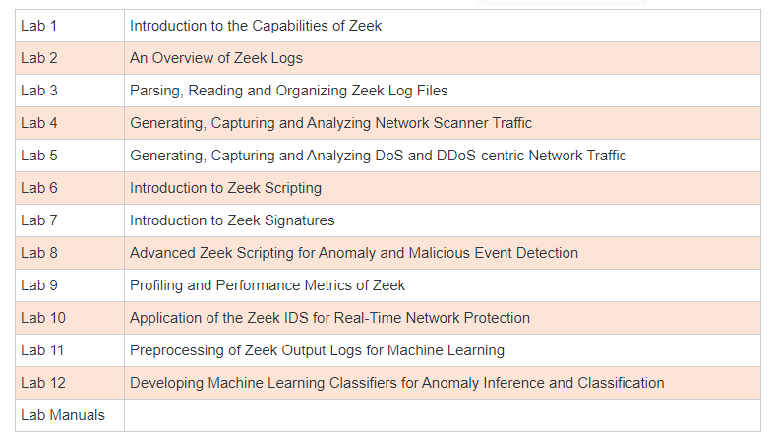
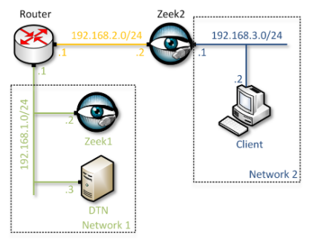
Virtual Labs – Zeek Intrusion Detection
The Zeek labs provide hands-on experience on Intrusion Detection System (IDS)
Zeek is a passive, open-source network traffic analyzer
It is primarily used as a security monitor in national labs, campus networks, enterprises, research labs

Slide 17
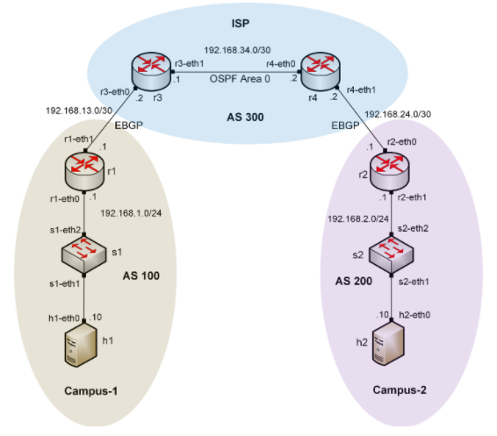
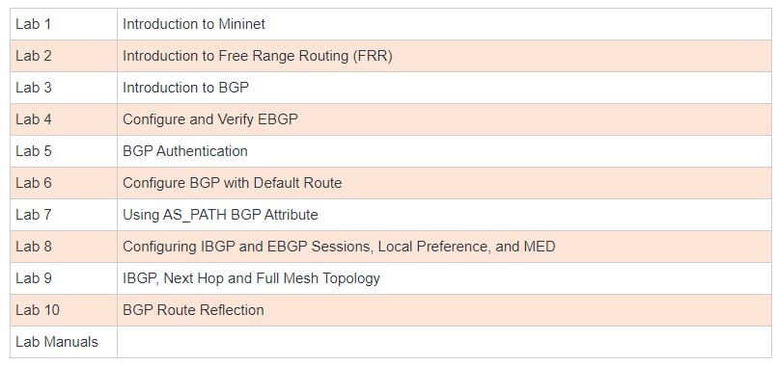
Virtual Labs – BGP
These labs provide a detailed, hands-on experience to understand the Border Gateway Protocol (BGP), adjust its attributes, and control traffic on the Internet
Routers use Free Range Routing (FRR) routing stack
FRR is an open-source protocol stack that provides IP-based routing services

Slide 18
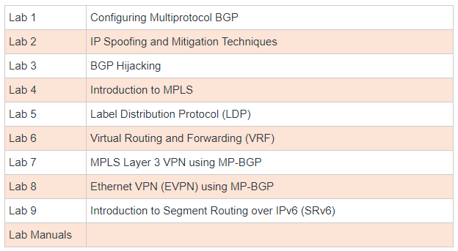
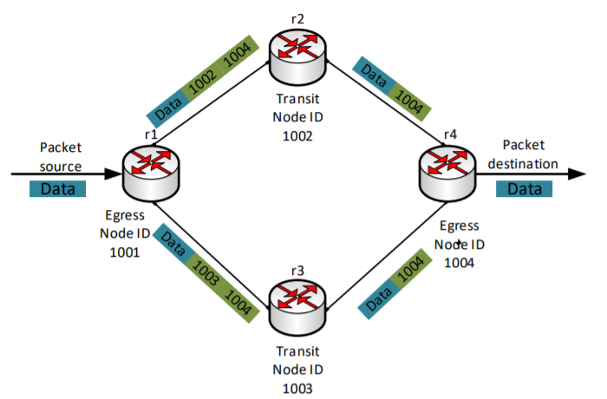
Virtual Labs – MPLS and Advanced BGP Topics
These labs provide a detailed, hands-on experience to understand advanced concepts and protocols
Examples include MPLS, Multi-protocol BGP, BGP hijacking, virtual private networks (VPNs), Ethernet VPNs, and Segment Routing

Slide 19
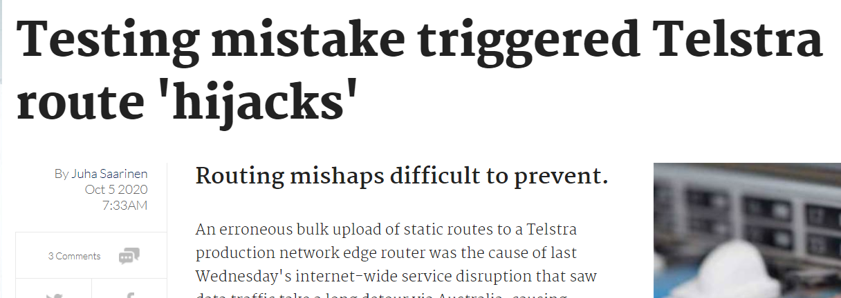
Virtual Labs – MPLS and Advanced BGP Topics
These labs provide a detailed, hands-on experience to understand advanced concepts and protocols
Examples include MPLS, Multi-protocol BGP, BGP hijacking, virtual private networks (VPNs), Ethernet VPNs, and Segment Routing

Slide 20
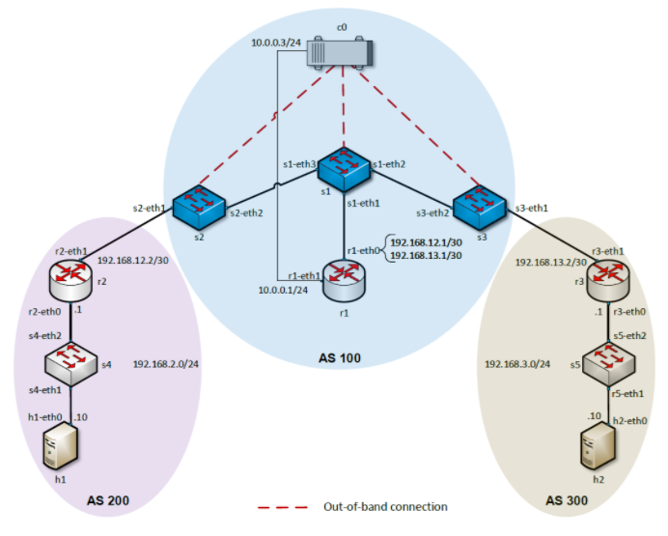
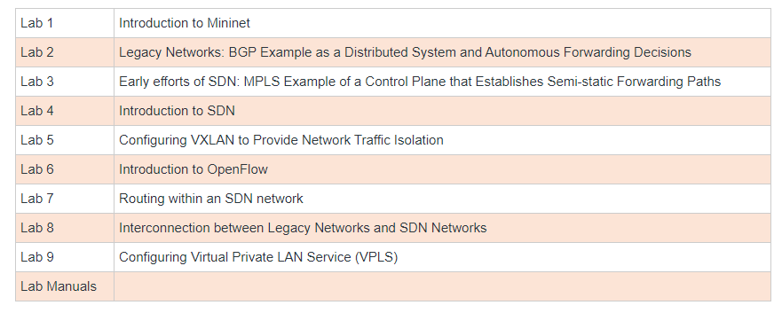
Virtual Labs – Software-defined Networking
These labs provide a detailed, hands-on experience to Software-defined Networking (SDN)
Devices and protocols include Open Virtual Switch (OVS), Open Network Operating System (ONOS) controller, VXLAN, and VPLS

Slide 21
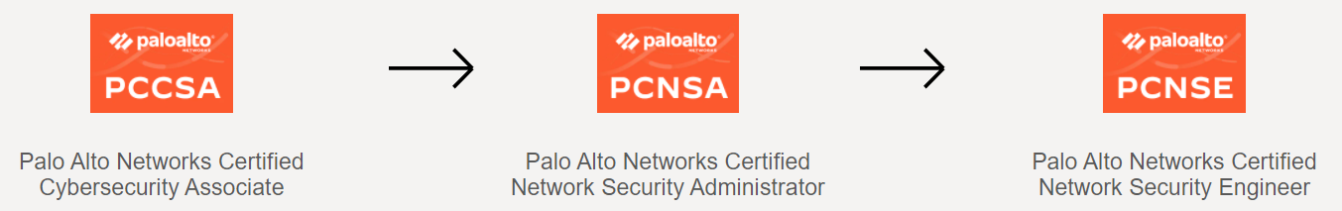
Virtual Labs – Palo Alto NG Firewall
These labs enhance the student’s understanding of how modern firewalls work, referred to as Next-generation Firewalls (NGFWs)
Students gain hands-on experience deploying, managing, and monitoring firewalls in a (virtual) lab environment, using live traffic
Material also prepares students for certificates
The IEEE/ACM group “acknowledges the value of vendor and industry certifications and encourages students to pursue them as they see necessary”¹
“Information Technology Curricula Guideline 2017 (IT2017),” report by the ACM / IEEE Task Force on Information Technology Curricula, Dec. 2017. Online: https://tinyurl.com/yxauot8w

Slide 22
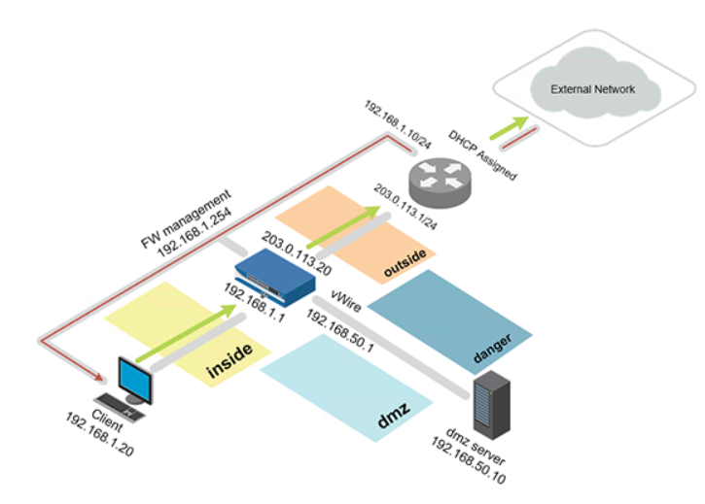
Virtual Labs – Palo Alto NG Firewall
These labs enhance the student’s understanding of how modern firewalls work, referred to as Next-generation Firewalls (NGFWs)
Next-generation Firewall Virtual Machine + licenses
Pod deployed in private cloud

Slide 23
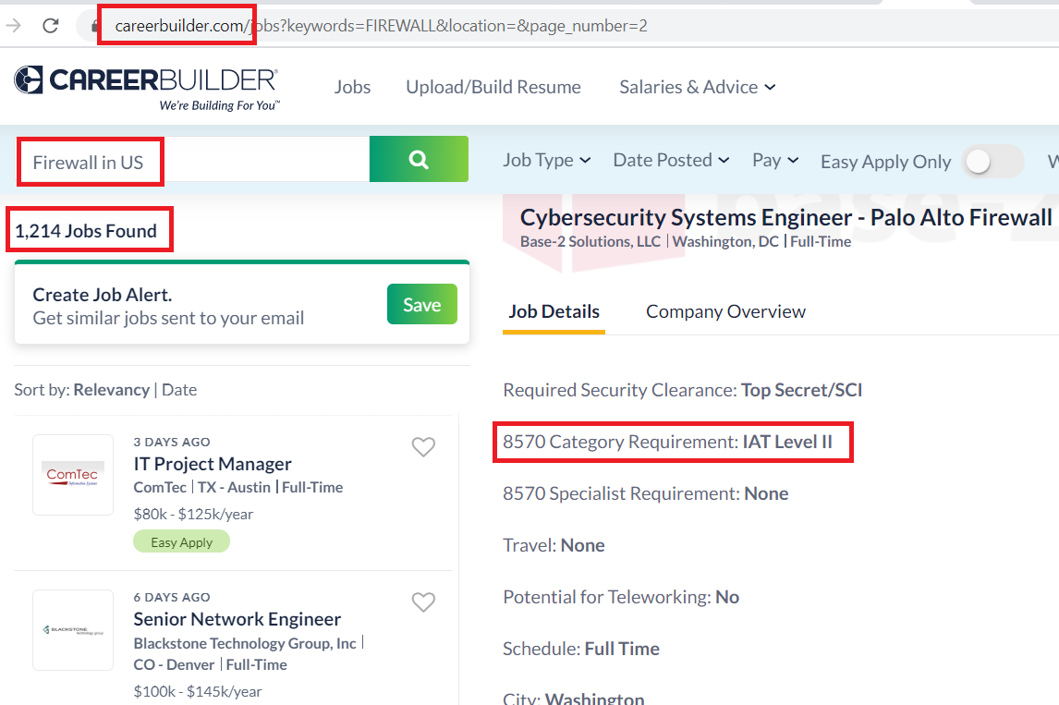
Virtual Labs – Palo Alto NG Firewall
These labs enhance the student’s understanding of how modern firewalls work, referred to as Next-generation Firewalls (NGFWs)
Pod deployed in private cloud
Job search

Slide 24
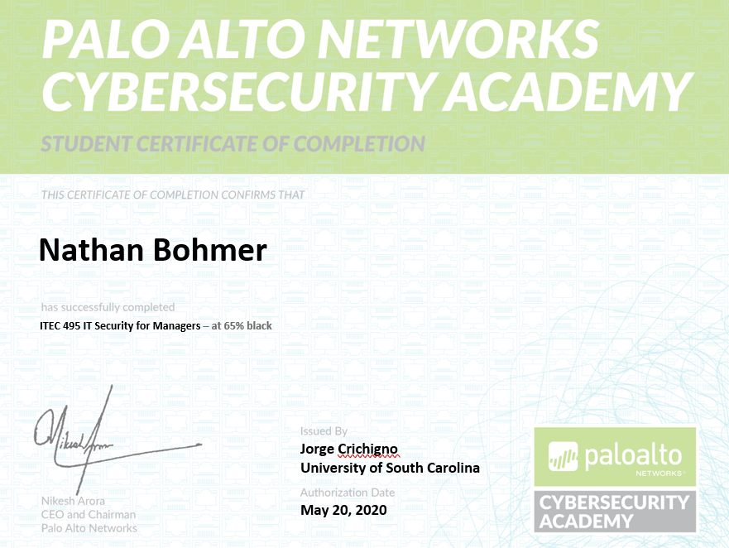
Virtual Labs – Palo Alto NG Firewall
These labs enhance the student’s understanding of how modern firewalls work, referred to as Next-generation Firewalls (NGFWs)
Additional credentials
Job search

Slide 25
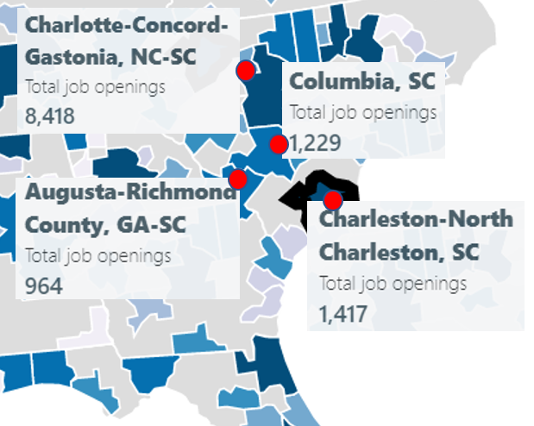
ONR’s Cyber Project
Office of Naval Research (ONR) is funding the project “Enhancing the Preparation of Next-generation Cyber Professionals”
South Carolina cybersecurity needs
  Naval Information Warfare Center (NIWC) Atlantic, SRNL, Fort Jackson, Shaw Air Force Base
Recruiting the American military’s cyber force is more difficult than ever
  DoD has been struggling to hire more than 8,000 cyber positions (2018)¹
The College of Engineering and Computing is addressing the workforce needs:
  Encourage Reserve Officers' Training Corps (ROTC) students to obtain an IT minor
  Undergraduate applied research
Cybersecurity job openings in four metro areas near Columbia, Feb. 2020
1. J. Lynch, “Inside the Pentagon’s Struggle to Build a Cyber Force,” Fifth Domain publication, October 29, 2018. Online: https://tinyurl.com/yyelqomp
Notes:
Reserve Officers' Training Corps (ROTC))

Slide 26


ONR’s Cyber Project
Minor in IT – Cyber specialization
  Option to earn DoD’s approved baseline certificates for Information Assurance Technical (IAT)
  Self-contained specialization; no pre-reqs
Undergraduate applied research
Private cloud with professional tools and platforms
Collaboration with industry
Minor in IT and undergraduate research

Slide 27
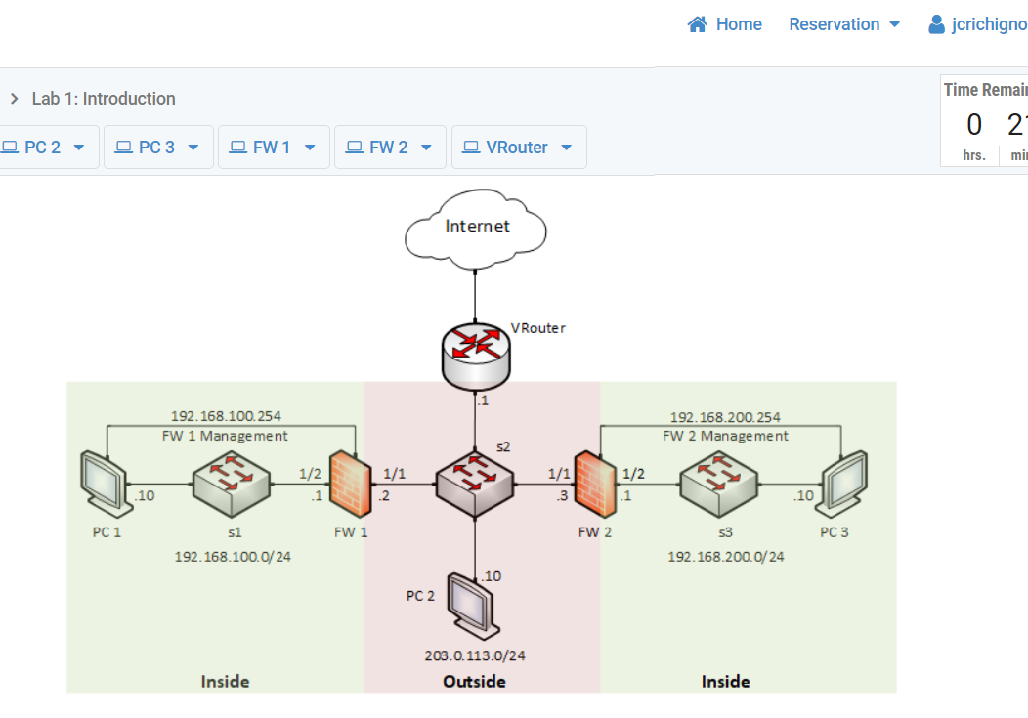
ONR’s Cyber Project
Undergraduate students work 18 hours per week, 15 weeks, $18 per hour ($4,050)
  Applied research
  Professional tools, platforms, market validation
  Cisco Systems, Palo Alto Networks, VMware, Juniper, Intel
  Focus on relevant technology, customized scenarios; e.g., IPsec-based VPNs with NGFWs

Slide 28
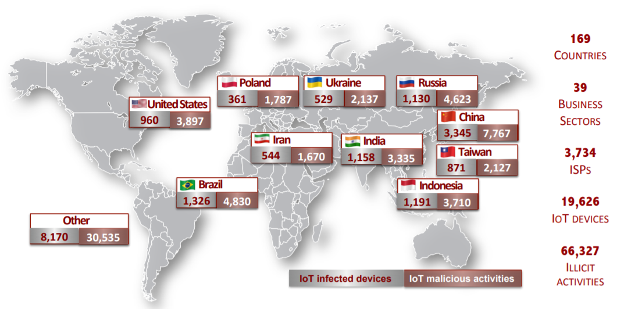
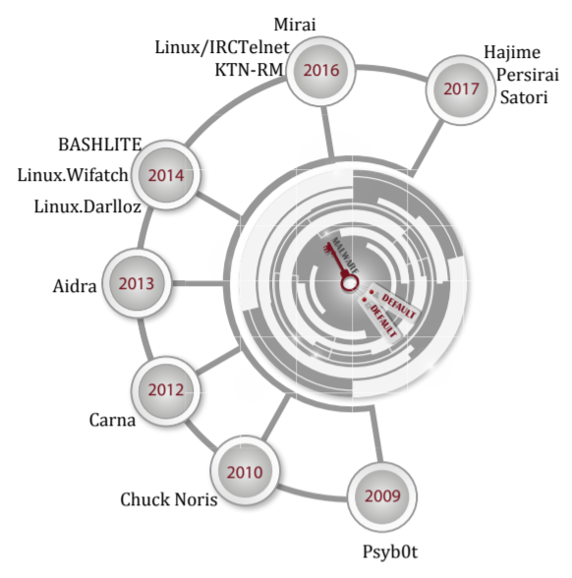
Graduate Projects
Development of new techniques against attacks targeting “Internet-of-Things” devices
Agreement with the Center for Applied Internet Data Analysis (CAIDA) (San Diego)
Global distribution of exploited IoT devices; results from this research project
Malware exploiting default credentials

Slide 29
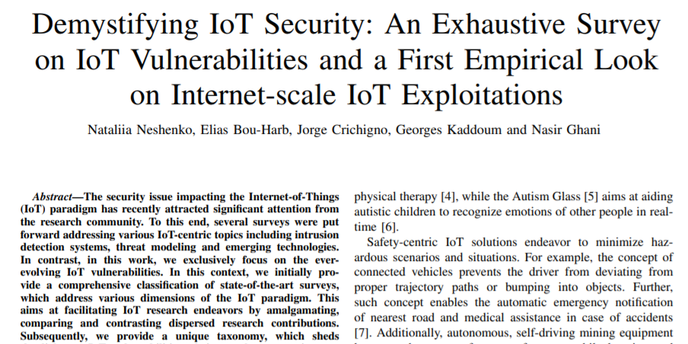
Graduate Projects
Development of new techniques against attacks targeting “Internet-of-Things” devices
Agreement with the Center for Applied Internet Data Analysis (CAIDA) (San Diego)

Slide 30
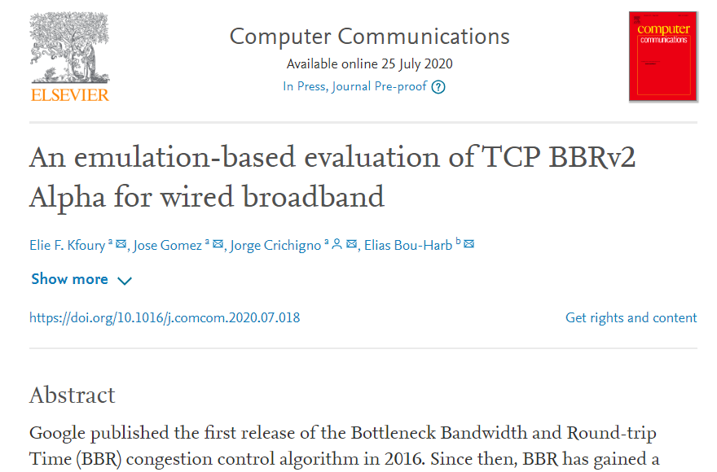
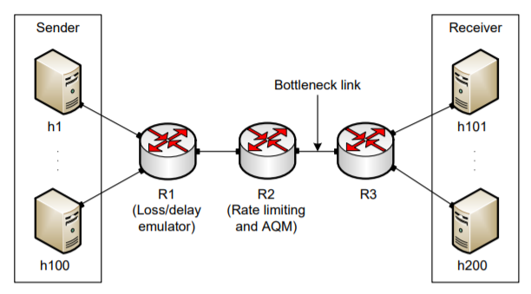
Graduate Projects
Performance testing Google’s new communication protocol
Feedback to Google (used in Youtube, Chrome, and other apps)
Emulating behavior in private cloud before Google’s protocol public release

Slide 31
Graduate Projects
Improving system’s performance using next-generation switches
Offloading computational tasks to network switches
  Orders of magnitude faster than general-purpose CPU
  Very limited instructions set (e.g., no multiplication, no division, simple operations)
Agreement with Intel (chips, software development environment)
Application example: media (voice) relay server
 | Programmable Switch | General-purpose CPU
Cost | $6,000 | $ 10,000 - 25,000
Capacity | ~35,000,000 connections per switch | ~500 connections per core
Latency | 400 nanoseconds | Tens to hundreds of milliseconds

Slide 32
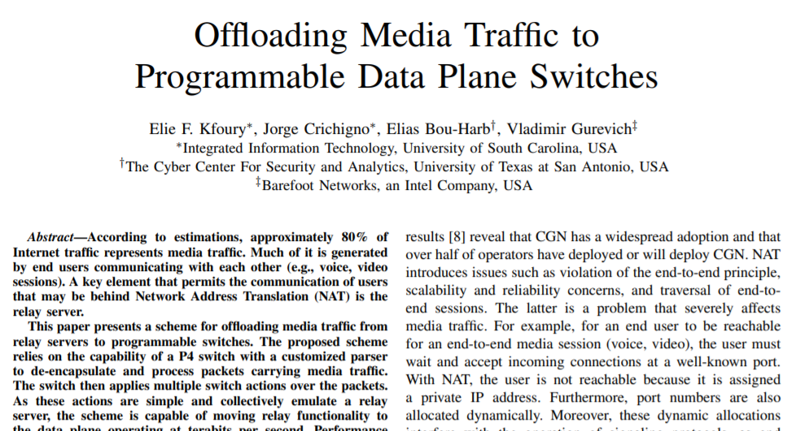
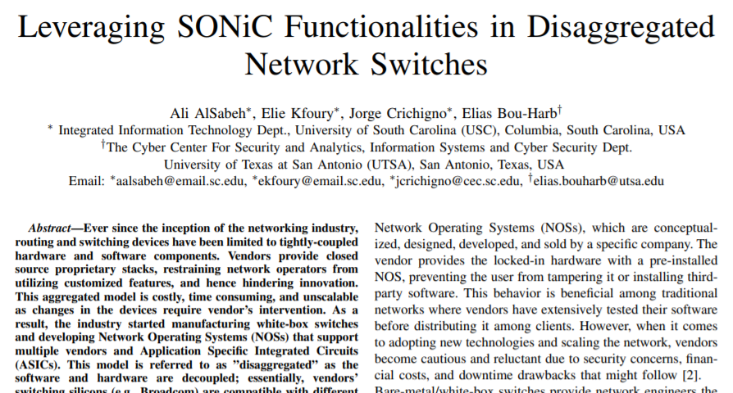
Graduate Projects
Improving system’s performance using next-generation switches
Offloading computational tasks to network switches
  Orders of magnitude faster than general-purpose CPU
  Very limited instructions set (e.g., no multiplication, no division, simple operations)
Agreement with Intel (chips, software development environment)

Slide 33

The END

