Slide 1


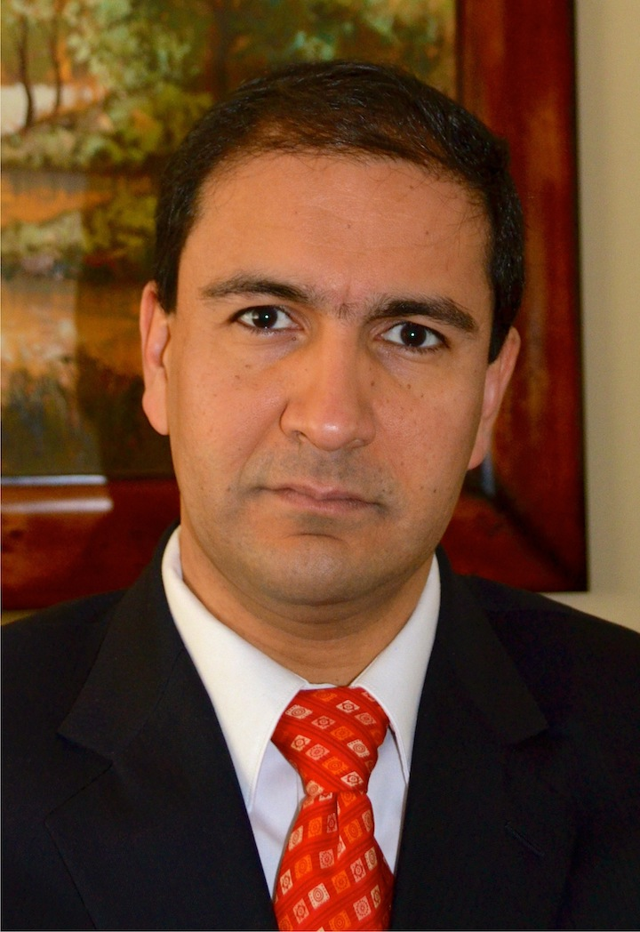
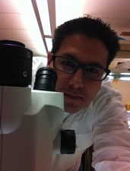
NSF Campus Cyberinfrastructure PI and
Cybersecurity Innovation for Cyberinfrastructure PI Workshop
October 3-4 Albuquerque, New Mexico
NSF Program: Campus Cyberinfrastructure (CC-NIE)
Program Area: Small Institutions
Award Number: 1541352
Jorge Crichigno
Chair & Associate Professor, Engineering
Northern New Mexico College (NNMC)
jcrichigno@nnmc.edu
PI: Jorge Crichigno
co-PIs: Ivan Lopez-Hurtado, Mario Izaguirre-Sierra
Project Title: Northern’s Network Expansion for Large Science and Engineering Data Flows
Project Goals:
Address the severe LAN and WAN data movement limitation imposed by the current 100 Mbps capacity.
Establish a 10 Gbps dedicated research network and Science DMZ.
Increase the undergraduate research activities in Science and Engineering.
Enhance undergraduate programs to address workforce needs and preparation for graduate schools.
Ivan Lopez-Hurtado
Provost, NNMC
ilopez@nnmc.edu
Mario Izaguirre-Sierra
Assistant Professor, Biology, NNMC
mario.izaguirre@nnmc.edu

Slide 2


Northern’s Network Expansion for Large Science and Engineering Data Flows: Introduction
Northern New Mexico College (NNMC) is located in Espanola, NM
Student population of 75% Hispanics and 15% Native Americans
First designated community college of NM, dual-mission since 2005
100 Mbps switched network and WAN connectivity
~50 msec RTT to ABQG, no traffic monitoring
Border router Cisco 2800
Single-mode 1 Gbps fiber among some buildings only
P2P connection to ABQG; traffic monitoring
Cisco ASR-family border router
Multi-mode 10 Gbps; research network
Research activity; workforce development
Notes:
Cisco 2800: Cisco announces the end-of-sale and end-of life dates for the Cisco 2800 Series Integrated Services Routers. The last day to order the affected product(s) is November 1, 2011.

Slide 3
Northern’s Network Expansion for Large Science and Engineering Data Flows: Challenges
No network engineer
Available expertise includes engineering faculty, IT director
Cyberinfrastructure funded by grants
  EPSCoR 2010: campus enterprise network
  CC*DNI 2015: Science DMZ and research network
  EPSCoR 2015: storage area network
Maintenance and operation
  IT, faculty member and students
  University of New Mexico
  Contractor when needed
Engagement
  Teaching load is four classes per semester;
  motivated faculty usually includes tenure track
  Undergraduate research, hands-on activities
  more recognized now

Slide 4
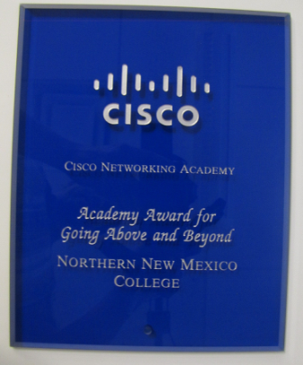
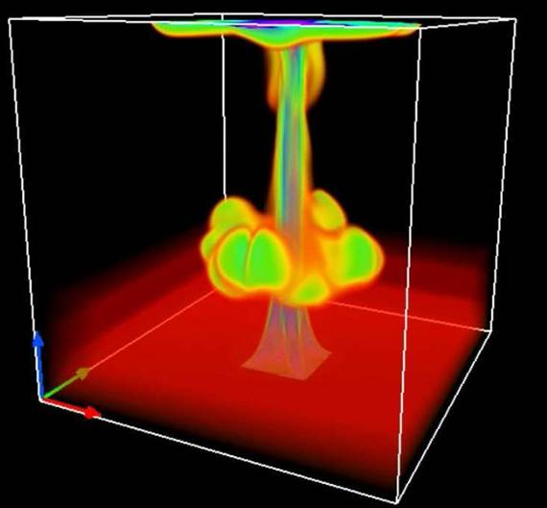
Northern’s Network Expansion for Large Science and Engineering Data Flows: Advancement
Undergraduate research and workforce development
Albuquerque’s Prosperity site (utility company) to NNMC (finalist Platts Global Energy Award)
Undergraduate research and workforce development
Plant genomics
3D convection modeling
National Center for Genome Resources (NCGR)

Slide 5
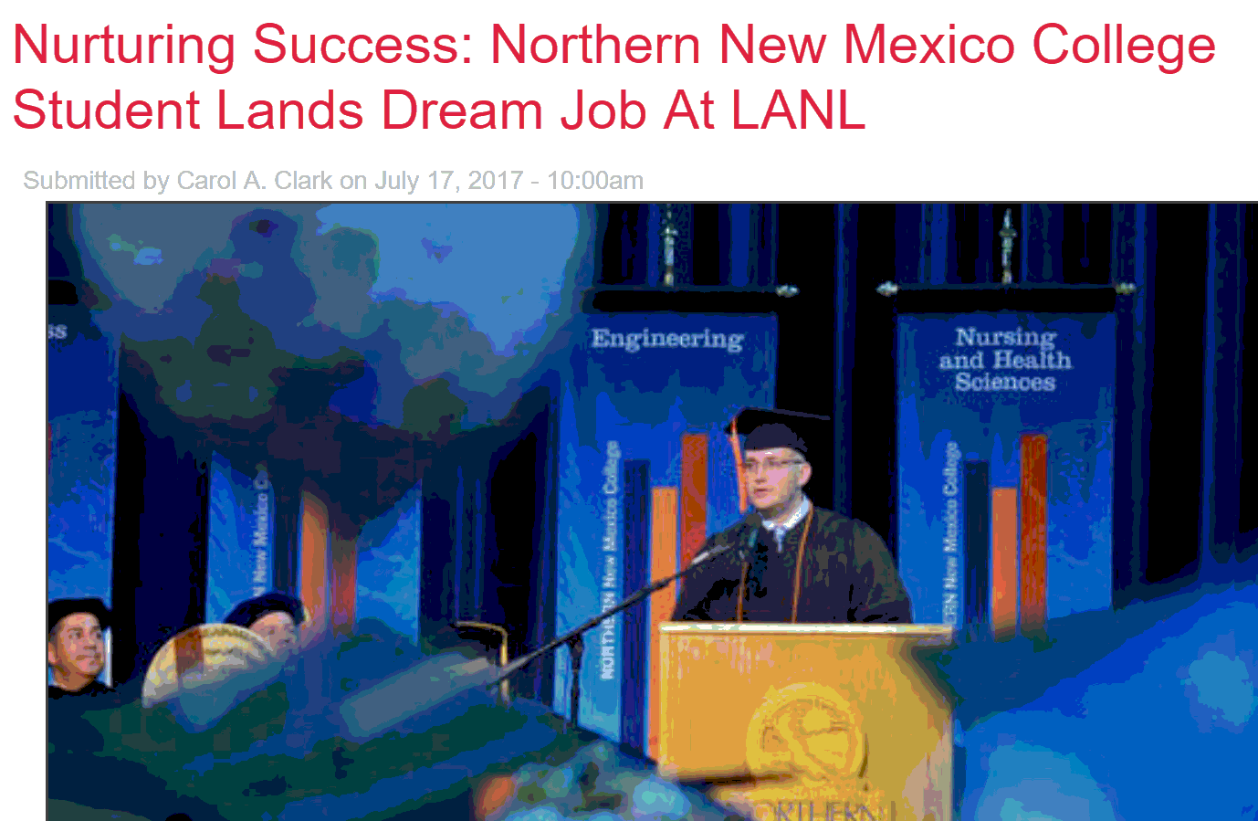



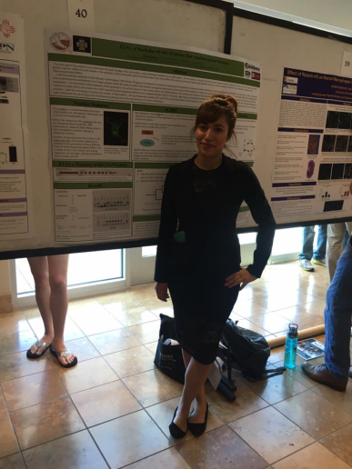
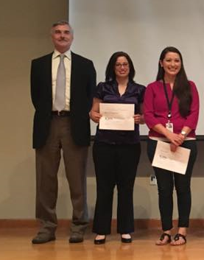
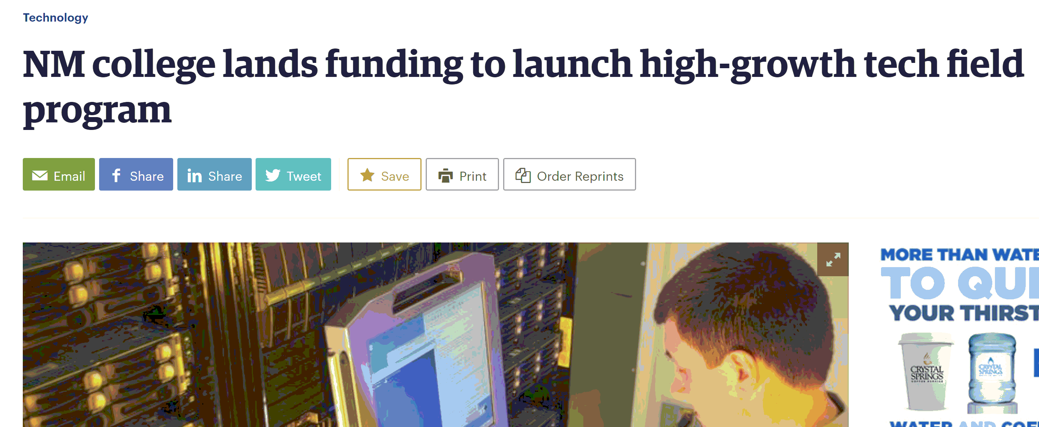

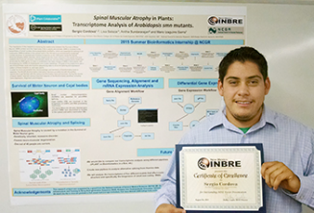
Northern’s Network Expansion for Large Science and Engineering Data Flows: Advancement
Science DMZ team, from left to right
Chase: Comp. Sys. Professional 2, LANL; Joseph: Scientist 1 at LANL, GA Tech Master program; Sergio: to graduate in Fall 2017, intern at LANL, Analysis, Intelligence, and Technology, plan to attend GA Tech
Los Alamos Daily, July 17, 2017
Albuquerque Business First, Aug. 24, 2017
Co-PI Biology team, NM IMBRE ‘16 Conf.
Top: Maria, Colo. State Research Symp. ’16, 2nd place award
Bottom: Britney, NM Biomedical Symp. ‘16
LANL – NNMC: Internship program, Biology and Information Engineering Technology, starting Spring 2018
1st place award, Bioinformatics; 2016 NM IMBRE conference

Slide 6
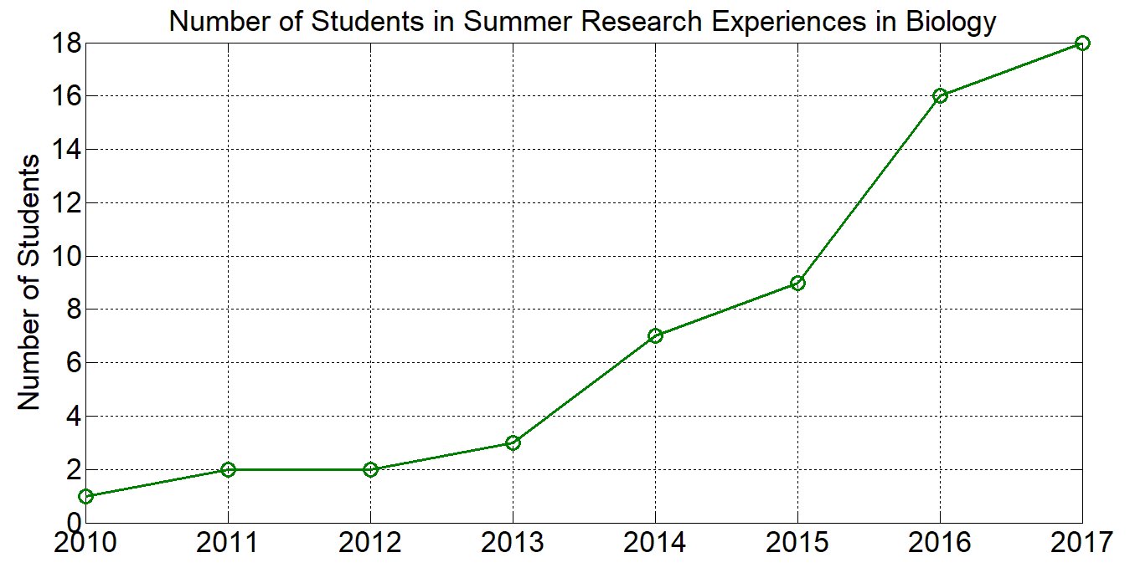
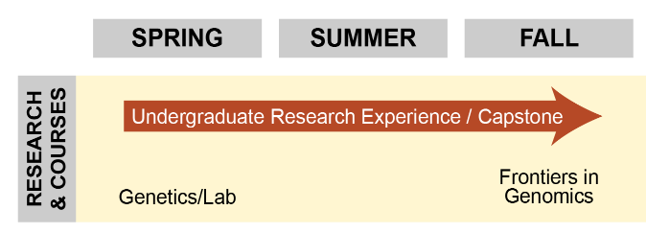

Northern’s Network Expansion for Large Science and Engineering Data Flows: Advancement
Undergraduate research and workforce development
LANL – NNMC
3-5 years for an employee to be fully involved
Need for technicians, 2-year / 4-year degrees
3.0 GPA, no drug history, get Q-clearance
Skills, aptitude, local, long-term employment
Information Engineering Technology program: 10 interns technicians starting Spring 2018
  To expand in cybersecurity
Sciences: radiation protection, radiation control: 10 interns technician starting Spring 2018
Bachelor graduates: analysts, net. engineers, Scientist I

Slide 7
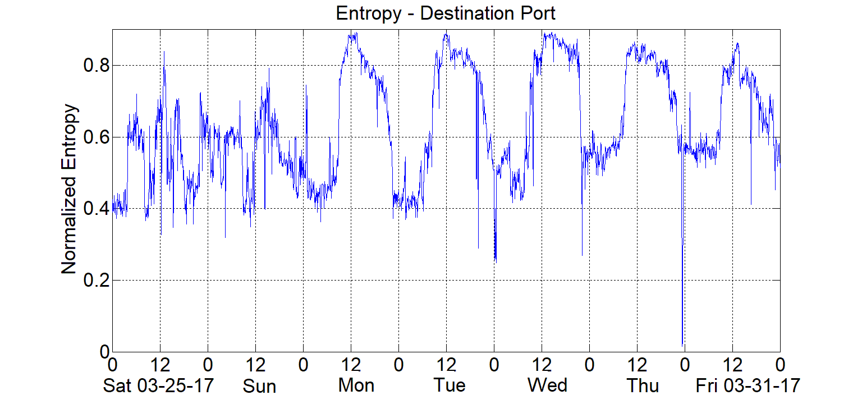
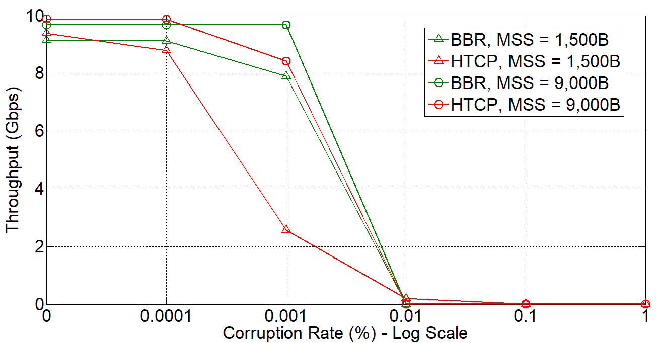
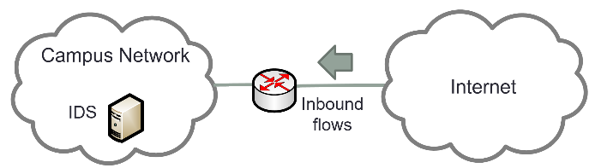
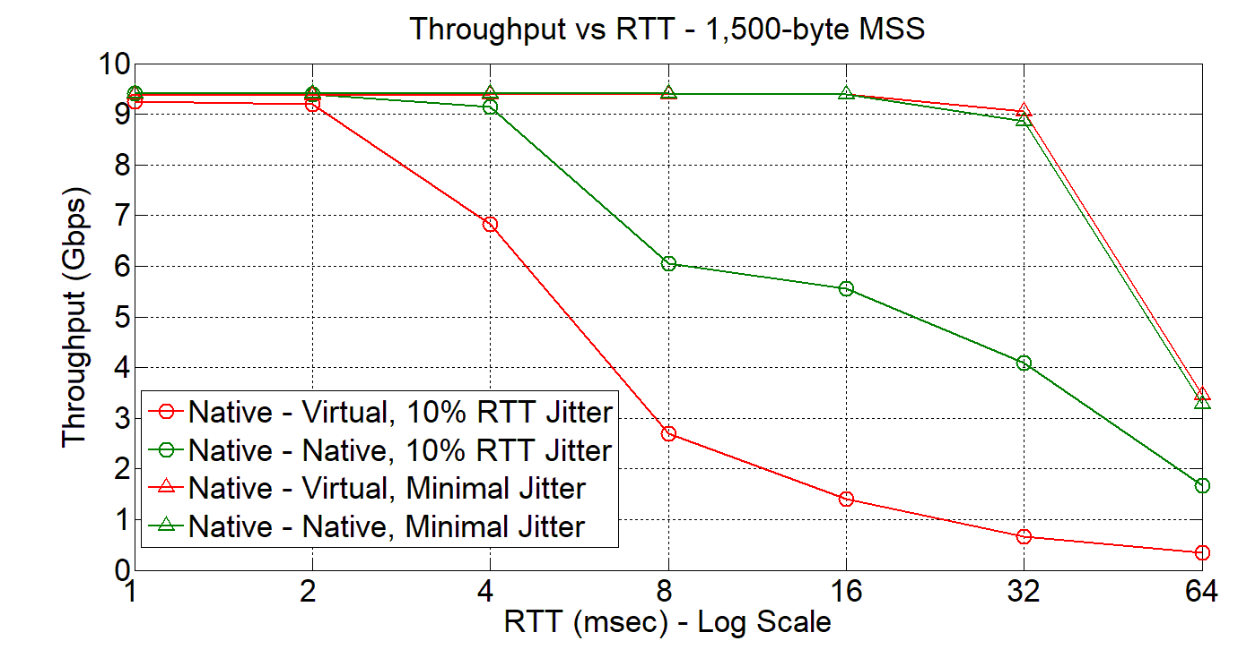
Northern’s Network Expansion for Large Science and Engineering Data Flows: Advancement
Window-based Vs Rate-based Congestion Control
Netflow-based IDS
Maximum Segment Size (MSS) Impact
Virtualization Effect on 10 Gbps Science DMZ
Notes:
Students use analytical skills, average, coefficient of variation, variance, etc. Hands-on, applicable, real-life, connection with abstract concepts, etc.

