Slide 1
Workshop on P4 Programmable Switches
Hands-on Session 2: Parser Implementation
Ali AlSabeh, Jorge Crichigno
College of Engineering and Computing, University of South Carolina
http://ce.sc.edu/cyberinfra
University of South Carolina (USC)
August 22, 2023

Slide 2
Parser Implementation
Lab activities are described in Lab 4, P4 Programmable Data Plane Switches (BMv2) Planes lab series

Slide 3
Programmable Parser
The parser enables parsing arbitrary headers with a finite state machine
The state machine defines the order of the headers within the packets
The packet is split into the defined headers and the remaining is treated as the payload

Slide 4
Packet Headers
The packet headers are specified by the programmer
The programmer has the flexibility of defining custom/non-standardized headers
Such capability is not available in non-programmable devices

Slide 5
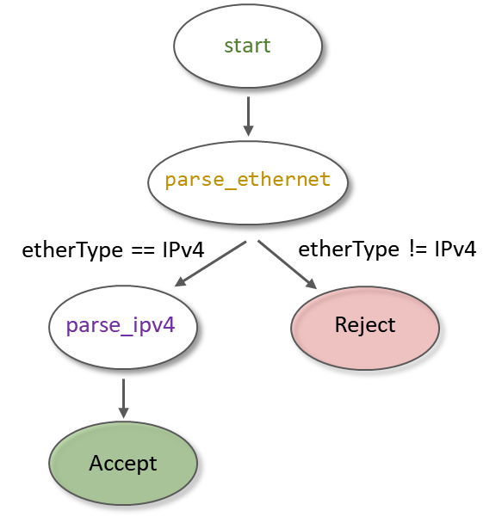
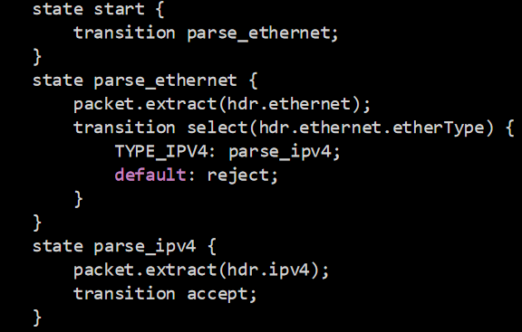
Programmable Parser
The parser enables declaring arbitrary headers with a finite state machine
The state machine defines the order of the headers within the packets

Slide 6
Lab Topology and Objectives
The topology consists of two hosts: h1 and h2; one P4 switch: s1
Defining the headers for Ethernet, IPv4 and IPv6
Implementing the parser
Testing and verifying the switch behavior when IPv4 and IPv6 packets are received

Slide 7
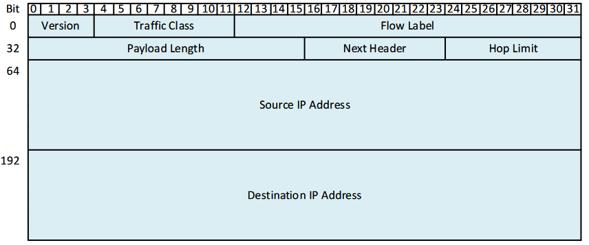
Headers Format
Ethernet header:
IPv4 header:
IPv6 header:

