Slide 1
Hands-on Workshop on
Open vSwitch and Software-defined Networking
Ali AlSabeh, Jorge Crichigno
University of South Carolina
http://ce.sc.edu/cyberinfra
aalsabeh@email.sc.edu, jcrichigno@cec.sc.edu
WASTC 2021 virtual Faculty Development Weeks (vFDW)
June 22, 2021

Slide 2
Interconnection between legacy networks and SDN networks

Slide 3
Potential Drawbacks of SDN
SDN networks have many advantages over traditional networks
Ease of network management
Enforcement of security policies
Customized network behavior
However, SDN is typically not fully deployed in networks due to several reasons
Limited budget for new network infrastructure
Fear of downtime during the transition to SDN
Limited training opportunities in SDN technology
R. Amin, M. Reisslein, N. Shah, Hybrid SDN networks: A survey of existing approaches, IEEE CST, Vol. 20, Issue: 4, 2018.

Slide 4
Potential Drawbacks of SDN
One possible solution to address these concerns is to deploy a limited number of SDN-enabled devices alongside the traditional (legacy) network devices
Incrementally replacing traditional network devices by SDN devices
The network can be converted in stages, targeting specific network areas for conversion and rolling out the changes incrementally
A network containing a mix of SDN and legacy network devices is referred to as a hybrid SDN network

Slide 5
Advantages of Hybrid SDN Networks
Hybrid SDN networks ease these budget concerns
Cost of replacing legacy devices by SDN devices
Train engineers to design, configure, and operate the SDN network
SDN provides fine-grained control for data traffic flows
If this is required for a small network portion, then SDN can be implemented in that portion only
Scenarios where two SDN networks are interconnected by legacy network devices require hybrid SDN network mechanisms

Slide 6
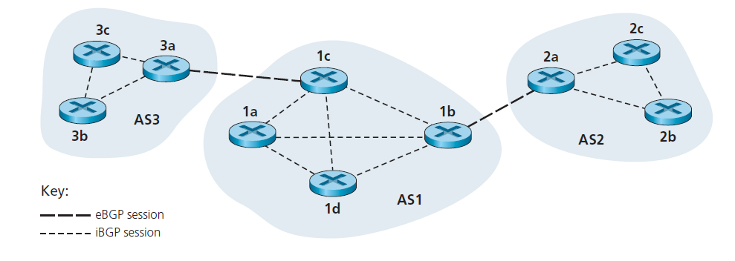
Border Gateway Protocol
The Border Gateway Protocol (BGP) version 4 is the standard inter-autonomous system (AS) protocol in today’s Internet
An AS is a group of routers that is under the same administrative control (e.g., ISP, company)
BGP is the “glue that holds the Internet together”
In BGP, pairs of routers exchange routing information over TCP (default port 179)
J. Kurose, K. Ross, Computer Networking: A Top-Down Approach, 7th Edition, Pearson/Addison Wesley, 2017.

Slide 7
Border Gateway Protocol
BGP provides each AS a way to:
Obtain reachability information from neighboring ASes (eBGP)
Propagate reachability information to internal routers (iBGP)
Determine “good” routes to other networks based on reachability information and policy
Allows a subnet to advertise its existence to rest of Internet: “I am here”
J. Kurose, K. Ross, Computer Networking: A Top-Down Approach, 7th Edition, Pearson/Addison Wesley, 2017.

Slide 8
Lab 8: Interconnection between legacy networks and SDN networks

Slide 9
Lab 8: Interconnecting Legacy and SDN networks
Two legacy networks connected to an SDN network
The SDN network consists of switches controlled by an ONOS controller
The ONOS controller interacts with an application referred to as SDN-IP
SDN-IP allows the SDN network to i) exchange BGP information with an iBGP router; and ii) translates routing information to SDN flow rules

Slide 10
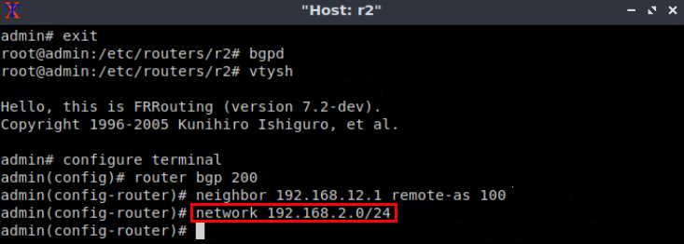
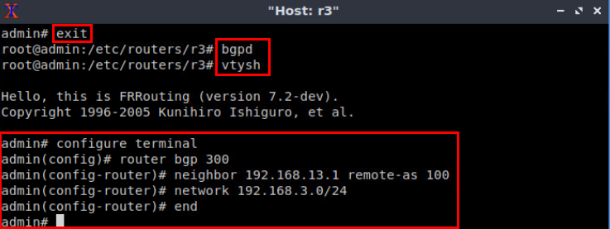
Configuring BGP in Legacy Networks
Router r2
Router r3

Slide 11
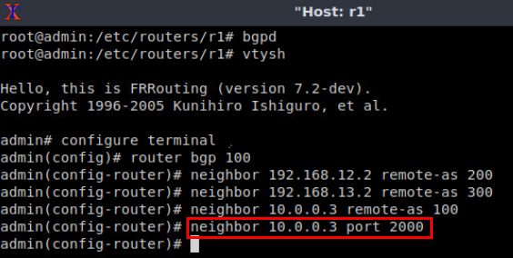
Configure BGP in SDN Network
Router r1

Slide 12
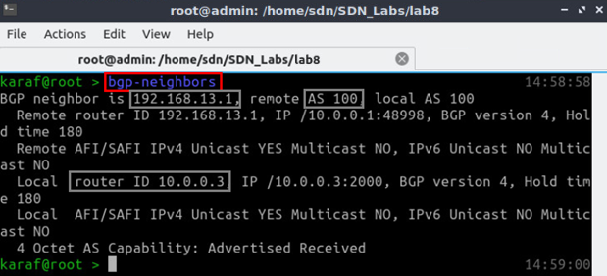
SDN-IP Application
ONOS CLI – BGP neighbors

Slide 13
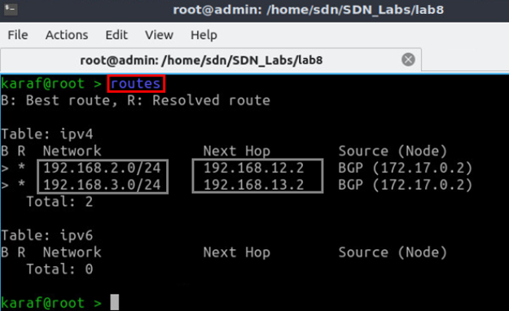
SDN-IP Application
ONOS CLI – advertised routes

Slide 14
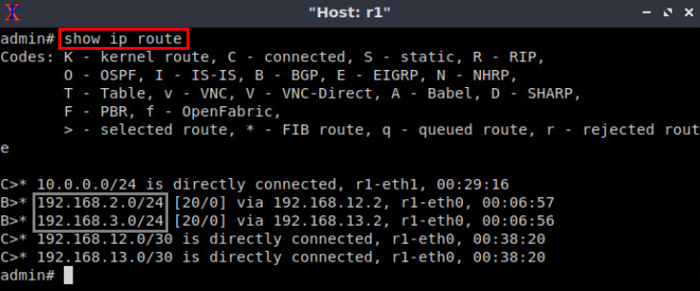
SDN Network
BGP table of router r1

Slide 15
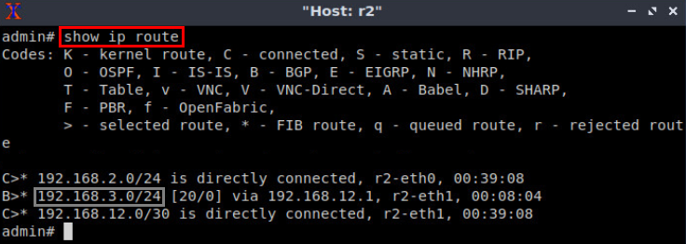
Legacy Network
Routing table of router r2

