Slide 1
Cybersecurity (Security+) and P4
Programmable Switches
An Overview of P4 Programmable Switches and
Motivation for Data Plane Programmability
Jorge Crichigno
University of South Carolina
http://ce.sc.edu/cyberinfra
Western Academy Support and Training Center (WASTC)
University of South Carolina (USC)
Energy Sciences Network (ESnet)
June 22nd, 2023

Slide 2
Agenda
Motivation
Limitations of traditional devices
Limitations of Software Defined Networking (SDN)
Data plane programmability
Evolution of computing industry
Fixed-function vs programmable
Essentials of P4 programmable switches
Advantages
Generalized forwarding: Match + Action
Protocol Independent Switch Architecture (PISA)

Slide 3
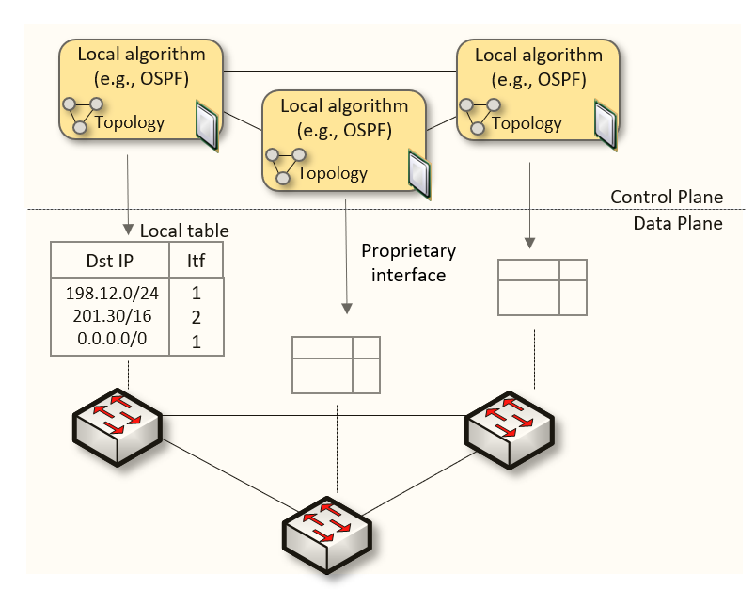
Traditional (Legacy) Networking
Since the explosive growth of the Internet in the 1990s, the networking industry has been dominated by closed and proprietary hardware and software
The interface between control and data planes has been historically proprietary
Vendor dependence: slow product cycles of vendor equipment, no innovation from network owners
A router is a monolithic unit built and internally accessed by the manufacturer only

Slide 4
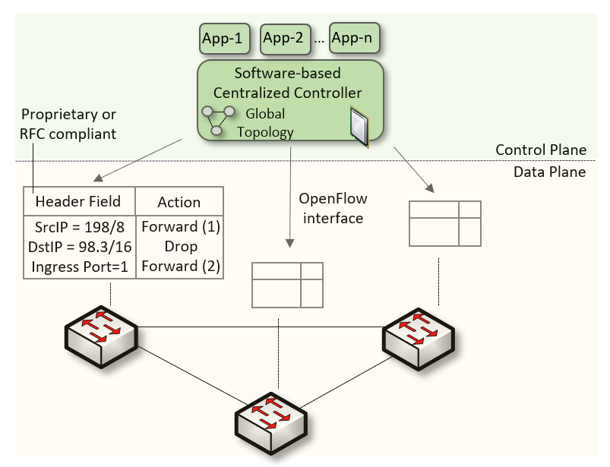
SDN
Protocol ossification has been challenged first by SDN
SDN (1) explicitly separates the control and data planes, and (2) enables the control plane intelligence to be implemented as a software outside the switches
The function of populating the forwarding table is now performed by the controller

Slide 5
SDN Limitation
SDN is limited to the OpenFlow specifications
Forwarding rules are based on a fixed number of protocols / header fields (e.g., IP, Ethernet)
The data plane is designed with fixed functions (hard-coded)
Functions are implemented by the chip designer

Slide 6
Can the Data Plane be Programmable?
“Programmable switches are 10-100 times slower than non-programmable ones. They are more expensive and consume more power”¹
1. Vladimir Gurevich, “Introduction to P4 and Data Plane Programmability,” https://tinyurl.com/2p978tm9.

Slide 7
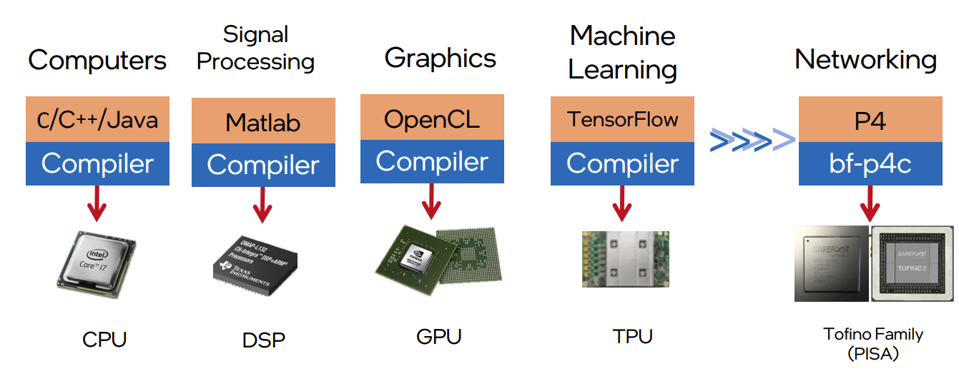
Can the Data Plane be Programmable?
Evolution of the computing industry
1970s 1970s-80s 1990s-2000s 2010s 2014
1. Vladimir Gurevich, “Introduction to P4 and Data Plane Programmability,” https://tinyurl.com/2p978tm9.

Slide 8
Can the Data Plane be Programmable?
“Programmable switches are 10-100 times slower than non-programmable ones. They are more expensive and consume more power”
The above assumption was challenged by a group of researchers at Stanford and Texas Instruments that led to “Barefoot Networks” in 2013
1. Vladimir Gurevich, “Introduction to P4 and Data Plane Programmability,” https://tinyurl.com/2p978tm9.

Slide 9
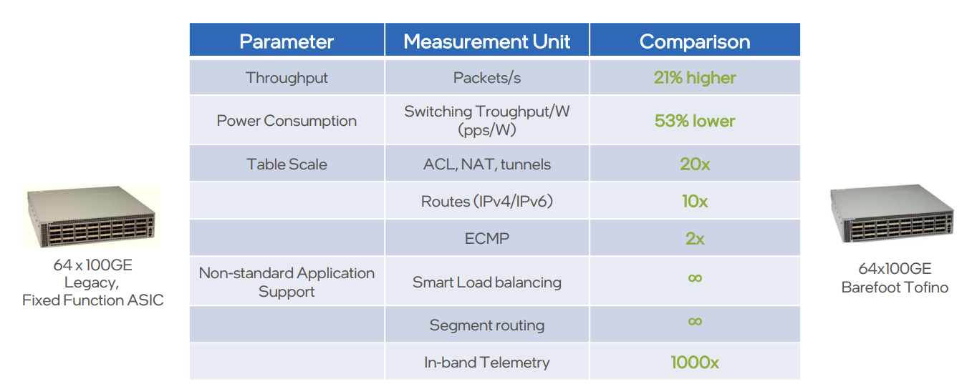
Can the Data Plane be Programmable?
Data plane comparison: fixed-function vs P4 programmable
1. Vladimir Gurevich, “Introduction to P4 and Data Plane Programmability,” https://tinyurl.com/2p978tm9.

Slide 10
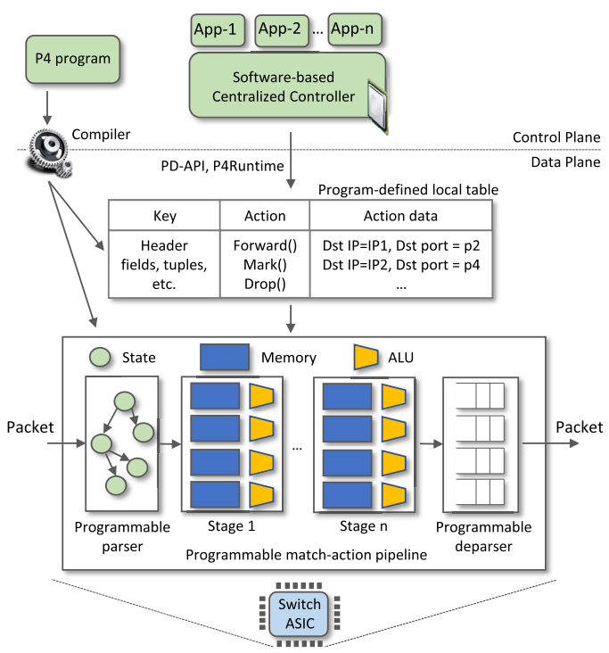
P4 Programmable Switches
P4¹ programmable switches permit a programmer to program the data plane
Define and parse new protocols
Customize packet processing functions
Measure events occurring in the data plane with
high precision
Offload applications to the data plane
1. P4 stands for stands for Programming Protocol-independent Packet Processors

Slide 11
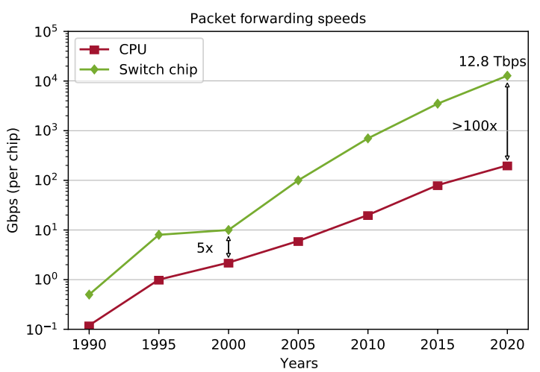
P4 Programmable Switches
P4¹ programmable switches permit a programmer to program the data plane
Define and parse new protocols
Customize packet processing functions
Measure events occurring in the data plane with
high precision
Offload applications to the data plane
Reproduced from N. McKeown. Creating an End-to-End Programming Model for Packet Forwarding. Available: https://www.youtube.com/watch?v=fiBuao6YZl0&t=4216s

Slide 12
Generalized forwarding: Match + Action
Each switch contains table/s
Match bits in arriving packet (match phase)
Take action - Many header fields can determine action (action phase)
Drop
Copy
Modify
Log packet
Forward out a link (destination-based forwarding is just a particular case)

Slide 13
PISA: Protocol Independent Switch Architecture
Match+Action Stage
Memory
ALU
Programmable Parser
Programmable Match-Action Pipeline
Reproduced from N. McKeown. Creating an End-to-End Programming Model for Packet Forwarding. Available: https://www.youtube.com/watch?v=fiBuao6YZl0&t=4216s

Slide 14
PISA: Protocol Independent Switch Architecture
Reproduced from N. McKeown. Creating an End-to-End Programming Model for Packet Forwarding. Available: https://www.youtube.com/watch?v=fiBuao6YZl0&t=4216s
14

Slide 15
Example P4 Program
Parser Program
Header and Data Declarations
Tables and Control Flow
parser parse_ethernet { extract(ethernet); return switch(ethernet.ethertype) { 0x8100 : parse_vlan_tag; 0x0800 : parse_ipv4; 0x8847 : parse_mpls; default: ingress; }
header_type ethernet_t { … }
header_type l2_metadata_t { … }
header ethernet_t ethernet;
header vlan_tag_t vlan_tag[2];
metadata l2_metadata_t l2_meta;
table port_table { … }
control ingress { apply(port_table); if (l2_meta.vlan_tags == 0) { process_assign_vlan();
} }
Memory
ALU
Programmable Parser
Programmable Match-Action Pipeline
Reproduced from N. McKeown. Creating an End-to-End Programming Model for Packet Forwarding. Available: https://www.youtube.com/watch?v=fiBuao6YZl0&t=4216s
15

Slide 17
U.S. Initiatives Related to P4 Programmable Switches
FABRIC (https://whatisfabric.net/)
>$20M investment by the U.S. National Science Foundation (NSF)
Analogous to Arpanet (predecessor of the Internet)
Adaptable programmable research infrastructure, for network research

Slide 18
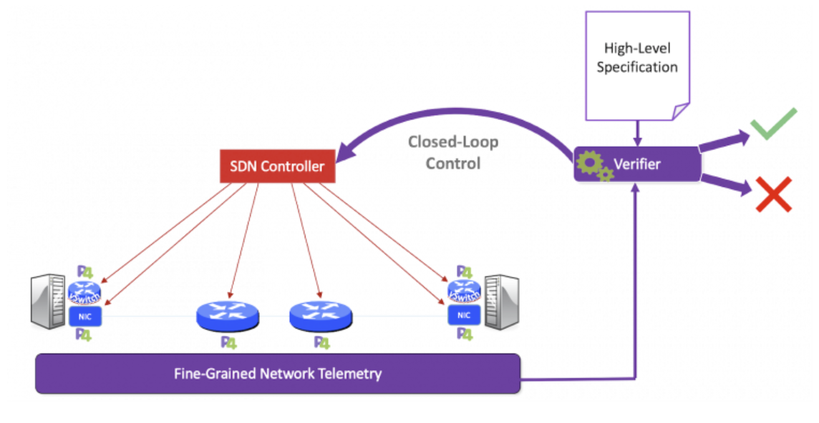
U.S. Initiatives Related to P4 Programmable Switches
Pronto Project (https://prontoproject.org)
$30M investment by the U.S. Department of Defense (DoD)
Project Pronto is building and deploying a beta-production end-to-end 5G connected edge cloud leveraging a fully programmable network empowered by unprecedented visibility, verification and closed-loop control

Slide 19
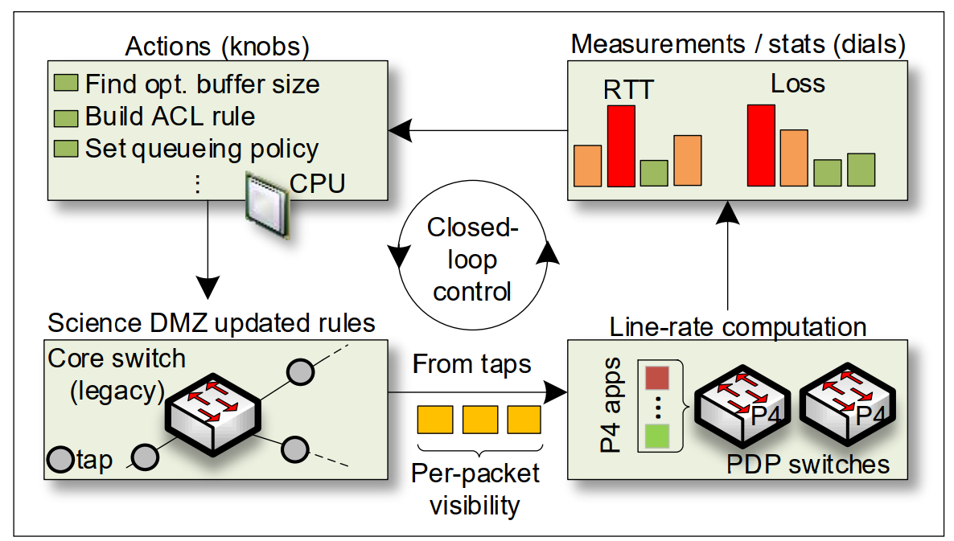
Projects – Cyberinfrastructure Lab at USC
Track flows in the data plane, fine-grained network measurements
Project funded by a business ($150,000)
Closed-loop control system

