Slide 1
Hands-on Open vSwitch and Software-defined Networking
Jorge Crichigno, Shahrin Sharif, Elie Kfoury
University of South Carolina
http://ce.sc.edu/cyberinfra
jcrichigno@cec.sc.edu, ssharif@email.sc.edu, ekfoury@email.sc.edu
​
WASTC 2021 virtual Faculty Development Weeks (vFDW)
June 24, 2021

Slide 2
Lab 4: Open vSwitch Flow Table

Slide 3
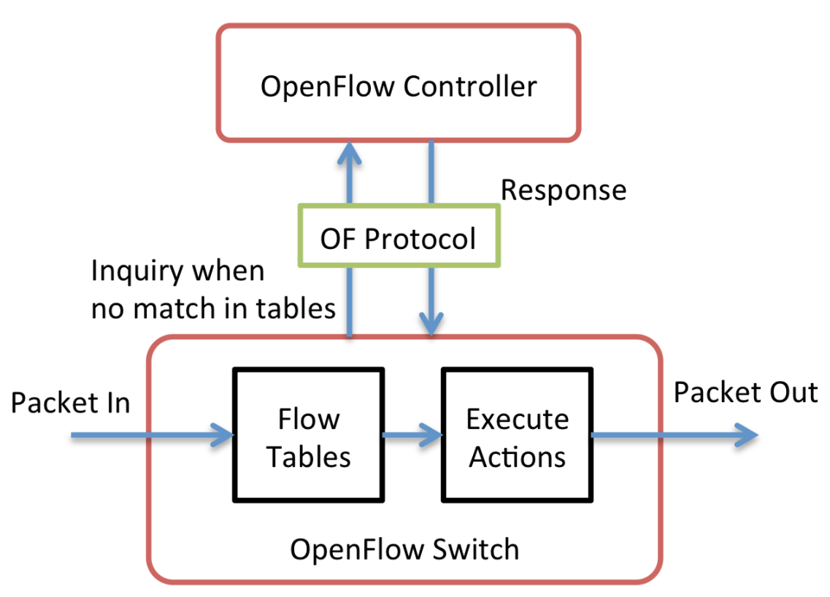
OpenFlow overview
OpenFlow is a protocol specification that describes the communication between OpenFlow switches and an OpenFlow controller
OpenFlow consists of three components
OpenFlow controller
OpenFlow protocol
OpenFlow switch

Slide 4
Flow Table
A flow table consists of flow entries
A flow entry consists of header fields, counters, and actions associated with that entry

Slide 5
Lab Topology
Switch s1 connected to hosts h1 and h2
Hosts h1 and h2 belong to network 10.0.0.0/8
The lab aims to demonstrate how to manage flows manually in the switch s1

Slide 6
Forwarding Using Layer 1
Everything that comes from s1-eth1 is sent out to s1-eth2
Everything that comes from s1-eth2 is sent out to s1-eth1

Slide 7
Forwarding Using Layer 2
Flow entries based on MAC addresses of the hosts

Slide 8
Forwarding Using Layer 3
Flow entries based on IP addresses of the hosts

Slide 9
Forwarding Using Layer 4
Flow entries based on TCP
A simple python web server is running in host h2
Host h1 can connect to the server using port 80

Slide 10
Setting Match Priority
Packets are matched against flow entries based on prioritization

