Slide 1
Understanding, Detecting, and Mitigating Denial-of-Service Attacks Using Next-Generation Firewalls
Brian Nelson, Dakota McDaniels
Department of Integrated Information Technology
University of South Carolina
December 1st, 2020

Slide 2
Agenda
Purpose
Introduction
Problem description
Background information
Denial-of-Service (DoS) and Distributed Denial-of-Service (DDoS) Attacks
Next-generation Firewalls (NGFWs)
Proposed solution and implementation
Conclusion

Slide 3
Purpose
Understand DoS/DDoS
Understand mitigation of DoS/DDoS
Implement mitigation practices
Observe mitigation in effect

Slide 4
Introduction
Denial-of-Service (DoS) and Distributed Denial-of-Service (DDoS) are a leading threat to many businesses, government entities, and citizens
Characteristics of DoS attacks
Simple to complete
Effective against small networks/ single target
Detection is not difficult
Damage/risk potential is low
Characteristics of DDoS attacks
Require multiple attackers
Usually a botnet
Effective against small or large networks
Detection is not difficult
Mitigation can be complicated
Damage/risk potential is high

Slide 5
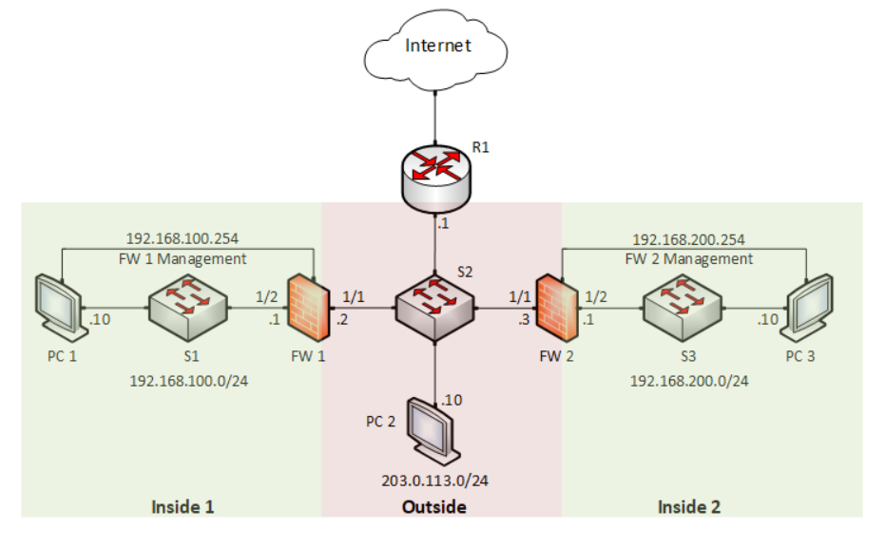
Problem Description
Volatile network connectivity
Random disruptions of services
Suspected malicious activity
Currently, there are no measures taken for threat detection and mitigation
Figure 1. Effectiveness of DDoS Filtering on Next-Generation Firewalls - Topology

Slide 6
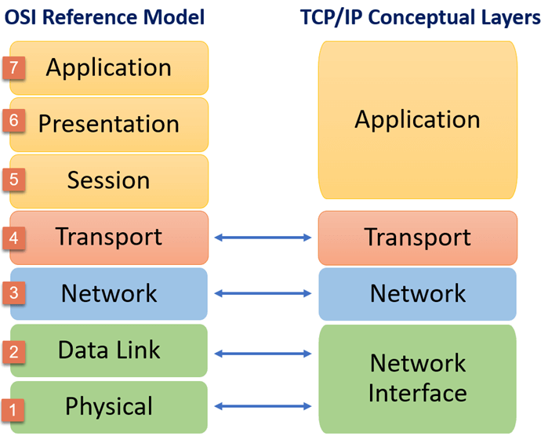
Background Information
Next-Generation firewalls
Configuration
Objects
Policies
TCP/IP and OSI model
Figure 2. TCP/IP Model: Layers &amp; Protocol: What is TCP IP Stack? (n.d.). Retrieved November 12, 2020, from https://www.guru99.com/tcp-ip-model.html.

Slide 7
Proposed Solution and Implementation
PaloAlto Next-Generation Firewall
Configure detection methods
View and understand logs
Configure the firewall mitigation measures
Configure DoS Protection Object and Policy
View mitigation
Logs
Hands-on exercise

Slide 8
Conclusion
Why is this work important?
Future projects/concepts with this knowledge
Questions?
Thank you for listening and watching

