Slide 1
Using External Dynamic List for Live Threat Updates
Zachary Fowler
Bryson Livingston
Advisor: Jorge Crichigno, Ali Alsabeh
Department of Integrated Information Technology
University of South Carolina
April 2021

Slide 2
Agenda
Introduction
Problem Description
Background Information
Proposed Solution and Implementation
Conclusion

Slide 3
Introduction
Next Generation Firewalls (NGFWs) use security policies to block/allow traffic from specified sources and destinations
Security policies on NGFWs need to frequently updated to protect against new threats
External Dynamic Lists (EDL) are used to keep security policies up to date

Slide 4
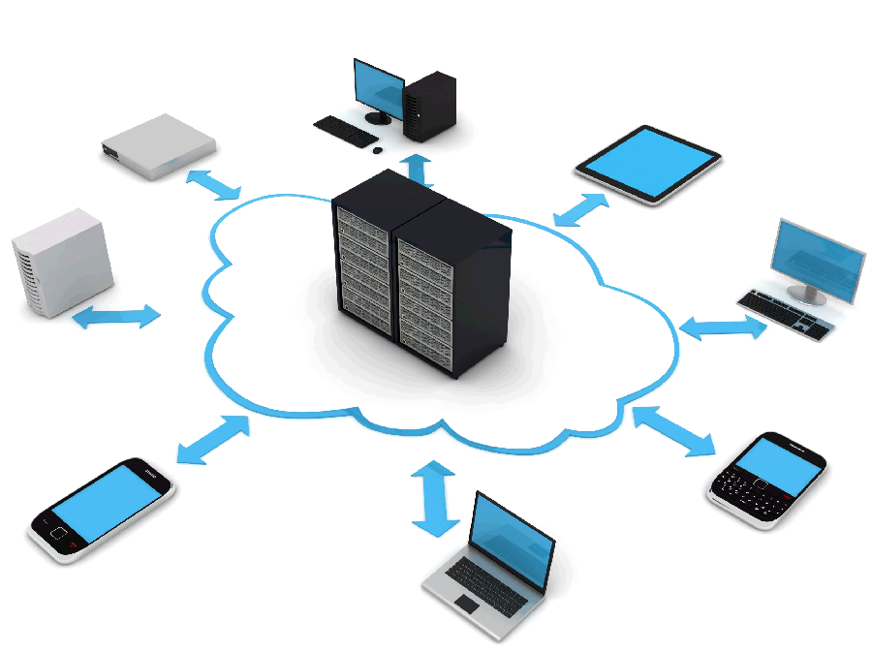
Problem Description
Using a non-dynamic list of objects in a security policy has multiple issues
Does not automatically update to include new threats
Policy creator will constantly have to manually update the list to include new threats
Ultimately leads to a less secure network
External Dynamic Lists solve both issues

Slide 5
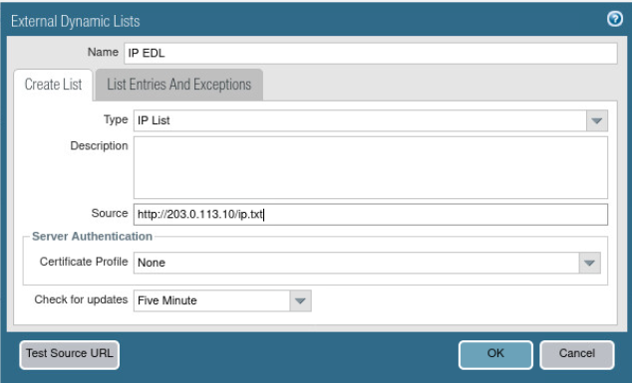
Background Information
External Dynamic Lists (EDL) are text files stored on an external server
The text files are updated frequently to protect from new threats
Text files contain lists of one of 4 types of EDL
IP Address
URL
Domain
Predefined IP Address
These lists consist of dangerous source and destination objects
Used in security policies on NGFW

Slide 6
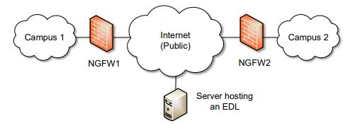
Proposed Solution and Implementation
A text file (i.e. list of malicious IP addresses) is hosted on the external server
NGFW1 uses the text file in a new security policy to block traffic to and from any IP address on the file
NGFW1 dynamically imports the list at the configured interval and enforces policy without the need to make a configuration change or a commit on the firewall

Slide 7
Proposed Solution and Implementation
Security Policy #1 uses the IP EDL in the address column to deny traffic to any IP address on the EDL

Slide 8
Conclusion
With the use of External Dynamic Lists in security policies, users can more easily protect their networks from dangerous sources by using frequently updated object lists
The possibility of an attack from a dangerous source significantly decreases with the use of EDLs

