Slide 1
“Enhancing the Preparation of
Next-generation Cyber Professionals”
ONR Project N00014-19-S-F009
Jorge Crichigno
August 31, 2021

Slide 2
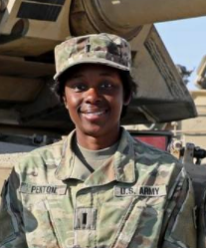
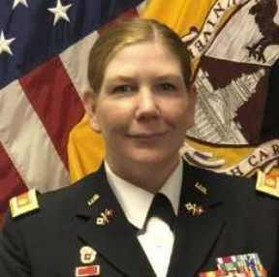
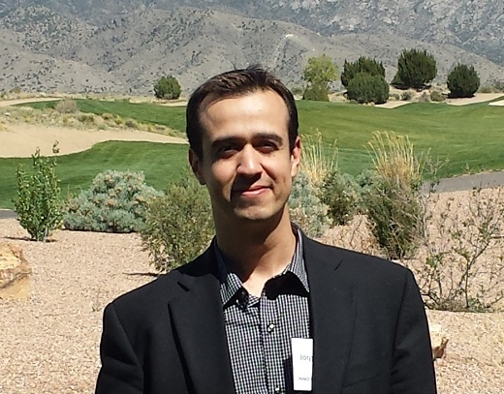

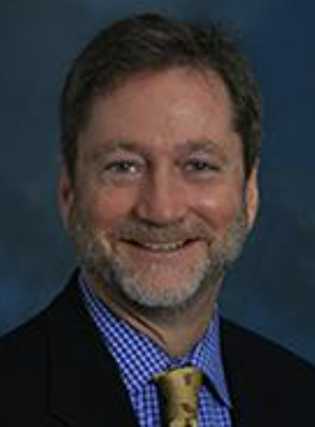
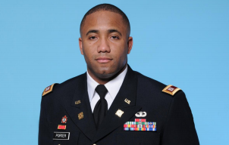
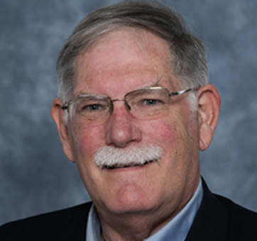
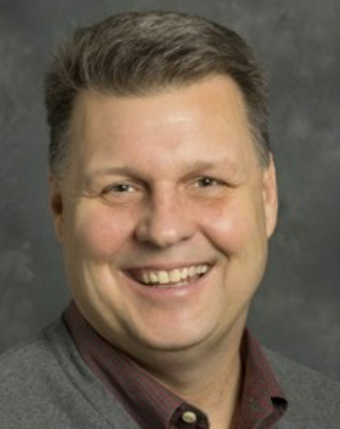
USC Team
Dr. Jorge Crichigno
(College of Engr. and Comp.)
Jodi Salter
(ROTC, Walker Institute)
1LT Ebony Penton
(ROTC Command)
MAJ Christina Knight
(Former ROTC Command, Co-PI)
MAJ Kala Brady
(ROTC Command)
Dr. Robert Cox
(Faculty, Cyber Intelligence)
MAJ Jason Porter
(Former ROTC Command)
Dr. John Gerdes
(College of Engr. and Comp.)
Anthony Dillon
(Internships)

Slide 3
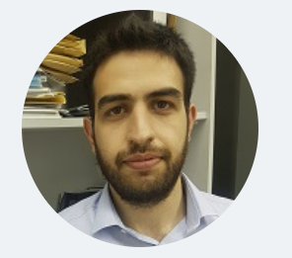
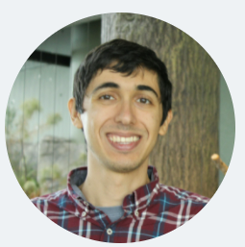
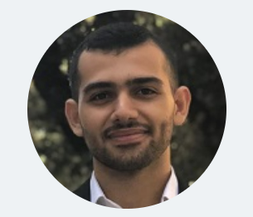
USC Team
Elie Kfoury
(Graduate Student)
Jose Gomez
(Graduate Student)
Ali AlSabeh
(Graduate Student)

Slide 4
Project Overview
Project title: “Enhancing the Preparation of Next-generation Cyber Professionals through a Hands-on Academic Program, Undergraduate Research Experiences, and Community Partnerships”
Period: July 22, 2020 – May 31, 2022

Slide 5
Project Overview
Goals:
1. Develop a cybersecurity concentration within an academic minor in Information Technology.
2. Establish an Undergraduate Research Program in Applied Cybersecurity.
3. Deploy virtual equipment pods on a virtual platform, accessible over the Internet, to support and facilitate the research and teaching activities from anywhere, without compromising hands-on experiences.
4. Establish meetings among industry, government, high schools, and higher-education institutions to enhance cybersecurity preparation.

Slide 6
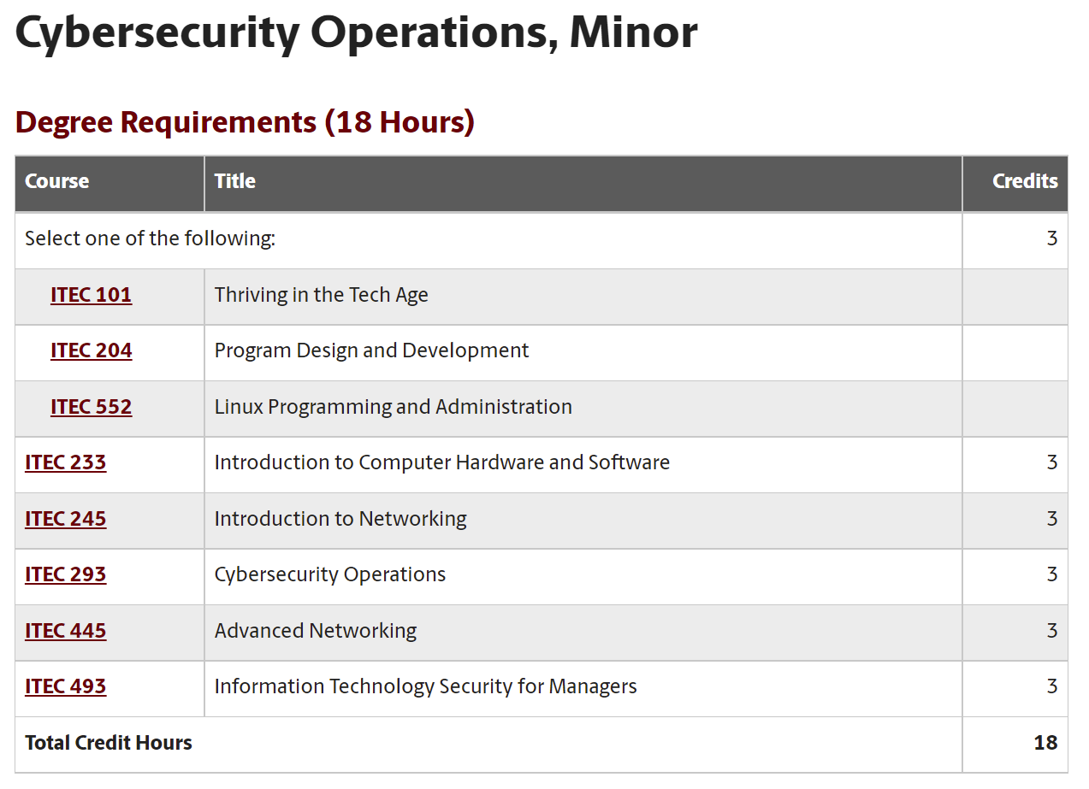
Project Overview
Goals:
1. Develop a cybersecurity concentration within an academic minor in Information Technology.
Status: Minor in Cybersecurity Operations is now offered, starting Fall 2021.
https://tinyurl.com/4mbj3z4k

Slide 7
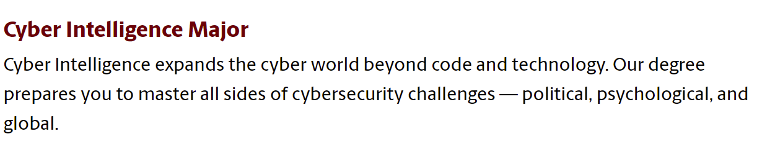
Project Overview
Goals:
1. Develop a cybersecurity concentration within an academic minor in Information Technology.
Status: Major in Cyber Intelligence is now offered, starting Fall 2021. Major includes the courses of the Cybersecurity Operations minor.
https://tinyurl.com/4x566mpu

Slide 8
Project Overview
Goals:
2. Establish an Undergraduate Research Program in Applied Cybersecurity.
Status: the program has been established and supports between 10-12 students per semester.
Cadet | Branch | Name | Semester | Project
1 | Navy | Christian S | Spring 2021 | Application ID
2 | Army | Brendan C | Fall 2020 | Protection against Bruteforce Attacks with NGFW
3 | Army | Jack S | Fall 2020 | Mitigating Routing Hijacking Attacks
4 | Army | Matthew D | Fall 2020 | Mitigating Routing Hijacking Attacks
5 | Army | Chris N | Fall 2020 | Protection against Reconnaissance and Scan Attacks
6 | Army | Jack S | Spring 2021 | Policy-based Forwarding
7 | Army | Matthew D | Spring 2021 | Policy-based Forwarding
8 | None | Keegan S | Fall 2020 | An open-source library for computer networks and cybersecurity
9 | None | Dakota M | Fall 2020 | Distributed Denial of Service (DDoS) Protection with Next Generation Firewalls (NGFWs)
10 | None | Lauren W | Fall 2020 | Protection against Bruteforce Attacks with NGFW
11 | None | Josue H | Fall 2020 | Site to site VPN with NGFWs
12 | None | Brian N | Fall 2020 | Distributed Denial of Service (DDoS) Protection with Next Generation Firewalls (NGFWs)

Slide 9
Project Overview
Goals:
2. Establish an Undergraduate Research Program in Applied Cybersecurity.
Status: the program has been established and supports between 10-12 students per semester.
Cadet | Branch | Name | Semester | Project
13 | None | Kyle R | Fall 2020 | Protection against Reconnaissance and Scan Attacks
14 | None | Ryan T | Fall 2020 | IPsec VPN with Routers
15 | None | Nathan B | Fall 2020 | Site to site VPN with NGFWs
16 | None | Bryson L | Spring 2021 | External Dynamic List
17 | None | Ryan T | Spring 2021 | IPsec VPN with Next Generation Firewalls
18 | None | Brad W | Spring 2021 | Application ID
19 | None | Zach F | Spring 2021 | External Dynamic List
20 | None | Nathan L | Spring 2021 | Geoblocking
21 | None | Ty L | Spring 2021 | Geoblocking

Slide 10
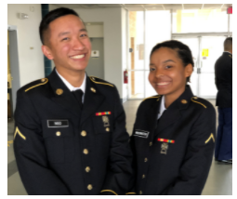
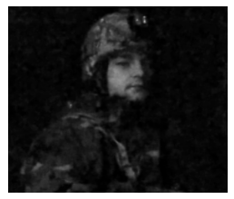
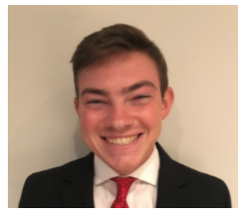
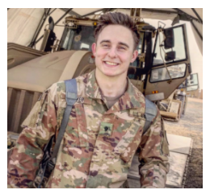
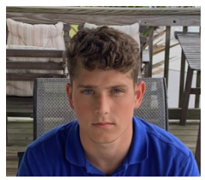
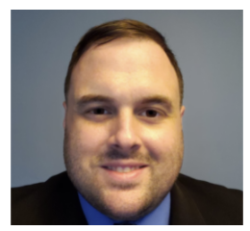
Project Overview
Goals:
2. Establish an Undergraduate Research Program in Applied Cybersecurity.
Status: the program has been established and supports between 10-12 students per semester.
Chris Ngo
Jack Sadle
Brendan Curran
ROTC cadets and veterans
Matt Driver
Christian Tsirlis
Ryan Tallent

Slide 11
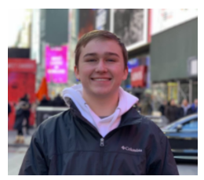
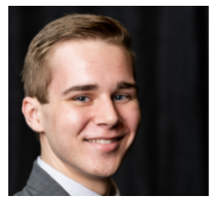
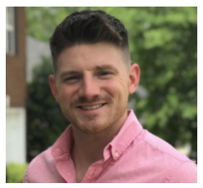
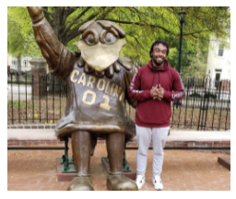
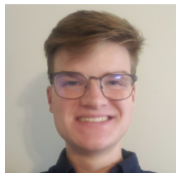
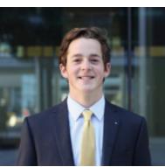
Project Overview
Goals:
2. Establish an Undergraduate Research Program in Applied Cybersecurity.
Status: the program has been established and supports between 10-12 students per semester.
Dakota McDaniels
Keegan Sprankle
Brian Nelson
CS and IT (STEM students)
Ty Love-Baker
Brad Wilson
Bryson Livingston

Slide 12
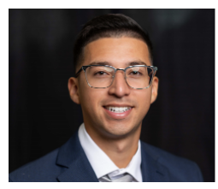
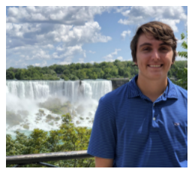
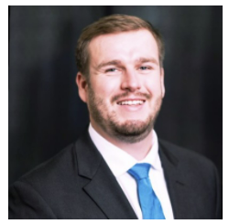
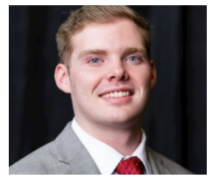
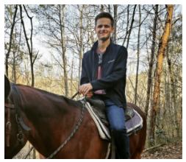
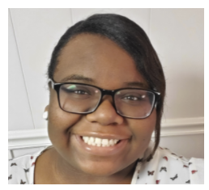
Project Overview
Goals:
2. Establish an Undergraduate Research Program in Applied Cybersecurity.
Status: the program has been established and supports between 10-12 students per semester.
Josue Hernandez
Nate Bohmer
Zach Fowler
CS and IT (STEM students)
Kyle Radzak
Lauren Waddell
Nathan Long

Slide 13
Project Overview
Goals:
2. Establish an Undergraduate Research Program in Applied Cybersecurity.
Status: the program has been established and supports between 10-12 students per semester.
Jack Sadle, ROTC
Name | Position
Ty Love-Baker | 2nd Lt. at United States Marine Corps, DC
Dakota McDaniel | Information Security Analyst at Lowe's
Lauren Waddell | IT Specialist, SC Department of Insurance
Josue Hernandez | Technical Solution Specialist at IBM
Kyle Radzak | IT Specialist at Lowe's Companies
Nathan Bohmer | Project Coordinator at Black Box Networks
Brad Wilson | IT Intern Savannah River National Lab
Zach Fowler | IT Intern at Blue Cross Blue Shield
Nathan Long | Technology Analyst at AIG
“During my semesters conducting research under ONR, I learned many valuable skills that would help me improve my chances at becoming a Cyber Operations Officer in the United States Army. The skills I learned during this period carried over into internships with 3rd Special Forces Group Cyber Effects Cell, as well as the Army Cyber Institute at West Point. Understanding the vulnerabilities with routing protocols greatly improved my value as a member of a research team examining malware and phishing attacks…”
Currently senior student, employed with UofSC’s IT and at the 359th Theater Tactical Signal Brigade, Headquarters Company.

Slide 14
Project Overview
Goals:
2. Establish an Undergraduate Research Program in Applied Cybersecurity.
Status: the program has been established and supports between 10-12 students per semester.
Brad Wilson, IT student
Name | Position
Ty Love-Baker | 2nd Lt. at United States Marine Corps, DC
Dakota McDaniel | Information Security Analyst at Lowe's
Lauren Waddell | IT Specialist, SC Department of Insurance
Josue Hernandez | Technical Solution Specialist at IBM
Kyle Radzak | IT Specialist at Lowe's Companies
Nathan Bohmer | Project Coordinator at Black Box Networks
Brad Wilson | IT Intern Savannah River National Lab
Zach Fowler | IT Intern at Blue Cross Blue Shield
Nathan Long | Technology Analyst at AIG
“I learned vital cybersecurity skills, such as creating policies with Application Identification rules, generating traffic to ensure security policies are operating appropriately, and reading logs to understand where traffic is traversing the network. The skills I learned during my ONR project were very similar to those skills needed to become part of the Networking/Perimeter team at Savanna River National Laboratory (SRNL), which protects the internal network… My managers [at SRNL internship] were very pleased with my knowledge and experience with next generation firewalls. As a result of my experience with ONR and previous internship at SRNL I was offered a full-time position contingent upon my graduation in May 2022”.
Currently senior student.
…

Slide 15
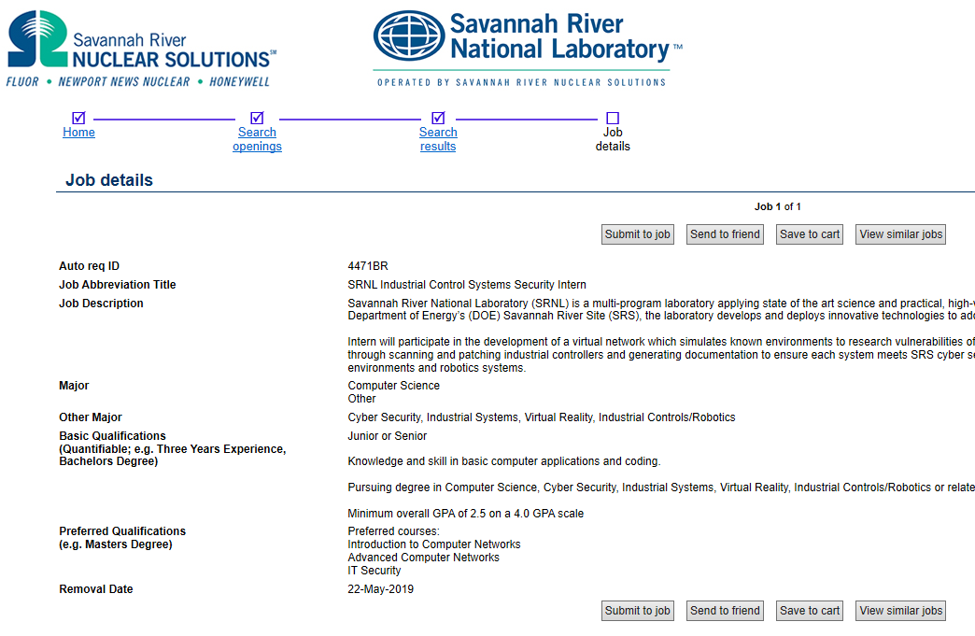
Project Overview
Goals:
2. Establish an Undergraduate Research Program in Applied Cybersecurity.
Status: the program has been established and supports between 10-12 students per semester.

Slide 16
Project Overview
Goals:
Deploy virtual equipment pods on a virtual platform, accessible over the Internet, to support and facilitate the research and teaching activities from anywhere, without compromising hands-on.
Status: local private cloud for teaching and research in cyber at UofSC. Live traffic, scalable.

Slide 17
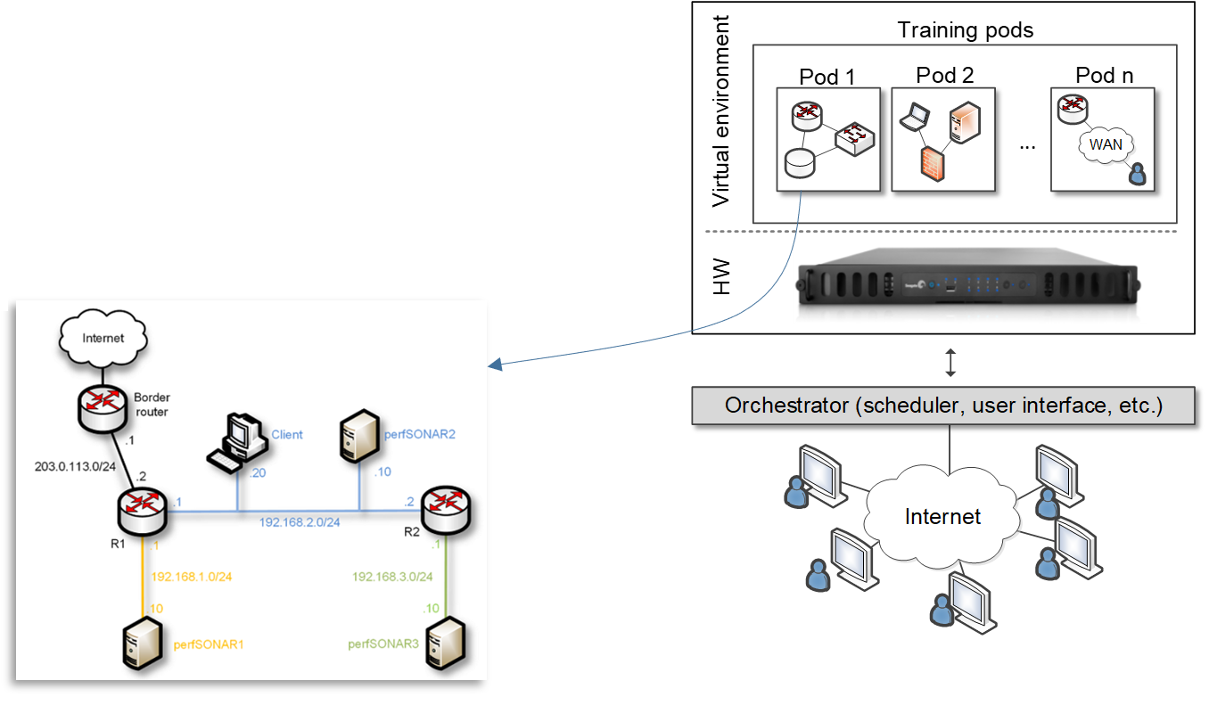
Project Overview
Goals:
Deploy virtual equipment pods on a virtual platform, accessible over the Internet, to support and facilitate the research and teaching activities from anywhere, without compromising hands-on.
Status: local private cloud for teaching and research in cyber at UofSC. Live traffic, scalable.

Slide 18
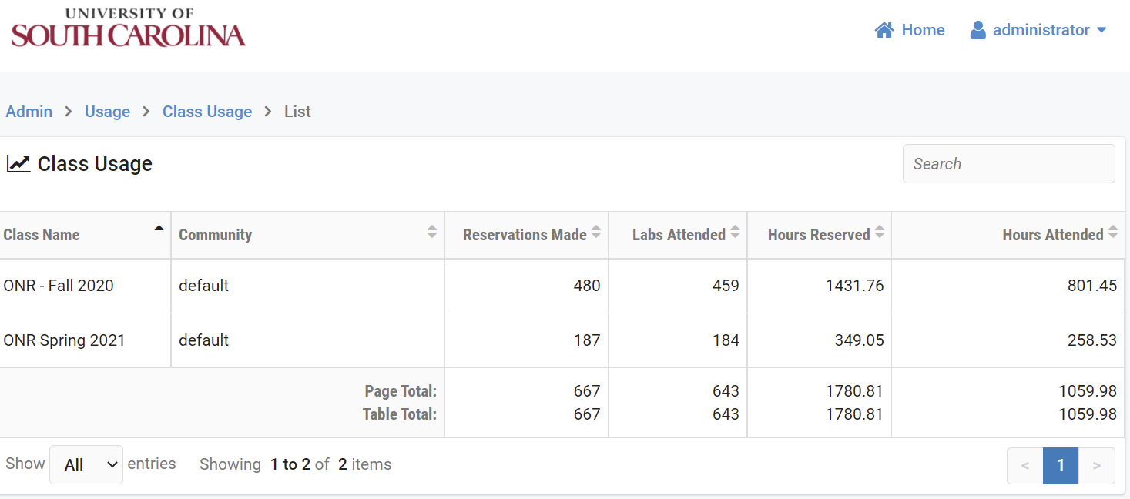
Project Overview
Goals:
3. Deploy virtual equipment pods on a virtual platform, accessible over the Internet, to support and facilitate the research and teaching activities from anywhere, without compromising hands-on.
Status: virtual equipment pods have been deployed on a virtual platform, accessible over the Internet. It allows students to conduct all activities online. Servers are supporting the system.

Slide 19
Project Overview
Goals:
Establish meetings among industry, government, high schools, and higher-education institutions to enhance cybersecurity preparation.
Status: agreement with industry (Cisco, Palo Alto, and VMware, Intel) which provide professional tools and platforms. These, along with open-source tools, were used by students to conduct research.

Slide 20
Project Overview
Goals:
Establish meetings among industry, government, high schools, and higher-education institutions to enhance cybersecurity preparation.
Status: the program incorporates preparation for DoD’s approved baseline credentials¹ for Information Assurance Technical (IAT) positions, Cybersecurity Service Provider (CSSP) Analyst, and CSSP Incident Responder.
Cybersecurity courses with content for DoD’s Approved 8750 baseline certifications
Course | IAT 1-2 | CSSP Analyst | CSSP Incident Responder | Security Plus | NICE Framework Objectives
Intro to Computer Security |  |  |  | P | P
Cybersecurity Operations |  | P | P |  | P
Intro to Networks | P | P | P |  | P
IT Security for Managers |  |  |  | P | P
Advanced Networks | P | P | P |  | P
NICE: National Initiative for Cybersecurity Education
¹Department of Defense (DoD) Cyber Workforce Management Program Website. https://tinyurl.com/55t7sdnm

Slide 21
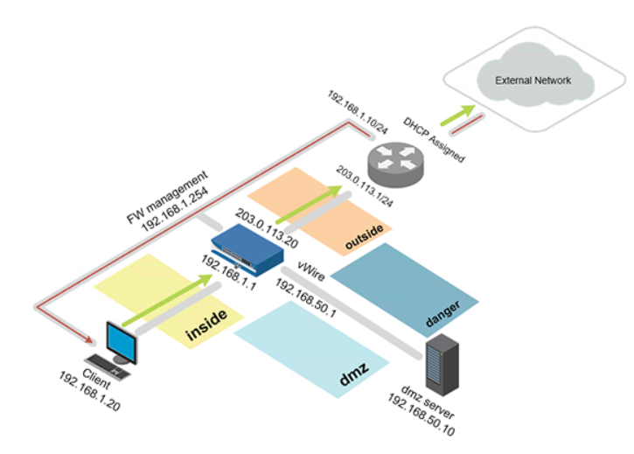
Project Overview
Goals:
Establish meetings among industry, government, high schools, and higher-education institutions to enhance cybersecurity preparation.
Status: industry partners allow us to use their tools and platforms
Next-generation Firewall Virtual Machine + licenses

Slide 22
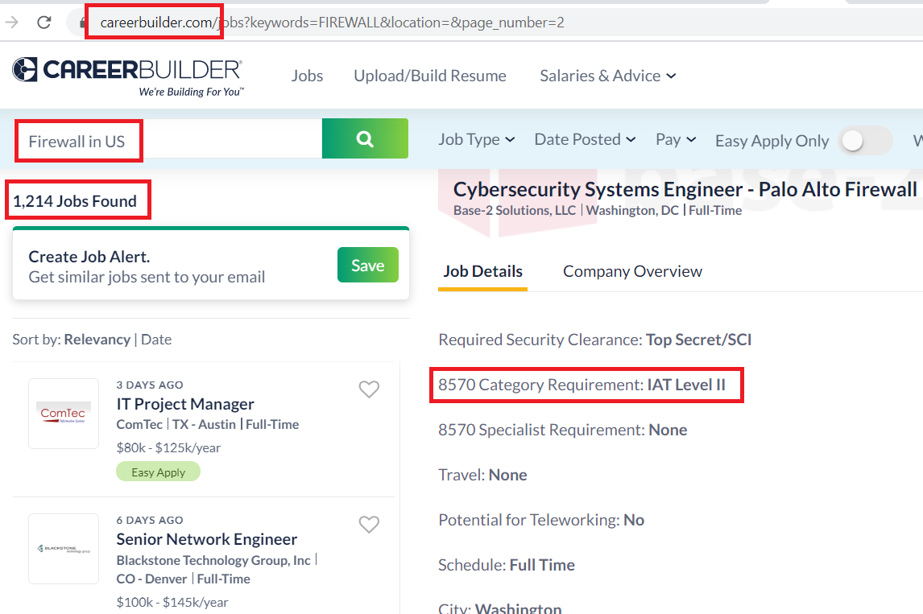
Project Overview
Goals:
Establish meetings among industry, government, high schools, and higher-education institutions to enhance cybersecurity preparation.
Status: industry partners allow us to use their tools and platforms
Job search

Slide 23
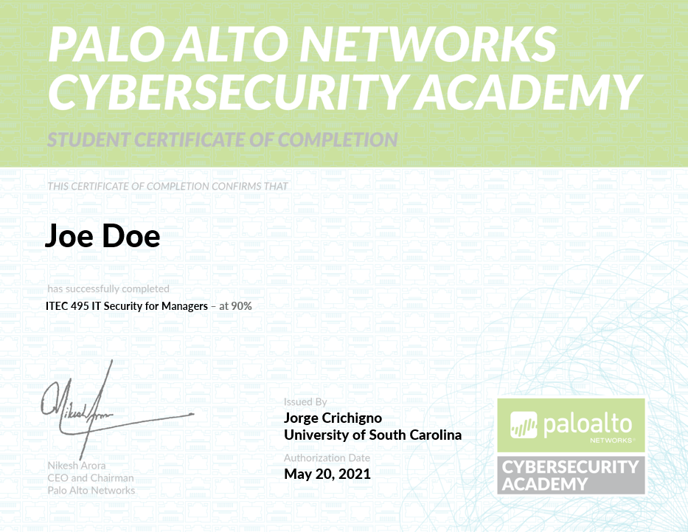
Project Overview
Goals:
Establish meetings among industry, government, high schools, and higher-education institutions to enhance cybersecurity preparation.
Status: industry partners allow us to use their tools and platforms
Additional credentials
Job search

Slide 24
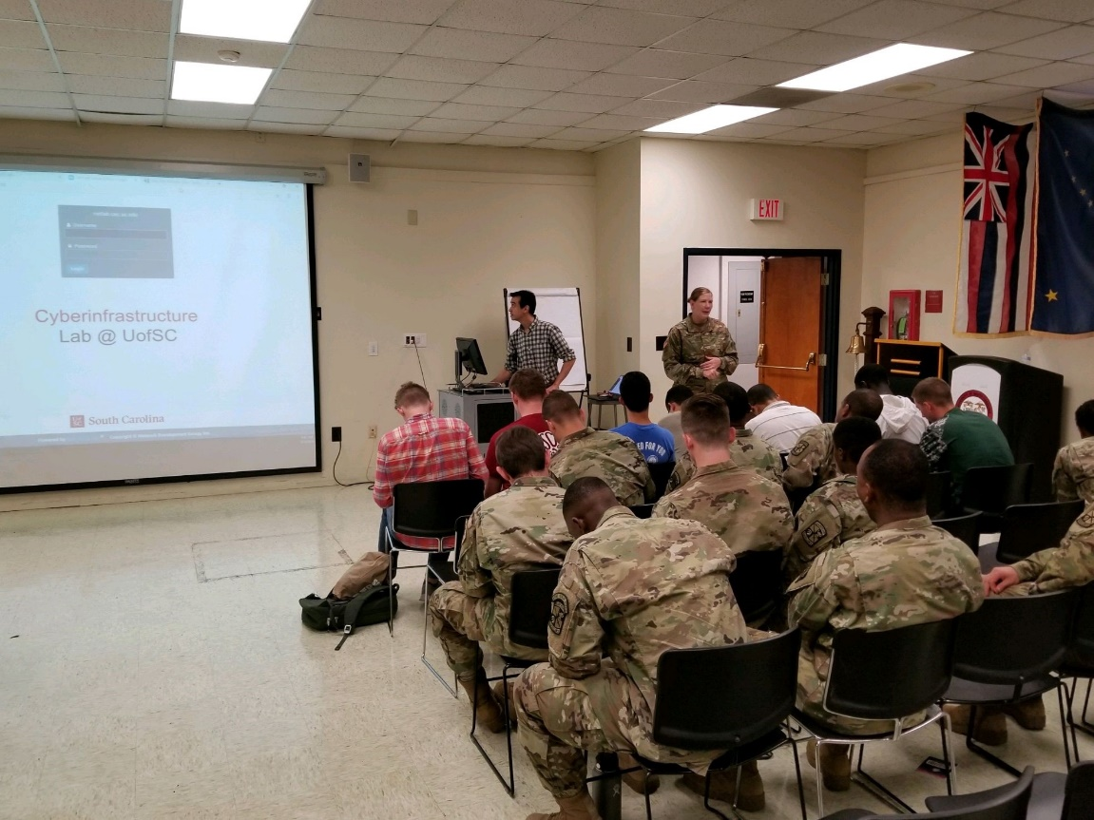
Project Overview
Goals:
Establish meetings among industry, government, high schools, and higher-education institutions to enhance cybersecurity preparation.
Status: industry partners allow us to use their tools and platforms
Additional credentials
USC’s ROTC

Slide 25
Project Overview
Goals:
Establish meetings among industry, government, high schools, and higher-education institutions to enhance cybersecurity preparation.
Status: workshops open to the public
Two workshops: one in the Spring (Spring 2021) (~80 people) and another in the Fall (December 2020) (> 100 people). These events enabled students to showcase the research work. The presentations and videos of the work presented during the workshops can be found online at:
Workshop Fall 2020: http://ce.sc.edu/cyberinfra/onr_workshop.html
Workshop Spring 2021: http://ce.sc.edu/cyberinfra/onr_workshop_spring_2021.html

Slide 26
Project Overview
Goals:
Establish meetings among industry, government, high schools, and higher-education institutions to enhance cybersecurity preparation.
Status: we have made the platform available to other institutions, establishing agreements with government, high schools, and other higher-education institutions.
  Berkeley National Lab
  SANS institute (“girlsgocyber”)
  Multiple higher-ed institutions
  International Networks at Indiana
  Fort Gordon (2 cyber courses)
  Texas’ Lonestart Education and Research
  U.S. Army Cyber Center of Excellence (CCoE) (Signal School)

Slide 27
Project Overview
Goals:
Establish meetings among industry, government, high schools, and higher-education institutions to enhance cybersecurity preparation.
Status: increased relation with agencies and industries, internships. We are organizing a pre-internship course, hosting speakers from industry
 | DATE | NAME | COMPANY
1 | 28-Aug-20 | Ron Scherba | Google
2 | 31-Aug-20 | Angie Greenwood | Blue Cross / Blue Shield
3 | 4-Sep-20 | Jeff Ruble | Richland Co. Economic Development
4 | 9-Sep-20 | Kaitlyn Flake | Capgemini
5 | 11-Sep-20 | Lewann Belton | Savannah River Site - SRS
6 | 14-Sep-20 | Lucio Bicalho | Electrolux
7 | 16-Sep-20 | Stephen Lariviere | SPAWAR / NIWC
8 | 18-Sep-20 | David Nance | Amarok
9 | 21-Sep-20 | Willis Cantey | Cantey Tech
10 | 23-Sep-20 | Neil Stanley | Microsoft
11 | 25-Sep-20 | Lari Young | Crowd Strike
12 | 28-Sep-20 | Doug Foster | USC - DoIT
13 | 30-Sep-20 | Chris Reeder | ACS Technologies

Slide 28
Project Overview
Goals:
Establish meetings among industry, government, high schools, and higher-education institutions to enhance cybersecurity preparation.
Status: increased relation with agencies and industries, internships. We are organizing a pre-internship course, hosting speakers from industry
 | DATE | NAME | COMPANY
13 | 30-Sep-20 | Chris Reeder | ACS Technologies
14 | 2-Oct-20 | Elvin Boone | Blackboard
15 | 5-Oct-20 | David Ulmer | SC DHHS
16 | 7-Oct-20 | Aubrey Hawes | Oracle
17 | 12-Oct-20 | Abby Blackwell | Scansource
18 | 14-Oct-20 | Roberto Dominguez | Hilti
19 | 16-Oct-20 | TJ Rich / Phillip Cockrell | SC Department of Administration
20 | 19-Oct-20 | Lola Jordan | Companion Data Services
21 | 21-Oct-20 | Caitlin Deltgen / Presley Pender | Gartner
22 | 23-Oct-20 | Jill Menhart | VC3
23 | 26-Oct-20 | Malik Walker | US Patent Office
24 | 28-Oct-20 | Amy Beekley | Lowes
25 | 30-Oct-20 | Tim Hutto | Fort Gordon / OSC Edge
26 | 2-Nov-20 | Elizabeth Gibbs | American Specialty Health

Slide 29
Project Overview
Goals:
Establish meetings among industry, government, high schools, and higher-education institutions to enhance cybersecurity preparation.
Status: increased relation with agencies and industries, internships. We are organizing a pre-internship course, hosting speakers from industry
 | DATE | NAME | COMPANY
27 | 4-Nov-20 | Erika Fosu | Vanguard
28 | 6-Nov-20 | Jeff McBride | AFL Global
29 | 9-Nov-20 | Jim Morris | SC Economics
30 | 11-Nov-20 | Cassius Rhue | SIOS
31 | 13-Nov-20 | Tracy Newkirk | ICAP Solutions
32 | 16-Nov-20 | Rachel Kehoe | Blackbaud
33 | 18-Nov-20 | Robert Cameron | Dell
34 | 20-Nov-20 | Amanda Mason | Global Lending Services
35 | 13-Jan-21 | Angie Greenwood | Blue Cross / Blue Shield
36 | 22-Jan-21 | Malik Walker / John Lau | US Patent Office
37 | 25-Jan-21 | Bethany LeClair | Thomson Construction
38 | 27-Jan-21 | Amy Beekley | Lowes
39 | 29-Jan-21 | Rachel Kehoe | Blackbaud

Slide 30
Project Overview
Goals:
Establish meetings among industry, government, high schools, and higher-education institutions to enhance cybersecurity preparation.
Status: increased relation with agencies and industries, internships. We are organizing a pre-internship course, hosting speakers from industry
 | DATE | NAME | COMPANY
40 | 1-Feb-21 | Jason Gibbs | Extra Hop
41 | 3-Feb-21 | Doug Foster | USC - DoIT
42 | 8-Feb-21 | Abby Blackwell | Scan Source
43 | 12-Feb-21 | Lide Winburn | Soft Docs
44 | 17-Feb-21 | Bob Kenney / Zane Reed | Fluor
45 | 19-Feb-21 | Phillip Cockrell / Thomas Rich | SC Department of Administration
46 | 22-Feb-21 | Lola Jordan | Companion Data Services
47 | 24-Feb-21 | Brianna Berry / Victoria Turner | Synnex
48 | 26-Feb-21 | Traci Newkirk | ICAP Solutions
49 | 1-Mar-21 | Willis Cantey | Cantey Tech
50 | 3-Mar-21 | John Webster | ACST
51 | 5-Mar-21 | Joe Smith | Verizon
52 | 10-Mar-21 | Tim Hutto | OSC Edge

Slide 31
Project Overview
Goals:
Establish meetings among industry, government, high schools, and higher-education institutions to enhance cybersecurity preparation.
Status: increased relation with agencies and industries, internships. We are organizing a pre-internship course, hosting speakers from industry
 | DATE | NAME | COMPANY
53 | 15-Mar-21 | Ron Scherba | Google
54 | 17-Mar-21 | Byron Doyle | DISA
55 | 19-Mar-21 | Jeff Ruble | Richland Co. Government
56 | 22-Mar-21 | Elizabeth Gibbs / David Cristinzio | American Specialty Health
57 | 24-Mar-21 | Paige O'Brien | Dell
58 | 26-Mar-21 | Cassius Rhue / Sajid Shaikh / Takofumi Noso | SIOS
59 | 29-Mar-21 | Ron Harvey | Global Core Strategies
60 | 2-Apr-21 | Jackie Chen / Robert Willm | Nephron Pharmaceuticals
61 | 5-Apr-21 | Jim Morris | SC Economics
62 | 7-Apr-21 | Aubrey Hawes | Oracle
63 | 9-Apr-21 | Jeff McBride | AFL Global
64 | 12-Apr-21 | Kaitlyn White | Capgemini
65 | 14-Apr-21 | Erica Fosu | Vanguard
66 | 16-Apr-21 | Randall Hugee | TIAA
67 | 19-Apr-21 | Juan DeFillippis | IBM

Slide 32
Project Overview – Future Plans
Promote Cyber Intelligence Major, Cybersecurity Operation Minor
Support the military, ROTC, National Labs, Internet2, training centers
Engage with industry, agencies
Expand, scale the virtual platform nationally (now serving thousands of learners)
Increase, disseminate training material

Slide 33
Project Overview – Future Plans
Promote Cyber Intelligence Major, Cybersecurity Operation Minor
Support the military, ROTC, National Labs, Internet2, training centers
Engage with industry, agencies
Expand, scale the virtual platform nationally (now serving thousands of learners)
Increase, disseminate training material
 | Workshop Title | Format | Dates | URL | Att.
1 | LEARN Hands-on Workshops for Network Engineers | Online | Sep 22-23, 2020 | http://ce.sc.edu/cyberinfra/workshop_2020_3.html | 30
2 | 2020 Midwest Academy Conference | Online | Sep 24-25, 2020 |  | 19
3 | WAST 2021 Winter Education Conference | Online | Jan 7-8, 2021 | https://www.wastc.org/events/wastc-2021-winter-ict-educators-conference | 305
4 | Academic Support Center Conferences | Online | April 6, 13, 20, 27 |  | 80
5 | NSF CC* Workshop | Online | Apr. 8, Apr. 15, 2021 | http://ce.sc.edu/cyberinfra/nsf_cc_workshop.html | 194
6 | Advanced Networking Topics: BGP, BGP Hijacking, MPLS, | Online | June 14-18, 2021 | http://ce.sc.edu/cyberinfra/workshop_2021_wast.html | 20
7 | Hands-on Workshop on Open vSwitch and SDN | Online | June 21-25, 2021 | http://ce.sc.edu/cyberinfra/workshop_2021_wast_2.html | 20
 |  |  |  | TOTAL | 668

