Slide 1
Using External Dynamic List for Live Threat Updates
David Williams
Tucker Baron
Advisors: Jorge Crichigno, Ali Alsabeh
Department of Integrated Information Technology
University of South Carolina
April 2022

Slide 2
Agenda
Introduction
Problem Description
Background Information
Proposed Solution and Implementation
Conclusion

Slide 3
Introduction
Next Generation Palo Alto Firewalls use security policies to monitor and block traffic from specific sources and destinations
New threats are discovered every day so the firewall needs to be updated regularly
External Dynamic Lists are used to keep security policies up to date

Slide 4
Problem Description
Using a non-dynamic list of objects in a security policy has multiple issues
Does not automatically update to include new threats
Policy creator will constantly have to manually update the list to include new threats
Ultimately leads to a less secure and harder to manage network
External Dynamic Lists make it easy to update the policy

Slide 5
Background Information
External Dynamic Lists (EDL) are text files stored on an external server
There are 3 types of External Dynamic Lists (EDL)
IP Address
URL
Domain
These lists consist of entries for items that need to blocked
Used in security policies on the Firewall

Slide 6
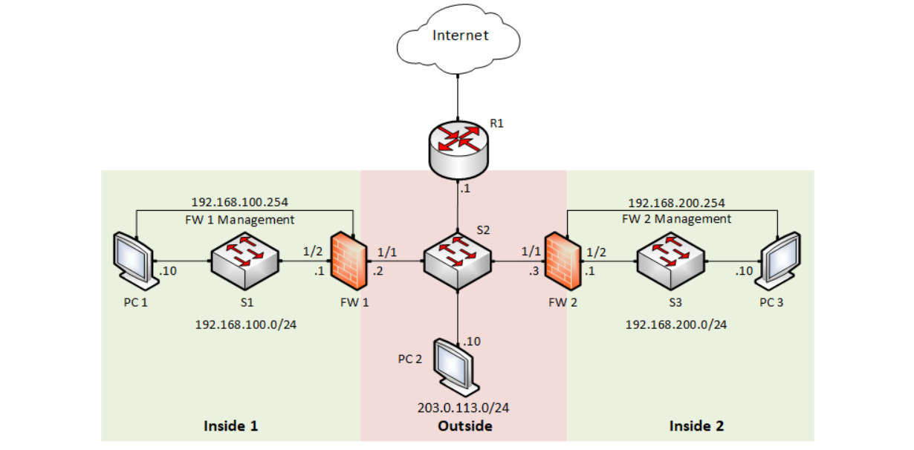
Proposed Solution and Implementation
A text file (i.e. list of IP addresses, Domains or URLs we want to block) is hosted on the external server
FW1 uses the text file in a new security policy to block traffic to and from any IP address, Domain or URL on the file
FW 1 will regularly update without having to commit any changes

Slide 7
Proposed Solution and Implementation
Configure a security policy that targets the items on the External dynamic list
Set it to block or monitor based on you needs

Slide 8
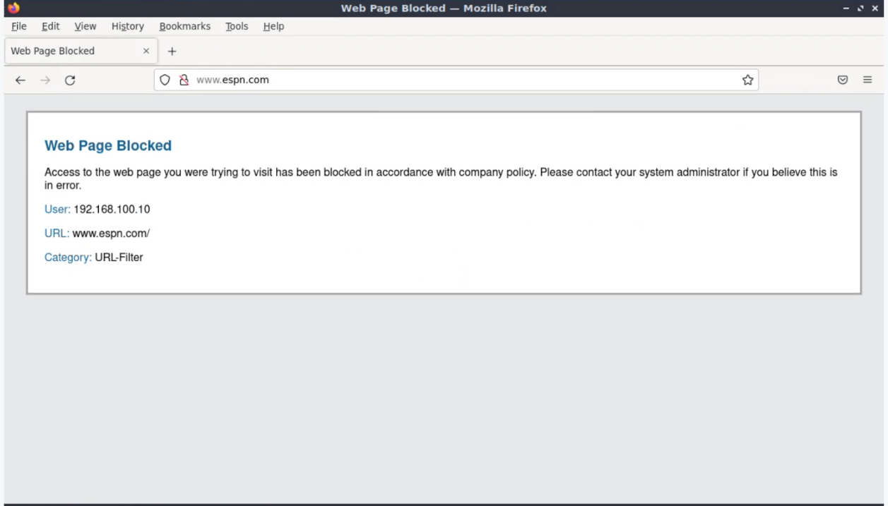
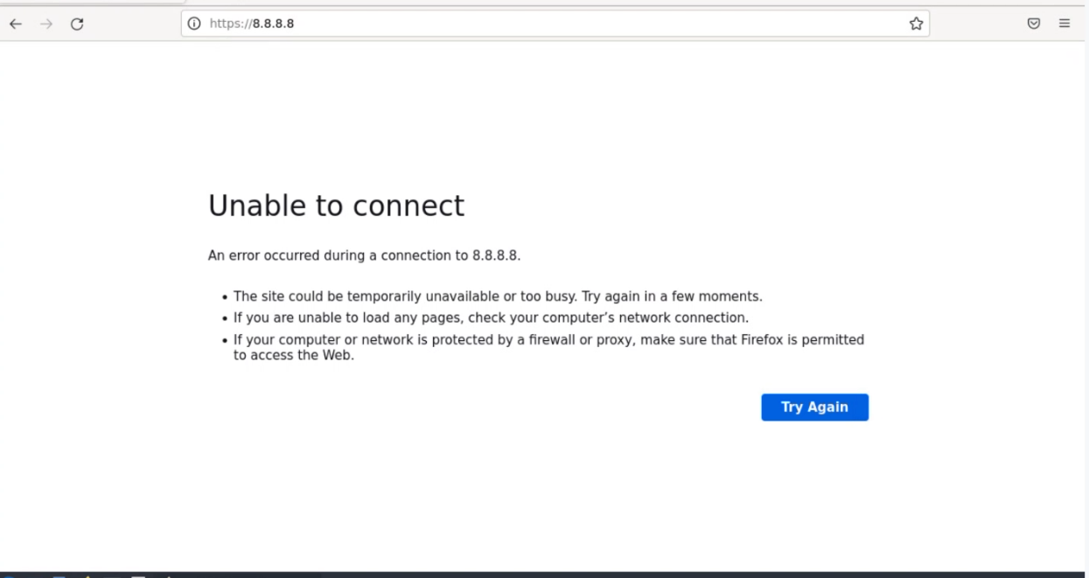

Slide 9
Conclusion
Using External Dynamic Lists in security policies, users can easily block and monitor certain IP address, Domain or URL
External Dynamic Lists are an easy way to keep an updated security policy
These lists can be used used to both block and monitor both harmful sources as well as sources that might be time wasters, such as social media

