Slide 1


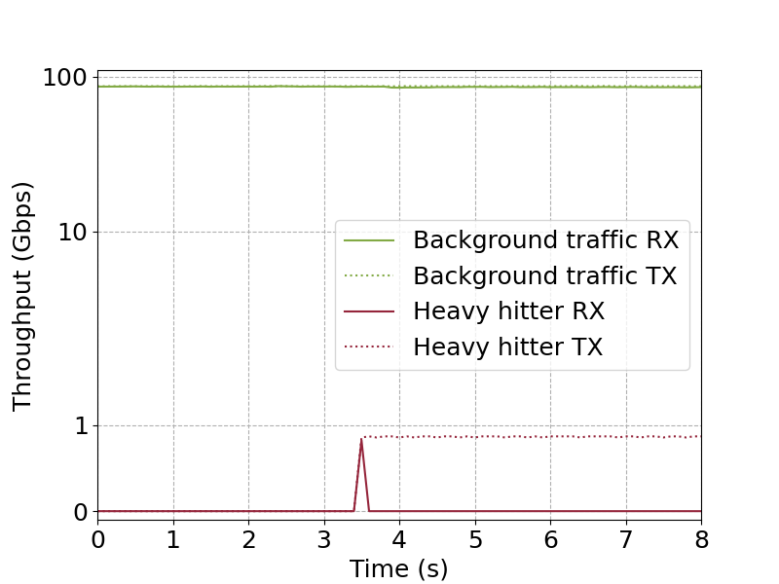
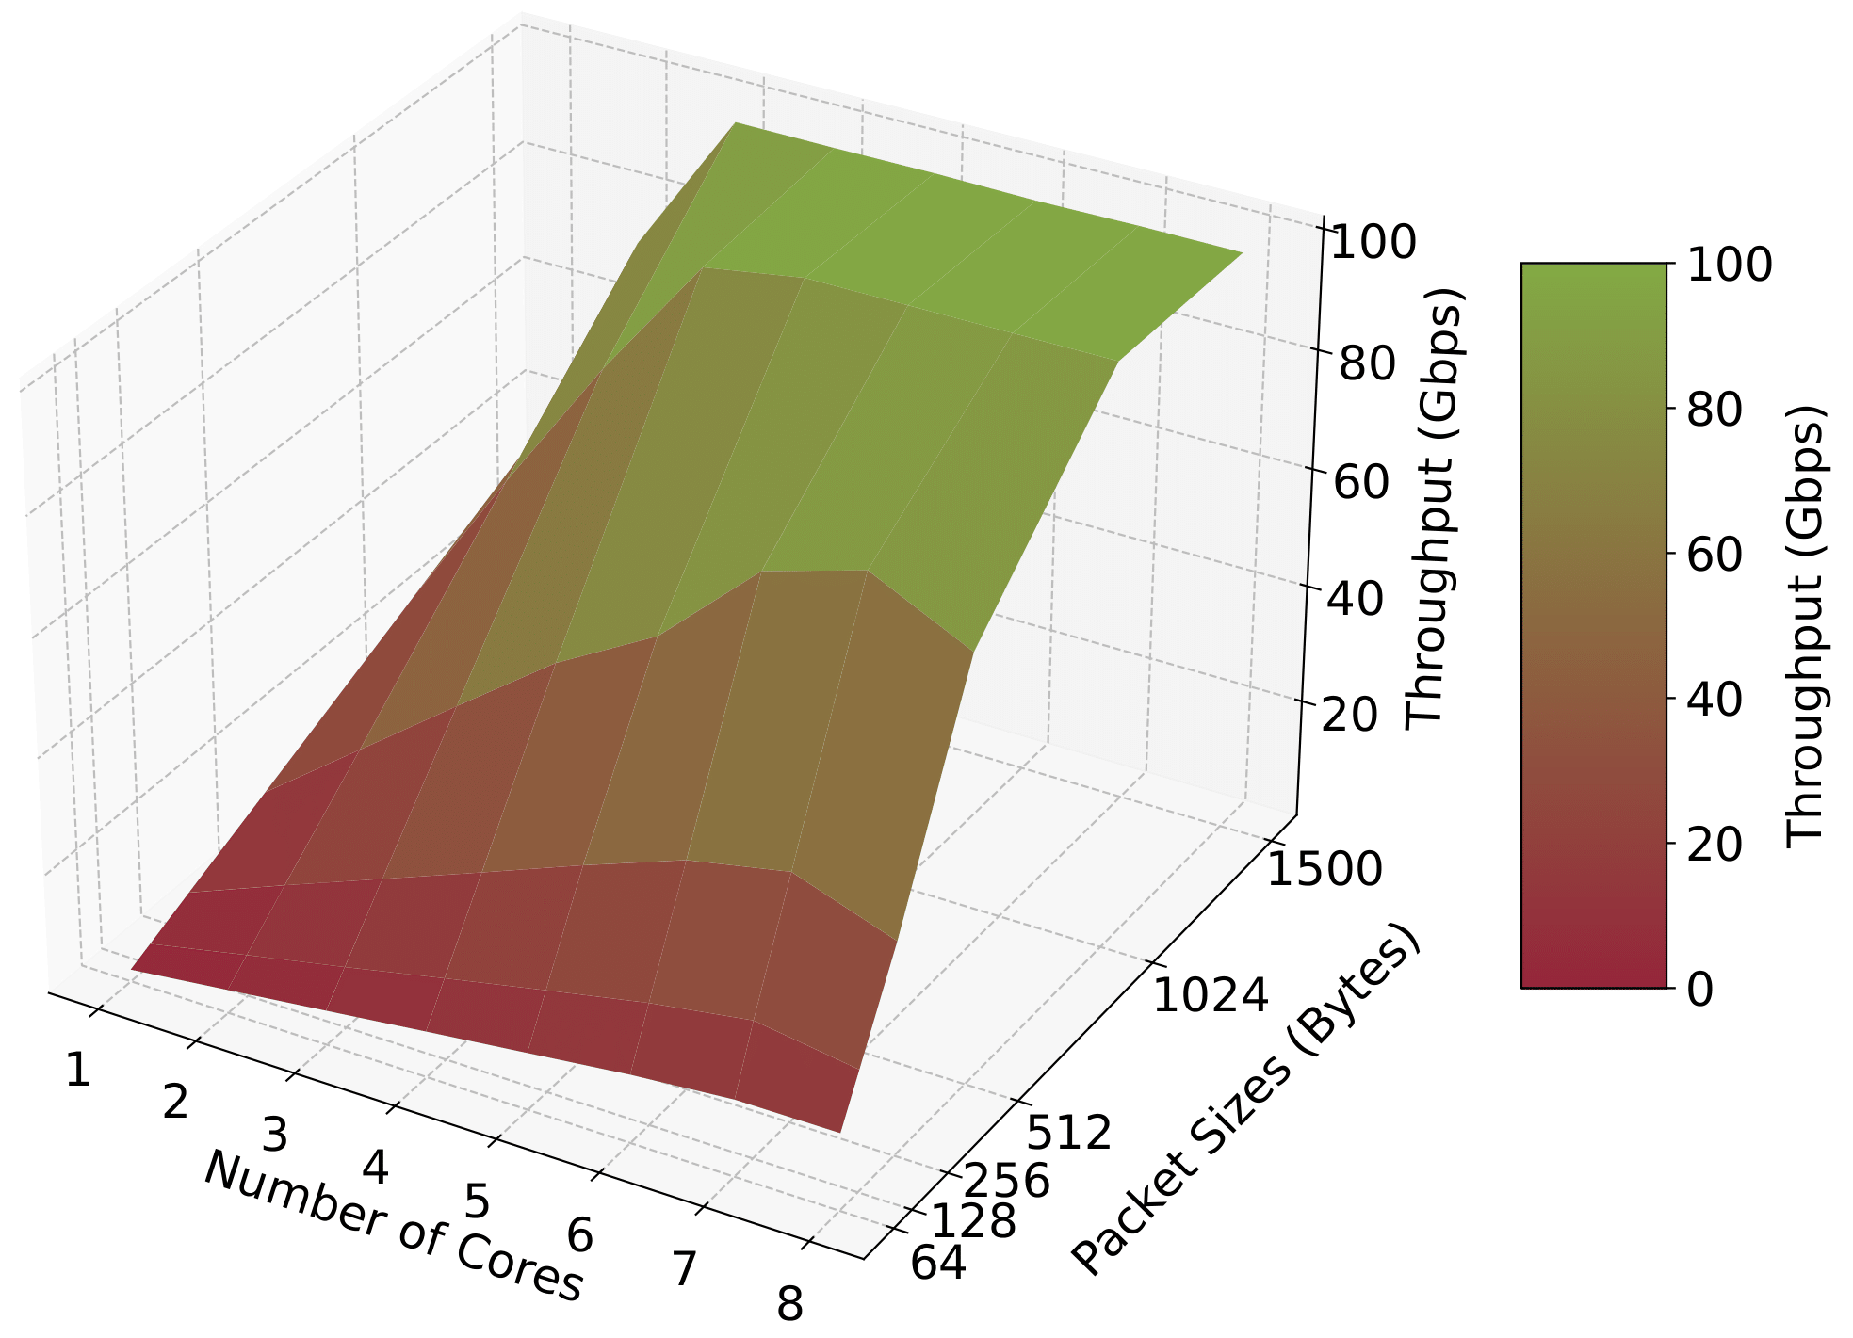
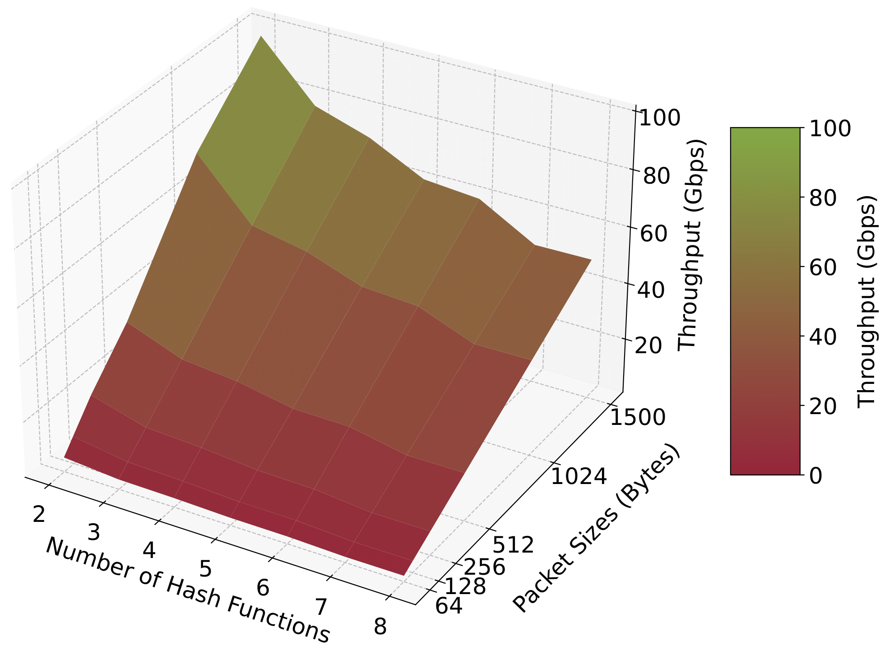
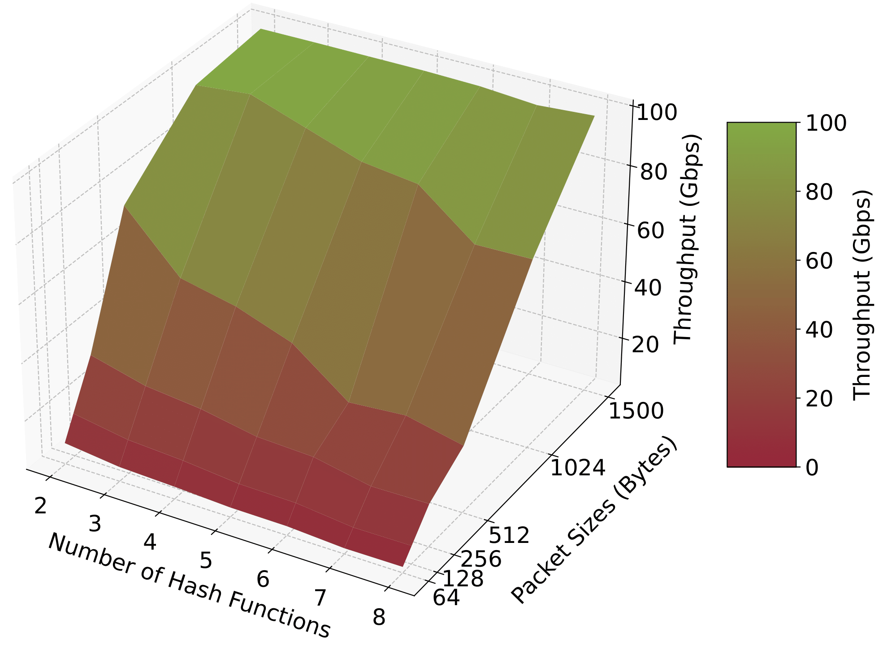
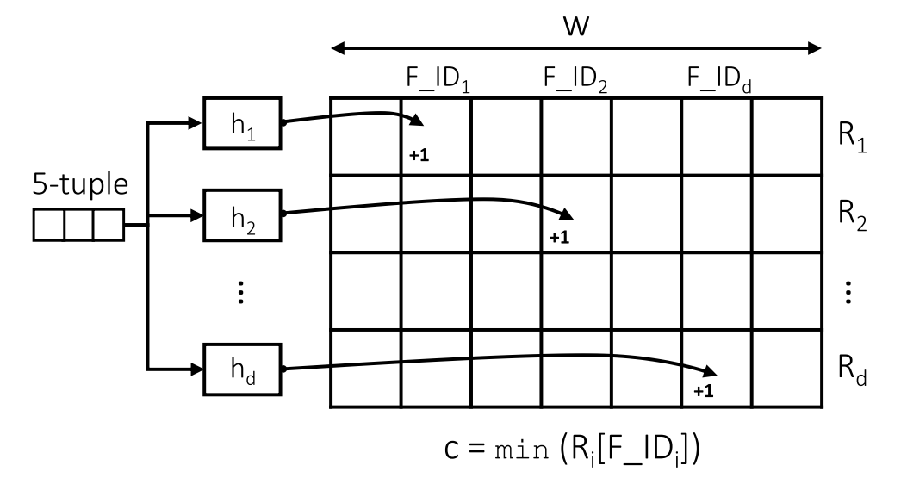
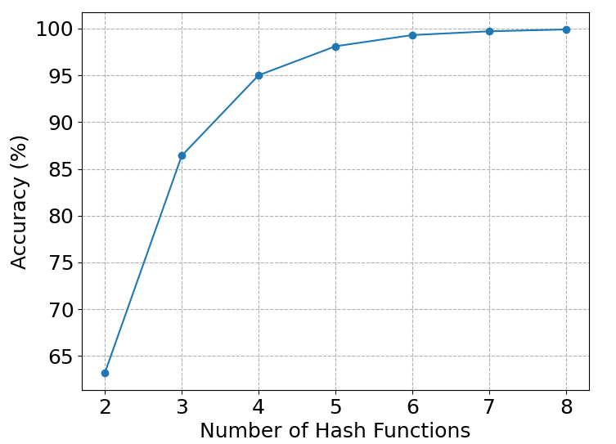
Scalable Heavy Hitter Detection in Virtualized Environments:
A DPDK-based Software Approach with P4 Integration
Samia Choueiri, Ali Mazloum, Elie Kfoury, Jorge Crichigno
University of South Carolina, Columbia, South Carolina
Abstract
System Architecture
Performance Results of Heavy Hitter Detection
Identifying heavy hitters is vital for applications like Denial of Service (DoS) detection and traffic engineering.
Hardware solutions (e.g., programmable data plane switches) offer high performance but require adding hardware, which is not ideal for virtualized environments (e.g., cloud).
Software solutions are flexible but suffer from performance issues due to the packet processing overhead in the OS kernel.
The proposed system implements a scalable heavy hitter detection algorithm in the software, bypassing the kernel using the Data Plane Development Kit (DPDK).
The Count-min Sketch (CMS) algorithm is used to track the number of packets per flow.
The system is implemented in P4 and deployed on the P4-DPDK target running on CPU cores.
The system was tested with various packet sizes, number of CPU cores, and number of hash functions.
Evaluation results show accurate identification of heavy hitters at traffic rates approaching 100Gbps.
The P4 language with the Portable NIC Architecture (PNA) is used to implement the heavy hitter detection algorithm.
The p4c-dpdk compiler translates P4 programs into DPDK API, allowing the configuration of the DPDK pipeline.
The DPDK pipeline is compiled and loaded on the CPU cores of the host.
The SmartNIC uses Receive Side Scaling (RSS) to distribute the load across the pipelines in the CPU cores.
Background traffic is generated at the rate of 100Gbps using DPDK-pktgen.
A heavy hitter is “immediately” identified and blocked even while processing 100Gbps of background traffic.
The maximum throughput that can be achieved increases as the number of CPU cores running the pipelines increases.
Heavy hitter mitigation at line rate
Throughput as a function of number of cores and packet size
Related Work
Evaluating the Impact of the Number of Hash Functions on the Throughput
P4 switches approaches:
  HH-IPG [1] is a per-flow heavy hitter detection approach on P4 Tofino. The system requires adding hardware.
  Ding et al. [2] proposed a network-wide monitoring heavy hitter algorithm using the Count-min Sketch implemented in P4. The system requires adding hardware
DPDK approaches:
  Elastic Sketch [3] is a network-wide detection of heavy flow implemented on P4-OVS with DPDK. The system is tested with low traffic rates (10Gbps).
  [1] SK. Singh et al., “HH-IPG: Leveraging Inter-Packet Gap Metrics in P4 Hardware for Heavy Hitter Detection,” 2023.
  [2] D. Ding et al., “An incrementally-deployable P4-enabled architecture for network-wide heavy-hitter detection,” 2020.
  [3] T. Yang et al., “Elastic Sketch: Adaptive and Fast Network-wide
  Measurements,” 2018.
P4-DPDK heavy hitter detection system architecture
Methodology
The CMS algorithm is used to detect heavy hitters.
CMS is a probabilistic data structure that serves as a frequency table of events in a stream of data.
It uses multiple hash functions and register arrays. The hash functions map the events to frequencies in each of the arrays.
The hash function takes as input the 5-tuple: source/destination IP, source/destination port, and protocol.
The heavy hitter is detected by comparing the minimum frequency for a flow in the CMS against a predefined threshold.
Experiment Topology
Throughput as a function of the number of hash functions
and packet size using two CPU cores
Throughput as a function of the number of hash functions
and packet size using four CPU cores
The heavy hitter detector also reflects packets.
All the servers are on the same FABRIC site.
DPDK-pktgen is used to generate traffic.
Lessons Learned and Future Work
While CMS introduces some estimation errors, it offers a tunable trade-off between accuracy and memory usage based on the number of hash functions and the size of the register arrays.
The experimental results show that increasing the number of hash functions improves the counting accuracy but degrades the throughput.
Using two CPU cores, the performance penalty is high, especially with small packet sizes. With four CPU cores, the performance penalty is eliminated even with a high number of hash functions.
Future work includes 1) testing the system with real traffic from CAIDA; 2) augmenting the P4 program to detect cyberattacks; 3) profiling the performance of P4-DPDK with various P4 programs.
Count-Min Sketch (CMS) for estimating the per-flow packet counts
Acknowledgement
This work was supported by the National Science Foundation (NSF), Award 2118311.
Packet count accuracy based on the number of hash functions

