Slide 1
Implementing a Stateful Packet Filter Using a P4 Programmable Switch
Andrew Smith & Nolan Pelino
Advisor: Ali AlSabeh
Department of Integrated Information Technology (IIT)
University of South Carolina
December 07, 2023

Slide 2
Agenda
Introduction/Background
Project Objective
Implemented Solution
Conclusion

Slide 3
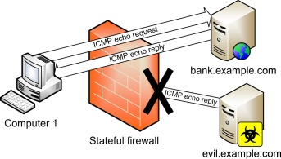
Introduction
The data plane is the structured pipeline that processes a stream of bits as they move through a switch
P4 is a programming language that describes the behavior of the data plane, providing the programmer an unprecedented amount of control
Stateful packet filters examine every packet passing through a switch, maintaining a log of various connections
This data is then leveraged to enhance the precision of filtering decisions
Notes:
Stateful firewall. Stateful Firewall - an overview | ScienceDirect Topics. (n.d.). https://www.sciencedirect.com/topics/computer-science/stateful-firewall

Slide 4
Project Objective
The objective of this project is to implement a stateful packet filter on the Tofino P4-Programmable ethernet switches
The packet filter is developed to interact with both TCP and ICMP
The code is initially written on a BMv2 software switch and then migrated to be compatible with Tofino hardware switches
The purpose of this project is to demonstrate P4's suitability in high-speed, stateful traffic filtering applications

Slide 5
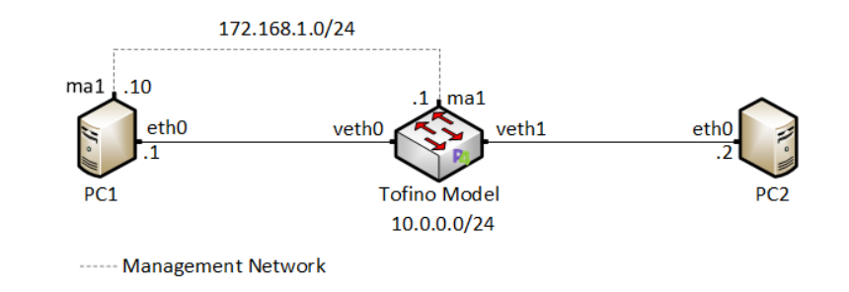
Implemented Solution
Topology
PC1 and PC2 are hosts on the 10.0.0.0/24 network
PC1 is used as the management interface for the Tofino switch
The goal is to allow connections initiated from PC1 to PC2 only, at the level of TCP and ICMP protocols

Slide 6
Implemented Solution
Registers
Registers are used within P4 to save arbitrary data
Multiple packets can access or modify register data
We use them here to store and access the ICMP identifier field of packets
ICMP register
TCP register
Index | Value
register_index1 | ICMP Flow Identifier1
register_index2 | ICMP Flow Identifier2
… | …
register_indexN | ICMP Flow IdentifierN
Index | Value
register_index1 | TCP Flow Identifier1
register_index2 | TCP Flow Identifier2
… | …
register_indexM | TCP Flow IdentifierM

Slide 7
Implemented Solution
Hashes
A hash function maps any given input values to an output of fixed length
In P4, we specify the hashing algorithm (CRC16) then initialize the variable that the hash will be stored in
Subsequently, the hash will be used to access the register entry corresponding to flow we are monitoring
Line 1 specifies the algorithm we will use for the hash
Line 2 initializes the variable that the hash will be stored in
The input of the hash function is the source and destination IP addresses of the packet. The output is a 16-bit hash value and will be stored in the variable sel_hash. This will later be used as the register index for the flow

Slide 8
Implemented Solution
Index | Value
sel_hash | ICMP Flow Identifier
sel_hash | ICMP Flow Identifier
sel_hash | ICMP Flow Identifier

Slide 9
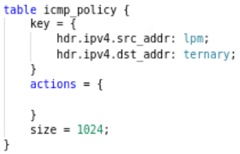
Implemented Solution
Match-action Tables
Match-action tables allow the programmer to define actions to be executed on a certain match (key), specified in the control plane
The icmp_policy and tcp_policy tables were designed to implement policies for the ICMP and TCP protocols
The key for the tables identify the flow ID
For example, in ICMP the flow ID is the source and destination IP addresses

Slide 10
Implemented Solution
Match-action Tables
There are no actions in the policy tables (NoAction), since no logic needs to be applied from the control plane
When a match occurs, we can interpret this as “true – the packet matches the policy, forward the packet” and on no match, as “false – the packet does not match the policy, drop the packet”
The size of the table is 1024, which is the number of entries in the table (i.e., number of policies we can implement)

Slide 11
Implemented Solution
Apply Logic
First check which of the ICMP or TCP headers are valid before processing
If the ICMP packet is an echo request, store the ICMP ID in a register at the hashed index then forward
...

Slide 12
Implemented Solution
Apply Logic
If the ICMP packet is an echo reply, read the value at the hashed index and forward if the current ICMP ID matches
The hashed index is the source and destination IP addresses reverse
This results in the same hash value of the ICMP request, where the flow ID was stored

Slide 13
Implemented Solution
Apply Logic
If the TCP packet is valid and hits on tcp_policy, store the source and destination port at the hashed index of the register
If the TCP packet does not hit on tcp_policy, read the value at the hashed index. If the stored source and destination ports match the current packet, proceed in forwarding
Otherwise, drop all packets
The hashed index consists of the source and destination IP addresses and port numbers

Slide 14
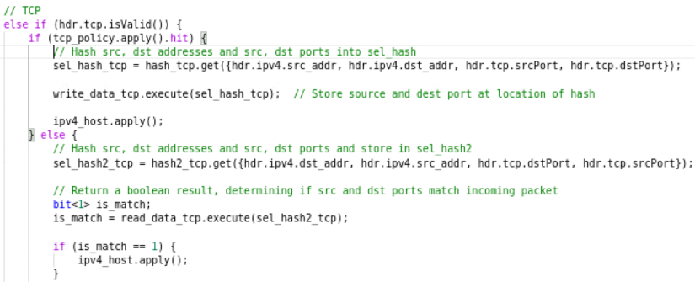
Implemented Solution
TCP apply block

Slide 15
ICMP Evaluation
When attempting to initiate a ping from PC1 to PC2, the action is successful
However, attempting to ping PC1 from PC2 fails due to the implemented policy
PC1 -> PC2
PC2 -> PC1

Slide 16
TCP Evaluation
Setting up an iPerf server on PC2 and configuring PC1 as the client results in a successful client-server connection
Attempting to initiate PC1 as the server and PC2 as the client leads to connection refusal, again, due to TCP forwarding rules and apply logic
Successful connection
Failed connection​

Slide 17
Conclusion
We implemented a stateful packet filter on a BMv2 software switch and on Tofino hardware switch
Our P4 code successfully demonstrates the packet filter in accordance with environment configuration and forwarding tables
We tested our code to allow connections originating from the internal network only
For future work, we plan on implementing timeout on stale entries and collision resolving on flows that produce the same hash value

