Slide 1
Implementation of DNS Sinkholes in Next-Generation Firewalls
Christian Tsirlis, Brad Wilson
Advisor: Jorge Crichigno
Department of Integrated Information Technology
University of South Carolina
December 2nd, 2021

Slide 2
Agenda
Purpose
Introduction
Problem description
Proposed solution and implementation
Anti-spyware profile
External dynamic list
DNS Sinkhole Validation
Use of nslookup command
Analyzing traffic logs
Conclusion

Slide 3
Purpose
Understand DNS Sinkholes
Implement DNS Sinkholes in Security Policies
Protect network from malicious attackers inside and outside of the network
Analyze DNS and web browser traffic traversing the network
Build stronger policies to minimize attacks

Slide 4
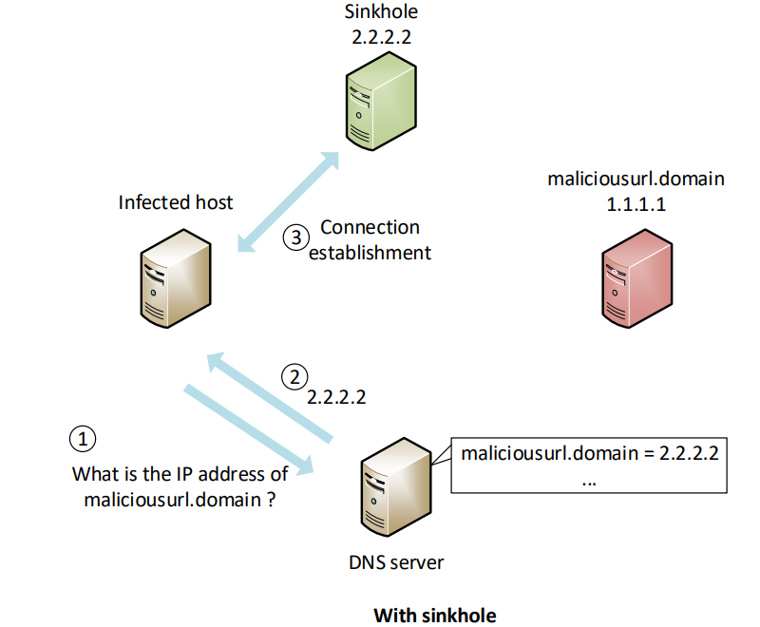
Introduction
A DNS sinkhole is a technique used to protect hosts from malicious domains.

Slide 5
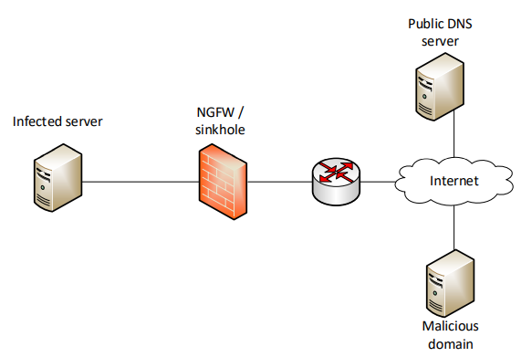
Problem Description
Suspected malicious activity from internal network attempting to access malicious domains.
Effectiveness of security policies using DNS sinkholes to protect internal network.

Slide 6
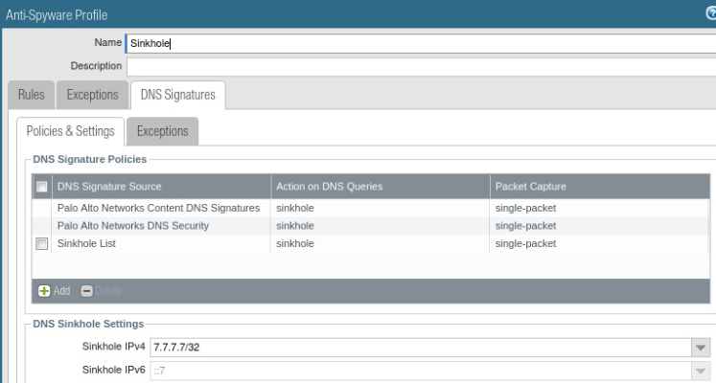
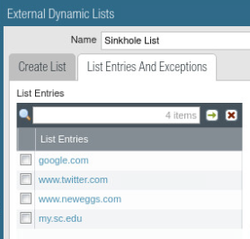
Proposed Solution and Implementation
Sinkhole anti-spyware profile created.
Alerts network administrations and logs traffic.
Used in security policy to perform sinkhole action.
Sinkhole external dynamic list created.
Unique list to test sinkhole effectiveness.
Used in anti-spyware profile to filter DNS request.

Slide 7
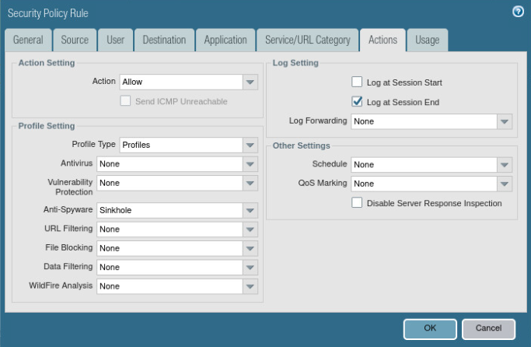
Proposed Solution and Implementation
Security policy with anti-spyware profile attached.
Closer look at the security policy rule.
Focusing on the Actions tab.
Anti-spyware was added as a profile setting.

Slide 8
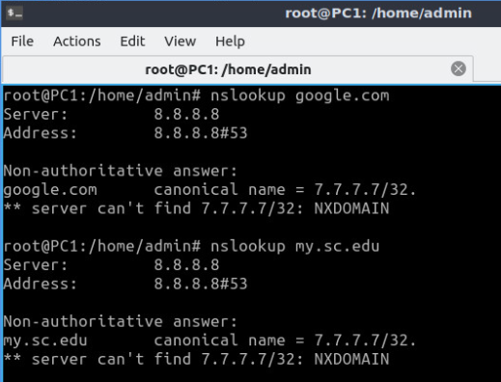
DNS Sinkhole Validation
How to verify?
nslookup returns the ip address of the requested domain.
We used the nslookup command to confirm if the sinkhole was working.
Results
DNS Sinkhole works with nslookup.
Web browser can evade DNS sinkhole using encrypted web browser traffic.

Slide 9
Analyzing Traffic Logs
Search traffic logs by “sinkhole” action.
Ability to know the source address of DNS request.
Provides the URL requested by client.

Slide 10
Conclusion
Why is this work important?
Our test highlights, that there are some weaknesses in DNS sinkholes and how web browsers can encrypt data, which makes the domain request impossible to see.
Future work includes deeper packet analysis
Use of URL filtering with DNS sinkhole is effective
Questions?
Thank you for listening and watching

