Slide 1
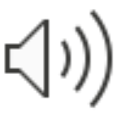
Geo-blocking Using NGFWs
Ty Love-Baker, Nathan Long
Department of Integrated Information Technology
University of South Carolina
April 12th, Spring 2021

Slide 2
Agenda
Introduction
Project description
Background information
Proposed solution and implementation
Conclusion

Slide 3
Project Description
Explore the use of Geo-blocking and its effectiveness
Build a security policy using diverse geolocations and regions
Protect the internal network using NGFWs
Restrict internet access based on location
Determine the location of a user using geolocation methods

Slide 4
Background Information
Geo-blocking is a technology that restricts access to Internet content based upon the user’s geographical location
The user location is determined using Internet geolocation techniques
User IP address against a blacklist or whitelist
Accounts
Measuring the end-to-end delay of a network connection to estimate the physical location of the users

Slide 5
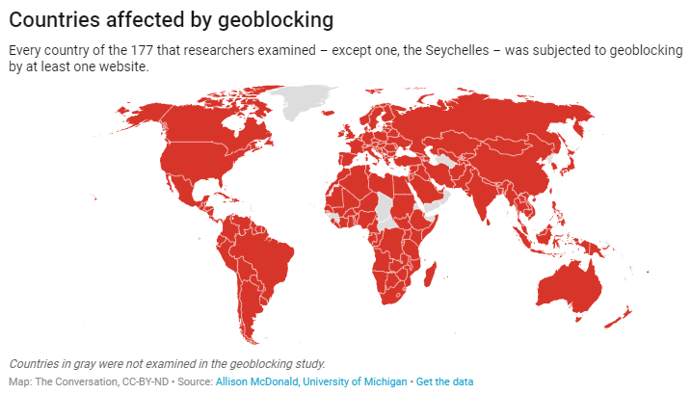

Slide 6
Proposed Solution and Implementation
Block all incoming and outgoing traffic besides the U.S.
This solution allows for maximum security by allowing for U.S. IP access only and blocking any IP from the outside

Slide 7
Conclusion
Other concepts and uses for geolocation
Nearby services
Financial services and usage tracking
Advertising and monitoring consumer behavior
Questions?

