Slide 1
Connecting Remote Sites Securely using an
Router Based IPsec Virtual Private Network
Ryan Tallent
Department of Integrated Information Technology
University of South Carolina
December 2020

Slide 2
Agenda
Introduction to network security and confidentiality
Background information
Generic Routing Encapsulation (GRE)
IPsec Virtual Private Networks (VPN)
Implementation of hybrid system using GRE and IPsec
Conclusion

Slide 3
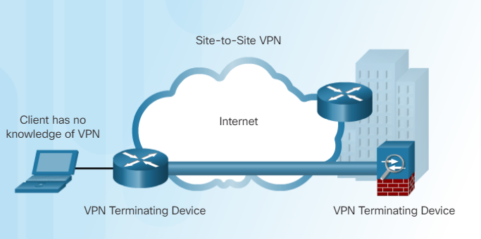
Introduction
Network communication frequently relies on Internet Service Provider (ISP) networks or other untrusted network connections to carry the information to its destination.
In order to enable secure communication between two networks, which are separated by a public network (e.g., the Internet), encryption is required.
Site-to-site virtual private networks (VPN) enable remote sites to communicate confidentially, using cryptographic techniques (encryption, hash functions).
Cisco CCNA Security Chapter 8.1.2.3

Slide 4
Problem Description
When communications travel past the local router and onto untrusted networks, they become much more vulnerable to falling into the wrong hands.
Cisco Routing and Switching Essentials Page 8.3.1.3

Slide 5
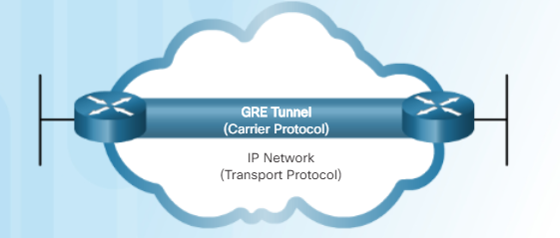
Background Information
Generic Routing Encapsulation (GRE) allows remote networks to be discovered through dynamic routing advertisements.
GRE enables broadcast and multicast traffic to be transmitted to the remote end point via the GRE tunnel
Cisco CCNA Security Chapter 8.3.1.5

Slide 6
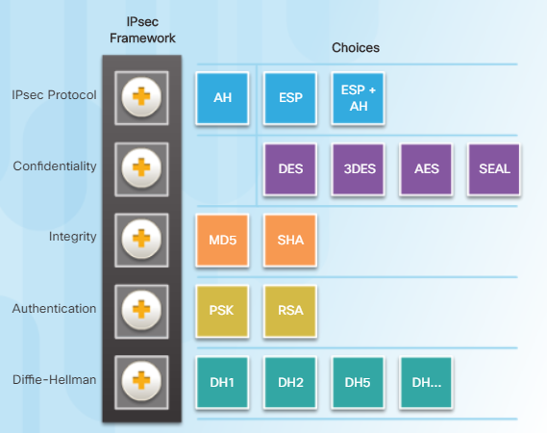
Background Information
IP security (IPsec) is a standard framework composed of five building blocks
Protocol: encapsulation protocol carrying the data
Confidentiality: encryption algorithm used for privacy
Integrity: hash function used for integrity control
Authentication: mechanism used to ensure the identity of the two end points of the VPN
Diffie-Hellman: algorithm used to create the keys used to encrypt the data
IPsec only works with unicast transmissions
Cisco CCNA Security Chapter 8.2.1.1

Slide 7
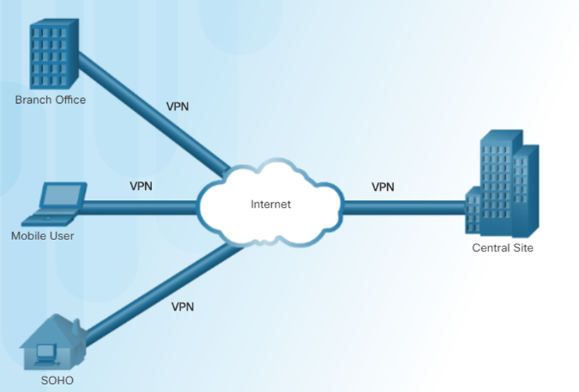
Proposed Solution and Implementation
The combination of the GRE and VPN is necessary to accomplish the task of transmitting data securely. GRE will create an envelop for the data to be transmitted through untrusted networks. The IPsec protocol, encapsulation security payload (ESP), is the means of sealing that envelop and protecting its contents from being changed or compromised
Cisco CCNA Security Chapter 8.1.1.2

Slide 8
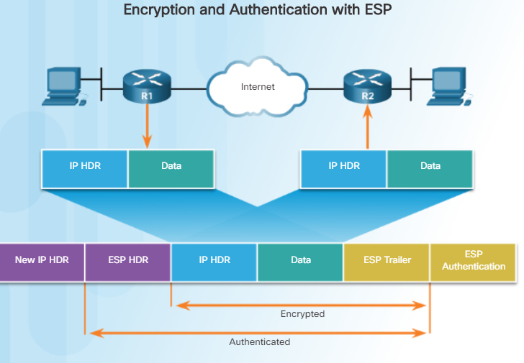
Establish VPN
The VPN enables information to be securely transmitted across the Internet. The communicating hosts can be assured their data is private, intact, and sent from a verified and trustworthy source.
Cisco CCNA Security Chapter 8.2.2.4

Slide 9
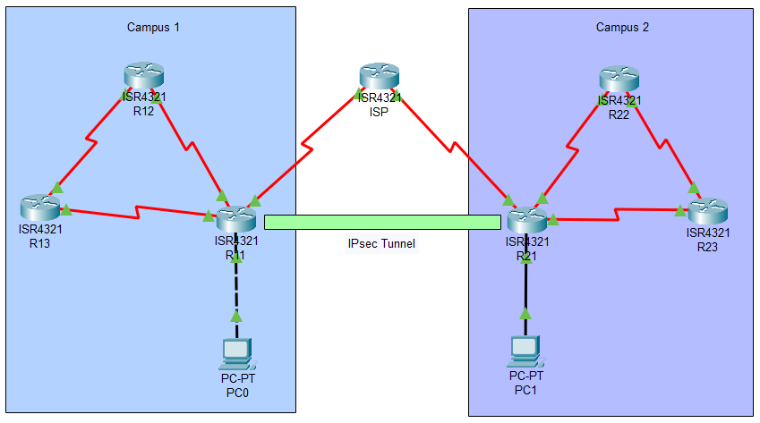
Conclusion
Through the implementation of a VPN, a high level of security and privacy can be achieved. The likelihood of information being intercepted, tampered with, or compromised by malicious outside actors is greatly reduced.

