Slide 1

Overview of the Cyberinfrastructure Lab (CI) at USC
https://research.cec.sc.edu/cyberinfra
Jorge Crichigno
Department of Integrated Information Technology
College of Engineering and Computing
University of South Carolina
jcrichigno@cec.sc.edu
Idaho National Laboratory
Idaho Falls, Idaho
April 16-17

Slide 2
Agenda
Cyberinfrastructure Lab at the University of South Carolina (USC)
Funding and projects
NSF Advanced Technological Education (ATE) project
Capability / Other projects: DARPA’s 5G, ONR Cybersecurity, NSF Cybertraining
List of virtual labs libraries developed by USC

Slide 3
Cyberinfrastructure Lab – Overview

Slide 4
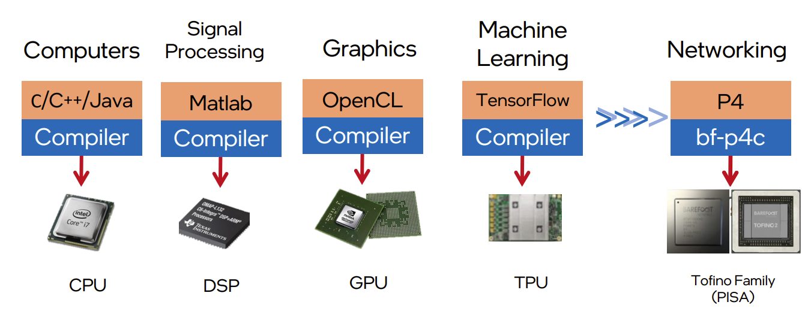
Programmable Data Plane Switches
Evolution of the computing industry
1970s 1970s-80s 1990s-2000s 2010s 2017
1. Vladimir Gurevich, “Introduction to P4 and Data Plane Programmability,” https://tinyurl.com/2p978tm9.

Slide 5
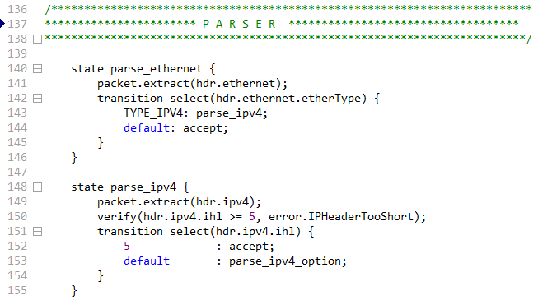
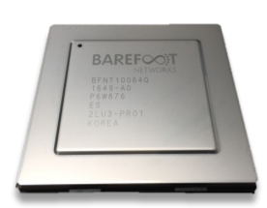
Cyberinfrastructure Lab
The CI lab studies the performance and security of IT systems
  Developing high-performance and security applications for high-speed networks, using P4 programmable devices
Programmable chip
P4 code
1. P4 stands for stands for Programming Protocol-independent Packet Processors
Notes:
Testing and measuring the performance of data transfers on high-throughput high-latency environments
Enhancing the performance of 5G networks using millimeter-wave links
Developing security applications (e.g., firewalls, IDS/IPS) in the data plane that run at line rate
Securing Science Demilitarized Zones (DMZs) without sacrificing performance
Detecting and classifying malware
Developing deep learning classifiers to fingerprint IoT devices

Slide 6
P4 Programmable Switches
P4 programmable switches permit programmers to program the data plane
  Customize packet processing functions in the chip
  Measure events occurring in the data plane with
  high precision
  Offload applications to the data plane
Programmable chip
Reproduced from N. McKeown. Creating an End-to-End Programming Model for Packet Forwarding. Available: https://www.youtube.com/watch?v=fiBuao6YZl0&t=631s

Slide 7
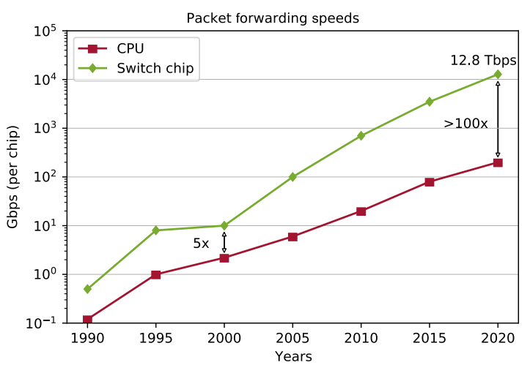
P4 Programmable Switches
P4 programmable switches permit programmers to program the data plane
  Customize packet processing functions in the chip
  Measure events occurring in the data plane with
  high precision
  Offload applications to the data plane
Reproduced from N. McKeown. Creating an End-to-End Programming Model for Packet Forwarding. Available: https://www.youtube.com/watch?v=fiBuao6YZl0&t=631s

Slide 8
NSF Advanced Technological Education Project:
Cyber-con²: “Multi-sector Convergence to Advance the Preparation of Learners for OT and IT Cybersecurity Convergence Workforce”
July 1 2024 – June 30 2027
Amount: $650,000

Slide 9
NSF ATE
Cyber-con²: “Multi-sector Convergence to Advance the Preparation of Learners for OT and IT Cybersecurity Convergence Workforce”

Slide 10
NSF ATE
Goal 1: Expand the Academic Cloud to support large-scale learning on OT/ICS and IT cybersecurity
  Develop and deploy virtual labs on OT/ICS cybersecurity
  Develop and deploy virtual labs on IT cybersecurity
Lib # | Lib Name | Sample Outcomes | CIE’s Pillar | Level
1, 2 | Intro to OT / ICS Cybersecurity (2 libraries) | Understand the fundamentals of PLCs used in critical infrastructures. Write basic apps with OpenPLC using Ladder diagrams. Describe the elements of a SCADA system. | Awareness. | Entry-level high school.
 |  |  | Awareness, Education. | Entry-level college.
3 | ICS Protocols (1 library) | Understand the Modbus Remote Terminal Unit (RTU) and Modbus over TCP. Implement a SCADA system with Modbus. Secure SCADA systems and protocols for ICS | Development, Current Infrastructure. | Intermediate-level college.
4 | Adv. Cybersecurity for OT / ICS (1 library) | Use passive and active discovery tools to map ICS devices. Launch C2 attacks against an ICS using Metasploit. Exploit the vulnerability of a SCADA/PLC system. | Development, Current Infrastructure. | Advanced-level college.
5 | Water Quality (WQ) Critical Infrastructure Models (1 library) | Explain how to model WQ within critical ICSs. Replay attacks to water distribution networks (WDNs). Characterize and analyze attacks on WDNs, including reconnaissance, DDoS, MITM. Develop mitigation algorithms for WDN attacks. | Development, Current Infrastructure. | Advanced-level college
CIE: Cyber Informed Engineering (national strategy): https://tinyurl.com/y3a8jntm

Slide 11
NSF ATE
Goal 1: Expand the Academic Cloud to support large-scale learning on OT/ICS and IT cybersecurity
  Develop and deploy virtual labs on OT/ICS cybersecurity
  Develop and deploy virtual labs on IT cybersecurity
Lib # | Lib Name | Sample Outcomes | Cert | Level
6, 7 | Intro to IT Cybersecurity (2 libraries) | Analyze and explain the types of attack surfaces. Execute malwares using real deployments and investigate their behavior. Analyze and characterize C2 communication used against IT / OT systems. | CompTIA Security+. | Entry-level college.
 |  |  | Cisco CCST Cyber. | Entry-level high school.
8 | Intro to IT Networks (1 library) | Analyze TCP sessions using a protocol analyzer. Perform network hardening. Use secure protocols for network management. | Cisco CCNA. | Entry-level college.
9 | Cybersecurity Operations (1 library) | Explain features of OS (Linux, Windows) used for cybersecurity analysis. Use tools and log files (e.g., PowerShell, syslog) to identify anomalies. Apply the security onion to protect systems. | Cisco CyberOps. | Intermediate-level college.
10 | Open-Source Intelligence (1 library) | Perform Internet scanning and probing events. Analyze log files using Suricata. Develop ML classifiers for malwares with Zeek. | NA | Intermediate-level college.
11, 12 | Threat Detection w/ NGFWs, I and II (2 libraries) | Develop and implement security and NAT policies. Implement IDS and IPS using an NGFW. Use deep packet inspection to identify applications and users. | PCCE (Technician). | Intermediate-level college.
 |  |  | PCNSA (engineer). | Advanced-level college.
13 | Cloud Security (1 library) | Understand virtual patching in the cloud. Set up and manage a cloud infrastructure using APIs. Be familiar with Azure and AWS toolsets. | AWS Cloud Foundations, AWS Sec. Foundations | Advanced-level college.
14, 15 | Fine-gained Telemetry w/ P4 (2 libraries) | Describe the architectures of P4 devices. Identify and block attacks in the data plane. Develop security apps with P4 switches and smart NICs. | NA (state-of-the-art, research). | Advanced-level college.

Slide 12
NSF ATE
Integration of virtual labs into high-school and college programs
Virtual lab libraries marked with a ribbon will be aligned with stackable industry certificates

Slide 13
NSF ATE
Goal 2: Develop an internship program on OT/ICS and IT cybersecurity
  Pre-internship seminars will help connect interns with organizations
  Internship enables students to acquire soft skills, teamwork, time management, and communication skills
Pre-internship Seminars
Internships
Spring and Fall semesters
(Monday-Wednesday-Friday)
Summer semester
(400 hours)

Slide 14

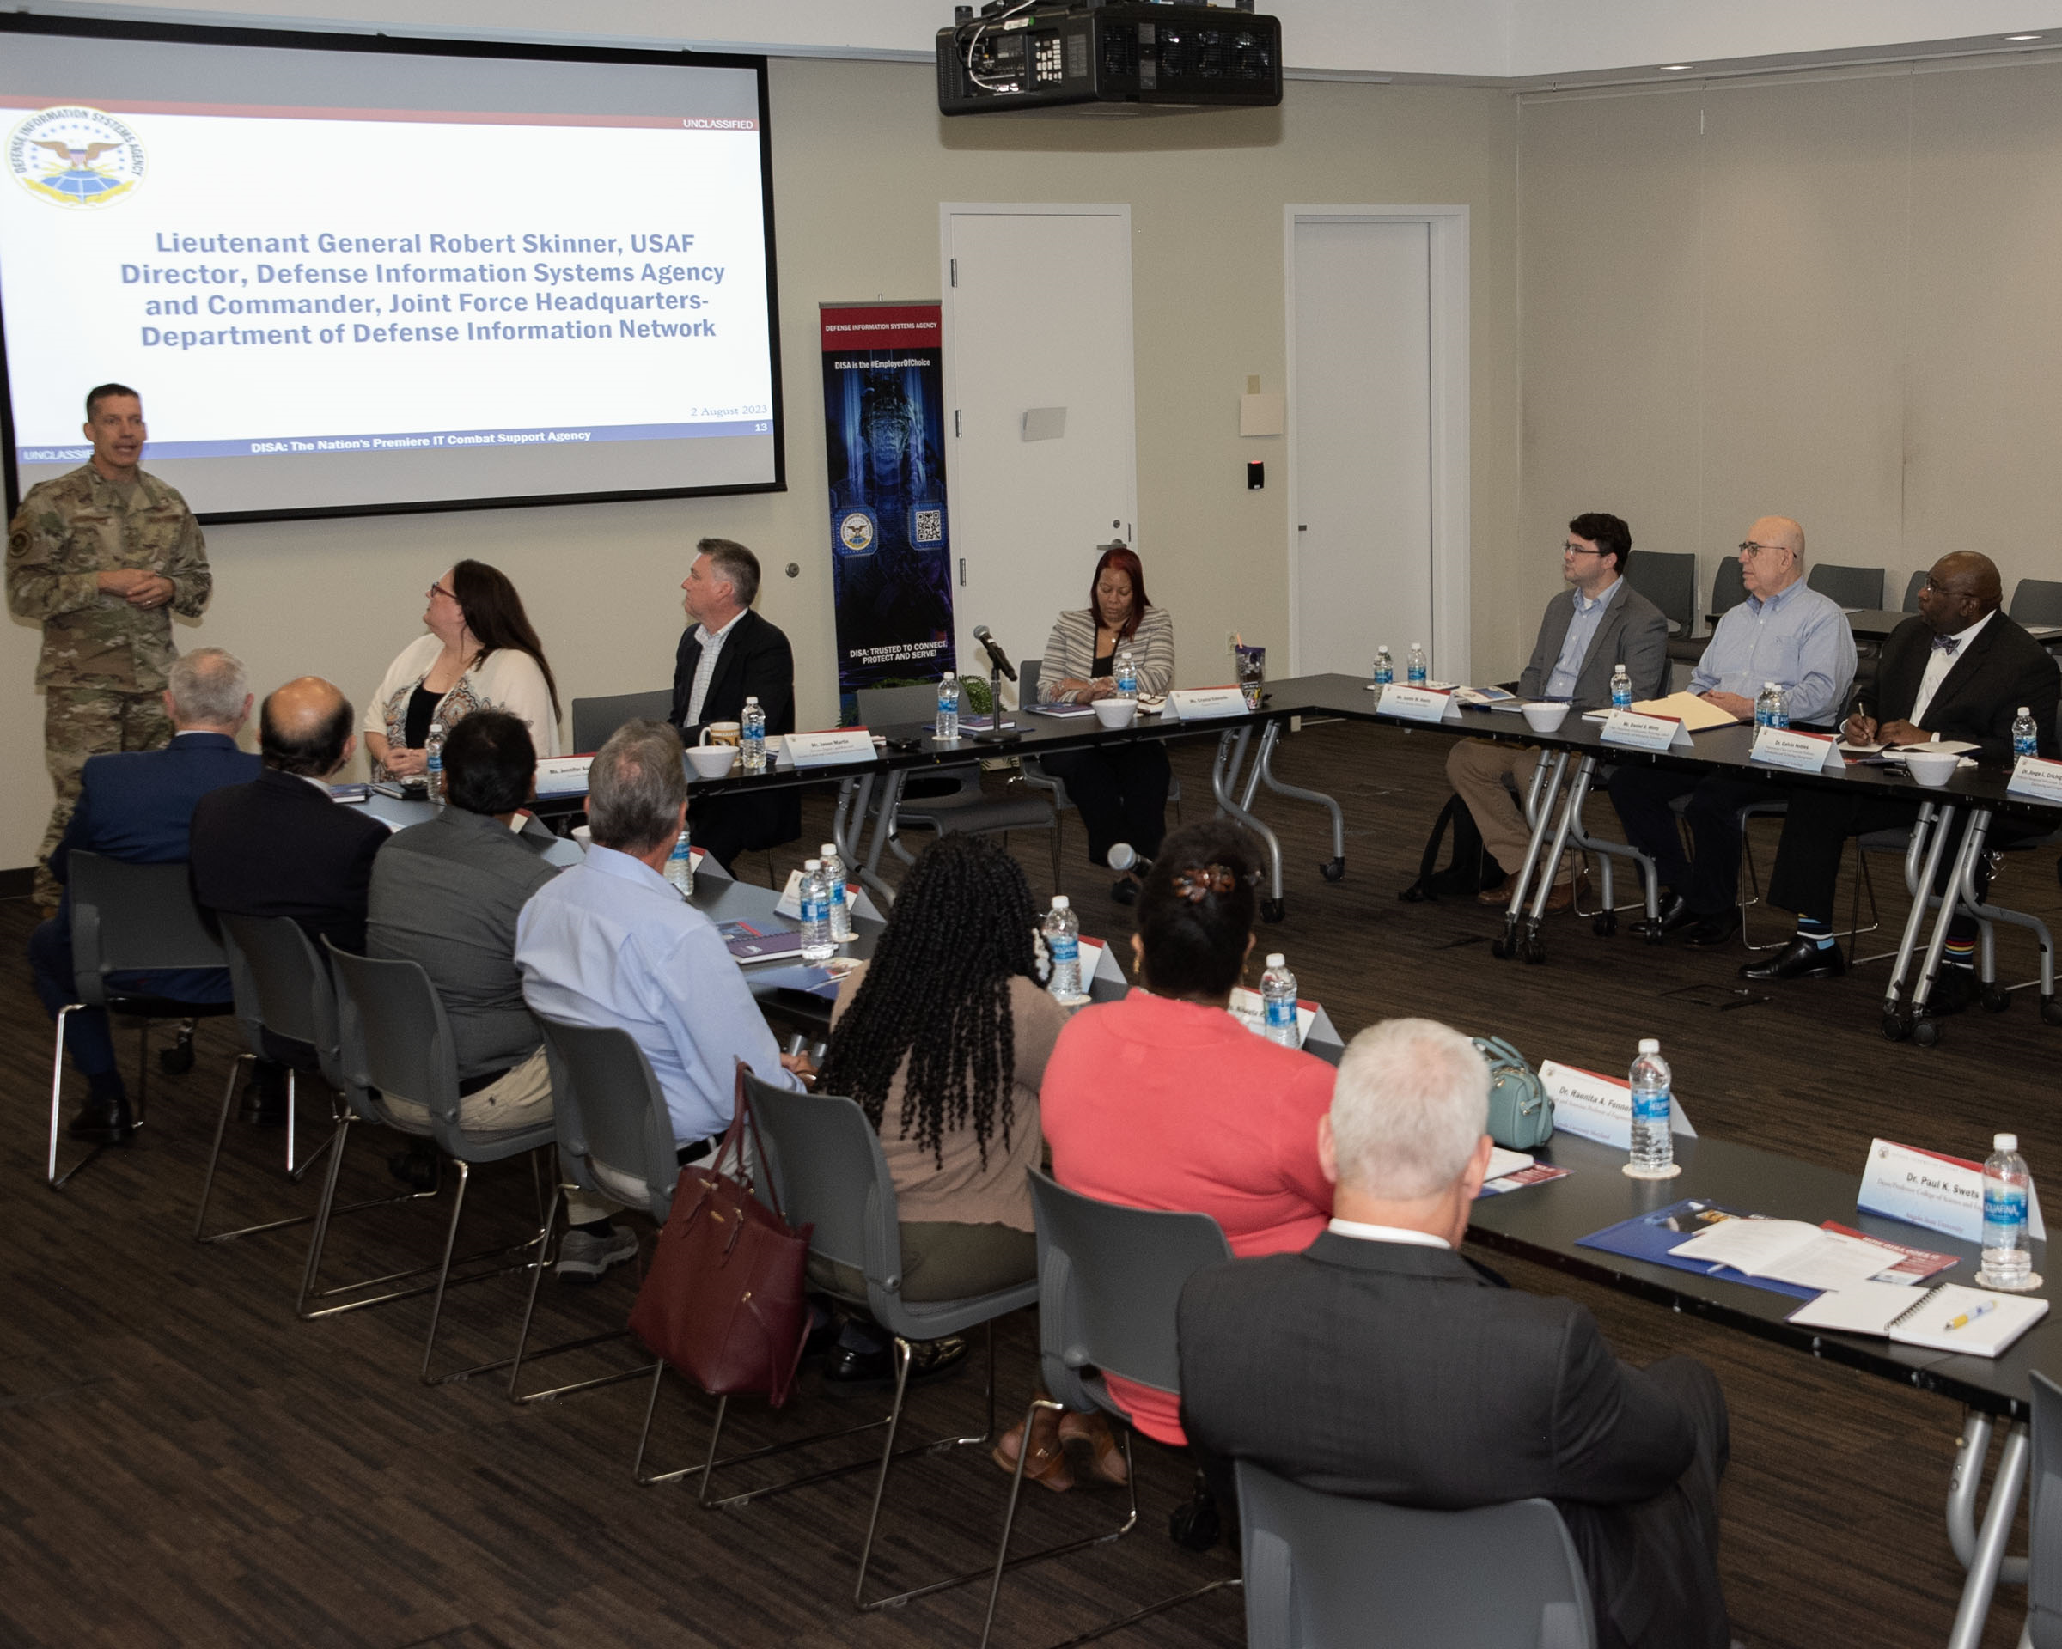








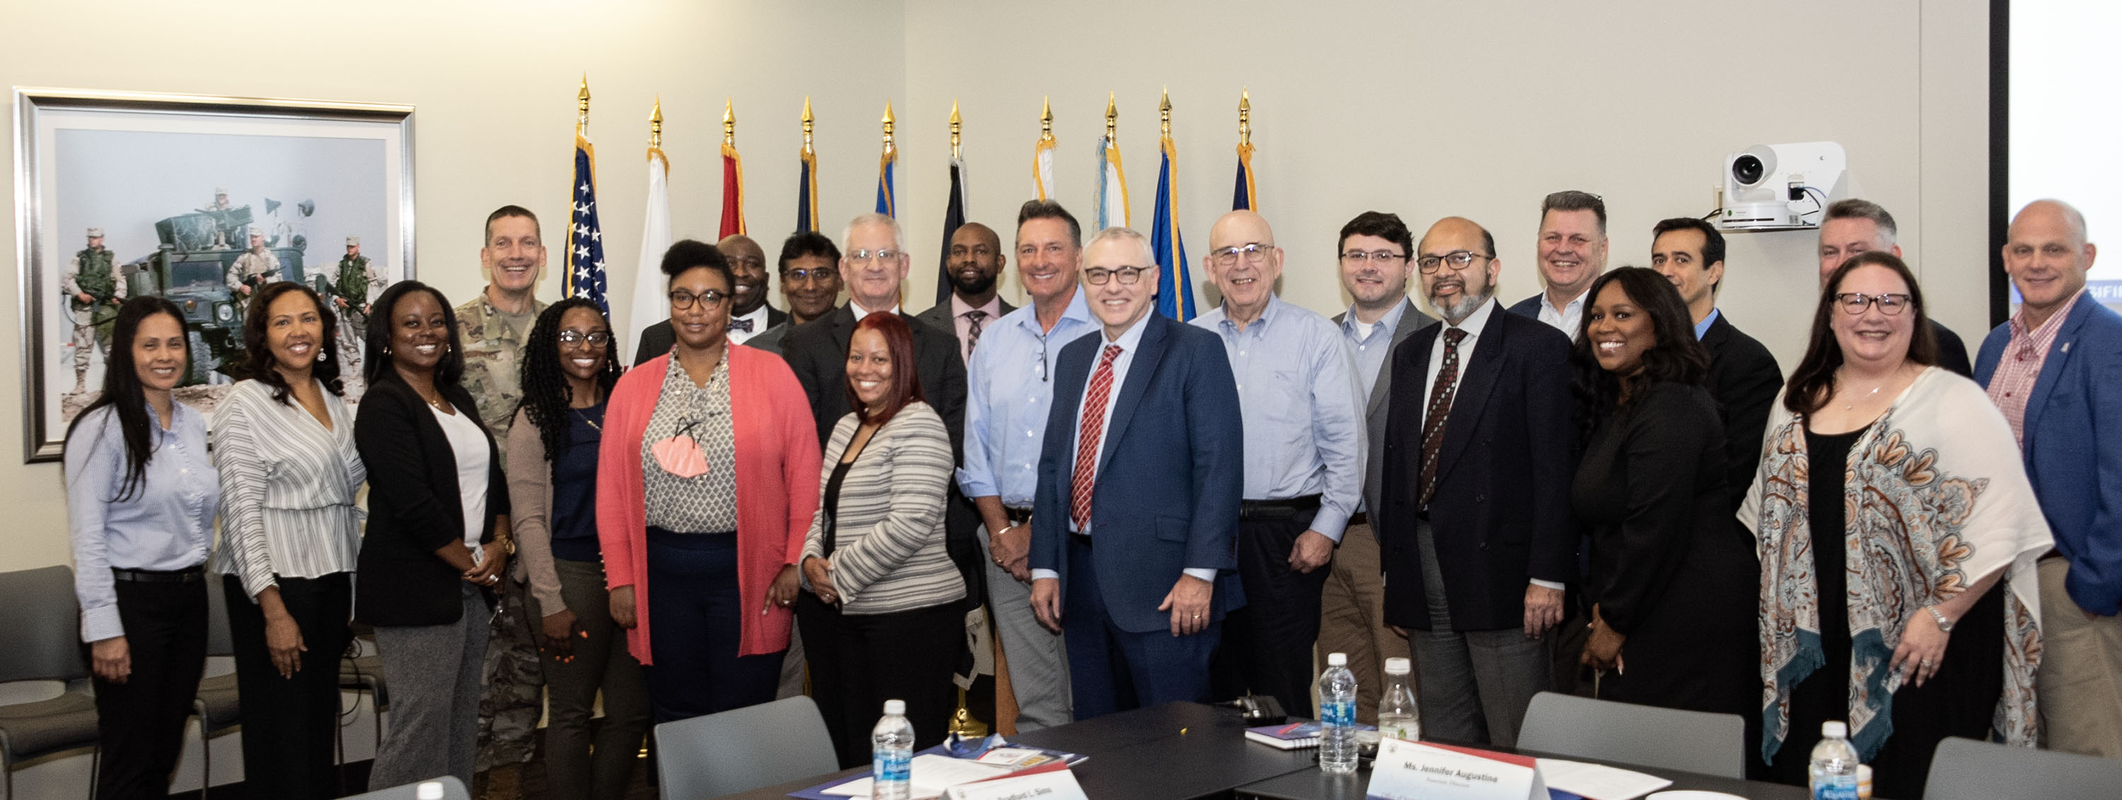
NSF ATE
Goal 2: Develop an internship program on OT/ICS and IT cybersecurity
  By the end of the Pre-internship Seminars, the goal is to secure 100+ paid internships each summer
Visit to the Defense Information Systems Agency (DISA)
August 2nd 2023 - Baltimore, MD

Slide 15
NSF ATE
Goal 3: Advance formal and informal communities for OT/ICS and IT cybersecurity training and education
 | Activity | Community | Subject / Libraries | Support Type
A | Academic courses (16-week – formal, supervised) | Colleges in the Carolinas | All college-level libraries | (1) Access to Academic Cloud; (2) Train instructors (train-the-trainer).
B | High school courses, 16+16- (formal, supervised) | High schools in the Carolinas | Intro to OT/ICS Cybersecurity | (1) Access to Academic Cloud; (2) Train instructors (train-the-trainer).
 |  |  | Intro to IT Cybersecurity and Intro to IT Networks
C | Third party academic courses (formal, unsupervised) | Other high schools, colleges, universities | All libraries | (1) Access to the Academic Cloud (unsupervised); (2) Train instructors (train-the-trainer).
D | Train-the-trainer courses (formal, supervised) | CSSIA, WASTC, SCC | All libraries | (1) Access to Academic Cloud; (2) Train instructors (train-the-trainer).
E | ICS courses (informal, unsupervised) | ICS COP | All OT / CCS cybersecurity libraries | (1) Access to Academic Cloud; (2) Train instructors (train-the-trainer).
F | IT tutorials (informal, unsupervised) | Internet2 and LBNL’s COP | All college-level IT cybersecurity libraries | (1) Access to Academic Cloud; (2) Training tutorials.

Slide 16
NSF ATE
Goal 3: Advance formal and informal communities for OT/ICS and IT cybersecurity training and education
 | Activity | Community | Subject / Libraries | Support Type
G | Self-paced training courses for military-connected personnel (informal, unsupervised) | CIAB, U.S. National Guard, NIWC | All college-level libraries | (1) Access to the Academic Cloud; (2) Courses to train military instructors (train-the-trainer).
H | FABRIC tutorials (informal, unsupervised) | FABRIC COP | Advanced programmable networks (smart NICs and P4 programmable switches) | (1) Access to Academic Cloud; (2) Co-located training tutorials to FABRIC community events.
I | Cybersecurity Competitions: DOE’s CyberForce and SC’s PCDC (informal, unsupervised) | High schools and colleges in the Carolinas | Libraries 1-2 for DOE’s CyberForce Competition, and libraries 6-8 for PCDC | (1) Access to Academic Cloud to high-school and college instructors and their students, participating in the competitions.

Slide 17
Potential Collaboration with INL – Current NSF ATE
Adoption of virtual lab libraries developed by INL
Development of new virtual lab libraries
Summer internships
Workshops, face-to-face and/or online
Capstones

Slide 18
Potential Collaboration with INL

Slide 19
NSF CIRC
The Community Infrastructure for Research in Computer and Information Science and Engineering (CIRC) program
  Focus on research agendas in computer and information science and engineering
  Enable advances not possible with existing research infrastructure
  Ensure that have access to such infrastructure
  Medium Community Infrastructure (Medium): up to $2M per three years
  URL: https://new.nsf.gov/funding/opportunities/community-infrastructure-research-computer

Slide 20
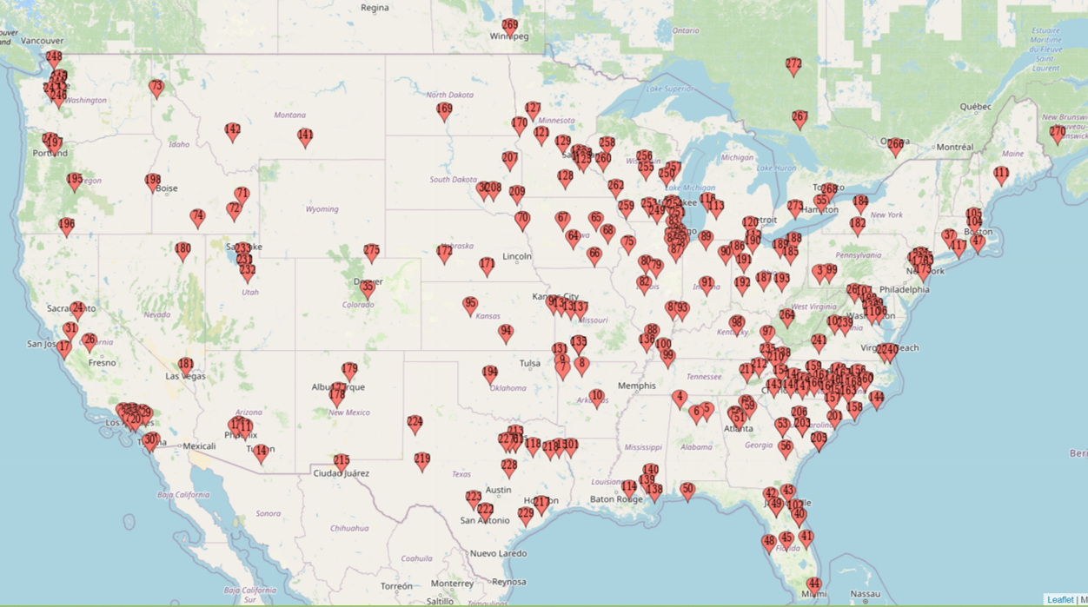
NSF CIRC
Broader impact by leveraging NDG’s Academic Cloud and NETLAB+

Slide 21
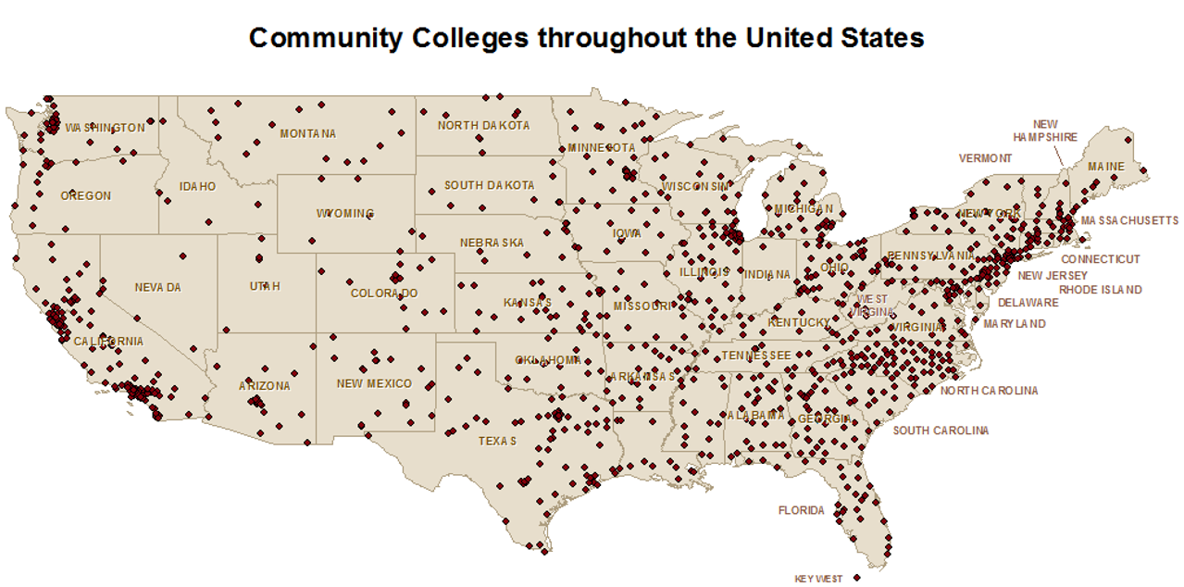
NSF CIRC
Broader impact by leveraging NDG’s Academic Cloud and NETLAB+

Slide 22
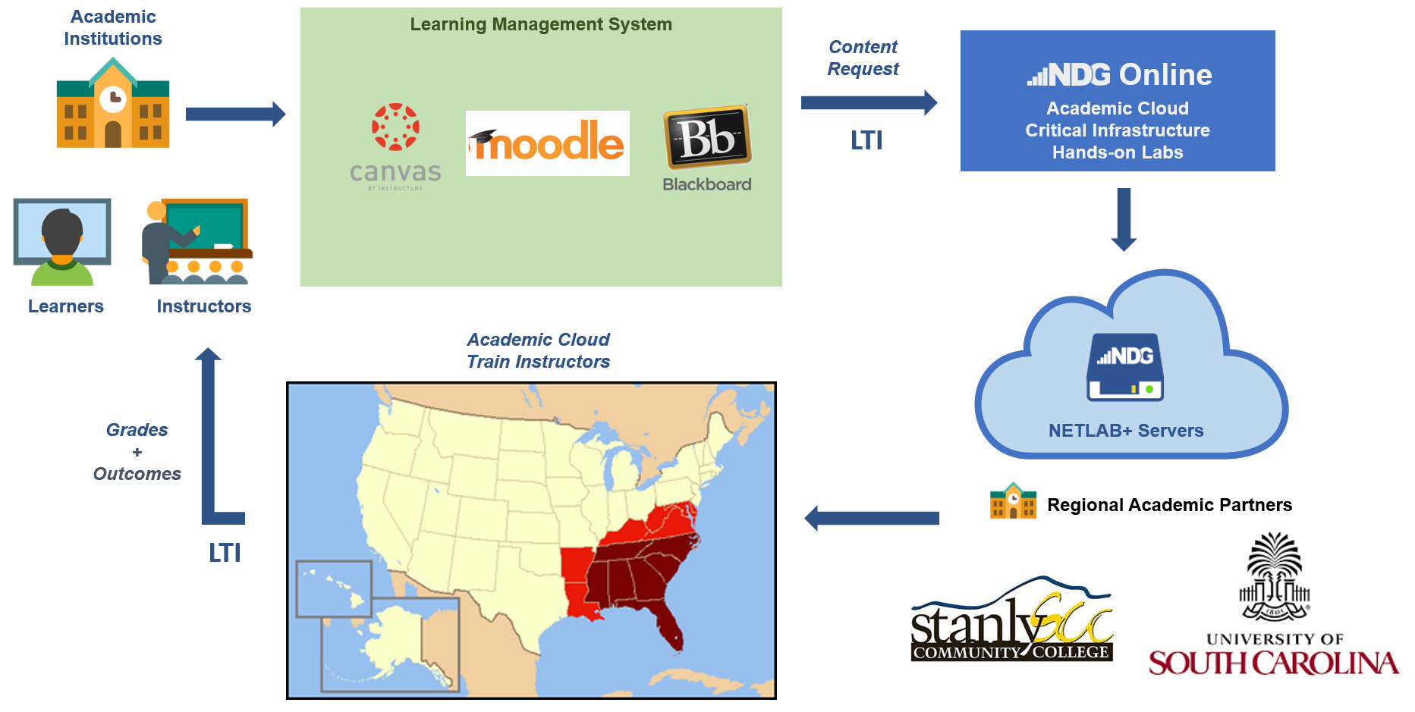
NSF CIRC
Academic Cloud + NETLAB System + Developers’ Expertise
PLATFORM | 2024 | 2023 | 2022
Academic Cloud | 73319 | 249153 | 263305
NETLAB+ | 33917 | 69025 | 64962
TOTAL | 107236 | 318178 | 328267

Slide 23
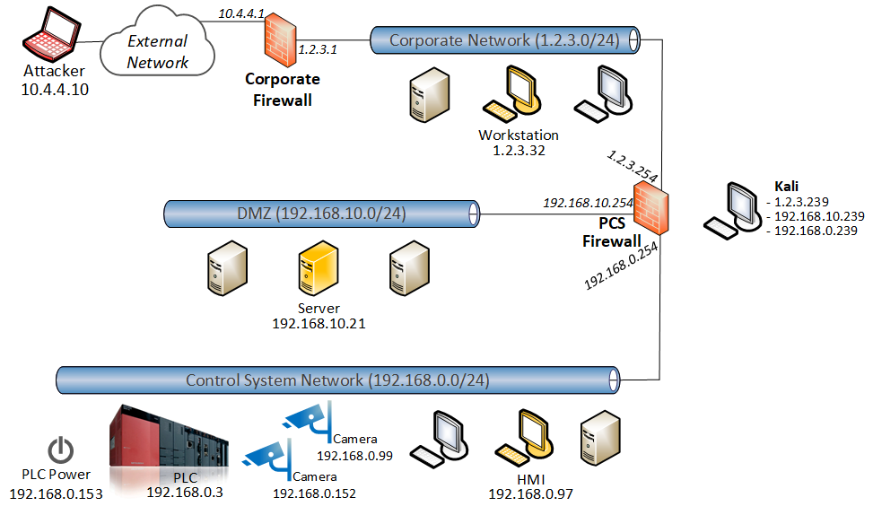
NSF CIRC
Academic Cloud + NETLAB System + Developers’ Expertise
DHS CISA 301 Labs
PLATFORM | 2024 | 2023 | 2022
Academic Cloud | 73319 | 249153 | 263305
NETLAB+ | 33917 | 69025 | 64962
TOTAL | 107236 | 318178 | 328267

Slide 24
Cyberinfrastructure Lab Capability
“5G Performance and Security”
January 1 2024– June 30 2026
Amount: $120,000 (USC Share)

Slide 25
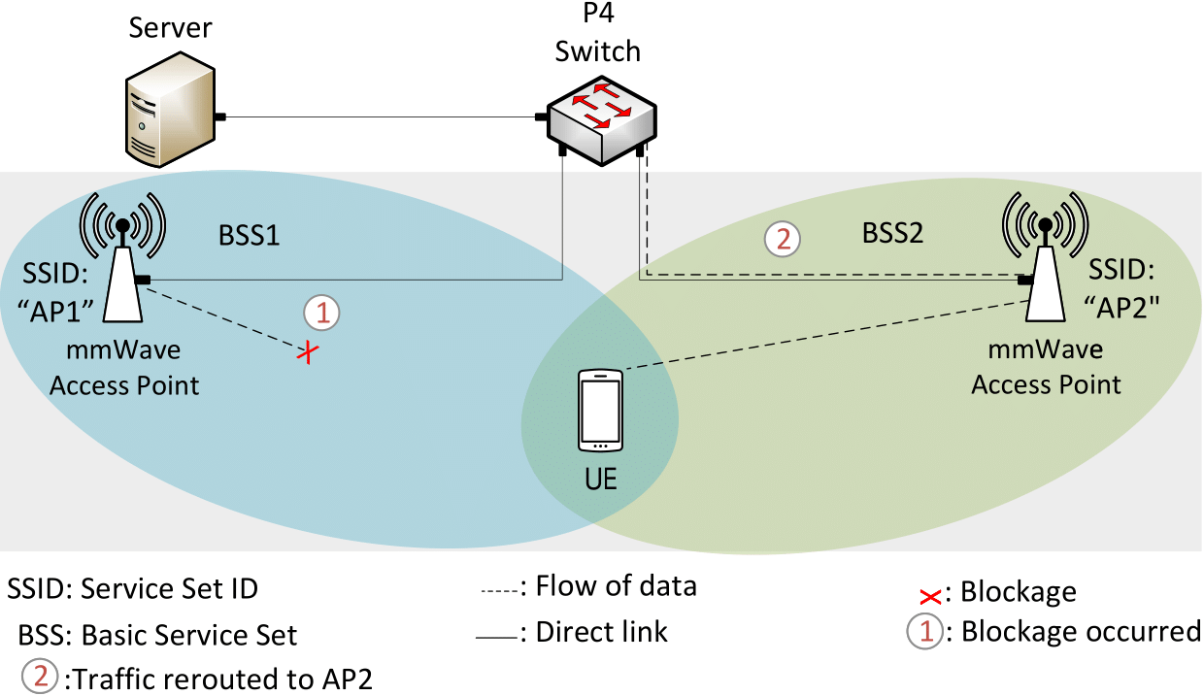
5G Performance and Security
Goal: Develop applications for enhancing performance and detecting/mitigating cyber-attacks on 5G networks

Slide 26
DEMO – Millimeter-wave blockage detection https://www.youtube.com/watch?v=b9jWcpBFsRs

Slide 27
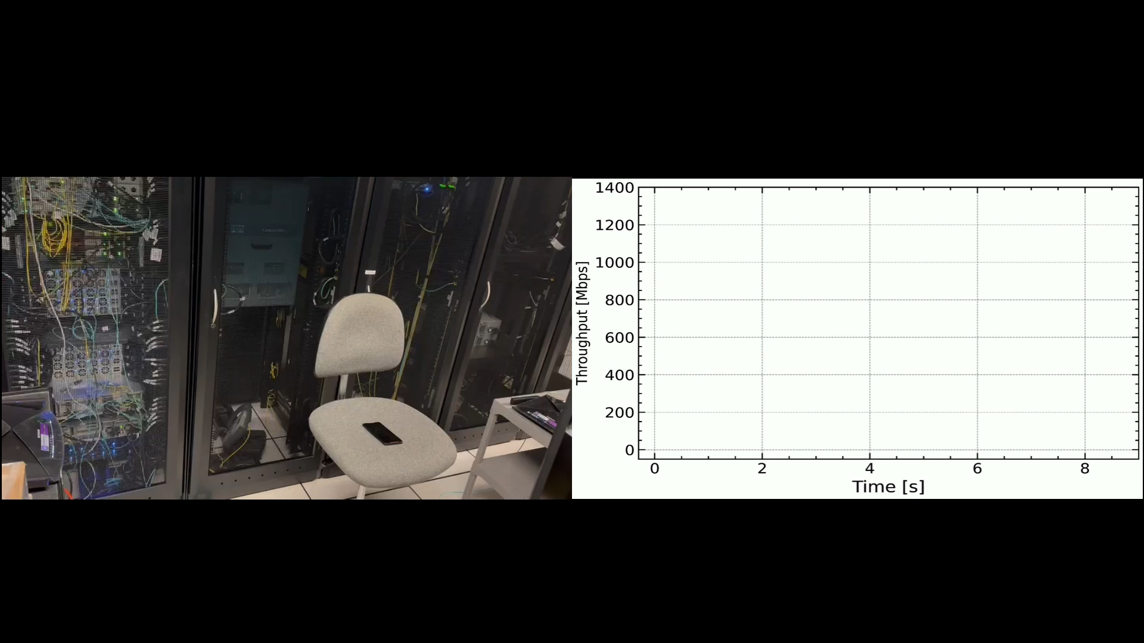

Slide 28
DEMO – Customized Application for DoS Detection https://youtu.be/EGQHUdrQ80M

Slide 29

P4 PDP Switches based on Intel’s Tofino Chip - Demo

Slide 30
Cyberinfrastructure Lab Capability
DoD – Office of Naval Research
“Preparing Cyber Warfare Professionals by Integration of Curriculum, Experiences, and Internships”
February 1 2023 – January 30 2026
Amount: $600,000

Slide 31
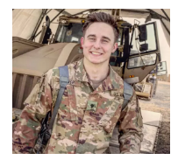
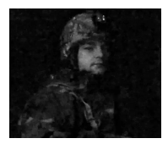
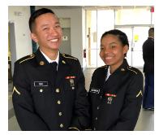
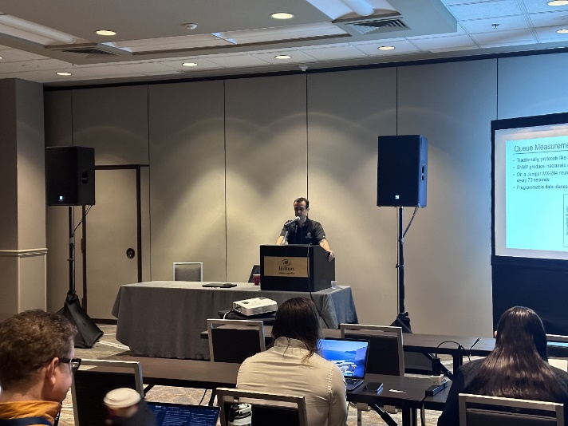
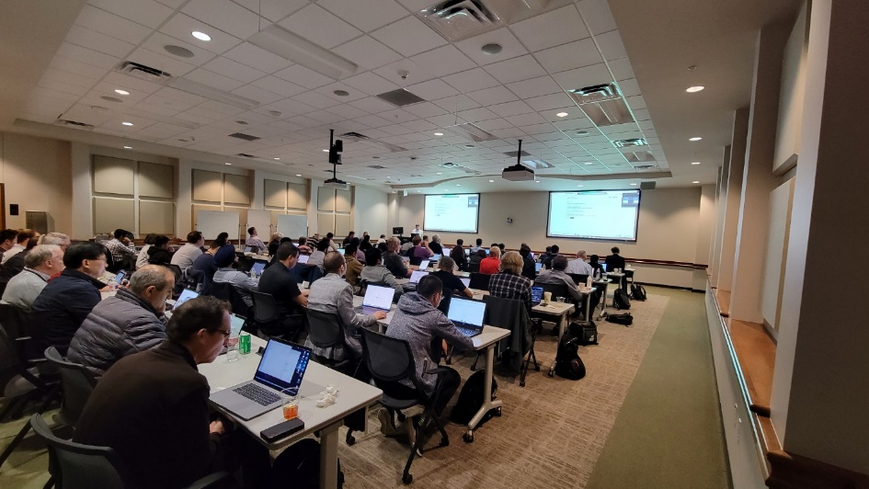
ONR Cyber
Goal 1: Advance formal and informal cyber communities
  Twelve-week C4ISR1 research experience (formal learning)
  Workshops and tutorials (informal learning)
Workshop on Security Applications with P4, FABRIC Community Workshop, Austin, TX, April 24, 2023 (with Texas Advanced Computing Center).
Workshop on Fine-grained Network Measurements with P4, Internet2 Technology Exchange Conference, Minneapolis, MN, Sep. 18, 2023 (with LBNL / ESnet).
1. C4ISR: Command, Control, Communications, Computers, Intelligence, Surveillance and Reconnaissance

Slide 32
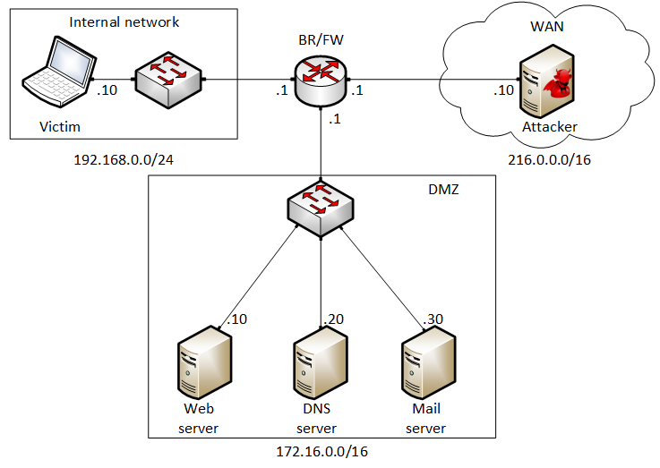
ONR Cyber
Goal 2: Expand the Academic Cloud
  Example: Lab library on “Fundamentals of Cybersecurity”
Lab 1: Reconnaissance: Scanning with NMAP, Vulnerability Assessment with OpenVAS
Lab 2: Remote Access Trojan (RAT) using Reverse TCP Meterpreter
Lab 3: Escalating Privileges and Installing a Backdoor
Lab 4: Collecting Information with Spyware: Screen Captures and Keyloggers
Lab 5: Social Engineering Attack: Credentials Harvesting and Remote Access through Phishing Emails
Lab 6: SQL Injection Attack on a Web Application
Lab 7: Cross-site Scripting (XSS) Attack on a Web Application
Lab 8: Denial of Service (DoS) Attacks: SYN/FIN/RST Flood, Smurf attack, and SlowLoris
Lab 9: Cryptographic Hashing and Symmetric Encryption
Lab 10: Asymmetric Encryption: RSA, Digital Signatures, Diffie-Hellman
Lab 11: Public Key Infrastructure: Certificate Authority, Digital Certificate
Lab 12: Configuring a Stateful Packet Filter using iptables
Lab 13: Online Dictionary Attack against a Login Webpage
Lab 14: Intrusion Detection and Prevention using Suricata
Lab 15: Packet Sniffing and Relay Attack
Lab 16: DNS Cache Poisoning
Lab 17: Man in the Middle Attack using ARP Spoofing
Lab 18: Understanding Buffer Overflow Attacks in a Vulnerable Application
Lab 19: Conducting Offline Password Attacks
  Border router implements policy rules to protect internal network

Slide 33
DEMO – Spyware https://youtu.be/x_7jsXsn_YU

Slide 34
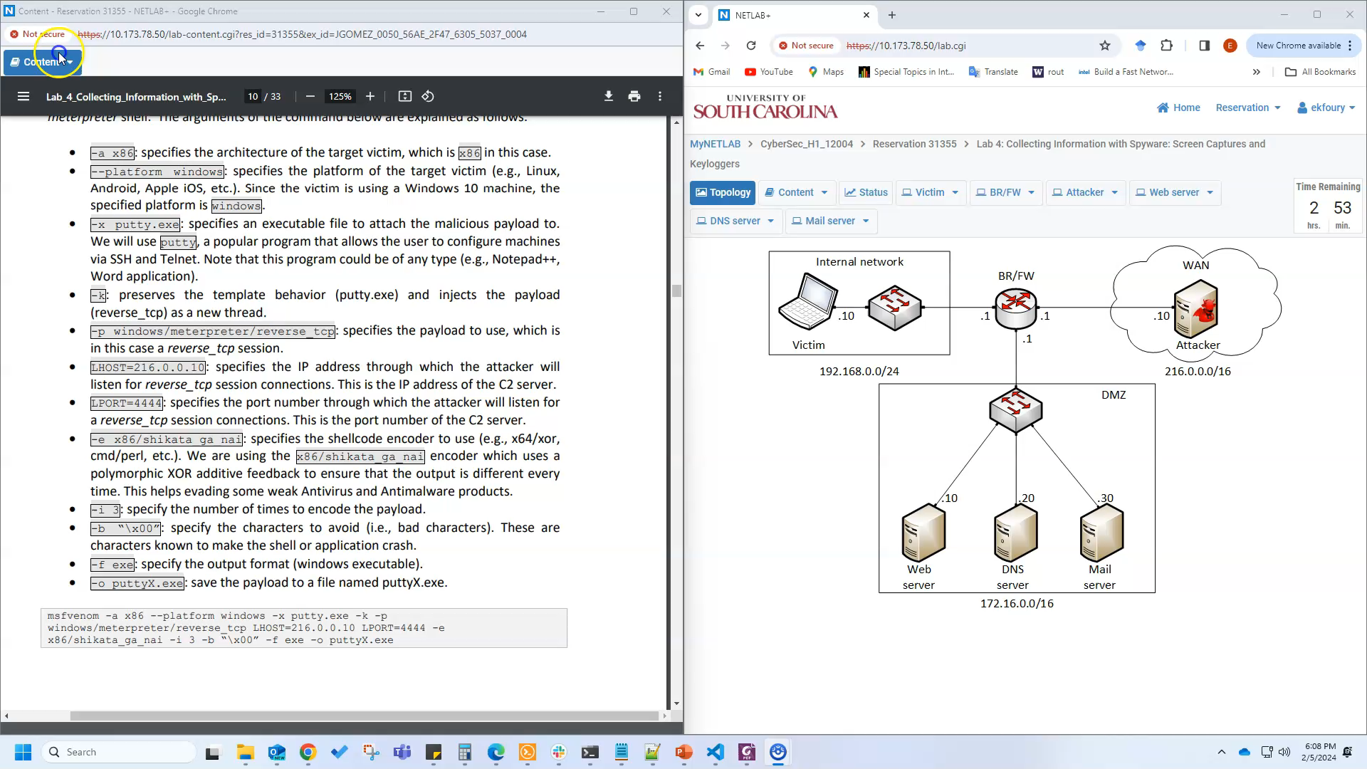
Demo

Slide 35
Cyberinfrastructure Lab Capability
National Science Foundation
“Cybertraining on P4 Programmable Devices using an Online Scalable Platform with Physical and Virtual Switches and Real Protocol Stacks”
October 1 2021– September 30 2025
Amount: $500,000

Slide 36
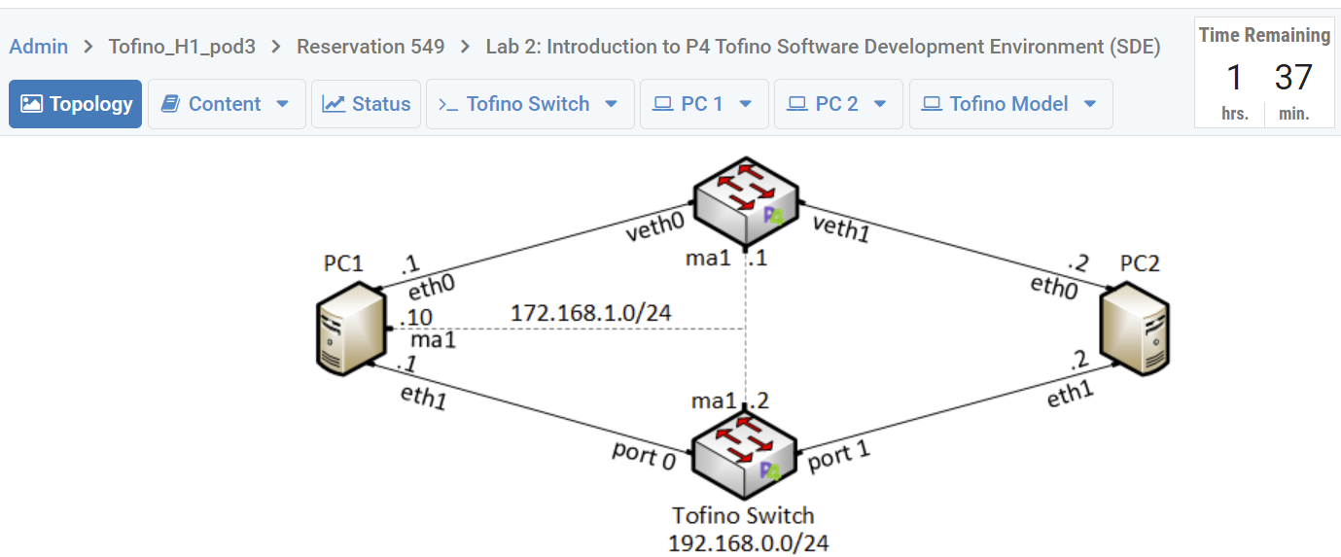
NSF Cybertraining
Goal 1: Develop virtual labs to facilitate the adoption of P4 devices by CI professionals.
  Six libraries have been developed: five fully virtualized and one with hardware switches.
  A virtual lab library is a systematic set of 10-15 lab experiments.
A learner conducting a lab experiment on the cloud. The pod includes physical hardware (programmable data plane and network connectivity via 100Gbps multi-mode fiber.

Slide 37
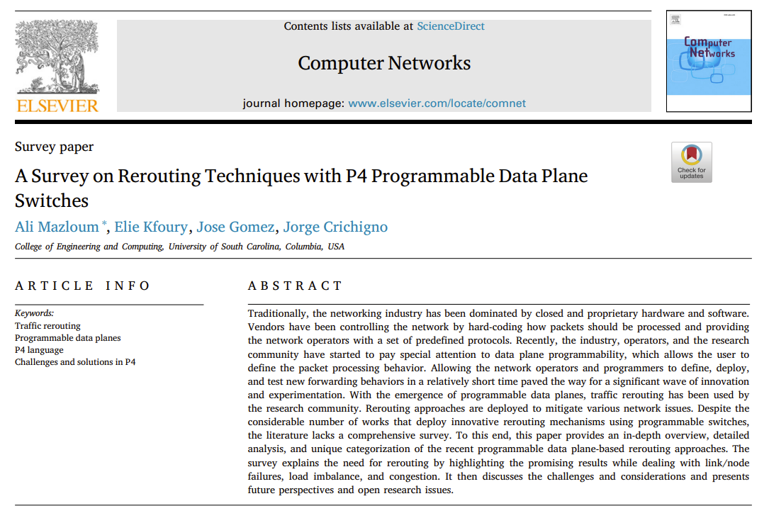

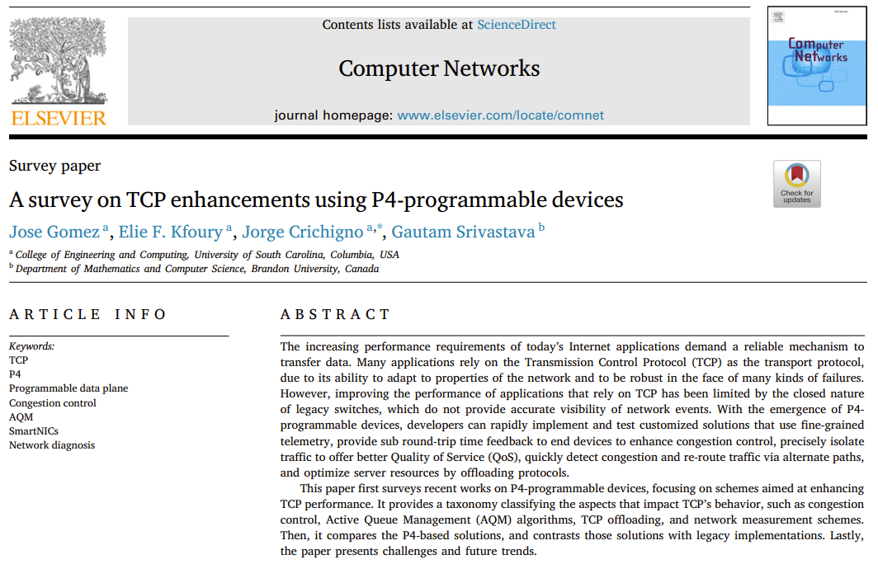
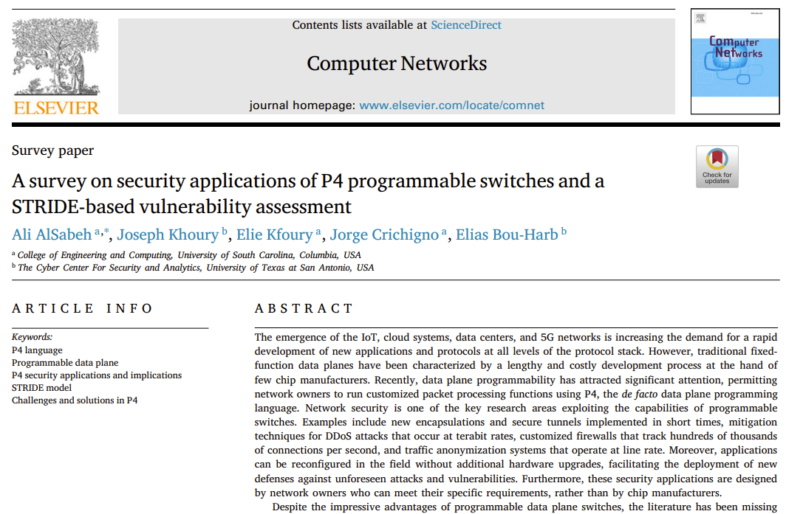
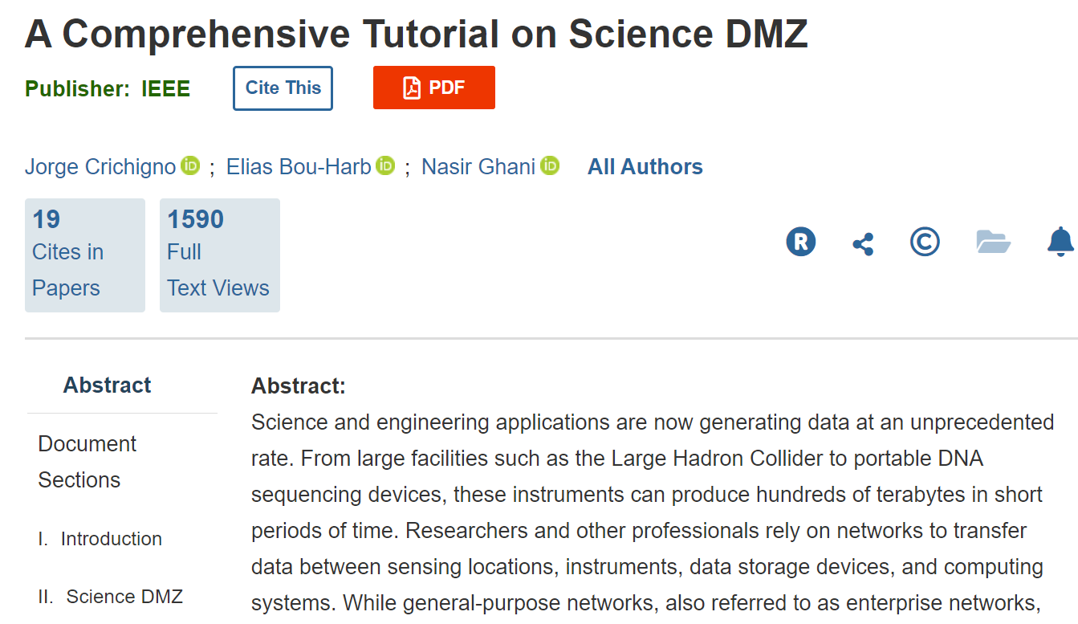
NSF Cybertraining
Goal 2: Facilitate the integration of P4 into academic degrees.
  Hands-on lab libraries, textbooks, technical tutorials

Slide 38
DEMO – High-resolution Measurements https://youtu.be/cWaWxsqVAgc

Slide 39
P4 PDP Switches based on Intel’s Tofino Chip - Demo

Slide 40
Virtual Lab Libraries Developed by the Cyberinfrastructure Lab
2019 – 2024

Slide 41
Virtual Lab Libraries
Introduction to IPv6
Cybersecurity Tools and Applications
Zeek Intrusion Detection and Prevention Systems
Cybersecurity Applications on P4 Programmable Data Planes
P4 Programmable Data Planes: Applications, Stateful Elements, and Custom Packet Processing
P4 Programmable Data Plane Switches based on BMv2
P4 Programmable Data Plane Switches based on Intel’s Tofino Chip
Introduction to Software Defined Networking (SDN)
Open Shortest Path First (OSPF)
Introduction to Border Gateway Protocol (BGP)
MPLS and Advanced BGP Topics
Open vSwitch (OvS)
Network Management Tools (Netflow, IPFix, sFlow)
Introduction to perfSONAR
PerfSONAR 5.0
Network Tools and Protocols (NTP)

Slide 42
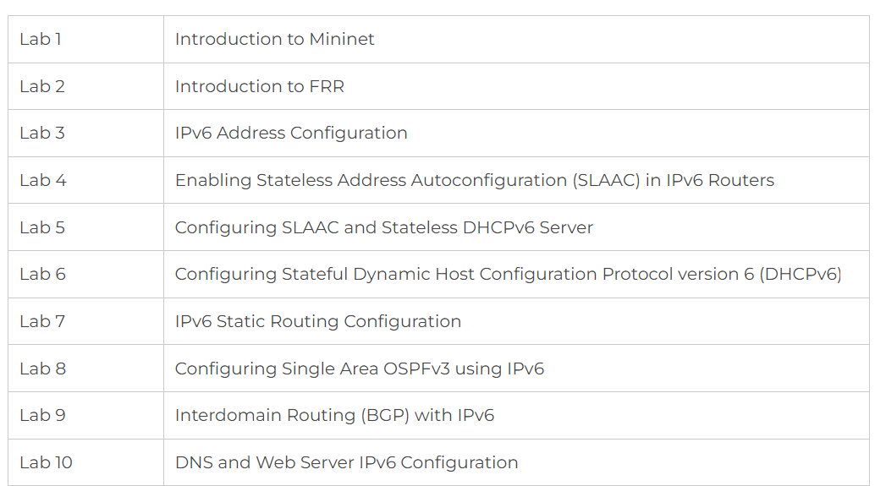
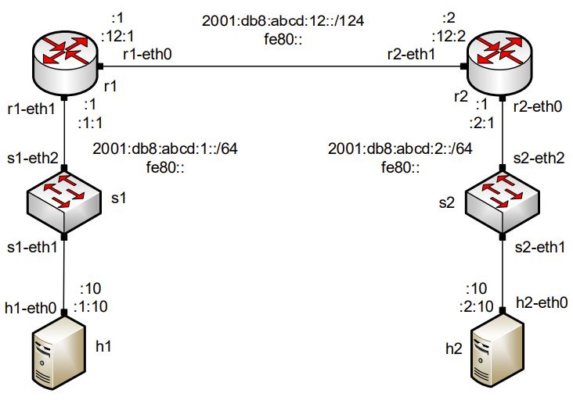
Introduction to IPv6
Introduction to IPv6 lab series
Pod example

Slide 43
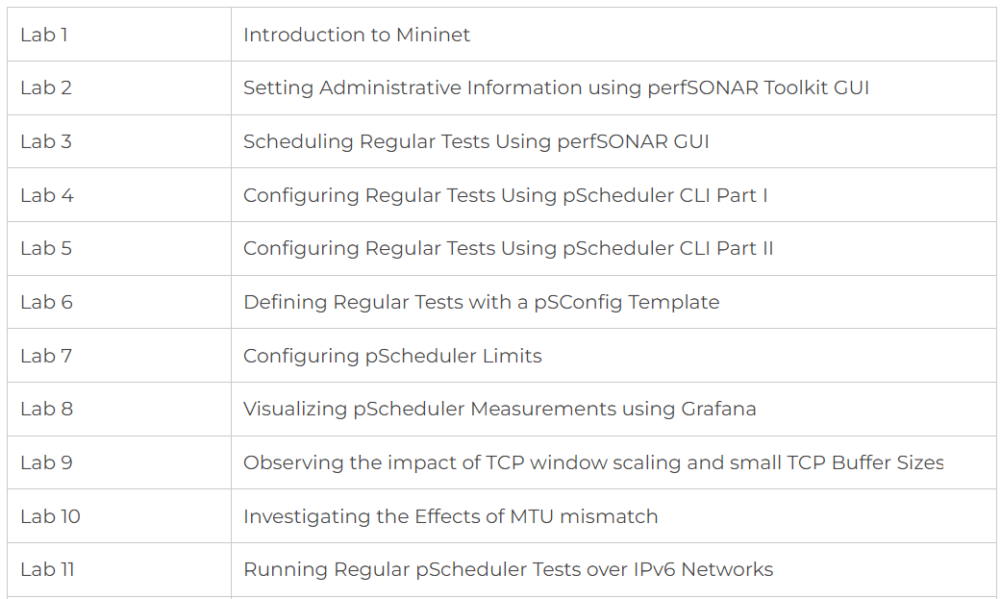
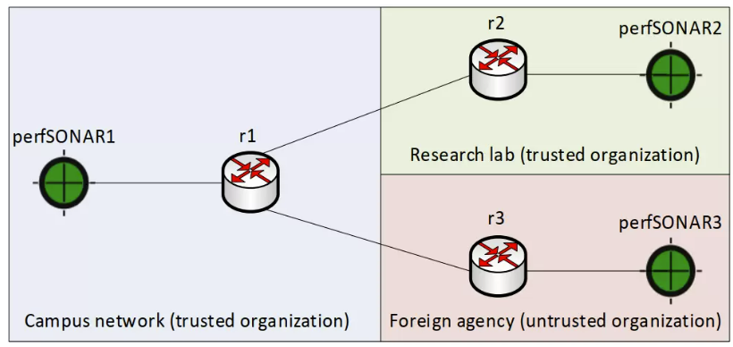
Introduction to perfSONAR 5
Introduction to perfSONAR 5 lab series
Pod example

Slide 44
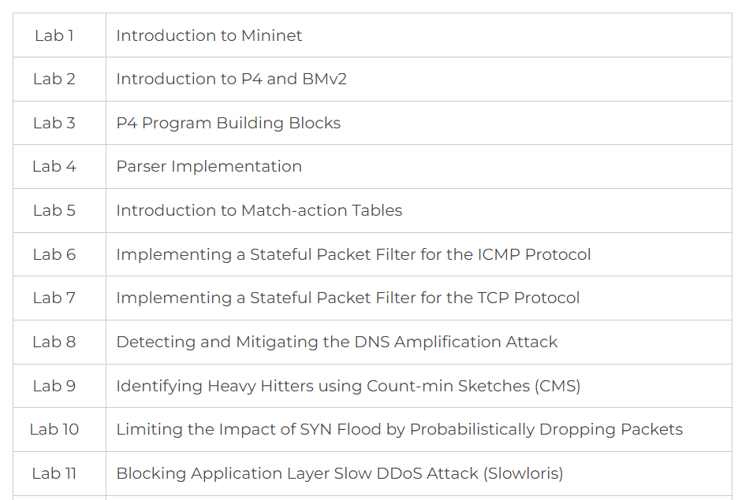
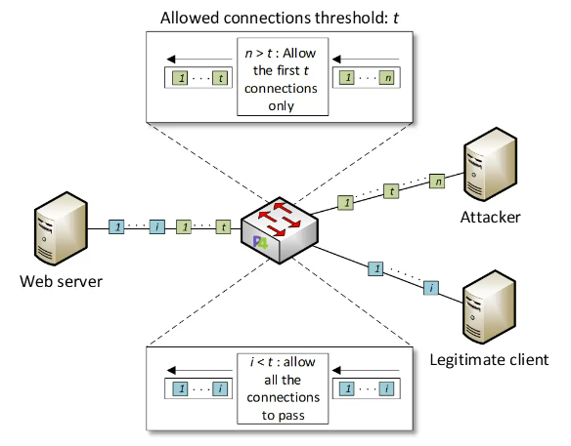
Cybersecurity Applications on P4 Programmable Data Planes
Cybersecurity Applications on P4 Programmable Data Planes lab series
Pod example

Slide 45
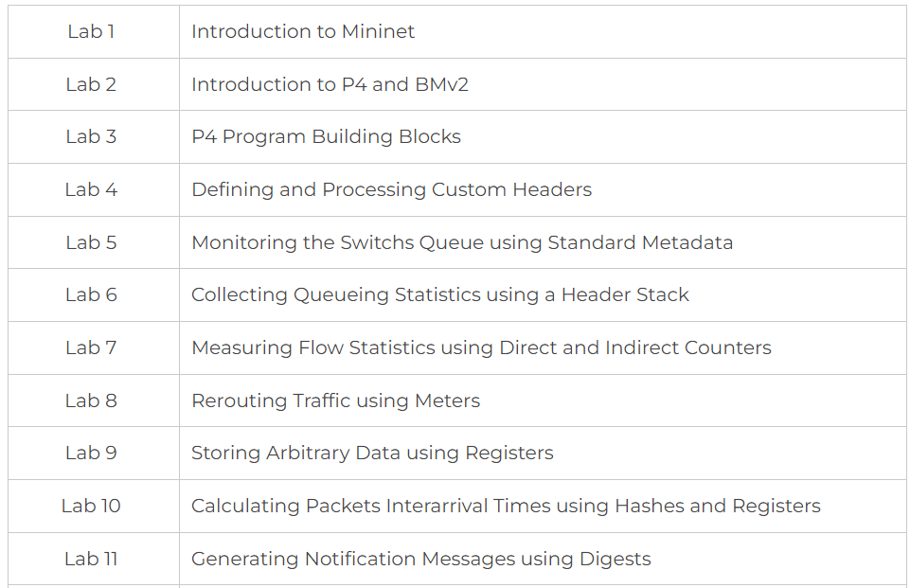
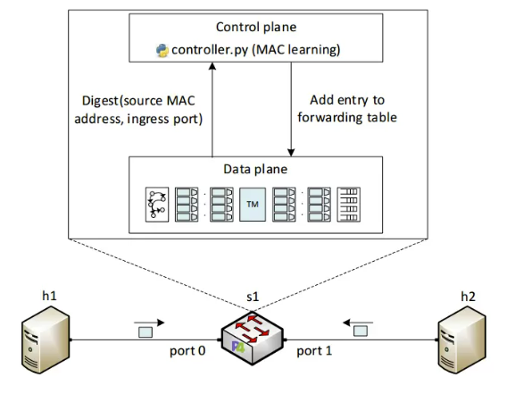
P4 Programmable Data Planes: Applications and Custom Packet Processing
P4 Programmable Data Planes lab series
Pod example

Slide 46
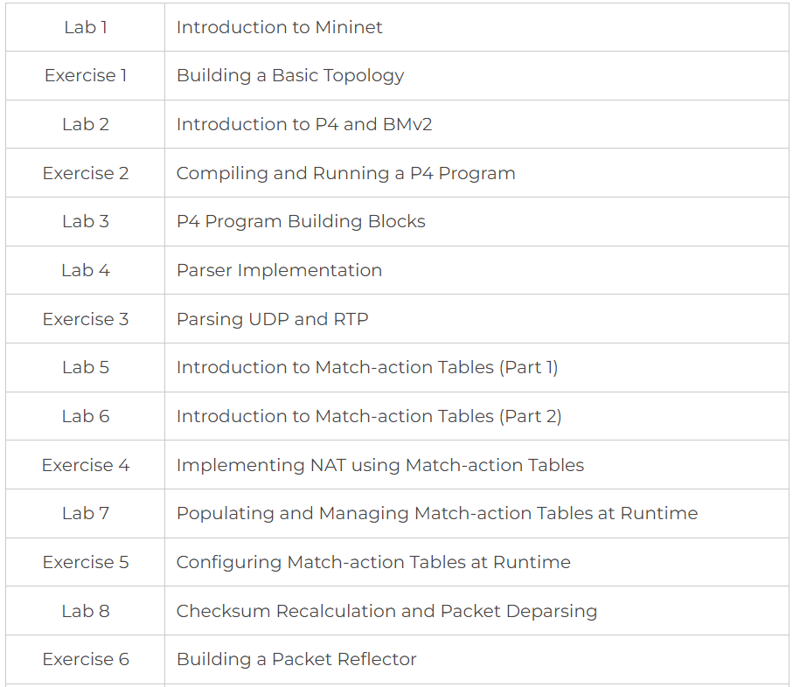
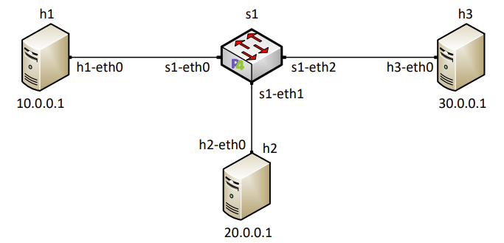
Introduction to P4 Programmable Data Plane Switches
Introduction to P4 Programmable Data Plane Switches lab series
Pod example

Slide 47
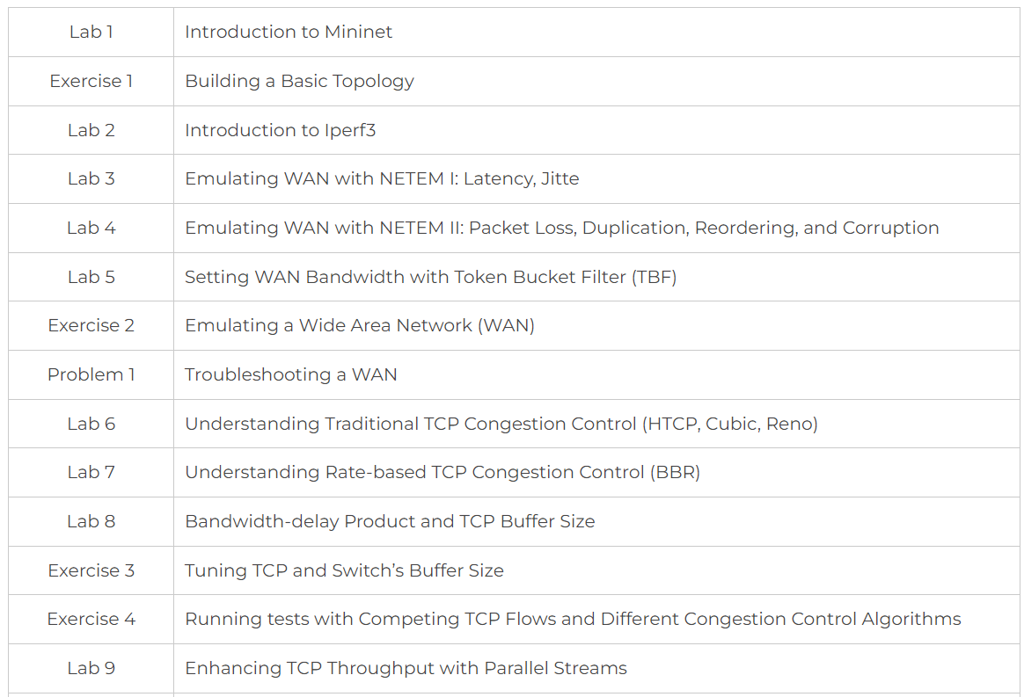
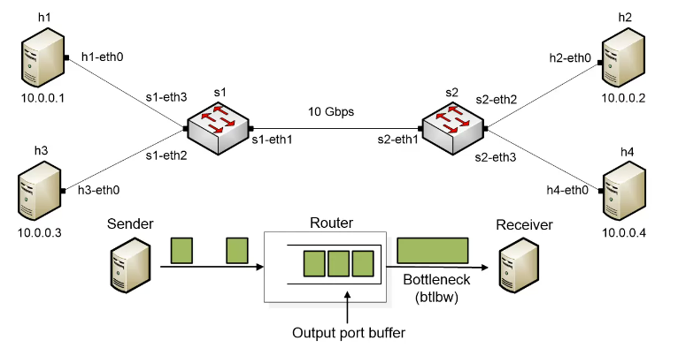
Network Tools and Protocols
Network Tools and Protocols lab series
Pod example

Slide 48
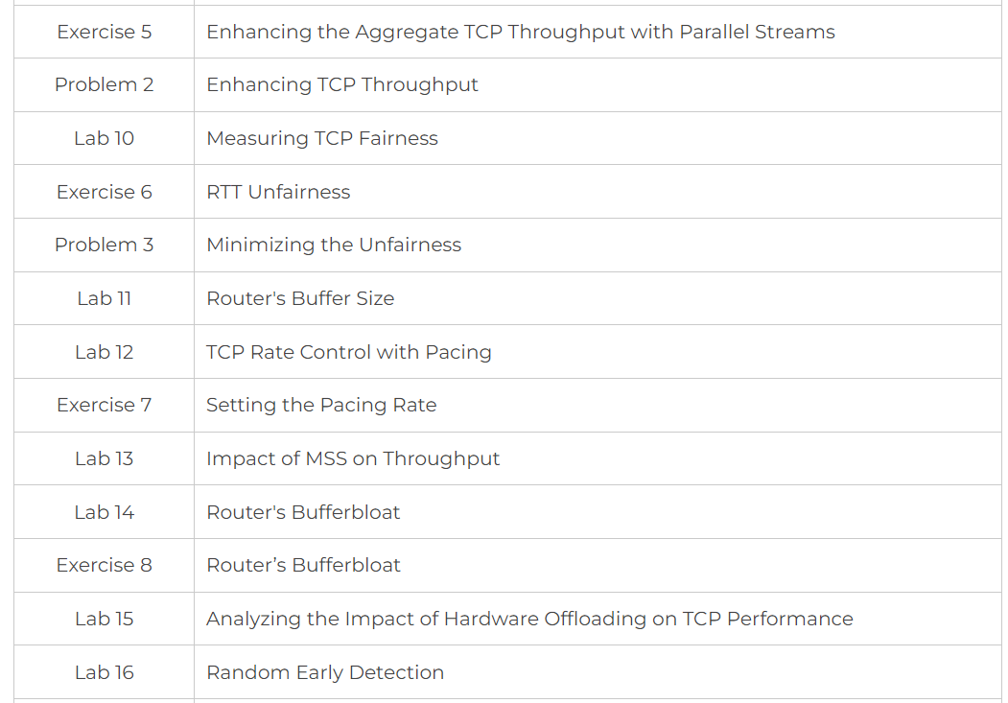
Network Tools and Protocols
Network Tools and Protocols lab series
Pod example

Slide 49
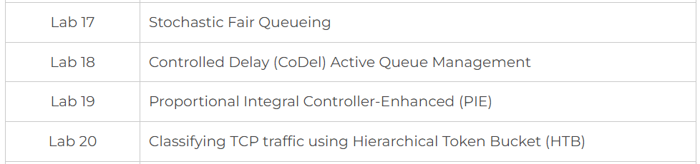
Network Tools and Protocols
Network Tools and Protocols lab series
Pod example

Slide 50
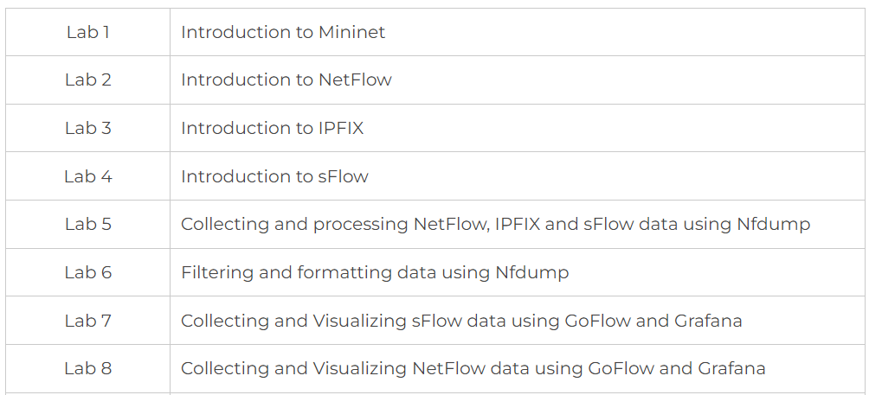
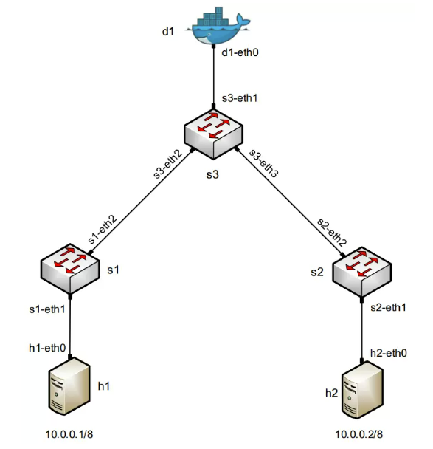
Network Management
Network Management lab series
Pod example

Slide 51
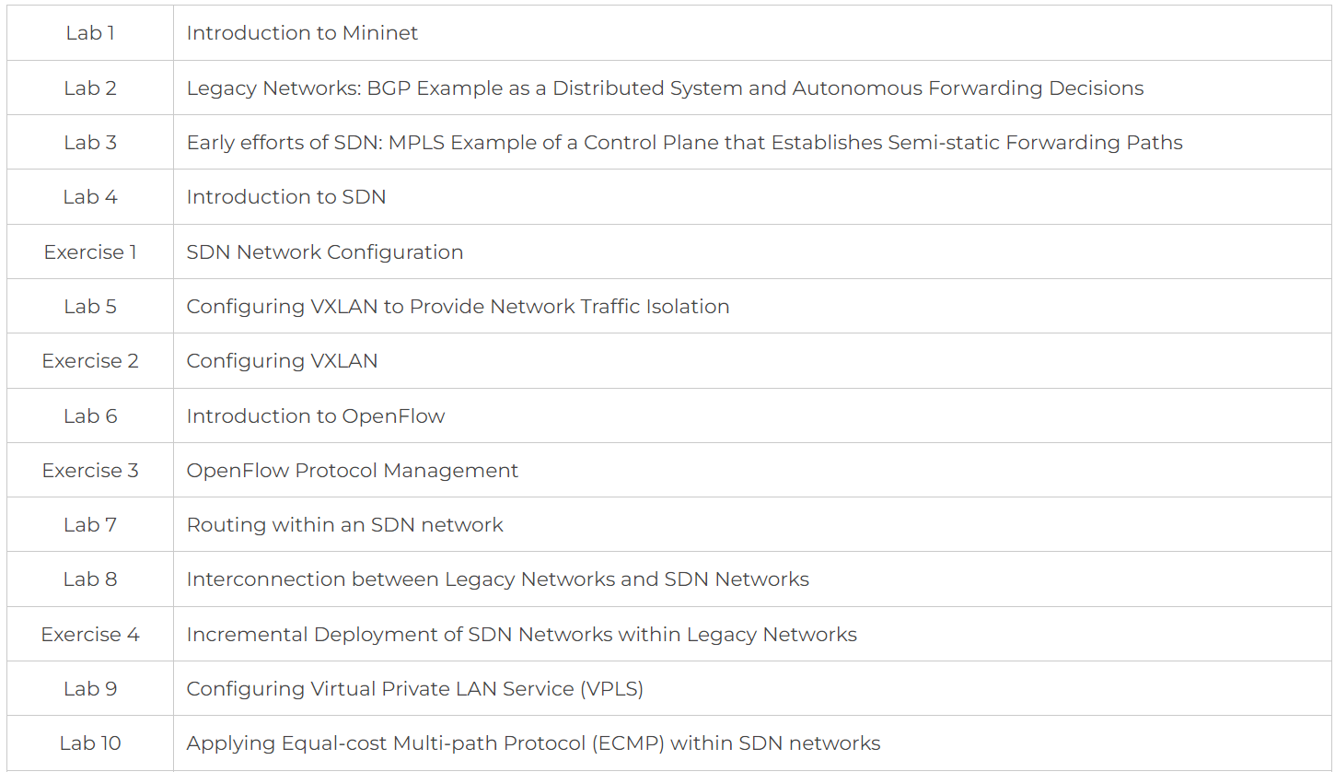
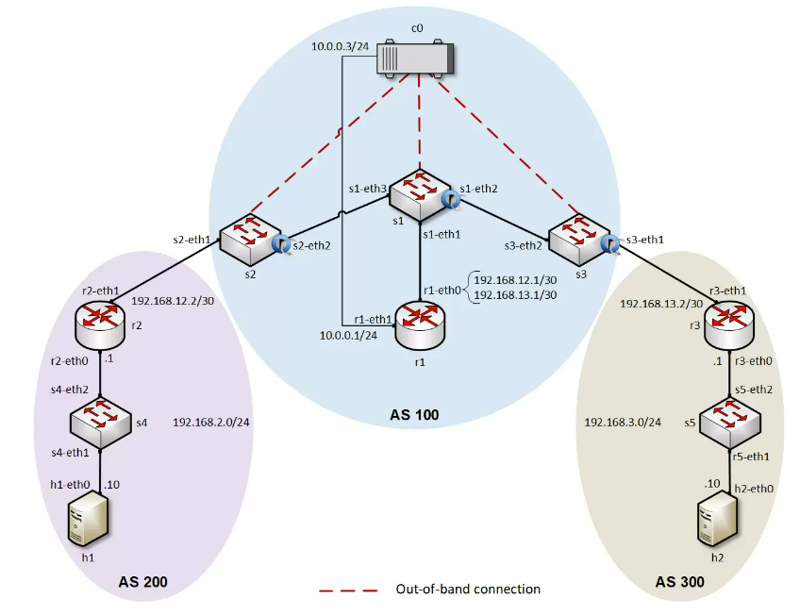
Introduction to Software-Defined Networking (SDN)
SDN lab series
Pod example

Slide 52
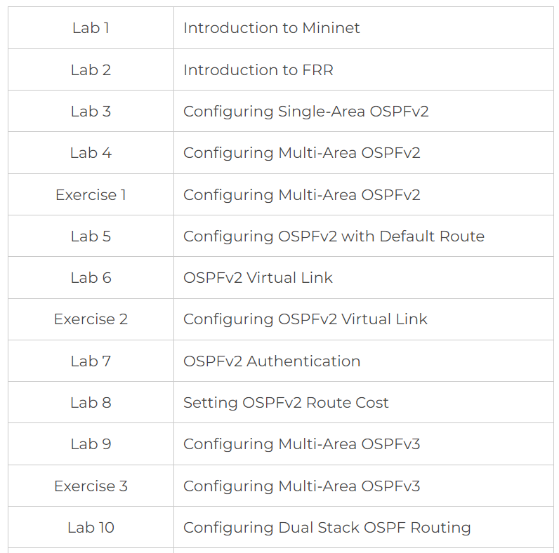
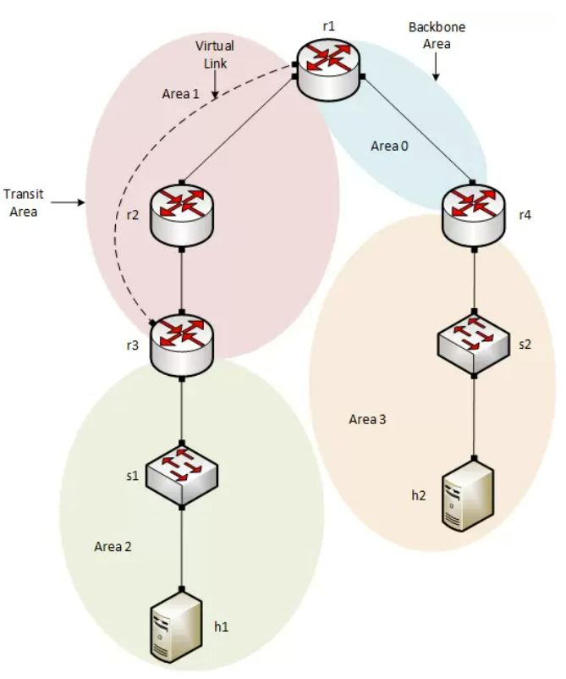
Open Shortest Path First (OSPF)
OSPF lab series
Pod example

Slide 53
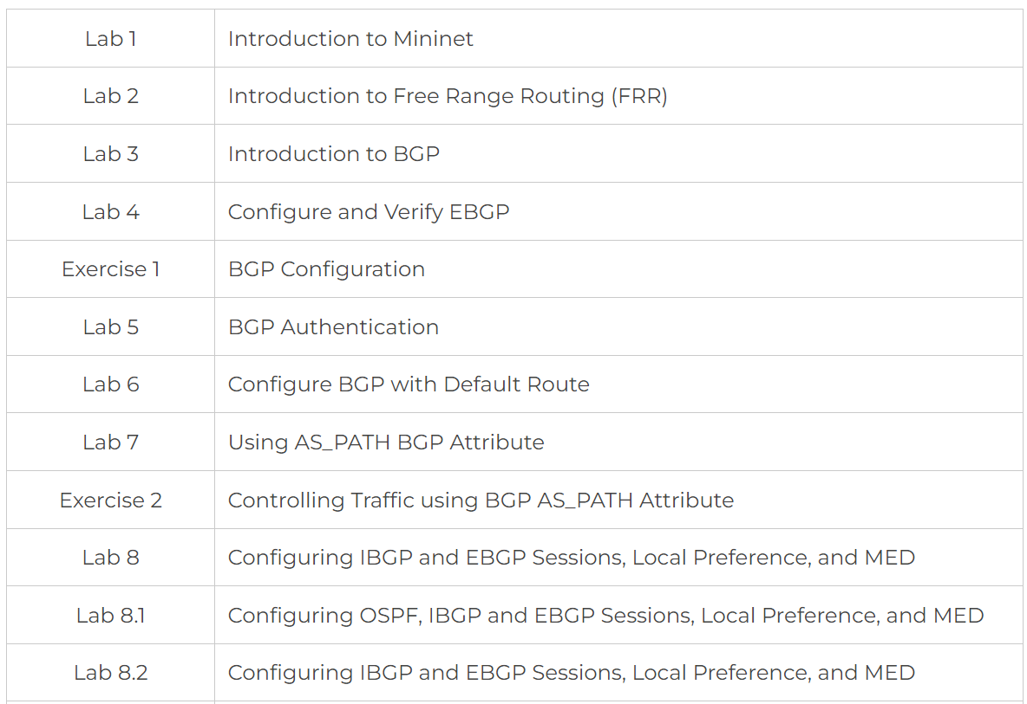
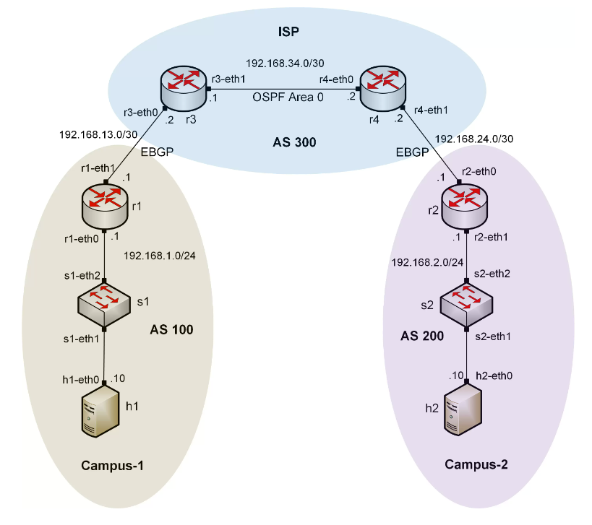
Introduction to Border Gateway Protocol (BGP)
Introduction to BGP lab series
Pod example

Slide 54
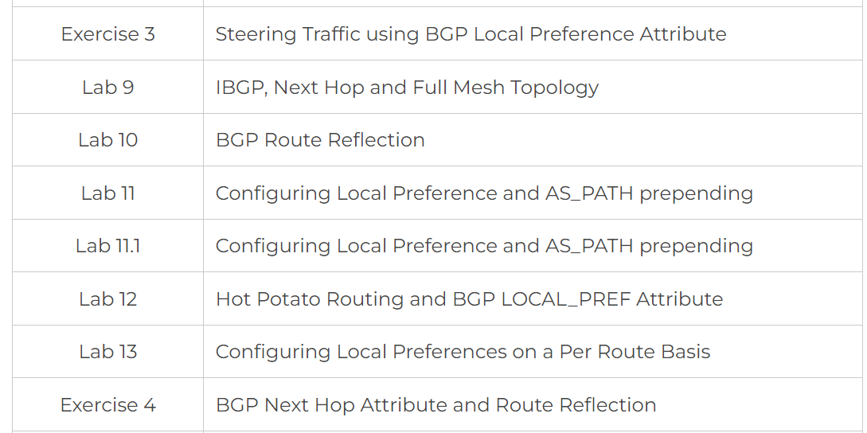
Introduction to Border Gateway Protocol (BGP)
Introduction to BGP lab series
Pod example

Slide 55
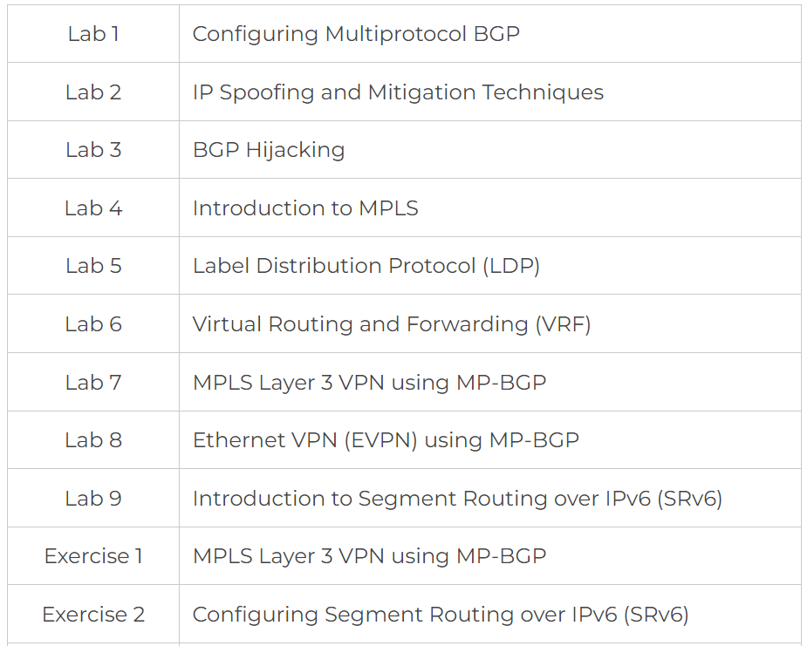
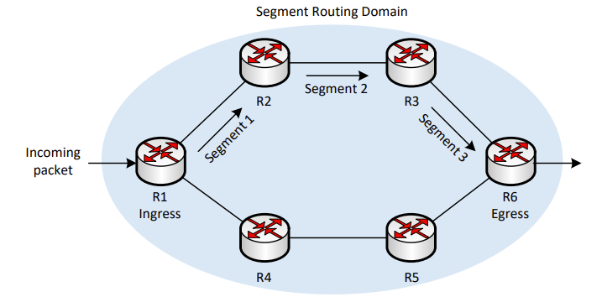
MPLS and Advanced BGP Topics
MPLS and Advanced BGP Topics lab series
Pod example

Slide 56
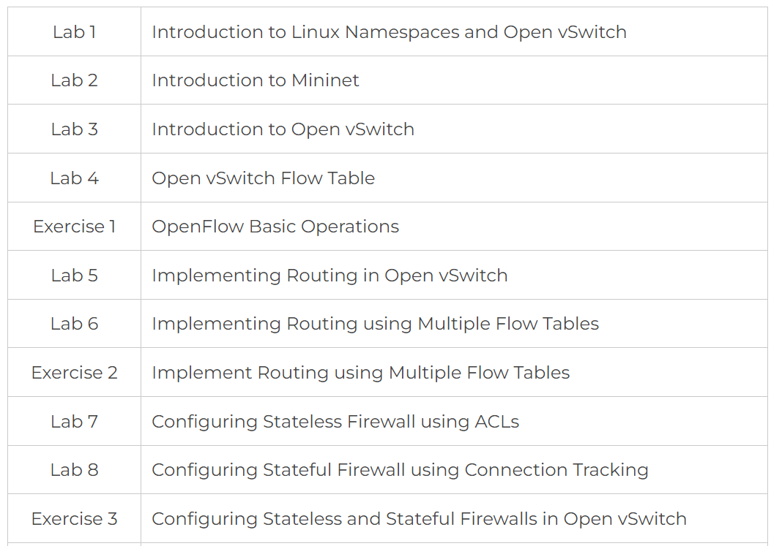

Open Virtual Switch (OVS)
OVS lab series
Pod example

Slide 57

Open Virtual Switch (OVS)
OVS lab series
Pod example

Slide 58
Open Virtual Switch (OVS)
OVS lab series
Pod example

Slide 59


Introduction to perfSONAR
Introduction to perfSONAR lab series
Pod example

Slide 60


Zeek Intrusion Detection System (IDS)
Zeek IDS lab series
Pod example

Slide 61
Additional Slides

Slide 62

NSF ATE
Goal 1: Expand the Academic Cloud to support large-scale learning on OT/ICS and IT cybersecurity
  Expand the Academic Cloud’s capacity
  Develop and deploy virtual labs on OT/ICS cybersecurity
  Develop and deploy virtual labs on IT cybersecurity
Academic Cloud. (a) A learner enters the cloud, (b) reserves a pod, and (c) interacts with the pod equipment. (d) By clicking on a device (e.g., PLC), a new window is opened, and the device can be manipulated.

Slide 63
NSF ATE
Goal 2: Develop an internship program on OT/ICS and IT cybersecurity
Bloom’s taxonomy in the context of the project

Slide 64


ONR Cyber
Goal 1: Advance formal and informal cyber communities
  Twelve-week C4ISR1 research experience (formal learning) - Between 50-75 undergraduates per year conducting research on cybersecurity at the University of South Carolina, South Carolina State University, UT San Antonio, LSU
1. C4ISR: Command, Control, Communications, Computers, Intelligence, Surveillance and Reconnaissance

Slide 65
ONR Cyber
Goal 1: Advance formal and informal cyber communities
  Workshops and tutorials (informal learning)
Workshop on Security Applications with P4, FABRIC Community Workshop, Austin, TX, April 24, 2023 (with Texas Advanced Computing Center).
Workshop on Fine-grained Network Measurements with P4, Internet2 Technology Exchange Conference, Minneapolis, MN, Sep. 18, 2023 (with LBNL / ESnet).

Slide 66
ONR Cyber
Goal 1: Advance formal and informal cyber communities
  Workshops and tutorials (informal learning)
Workshops organized between 2023-2024
 | Workshop / Tutorial | Date / Place | Website and Materials | Att.
1 | Workshop on IPv6 | Feb. 15-16, 2024, NYC, NY (8am-5pm) | https://tinyurl.com/mt45fasn | 35
2 | Workshop on Cybersecurity with P4 | Feb. 9, 2024, Tampa, FL (8am - 4pm) | https://tinyurl.com/ms229396 | 30
3 | Cybersecurity (Security+) and P4 Programmable Switches Workshop | Jan 4-5, 2024, San Jose, CA (8am-5pm) | https://tinyurl.com/yazac6n6 | 290
4 | Internet2 Technology Exchange Conference - Writing Fine-grained Measurements App with P4 Programmable Switches | Sep. 18, 2023, Minneapolis, MN (8am-12pm) | https://tinyurl.com/uw4t3nca | 20
5 | Internet2 Technology Exchange Conference - Hands-on Workshop on Science DMZs and Networking for All. Co-organizer: Minority Serving Cyberinfrastructure Consortium | Sep. 18, 2023, Minneapolis, MN (1-5pm) | https://tinyurl.com/3dje732n | 20
6 | Internet2 Technology Exchange Conference - Security Applications with P4 Programmable Switches | Sep. 18, 2023, Minneapolis, MN (1-5pm) | https://tinyurl.com/58p6yrf6 | 20
7 | Online Workshop on Cybersecurity | Jun. 17 –21, 2023, Online | https://tinyurl.com/yyrwjucj | 32
8 | FABRIC Community Workshop - Workshop on Security Applications with P4 | Apr. 24, 2023, Austin, TX (1-3pm) | http://tinyurl.com/2p8tcw8n | 70
 |  |  | TOTAL: | 517

Slide 67
ONR Cyber
Goal 1: Advance formal and informal cyber communities
  Workshops and tutorials (informal learning)
Workshop on Security Applications with P4, FABRIC Community Workshop, Austin, TX, April 24, 2023 (with Texas Advanced Computing Center).
Workshop on Fine-grained Network Measurements with P4, Internet2 Technology Exchange Conference, Minneapolis, MN, Sep. 18, 2023 (with LBNL / ESnet).

Slide 68


ONR Cyber
Goal 1: Advance formal and informal cyber communities
  Workshops and tutorials (informal learning)
Workshop on IPv6 and Cybersecurity, New York State Research and Education Network, NYC, Feb. 15-16, 2024 (with LBNL / ESnet and Texas Advanced Computing Center).
Workshop on Cybersecurity (Security+) and P4 Programmable Switches, San Jose, CA, Jan. 4-5, 2024 (with NDG).

Slide 69

ONR Cyber
Goal 1: Advance formal and informal cyber communities

Slide 70

5G Performance and Security
In clear LOS, the average IAT is 7 microseconds (us)
93.3% of IATs are less than 1 us
The recovery speed from blockage was evaluated
The line of sight (LOS) was blocked for 2 seconds
The proposed system required around 160 milliseconds to fully recover from the blockage
¹
¹Y. Oguma et. al. “Implementation and evaluation of reactive base station selection for human blockage in mmWave communications,” Asia-Pacific Conference on Communications (APCC), 2015
Notes:
The proposed system outperforms the throughput-based system and the RSSI-based system, at which the recovery speed of the proposed system is 5x faster than the throughput-based system and 10x faster than the RSSI-based system

Slide 71

ONR Cyber
The project is creating a pipeline of cyber-professionals from college to Navy and military communities
IT capability, Naval Information Warfare Systems Command¹
Organizations
1. Naval Information Warfare Systems Command, Generic View. February 2022. URL: https://tinyurl.com/4pnpy44n

Slide 72






Capability - Cyberinfrastructure Lab
Elie Kfoury
Assistant Professor
Jose Gomez
PhD Student
Samia Choueiri
PhD Student
Ali AlSabeh
PhD Student
Ali Mazloum
PhD Student
Christian Vega
PhD Student

