Slide 1
DNS Records (AAAA), DNS Server Configurations, IPv6 Security

Slide 2
IPv6 Security

Slide 3
Progress Bar:
1:00p - 2:00p
Questions or Discussion topics?

Slide 4
IPv6 Security - Unit Overview
IPv6 Security Myths
IPv6 Privacy Extensions
ICMPv6 Filtering
Host Security
RA Guard
Local Network Monitoring

Slide 5
IPv6 Security - 3 Myths
Myth #1: I haven’t enabled IPv6 on my network, I don’t need to secure it.
Myth #2: IPv6 isn’t vulnerable to port scans due to how large the IP space is.
Myth #3: IPv6 is too new to have vulnerabilities

Slide 6
IPv6 Security Myth - 1
Myth #1: I haven’t enabled IPv6 on my network, I don’t need to secure it.
  Hosts are already running IPv6 on your network
  All modern OS’s have IPv6 enabled by default
  Have they been secured?
  Configuration for firewall rules and applications is typically separate
  Ports running services will listen

Slide 7
IPv6 Security Myth - 2
Myth #2: IPv6 isn’t vulnerable to port scans due to how large the IP space is.
  While running `nmap -v -sn 2620:2800::/64` takes forever, there are “best guess” ways to scan and find hosts that cuts down on scan times.
  Neighbor Discovery Protocol (NDP) can show all ‘friends’ near you based on how IPv6 works.

Slide 8
IPv6 Security Myth - 3
Myth #3: IPv6 is too new to have vulnerabilities…
  IPv6 has been around for 20+ years. Bugs and vulnerabilities exist and are something that needs to be watched/patched just like you have been for IPv4
  CVE-2024-38063 - Remotely Exploiting The Kernel Via IPv6 a nice write up and code analysis.
      Recently found. This one goes back to Windows 10 and Windows Server 2008R2 - You patched, right?

Slide 9
IPv6 Security - Privacy Addresses
What are privacy addresses?
  For networks using SLAAC, having your device use the EUI-64 method means your device can be easily tracked from network to network.
  Defined in RFC 4941.
  Most devices rotate IP’s every 24 hours.
  Typically the old IP is kept for another 24 hours to receive responses to old connections, but no new connections are initiated.
Why do devices use privacy addresses?
  For networks using SLAAC, having your device use the EUI-64 method means your device can be easily tracked from network to network.
  Enable privacy extensions
How do I configure this on my device?
  Enabled by default on most modern OS’s*
  *Disclaimer: Trust, but verify. We can’t keep track of all the different OS’s and devices in circulation.

Slide 10
IPv6 Security - ICMPv6 Filtering (WAN)
Allow:
Type 1, <All Codes> - Destination Unreachable
Type 2 - Packet Too Big (PMTUD)
Type 3, Code 0 - Time Exceeded
Type 4, Codes 1 & 2 - Parameter Problem
Type 128 - Echo Request
Type 129 - Echo Response
Type 135 and Type 136 - Neighbor Solicitation and Neighbor Advertisement
Block:
Types 5-99, 100, 101, 102-126, 154-199, 200, 201, 202- 254

Slide 11
IPv6 Security - ICMPv6 Filtering (LAN)
Allow:
Type 1, <All Codes> - Destination Unreachable
Type 2 - Packet Too Big (PMTUD)
Type 3, Code 0 - Time Exceeded
Type 4, Codes 1 & 2 - Parameter Problem
Type 130, 131, 132, 143 - Multicast Listener Discovery (link local source address)
Type 133 and Type 134 - Router Solicitation and Router Advertisement
Type 135 and Type 136 - Neighbor Solicitation and Neighbor Advertisement
Type 141 and Type 142 - Inverse Neighbor Solicitation and Advertisement
Block:
Types 5-99, 100, 101, 102-126, 154-199, 200, 201, 202- 254

Slide 12
IPv6 Host Security - ip6tables Examples
ip6tables is the IPv6 equivalent of iptables*
Command syntax is the same
Example:
  ip6tables -A INPUT -d fe80::/64 -p udp -m udp --dport 546 -m state --state NEW -j ACCEPT
*Disclaimer: Yes, IPTABLES is moving toward deprecated. Much like old servers, old habits linger.

Slide 13
IPv6 Security - nftables Examples
NFTables Families
  ip - Used for IPv4
  ip6 - Used for IPv6
  inet - Support for IPv4 and IPv6. Best used for dual-stack servers/hosts
Example:
  # This rule affects only IPv4 packets:
    add rule inet filter input ip saddr 1.1.1.1 counter accept
  # This rule affects only IPv6 packets:
    add rule inet filter input ip6 daddr fe00::2 counter accept
  # These rules affect both IPv4 and IPv6 packets:
    add rule inet filter input ct state established,related counter accept
    add rule inet filter input udp dport 53 accept

Slide 14
IPv6 Security - UFW Examples
Check if UFW has IPv6 enabled
  cat /etc/default/ufw | grep IPV6
  If “IPV6=no”, then UFW is only allowing V6 traffic on the loopback interface
  Edit the file, change this to option to yes and then reload with “sudo ufw reload” or “sudo ufw disable-then-enable"
Add your first rules
  UFW doesn’t require different syntax between IPv4 and IPv6 rules. It will automatically detect and add the respective rules to the correct chain
  “ufw allow from fe80::/64”
  etc.

Slide 15
IPv6 Security - Firewalld Examples
Firewalld zone config mostly relies on ports and services
Rich Rules
  rule family="ipv4" source address="x.x.x.x/24" service name="tftp" log prefix="tftp" level="info" limit value="1/m" accept
  rule family="ipv6" source address="2001:DB8::/32" service name="tftp" log prefix="tftp" level="info" limit value="1/m" accept

Slide 16
IPv6 Security - RA Guard Overview
RA messages are unsecured, how do we protect against misconfigured or rogue routers?
RA Guard
  Similar to STP BPDU Guard, etc.
  Allows filtering based on the following:
    Source MAC address
    Source IPv6 address
    Source IPv6 address prefix
    Hop-count limit
    Router preference priority
    Managed configuration flag
    Other configuration flag

Slide 17
IPv6 Security - RA Guard Overview
RA messages are unsecured, how do we protect against misconfigured or rogue routers?
Stateless vs Stateful mode
  Stateless mode
    With policy: Interfaces marked as “trusted” validate the RA message against the set policy and then forward if it matches
    Without policy: Interfaces marked as “trusted” forward RA packet without being validated against a policy
    With/without policy: Interfaces marked as “blocked” block all RA packets
  Stateful mode
    Allows dynamically transitioning ports based on RA packets received during the learning process
    Ports that receive RA messages that match the policy during the learning process transition to forwarding
    Ports that do no receive RA messages or receive RA messages that do not match the policy during the learning process transition to blocking

Slide 18
IPv6 Security - RA Guard States
Off | The interface operates as if RA guard is not available. | Stateless/stateful
Untrusted | The interface forwards ingress RA messages if received RA messages are validated against the configured policy rules; otherwise, it drops the RA message. Untrusted state is the default state of an interface enabled for RA guard. | Stateless/stateful
Blocked | The interface blocks ingress RA messages. | Stateless/stateful
Forwarding | The interface forwards ingress RA messages if received RA messages are validated against the configured policy rules; otherwise, it drops the RA messages. | Stateful
Learning | The switch actively acquires information about the IPv6 routing device connected to the interface. The learning process takes place over a predefined period of time. | Stateful
Trusted | The interface forwards all RA messages directly, without validating them against the policy. | Stateless/stateful

Slide 19
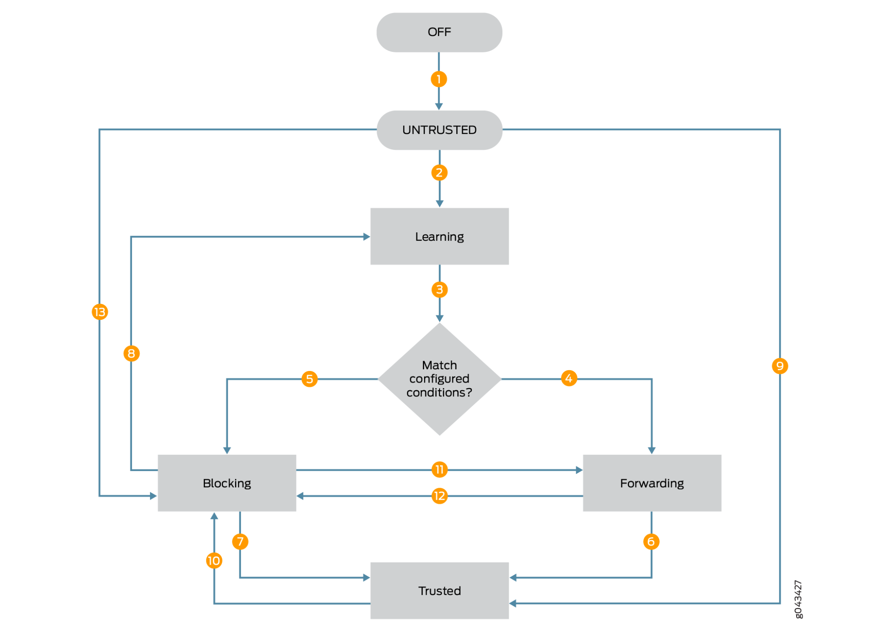
IPv6 Security - RA Guard States (Flow Chart)

Slide 20
IPv6 Security - RA Guard Example (Juniper Stateless w/ Policy)
Configure a RA guard policy:
  set policy-options prefix-list accept-ra-address $address
  set policy-options prefix-list accept-ra-prefix $prefix
  set policy-options prefix-list accept-ra-mac $macAddress
Apply the policy:
  set forwarding-options access-security router-advertisement-guard policy accept-ra accept match-list match-criteria match-all
  set forwarding-options access-security router-advertisement-guard policy accept-ra accept match-list source-prefix-list accept-ra-prefix
Configure RA Guard:
  set forwarding-options access-security router-advertisement-guard interface $interface policy $policy stateless
  set forwarding-options access-security router-advertisement-guard vlans $vlan policy $policy stateless

Slide 21
IPv6 Security - RA Guard Example (Juniper Stateless w/o Policy)
Configure RA Guard:
  set forwarding-options access-security router-advertisement-guard interface $interface mark-interface trusted
  set forwarding-options access-security router-advertisement-guard interface $interface mark-interface block

Slide 22
IPv6 Security - RA Guard Example (Juniper Stateful)
Configure a RA Guard Policy
  Example:
Configure RA Guard
  set forwarding-options access-security router-advertisement-guard interface $interface policy $policy stateful
  set forwarding-options access-security router-advertisement-guard vlans $vlan policy $policy stateful
Enable RA Guard
  By default, RA guard is off. You have to request on a per interface/vlan basis.
  Forward during learning: request access-security router-advertisement-guard-learn interface $interface duration $seconds forward
  Block during learning: request access-security router-advertisement-guard-learn interface $interface duration $seconds block
  Static forward: request access-security router-advertisement-guard-forward interface $interface
  Static block: request access-security router-advertisement-guard-block interface $interface

Slide 23
IPv6 Security - RA Guard Example (Cisco)
Cisco RA Guard Device Roles
  Host - Interface or VLAN where you connect a host. This where you apply the IPV6 RA Guard policy. The device-role host allows incoming RS packets, and blocks incoming RA or RR packets. RS packets that are received on another interface, are not redirected to the device-role host. Only RA and RR packets (that are allowed) are redirected to the device-role host.
  Switch - The device-role switch behaves similar to the device-role host. For example, you can use it as a label for a trunk port.
  Monitor - This device monitors network traffic. It behaves similar to the device-role host, except that RS packets are also sent to this interface. This helps capture traffic.
  Router - Interface that connects to the router. This interface allows incoming RS, RA, or RR packets.
Config Example - Host Port
  conf t
  ipv6 nd raguard policy host
  device-role host
  exit
  interface $interface
  ipv6 nd raguard attach-policy host

Slide 24
IPv6 Security - Local Network Monitoring
NDPMon:
  Deprecated
Arpwatch-V6:
  https://github.com/acobaugh/arpwatch-v6
Addrwatch:
  https://github.com/fln/addrwatch

Slide 25
IPv6 Security - Local Network Monitoring (2)
Things To Look Out For:
Wrong router MAC: invalid MAC address
Wrong router IP address, invalid IP address
Wrong prefix: invalid IPv6 prefix
Wrong RA flags: invalid flags in the RA
Wrong RA params: wrong parameter in the RA (lifetimes, timers...)
Wrong router redirect: the router which emitted the redirect is not valid
Router flag in Neighbor Advertisement: a node not declared as a router announced itself as one
Duplicate Address Detection DOS: duplicate address detection denial of service
Changed ethernet address: a Global IPv6 address has a new MAC address
Unknown MAC Manufacturer: MAC vendor unknown, might be a forged one
New node on the wire
New IPv6 Global Address: new IPv6 Global address for a node
New IPv6 Link Local Address: new IPv6 Link Local address for a node
Etc.

Slide 26
IPv6 DNS - General

Slide 27
DNS
“Just a sign post to a resource.”

Slide 28
Domain Name System ( DNS ) refresher
History:
Roots back in the ARPANET era (1969 - 1990) where a text file maintained a lookup table of numerical addresses to computer hostnames
  /etc/hosts and host files still exist
1983 first form of DNS as we know it today
1984 - Berkeley Internet Name Domain ( BIND )
1994 - Internet Systems Consortium ( ISC ) founded

Slide 29
Domain Name System ( DNS ) refresher
Purpose:
Phone book analogy
  Name to number and number to name.
    My kids have never used a phonebook!!
  Database in the sky with resilient distributed Top Level Domain ( TLD )
Has adjusted organically as needs change
  RFCs are very active in this space
  DNS over HTTPs / ToR / TLS / and more…
  DynDNS
  LOC records / ssh public keys / and other “fun” distributed DB in the sky tricks.
  DNSSEC

Slide 30
DNS
This section covers:
Public IPv6 DNS
BIND / Kea - perhaps with Stork
Idas for test labs ( pihole and such )

Slide 31

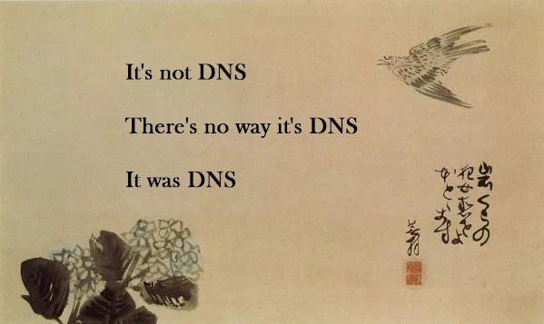
IPv6 DNS stewardship - DNS

Slide 32
Public IPv6 DNS services
Quick search for: “ public ipv6 DNS servers “
Google
  2001:4860:4860::8888
  2001:4860:4860::8844
Quad 9
  2620:fe::fe
  2620:fe::9
Cloudflare
  2606:4700:4700::1111
  2606:4700:4700::1001
And many many more with various feature sets.

Slide 33
DNS - ISC products - bind9, kea DHCP ( stork )
isc.org - Internet Systems Consortium as maintainers
BIND 9 - named: Berkeley Internet Name Domain
  Released in early 1980s as part of a DARPA grant on Berkeley Software Distribution (BSD) 4.3
  Currently BIND can store zones in flat files ( zone files ) or DB backed
  Ability to interact with DHCP ( in house dynamic DNS )

Slide 34
BIND9 - (named.conf)
Have IPv6 listening on all ports ( or a select port! )
options {
Listen-on-v6 port 53 { any; };
};
Allow transfers ( XFR ) from the following example host:
Transfer-source-v6 2001:db8::53/128;
Convert RFC-1886 automatically to RFC-2874 lookups:
allow-v6-synthesis;

Slide 35
BIND9 - named.conf - Dynamic DNS updates
Allow updates to zone awesome.example from the following example host:
zone “awesome.example” IN {
type master;
file “primary.fwd”;
allow-update{2001:db8::99/128};
};

Slide 36
BIND9 - named.conf - Dynamic DNS updates
Allow updates to zone awesome.example from the following example host:
zone “8.d.b.0.1.0.0.2-in-addr.arpa” in{
type master;
file “primary.rev”;
allow-update{2001:db8::99/128};
};

Slide 37
BIND9 - named.conf - Dynamic DNS updates
DHCPv6 will now interact with BIND9 to provide hostname updates dynamically
Absolutely fantastic for HPC
  cluster2-node33.awesome.example.com
  cluster2-node34.awesome.example.com
  cluster2-login4.awesome.example.com
Not so great when you have wi-fi clouds:
  iphone.awesome.example.lan
  iphone.awesome.example.lan
  chromecast.awesome.example.lan
  ….
Reservations can help for edge cases
Is DNS really needed for the clients?

Slide 38
DNS - ISC products - bind9, kea DHCP ( Stork )
isc.org - Internet Systems Consortium as maintainers
ISC DHCP - End of Life
  Still included in a vast array of products
  Plan upgrade roadmap now…
Kea DHCP
  IPv6 / IPv4 native
  Modular with excellent API hooks ( some require support license )
  Hooks enable Stork passive or active web UI.
  Excellent “import” tools

Slide 39
DNS - ISC products - bind9, kea DHCP ( stork )
isc.org - Internet Systems Consortium as maintainers
  Stork - Graphical dashboard for monitoring and interactions with BIND and DHCP
  One stop shop for monitoring and reservations
  Can ‘point and click’ all your DHCP / BIND needs

Slide 40
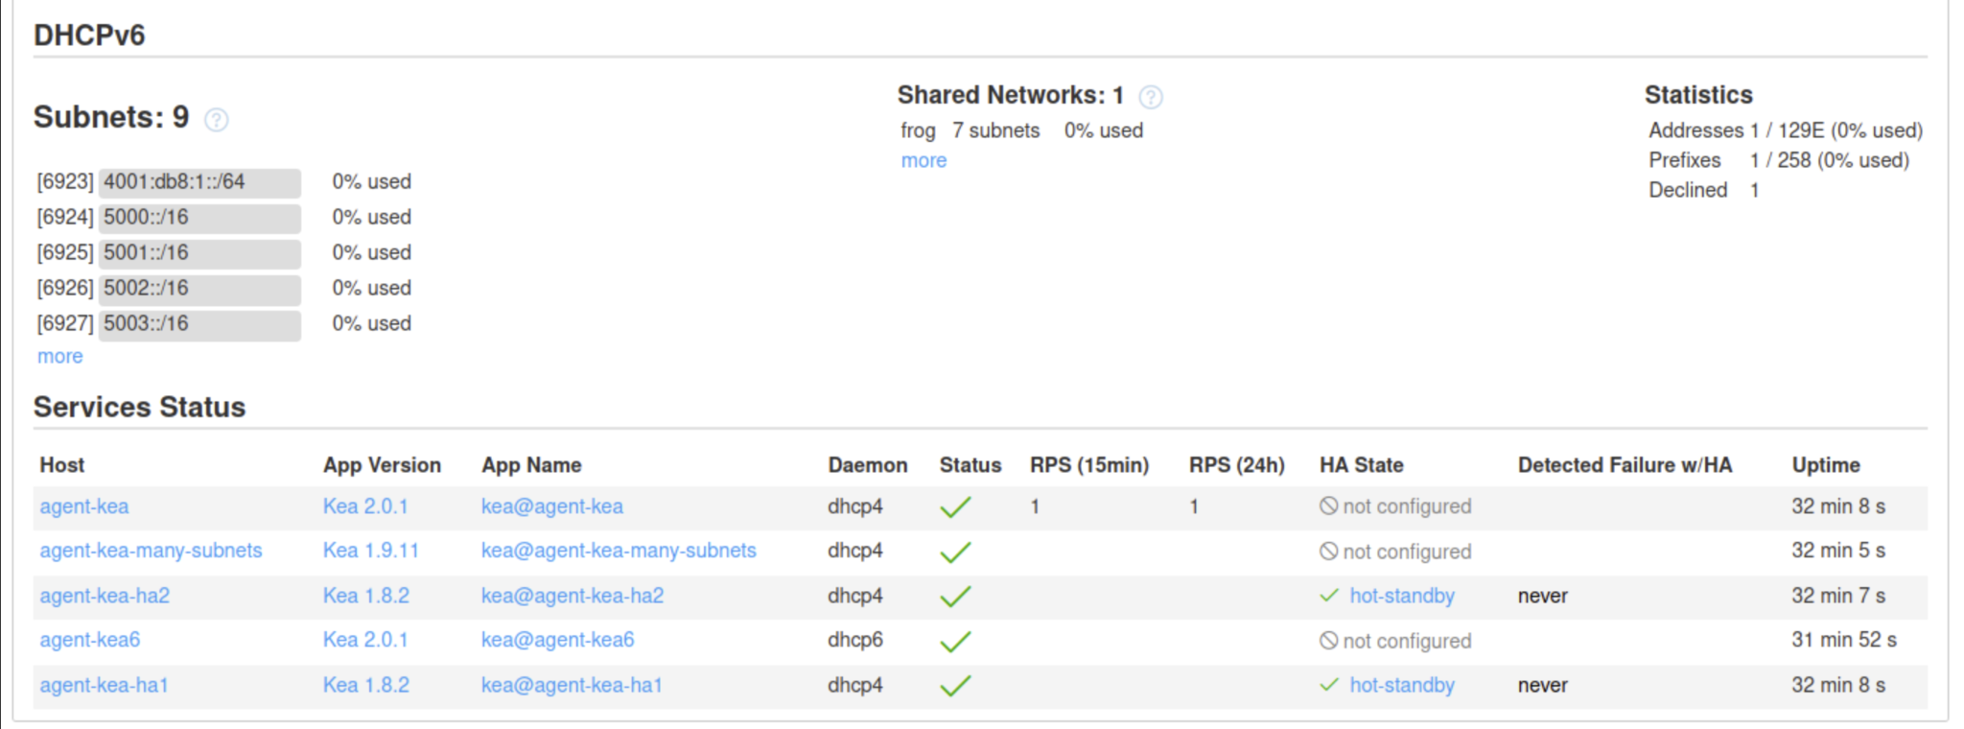
DNS - ISC products - bind9, kea DHCP ( stork )

Slide 41
Test setups
Take advantage of documentation space to play!
2001:db8::/32 AND 3fff::/20
  Just a few addresses…
  Your documentation is pretty and “works!”
  Safety nets and crash mats are ‘deployed’
You also have a built in backup protocol
  IPv4 as a ‘back door’ for lock outs.
What is being measured?
What is best possible outcome?
Have fun learning while at it!
  Failures are an option and where learning comes in.

Slide 42
IPv6 AAAA Records

Slide 43

IPv6 DNS stewardship - DNS - AAAA records
Fundamentals showed us that IPv6 space is ‘not’ tiny in any way shape or form with its true 128-bit sizes.
Prevent fragmentations to be a good netizen!
  Just like we wish to keep route-table sizes as small as possible ( try to advertise contiguous blocks or your entire allocation… keep it contiguous )
  Keep it easy, keep it elegant.
Likewise think of the zone files!
  Automation ( CM, git-ops, DHCPv6+DDNS, etc… )
  IPAM
  Careful planning now vs. later… Be kind to future you!

Slide 44
IPv6 DNS stewardship - DNS zone files
Loose Definition: Zone files are a file that help ISC’s bind9 to “lookup” DNS names to addresses ( forward ) or addresses to names ( reverse ).
Think of the security implications TO and FROM your DNS infrastructure…

Slide 45
IPv6 DNS stewardship - DNS zone files
Our scope today is to explore IPv6 and bind, continue to apply optimal security to your DNS infrastructure such as not limited to:
Ingress filtering with BCP38 ( stop that spoof! )
DNSSEC ( keep it real )
Well known well tested ‘simple’ architectures ( simple starts ):
  Authoritative and primary DNS servers hidden, on a patch cadence, logged, etc..
  Recursive DNS servers ( locked caches ) exist as “results” of primaries, have logical and sane timeouts, live in an anycast pool, patched and logged, etc…
  ACLs! ( in BIND and on the network )
  Who can transfer and lookup?
    Has that hypothesis been tested.

Slide 46
IPv6 DNS records
Also known as quad-”A” records or AAAA
Similar to IPv4 (just A records )
  Can be in the same ‘zone’ files ( not advised but, doable. )
Forward and Reverse record client checks
  dig
  host
  nslookup

Slide 47
A quick `host` refresher
Forward and reverse with dig asking for quad-a:
Forward
  host es.net
Reverse ( note no reverse PTR )
  host 2604:a880:800:c1::105:b001
Specific DNS server use server at the end
  Host es.net 2602:43:61f:ad00::53

Slide 48
IPv6 second verse same as the first with DNS
Configurations are similar identical…
Glue records act and behave the same as in IPv4
  Often used with
    load balancers
    storage clusters
    Directory Services enclaves ( AD / LDAP / Etc… )
  Delegate a subdomain with ease
    *.lb.example.com handed off to by your ns1 and ns2 in *.example.com
    CNAME and Aliases will do the right thing just as in IPv4
Use dig with +trace +additional and look at SOA records

Slide 49
IPv6 DNS stewardship - DNS zone files
Compatible and similar to IPv4 zones and management.
“Can” mix v4 and v6 into a single file ← < insert words of caution >
Try and keep things: Simple, elegant, and resilient…
localhost-forward basic example from documentation and ‘mixed’ v4 and v6
$TTL 3h
localhost. SOA localhost. nobody.localhost. 42 1d 12h 1w 3h
NS localhost.
A 127.0.0.1
AAAA ::1

Slide 50
; reverse IPV6 zone file for example.com
$TTL 2d ; default TTL for zone
$ORIGIN 0.0.0.0.8.b.d.0.1.0.0.2.IP6.ARPA.
; Start of Authority RR defining the key characteristics of the zone (domain)
@ IN SOA ns1.example.com. hostmaster.example.com. (
2010121500 ; sn = serial number
12h ; refresh = refresh
15m ; retry = refresh retry
3w ; expiry = expiry
2h ; nx = nxdomain ttl
)
; name server RRs for the domain
IN NS ns1.example.com.
; the second name server is
; external to this zone (domain).
IN NS ns2.example.net.
; PTR RR maps a IPv6 address to a host name
1.0.0.0.0.0.0.0.0.0.0.0.0.0.0.0.0.0.0.0 IN PTR ns1.example.com.
2.0.0.0.0.0.0.0.0.0.0.0.0.0.0.0.0.0.0.0 IN PTR mail.example.com.
....
F.F.0.0.0.0.0.0.0.0.0.0.0.0.0.0.0.0.0.0 IN PTR fred.example.com.
IPv6 DNS stewardship - DNS zone files REVERSE of a ‘tiny’ /120

Slide 51
; forward IPV6 zone file for example.com
$TTL 2d ; default TTL for zone
$ORIGIN example.com.
; Start of Authority RR defining the key characteristics of the zone (domain)
@ IN SOA ns1.example.com. hostmaster.example.com. (
2010121500 ; sn = serial number
12h ; refresh = refresh
15m ; retry = refresh retry
3w ; expiry = expiry
2h ; nx = nxdomain ttl
)
; name server RRs for the domain
IN NS ns1.example.com.
; the second name server is
; external to this zone (domain).
IN NS ns2.example.net.
; PTR RR maps a IPv6 address to a host name
ns1 IN AAAA 2001:db8::1
mail IN AAAA 2001:db8::2
....
fred IN AAAA 2001:db8::ff
IPv6 DNS stewardship - DNS zone files FORWARD of a ‘tiny’ /120

Slide 52
Discussion and Questions

