Slide 1
IPv6 Workshop - IPv6 Wireless / SC23

Slide 2
IPv6 Wireless - Planning
Client Planning
  Devices Per User
    Laptop
    Phone
    Tablet
    Etc.
  IP’s Per Device
    Link local address (fe80::/10)
    Globally Unique Address (SLAAC or DHCPv6)
    Privacy Address (Host Generated)
    Unique Local Address (fc00::/7)
  Check with your vendors to make sure they can handle this many IP’s
SLAAC vs DHCPv6

Slide 3
IPv6 Wireless - SLAAC vs DHCPv6
Most of this information was covered in unit 1.
Client Support:
MacOS
  SLAAC/DHCPv6 support
Windows
  SLAAC/DHCPv6 support
iOS
  SLAAC/DHCPv6 support
Android
  SLAAC Only
  DHCPv6-PD support “coming soon”

Slide 4
IPv6 Wireless - DHCP Option 108 (IPv6-only Preferred)
What is DHCP Option 108
  DHCP option for IPv6-Only preferred
  DHCP server contacts client over IPv4 and notifies the client to shutdown its IPv4 interface
  RA Option PREF64
    Router Advertisement - NAT64 Prefix
  Useful in helping organizations shift toward IPv6-mostly and IPv6-only networks
  Client Support:
    MacOS - Supported in recent versions
    Windows - Not supported, yet.
    iOS - Supported in 16+
    Android - Supported in recent versions
CLAT/464XLAT - Exercise left to the reader

Slide 5
IPv6 Wireless - NAT64 / DNS64
NAT64
  Useful for allowing IPv6 only clients to be able to access IPv4 only resources through NAT
  Stateless - Mostly used for providing IPv6 services to IPv4-only clients/hosts
  Stateful - Mostly used to enable IPv6-only clients to reach IPv4 services
  NAT Prefix: 64:ff9b::/96
  Vendor support varies, open source options available
  Requires DNS64 to be useful
DNS64
  RFC6147
  Supported in BIND, Unbound, etc.
  Translates A records into AAAA records by shimming the V4 address into the NAT64 prefix
  64:ff9b::<original-ipv4>

Slide 6
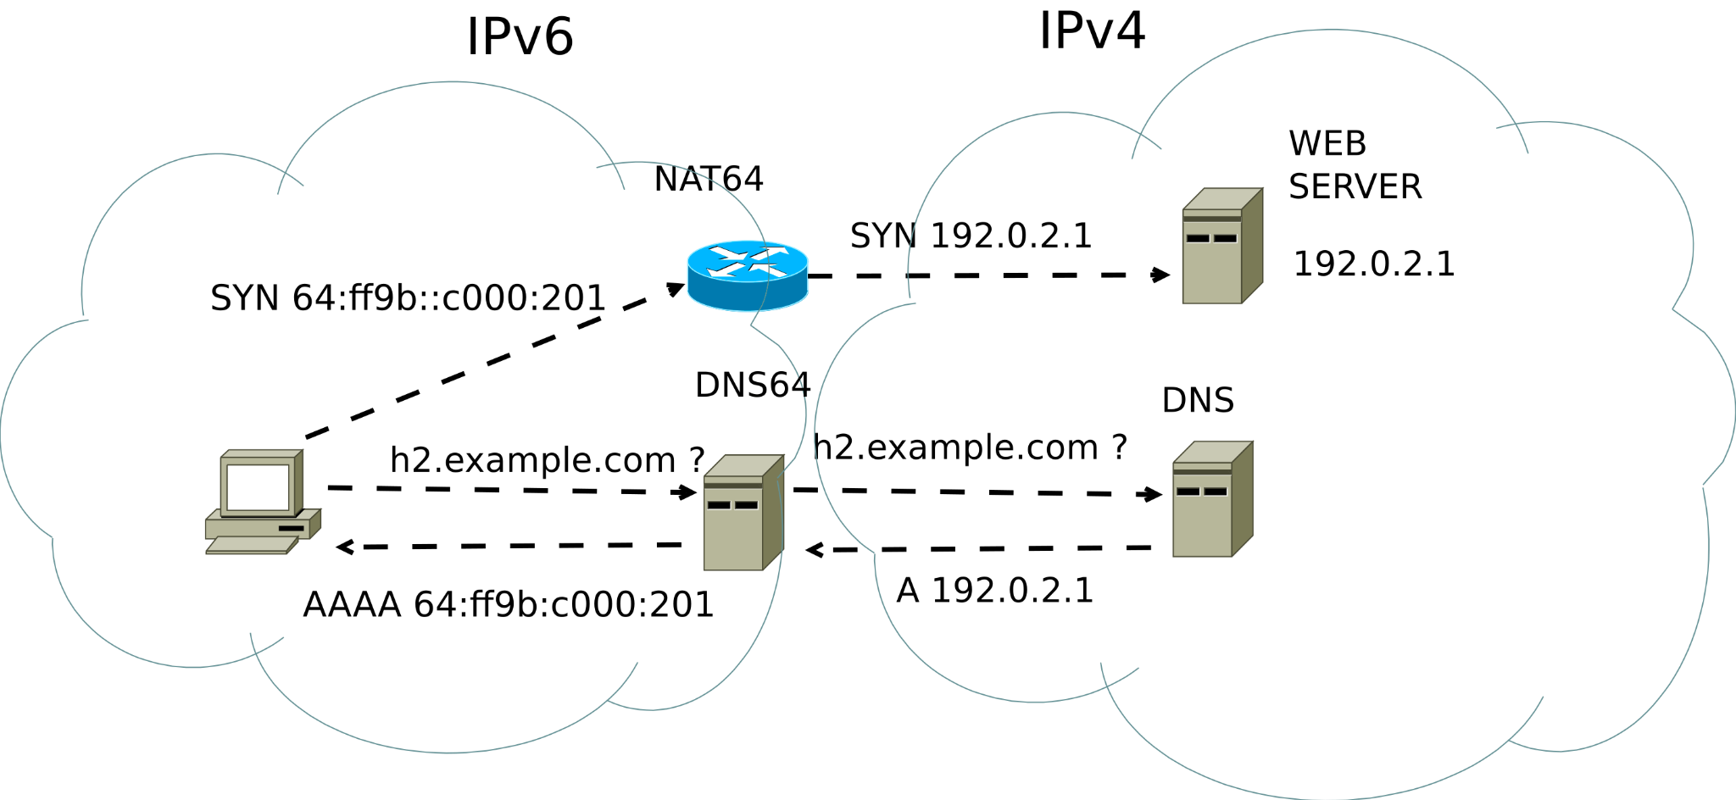

Slide 7
IPv6 Wireless - NAT64 Implementations
Network Vendors
  Palo Alto
    VM Series
    CN Series
  Juniper Networks
    SRX Series
    MX Series
  Cisco
    IOS-XR?
    IOS-XE
    Verify
  Open Source
    Tundra
    Jool
    Tayga (Last code push - 2011)
    OpenBSD PF
    Cilium (K8S CNI)
  Other Vendors
    This list is non-exhaustive. Verify with your vendor of choice what platforms and software versions support NAT64.

Slide 8
IPv6 Wireless - SCinet Overview
1+ years to plan (virtually and in person), ~2 weeks to build, 4 days to operate, 1 ½ days to tear down.
6.71 Tbps delivered to the CCC in Denver, CO
16 – 400 Gbps connections
28.7kW power draw
206 Scinet Volunteers
$40.5m in donated & loaned hardware, software, and optics from 30 contributors
12+ miles of Fiber deployed
421 wireless access points deployed
SC24: https://sc24.supercomputing.org/scinet/
  Tentatively, 9-10Tbps delivered to GWCC in Atlanta, GA

Slide 9
IPv6 Wireless - SCinet Team Overview
SCinet is made up of 14 teams with diverse skills sets:
  Architecture
  Communications
  Contributor Relations and Logistics
  DevOps
  Wireless and Edge
  Networked Research Exhibition (NRE)
  Experimental Networks (XNET)
  Fiber
  Help Desk
  Network Security
  Power
  Routing
  Volunteer Services (Students)
  WAN Transport

Slide 10
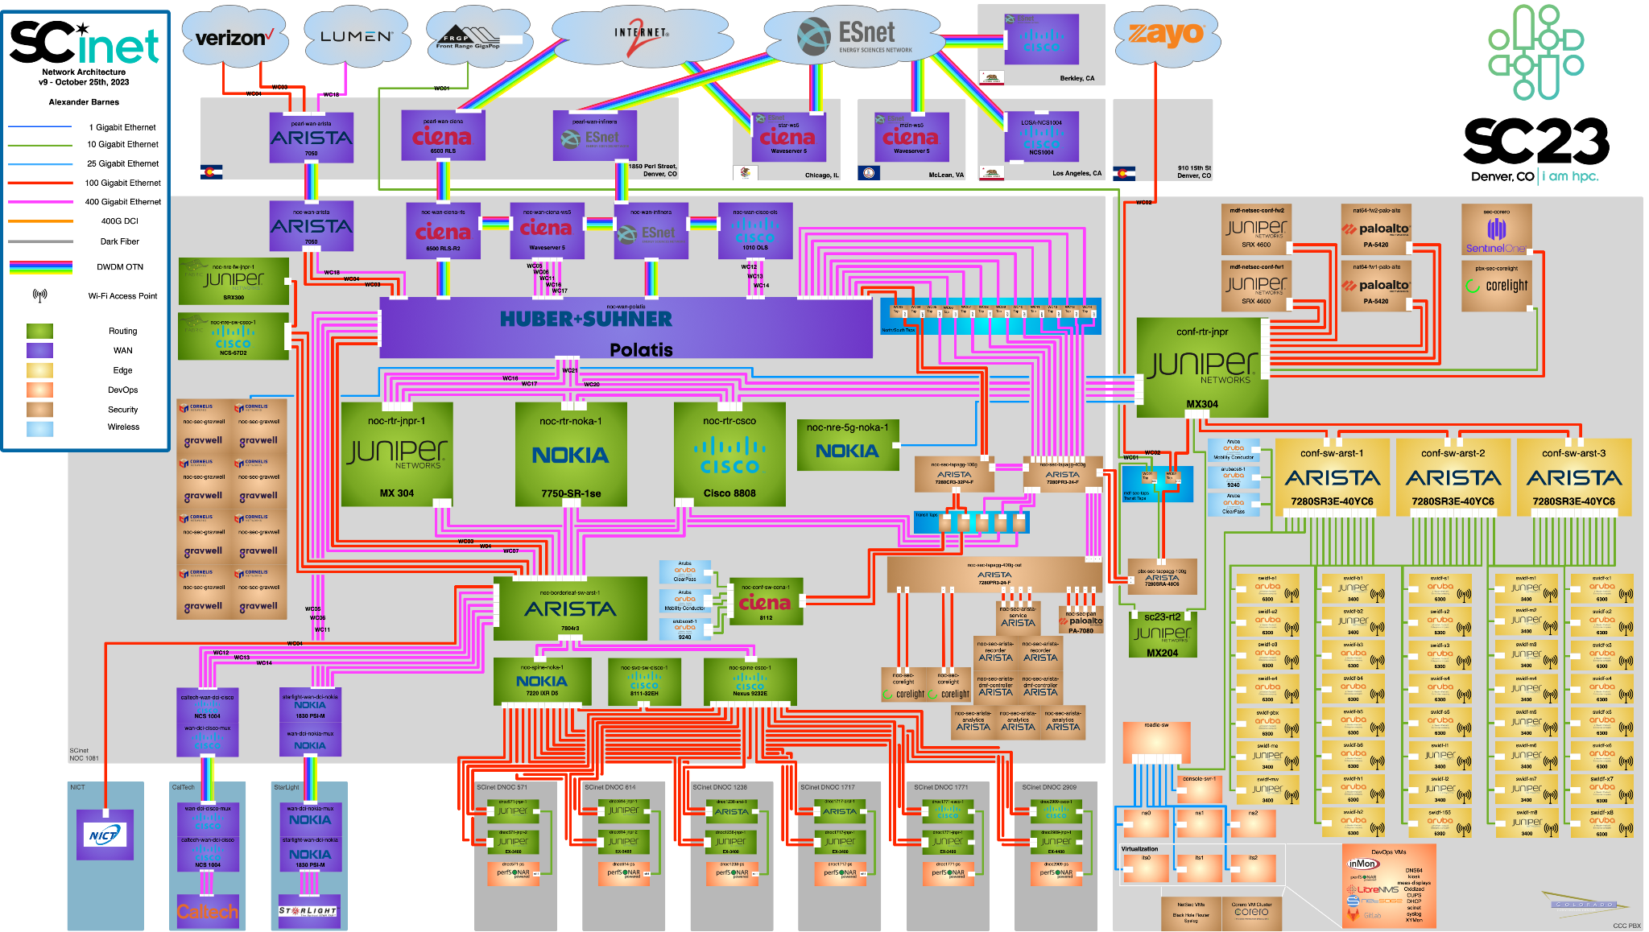

Slide 11
IPv6 Wireless - SCinet IPv6 Only Stats/Problems/Wins
IPv6 connection counts hovered between 35-55% of total connections!
Had to enable DHCPv6 for Windows hosts to use IPv6.
Stateless autoconfig (SLAAC) support not standard and can be hit or miss.
Lots of IPv6 DNS queries sent out with no answer
Applications still handle V6 and V4 differently.
Timeouts when V6 doesn’t respond before failing over to V4
Some use RFC8305 (happy eyeballs) and send out queries at same time. (https://www.rfc-editor.org/rfc/rfc8305)
Need to remember your firewall rules for V4 AND V6.

Slide 12
IPv6 Wireless - Open Discussion
Questions? Concerns? Want example configs? Reach out.
Corey Eichelberger - ceichelberger@tacc.utexas.edu
George Robb - grobb3@es.net

