Slide 1


Implementing a NAT Device using a P4 Switch
Talha Gill and Samuel Kelley
University of South Carolina
Advisors: Jose Gomez and Ali Mazloum
Professor: Dr. Jorge Crichigno
Spring 2022

Slide 2

Agenda
Introduction
Problem description
Background on P4
Proposed solution and implementation
Contributions

Slide 3
Introduction
Network address translation (NAT) conserves IP addresses that are legally registered and prevents their depletion
This is important to being able to connect with the Internet
NAT is used to achieve this
  Using configurable switches, we can create P4 programs to implement NAT
Notes:
What problem does NAT solve? There is not enough ipv4 addresses to be assigned to each device on the internet.
It takes all of the private IP addresses from a local network and puts them in a SINGLE public IP
Public IP means that it can be pinged or reached over the internet

Slide 4
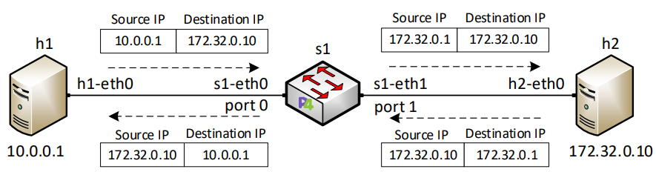
Problem Description
Be able to communicate with networks outside the Local Area Network (LAN)
Must translate a private IP address to a public IP address
Implementing NAT on P4 programmable switch
Testing the IP translation by sending packets to the Internet
Notes:
Be able to communicate with networks outside the Local Area Network (LAN).
Must translate a private IP address to a public IP address.
Implementing NAT on P4 programmable switch.
Testing the IP translation by sending packets to the internet.
Figure is a point-to-point NAT, Explain the translation. THE PUBLIC IP IS 172.32.0.10
It goes from h1 as 10.0.0.1 to 172.32.0.10 which is public so 10.0.0.1 must be translated to be able to communicate with the internet so now 10.0.0.1 is 172.32.0.1

Slide 5
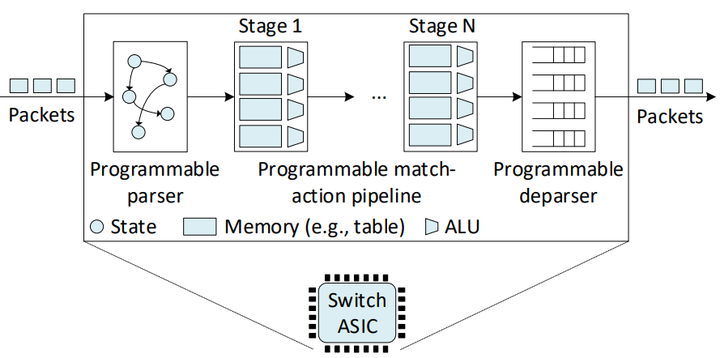
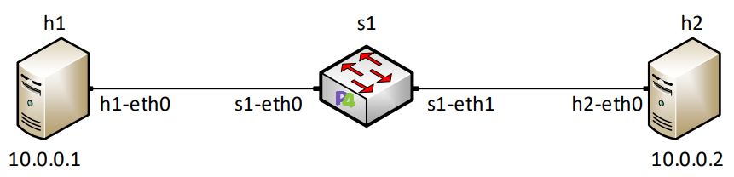
Background on P4
P4 is a programing language used to describe the processing behavior of a switch
Unlike traditional switches which come with a set of pre-defined protocols
Notes:
We have a device that has almost like an automotive assembly line, so that when a packet arrives it goes through this assembly line and goes through alterations or modifications that are defined by the user.
How do we do that? We do that with the programable parser (point to the top figure) and exact that information from the header. Then we use something called match action tables to apply the changes we defined in the P4 program. Then when we are finished with the modification we reassemble the packet with the programable deparser.
We are implementing NAT onto that P4 switch, how do you do that? We use match action tables.
The programmable forwarding can be viewed as a natural evolution of Software-Defined Networking (SDN), where the software that describes the behavior of how packets are processed, can be conceived, tested, and deployed in a much shorter time span by operators, engineers, researchers, and practitioners in general. The de-facto standard for defining the forwarding behavior is the P4 language5 , which stands for Programming Protocol-independent Packet Processors. Essentially, P4 programmable switches have removed the entry barrier to network design, previously reserved to network vendors.

Slide 6
Proposed Solution and Implementation
Create a program using P4 to enable NAT on the internal network to allow communication with the Internet
Develop a topology that represents all three private IP address ranges, the programable switch and the Internet
For example, the private IP address 192.168.0.1 is translated to the public IP address 203.0.113.1
We implemented NAT using match-action tables
Notes:
We implemented and tested our P4 program in a simple scenario. (EXPLAIN TOPOLOGY.) Name H1,H1,H3, AND H4. Then say H1 is apart of 192…. Network, H2 is apart of 172.16… network and so forth.
What NAT does is translate all of these private IP addresses you see here on the left to this SINGLE public IP address 203.0.113.1
Then it forwards it to the server on the right host H4 which is the INTERNET

Slide 7
Contributions
Implemented a NAT device on P4
Used match-action tables to perform the address translation
Tested the implementation with a packet generator available in Linux
Future works might include the implementation of dynamic NAT
Notes:
Implemented a NAT device on P4
Used match-action tables to perform the address translation
Tested the implementation with a packet generator available in Linux
Future works might include the implementation of dynamic NAT

