Slide 1
Introduction to P4-DPDK
Samia Choueiri, Elie Kfoury
University of South Carolina (USC)
https://research.cec.sc.edu/cyberinfra
University of South Carolina (USC)
The Engagement and Performance Operations Center (EPOC)
Minority Serving - Cyberinfrastructure Consortium (MS-CC)
Hands-on Workshop on Science DMZ and P4-DPDK
Thursday, August 8, 2024.

Slide 2
Introduction to P4-DPDK
Lab activities are described in Lab 1, P4-DPDK lab series

Slide 3
P4-DPDK Lab series
https://research.cec.sc.edu/files/cyberinfra/files/P4-DPDK_manuals.pdf
Lab 1 | Introduction to P4-DPDK
Lab 2 | P4 Program Building Blocks with the PNA Architecture
Lab 3 | PNA Parser Implementation
Lab 4 | Introduction to Match-action Tables (Part 1)
Lab 5 | Introduction to Match-action Tables (Part 2)
Lab 6 | Populating and Managing Match-action Tables at Runtime
Lab 7 | Checksum Recalculation and Packet Deparsing

Slide 4
DPDK Pipeline Model
DPDK libraries are needed to build a programmable pipeline for user applications
A DPDK pipeline is composed of three elements:
Input ports
Tables
Output ports

Slide 5
P4-DPDK Workflow
Workflow used to program the P4-DPDK pipeline
The labs use the p4c-dpdk compiler to compile the P4 code into a DPDK pipeline executable

Slide 6
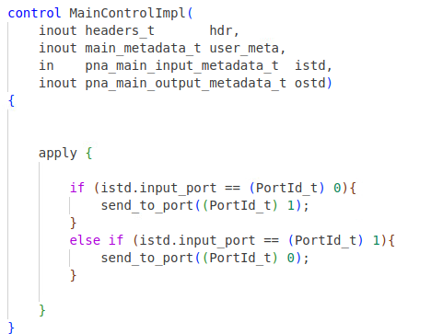
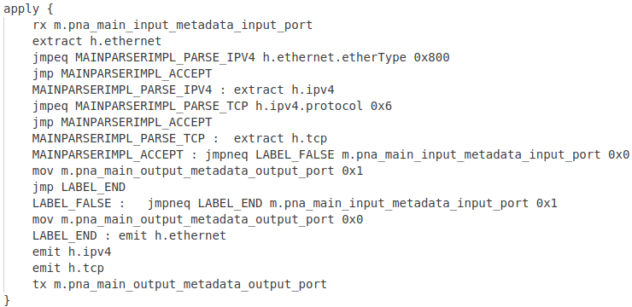
p4c-dpdk Compiler
p4c-dpdk
.p4
.spec

Slide 7
Lab Topology and Objectives
Two network namespaces, h1 and h2, are linked to the host running the P4-DPDK pipeline
Lab Objectives:
Implementing a DPDK pipeline from a P4 code
Building and running the pipeline
Building a network topology
Testing and verifying the P4 program

Slide 8
Access Platform
URL: https://netlab.cec.sc.edu/
Username: <Email address used for registration>
Temporary Password: nsf2024

