Slide 1
NSF 2118311: Cybertraining on P4 Programmable Devices using an Online Scalable Platform with Physical and Virtual Switches and Real Protocol Stacks
Jorge Crichigno (PI)
Department of Integrated Information Technology
College of Engineering and Computing
University of South Carolina
Project website: https://research.cec.sc.edu/cyberinfra/cybertraining
2023 NSF Cybertraining Principal Investigator Meeting
Houston, Texas
September 26-27, 2023

Slide 2
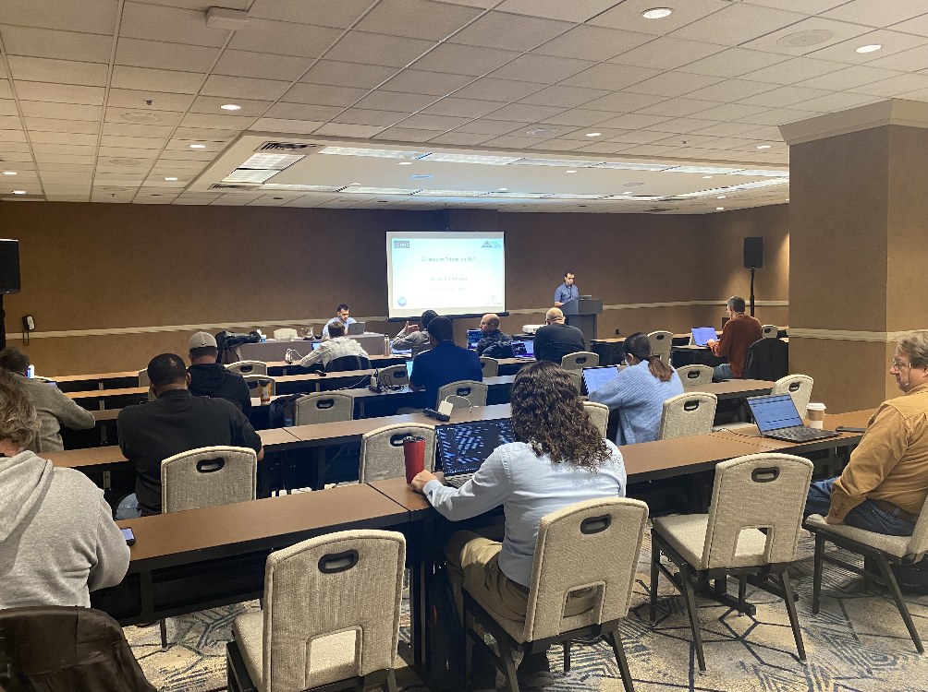
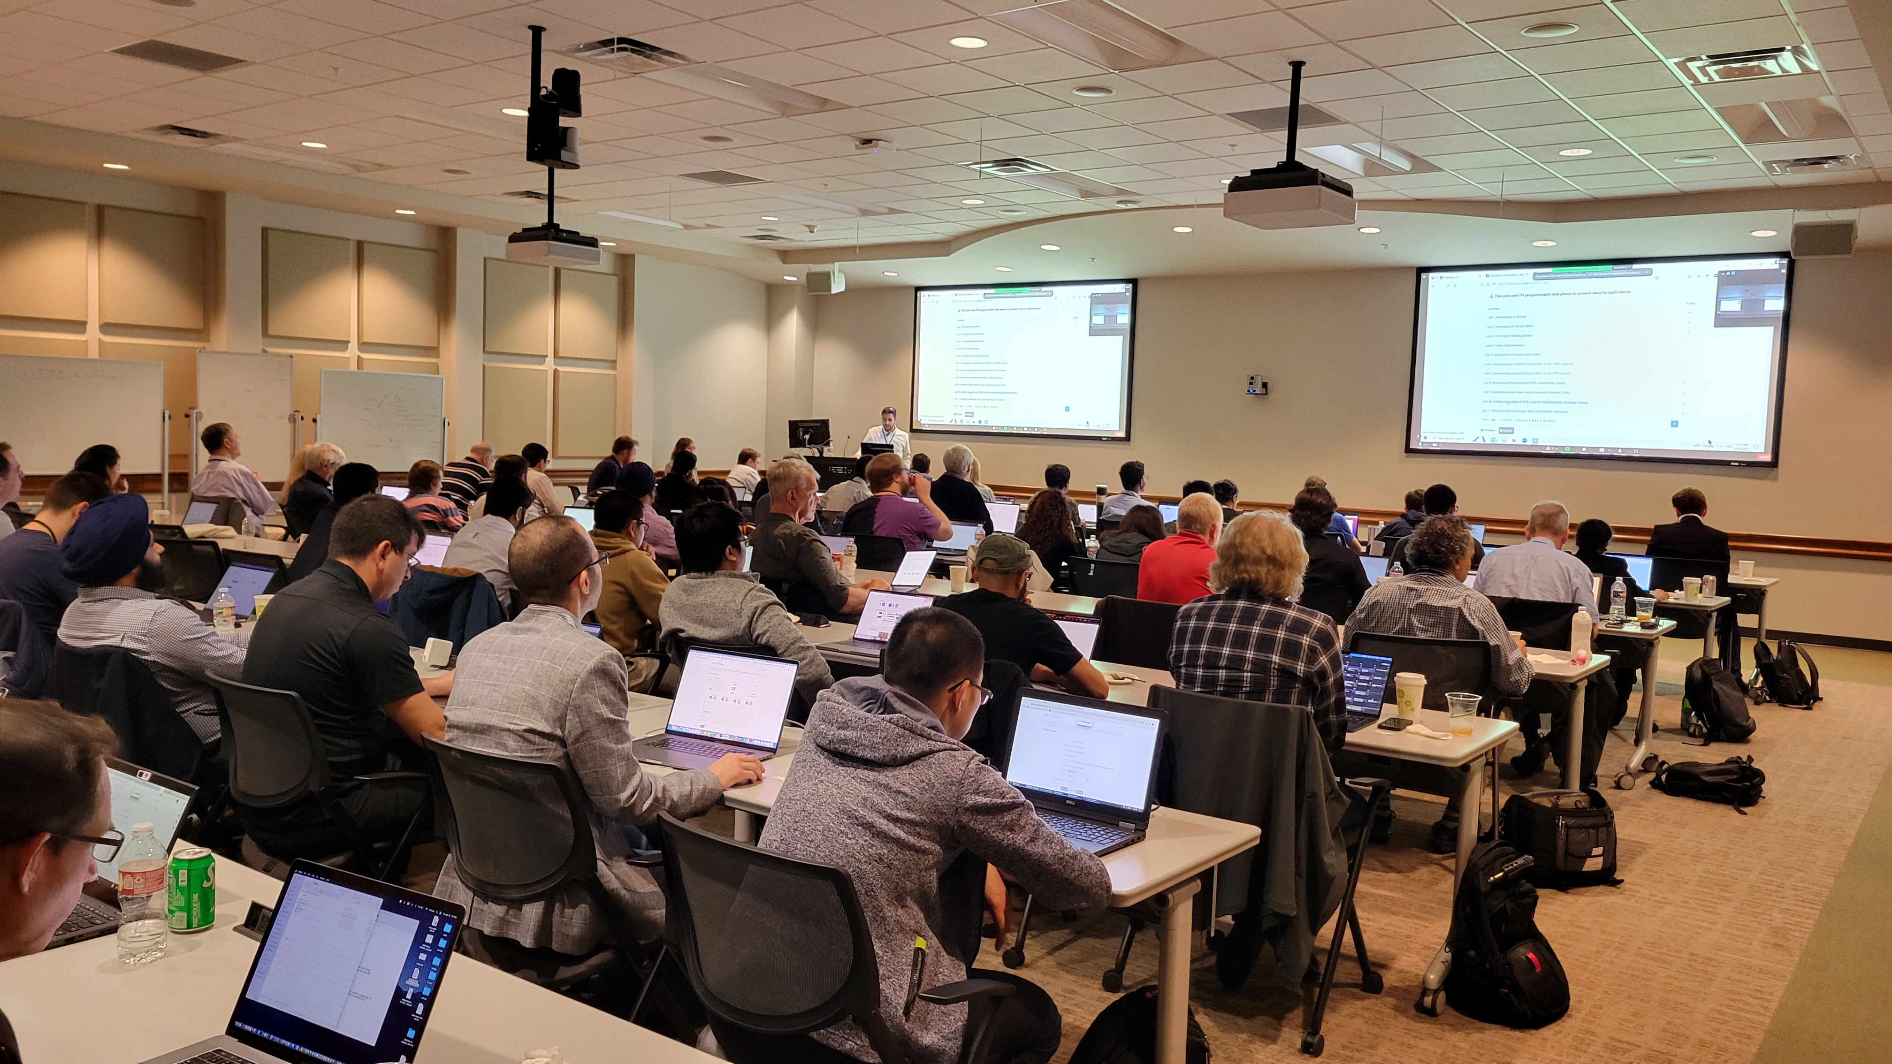
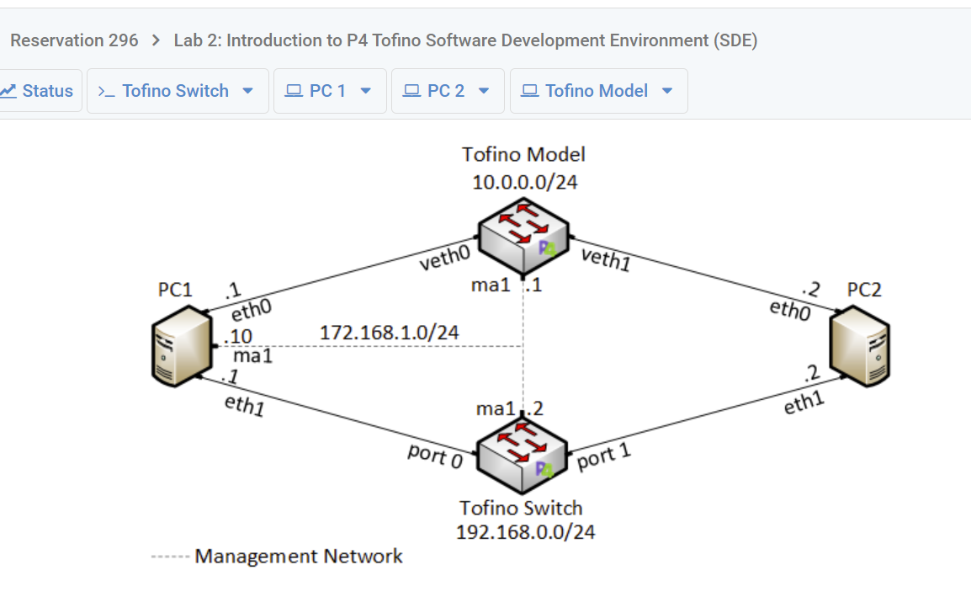
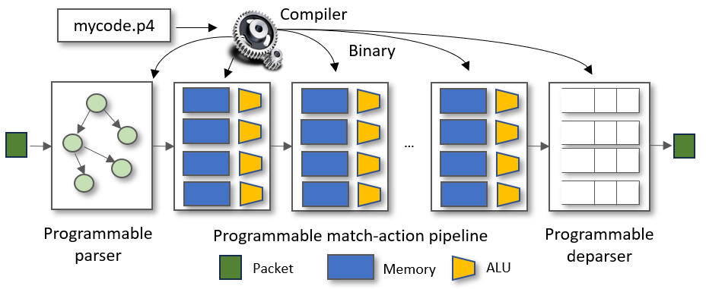
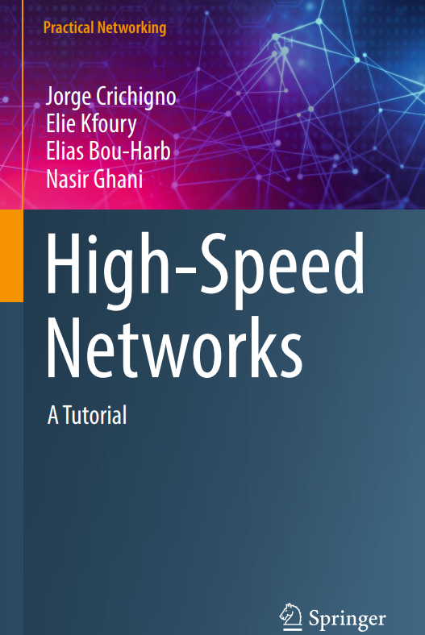
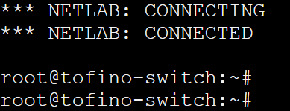
NSF 2118311: Cybertraining on P4 Programmable Devices using an Online Scalable Platform with Physical and Virtual Switches and Real Protocol Stacks
Jorge Crichigno (PI) - University of South Carolina (USC)
Project website: https://research.cec.sc.edu/cyberinfra/cybertraining
Goals
Academic Cloud
Impact - Workshops
Facilitate the adoption of programmable P4 devices by CI professionals and learners in general, by developing virtual labs.
Promote the integration of P4 and virtual labs into academic degrees.
A virtual platform that manages and orchestrates computing resources.
Tailored for education and research.
Physical hardware can be attached to the cloud, e.g., Tofino-based switches.
Workshops
21 hands-on workshops between 2022-3.
Nearly 1,500 learners.
Stand-alone and co-located to conferences such as Internet2 Technology Exchange.
Partnership with Internet2, FABRIC, LBNL / ESnet, ORNL, regional training centers, RENs from TX, LA, CA, SC, NC, MO, IN, AZ, NY, etc.
Motivation
Impact - Academic Cloud
There is no systematic material to learn P4.
P4 switches permit the programmer to program the switch data plane:
Define and parse new protocols.
Customize packet processing functions.
Measure events with high precision (nanosecond resolution).
Offload applications to the data plane (terabits per second processing rates).
Virtual labs on P4 used for training and academic courses at several institutions.
13,416 experiments, 66,072.42 hours (2022-3)
Impact - Publications
6 virtual lab libraries with
booklets.
5 conference papers.
5 journal papers, including
extended tutorials.
One book w/ virtual labs.

