Slide 1

Overview
Department of Integrated Information Technology
University of South Carolina
Jorge Crichigno
jcrichigno@cec.sc.edu
Center of Advanced Technical Studies
Chapin, SC
November 11, 2021

Slide 2
IIT Program
B. S. Integrated Information Technology
120 credit hours, 400-hour internship
Curriculum includes
  Cybersecurity
  IT Business Operations
  Databases
  Networking
  Project Management
  Web Development
The department is developing a fully online BSc
ABET accredited (“quality assurance”)

Slide 3
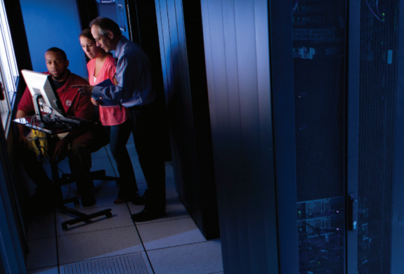
IIT Program
Programs are more practical than theoretical
Courses reinforce the theoretical knowledge with hands-on activities
What do graduates do?
They build, maintain, operate, and repair hardware and software associated with computer systems
  Network engineer
  Cybersecurity analyst
  Web design and services
  User experience / human-computer interaction professional
  Cloud system specialist
  Security Operation Center (SOC) analyst
  Data analytics professional

Slide 4
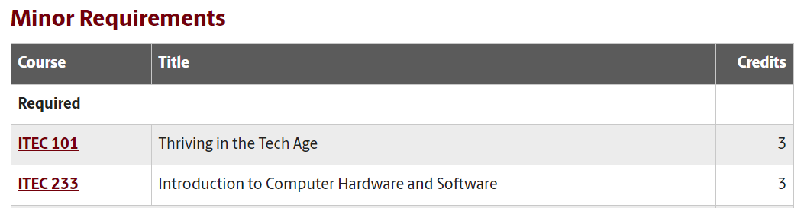
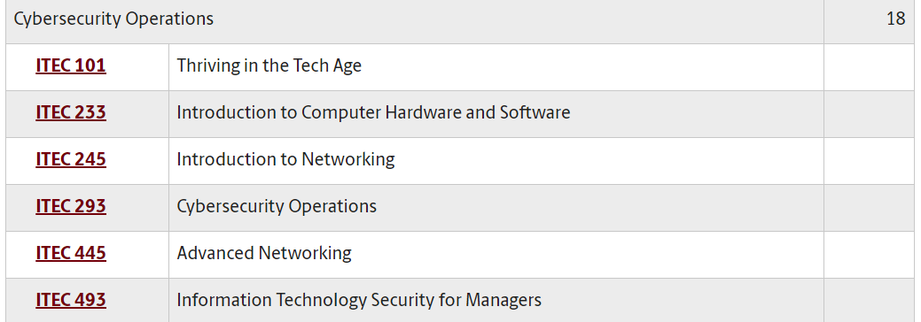
IIT Program
Minor in Integrated Information Technology
18 credit hours
Several concentrations
  Cybersecurity Operations
  IT Business Operations
  Databases
  Networking
  Project Management
  Web Development
Courses map learning objectives to the U.S. NICE framework (ITEC 293, ITEC 445, ITEC 493)
The National Initiative for Cybersecurity Education (NICE) Framework is a national-focused resource that categorizes and describes cybersecurity work

Slide 5
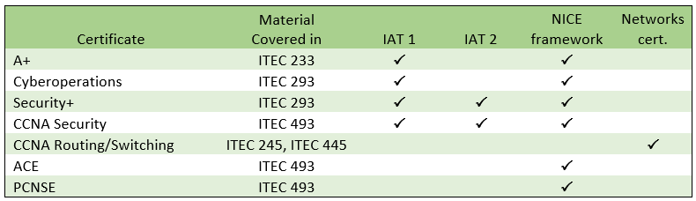
Additional Credentials
DoD’s Information Assurance (IA) workforce is classified in IA technical (IAT):
  Level 1 (IAT 1): Computing environment information assurance
  Level 2 (IAT 2): Network environment information assurance
  Level 3 (IAT 3): Enclave, advanced network & computer information assurance
It requires partnership
  Cisco Systems, Palo Alto Networks, VMware, Juniper, Intel
NICE: National Initiative for Cybersecurity Education

Slide 6
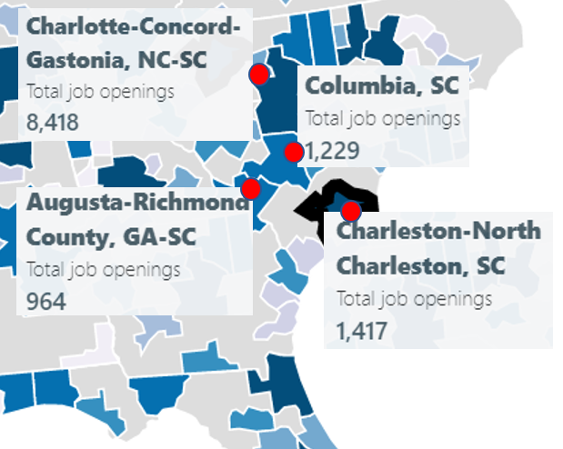
Office of Naval Research (ONR) Project
“Enhancing the Preparation of Next-generation Cyber Professionals”
South Carolina cybersecurity needs
  NIWC Atlantic, SRNL, Fort Jackson, Shaw Air Force Base, private industry
Recruiting the American military’s cyber force is more difficult than ever
  DoD has been struggling to hire more than 8,000 cyber positions (2018)¹
  Shortage of cybersecurity professionals
The College of Engineering and Computing is addressing the workforce needs:
  Encourage students to acquire “cyber” knowledge
  Undergraduate applied research
  Private cloud
  Collaboration among industry, government, education institutions
Cybersecurity job openings in four metro areas near Columbia, Feb. 2020
1. J. Lynch, “Inside the Pentagon’s Struggle to Build a Cyber Force,” Fifth Domain publication, October 29, 2018. Online: https://tinyurl.com/yyelqomp
Notes:
Reserve Officers' Training Corps (ROTC))

Slide 7
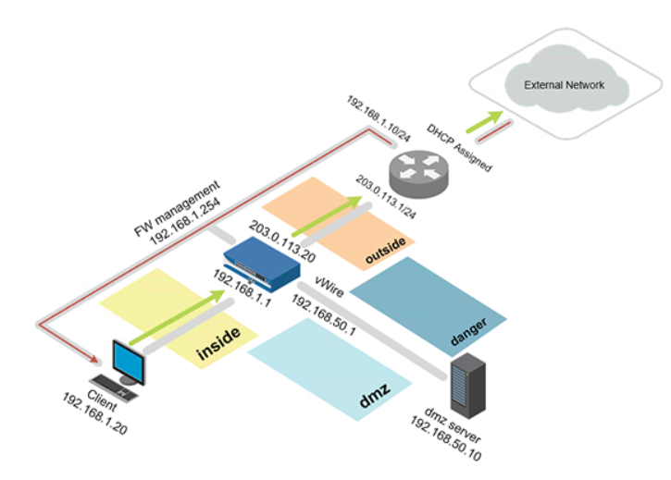
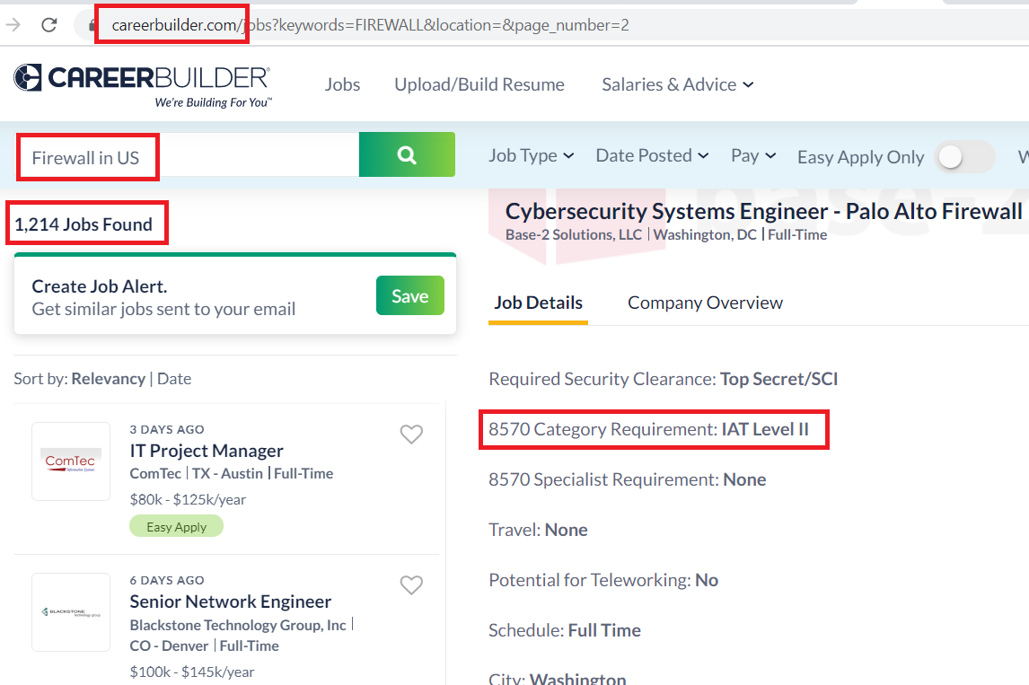
ONR’s Cyber Project
Collaboration
  Applied teaching and research -> professional tools, platforms, market validation
  Cisco Systems, Palo Alto Networks, VMware, Juniper, Intel
 Bachelor’s degree
 IAT credential
 Theory
 Hands-on expertise
Pod deployed in private cloud
Job search

Slide 8
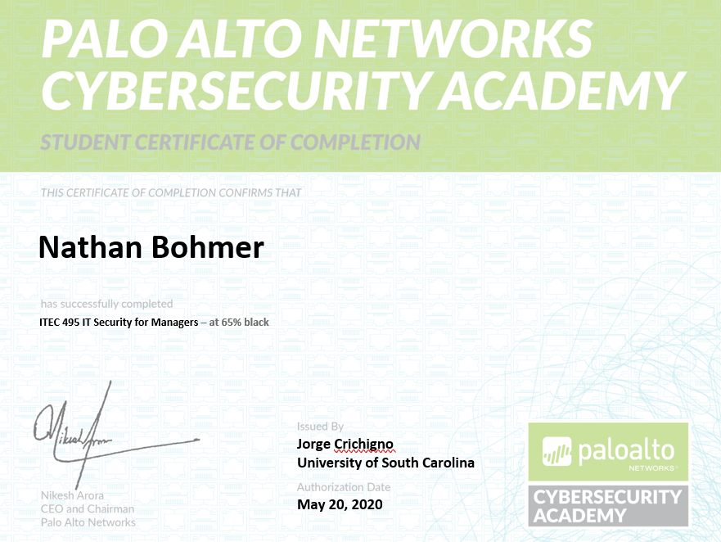
ONR’s Cyber Project
Collaboration
  Applied teaching and research -> professional tools, platforms, market validation
  Cisco Systems, Palo Alto Networks, VMware, Juniper, Intel
 Bachelor’s degree
 IAT credential
 Theory
 Hands-on expertise
Additional credentials
Job search

Slide 9
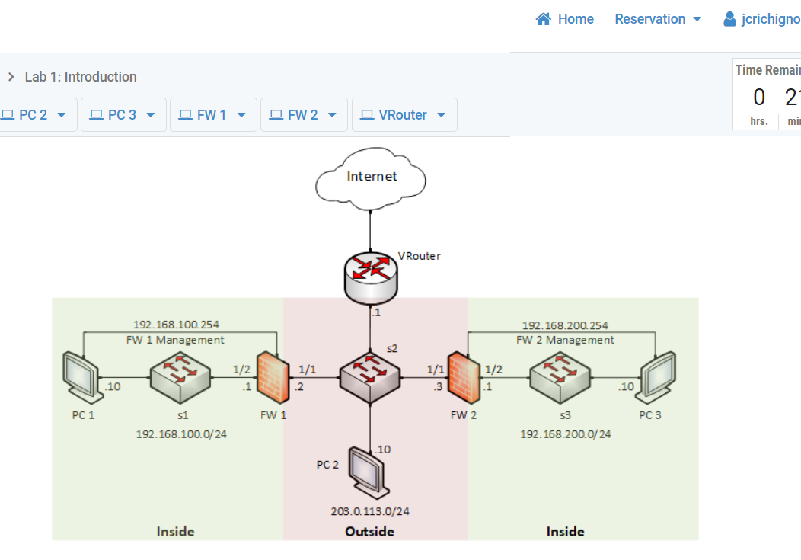
ONR’s Cyber Project
Undergraduate students work 18 hours per week, 15 weeks, $18 per hour ($4,050)
  Applied research
  Professional tools, platforms, market validation
  Cisco Systems, Palo Alto Networks, VMware, Juniper, Intel
  Focus on relevant technology, customized scenarios; e.g., IPsec-based VPNs with NGFWs

Slide 10
NSF ATE and CC
NSF Advanced Technical Education (ATE) and NSF Campus Cyberinfrastructure (CC) (2019)
Development of a multi-state distributed cloud to support teaching, research
2+2+2 program (HS + College + University)
Distributed cloud pools resources from SC and NC, serves institutions seamlessly
Requests to use the platform
  Berkeley National Lab
  SANS institute (“girlsgocyber”)
  Multiple higher-ed institutions
  International Networks at Indiana
  Fort Gordon (PAN’s NGFW, VMware Clouds)
  Texas’ Lonestart Education and Research

Slide 11
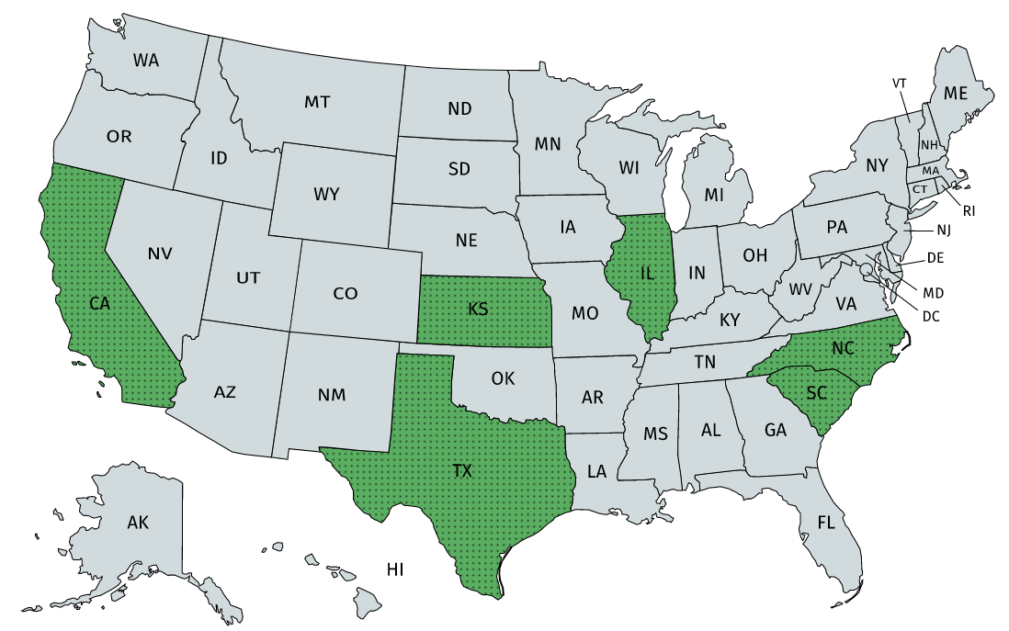

NSF ATE 2021- …
National Online Platform
Consortium of Colleges and Universities
Industry
  Palo Alto Networks Cybersecurity Academy
  Cisco Network Academy
  VMware IT Academy
  …

Slide 12
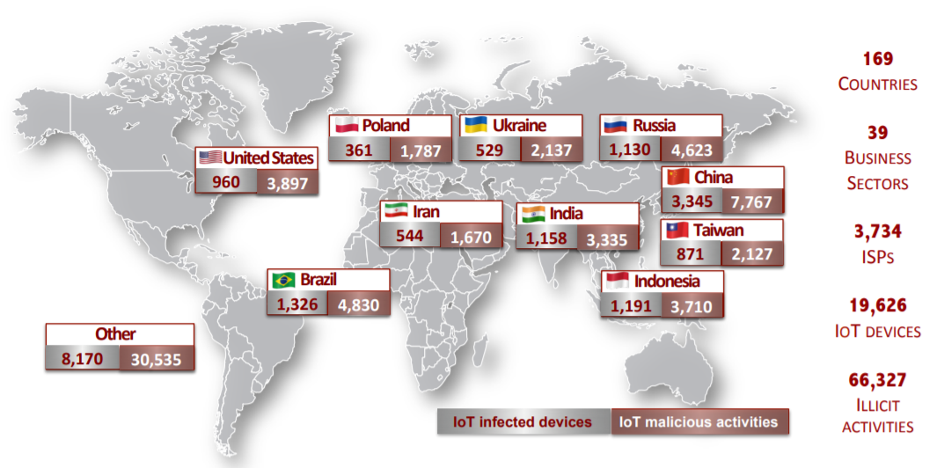
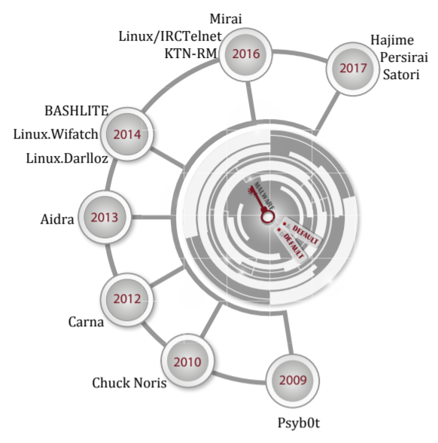
Graduate Projects
Development of new techniques against attacks targeting “Internet-of-Things” devices
Agreement with the Center for Applied Internet Data Analysis (CAIDA) (San Diego)
Global distribution of exploited IoT devices; results from this research project
Malware exploiting default credentials

Slide 13
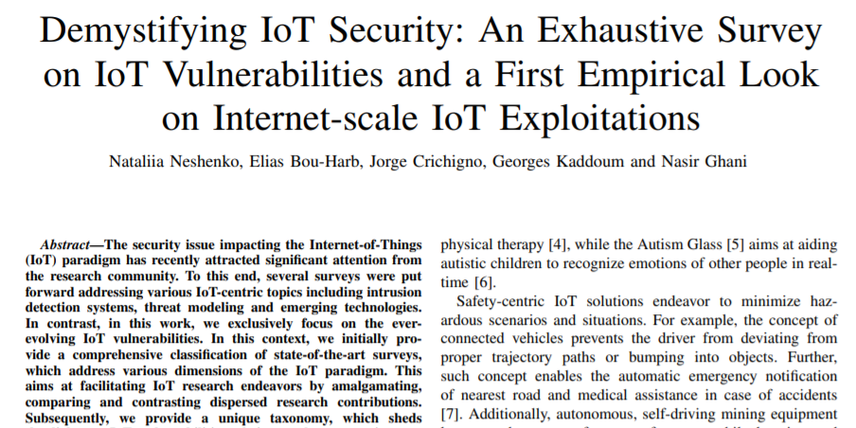
Graduate Projects
Development of new techniques against attacks targeting “Internet-of-Things” devices
Agreement with the Center for Applied Internet Data Analysis (CAIDA) (San Diego)

Slide 14
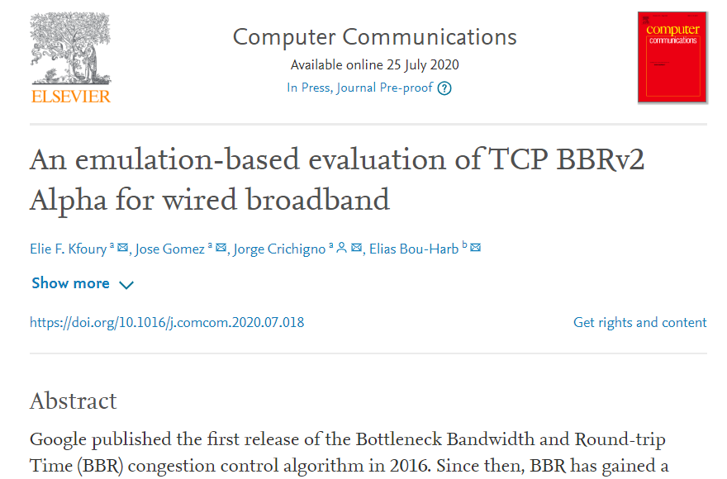
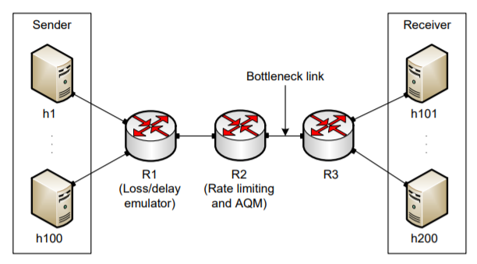
Graduate Projects
Performance testing Google’s new communication protocol
Feedback to Google (used in Youtube, Chrome, and other apps)
Emulating behavior in private cloud before Google’s protocol public release

Slide 15
Graduate Projects
Improving system’s performance using next-generation switches
Offloading computational tasks to network switches
  Orders of magnitude faster than general-purpose CPU
  Very limited instructions set (e.g., no multiplication, no division, simple operations)
Agreement with Intel (chips, software development environment)
Application example: media (voice) relay server
 | Programmable Switch | General-purpose CPU
Cost | $6,000 | $ 10,000 - 25,000
Capacity | ~35,000,000 connections per switch | ~500 connections per core
Latency | 400 nanoseconds | Tens to hundreds of milliseconds

Slide 16
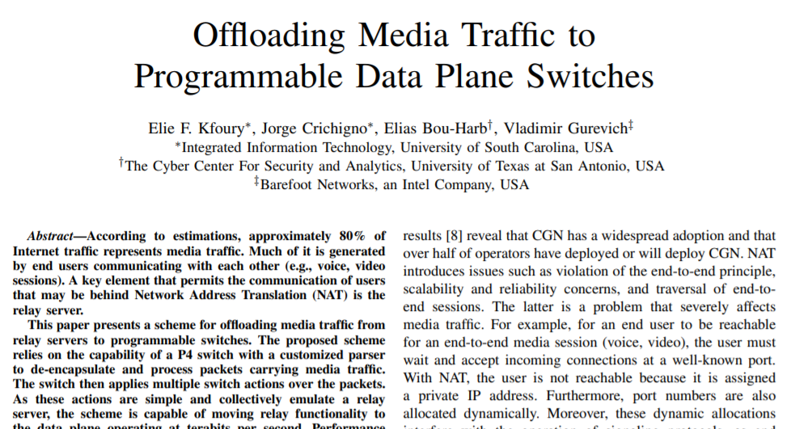
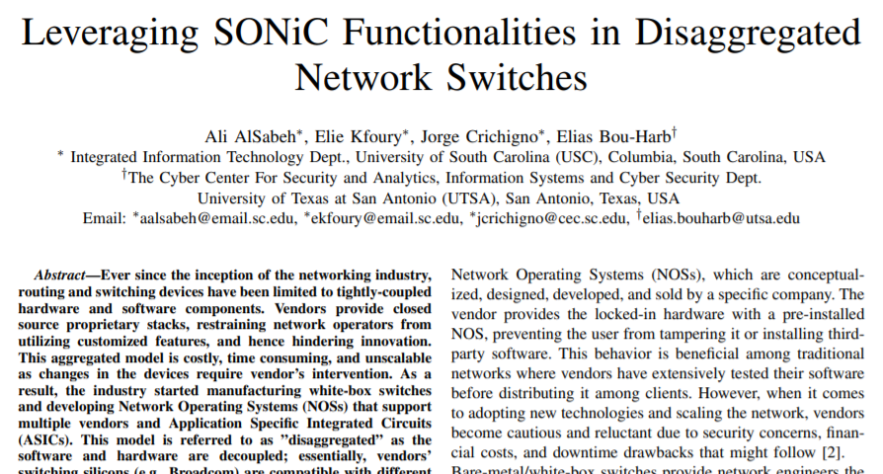
Graduate Projects
Improving system’s performance using next-generation switches
Offloading computational tasks to network switches
  Orders of magnitude faster than general-purpose CPU
  Very limited instructions set (e.g., no multiplication, no division, simple operations)
Agreement with Intel (chips, software development environment)

Slide 17


