Slide 1
Protection Against Brute-force Attacks
Timothy Dao, Dillion Barnhardt
Advisor: Jose Gomez
Department of Integrated Information Technology
University of South Carolina

Slide 2
Agenda
Description of Brute Force Attacks
Objectives
Scenario
Mitigation
Advantages of NGFW
Conclusion

Slide 3
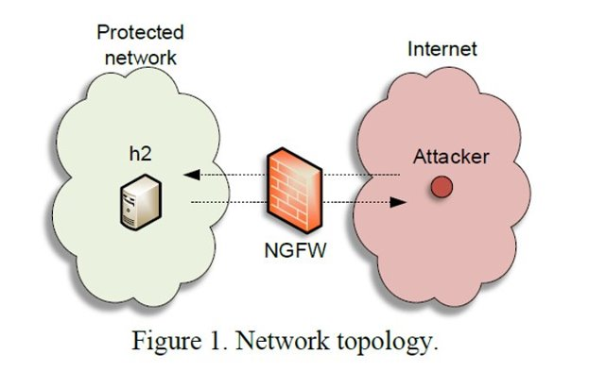
Description of Brute force Attacks
Attacker sends packets using a variety of protocols to continuously attack a destination IP address with the motivation of discovering credentials.
The attacker can gain access to classified information and critical systems.

Slide 4
Objectives
Determine the effectiveness of a Next Generation Firewall (NGFW) in detecting brute-force attacks, while providing best practices when deploying a NGFW
Implement a brute-force detection policy to detect and block malicious attacks using the SSH, FTP, Telnet, and HTTP protocols
Use an open-source tool to such as Ncrack and Hydra to perform Brute force
Prevent tools such as Ncrack and Hydra from discovering credentials on the network

Slide 5
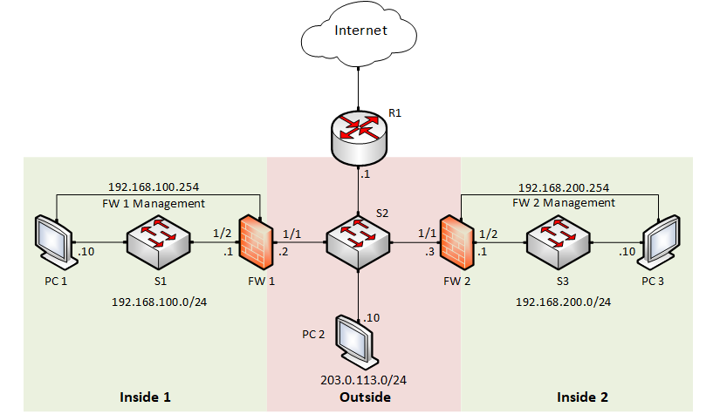
Scenario
Attack will use PC2 to attack PC1 using SSH, Telnet, FTP, and HTTP
NGFWs uses signatures to protect PC1 from a brute force attack

Slide 6
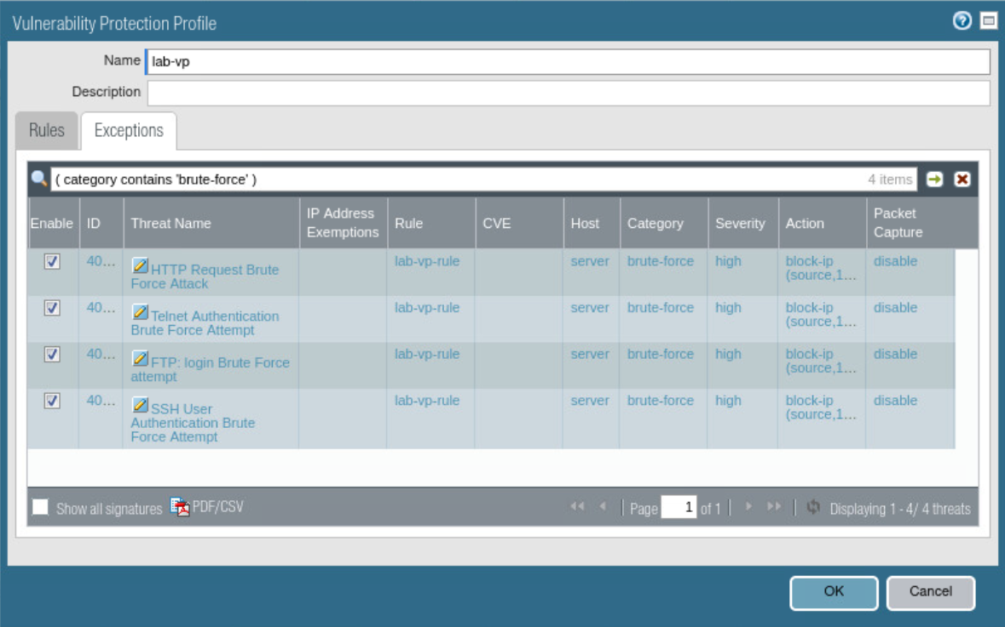
Mitigation
Vulnerability protection policy is enacted when traffic that matches the selected signatures is detected
Policy is triggered once there is over a certain criteria of detected SSH, Telnet, FTP, and HTTP packets sent.
Notes:
switch

Slide 7
Advantages of NGFW
Inspects incoming packets in depth to look for attack signatures and detect threats
Features malware and Denial of Service (DoS) protection that detects an blocks malicious traffic from entering and affecting users on the network
NGFWs can monitor traffic from layer 2 through 7, this allows for application and user-based policies

Slide 8
Conclusion
NGFWs are effective in detecting and blocking Brute-force attacks
Open-source tools that are available to the public can be utilized to perform a multitude of attacks on different protocols
Keeping a record of logs and utilizing attack signatures are an effective way to detect and block attacks

