Slide 1
DDOS Defense using Next Generation Firewalls Jacob Sherer, Matthew Kleeman Advisors: Ali Mazloum, Jorge Crichigno Department of Integrated Information Technology University of South Carolina December 2023
Notes:
Hello, My name is Jacob Sherer and my partner is Matthew Kleeman and this is our ONR project on DDOS Defense using Next Generation Firewalls. I wanted to thank Professor Chrichigno and our advisor Ali Mazloum for providing us this opportunity and assistance through this project.

Slide 2
Agenda
Background Information
Project Objective
Solutions
Conclusion
2
Notes:
The agenda for this presentation is to provide background information on DOS attacks and firewalls, state our project objective, provide our 2 solutions, and ending with a conclusion to summarize.

Slide 3
Background Information
A Denial of Service (DoS) attack renders a target computer unavailable for legitimate users by utilizing all the resources of a device.
DoS attacks have multiple forms including:
TCP SYN flood: Use the TCP three-way handshake to start many connections but never closing the connections.
ICMP flood: Use the ICMP protocol, generally many pings, to overwhelm the target's resources.
UDP flood: Send many UDP packets to a targeted server with the aim of overwhelming that device’s ability to process and respond.
Notes:
So DOS attack stands for Denial Of Service, which is a type of cyber attack which utilizes all the resources of an important device like a router or firewall in order to render it unavailable or inoperable for legitimate purposes. There are many different types of DOS attacks and this project focused on 3 of them. A TCP SYN flood uses the SYN packet of the TCP three way handshake to start and open many different connections but never closing them leaving all the available ports open and unusable. The ICMP flood uses the ICMP protocol to make requests, generally using the ping command, causing the server to use some of its resources to process and reply to each ICMP packet, and the large number of packets use up the systems resources. Finally, the UDP flood attack uses the UDP protocol to send large numbers of UDP packets which the server must process and check if there are any programs listening for that packet and respond that there is none using ICMP packets.

Slide 4
Background Information
Firewalls are network devices meant to protect the network through monitoring the inbound and outbound packets.
Firewalls are classified as either:
Stateless firewalls: Only consider packet headers while filtering the traffic.
Stateful firewalls: Consider the state of the flows besides the packet headers in the filtering process.
Next-generation Firewalls (NGFW) are stateful firewalls that have more advanced capabilities that can be used to protect a network against the previously mentioned attacks. Palo Alto NGFW are used in this scenario.
Notes:
Now, firewalls are the network devices which work to protect the network though monitoring the inbound and outbound packets. Firewalls can be stateless, meaning they only consider packet headers when filtering traffic, or Stateful, which consider the state of the connections as well as the packet information when filtering traffic. Next generation firewalls are more advanced versions of stateful firewalls that come with more capabilities that can be used to prevent the previously mentioned attacks. Specifically palo alto next generation firewalls are used in this project.

Slide 5
Project Objective
Goal: Use a Palo Alto NGFW to protect a network against various types of DoS attacks.
TCP SYN flood attacks
ICMP flood attacks
UDP flood attacks
5
Notes:
Our project objective is to use a Palo Alto next generation firewall to protect a network against the TCP Syn flood, ICMP flood, and UDP flood DOS attacks.

Slide 6
Solutions
Palo Alto NGFW has multiple ways to protect against these types of DoS attacks. This project focused on 2, Zone Protection Profiles, and DoS Protection Profiles.
These methods allow the firewall to detect, log, and block TCP SYN flood, ICMP flood, and UDP flood attacks.
The logs include information about the attacks like time, type, source and destination addresses, the action took, and more.
Notes:
So Palo Alto firewalls have multiple ways to protect against these DOS attacks which includes Zone protection profiles, and DOS protection profiles. Both of these methods allow us to use the firewall to detect, log, and block the three attacks mentioned before. The logs are especially important because they have information about these attacks like when they happened, the type of attacks, the source and destination addresses, and the action the firewall took to prevent them.

Slide 7
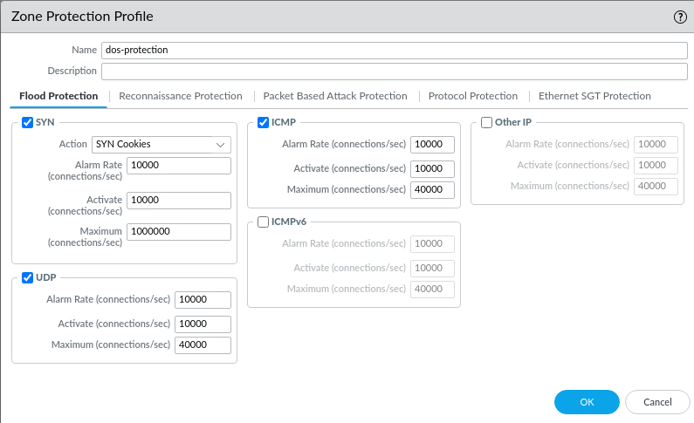
Solutions cont.
Zone Protection Profiles are the security rules assigned to the various security zones defined by the Palo Alto NGFW.
The configurable parameters are:
Alarm Rate: How many connections/second need to occur before being logged as a flood.
Activate: When the chosen action is enabled to block subsequent connections.
Maximum: How many connections can be initiated before the rest are dropped.
Notes:
The first method of stopping these attack is configuring Zone protection profiles. These are the sets of security rules that can be assigned to the security zones defined by the palo alto next generation firewalls. The configurable parameters are the alarm rate which determines how many connections need to be initiated before being logged as a flood attack, activate which determines when the chosen action will be enabled to mitigate the attack, and maximum which determined how many connectiosn can be initiated before the rest are all dropped no matter what. The action for the SYN flood includes either SYN cookies which replies to the syn requests without having a specific connecton open, and random early drop just drops packets before a queue can be filled up rather than dropping them after it fills. Only SYN flood protection can use SYN cookies, the others always use random early drop.

Slide 8
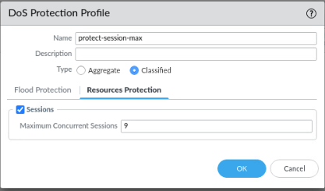
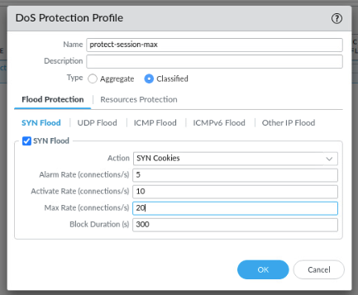
Solutions cont.
DoS Protection Profile are specialized security policies with more granular control to mitigate DoS attacks on specific systems.
An example of the added granularity is in classifying based on the source or destination addresses or users.
Notes:
The other method to prevent these attacks is to use DOS protection profiles. These are more specialized sets of security policies which provide more granular control on mitigating DOS attacks on specific systems. These flood protections include the same action, alarm rate,activate, and maximum parameters. The block duration specifies how long to prevent connectinos from a source IP address. The resources protection tab provides the number of concurrent connectiosn allowed to a device before new connections are dropped. These can be applied to a group of devices using the aggregate type or specific devices using the classified type.

Slide 9
Conclusion
DoS attacks aim at overwhelming a target machine’s resources.
NGFW provide the means of defense against these attacks.
The two utilized ways in this project are:
Zone protection profiles
DoS protection profiles
By the end of the project, we were able to detect, log, and block TCP SYN floods, ICMP floods, and UDP floods.
Notes:
In conclusion, DOS attacks aim to overwhelm a target machine and its resources to render it inoperable. Next generation firewalls provide defenses against these attacks. This project utilized both zone protection profiles, for more generalized protection, and DOS protection profiles, for more granular protection. By the end of this project, we were able to detect, log, and block TCP SYN flood, ICMP flood, and UDP flood DOS attacks.

