Slide 1
Implementing a Monitoring Device using a P4 Programmable Switch Samuel Dao, Mark-Anthony Box Advisors: Ali Mazloum, Ali AlSabeh Department of Integrated Information Technology University of South Carolina May 2022
Notes:
Hello everybody! My name is Samuel Dao, and my partner is Mark-Anthony and our ONR project was on implementing monitoring device using P4 programmable switches. Before we start, I want to thank Professor Crichigno for the opportunity and our advisors Ali Mazloum and Ali AlSabeh for guiding us through this project.

Slide 2
Agenda
Introduction
Background Information
Research Challenge
Solution
Conclusion
2

Slide 3
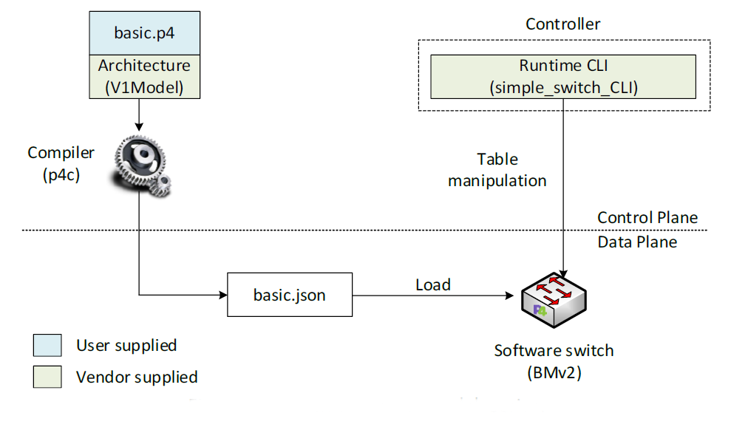
Introduction
Network devices allow hardware on a network to communicate. They process packets and route them to the proper destination.
Typically, only vendors have had control over network design and functionality in devices.
P4 is a new programming language that specifies how data plane devices, such as programmable switches and routers, process packets.
Notes:
So for today's agenda, we'll start by introducing what P4 is, give some background information about P4 and the problems it solves, briefly discuss our research challenge, how we solved it, then we'll do a live demonstration of our solution, then end with our conclusion. :)

Slide 4
Background Information
Current monitoring devices do not provide enough granularity to fix network issues.
P4 gives total control to developers. Implementing changes now takes minutes instead of years.
P4 utilizes programmable ASIC chips that control the functionality of the switch.

Slide 5
Research Challenge
Goal: Use the capability of P4 devices to monitor and track flows and collect corresponding statistics.
Source and destination IP addresses
Source and destination transport layer ports
Amount of the unidirectional traffic (bytes)
Bit rate per second
Flow start and end time
5

Slide 6
Solution
Using P4, we can record statistics of packets at line-rate without adding processing overhead.
Packets will be uniquely identified by flows. Flows are packets that contain the same information and belong to the same stream of data.
In this project, flows are defined as packets that contain the same: Source and Destination IP Addresses, same Source and Destination Ports, and the same IP protocol.

Slide 7
Solution cont.
Source IP address, destination IP address, source port, and destination port are extracted from the packet's headers.
Unidirectional traffic is measured at the data plane level through summing incoming packets length
Bit rate is calculated by dividing the flow's size by the duration of the flow
Flow start and end times are extracted from the P4 switch's standard meta-data
Unique Flow IDs will be generated using a hashing algorithm.

Slide 8
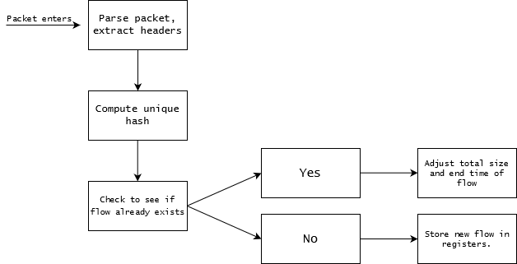
Solution cont.
Statistics of each flow are stored in a dedicated registers
We designed our own python script that can extract the values of the registers from the data plane
The python script is connected to the data plane through APIs provided by the vendors
High-level Overview of Workflow

Slide 9
Conclusion
Using P4, we were able to successfully pull the targeted information, from the headers of packets and metadata of the switch and store them in registers.
We can uniquely classify flows by calling a hashing algorithm against our targeted statistics.
We are then able to pull these values from the registers during runtime, and format them using a python script.

