Slide 1
Reconnaissance Mitigation Through NGFW (Next Generation Firewall)
By: Denzel Martin & Favour Agho
Advisors: Jorge Crichigno & Ali Mazloum
University of South Carolina
Department of Integrated Information Technology
December 1, 2023

Slide 2
Agenda
Reconnaissance
Next Generation Firewalls (NGFW)
Palo Alto Firewall Systems
Demo
Conclusion

Slide 3
Reconnaissance
​Reconnaissance refers to the process of gathering information about a target network or system to identify vulnerabilities and potential points of entry.
Types of Reconnaissance Attacks:​
Passive Reconnaissance: Collecting information without directly interacting with the target.​
Active Reconnaissance: Involves engaging with the target system, like scanning for open ports and services.​
Importance of Detection and Prevention:​
Early detection of reconnaissance activities is crucial to thwart potential cyber threats.​
A robust security strategy should include measures to prevent and mitigate reconnaissance attempts.

Slide 4
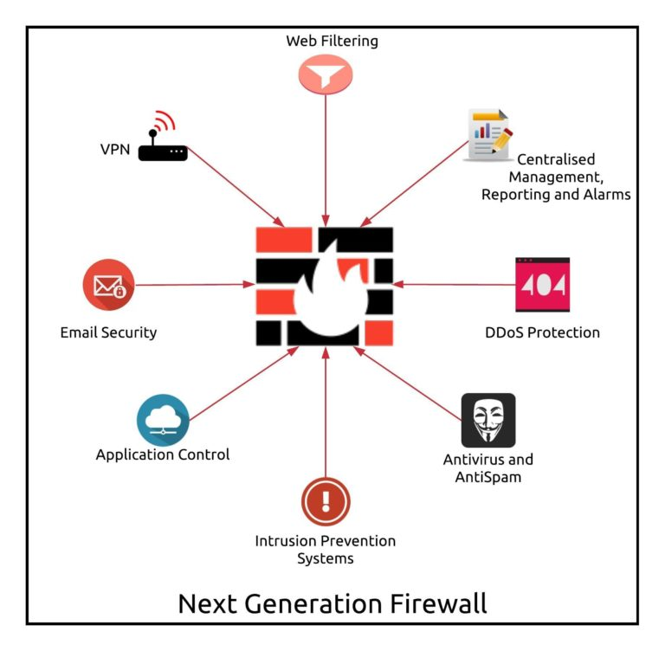
NGFW (Next Generation Firewall)
Definition and Characteristics:​
NGFWs combine traditional firewall capabilities with advanced security technologies.​
They offer deep inspection of network traffic, allowing granular control over applications and user activities.​
Capabilities Beyond Traditional Firewalls:​
Intrusion Prevention System (IPS) capabilities for real-time threat prevention.​
Application-layer filtering to control and monitor application usage.​
SSL and TLS inspection to detect threats hidden within encrypted traffic.​
Integration of Advanced Security Features:​
NGFWs often include features like antivirus, sandboxing, and threat intelligence integration.​
These advanced features enhance the firewall's ability to identify and block sophisticated threats.

Slide 5
Palo Alto Firewall Systems
Overview of Palo Alto Networks:​
Palo Alto Networks is a leading cybersecurity company known for its cutting-edge firewall technologies.​
The company's commitment to innovation is reflected in its comprehensive security platforms.​
Unique Features and Capabilities:​
Their approach emphasizes the importance of a prevention-first mindset, disrupting threats before they can cause harm.​
Role in Protecting Against Reconnaissance:​
Palo Alto Firewalls play a vital role in detecting and preventing reconnaissance activities.​
The integration of threat intelligence and continuous updates ensures Palo Alto's systems stay ahead of emerging threats.

Slide 6
Demo
Practical Demonstration of NGFW in Action​
Showcase of Reconnaissance Prevention

Slide 7
Conclusion
Reconnaissance is the first phase of cyber attacks​
NGFW provides the means to detect and mitigate Reconnaissance​
This project utilized Palo Alto NGFW to detect and mitigate Reconnaissance

