Slide 1
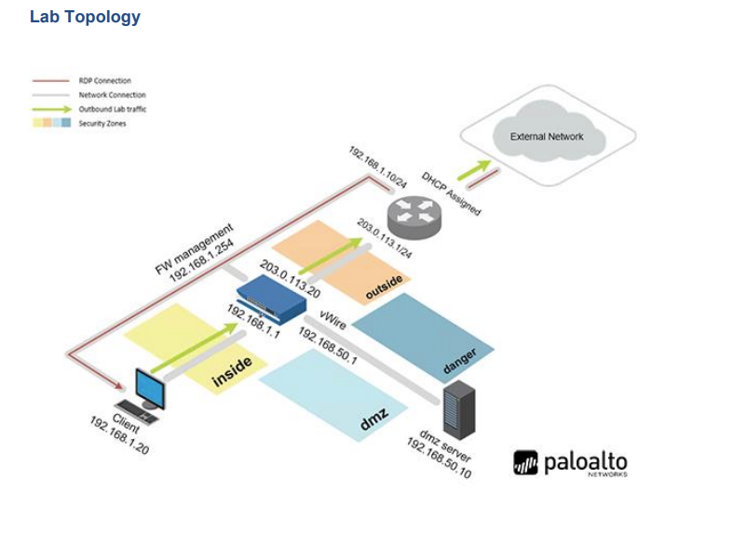
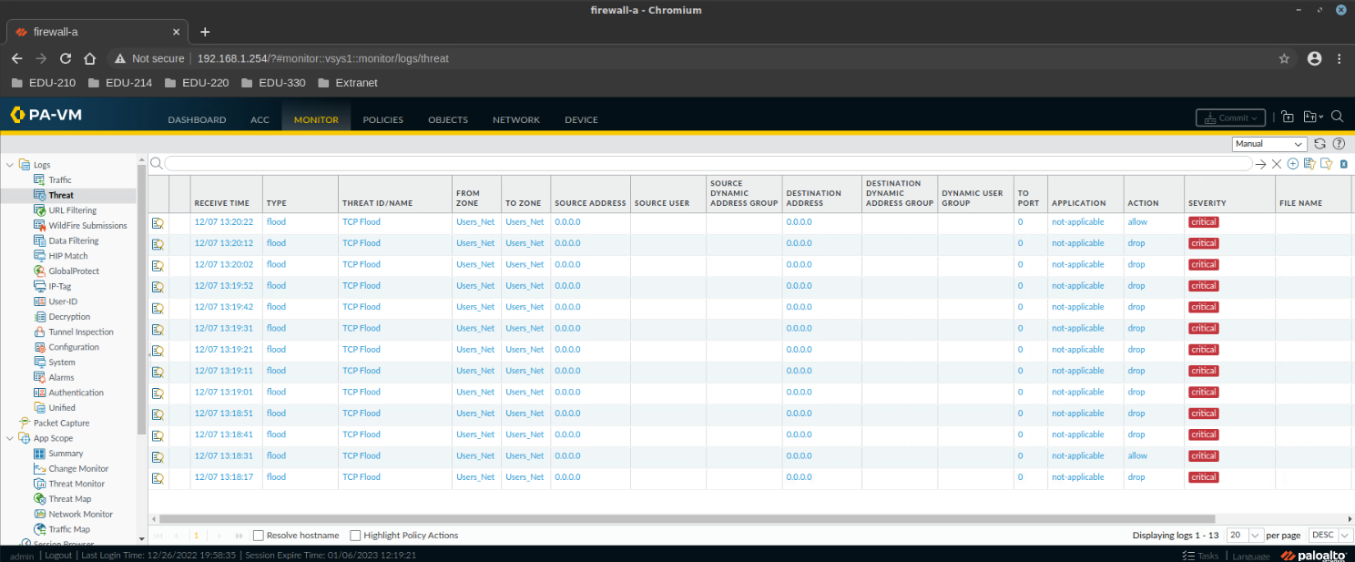
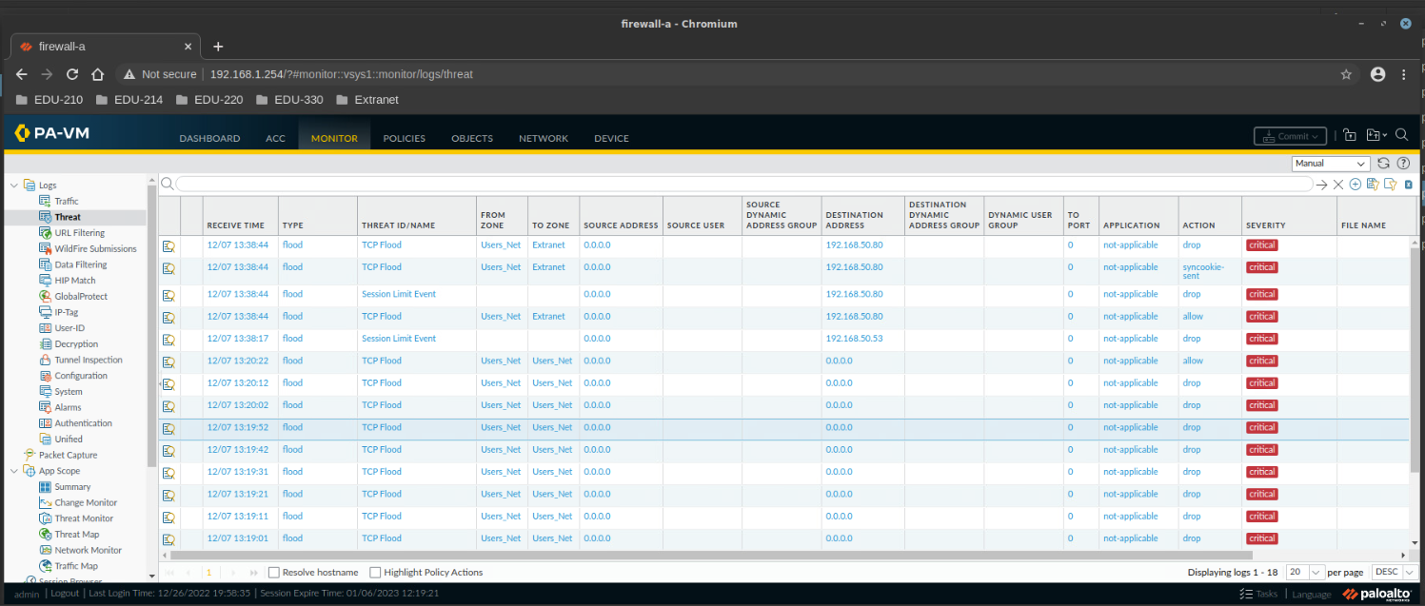
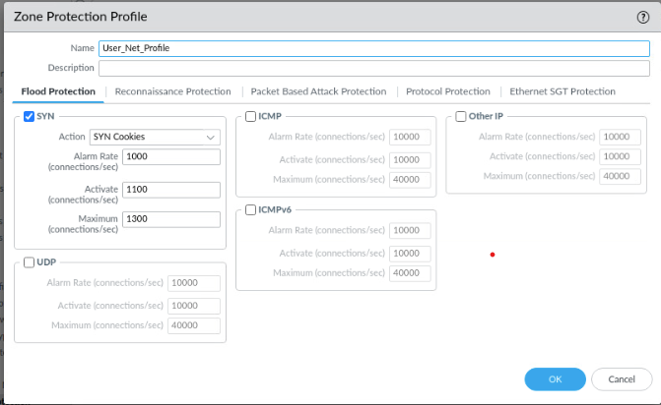
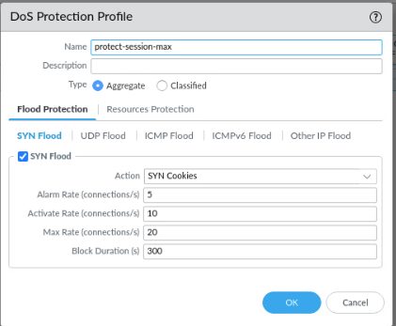
DDoS Defense Using NGFW
Matthew Kleeman, Jacob Sherer
Advisors: Ali Mazloum, Jorge Crichigno
Integrated Information Technology Department, University of South Carolina, Columbia, South Carolina
Abstract
Test System
Results
This project presents the configuration of a Palo Alto next-generation firewall to prevent TCP SYN flood, ICMP flood, and UDP flood DOS attacks.
Palo Alto next-generation firewalls are stateful firewalls with advanced capabilities to allow them to defend these types of DOS attacks.
DOS attacks stand for denial of service attacks, which utilize various network protocols to overwhelm a target device's resources.
In this project, a Palo Alto firewall is configured with a zone protection and DOS protection profile to inspect the connections to determine if a DOS attack occurs.
The results show that through the general zone protection profiles and more granular DOS protection profiles, a Palo Alto firewall is able to detect, log, and mitigate TCP SYN flood, ICMP flood, and UDP flood attacks.
For this project, we implemented a DMZ server, client devices, a switch, and a router.
The clients represent the devices in a company’s headquarters (User_Net Zone), The DMZ Server is a device located on a private network (Extranet), and the External Network represents the devices that are not managed by the company (Internet Zone).
Packets going from the User_Net zone to the Extranet Zone and vice versa are managed by different security policies and rules than packets going to host the Internet Zone.
Results show that the different types of DoS attacks such as SYN Floods, ICMP floods, and UDP floods have been successfully blocked.
In the first scenario, the sender sent a SYN Flood attack to the User_Net Zone
After the alarm rate for these packets with destination IP address 192.168.1.20 where reached, they were dropped.
The monitoring tool in the firewall has allowed us to confirm that the packets have been dropped based on the alarm rate and have been correctly labeled with the correct information.
In the second scenario, the sender sent a SYN Flood attack on the Extranet Zone using clients within the User_Net Zone
After the number of concurrent connections has exceeded or many packets have arrived within a short interval, the packets will be automatically dropped.
The monitoring feature in the firewall has allowed us to confirm that the packets have been dropped whenever they either exceeded the session limit, or if they had exceeded the alarm
Project Description
Palo Alto next generation firewalls have multiple ways to prevent these DOS attacks in the security zones.
Security zones are the groups of physical ports and logical addresses in a network.
This project focuses on 2 of these methods:
Zone protection profiles
DOS protection profiles
Palo Alto zone protection profiles are the sets of security rules and policies that can be applied to the various security zones on the firewall.
The zone protection profiles provide more generalized protection across an entire security zone.
Palo Alto DOS protection profiles are also sets of security rules and policies that can be applied to the security zones and specific hosts or interfaces.
The DOS protection profiles provide more specialized and specific control in their configuration, such as only applying to specific classified interfaces.
This project aims to implement both of these types of profiles to protect a network against TCP SYN, ICMP, and UDP flood DOS attacks.
Experimentation
The following scenarios were implemented using the Zone Protection Profiles and DoS Protection Profiles to protect and monitor against the different types of DoS attacks:
Scenario 1: Zone Protection Profile
The Zone Protection Profile is populated with the following settings:
Based on the settings, it can allow the firewall to determine whether to forward or drop packets depending if they have reached a certain number of packets for a particular protocol, such as UDP requests, ICMP echo-request, and SYN requests within a given time.
It can also be used to protect against other types of attacks, such as reconnaissance attacks, packet-based attacks, protocol-based attacks, and more.
Scenario 2: DoS Protection Profile
This scenario requires you to create and implement a DoS Protection Profile into your DoS Rule
The DoS Protection Profile drops packets that either exceed the session limit between the two zones or if the number of packets/requests has exceeded the alarm rate within a given time.
Background Information
Lessons Learned
A Denial of Service (DoS) attack renders a target computer unavailable for legitimate users by utilizing all the resources of a device.
DoS attacks have multiple forms including:
TCP SYN flood which uses the SYN packet of the TCP three-way handshake to start many connections but never closing the connections.
ICMP flood which uses the ICMP protocol, generally using the ping command, to overwhelm the target's resources by responding to each ping individually.
UDP flood which sends many UDP packets to a targeted device, requiring it to check its running processes and respond with an IMCP packet that nothing was found, utilizing all the devices resources.
Firewalls are network devices that protect the network by monitoring and filtering the packets coming in and going out of the network.
Firewalls are classified as either:
Stateless firewalls that only consider the packet headers while filtering traffic.
Stateful firewalls that consider the state of the flows as well as the packet headers and data when filtering traffic.
Next-generation firewalls are stateful firewalls that have more advanced capabilities that can be used to protect a network against the previously mentioned attacks and many other types of attacks.
Palo Alto is a company that has developed these next generation firewalls and their operating system.
Learned how to access a Palo Alto management interface
Applied zone protection profiles to mitigate DOS attacks
Applied DOS protection profiles to mitigate DOS attacks with more granularity
Validated the implementation of the zone protection and DOS protection profiles in the Netlab environment
Understood the use and importance of logs in network firewall security
Conclusion
This project detected, logged, and mitigated TCP SYN flood, ICMP flood, and UDP flood DOS attacks using a Palo Alto firewall
Palo Alto next-generation firewalls provide many ways to secure a network
Zone protection profiles provide the security policies to detect and block these DOS attacks on a security zone as well as other parameters
DOS protection profiles provide specific security policies to detect and block DOS attacks on a security zone or specified devices with more granularity
Future works can include more configuration and security policies on a Palo Alto NGFW
Acknowledgement
This work was supported by the Office of Naval Research (ONR), grant N00014-20-1-2797: “Enhancing the Preparation of Next-generation Cyber Professionals”

