Slide 1
Protection Against Brute-Force Attacks
Lauren Waddell and Brendan Curran
University of South Carolina
Integrated Information Technology Department
USC ROTC
December 1, 2020

Slide 2
Agenda
Overview
Motivation
Advantages of NGFW
Objectives
Custom Scenario
Mitigation
Results
Conclusion

Slide 3
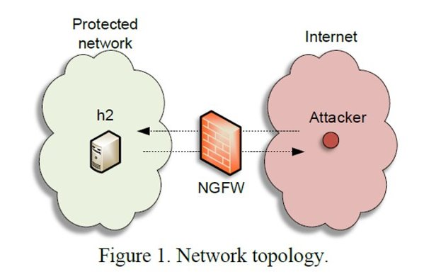
Overview
A brute force attack uses a large volume of requests/responses from the same source or destination IP address to break into a system.

Slide 4
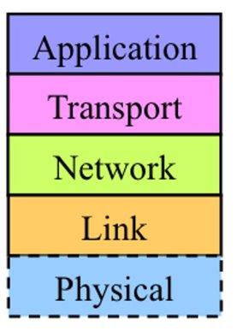
Motivation
Test the ability of Next Generation Firewalls (NGFWs) to mitigate the effectiveness of a brute force attack on a network.
Firewall- network security device that monitors incoming and outgoing network traffic and decides whether to allow or block specific traffic based on a defined set of security rules.
Two types:
Traditional Stateful
NGFW

Slide 5
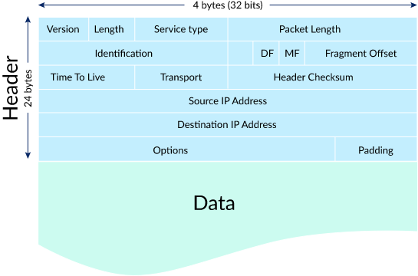
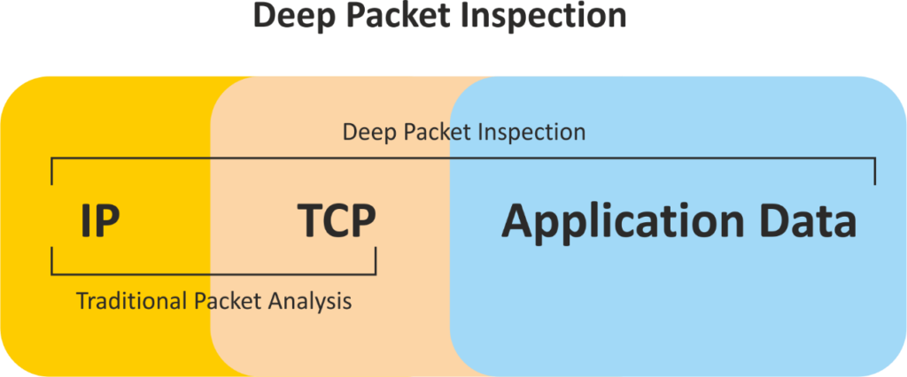
Advantages of NGFW
Set Application layer specific rules
Deep Packet Inspection
See full content of packet header
NGFW powerful scanner

Slide 6
Objectives
The goal of this project is:
To determine the effectiveness of a modern Next-generation Firewall (NGFW) to detect brute-force attacks
To provide best practices when deploying a NGFW to prevent such attacks.
Use Ncrack(an open-source tool) to understand the anatomy of brute-force attacks
Implement a brute-force protection policy
Protect the network against attacks to well-known services such as SSH and FTP.

Slide 7
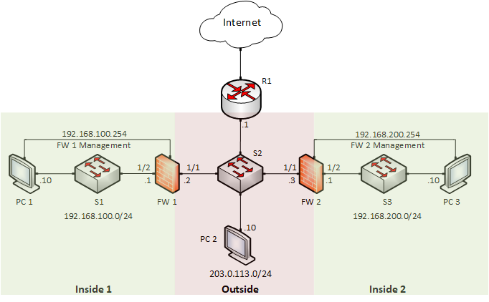
NetLab Custom Scenario

Slide 8
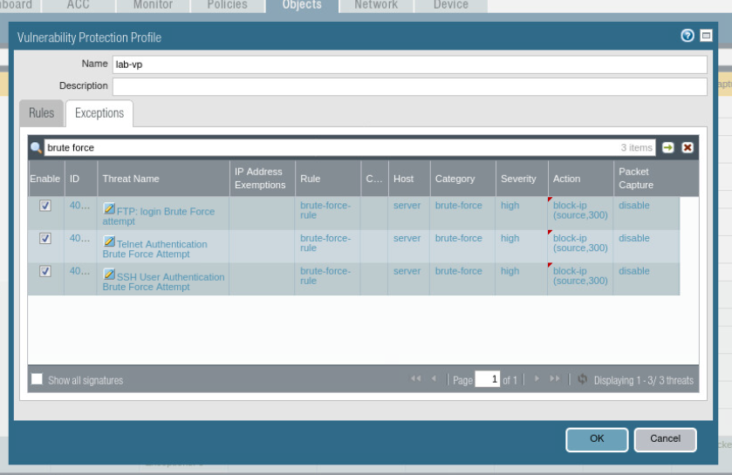
Mitigation
Security Policy to allow Traffic to flow between zones
Vulnerability Profile (VP)
Brute Force Signatures Detected
Attach VP to security rule

Slide 9
Results
Monitor Threat Log

Slide 10
Conclusion
Security engineers must develop skills to analyze network traffic.
Threat logs are essential tools for traffic analysis, for identifying cyber attacks, and for mitigating them.
NGFWs are effective to mitigate brute force attacks on a network.

