Slide 1
Spring 2021 Undergraduate Research Cybersecurity Workshop &
Capstone Project Expo
Department of Integrated Information Technology (IIT)
Army, Navy, and Air Force ROTC programs
University of South Carolina
April 22, 2021

Slide 2
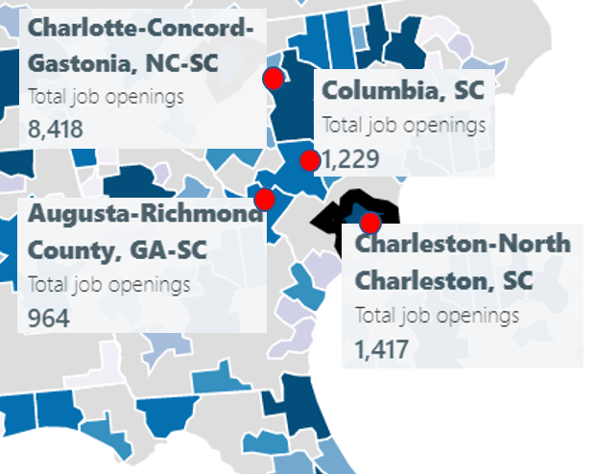
ONR’s Cyber Project
“Enhancing the Preparation of Next-generation Cyber Professionals” (2020)
South Carolina cybersecurity needs
SRNL, Fort Jackson, Shaw Air Force Base, private industry
Recruiting the American military’s cyber force is more difficult than ever
DoD has been struggling to hire more than 8,000 cyber positions (2018)¹
The College of Engineering and Computing is addressing the workforce needs:
Strengthening the curriculum
Providing undergraduate applied research
Deploying cloud systems w/ open source and professional tools
Collaborating with industry, government (Cisco, Palo Alto,
Intel, Juniper, VMware)
Cybersecurity job openings in four metro areas near Columbia, Feb. 2020
1. J. Lynch, “Inside the Pentagon’s Struggle to Build a Cyber Force,” Fifth Domain publication, October 29, 2018. Online: https://tinyurl.com/yyelqomp
Notes:
Reserve Officers' Training Corps (ROTC))

Slide 3
ONR’s Cyber Project
Option to earn credentials
DoD’s Information Assurance (IA) workforce is classified in IA technical (IAT):
Level 1 (IAT 1): Computing environment information assurance
Level 2 (IAT 2): Network environment information assurance
Level 3 (IAT 3): Enclave, advanced network & computer information assurance
NICE: National Initiative for Cybersecurity Education (NIST)

Slide 4
Spring 2021 Undergraduate Research Cybersecurity Workshop &
Capstone Project Expo
Department of Integrated Information Technology (IIT)
Army, Navy and Air Force ROTC programs
University of South Carolina
Undergraduate Research Cybersecurity (Main room)
http://ce.sc.edu/cyberinfra/onr_workshop_spring_2021.html

Slide 5
Spring 2021 Undergraduate Research Cybersecurity Workshop &
Capstone Project Expo
Department of Integrated Information Technology (IIT)
Army, Navy and Air Force ROTC programs
University of South Carolina
Capstone projects (Breakout Rooms)
Room 1: UofSC Academic Advising Process Improvement
Room 2: Boeing Flight Trends and Analysis Dashboard
Room 3: Creating websites for UofSC COE projects
Room 4: IIT Cyber Security Lab
Room 5: HRSM Database
Room 6: IIT PHD and Online Program Pages
Room 7: IIT Internship Database
Room 8: IIT Internship Location Map
Room 9: International Law Dispute Resolution App
Room 10: SC Health and Human Services Metrics Update Project
Room 11: SC Office of Information Assurance Policy Repository
Room 12: IIT Website to Showcase Student Work
Room 13: IIT Promotional Video Team
Room 14: SET solutions project team
Room 15: Softdocs Etrieve Database
Room 16: Mobile App Prototype for the UofSC Visitors Center
To enter a breakout room, please check at the bottom of your screen.
If you do not see this symbol, please ask for assistance in the chat window

Slide 6
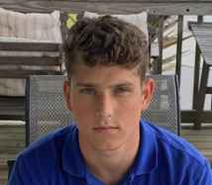
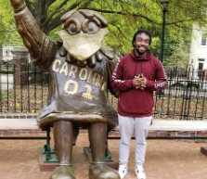
Identifying Applications using Deep Traffic Inspection (App-ID)
Christian Tsirlis
Brad Wilson
Junior IIT and Cyber Intelligence major
3/C Marine-Option Midshipman at the NROTC Unit
Junior IIT student
Intern at Savannah River Nuclear Solutions

Slide 7
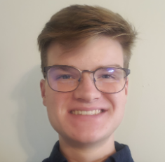
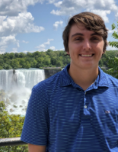
External Dynamic List for Blocking Malicious Sites
Bryson Livingston
Zachary Fowler
Senior IIT student
Internship at Sonoco in Hartsville, South Carolina
Interest/work in networking and cybersecurity
Senior IIT student
Interested in Cybersecurity as career path

Slide 8
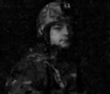
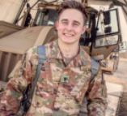
Policy-based Forwarding
Jack Sadle
Matthew Driver
Senior IIT student, ROTC w/ Minor in Military Science
Enlisted in the US Army Signal Corps as a 25B IT Specialist since 2017
Senior IIT student, ROTC
He has been in the military for seven years, including one year in Syria

Slide 9
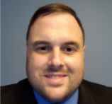
Site-to-site VPN with Next-generation Firewalls
Ryan Tallent
Junior IIT student, working to become an expert in cyber security
Navy Veteran, deployed in the Operation Iraqi Freedom (2003)

Slide 10
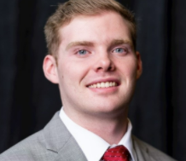
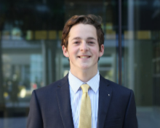
Blocking Cyberattacks using Geographical Information
Nathan Long
Ty Love-Baker
Senior IIT student
Experience in Cyber Security during my summer internship with AIG (Cyber Threat Intelligence)
Career path in cybersecurity
Senior IIT student
Graduated from the United States Marine Corps Officer Candidate School, in Quantico, VA

