Slide 1
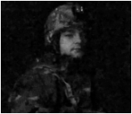
OSPF Hijacking
Matthew Driver
Jack Sadle
Integrated Information Technology
ROTC
University of South Carolina
December 1st, 2020

Slide 2
Agenda
Introduction
Problem description
Background information
Open Shortest Path First
Hijacking
Proposed solution and Implementation
Conclusion

Slide 3
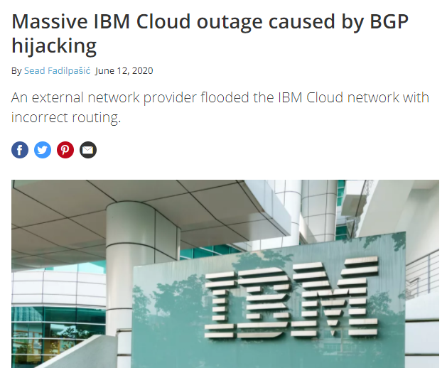
Problem Description
Computer networks can be attacked by disrupting peer network routers.
Using OSPF (Open Shortest Path First), routers send data to each other in a network via packets on routes that are established based on their distance to each other.
In an OSPF network, the packet will take the shortest path along the routers in the network to get to their destination.
Attackers can falsify the information carried within the routing protocols, thus hijacking IP addresses.
This is done when an attacker manipulates the OSPF routing protocol so that traffic is misdirected to a rogue router projecting false routes.
Attacks occur frequently across the world; e.g., see figure.

Slide 4
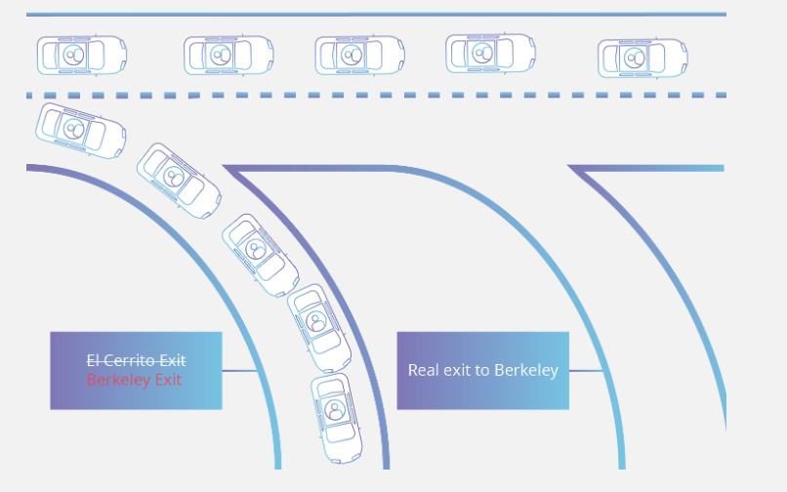
Problem Description
Spoofing routing information can generally be used to cause systems to misinform (lie to) each other, cause a Denial of Service (DoS) attack, and redirect traffic to follow a path it would not normally follow.
These kinds of threats to data security can cause the theft of information, shutdowns, and many other harmful results.
Real shortest path
R1
R2
R3
R4
Destination network
Hijacked route
Malicious router
https://www.cloudflare.com/learning/security/glossary/bgp-hijacking/

Slide 5
Background Information
OSPF is perhaps the most widely used routing protocol in the world.
It was developed so that the shortest path through a network is calculated based on the cost of the route, taking in account the bandwidth, delay and load.
OSPF routers are configured by adding the adjacent Local Area Networks (LANs) and Wide Area Networks (WANs) to its routing table.
A router would add the networks connecting all other routers in order to establish OSPF communication with these devices.
These entries in the routing table have established distances so that the OSPF protocol can identify the shortest path to a destination network.
In order to hijack an OSPF route, a rogue router advertises a shorter route to a legitimate network, therefore adding itself as the more viable route in the routing table.

Slide 6
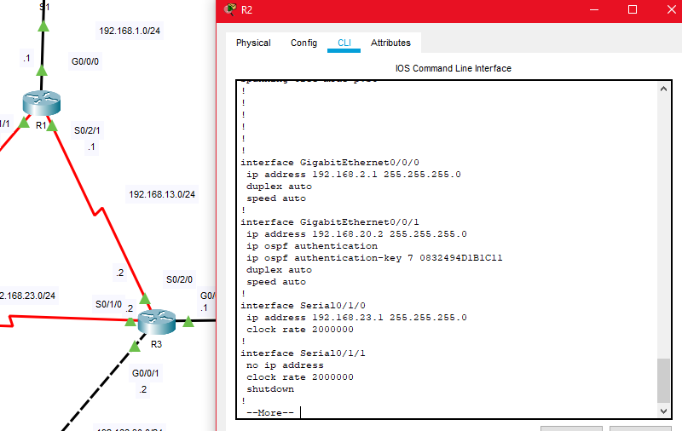
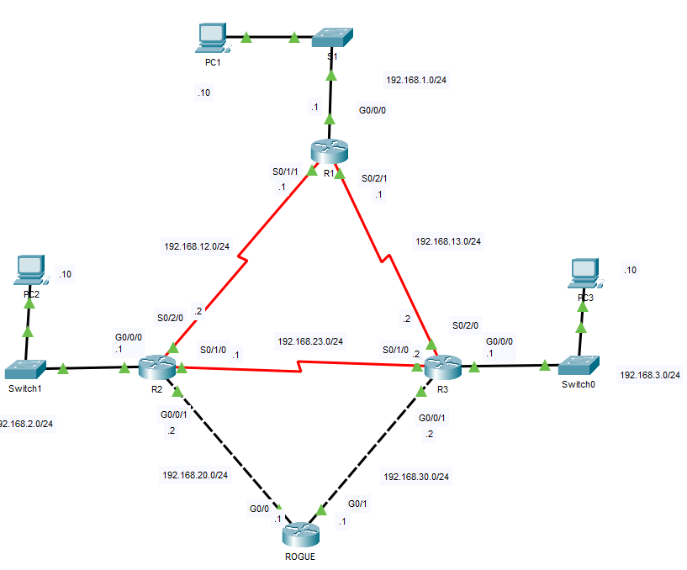
Proposed Solution and Implementation
The proposed solution to minimize an attack on an OSPF network is to implement OSPF Authentication on each router. Each router should have a password to authenticate, each of different characters.
This is an OSPF Topology with an active spoofed router trying to infiltrate the network
To combat security issues, we implement authentication measures on all routers through each interface

Slide 7
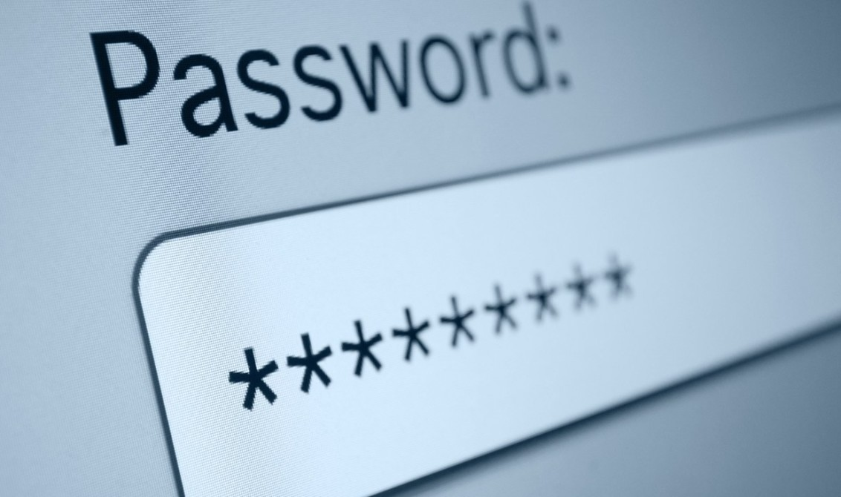
What is Router Authentication?
Authentication is for security
The risks of having no authentication means a rogue router may enter the network and gather data from the net
OSPF supports 3 types of authentications:
Null (none)
Simple Password Authentication
MD5 Authentication
MD5 is the safest method of authentication because it is calculated using the MD5 Algorithm and is never exchanged by peers.
Notes:
Citation:
AZAM, W. AND PROFILE, V.
OSPF Authentication Types, Configuration & Verification
In-text: (Azam and profile, 2020)
Your Bibliography: Azam, W. and profile, V., 2020. OSPF Authentication Types, Configuration & Verification. [online] Ccnacompletecourse.blogspot.com. Available at: <https://ccnacompletecourse.blogspot.com/2019/10/ospf-authentication-types-configuration.html#:~:text=OSPF%20supports%20three%20types%20of,configured%20globally%20or%20by%20interface.> [Accessed 9 November 2020].
Simple Password authentication is an unencrypted password

Slide 8
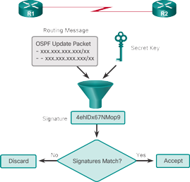
Router Authentication Process
R1 will combine the shared secret key with the routing message creating what is called a hash
Using the MD5 Algorithm, a digital signature is calculated and sent to R2
R2 will receive the message
R2 will then combine the shared secret key with the routing message
R2 will use the MD5 Algorithm to calculate the digital signature
If the Digital signatures match, R2 will accept the OSPF update packets
If the digital signatures do not match, R2 will not accept the OSPF update packets

Slide 9
Conclusion
OSPF Hijacking can do massive damage with relative ease
Attackers manipulate the OSPF routing protocol to steal network traffic
Implementing authentication measures can help protect networks from these attacks

